Slide 1

Counterclaims as a Tool for Eviction Defense
Liz Leiserson, LASMTC
EJU 2026

Slide 2


What is Legal Aid Society?
Legal Aid Society is a 501(c)(3), non-profit law firm that that offers education and legal representation in civil matters to low-income individuals, families, and seniors who typically lack the means to afford legal services.
Mission:​
To advance, defend, and enforce the legal rights of low-income and vulnerable people in order to secure for them the basic necessities of life.

Slide 3

Disclaimer: The information provided in this presentation cannot take the place of legal advice. Each case is different and needs individual attention.​

Slide 4
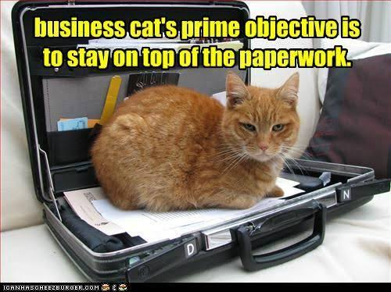
Objectives
Understand why counterclaims can be an effective tool in defending eviction cases.
Identify common housing counterclaims.
Be ready to prepare a counterclaim for trial using the resources provided.

Slide 5
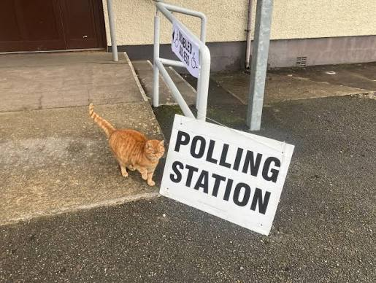
Polls
How many of you have represented a tenant (or helped represent a tenant) in an eviction case?
How many of you have you filed (or helped file) a counterclaim in an eviction case?

Slide 6

What is a counterclaim?
TRCP 13.01. Compulsory Counterclaims.
A pleading shall state as a counterclaim any claim, other than a tort claim, which at the time of serving the pleading the pleader has against any opposing party, if it arises out of the transaction or occurrence that is the subject matter of the opposing party's claim and does not require for its adjudication the presence of third parties of whom the court cannot acquire jurisdiction, except that a claim need not be stated as a counterclaim if at the time the action was commenced the claim was the subject of another pending action. This rule shall not be construed as requiring a counterclaim to be filed in any court whose jurisdiction is limited either as to subject matter or as to monetary amount so as to be unable to entertain such counterclaim.
TRCP 13.02. Permissive Counterclaim.
A pleading may state as a counterclaim any claim against an opposing party, whether or not arising out of the transaction or occurrence that is the subject matter of the opposing party's claim.
But see: TRCP 1. Scope of Rules.
The Rules of Civil Procedure shall not apply to general sessions courts [with some exceptions, not relevant here].

Slide 7
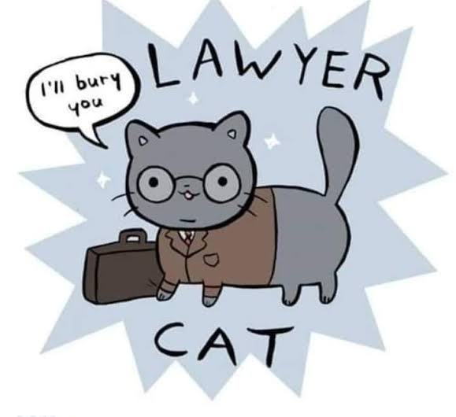
Why Counterclaims?
Without a counterclaim | With a counterclaim
“I never got to tell the judge what was going on. He only cared about being behind on rent.” | “At least I got to tell the judge the truth.”
“My only choice was to sign whatever they put in front of me.” | “I won’t just let them walk all over me.”
Counterclaims give voice to clients’ stories, expand opportunities for recovery, and shift negotiating power.

Slide 8

Client #1: Repairs
Two months ago, while Ms. White was out of town, her bathroom flooded. When she got home, there was standing water in the bathroom and flooding into the carpeted hallway. She doesn’t know what caused it.
She sent her property manager an angry email saying she’d be withholding rent until the problem was fixed.
She never got a response to her email, but maintenance did come by to mop up the water and put out fans to dry things out. Ms. White could still smell mold, so she didn’t restart her rent payments.
Her landlord eventually sent her a 14-day notice for nonpayment of rent, then filed a detainer warrant.
Is a counterclaim a good idea here? Why/why not?

Slide 9
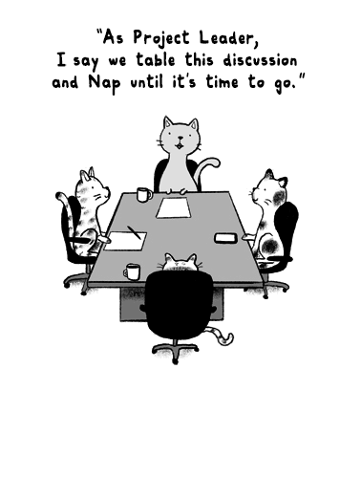
Part 1: Common Counterclaims

Slide 10
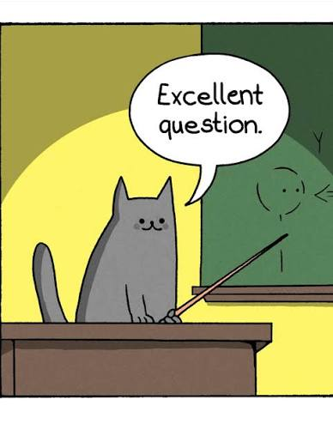
Question
Besides conditions issues, what are other examples of common counterclaims in the eviction context?

Slide 11

Example Counterclaims
“The window won’t shut, so the rain comes in and ruined my couch, and the faucet leaks so my water bill is huge.” → Failure to Make Repairs (URLTA/Contract)
“I dropped off my payment, but instead of depositing it to my account, they just held onto it and let me run up late fees.” → Breach of Contract, TCPA Violation
“After I filed a Codes complaint, the landlord just shut off the electricity.” → Illegal Ouster (URLTA/Contract), Quiet Enjoyment, Retaliation
“They know my cat is an emotional support animal, but they charge me a pet fee anyway.” → Fair Housing violation

Slide 12
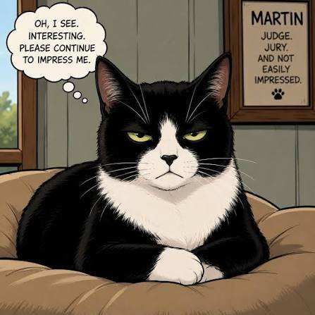
Counterclaim or Affirmative Defense?
Counterclaim | Affirmative Defense
Breach of contract | No good cause
Failure to make repairs | Accepted rent without reservation, estoppel
Discrimination or retaliation | Failure to provide notice
Excessive late fees | Lack of standing
Counterclaims are why the court should grant the tenant relief.
Affirmative defenses are why the court should not grant the landlord relief.

Slide 13
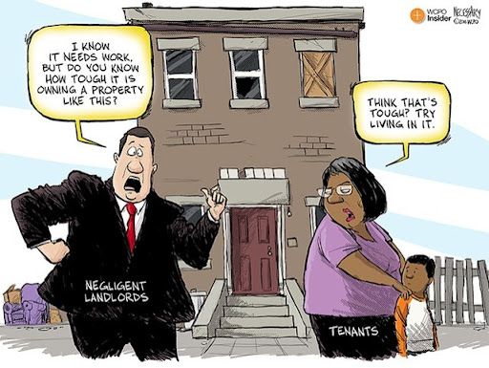

Common Category #1: Repairs/Conditions
Structural disrepair
No heat or A/C
Electrical problems
Plumbing issues
Roaches/bugs
Mice/rats
Leaks
Mold
Window/door issues
The list goes on…

Slide 14

Repairs/Conditions
Key Questions
Did then tenant give notice? When? In writing?
What damages resulted?
  Belongings replaced
  Storage fees
  Alternate housing
  Relocation
What proof is there? Photos? Videos? Inspection reports?
Has the landlord attempted repair? When?
If it’s mold: where is the water coming from?

Slide 15

Common Category #2: Junk Fees & Money Stuff
Look for:
Charges not in the lease
Late fees over 10% (URLTA) or above lease amount
Deposit disputes
Misapplied/missing payments
Evidence:
Lease
Ledger
Proof of payment (money order receipts, app payment history, bank records)

Slide 16
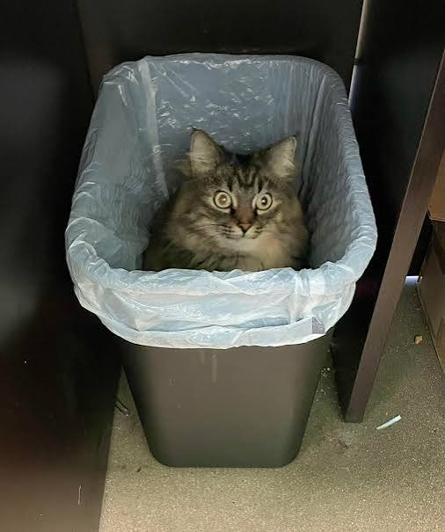
See: Junk Fees & Money Stuff.
Think: TCPA.
The Tennessee Consumer Protection Act prohibits “[r]epresenting that a consumer transaction confers or involves rights, remedies, or obligations that it does not have or involve or which are prohibited by law.” T.C.A. § 47-18-104(b)(12).
Defendant is renting or leasing real property, and so satisfies the definition of a consumer within the meaning of the Tennessee Consumer Protection Act, see T.C.A. § 47-18-103(6).

Slide 17
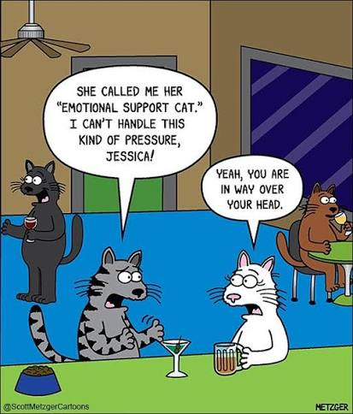
Common Category #3: Fair Housing
Scenario: Client is behind on rent—but she’s also been charged a pet fee for her emotional support animal for the last three years. If you can get those fees knocked off, she’ll be caught up.
How do you turn this violation into a counterclaim?

Slide 18
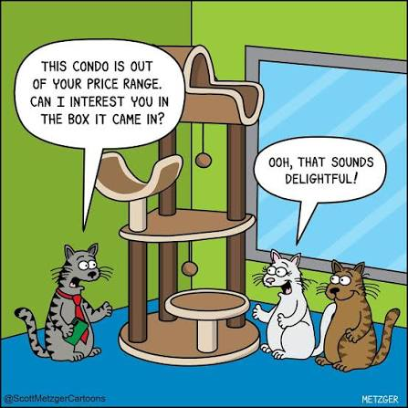
Common Category #3: Fair Housing
Ask opposing counsel for the accommodation in writing.
Give a time limit to respond in light of the pending court date.
Possible outcomes:
  They say yes. Great!
  They say no. Counterclaim – failure to accommodate.
  They don’t reply. Counterclaim – failure to engage in the interactive process.

Slide 19
What about agency complaints for Fair Housing issues?
Sure, if your client wants to.
HUD/CRED Complaint | Counterclaim
On agency timeline – months or years | On General Sessions timeline – days or weeks
Weak enforcement powers | Enforceable judgments
Agencies understand Fair Housing law… but can be political footballs. | Judges… probably understand Fair Housing law?
Client talks privately to investigator | Client talks publicly to judge, adverse party, and the world

Slide 20

Common Category #4: Retaliation
The Good: Judges understand them Clients care deeply about them Statutory authority (TCA § 66-28-514, Fair Housing Act) The Bad: Unless the landlord is an idiot, can you carry the burden to prove it was retaliation? The Ugly: You: "The landlord is evicting my client because she exercised her rights.“ Landlord: “No, we’re evicting her because over the last three years, she’s had 12 noise complaints from her neighbors, 8 aggressive run-ins with property management, 6 housekeeping complaints, and she has a partridge and a pear tree on her patio.”

Slide 21

Retaliation Strategy
Ask:
What is the protected activity?
What is the timeline?
What legitimate reasons will the landlord give?
Will pleading retaliation advance the client’s goals?
Even assuming retaliation exists, does alleging retaliation help your client more than the landlord’s rebuttal will hurt them?

Slide 22
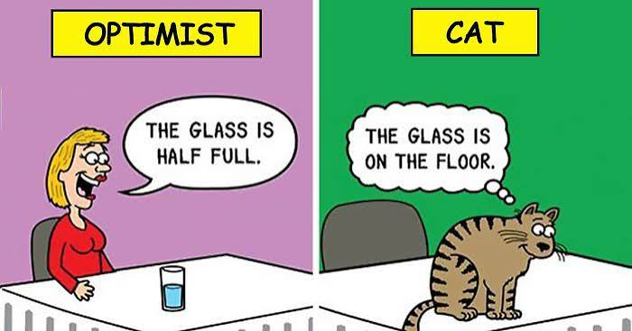
Poll
Looking at your caseload now, what percentage of your cases contain at least one potentially viable counterclaim?

Slide 23

Part 2: Prepping Counterclaims

Slide 24
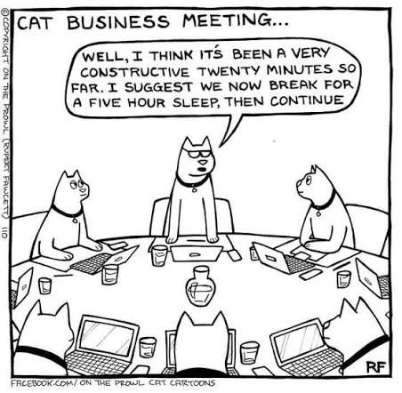
Discussing Counterclaims with Clients
Stage 1 – Before you draft
Is written notice needed? (E.g., URLTA claims)
What are the client’s main concerns?
Ask open-ended questions. Get details, pictures, and receipts.
Set expectations.
Stage 2 – When you’re ready to file
Check every detail with client.
Practice a mini direct
Decide on an opening demand, again setting expectations.

Slide 25
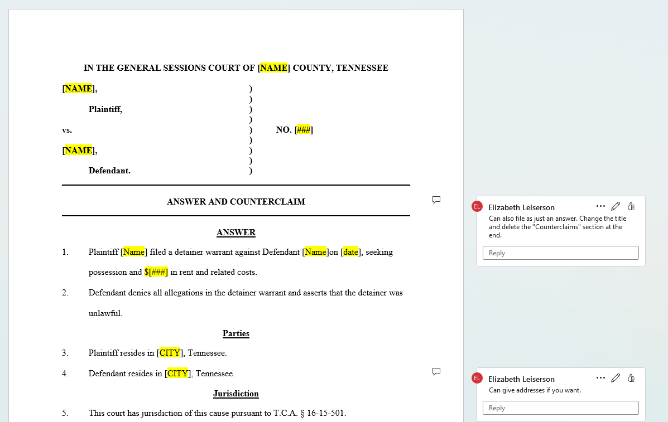
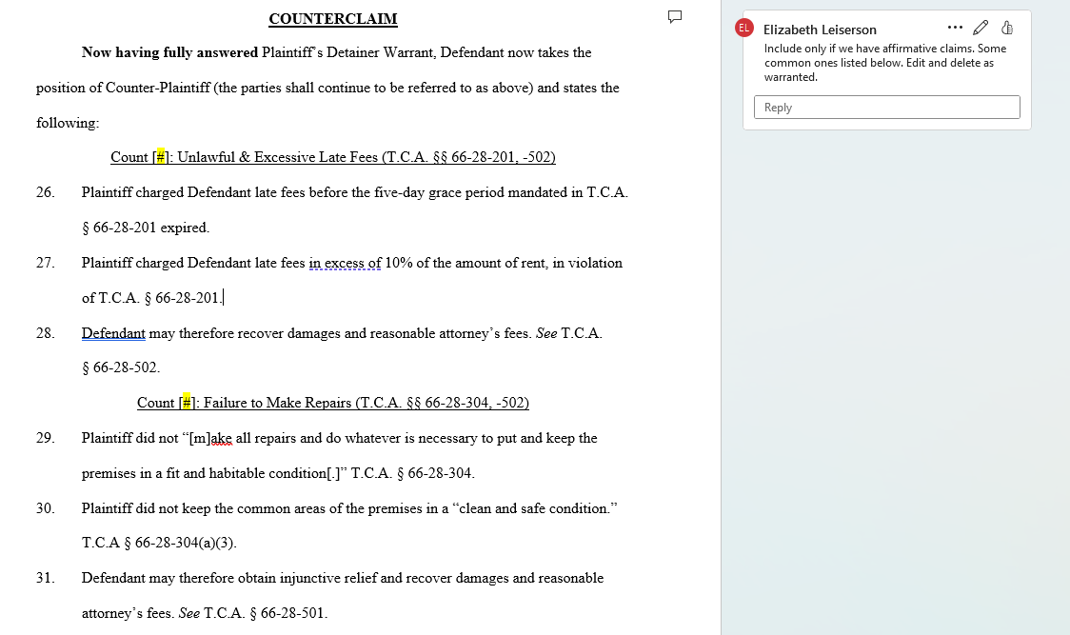
The template is your best friend.

Slide 26

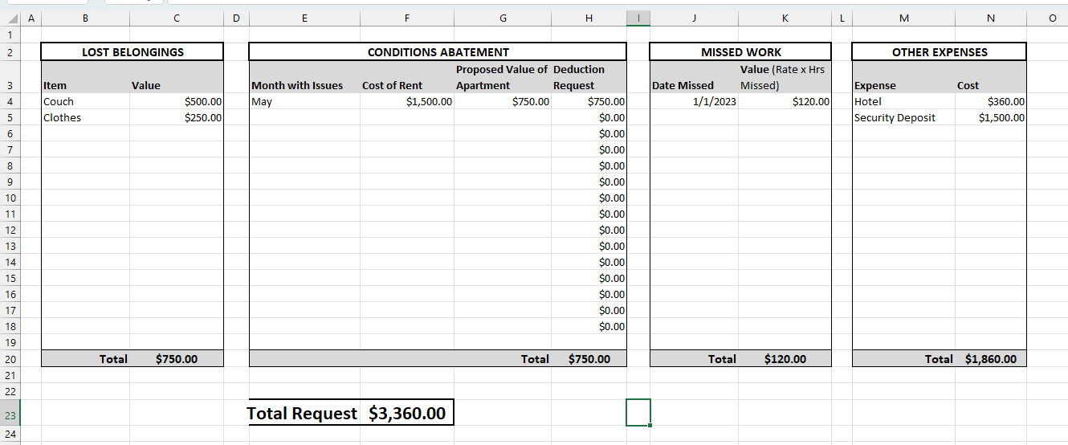
Remedies 1: Compensatory Damages
What types of claims? All of them!
How to calculate? Add up everything this cost the tenant. A Damages Spreadsheet can help.
Special issues to be aware of: None.

Slide 27
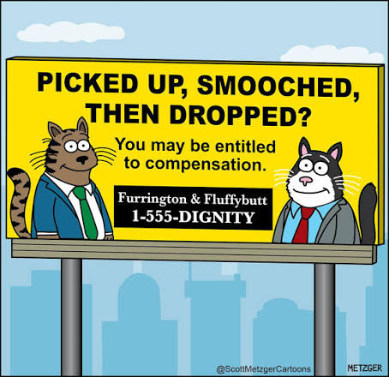
Remedies 2: Punitive Damages
What types of claims? NOT everything!
  Willful or knowing TCPA violations (TCA 47-18-109(a)(3)-(4))
  Fair Housing (42 USC 3613(c)(1))
  URLTA ouster (TCA 66-28-504)
How to calculate? With a lot of judicial discretion. Often a multiple of compensatory damages
  TCPA has treble damages; factors at TCA 47-18-109(a)(4)
  Long list of factors in caselaw. Hodges v. S.C. Toof & Co., 833 S.W. 2d 896, 901-02 (Tenn. 1992)
Special issues to be aware of: Potential constitutional issues if punitive damages are more than 10x compensatory damages. Goff v. Elmo Greer & Sons Const. Co., 297 S.W.3d 175 (Tenn. 2009).

Slide 28
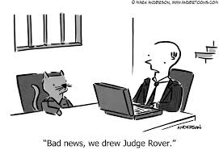
Remedies 3: Injunctive Relief
What types of claims? NOT pure contract claims.
  URLTA violations after 14 days’ written notice (TCA 66-28-501(a))
  Fair Housing, TCPA
How to design? Be as specific as possible. Ask for the case to be continued to monitor enforcement – and if they don’t perform, consider asking for punitive damages.
Special issues to be aware of: Some General Sessions judges think they can’t issue injunctions. This is wrong. See TCA 16-15-401(b) (“Judges of general sessions courts have the same authority as circuit court judges or chancellors to grant fiats for writs of injunction, attachments and other extraordinary process.”).

Slide 29
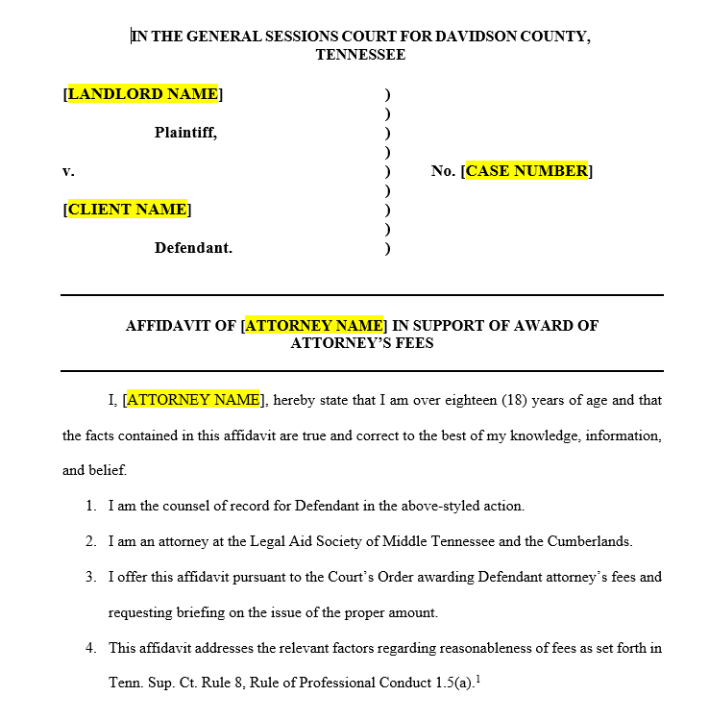

Remedies 4: Attorney’s Fees
What types of claims? NOT pure contract claims.
  URLTA violations after 14 days’ written notice (TCA 66-28-501(a))
  Fair Housing, TCPA
How to calculate? Pull your hours spent on the case. Multiply by a reasonable hourly rate for your services Adjust based on the factors in Rule of Professional Conduct 1.5(a).
Special issues to be aware of: Landlords’ attorneys routinely request a fee based on amount at issue (e.g., 30% of total). You may want to do the same – or may not.

Slide 30
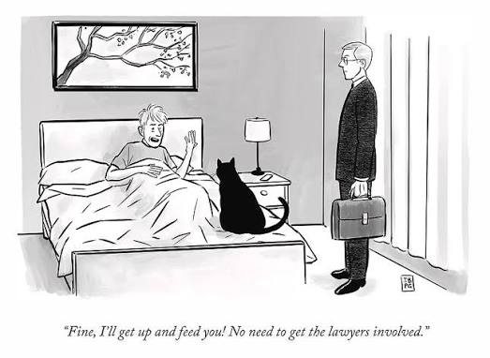
Filing Details
Which to file:
  Answer & Counterclaim
  Answer
  Pre-trial brief
Filing fee. In Davidson, it’s $42.
Service. Can use sheriff service, e-service, or hand deliver a copy, as allowed by your court.
Bring copies when you come to court!

Slide 31
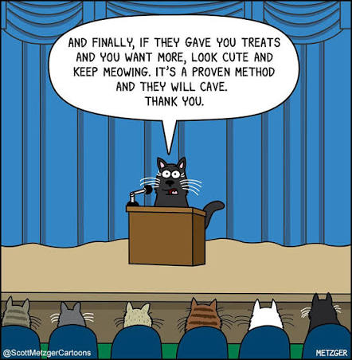
Part 3: Practice

Slide 32

Client A
Mr. Green placed his voucher at a terrible LIHTC complex in Nashville. Section 8 inspected the apartment last summer, and the landlord was supposed to fix some structural issues and one burner on the stove. He was supposed to fix a hole he’d put in the wall moving furniture. They eventually fixed the stove but never did fix the structural problems, and he never got around to fixing the hole.
Last month, Section 8 stopped paying their portion because the issues weren’t fixed. The landlord gave him a 14-day notice, then filed the eviction.
Mr. Green is happy to move if they’ll just give him time to place his voucher somewhere else.

Slide 33

Client B
Ms. Black has lived in a project-based section 8 complex for years. She’s older and can’t get around easily these days. Her son comes by a lot to help her out. He drops off groceries and does chores. Sometimes he leaves his kids for her to watch while he’s at work. Last month, he stayed for a week while she was recovering from a surgery.
New management keeps hassling Ms. Black about her son. A few weeks ago, they told her she needed to add him to the lease and recertify based on his income. She said no, he doesn’t live there. It got heated, and Ms. Brown admits she raised her voice.
She received a three-day notice saying she was threatening staff, then a detainer warrant. She just wants to stay in her home.

Slide 34
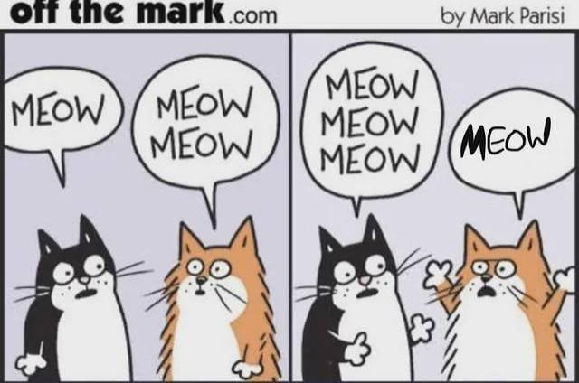
Discussion points
What counterclaims does your client have?
What evidence do you need to collect?
How would you calculate damages?
How would you start negotiation to meet the client’s goals?

Slide 35
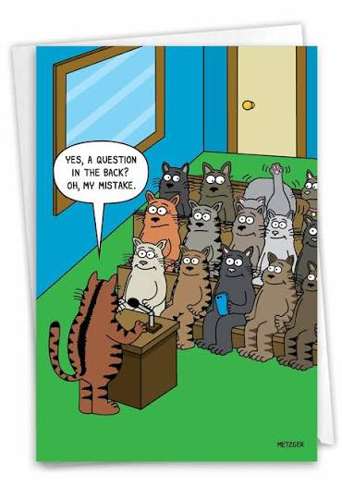
Questions?
Stay in touch:
eleiserson@las.org

