Slide 1
Not Another Flyer: Outreach to Meet Clients Where They Are
Presented By
Zane Jud & Sofia Colby

Slide 2
Introduction
When you think of nonprofit outreach, what comes to mind?
Maybe it's a resource fair or a table covered in brochures. Perhaps it's someone handing you a flyer. Those methods are still incredibly important—but today, they're only one piece of the outreach puzzle.
Printed materials are tangible, easy to distribute, and remain an important way to connect people with resources. But as the ways people search for and consume information continue to change, outreach has an opportunity to evolve alongside them. So today, we'd like to explore what it looks like to expand—not replace—traditional outreach and meet clients where they already are.

Slide 3
Traditional Outreach
What Works & What Doesn't
Strengths
Limitations
  Tangible and easy to distribute
  Doesn't require internet access
  Great for courts, libraries, clinics, and community events
  Can be translated into multiple languages
  Familiar and relatively inexpensive
  Information becomes outdated quickly
  Limited space for detailed explanations
  Difficult to measure impact
  Easy to throw away or overlook
  Doesn't reach people who aren't attending in-person events

Slide 4
Multi-channel Outreach
In today's digital age, people are increasingly turning to online platforms for information, including:
  Social media (Instagram, Facebook, TikTok, etc.)
  Webinars
  YouTube videos
  Search engines and AI tools
The question is no longer just "How do we share information?" but "How do we make sure people can find it?"

Slide 5
Social Media
Moving Beyond Simply Posting Information
Social media platforms like Facebook and Instagram have evolved beyond traditional posts. Features such as Reels, Stories, and short-form videos allow organizations to share information in new and more engaging ways.
However, simply posting information does not guarantee that people will see or engage with it. To expand our reach, we need to think strategically about the content we create and how people interact with it.

Slide 6
Social Media Continued
Ways to increase engagement and reach:
  Know your audience: Use platform analytics to understand who is engaging with your content (age groups, location, interests, etc.) and tailor content accordingly.
  Make information easy to engage with: Use clear messaging, attention-grabbing visuals, and accessible language while ensuring design elements support—not distract from—the message.
  Use current trends strategically: Incorporate relevant social media trends, formats, and sounds when appropriate to increase visibility.
  Create shareable content: Ask yourself, "Would someone share this with a friend or family member who needs this information?"
  Think outside the box: Find creative ways to make your organization's information stand out in a crowded digital space.

Slide 7
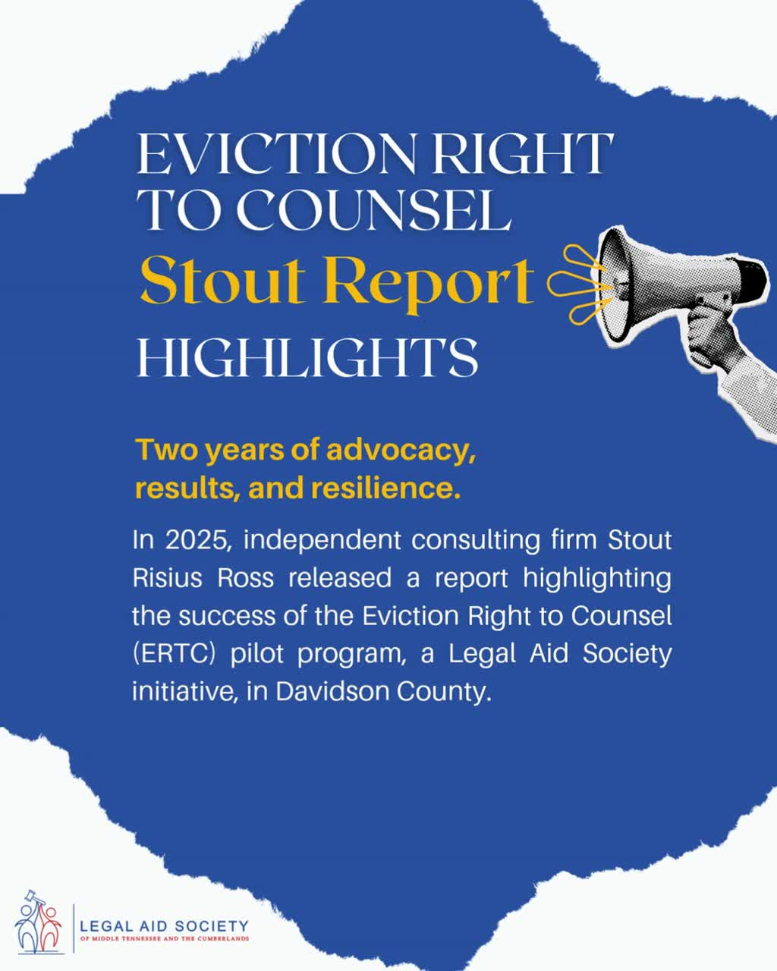
Example:

Slide 8
Webinars
Bringing Legal Education Directly to the Community
Benefits
  Live Q&A
  Reach people who cannot attend in person
  Record once, use repeatedly
  Partner with community organizations

Slide 9

Example:

Slide 10
KYR Videos
Short Videos with Long-Term Impact
Instead of expecting someone to read an entire brochure...
Create:
  1–3 minute videos
  Include:
    Frequently Asked Questions
    Step-by-step explanations
  Publish them in multiple languages
Benefits:
  Easy to understand
  Highly shareable
  Accessible anytime

Slide 11
Synthesia
Making Information More Accessible
Benefits
  AI avatars (no camera or filming required) aka increased efficiency
  Multiple language translations
  Faster content creation and updates
  Consistent messaging
  Easy to repurpose existing materials
Key point: AI should support—not replace—attorneys and outreach staff.

Slide 12
Other Digital Tools
Additional Ways to Reach Communities
  QR codes
  Text messaging campaigns
  Email newsletters
  YouTube playlists
  Podcasts
  Interactive websites
  Online resource guides
  Chatbots/AI assistants (carefully designed)
  Online resource hubs (housing resources, FAQs, forms)

Slide 13
Implementation
Starting Small: A Sustainable Approach
Step 1
Continue existing outreach.
Step 2
Repurpose brochures into digital content.
Step 3
Create short videos answering common questions.
Step 4
Host quarterly webinars.
Step 5
Measure engagement and adjust content as needed.

Slide 14
The Future of Outreach
Rather than replacing traditional methods...
We will likely see:
  More multilingual video content
  Greater use of AI translation
  Resources optimized for mobile devices
  Interactive legal education
  Personalized digital resources
  Hybrid outreach combining in-person and online engagement
Key point:
The future isn't less personal—it's more accessible.

Slide 15
Looking Ahead
Final takeaway:
The goal has never been to hand out the most flyers. It's to ensure that every person who needs legal information can access it in a format that works for them.
Traditional outreach remains essential; digital outreach expands our reach, increases accessibility, and helps legal aid organizations educate more people than ever before.

