Slide 1

Immigration Basics
Chay Sengkhounmany
August 27, 2026

Slide 2
Who are we and
what do we do?

Slide 3



Slide 4
7,305 Cases Handled or Opened During the Year
561,000 Unique Visitors to Legal Aid Society’s Website
50 Attorneys
Over 275 Media Placements
Over 7.1 million People Reached Through Community Outreach and Education
39,141 Self- Help Educational Booklets Distributed
951 People attended Legal Aid Society Presentations
$11.20 Return on Investment for Every Dollar Donated to Legal Aid
$16+mm of Financial Benefits and Savings Awarded for Clients in 2025

Slide 5
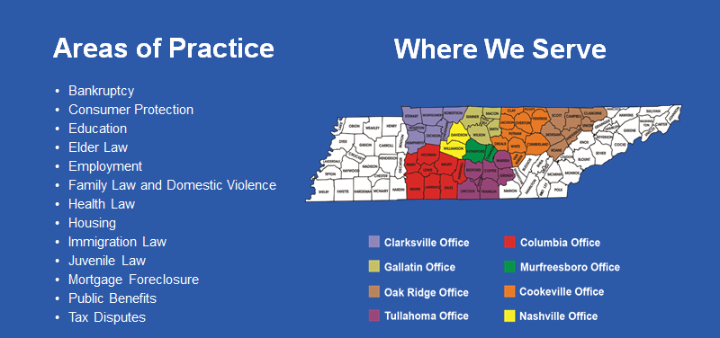

Slide 6

Survivors Immigration Legal Project (Immigration Unit)
Began taking cases in 2019
Provide immigration legal help to those who qualify
Can only help survivors of domestic violence, sexual assault, stalking, human sex trafficking
  OVW-LAV grant provides funding to serve survivors (11 and older) of domestic violence, sexual assault, or stalking
  Other grants are used to fund services to survivors of human sex trafficking and those 10 and younger

Slide 7





Clients Served By SIL Project
Medically-fragile boy in foster care because of severe abuse by mother – SIJS, work permit, SSN, removal proceedings dismissed
Gay male who fled Jamaica (same-sex acts are criminal) after he was gang-raped. In the US, he was also robbed at gun point – filed for asylum and U visa
Human trafficking survivor who was forced to travel to US to become trafficker’s sex slave – T visa and work permit
Minor who was sexually assaulted and stalked by family acquaintance – Filed U visa for client and 5 family members

Slide 8
What government agencies are in charge of handling immigration laws?

Slide 9

Sources of Laws
“establish an uniform Rule of Naturalization”
Legislative
Immigration & Nationality Act
Judicial
Cases
Executive
Regulations
BIA Decisions
Agency Policies & Guidance
Executive Orders

Slide 10

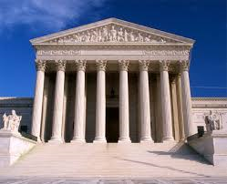
Key Players
Appeals go to the Federal Court of Appeals or U.S. District Court
USCIS
ICE
CBP
EOIR
BIA
Immigration Court
OIL
U.S. Embassies
U.S. Consulates
Notes:
Additionally, the Office of Refugee Resettlement within the Department of Health and Human Services oversees the placement of refugees and unaccompanied children. The mission and purpose of the ORR is to assist in the relocation process and provide needed services to these individuals

Slide 11
What is immigration status and why does matter?

Slide 12
Definitions
US Citizens
Non-citizens
    Immigrant – Person entering the US to reside permanently (Legal Permanent Resident)
    Nonimmigrant – Temporarily admitted to US for a specific purpose other than LPR
    Refugees or asylees – Persecuted person
Naturalization
Visa vs. Status
Inadmissibility
Unlawful Presence
Removal
Removal Proceedings (Formerly Called Exclusion and Deportation)

Slide 13


Status – Right to be in the house (US)
  Can be temporary (renters) or permanent (home owners)
Visa – Key to the house
  Can lose key or have it taken away but may still have rights to be in the house
  May have a key to the house but do not have permission to be in the house

Slide 14
Immigration Law: Visa Alphabet Soup Overview
B
Tourist
C
Crewmember
F
Student
H
Temporary worker
I
International media
K
Fiancé
J
Exchange visitor
L
Intracompany transfer
M
Vocational student
O
Workers of extraordinary ability
P
Athletes and performers
Q
Cultural ambassadors
R
Religious workers
S
“Snitch”
T
Trafficking victim
U
Victims of certain crimes
A
Ambassadors and Diplomats
E
Investor / Trader
G
International Orgs and NATO
Notes:
All temporary statuses. Some allow work, some do not. People on temporary visas who like the United States and want to stay are often looking for a way to become LPRs.
Visas are now being revoked based on new DOS guidance on DUIs. Tied to the ground of inadmissibility for mental health disorder involving behavior that poses a danger to others. Rehabilitation and medical exams.

Slide 15
Spectrum of Status
Deferred Action
Nonimmigrant Visa Holder
Undocumented
U.S. Citizen
Lawful Permanent Resident (LPR)
POSABAG
Order of Supervision
Not lawful status but
authorized stay
Unlawful status
Lawful status
Notes:
period of stay authorized by the Attorney General
United States Citizen (USC)
Someone who is either born in US, born abroad to a USC, naturalized as a UCS, or automatically became USC when parent(s) became naturalized
Lawful Permanent Residents (LPR)
Any noncitizens who make the US their home, have authorization to work in the US. and have the most stable immigration status
Conditional Residents
A noncitizen granted LPR status for 2 years on a conditional basis because the marriage that the status was based on was less than two years old. Conditional LPR must jointly petition with their spouse to remove the conditions before the expiration of status
Asylees
A noncitizen in the US or at a port of entry who cannot return to his or her country because of persecution or a well-founded fear of persecution based on the noncitzen’s race, religion, nationality, membership in a particular social group, or political opinion
Non-Immigrant
Noncitizens who seeks temporary entry to the US for a specific purpose. The noncitizen must have a permanent residence abroad (for most classes of admission) and qualify for the nonimmigrant classification sought.
Undocumented Immigrants
Noncitizens who either entered the US without US government’s permission or whose legal immigration documents have expired since they entered. All undocumented immigrants are deportable, but some have a defense or other forms of relief available.

Slide 16
Spectrum of Status
Deferred Action
Nonimmigrant Visa Holder
Undocumented
U.S. Citizen
Lawful Permanent Resident (LPR)
POSABAG
Order of Supervision
Not lawful status but
authorized stay
Unlawful status
Lawful status
MOM
DAD
CHILD
Notes:
Period of Stay Authorized by the Attorney General
periods of authorized stay are only relevant when determining an alien’s accrual of unlawful presence for inadmissibility purposes.^{[17]} Although an alien in a lawful immigration status is also in a period of authorized stay, the opposite is not necessarily true. Those in a period of authorized stay may or may not be in a lawful immigration status.
United States Citizen (USC)
Someone who is either born in US, born abroad to a USC, naturalized as a UCS, or automatically became USC when parent(s) became naturalized
Lawful Permanent Residents (LPR)
Any noncitizens who make the US their home, have authorization to work in the US. and have the most stable immigration status
Conditional Residents
A noncitizen granted LPR status for 2 years on a conditional basis because the marriage that the status was based on was less than two years old. Conditional LPR must jointly petition with their spouse to remove the conditions before the expiration of status
Asylees
A noncitizen in the US or at a port of entry who cannot return to his or her country because of persecution or a well-founded fear of persecution based on the noncitzen’s race, religion, nationality, membership in a particular social group, or political opinion
Non-Immigrant
Noncitizens who seeks temporary entry to the US for a specific purpose. The noncitizen must have a permanent residence abroad (for most classes of admission) and qualify for the nonimmigrant classification sought.
Undocumented Immigrants
Noncitizens who either entered the US without US government’s permission or whose legal immigration documents have expired since they entered. All undocumented immigrants are deportable, but some have a defense or other forms of relief available.

Slide 17
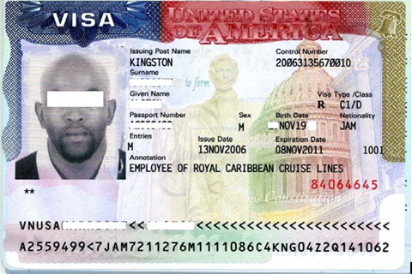

Visa and Entry Stamp

Slide 18
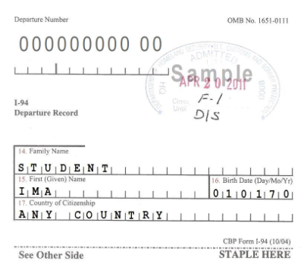
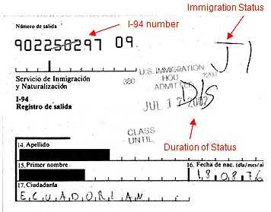
I-94 with various notations

Slide 19
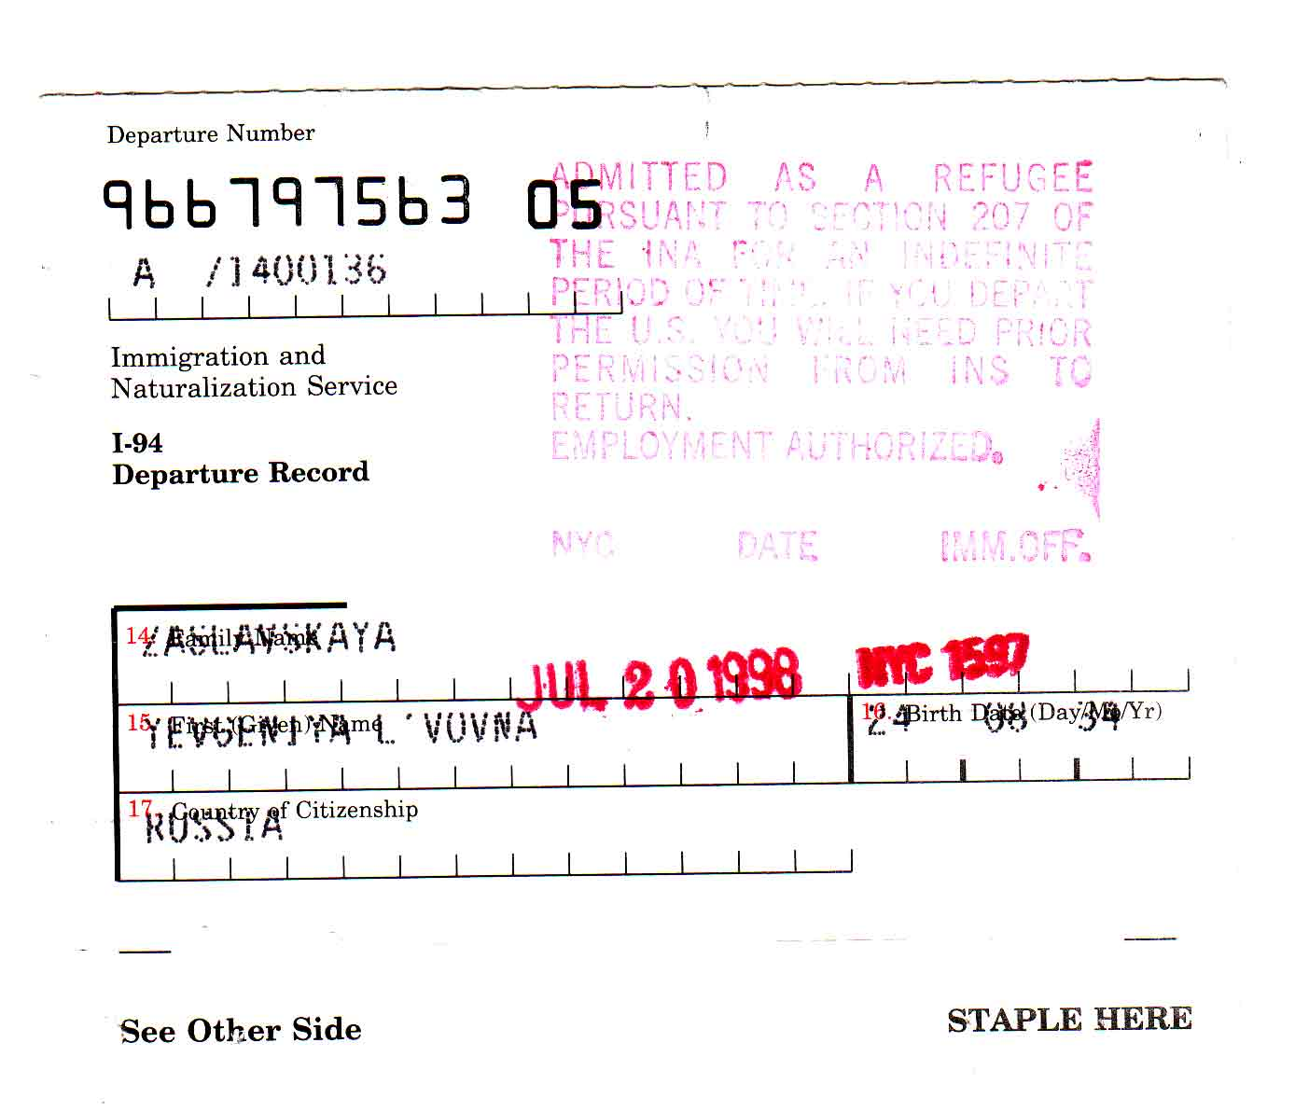
I-94 Refugee

Slide 20
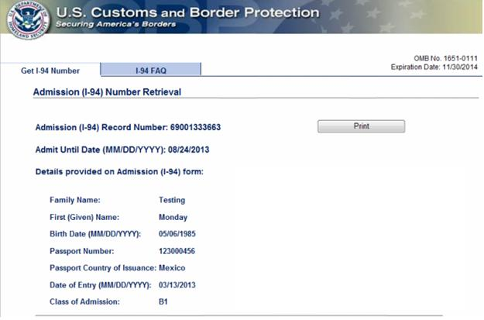
Electronic I-94

Slide 21
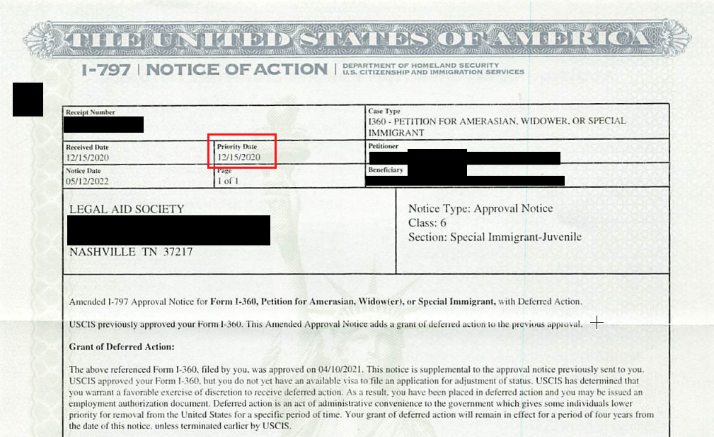
I-360 SIJS Approval Notice

Slide 22
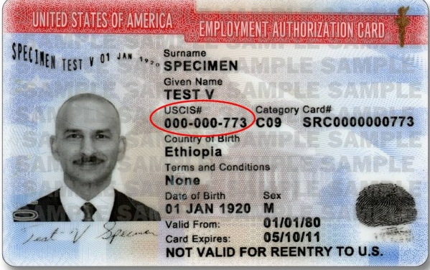
Employment Authorization Document
AKA:
Work permit
Permiso para trabajar
What is this?
Document that authorizes a noncitizen to work during dates indicated on card. This document does not grant lawful immigration status.
MANY types of noncitizens may have work permits
Look at the category though, which can confirm eligibility

Slide 23
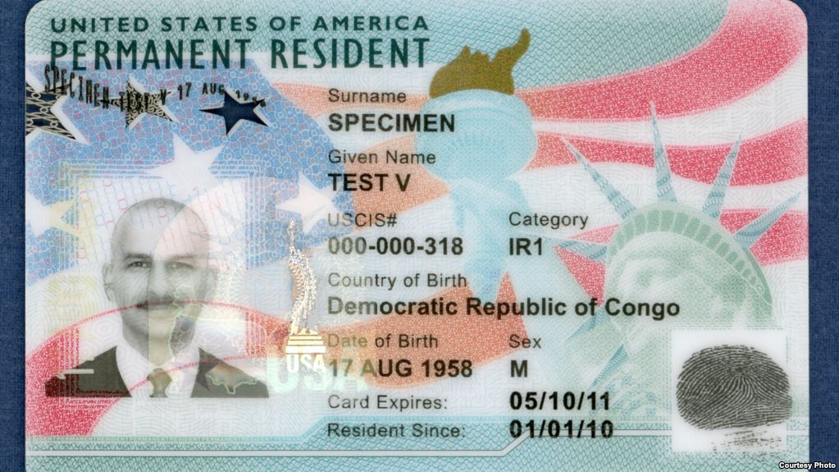
Lawful Permanent Resident

Slide 24
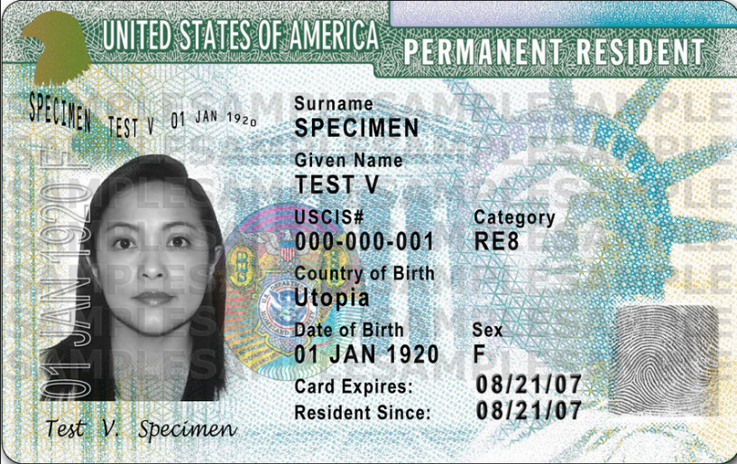
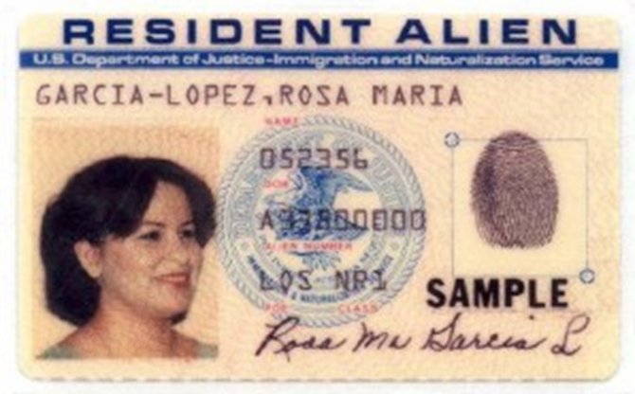
Lawful Permanent Resident

Slide 25
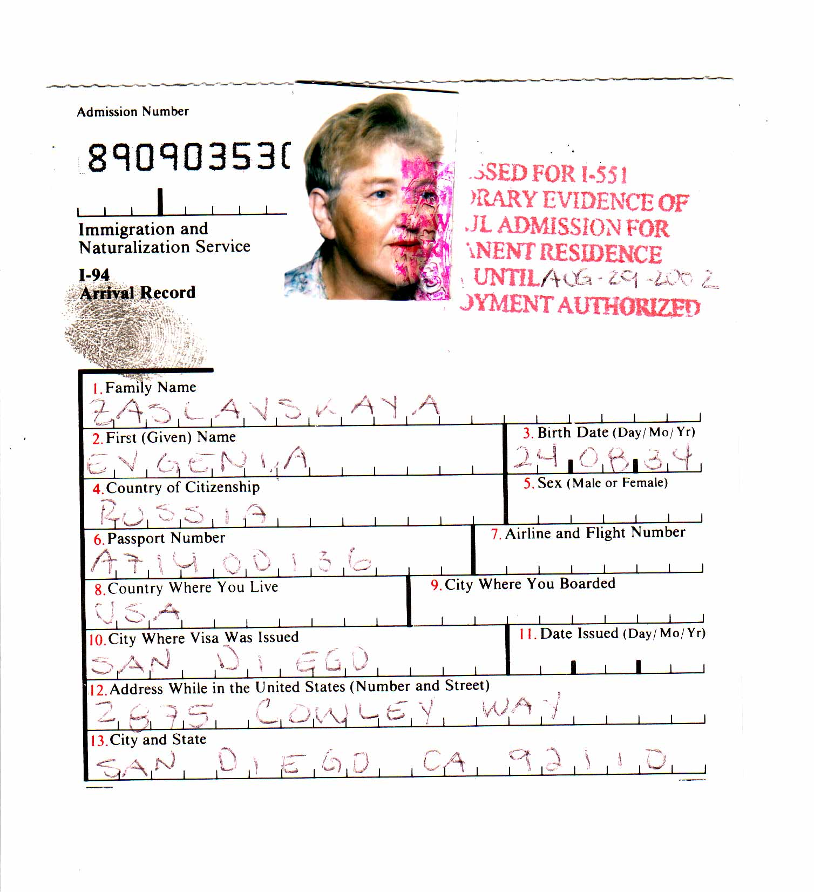
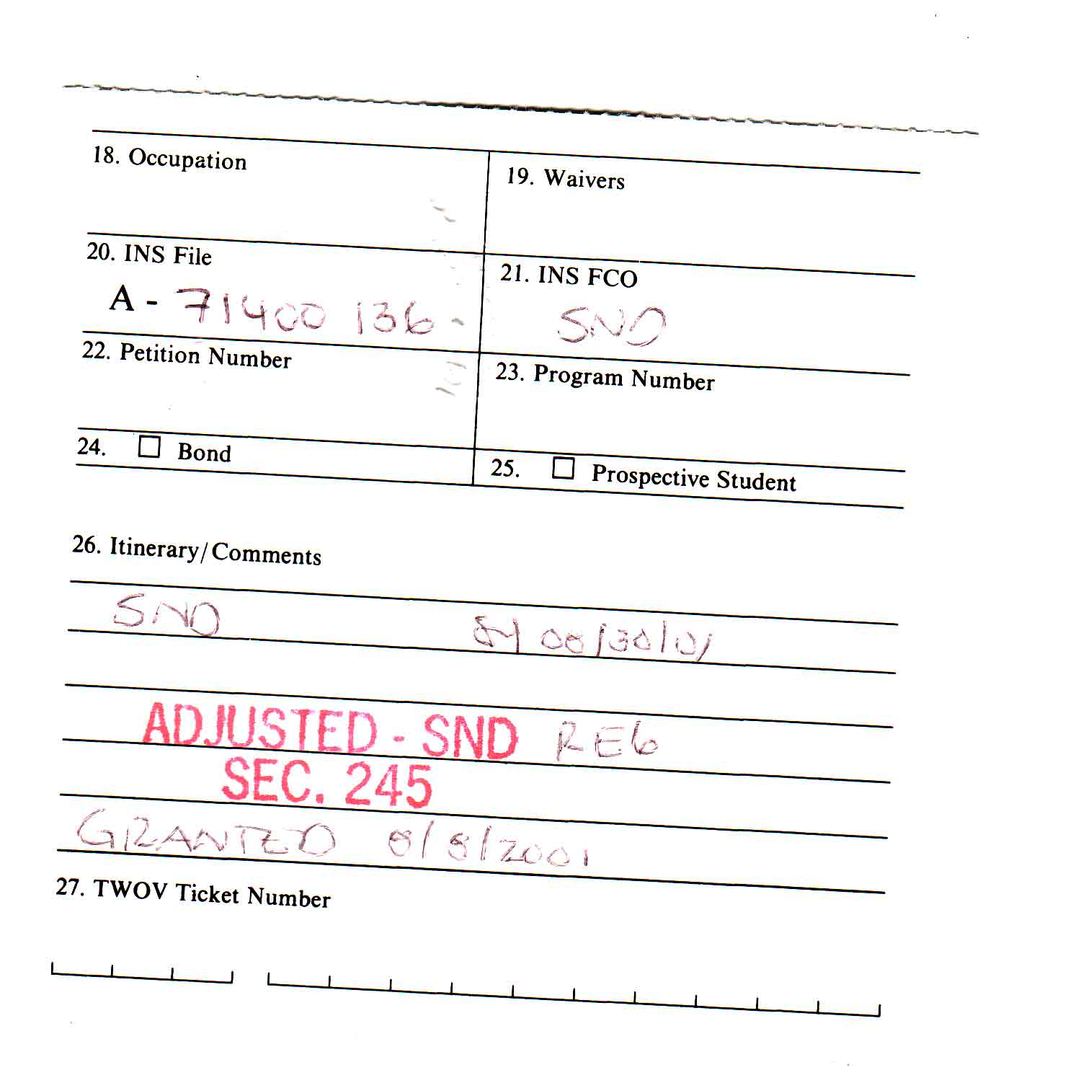
Temporary I-94 w/I-551

Slide 26
I just want to be able to work. Can I apply for a work permit?

Slide 27
Immigration Law: Visa Alphabet Soup Overview
B
Tourist
C
Crewmember
F
Student
H
Temporary worker
I
International media
K
Fiancé
J
Exchange visitor
L
Intracompany transfer
M
Vocational student
O
Workers of extraordinary ability
P
Athletes and performers
Q
Cultural ambassadors
R
Religious workers
S
“Snitch”
T
Trafficking victim
U
Victims of certain crimes
A
Ambassadors and Diplomats
E
Investor / Trader
G
International Orgs and NATO
Notes:
All temporary statuses. Some allow work, some do not. People on temporary visas who like the United States and want to stay are often looking for a way to become LPRs.

Slide 28
Notes:
This slide is not meant to be legible. It is used as a visual to illustrate how complicated the immigration process is.

Slide 29
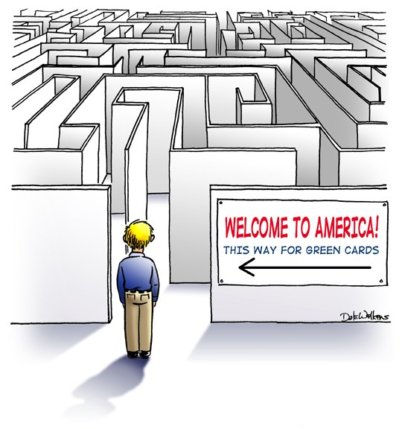
Routes to Coming to the United States
Family-based Immigration
Employment-based Immigration
Refugee/Asylee
Special Legislation
Diversity Lottery
Non-immigrant visas
  Tourist, Student, Temporary worker, etc.
Other highly specialized visas
  Religious workers, investors, individuals with extraordinary abilities, etc.

Slide 30

Primary Path to LPR status
Family-based Immigration – 226,000 (not counting immediate family members)
  VAWA self-petitions
Employment-based Immigration – 141,918
Special Legislation – Cuban Adjustment Act
Diversity Lottery – 50,000
U visas – 10,000
T visas – 5,000
Asylum
Cancellation of Removal – 4,000

Slide 31
Two-Step Process of Getting Green Card
Step 1 – Qualifying Relationship or Circumstances | Step 2 – Applying for green card (Legal Permanent Residence)
Petition to show you have a qualifying relationship | Must meet the requirements to get a green card
Get priority date | Adjustment of Status (Inside U.S.)
 | Consular Processing (Outside U.S.)
Many undocumented people often have a qualifying relationship and are able to get an approval for this step but cannot get approval for step 2 | Must show admissible Must not have Committed certain immigration violations Committed certain crimes Certain contagious diseases
 | Problem of 3 or 10 year bar
Notes:
Getting permission to live in the United States legally is a two-step process:
Step One -- You must show you have a qualifying relationship, such as a family member (family sponsorship), employer or that you are under a special group such as: a victim of trafficking, crime or domestic violence; being a refugee; seeking political asylum; or diversity lottery.
Many people who are undocumented often have a qualifying relationship and are able to get an approval for this step.
Family Sponsorship – You must have a qualifying relative who is willing to sponsor you. The qualifying relative, who is an adult U.S. citizen, can sponsor their spouse, parent, child or sibling. A Lawful Permanent Resident can sponsor their spouse and unmarried children.
Employment-based immigration – Immigration law allows about 140,000 employment visas to be admitted to the United States to work. Most of these immigrants are highly skilled professionals. A worker usually needs an employer to petition on his or her behalf. Some workers – priority workers, investors, and certain special immigrants may petition on their own.
Step Two – You must meet the requirements to get a green card. Some of these requirements mean that you must not have:
Committed certain immigration violations
Committed certain crimes
Certain contagious diseases
These are just a few of the requirements. There are many more. There are a few exceptions to the requirements, but they may be difficult and risky prove. You should consult with an experienced immigration attorney or BIA accredited advocate when you have questions about your immigration status.
Many people have immigration violations, such as entering the United Sates without permission. People, who came to the United States without permission, usually cannot apply for a green card in the United States. They must go to their home country to apply and also request a waiver which are often difficult to obtain.
Depending on how long they have been in the United States unlawfully, they may not be allowed back into the United Sates for several years once they leave, even if they have a qualifying relationship.
Disabled or sick - Having a disability or illness does NOT make you eligible for lawful residency. In fact, it may be a problem when USCIS (the immigration agency) looks to see if you are likely to become a “public charge.” A “public charge” is someone who depends on the government for public cash assistance or other government benefits.

Slide 32
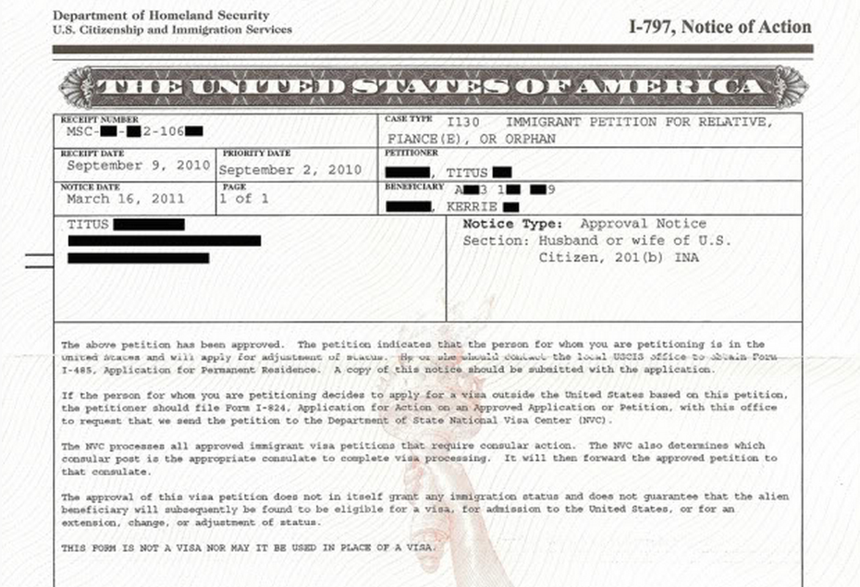
I-130 Family Petition
Common proof of filing of immigration application

Slide 33
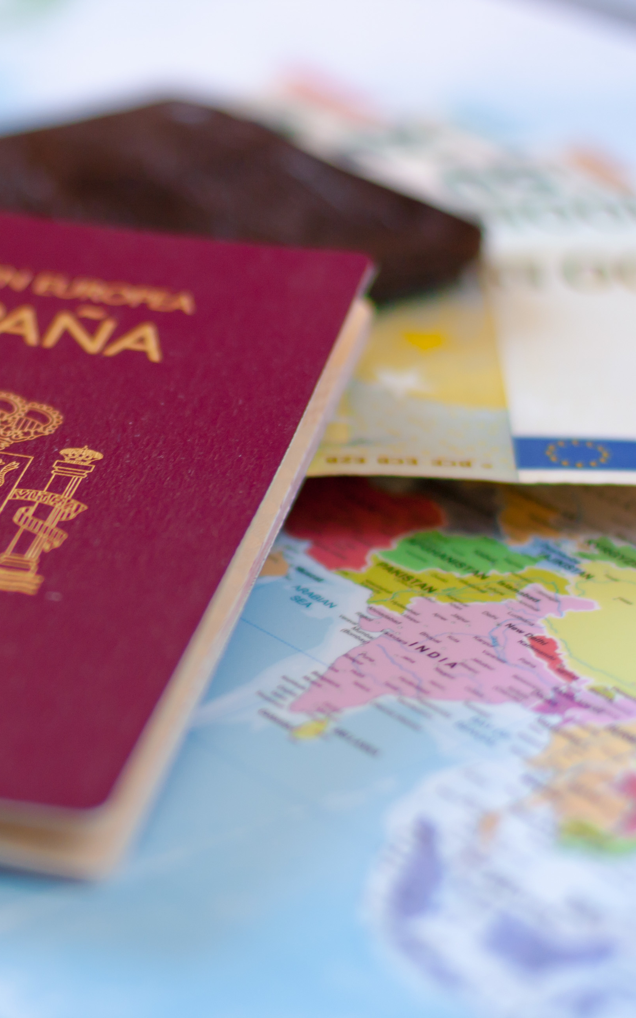
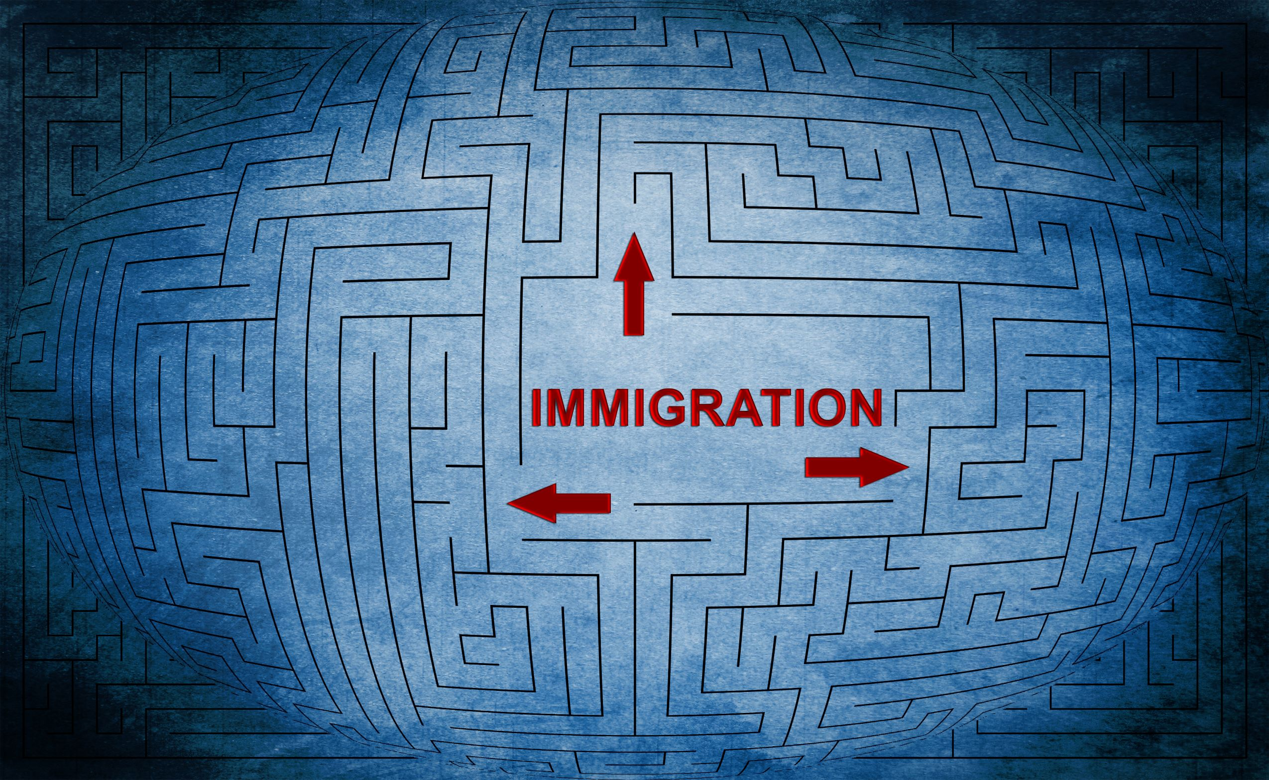

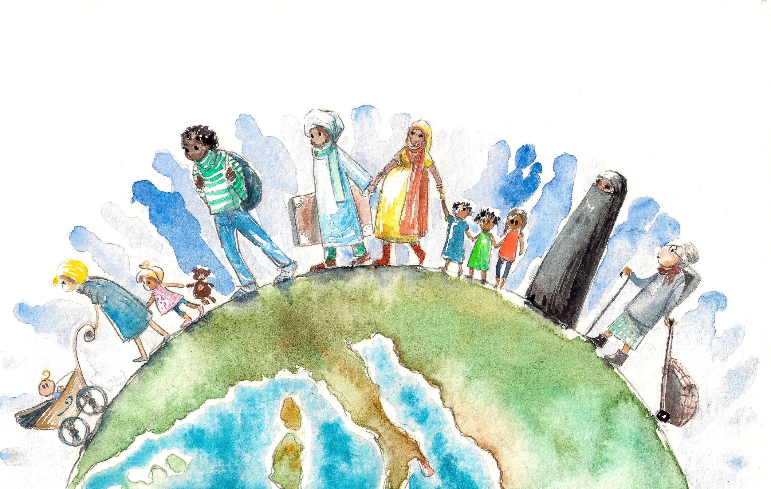
Immigration Relief
Available to Survivors
Asylum, Withholding of Removal, Convention Against Torture
Cancellation of Removal
Special Immigrant Juvenile Status
Conditional Resident Waivers
Violence Against Women Act (VAWA) Self-Petition
U Visa – Victim of Crime Status
T Visa – Human Trafficking Status
Naturalization (Citizenship)

Slide 34
My spouse is abusing me and always tells me he is going to call ICE on me. Do I have to stay with him to get my green card?

Slide 35

VAWA Self-Petition
Status for victims of domestic abuse

Slide 36
VAWA Self-Petition
Who is eligible
Benefits
Immigrant abused by
  USC or LPR spouse or former spouse
  USC or LPR parent
  USC or LPR son or daughter
Immigrant whose child abused by USC or LPR spouse or former spouse during the marriage
Legal permanent residence under VAWA special provisions
VAWA confidentiality protections
Exempt from public charge ground
With prima facie notice, may be eligible for certain public benefits if arrived in the U.S prior to 8/22/1996
Can get work permit while awaiting permanent residency
US citizenship after 5 years in LPR status
Puts control back in the hands of the victim

Slide 37
Abuse Experienced by Non-citizens
“If I leave him, I will lose custody of my children because I don’t have legal status”
  “My wife tells everyone I only married her for papers”
“My husband threatened to notify Immigration if I leave him”
  “My abuser has hidden my immigration documents so that I cannot leave him”
“My abuser won’t let me call my family”
  “Domestic violence does not exist in my culture. All failures of the marriage are my fault”

Slide 38
Dynamics of Domestic Violence and the Immigrant Client
1
2
3
4
5
6
Social Pressure
Language Issues
Limited Information
Isolation
Immigration Issues
Fear of Authority

Slide 39
What if I am not married to my abuser or my abuser is undocumented?

Slide 40
U Visa
Status for victims of certain crimes

Slide 41
U Visa
Requirements
Benefits
Is a victim of a listed crime
Suffered substantial physical or emotional harm
Has been helpful, is being helpful, or is likely to be helpful in investigation
Obtain certification from law enforcement or prosecutor certifying these elements
Available to those who
  Are not married to perpetrator
  Are not married to a USC or LPR
  Are dependent on spouse’s non-immigrant visa
4 years of non-immigrant status
Work permit
Legal permanent residence after 3 years in U status

Slide 42
Enumerated Crimes or Similar Activity under the U visa Statute
Female Genital Mutilation
Rape
Blackmail
Torture
Hostage Taking
Extortion
Trafficking
Peonage
Manslaughter
Incest
Involuntary Servitude
Murder
Domestic Violence
Slave Trade
Stalking
Fraud in Foreign Labor Contracting
Sexual Assault
Kidnapping
Abusive Sexual Contact
Abduction
Felonious Assault
Unlawful Criminal Restraint
Prostitution
Witness Tampering
Sexual Exploitation
False Imprisonment
Obstruction of justice
Perjury
Or attempt, conspiracy, or solicitation to commit any of the above mentioned crimes

Slide 43
Will the police call ICE if I contact them to report a crime
against me?

Slide 44
Right to Be Free From Violence
All persons, regardless of their immigration or citizenship status, have the right:
To access the courts for protective orders
To seek custody
To seek divorce
To file criminal proceedings
Right to access police protection
Should be advised of rights in own language
Should not be asked about status
Right to an interpreter in court, with police, with other providers (Title VI of Civil Rights Act)
Access to Protection
Access to an Interpreter
Access to Judicial System
Notes:
Being in the U.S. without documentation is not a crime and is not in the jurisdiction of the police ( Gonzales v. US)
All permanent legal or undocumented immigrants within the jurisdiction of the United States have the same rights in every state and territory to sue, be parties, give evidence, and have the full and equal benefit of all state and federal laws
Graham v. Richardson, 403 U.S. 365 (1971)
Martinez v. Fox Valley Bus Lines, 17 F. Supp. 576 (N.D. Ill. 1936)
Fundamental right to due process and equal protection under U.S. Constitution
Individuals are entitled to the protections of the Due Process and Equal Protection Clauses regardless of immigration status
Immigrants whose presence in this country is unlawful are still recognized as “persons” in the ordinary sense of the term, thus, guaranteeing them the Fifth and Fourteenth Amendment rights to due process of the law
Plyer v. Doe, 457 U.S. 202 (1982)

Slide 45
Encounters with Law Enforcement
Right to Remain Silent
Do Not Open Your Door
Right to Speak to Lawyer
Don’t answer any questions. May say that you want to remain silent
Don’t say anything about where you were born or how you entered the US
Carry a know-your-rights card and show it if an officer stops you
Do not have to let police or immigration agents into your home unless they have certain kinds of warrants
ICE must have a warrant signed by a judge
You can talk to ICE agent through door
Say, “I need to speak to my attorney”
Notes:
ICE must have a warrant signed by a judge. Do not open your door unless an ICE agent shows you a warrant. To be valid, the warrant must have your correct name and address on it.
You can talk to ICE agent through door. Once open the door, it is much harder to refuse to answer questions.

Slide 46
Encounters with Law Enforcement (cont.)
Do Not Sign Anything w/o Speaking to Lawyer
Carry Copies of Immigration Documents
Create a Safety Plan
Be sure you understand what a document actually says before signing it
ICE may try to get you to sign away your right to see a lawyer or a judge
If have work permit or green card, always carry with you for ID
Never carry anything that is fake or fraudulent with you
Do not carry social security card in wallet
Memorize the phone number of a friend or family member
Make a plan to have children taken care of if you are detained
Keep important documents such as birth certificates and immigration documents in a safe place

Slide 47
Tennessee Laws
Related to Immigration

Slide 48
Mandating Police Communication with ICE
HB 2124/SB 2576: Effective July 1, 2024
Requires that law enforcement communicate with ICE the immigration status of noncitizens who are arrested when they are charged with a crime
Most law enforcement already communicating with ICE
Should not avoid seeking the protection of law enforcement because afraid they will be reported to ICE Person will have to make a risk assessment
ICE does not have time or resources to pick up everyone ICE got lots of money in July
  Priorities are set by DHS
  Priorities have changed with new administration
  Big Bill signed into law by President on July 4, 2025 gave $29.9 billion toward ICE’s enforcement and deportation operations

Slide 49
Law Creating State Crime of Human Smuggling
HB 0322 / SB 0392 ; Effective July 1, 2025
Creates felony for any “person,” acting “for the purpose of commercial advantage or private financial gain,” to “[i]ntentionally conceal[], harbor[], or shield[] from detection” “an individual that the person knows has illegally entered or remained in the United States, as determined by the bureau of immigration and customs enforcement
Harbor means to provide shelter to or conceal the whereabouts of an individual whom the person knows has illegally entered or remained in the United States
TIRRC along with other orgs have filed class action lawsuit challenging this law as unconstitutional

Slide 50
Tennessee Immigration-Related Laws
Restricts certain professional licenses to people who are “lawfully present”
Creates a Centralized Immigration Enforcement Division and a Chief Immigration Enforcement Officer (“border czar”) within state government
Expands state/local participation in federal 287(g) agreements with ICE
Requires proof of U.S. citizenship for a standard driver's license; creates a distinctly marked temporary license for lawfully present non-citizens
Creates a Class A misdemeanor (up to 1 yr jail) for a person who remains in Tennessee more than 90 days after a final federal removal order
Creates a separate Class A misdemeanor for entering, attempting to enter, or being found in the state after having been denied admission, excluded, deported, or removed from the U.S.

Slide 51
Tennessee Immigration-Related Laws (cont.)
Requires adults (18+) applying for specified state/local public benefits to prove U.S. citizenship or lawful immigration status
Requires state and local agencies – including public health departments – to report individuals who are not lawfully present to the state's Centralized Immigration Enforcement Bureau
Imposes criminal penalties on public employees who fail to make required reports

Slide 52
Immigrant Survivors’ Access to Services

Slide 53
Access to State Courts
All permanent legal or undocumented immigrants within the jurisdiction of the United States have the same rights in every state and territory to sue, be parties, give evidence, and have the full and equal benefit of all state and federal laws
  42 USC 1981 (1970)
  Wong Wing v. United States, 163 U. S. 228, 238 (1896)
  Mathews v. Diaz, 426 U. S. 67, 77 (1976)
Fundamental right to due process and equal protection under U.S. Constitution

Slide 54
14th Amendment of U.S. Constitution
All persons born or naturalized in the United States and subject to the jurisdiction thereof, are citizens of the United States and of the State wherein they reside. No State shall make or enforce any law which shall abridge the privileges or immunities of citizens of the United States; nor shall any State deprive any person of life, liberty, or property, without due process of law; nor deny to any person within its jurisdiction the equal protection of the laws.

Slide 55
Due Process and Equal Protection
Individuals are entitled to the protections of the Due Process and Equal Protection Clauses regardless of immigration status
Immigrants whose presence in this country is unlawful are still recognized as “persons” in the ordinary sense of the term, thus, guaranteeing them the Fifth and Fourteenth Amendment rights to due process of the law
Plyer v. Doe, 457 U.S. 202 (1982)

Slide 56
Access to Services and Benefits
Federally Funded Legal and Social Welfare Programs
Benefits Opened to All
Necessary for Life
and Safety
Legal services by LSC-funded programs
Programs and services funded
  STOP
  HUD
  HHS
  VOCA
  LAV
ER Medicaid and ER medical services
Immunizations
Testing and Treatment for communicable diseases
Housing assistance if receiving on
8-22-1996
School lunch and breakfast
WIC (state option)
Community level programs that are necessary to protect life and safety
Child protection and adult protective services
Violence and abuse prevention
Mental illness or substance abuse treatment
Short-term shelter or housing assistance
Programs during adverse weather conditions
Soup kitchens, food banks, senior nutrition programs
Programs to protect the life and safety of workers, children or community residents

Slide 57

Language Barriers
Confusion or misunderstanding about eligibility for benefits by the immigrant or by the state agency worker
Barriers to Accessing Services
Fear of deportation or other negative USCIS/ICE action
Fear that receiving benefits will result in denial of lawful permanent residence on grounds that the immigrant is a “public charge"

Slide 58
Non-citizen eligibility for healthcare services:
Healthcare Program | Eligible Non-Citizens
Full Medicaid (TennCare) | LPRs (green card holders) only after 5 years Humanitarian status holders (refugees, asylees, special immigrant status, withholding of deportation, Cuban entrants) Victims of trafficking
Emergency Medicaid | Any non-citizen who would be eligible for Medicaid but for immigration status
Children’s Health Insurance Program (CHIP/CoverKids) | LPRs (green card holders) only after 5 years Humanitarian status holders (refugees, asylees, special immigrant status, withholding of deportation, Cuban entrants) Victims of trafficking Pregnant women regardless of immigration status (until 60 days postpartum)
Medicare | Lawfully present immigrant with 40 work credits Qualifying immigrant without sufficient work history can buy in only if have resided continuously in the U.S. for 5 years
ACA Premium Tax Credits | Broader range of non-citizens can participate in health insurance marketplace (including applicants for certain statuses) Non-citizens under 100% FPL can qualify for premium tax credits
Notes:
For Medicaid/CHIP, beginning October 1, 2026, only the following non-citizens will remain eligible for federally-funded Medicaid/CHIP coverage:
LPRs (after the five-year waiting period);
Cuban/Haitian entrants;
COFA migrants; and
Lawfully residing children and pregnant individuals under CHIPRA 214 (at state option).
ACA
LPRs;
Cuban-Haitian entrants; and
COFA migrants (Compacts of Free Association)

Slide 59
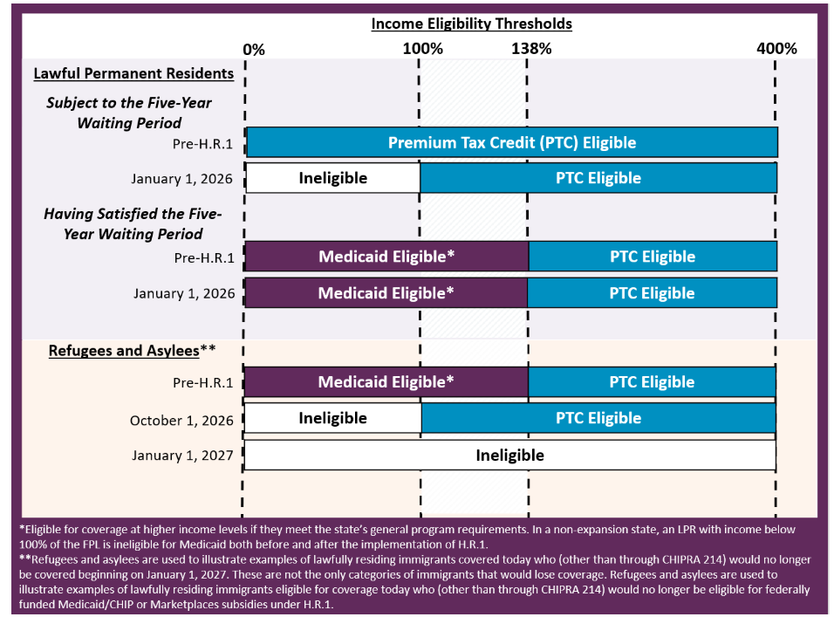
Notes:
This graphic looks at someone who is eligible under the Medicaid expansion for adults with income under 138% of the FPL. The coverage implications would be different for non-citizens in non-expansion states or if a non-citizen qualifies for coverage through another eligibility category. This graphic does not account for eligibility under the CHIPRA 214 option.

Slide 60


Thank you
Chay Sengkhounmany
csengkhounmany@las.org

