Slide 1
Using Affirmative Litigation and the Appellate Process to Further Access Justice for our Clients
Presenters:
Rebecca Delius & Sydney Butler

Slide 2
Disclaimer: The information provided in this presentation cannot take the place of legal advice. Each case is different and needs individual attention.​

Slide 3
AGENDA
Affirmative Litigation
  Choosing a Good Case
  Determining Damages
  Choosing Where to File
  Filing the Case
Appealing Negative General Sessions Decisions
  Choosing a Good Case
  Detainer Warrant Appeal Bond

Slide 4
AFFIRMATIVE LITIGATION CASES TO FILE
Illegal Lock Outs / Utility Shut Offs
Violence Against Women's Act violations
Landlord’s Failure to Make Repairs

Slide 5
CONSIDERATIONS WHEN DECIDING WHETHER
TO FILE AN AFFIRMATIVE LAWSUIT
Actual Damages
Area of Law
Client Reliability

Slide 6
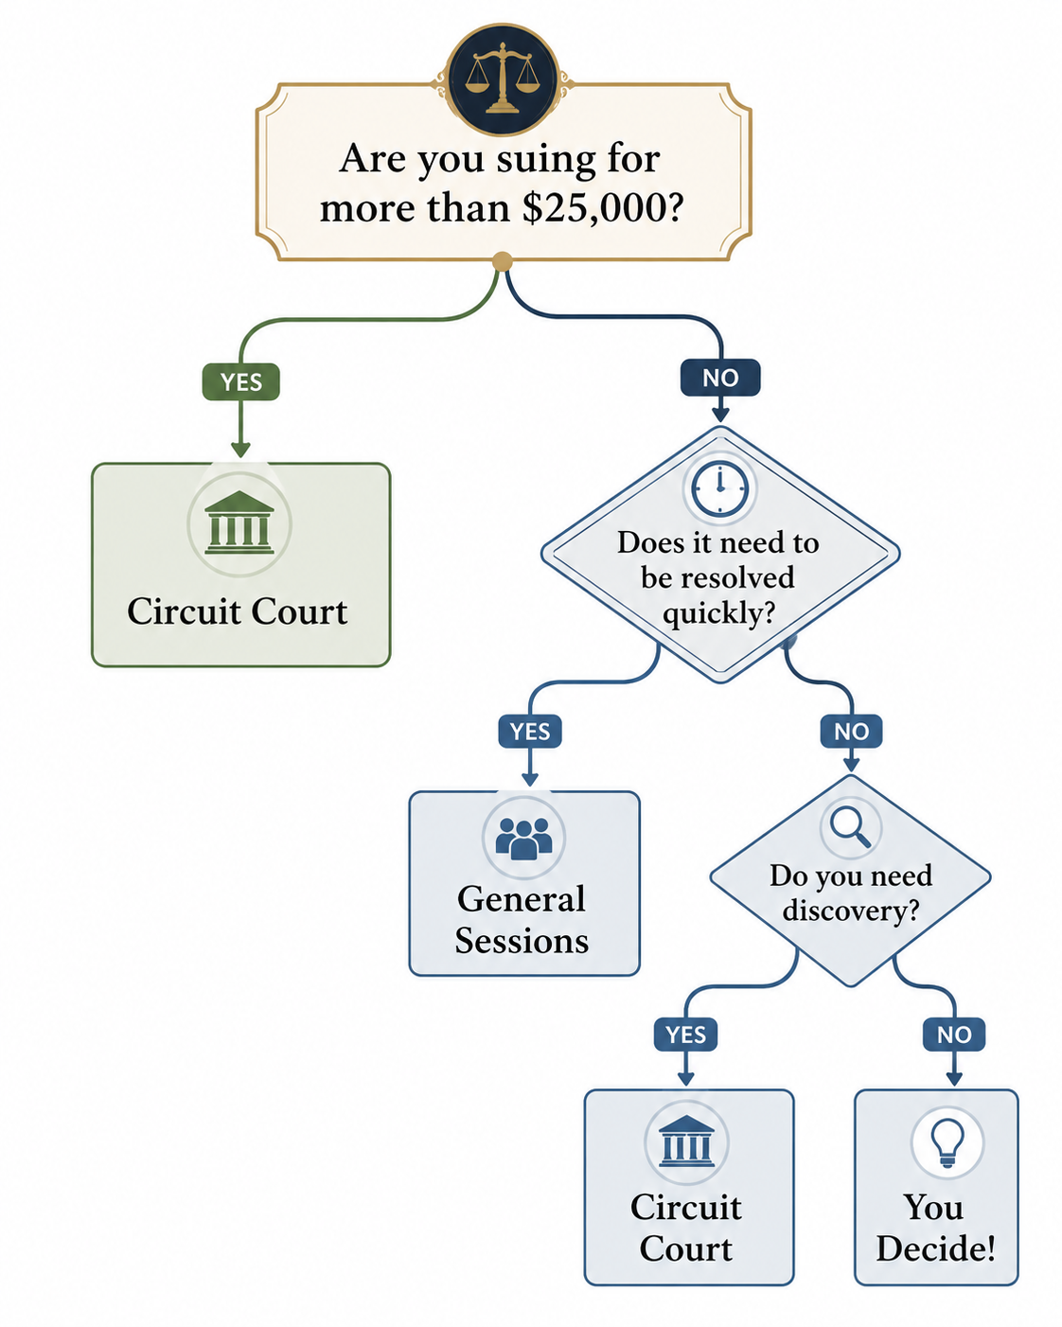
WHERE TO SUE?

Slide 7
DETERMINING HOW MUCH TO SUE FOR
Speak with the client and complete a damages spreadsheet to get a sense of:
What they've lost
What they've had to spend money on to remedy the situation,
And what they have paid in rent versus what they think their unit was worth during the tenancy.

Slide 8

LOST BELONGINGS
Walk the client through each room of the home affected by the issue
Clients often think of big items like furniture or electronics but ask them about linens, dishes, clothing, and smaller items.
Ask either what the client paid for the item or what a comparable item is now selling for on sites like Amazon.
You'll need proof of the value for each lost item, so having something to compare it to on a site like Amazon is helpful if they no longer have receipts or proof of purchase.
Often clients will have items they consider to be irreplaceable or invaluable due to sentimental value. If an item is an antique, you can search a site like eBay to get a sense of what it would be worth if sold now.
For things like important documents (birth certificate, social security card, etc.) consider how much it would cost to replace the item.

Slide 9

CONDITIONS ABATEMENT
AKA WHAT I PAID VS HOW MUCH IT WAS WORTH
Figure out which months of the client's tenancy had issues in the unit and which rooms or spaces were affected
Enter the rent amount for each month
You can ask the client what they think the apartment was worth for each month without the use of the affected spaces
Or, you can use a simple "quick and dirty" equation of Rent /Rooms = Deduction Request
Example: $1200 rent divided by 5 rooms. Plumbing issues in 1 room rendered that room unlivable, so deduction request would be $240 a month for that room with a proposed rent cost of $960

Slide 10

Other Expenses
This could be money spent on a hotel, given to friends or family for temporary accommodations or money spent on moving early if through no fault of the client.
Cleaning supplies, humidifiers, tarps, air conditioners, or anything paid for by the client to remedy the issue in the home.
Lost wages from missing work to wait on maintenance, contractors, or because conditions in the home made it difficult to work.

Slide 11
BEFORE FILING THE CASE
If LSC – need 1644 litigation record and 1636 statement of facts.
Should always try to get affidavit of indigency / indigency waiver.
Draft complaint, put reasonable damages in there.
Make sure client’s approval is in writing.
Explain to client that all the money asked for is best case scenario.

Slide 12

PRACTICAL TIPS FOR AFFIRMATIVE LITIGATION
File Affidavit of Indigency
Check Local Rules
Set Client Expectations

Slide 13
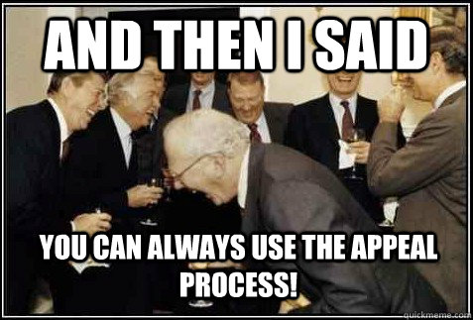
APPEALS
TYPES OF APPEALS TYPICALLY HANDLED:
De novo appeals from General Sessions to Circuit Court
Appeals from Circuit Court to Appellate Court

Slide 14
WHEN TO APPEAL
Misapplication of Law
Need discovery or Rules of Civil Procedures
Challenge current laws

Slide 15
PROCEDURAL APPEAL REQUIREMENTS FROM GENERAL SESSIONS TO CIRCUIT COURT
General Sessions judgment becomes finalized in 10 days
Need to file appeal or Motion to Set Aside before 10-day deadline
Check Local Rules
File any indigency waivers

Slide 16
EVICTION BARRIER TO APPEAL: APPEAL BOND
Immediate execution of writ of possession — Bond, cash deposit, or letter of credit pending appeal.
(a) When judgment is rendered in favor of the plaintiff, in any action of forcible entry and detainer, forcible detainer, or unlawful detainer, brought before a judge of the court of general sessions, and a writ of possession is awarded, the same shall be executed and the plaintiff restored to the possession immediately. […]
(b)(2)(A) If the defendant prays an appeal, then an appeal must not be allowed unless the defendant has executed bond, or posted either a cash deposit or irrevocable letter of credit from a regulated financial institution, or has provided two (2) good personal sureties with good and sufficient security in the amount of one (1) year's rent of the premises, conditioned to pay all costs and damages accruing from the failure of the appeal, including rent and interest on the judgment as provided for in this section, and has abided by and performed whatever judgment may be rendered by the appellate court in the final hearing of the cause.
Tenn. Code Ann. § 29-18-130

Slide 17

HOW TO CHALLENGE THE APPEAL BOND
Procedurally:
Posting Bond Under Protest and Filing for Motion for Summary Judgment
Not Posting Bond and Filing a Temporary Restraining Order to Prevent Writ from Being Issued While Constitutionality is Decided
Substantively:
Equal Protection clauses
Open Courts Doctrine
EQUAL PROTECTION CLAWS

Slide 18
WHEN TO CHALLENGE APPEAL BOND
No Dispute of Applicability of Law
Sympathetic Client
No Unpaid Rent
Eviction Based on 14-Day Notice

Slide 19
QUESTIONS?

