Slide 1
Navigating the Social Security Administration:
Options for Advocates
Kate Lang, Director of Federal Income Security
August 27, 2026

Slide 2
Justice in Aging is a national organization that uses the power of law to fight senior poverty by securing access to affordable health care, economic security, and the courts for older adults with limited resources.
Since 1972 we’ve focused our efforts primarily on fighting for people who have been marginalized and excluded from justice, such as women, people of color, LGBTQ+ individuals, and people with limited English proficiency.

Slide 3
Join Our Network!
Want to receive Justice in Aging trainings and materials?
Go to justiceinaging.org and click “Sign up” or send an email to info@justiceinaging.org.

Slide 4
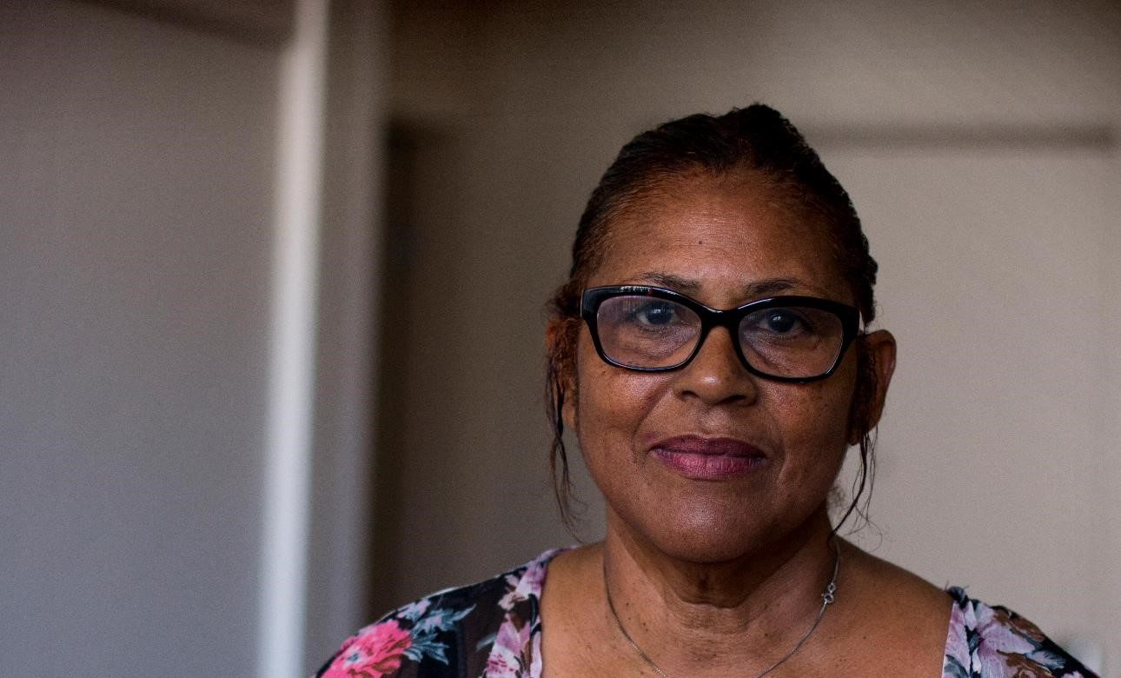
Recent Research

Slide 5

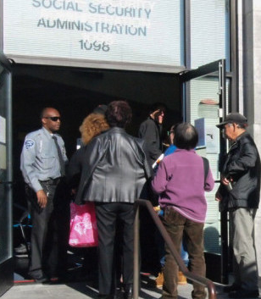

“IN THE LAST YEAR, IT’S GOTTEN A LOT WORSE”: BARRIERS TO DISABILITY BENEFITS IN 2025
Scan for full report:
KATIE SAVIN, CALLIE FREITAG & MATT BORUS
5
Notes:
In 2025, the Social Security Administration (SSA) underwent a rapid series of administrative, staffing, and policy changes following the inauguration of the second Trump administration and its creation of the Department of Government Efficiency (DOGE). These changes included the largest-ever SSA staffing cut of over 7,000 employees, the consolidation of ten regional offices down to four, the push to move customer service activities online, and the expansion of automated and Artificial Intelligence (AI)-based services, Media reports and SSA press releases have often presented conflicting accounts of how these unprecedented changes impact SSA claimants and beneficiaries.
In this report from Katie Savin, Callie Freitag and Matt Borus published in March 2026, they offer findings from a qualitative study. Between July and September 2025, they interviewed 52 attorney and non-attorney benefits specialists at 32 organizations that assist claimants with obtaining and maintaining SSI and SSDI benefits.
Findings
They found that the SSA policy and process changes implemented by the second Trump administration created significant barriers for those seeking to apply for and maintain disability benefits, as well as the attorneys and benefit specialists who represent them. They organized their findings into seven interrelated themes that together characterize how disability benefit access changed in 2025:
SSA’s 2025 changes in context: “It’s always been bad… it has, I think, gotten worse.” Respondents compared their experiences with SSA in 2025 to their past experiences, concluding that many of the challenges they faced in 2025 are new and unprecedented.
Difficulties accessing disability benefits: “Getting stuck in a loop.” The authors identified five major areas to which respondents attributed worsening disability benefits access: (a) changes to the phone system, (b) field offices’ appointment and walk-in policies, (c) staffing cuts and reassignments, (d) increased processing times and denials, and (e) increased overpayments and payment center delays.
The dire consequences of unresponsive customer service: Respondents underscored the dire consequences of these access barriers on their clients, describing instances of health deterioration, homelessness and even death as claimants awaited benefits.
Differential impact of SSA’s administrative burdens: Respondents observed that administrative burdens in disability benefit access were disproportionately borne by people with limited technological literacy and internet access, those with psychiatric, cognitive or communication disabilities, people with unstable housing, and members of mixed-status immigrant families.
The erosion of accountability mechanisms within SSA: Respondents described the erosion of accountability mechanisms within SSA resulting in part from the consolidating of regional offices, which greatly diminished advocates’ ability to resolve errors when routine problem-solving failed.
Unpredictability and contradiction in SSA operations: “They’re making up their own rules.” Respondents commonly described SSA staff arbitrarily departing from national policy and inventing their own rules, undermining SSA’s rules-based system.
Impacts on the advocates and organizations who serve disability claimants: “The amount of resources spent just to get basic information is phenomenal.” Deterioration of customer service has had a cumulative impact on advocates and organizations that serve SSI and SSDI claimants, as the increasingly granular work of representing clients to SSA has strained organizational capacity,

Slide 6
Spring 2026 Survey
Social Security Administration Customer Service Challenges: Survey Responses from Advocates and Representatives in the Field
  187 responses from advocates in 34 states, Washington DC and Puerto Rico
  Experience with contacting field offices between April 1 and June 1, 2026
  More than 50% of respondents reported contacting SSA field offices more than 20 times over previous six weeks
Notes:
In late May 2026, the National Coalition of Social Security and Supplemental Security Income (SSI) Advocates, comprised of more than five hundred advocates from nonprofit legal services organizations, partnered with the National Organization of Social Security Claimants’ Representatives (NOSSCR) to conduct a survey of advocates and representatives who frequently interact with SSA.
4 page report on the survey responses in materials for this session

Slide 7
Spring 2026 Survey
Most cited reasons for advocates to contact SSA:
  Verifying receipt and processing of SSA-1696
  Confirming receipt and processing of appeals
  Resolving overpayment or underpayment
  Requesting copy of Notice of Award, or other notice
  Resolving other payment issues
More than 70% reported being unable to resolve their clients’ issues in two or fewer contacts
  More than one-third reported contacting SSA an average of three times to resolve an issue
  More than one-third reported an average of four or more contacts to resolve an issue

Slide 8

Social Security Administration Hierarchy and Business Processes

Slide 9
SSA Operations – Field Office Positions and Hierarchy
Area Director (AD)
District Manager (DM)
Manages all field offices in defined area.
Field Office Manager
Assistant District Manager (ADM)
Can be good resources to get things done
Operations Supervisors (OS)
First line supervisors for either T2 or T16
Technical Experts (TE)
Claims Specialists (CS)
Customer Service Reps (CSR)
Specially trained for more complex issues; separate T2 and T16
Assigned specific cases, often in separate T2 and T16 units
Field office counters and answer phones
9

Slide 10
SSA Hearing Operations – Hearing Offices
Hearing Office Chief Administrative Law Judge (HOCALJ)
Administrative Law Judges (ALJs)
Hearing Office Director (HOD)
Chief Judge
Assigned individual cases for adjudication
Office of Hearing Operations (OHO) Manager
Group Supervisors (GS)
Attorneys and non-attorneys; first-line supervisors
(Senior) Case Technicians (CT, SCT)
Judges’ assistants; often assigned to specific judges; sometimes referred to as “clerks”
(Senior) Attorney Advisors
Schedulers
Receptionists
Decision writers
Schedule hearings; often assigned to specific judges
Often rotating SCTs
10

Slide 11

Disability Determination Services – Office Positions and Hierarchy
Bureau Chief
Head of office
Public Relations Specialists
Can be a good ally
Managers
First line supervisors
Medical Consultants (MCs)
Analysts
MDs/PhDs/PsyDs who review medical records and make determinations
Specially-trained laypeople who review medical records and make suggestions for the MCs
11

Slide 12
Best Places to Exert Pressure
Aside from contacting Members of Congress
Operations
Hearings
DDS
Technical Experts
Public Affairs Specialists
Group Supervisors
Bureau Chiefs
District Managers or Assistant District Managers
Regional Communications Director
Hearing Office Directors
Public Relations Specialists
Head of Hearing Hubs A-E
Area Director
12

Slide 13
Payment Centers
The original “black hole”
Back-end processing
  no contact from members of public
  limited ways to contact for representatives – Representative Call Center at 877-626-6363
Limited oversight/accountability

Slide 14

Other Options

Slide 15
Congressional Inquiries
Three options – two Senators and one Representative
  Only one inquiry at a time (SSA will send back duplicates)
  Representative’s office may have more capacity
  Administrative assistance – moving things along, not advocating for particular outcome
    Congressional caseworkers are not experts on SSA rules
    Can’t provide guidance or recommendations on choices or strategy
    Not acting as representative before agency
Notes:
Caseworkers are most effective at the field office, DDS office, or payment center – caseworker relationships with different agency employees in different components
can also help at hearings offices and appeals council
Serve as translators in both directions – explaining to constituent or their representative “This is the information/document that SSA wants from you” or “Here are your options in this situation” (not recommending which option to choose)
explaining to SSA “This is their question about what is going on” or “Please expedite this decision because the person is in dire need”
However, tagging as congressional inquiry does not guarantee an accelerated timeline
Can also inform the legislative advocacy and policy priorities of that Member of Congress

Slide 16
Media Attention
Local news – “consumer” reporters
Local newspaper
Give Regional Communications Director “heads up” that case has PR component, while story is in development

Slide 17
Writs of Mandamus
Mandamus authority: 28 U.S.C. §1361
Action to compel an officer or an employee of the U.S. to perform their duty
“The district courts shall have original jurisdiction of any action in the nature of mandamus to compel an officer or employee of the United States or any agency thereof to perform a duty owed to the plaintiff.”

Slide 18
“The Rare Writ”
Plaintiff must have exhausted all other avenues of relief, all administrative remedies
Defendant must owe plaintiff a clear, non-discretionary duty
No other adequate remedy available to Plaintiff
Asking court to compel SSA to take a specific action or issue a decision after an extended wait
Procedural dispute unrelated to merits of claim for benefits

Slide 19
Tips
Make sure the frequency and desperation of your contact with SSA matches the urgency and importance of the issue
Use online services as much as possible, for individuals (mySocialSecurity account) and representatives (ARS)
Appreciate SSA employees, but push back on errors
Set clients’ expectations for typical timelines, and what is within your control
Notes:
Benefits not in pay status v. receiving benefits while waiting for written notice
De-escalating urgency – getting benefits continuing while waiting for CDR, getting overpayment collection suspended while waiting for decision on waiver application

Slide 20
SSA Resources
EM-26011: Updated Instructions and Reminders for Expedited Development and Processing of Priority Casesheast Region (AL, FL, GA, KY, MS, NC, SC, TN)
Patti Patterson
Southeast Regional Communications Director
Atlanta Federal Center
61 Forsyth Street, S.W., Ste 23T29
Atlanta, GA 30303
Phone: 833-319-7112
Fax: 833-928-2398 Email: FieldOps.SE.RPA@ssa.gov
Dear Colleague letter on Hearings Hubs: Disability Adjudication - Hearings Hubs Announcement

Slide 21
Additional Resources
Social Security Administration Customer Service Challenges: Survey Responses from Advocates and Representatives in the Field (June 2026; in conference session materials)
Navigating the Social Security Administration: Common Scenarios (in conference session materials)
Navigating the Social Security Administration: Options for Advocates Justice in Aging webinar (April 14, 2026)
Mandamus actions against SSA: https://bit.ly/2RfYbzW

Slide 22
Your Thoughts?
Where have the worst “pain points” at SSA been for you recently?
Any effective strategies/best practices to share?
Initial applications being handled on statewide basis in TN, not kept in claimants’ local office
  Phone calls
  Appointment scheduling calendar (EM-26018: Appointment Scheduling Calendar- Limited Rollout)
  Workload management of initial claims (EM-26017: Workload Management - Limited Rollout)
  Shift to “federal” CDR units

Slide 23

Questions?
Kate Lang klang@justiceinaging.org
Justice in Aging on LinkedIn

