Slide 1

Get Ready to Redact:
Understanding and Implementing the New Tenn. R. App. P. 20B
Equal Justice University
August 27, 2026
Murfreesboro, TN
Jacob A. Vanzin, Esq.
Dodson, Parker, Behm & Capparella, P.C.
1310 6th Avenue North, Nashville, TN 37208
(615) 254-2291
jacob@dodsonparker.com

Slide 2
What documents must be redacted?
Tenn. R. of App. P. 20B(3)(a)
(a) Unless the Court orders otherwise, all Confidential Information must be omitted or redacted from a Filing before the Filing is filed or submitted in an Appellate Court.
Tenn. R. of App. P. 20B(2)(e)
(e) “Filing” means any paper filed or submitted, whether electronically or otherwise, in an Appellate Court and includes appendices, exhibits, and attachments filed or submitted with the Filing.

Slide 3
What documents need not be redacted?
Tenn. R. of App. P. 20B(3)(h)
(h) Redaction is not required for:
(i) Filings made under seal pursuant to a court order;
(ii) Filings to which public access is otherwise prohibited, such as Filings in appeals involving the termination of parental rights or in appeals from juvenile court;
(iii) a financial-account number that identifies property allegedly subject to forfeiture in a forfeiture proceeding;
(iv) the record of an administrative or agency proceeding; or
(v) the official record of a state-court proceeding.

Slide 4
What must be redacted?
Tenn. R. App. P. 20B(d)
(d) “Confidential Information” means information that is protected from public disclosure or is required to be kept confidential by Tennessee law, federal law, or court rule or order. Confidential Information includes but is not limited to:
  (i) personal identification numbers such as Social Security numbers, driver’s license numbers, taxpayer identification numbers, and passport numbers;
  (ii) financial account numbers, credit and debit card numbers, and passwords securing those accounts and cards;
  (iii) home addresses and contact information of informants, victims, witnesses, and persons protected under restraining or protection orders;
  (iv) dates of birth;
  (v) names of persons known to be minors;

Slide 5
Gotcha! You thought you were done.
Tenn. R. App. P. 20B(d)
(d) “Confidential Information” means information that is protected from public disclosure or is required to be kept confidential by Tennessee law, federal law, or court rule or order. Confidential Information includes but is not limited to:
  (vi) case numbers of confidential, expunged, or sealed records in cases other than the one in which the Filing is made;
  (vii) information identifying a person receiving mental health or substance-use-disorder services;
  (viii) information identifying victims of sexual offenses;
  (ix) medical information the confidentiality of which is protected by Tennessee or federal law; and
  (x) records of students in education institutions the confidentiality of which records is protected by Tennessee or federal law.

Slide 6
(vi) case numbers of confidential, expunged, or sealed records in cases other than the one in which the Filing is made;
What does this mean?
  Any time that you state a case number other than the one in which you are filing (e.g., mentioning your criminal defendant’s other conviction), you must determine whether it is confidential, expunged, or sealed and then redact accordingly.
Does this apply to citations to unpublished opinions, which require the “case number” to be included in the citation?
  It’s unclear, but probably not.

Slide 7
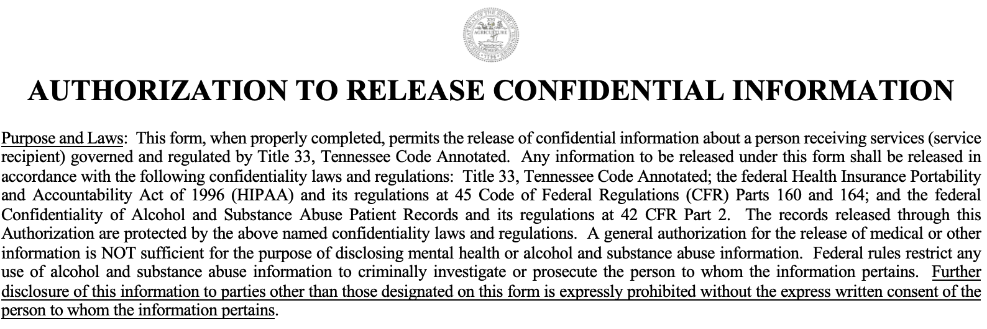
(vii) information identifying a person receiving mental health or substance-use-disorder services;
What does this mean?
Must I redact both the identifying information (e.g., name) and the information itself?
  Yes. See Tenn. R. App. P. 20B(d)(ix)

Slide 8
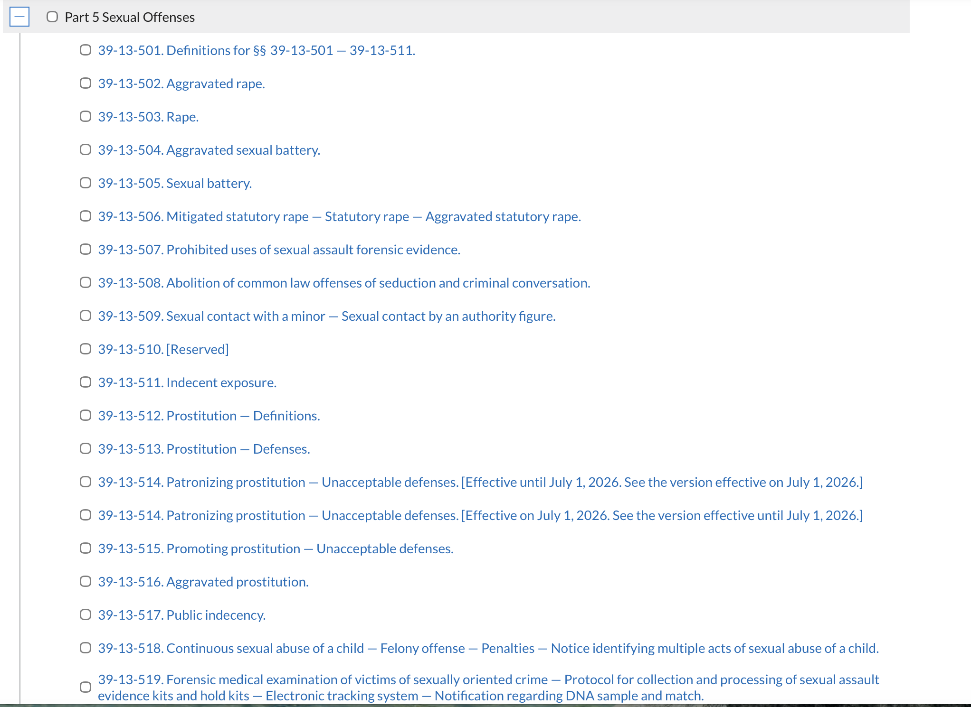
(viii) information identifying victims of sexual offenses;
What does this mean?
Note: There are more sexual
offenses in Chapter 39 of the
Code. I had to cut this off to
fit the picture.

Slide 9
(ix) medical information the confidentiality of which is protected by Tennessee or federal law; and
What does this mean?
If there’s medical information in your brief, you should probably redact it. (There are HIPAA lawyers who don’t know everything HIPAA covers.)
See the “HIPAA Reference Guide” available at:
https://www.tn.gov/partnersforhealth/agency-benefits-coordinators/hipaa.html

Slide 10
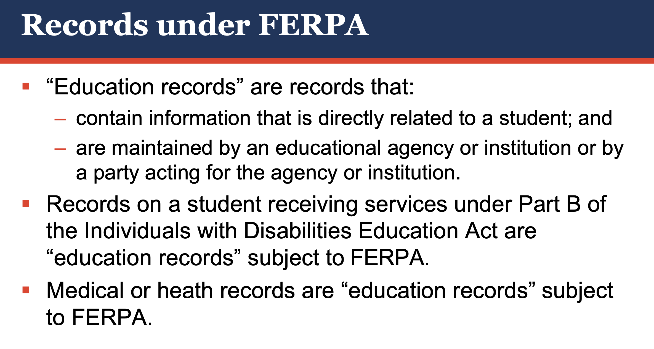
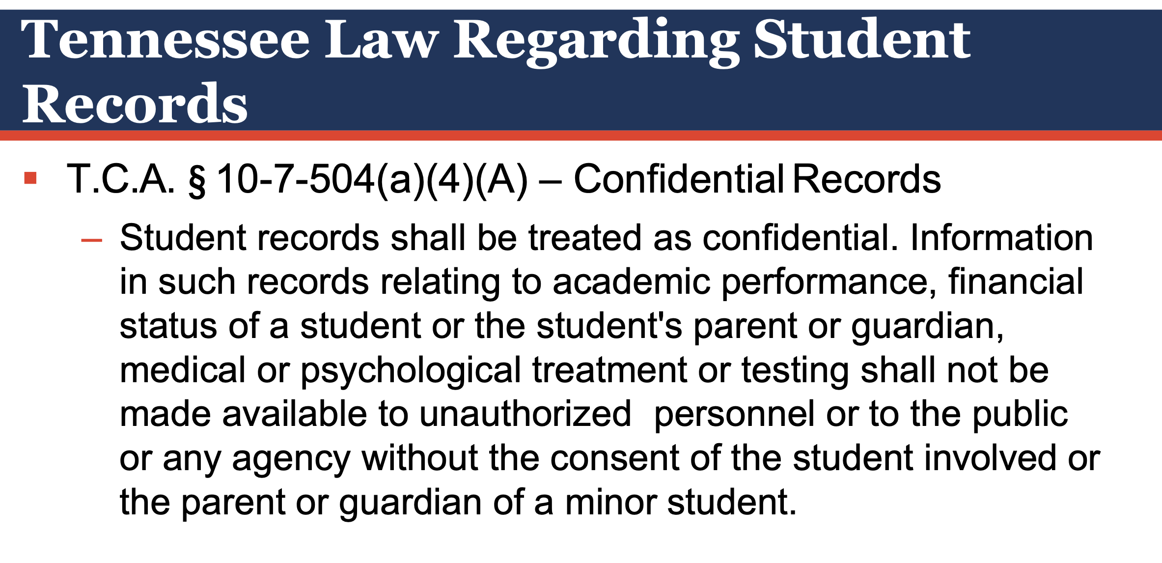
(x) records of students in education institutions the confidentiality of which records is protected by Tennessee or federal law.
What does this mean?
Credit: Tennessee Department of Education, Rachel Suppé and Keith Woodruff, “Charter School
Legal Issues.” https://www.tn.gov/content/dam/tn/education/nonpublic/chtr_sch/chtr_sch_legal_issues.pdf

Slide 11
How to Redact
Acknowledgement: The author is indebted to Benjamin K. Raybin, Esq. of Raybin & Weissman, P.C., who developed and first explicated to the author much of the redaction system shown on the following slides.

Slide 12
Before redaction, remember. . . !!!!
Save an unredacted copy of your filing somewhere safe where you can’t mess it up during the redaction process. (One technique is to email it to yourself.)
Make a duplicate for redaction purposes.
Remember: You will need to file both a redacted and unredacted copy of your filing. See Tenn. R. App. P. 20B(3)(f)

Slide 13
Methods of Redaction
See Tenn. R. App. P. 20B(5)(b)
  (b) Redaction may be accomplished manually or by use of technology, such as redaction software.
But see Tenn. Sup. Ct. R. 46 § 3.02(b)
  (b) All original documents (e.g., applications, briefs, motions, memoranda of law, and similar documents) that are e-filed shall be prepared through direct conversion from the word processing file to Portable Document Format and not through scanning of the original paper document. Notwithstanding the foregoing sentence, all attachments and appendices containing photocopies of documents may be scanned into Portable Document Format. E-filed PDF documents shall be text searchable, if possible.

Slide 14
Technical Redaction Requirements
Tenn. R. App. P. 20B(5)(a)
  Redaction is the process of permanently and completely obscuring or removing Confidential Information in a Filing before it is filed or submitted so that the Confidential Information is not accessible from the Filing.
Tenn. R. App. P. 20B(5)(c)
  Whatever redaction method is used must protect the confidentiality of the redacted information and ensure that all Confidential Information, including all metadata, has been completely and permanently obscured or removed and cannot be restored or accessed. Redacted Filings must make clear when and where information has been redacted, as appropriate, for example by replacing the redacted information with blackout boxes or bars, asterisks, an individual’s initials, a generic descriptor (e.g. SS#), or ellipses.

Slide 15
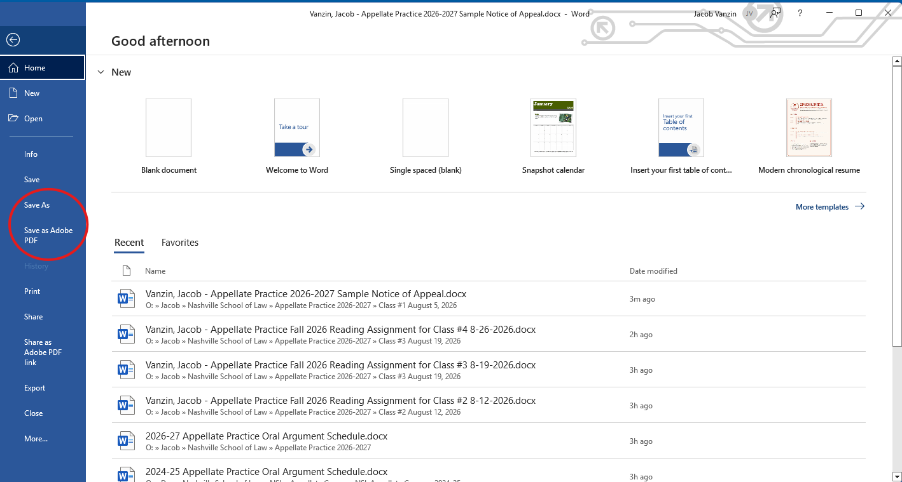
Step 1: Convert to PDF (Option A)

Slide 16
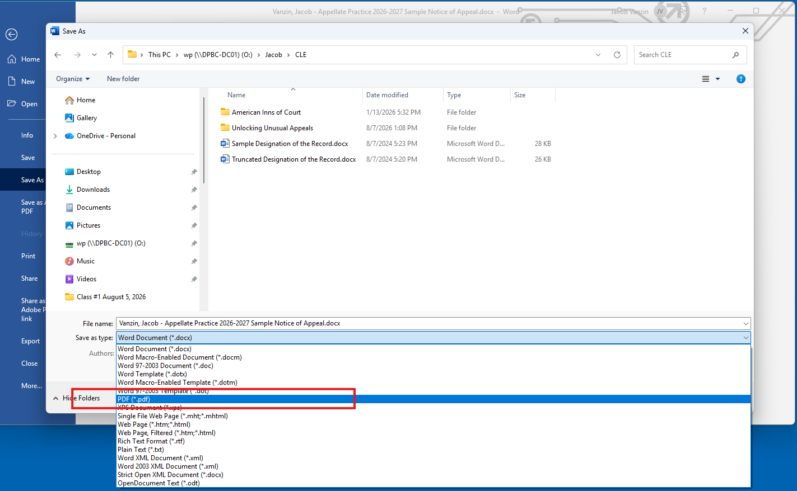
Step 1: Convert to PDF (Option B)

Slide 17
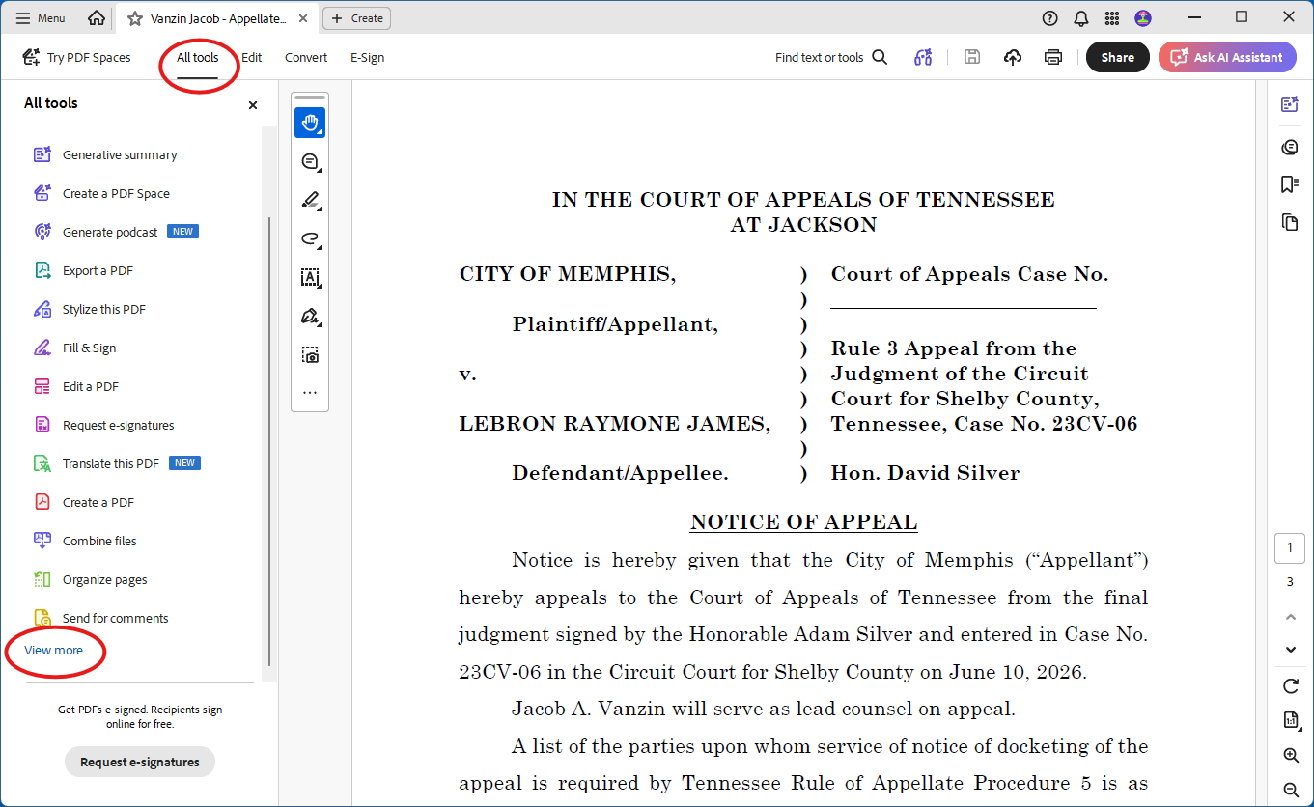
Step 2: Select “All tools,” then, if necessary, “View more.”

Slide 18
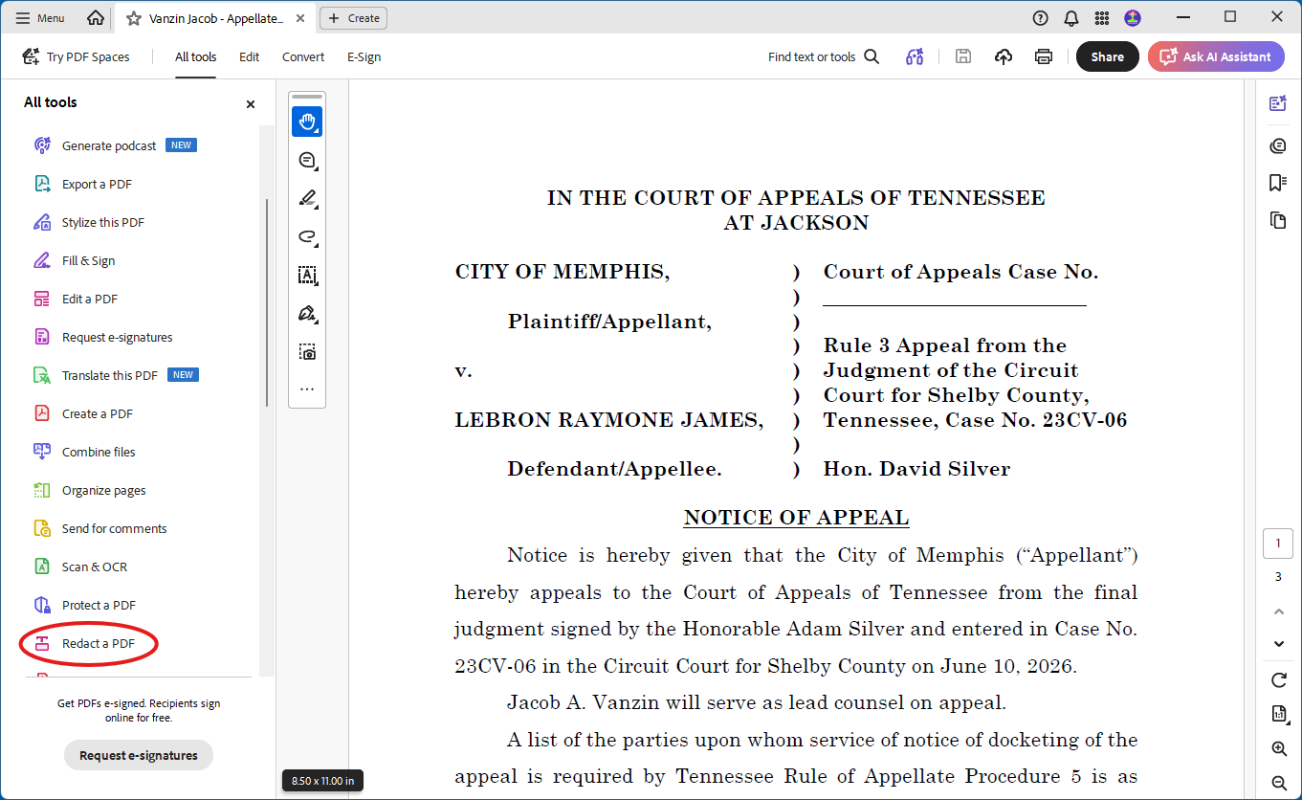
Step 3: Select “Redact a PDF”

Slide 19
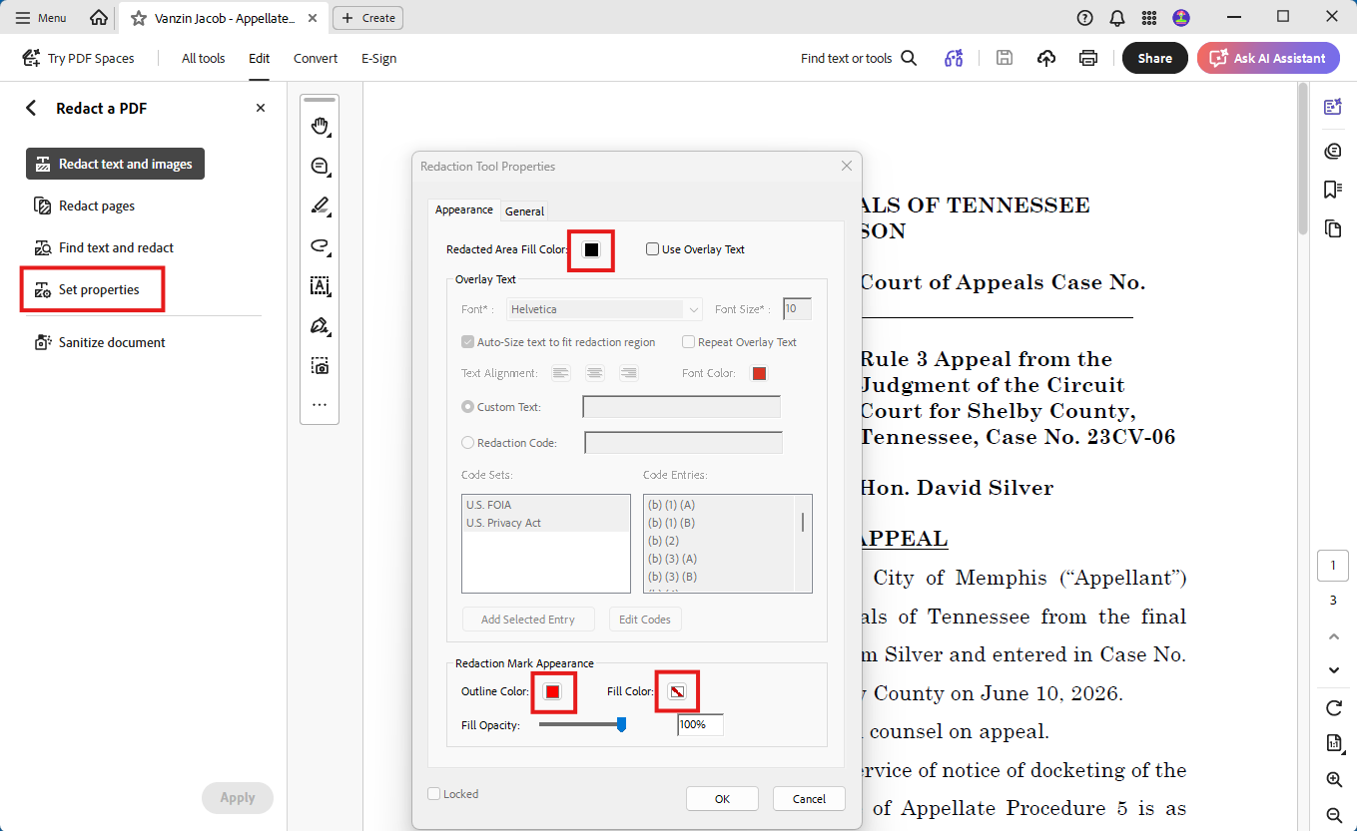
Step 4: Select “Set Properties” and set your properties accordingly.

Slide 20
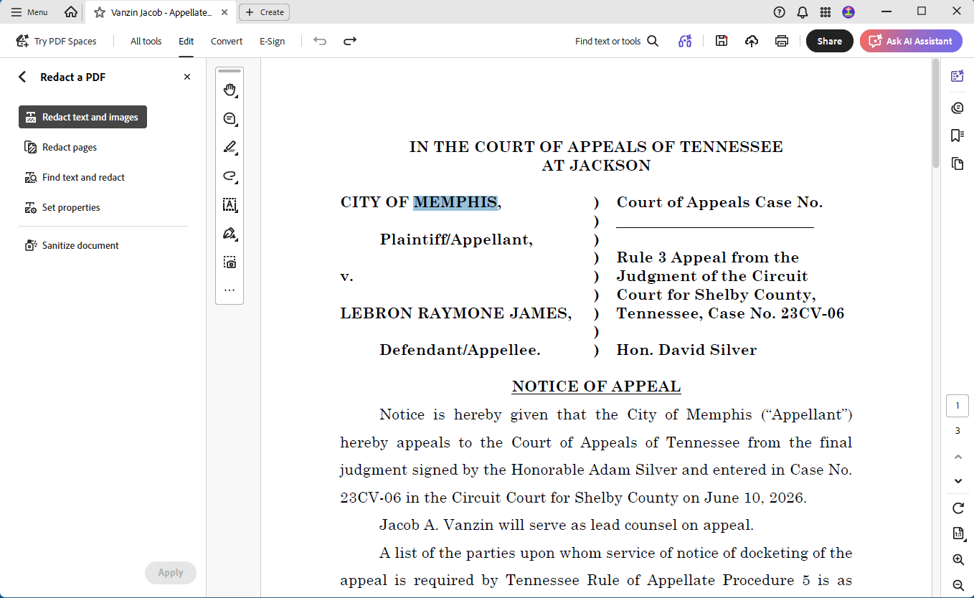
Step 5: Select “Redact text and images” and highlight text you wish to redact.

Slide 21
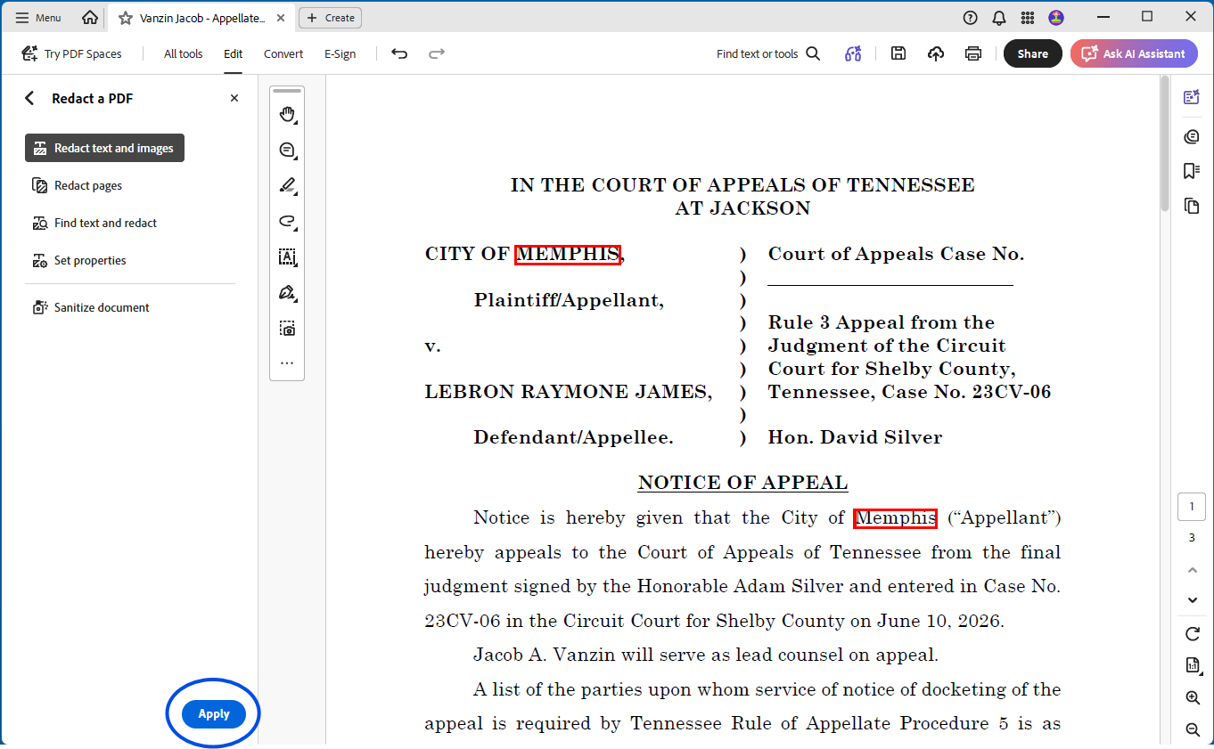
Step 6: Review and “Apply” your redactions.

Slide 22
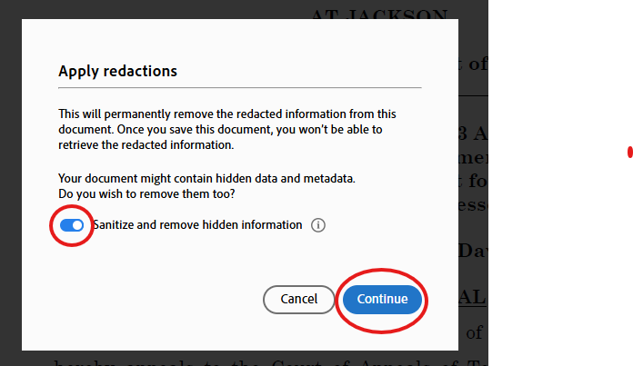
Step 7: Sanitize during redaction.

Slide 23
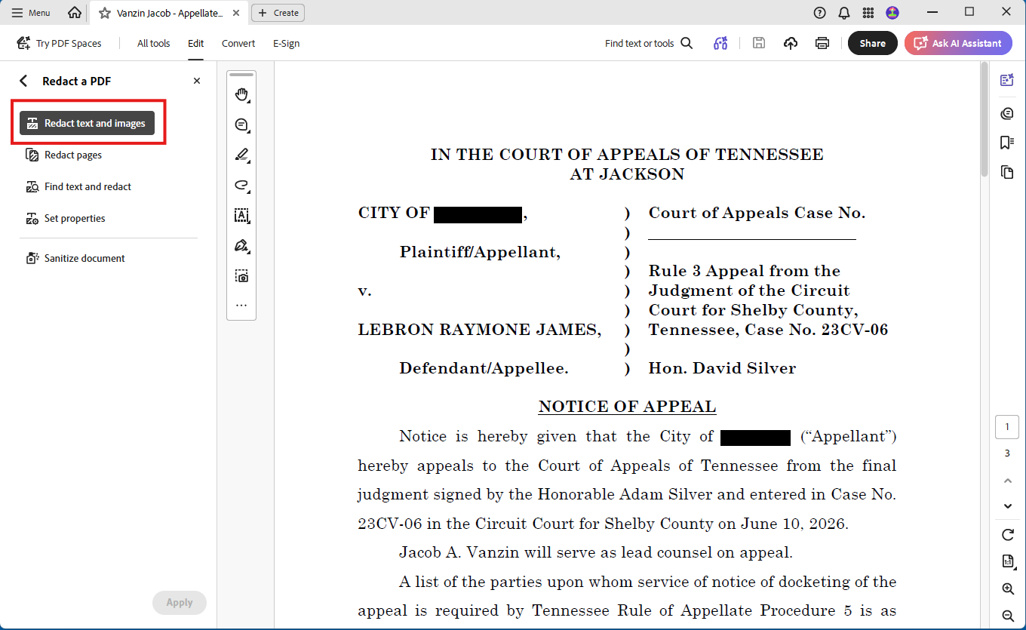
Step 8: Make sure you close the redaction tool.

Slide 24
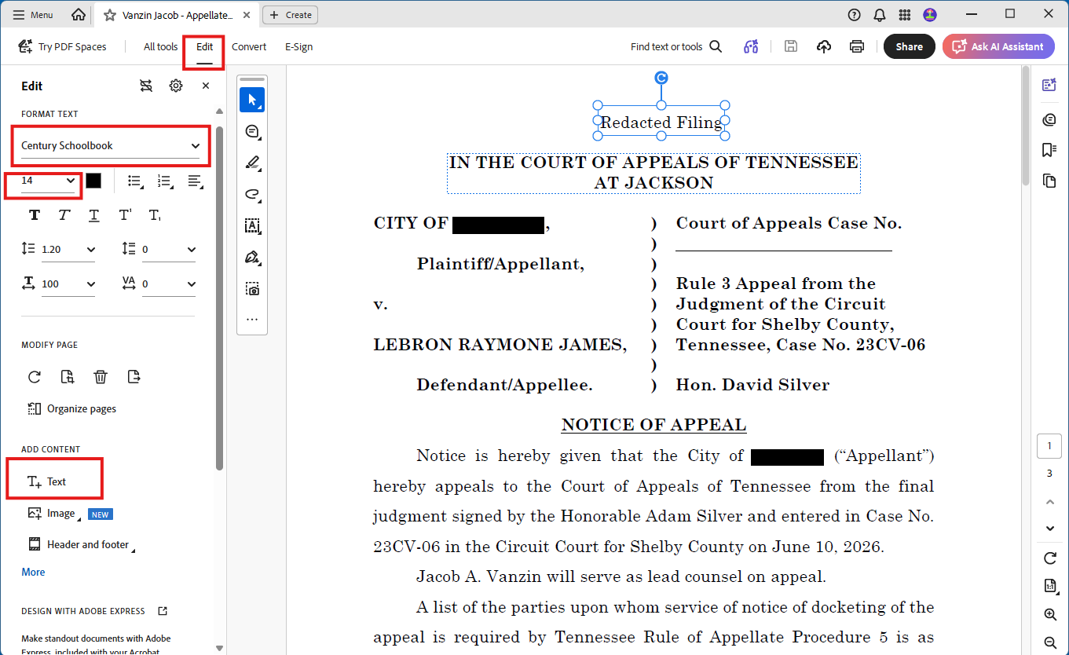
Step 9: Add words “Redacted Filing” to cover page.

Slide 25
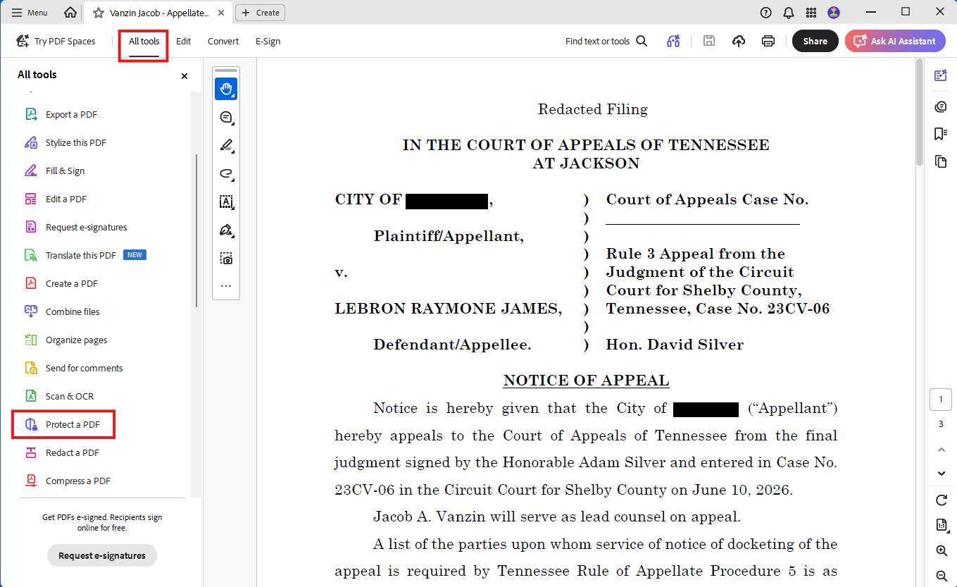
Step 10: Select “All tools,” then “Protect a PDF.”

Slide 26
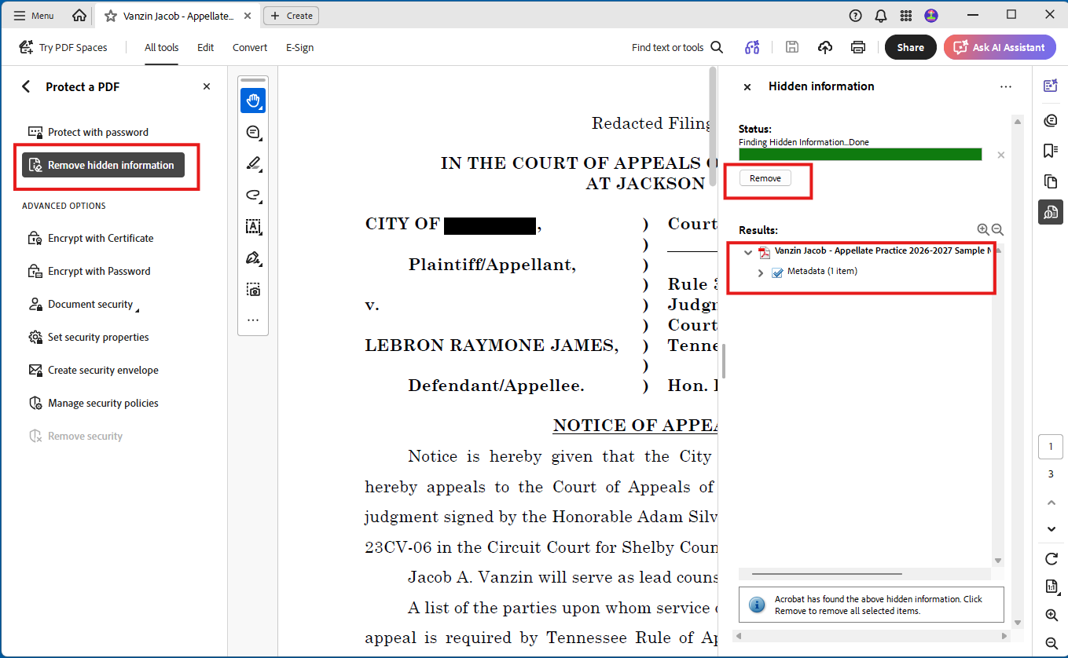
Step 11: See if there is information to scrub.

Slide 27
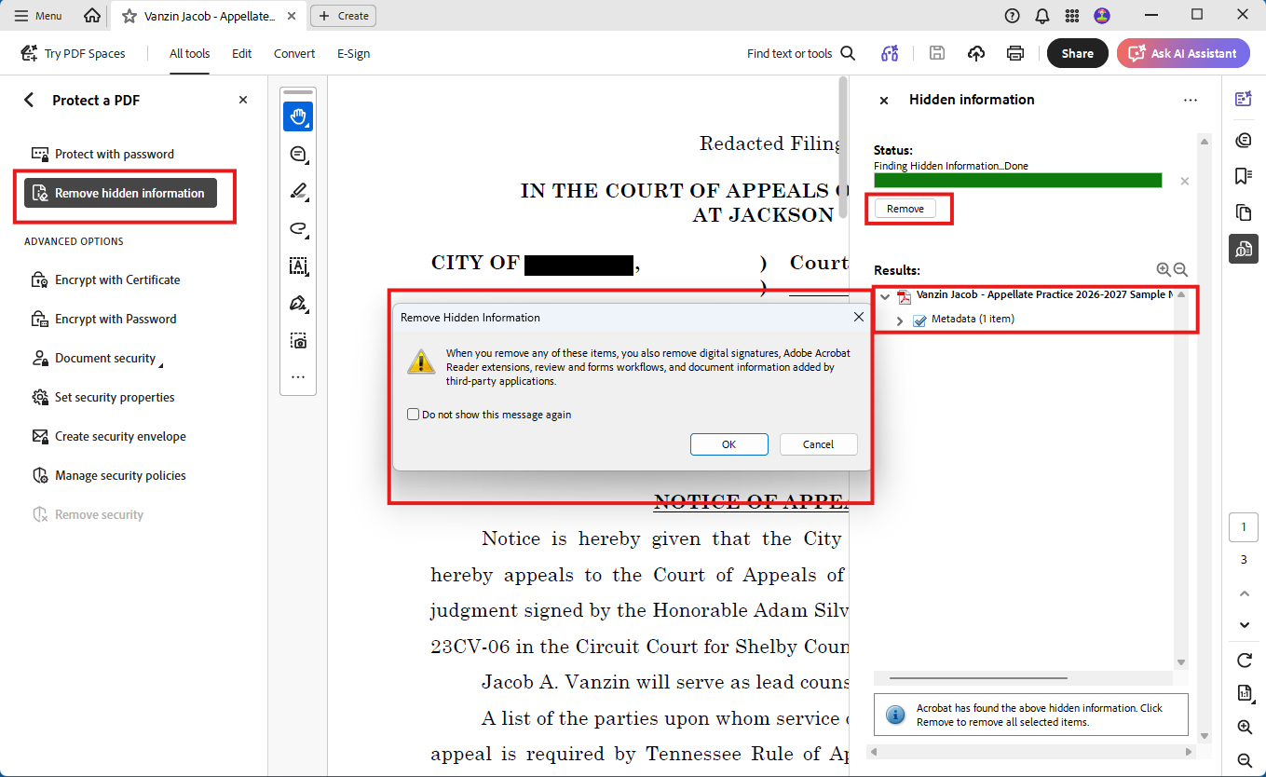
Step 12: Scrub information.

Slide 28
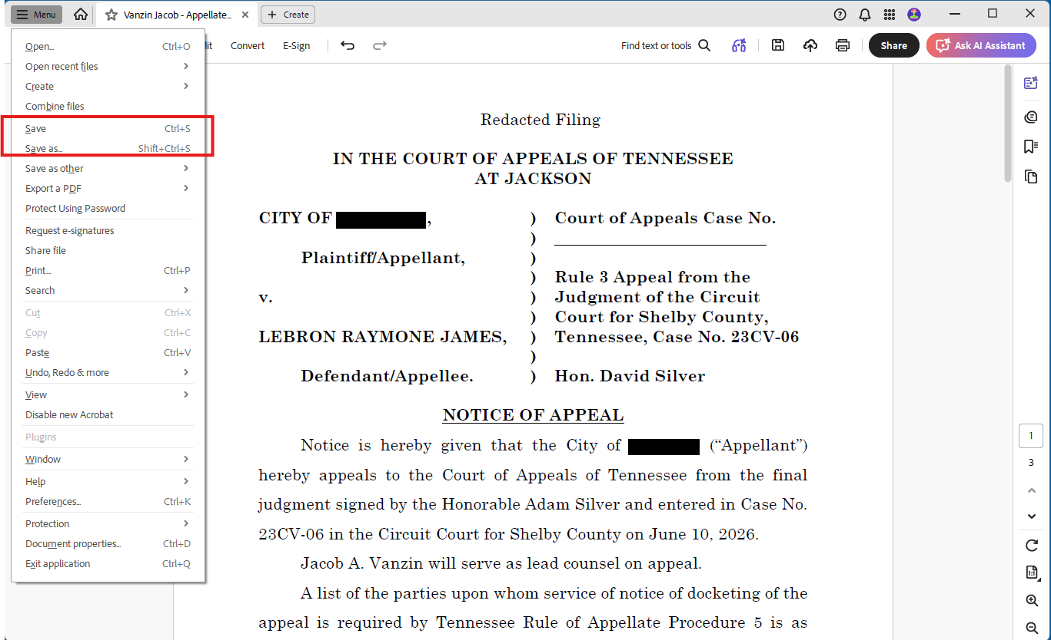
Step 13: Save appropriately.

Slide 29
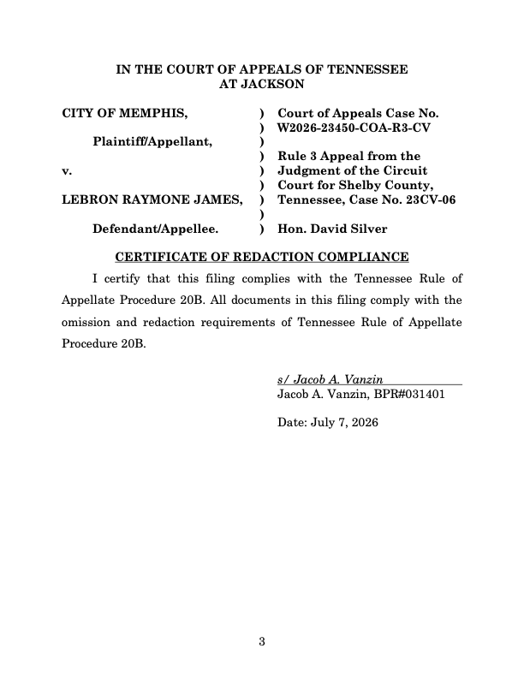
Include Certificate of Redaction Compliance
Tenn. R. App. P. 20B(4)
(a) The person or entity responsible for omitting and redacting Confidential Information must certify in writing that the Filing complies with this Rule. Certification is made by attaching to or including in the Filing a signed, dated Certificate of Redaction Compliance identifying the Filing by case style and number and verifying that all documents in the Filing comply with the omission and redaction requirements of this Rule.
(b) When a Filing is accompanied by a signed Certificate of Redaction Compliance, neither the Court nor the Clerk is required to review the Filing to confirm that the required omissions and redactions have been properly made.
(c) On motion by a party, an interested person or entity, or on its own, the Court may order remedies for failure to comply with the omission and redaction requirements and may impose sanctions if it finds certification of redaction compliance was not made in good faith.

Slide 30
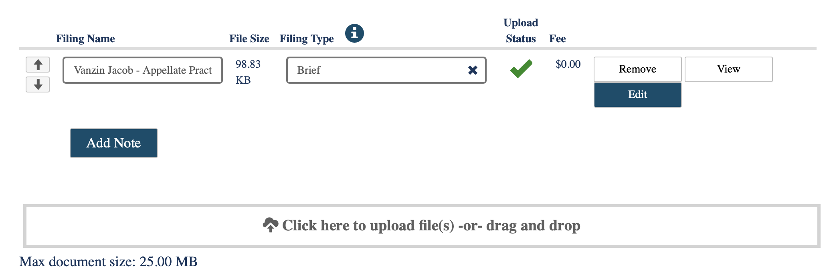
Don’t Forget!!
You must also file an unredacted copy of your “Filing” under seal with the notation “Unredacted Filing Under Seal” on the cover page. See Tenn. R. App. P. 20B(3)(f).
You should file your redacted Filing and your unredacted Filing at the same time if you can. Truefiling will let you file more than one document at the same time.

Slide 31
Why do we have to do this again?

Slide 32
Tenn. R. App. P. 20B(6)
(6) Electronic Access to Filings
(a) As of July 1, 2026, the Clerk must offer access to Filings accompanied by a
Certificate of Redaction Compliance through a system that allows members
of the public to search electronically for, inspect, and copy a Filing, but the
Clerk must not make public access available for (i) Filings made under seal,
(ii) Filings in appeals involving the termination of parental rights, (iii) Filings
in appeals from juvenile court cases, or (iv) Filings otherwise protected by
statute, court rule, or court order.
(b) Electronic access by the public may be temporarily suspended if the Clerk
determines that public demand for electronic access is adversely affecting the
Appellate Courts’ systems or operations.

Slide 33
Issues?
Confusion. (What constitutes “information identifying”?)
Cost. (Who is paying for the time it takes to redact all of this information?)
Effectiveness. (The record need not be redacted – just the “Filings” from counsel. Couldn’t a member of the public just go look up the confidential information in the record?)
For further reading: https://www.tba.org/docDownload/2818622

Slide 34
Thanks.

