Slide 1

VA BENEFITS 101
COLE ADAMS

Slide 2








West Tennessee Legal Services
WTLS offers no-cost civil legal aid to West Tennesseans in 21 counties, focusing on issues that affect family safety, cohesiveness, and stability. Our legal practice areas include:
Benefits
Fair Housing
Reentry
Elder Law
Victims Rights
Disaster Assistance
Family Law
Consumer Debt
2

Slide 3
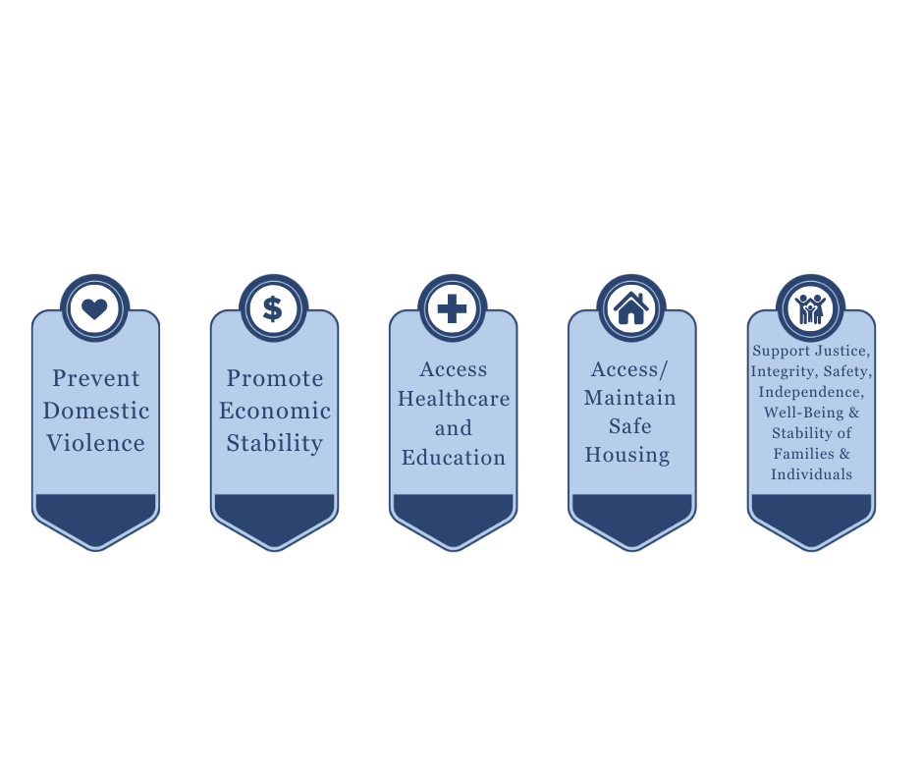
WTLS Priorities
Our clients pay no legal fees. WTLS exists because of funding from grants from federal, state, and local governments and donations from private foundations and individuals. Due to limited resources, WTLS must make hard decisions about which cases to accept based on our priorities:
2

Slide 4

About the Presenter
Cole Adams (he/him) is a Staff Attorney in the Public Benefits Unit in the Memphis Office of West Tennessee Legal Services. In his practice, he represents and advises clients on Veterans’ Benefits, Social Security, Medicaid, SNAP, Families First, and Unemployment Compensation issues. Previously, Cole worked at Disability Rights Delaware (formerly the Disabilities Law Program at Community Legal Aid Society, Inc.), the Protection & Advocacy System for the State of Delaware, where he represented individuals with disabilities with Social Security, Medicaid, Americans with Disabilities Act, and other disability-related issues. Cole graduated from the University of Alabama School of Law in May of 2023. While in Law School, Cole worked at the Alabama Disabilities Advocacy Program (the Protection & Advocacy System for the State of Alabama), Justice in Aging, the American Civil Liberties Union of Alabama, and West Tennessee Legal Services. Prior to law school, Cole received his B.A.C. in Communication Studies with a second major in history and a minor in Social Welfare from the University of Alabama.
2

Slide 5
Disclaimer
This presentation is not intended to be legal advice. Cases present challenging and unique issues which need to be addressed on a case-by-case basis. Discussion of any case scenarios or actual cases in this presentation are not advice from a lawyer and their discussion do not create an attorney/client relationship.
2

Slide 6
Roadmap/Objectives
Today’s roadmap will follow the pathway towards receiving benefits that many veterans have to face. Our look at the claims process will not be comprehensive, but is intended to provide an introductory view of the issues and challenges veterans face along the way. First, we will examine the threshold issue of discharge, and we will discuss the ways less than honorable discharges can be upgraded so that veterans may access services and benefits they need. Then we will take a cursory look at those benefits themselves, discussing the various rules and eligibility criteria for each. We will end with guidelines and tips for advocating for veterans and navigating the VA.
2

Slide 7
DISCHARGE UPGRADES
2

Slide 8
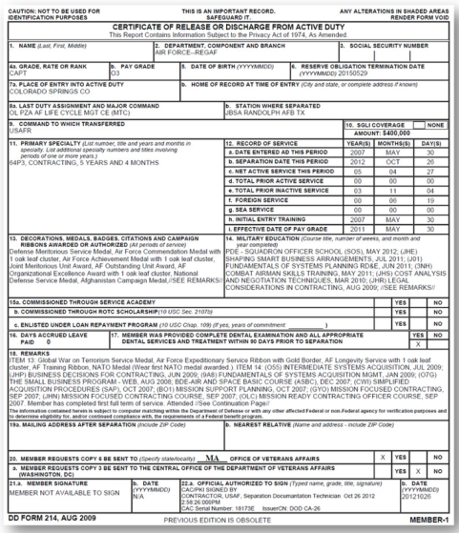
Separation Process
Separation Paperwork= form DD 214
  Form that formally separates and characterizes the separation of the service member
  Note for National Guard Veterans:
    They receive a DD 214 after completing training and each time they are called up for Federal Active Duty
    Their separation form is NGB 22
Character of Service field and Narrative Reason for Separation are what to look for on this form
Other important information: date of discharge; VA eligibility/involvement; other commendations and notations
2

Slide 9
Character of Service
Administrative Separations
  Honorable
  General (under honorable conditions)
  Other than Honorable
  Uncharacterized
Punitive Separations (generally require a conviction either under Special or General Courts Martial)
  Bad conduct
  Dishonorable
2

Slide 10
Narrative Reason for Separation
Non-exhaustive List:
  Sufficient service for retirement
  Expiration of term of service
  Reduction in force
  Misconduct
  Misconduct (serious offense)
  Pattern of misconduct
  Personality disorder
  Alcohol rehabilitation failure
  Drug use
  Hardship
  Conscientious objection
  Homosexual Act
2

Slide 11
“Bad Papers,” Discharge Stigma, and Why Characterization Matters
Tangible Impacts of Characterization
  Employability
  Re-enlistment
  Recognition of service
  VA benefits
  State veterans’ benefits
Risks for Veterans with less than honorable discharges
  Twice as likely to die by suicide
  Twice as likely to face homelessness
  More difficult access to employment
  More difficult access to health care
The paper doesn’t tell the full story
  “Misconduct” could mean:
    Retaliation for reporting military sexual trauma (MST)
    Manifestations of misdiagnosis or improper treatment of mental health impairment
    Discrimination based on race, religion, LGBTQ+ identity, or gender
2

Slide 12
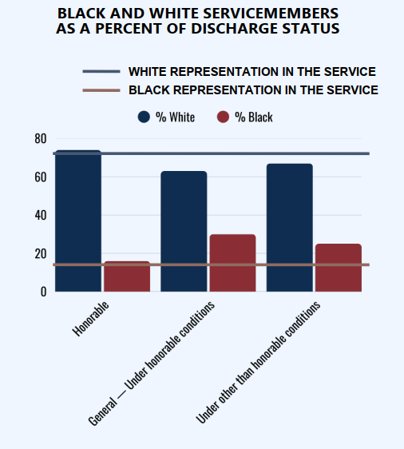
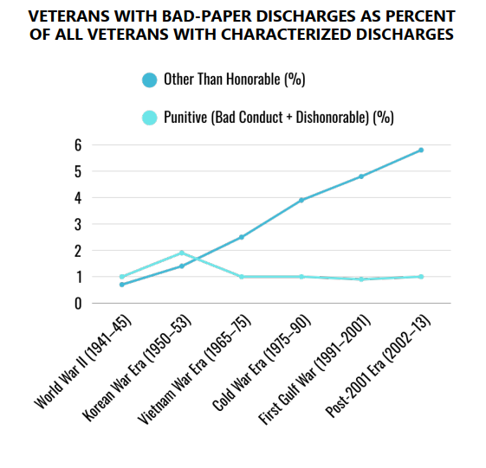
“Bad Papers,” Discharge Stigma, and Why Characterization Matters Con.
2

Slide 13
Discharge Procedure
Governed by Uniform Code of Military Justice (USMJ) 10 U.S.C. Sec. 801 et seq.
  Punitive Articles Sec. 877-934
Issuance by respective branch of service and governed by their own regulations
  Air Force: AFI 36-3208
  Army: AR 635-200
  Coast Guard: COMDINST M1000.4
  Marines: MCO P1900.16
  Navy MILPERSMAN 1900-1999, NAVPERS 15560D
Command Discretion
  Individual commanding officers have extremely wide latitude for issuing punishments
  Punishments may be selectively enforced based on personal biases, and could range from taking no action to charging the service member under the UCMJ
2

Slide 14
Discharge Review: Review Boards
  Enabling Statute: 10 USC Sec. 1553
  Powers of Discharge Review Boards (DRBs):
    Upgrade character of discharge (i.e. OTH to honorable)
      Except: cannot review discharges resulting conviction in General Court Martial
    Change a narrative reason of separation (i.e. bad conduct to manifestation of untreated PTSD)
      Except: cannot alter narrative reason to or from “Medical Retirement”
  DRBs cannot reinstate someone to service
  DRBs cannot issue less favorable discharge than what was issued at time of separation See 32 CFR 70.9(a).
2

Slide 15
DRBs Con.
  Statute of Limitations for requesting discharge upgrade
    15 years from date of discharge
    No exceptions for DRB
  Upgrades can be issued on basis of:
    Propriety 32 CFR 70.9(b)
    Equity 32 CFR 70.9(c)
    Clemency (convictions in Special Court Martial) 10 USC Sec. 1553(a)
  DRBs can conduct Records Review or Personal Appearance Hearing
    Applicant can request either
    If requesting records review, applicant can subsequently request hearing if denied
  Records review: paper review only; applicant can submit additional statements or records to be considered
  Hearing: applicant can call additional witnesses and make sworn or unsworn statements; ROE do not apply, but DRB members can examine witnesses
  Don’t know what to ask for? Look at time remaining on SOL!
    SOL is not tolled during pendency of paper review, so if close, ask for hearing
    If there is time, records review affords you two bites at the apple
2

Slide 16
Boards for Corrections of Military Records (BCMRs)
  Appeals from DRBs (de novo review on application)
  Upgrade requests outside of 15-year SOL
  Broader authority than DRBs, but DRB application for relief required first if DRB can grant relief sought
  Cannot issue less favorable discharge characterization
  SOL 10 USC Sec. 1552(B): 3 years from the date the veteran “discovers the error or injustice.”
    Failure to file can be excused if found by board to be “in the interest of justice.”
  No right to a hearing
    Hearing may be granted if “justice” so requires
    Documentary review of:
      Application (DD 149)
      Attorney or advocate brief
      Evidence, narrative, or other statement provided by applicant
  Standard of review:
    Presumption of Regularity 32 CFR 70.8(b)(12)(vi)
  Discharge Appeal Review Board- appeals from BCMRs IF discharge on/after 12/20/2019; one year to apply
  Further Appeals: U.S. District Court Review pursuant to Admin. Procedures Act; 6-year deadline from DRB or BCMR decision
2

Slide 17
Discharges Relating to Don’t Ask; Don’t Tell (DADT)
  Farrell v. DoD settlement agreement controls if:
    Veteran or Army, Air Force, Navy, or Marines;
    Separated before 09/20/2011; and
    DD 214 references sexual orientation in narrative reason for separation or separation code
  Process:
    Hon and uncharacterized vets can use administrative change process
    OTH may request expedited discharge review
  Deadlines
    Navy/Marines: 05/09/2028
    Army: 07/03/2028
    Air Force: 07/14/2028
  Justiceforlgbtqveterans.com (settlement webpage)
2

Slide 18
Helpful DoD Memoranda
  Related to Mental Health
    Hagel Memo (2014)
      “liberal consideration” that mental health impairment caused misconduct
    Carson Memo (2016)- waiver of BCMR 3-year SOL
    Kurta Memo (2017)
      Four question test for whether condition/experience should be grounds for discharge upgrade
        1- Did the veteran have a condition or experience that may excuse or mitigate the discharge?
        2- Did that condition exist or was it experienced during service?
        3- Does that condition/experience actually excuse or mitigate the discharge?
        4- Does the condition or experience outweigh the discharge?
  Stanley Memo (2011)- for LGBTQ+ veterans discharged prior to appeal of DADT
  Wilkie Memo (2018)- clarifies standards of review for discharge upgrade review; emphasizes fairness and second chances; other collateral post-service records/achievements allowed to serve as evidence of consideration of discharge
2

Slide 19
The VA and VA Benefits
2

Slide 20
Who is a Veteran?
  38 USC Sec. 101(2)
    Qualifying Active + Federal Service
  Active Duty
    Army, Navy, USMC, USCG, USAF, Space Force
    Always active and always federal
  Reservists
    Active and federal when mobilized
    Relevant for Army, Navy, USAF, USMC, and USCG
  National Guard
    Active when mobilized by state governor or by president
    Only federal when mobilized by president pursuant to “Title 10 Orders”
    Relevant for Army and Air Force
  Exception for Reserve/NGs: when service-connected conditions established from training, veterans are considered to have qualifying active service. 38 USC Sec. 101(24)
2

Slide 21
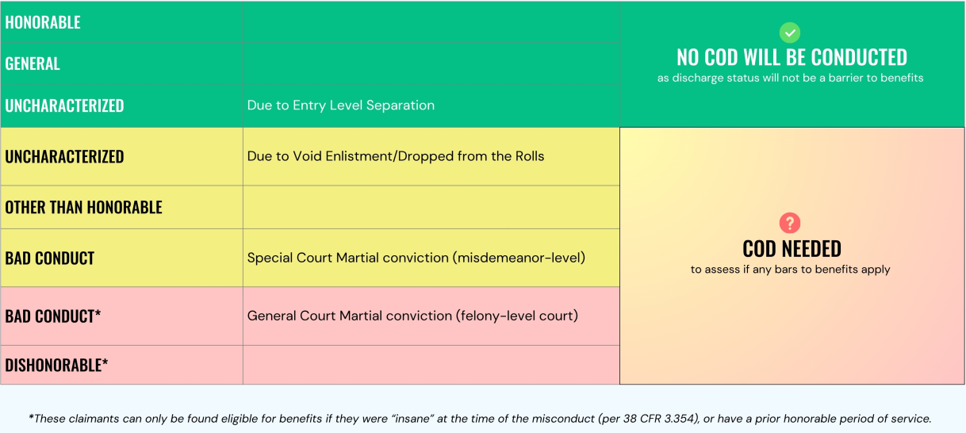
Character of Discharge (COD)
  Determination made by VA to determine if a discharge was under OTH conditions
2

Slide 22
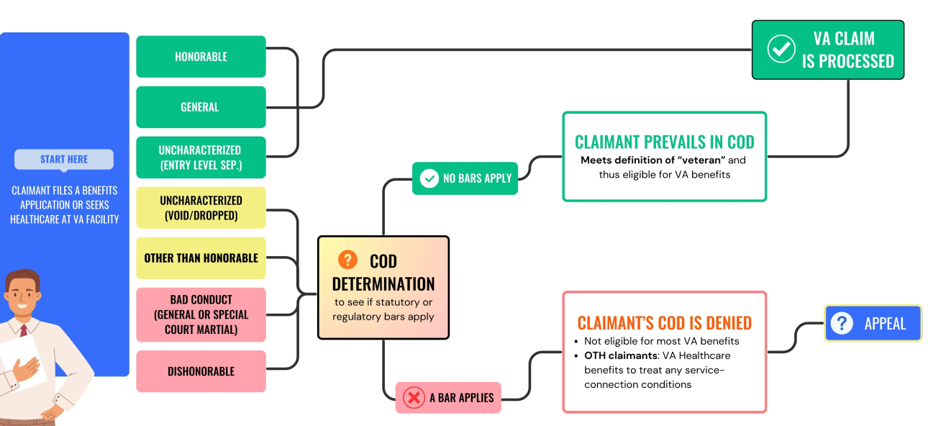
Character of Discharge (COD) Con.
2

Slide 23
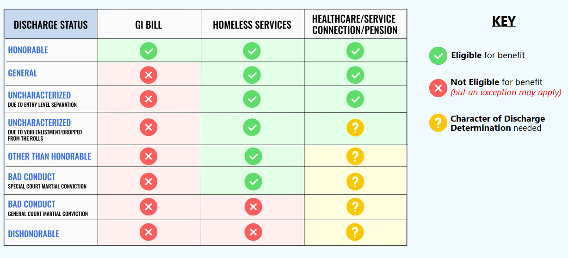
Character of Discharge (COD) Con.
2

Slide 24
COD Statutory and Regulatory Bars
    Statutory—Discharged under:
      General Court Martial conviction
      Conscientious objector or deserter
      Resignation by an officer for the good of the service
      As an alien during a period of hostilities, where it is shown that the former service member requested their release
      Absence without official leave (AWOL) for continuous period of at least 180 days without compelling circumstances
    Regulatory—Discharged:
      In lieu of General Court Martial
      Mutiny or spying
      Willful and persistent misconduct
      Moral turpitude (usually related to felony conviction)
    Bars only applied if:
      Misconduct leading to discharge is clearly supported by military record
      Evidence in favor of applying the bar outweighs the evidence against applying the bar (i.e the benefit of the doubt standard)
      Misconduct relating to the bar formed the basis of the discharge
2

Slide 25
Veterans’ Health Care (VHA)
  Eligibility
    Meet definition of veteran (38 USC Sec. 101(2))
    Meet VHA’s minimum time in service requirement
      National Guard and Reservists: complete full period ordered to federal active duty
      Active Duty (enlisted after 09/07/1980 or officers commissioned after 10/16/1981): 24 consecutive months of active duty, unless:
        Service-connected disability rating of 10% or more, or
        Hardship discharge granted
  Service may be available outside of eligibility above if within criteria of VHA Directive 1601A.02
    Physical/mental health care related to MST
    Mental health care while eligibility determination is pending
    Chapter 17 benefits (OTH discharge + service-connected conditions)
2

Slide 26
Service-Connected Disability
  Definition
    Monthly case benefit for veterans who have a current physical or mental health condition that was incurred or aggravated during active military service, and the health condition is not the result of the veteran’s willful misconduct
  Includes automatic VHA priority and other VA services and benefits
  Eligibility net is wide
    No means test; no income offset
    No length of service requirement
    No wartime service requirement
    Lifelong income
  Rating assigned at 0%- 100%
    Rating based on severity of health conditions
    Rating can increase when conditions worsen
    Schedule of ratings 38 CFR Part 4 et seq.
  Additional benefits
    For dependents if rating is 30% or higher
    Individual unemployability
    Anatomical or sensory loss
    Homebound and Aid & Attendance status
2

Slide 27
Proving Claim
  Three elements:
    Current physical or mental health condition;
    Nexus between;
    In-service incident or causation
  Standard or review: “Benefit of the doubt” or “at least as likely as not”
  VA has duty to assist veteran
    To obtain records and other evidence to prove elements
    Conduct Compensation & Pension Exam
  Objective medical evidence
    VA-generated evidence or diagnosis not required
    In reviewing medical evidence of record, the VA must consider in light most favorable to veteran
  Service connection
    “In-service” condition could mean: injury, diagnosis, symptoms, exposure, or experience
    Or for presumptive conditions: post service diagnosis or symptoms within a presumptive period
  Nexus between condition and in-service
    1-direct service connection
    2-aggravation of pre-existing condition caused by service
    3- secondary service connection: condition caused by already service-connected condition
    4-presumptive service connection
    5- condition caused by VA medical care (FTCA)
2

Slide 28
Examples of Presumptive Service Connection
  Chronic or tropical diseases manifesting within one year of discharge (such as Diabetes, arthritis, epilepsy, leukemia, psychosis, cholera, dysentery, or malaria)
  Conditions of POWs
  Gulf War Illness
  TBI: also establishes presumption for secondary conditions
  MS manifesting within 7 years of discharge
  ALS any time after service
  Camp Lejeune exposure
  Burn Pit exposure (as codified by the PACT Act)
  Agent Orange Exposure
2

Slide 29
Service-Connected Disability Advocacy
  Increasing Disability Rating
    Remember VA duty to assist!
    Application
      VA Form 21-526EZ
      Current medical records submitted too
      Provider letters/medical source statements
      Letters from veteran and/or family/friends
  Total Disability Based on Unemployability
    Pays veteran at 100% disability rating even if they do not meet that rating criteria but are unable to work due to nature of service-connected disability
    For single disability, rating must be at least 60%
    For multiple disabilities, one must be rated at 40% and combined total must equal or exceed 70%
    VA Form 21-8940 and evidence of inability to work
  Proposed Disability Rating Decrease
    May occur in response to improved symptomology or new evidence
    Veteran has the right to see new evidence and right to new C&P Exam
    30 days to request hearing and 60 days to submit their own evidence
2

Slide 30
Special Monthly Compensation
  Housebound Status
    Single service-connected disability rated at 100% and veteran is literally housebound due to condition, or
    Single service-connected disability rated at 100% or TDIU PLUS other service-connected disabilities that involve a different body system with combined rating of 60%
  Aid and Attendance
    Due to service-connected condition(s), veteran requires regular assistance to perform activities of daily living
    Higher SMC rates if disabilities are more severe
  Survivor’s Benefits (service-connected disability related)
    Dependency and Indemnity Compensation (DIC)
    Veteran died of service-connected condition or had totally disabling condition for period of time prior to and at time of death
    Can be proved posthumously
    Not means tested for surviving spouse or children
    Is means tested for surviving parents
2

Slide 31
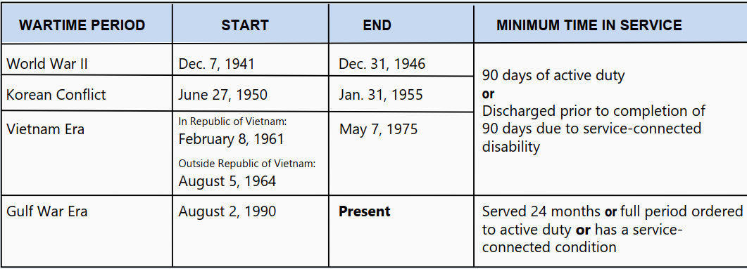
Wartime Pension
  Means tested monthly cash benefit for low-income wartime veterans
  Permanent disability or attaining age 65+ required
  Award amount based on household income and number of dependents
  Eligibility requires at least one day of service during wartime period (deployment not required)
  Age 65+, SSI/SSDI beneficiaries, and nursing home residents are presumed disabled
  All others must prove disability (service-connection not required, only that disabling condition not arise from willful misconduct)
2

Slide 32
Wartime Pension Con.
  Income Limit
    Must be below Maximum Annual Pension Rate (MAPR)
    2026 numbers:
      Basic: 17,441/year (1,453/month)
      Housebound: 21,313/year (1,776/month)
      Aid & Attendance: 29,093/year (2,424/month)
      Increases based on number of dependents
    Dollar for dollar reduction based on countable income from MAPR calculated annually
  Asset limit
    $159,240
    Primary home and car not counted
    3-year lookback period
2

Slide 33
Overpayments
  Should not be assessed if solely due to VA administrative error. 38 CFR 3.500(b)(2); 38 USC 5112(b)(10).
  Common ways overpayments occur
    Unreported income or assets and receiving wartime pension
    Incarceration or other justice involvement
    School enrollment changes while receiving GI Bill
    Award amount not changed when number of dependents does (such as in divorce)
  How to respond:
    1- Appeal validity or amount owed on OP; no deadline to file; 38 CFR 1.911(c)(3)
    2- Waiver request; one year to file; factors considered: 38 USC 5302; 38 CFR 1.965(a)
    3- Negotiate/Compromise lower lump sum payment (no deadline)
    4- Payment Plan- no deadline to request
2

Slide 34
Practicing Before the VA
  Accreditation required
    Attorneys
      Bar admission and good standing required
      Complete VA Form 21a
      Submit via fax 202-495-5457
      Attach certificates of good standing from all admitted courts/federal agencies
    Processing time: 60-120 Days
    For initial accreditation, completion of 3.0 hours of approved CLEs required (PLI has a yearly course that meets this requirement)
    At one-year mark, send completion certificate for CLEs and good standing certifications to OGC
  For each subsequent year
    After initial accreditation, only good standing materials required
    Then alternating between CLE completion + good standing materials and just good standing materials
  Accredited Representative Hotline: 855-225-0709
2

Slide 35
Questions?
cole@wtls.org | 731-426-1393

Slide 36


CONTACT US
Main: 731-423-0616
Intake: 800-372-8346
Website: www.wtls.org
@WestTNLegalServices
113 West Paris Street
Huntingdon, TN
1407 Union Ave, Ste 110
Memphis, TN
OFFICE LOCATIONS:
208 South Church Ave
Dyersburg, TN
210 W. Main Street
Jackson, TN
141 North Third Street
Selmer, TN
2

