Slide 1

Depositions
101
Taking and Defending Depositions
Martie Lafferty, Esq.
Executive Director • Tennessee Fair Housing Council
martie@tennfairhousing.org • 615.874.2344
DEPOSITIONS 101
01

Slide 2
Applicable Rules
FEDERAL RULES OF CIVIL PROCEDURE
TENNESSEE RULES OF CIVIL PROCEDURE
Rule 30
Rule 30
Depositions by Oral Examination
• Limited to 10 except with permission of court
• Each deposition limited to 7 hours
Depositions Upon Oral Examination
• No limits on number or length of depositions
Check Local Rules
DEPOSITIONS 101
02

Slide 3

What even is a deposition, anyway?
01
Discover
Learn or confirm information.
DISCOVERY TOOL
02
Assess
Evaluate credibility, memory, and demeanor.
DEPOSITIONS 101
03

Slide 4
Types of Depositions
• Individuals who are Parties or Witnesses
• Organizations/Businesses FRCP 30(b)(6); TRCP 30.02(6)
• Experts
DEPOSITIONS 101
04

Slide 5


PLANNING FIRST
Preparation is key.
REVIEW THE CASE
BEFORE THE FIRST QUESTION
01
Big Picture
Review the key facts and concepts for your case and what you need to prove.
Make an outline of the topics you want to cover.
02
Details
Review the pleadings and prior discovery.
03
Experts
If you have an expert, consider using them to help with your deposition prep.
04
Outline
Create an outline of the deposition. Include intro items and topics you want to cover.
05
Exhibits
Select and prepare copies of exhibits you plan to cover.
DEPOSITIONS 101
05

Slide 6
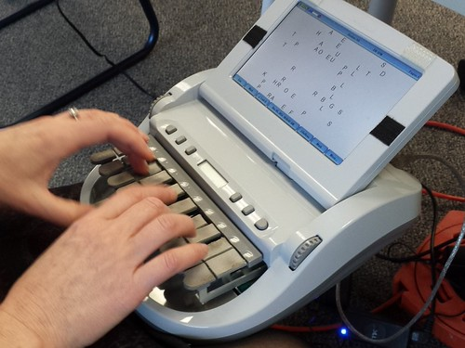
Planning Logistics
Details matter for depositions.
1
Court Reporter
Role of Co-Counsel
Is this a deposition you should do solo or would it be helpful to take co-counsel along?
2
Interpreter(s), if needed
3
Setting
DEPOSITIONS 101
06

Slide 7
Key Concepts & Skills
01
02
03
04
05
Efficiency
Communication
Focus
LISTEN
Don’t Rush
Clear
Simple
Be Present. Don’t get distracted.
Pause
Check your notes
Take breaks
“What if you don’t understand a word the witness uses or a concept they talk about?” ASK
LISTEN
The follow-up you need is often not in the outline.
Depositions are about learning.
DEPOSITIONS 101
06

Slide 8

STORY TIME
The Ghost of Depositions Past
DEPOSITIONS 101
07

Slide 9

DEPOSITIONS 101
07

