Slide 1

Personal Transparency and Burnout Prevention
Amy Willoughby Bryant

Slide 2

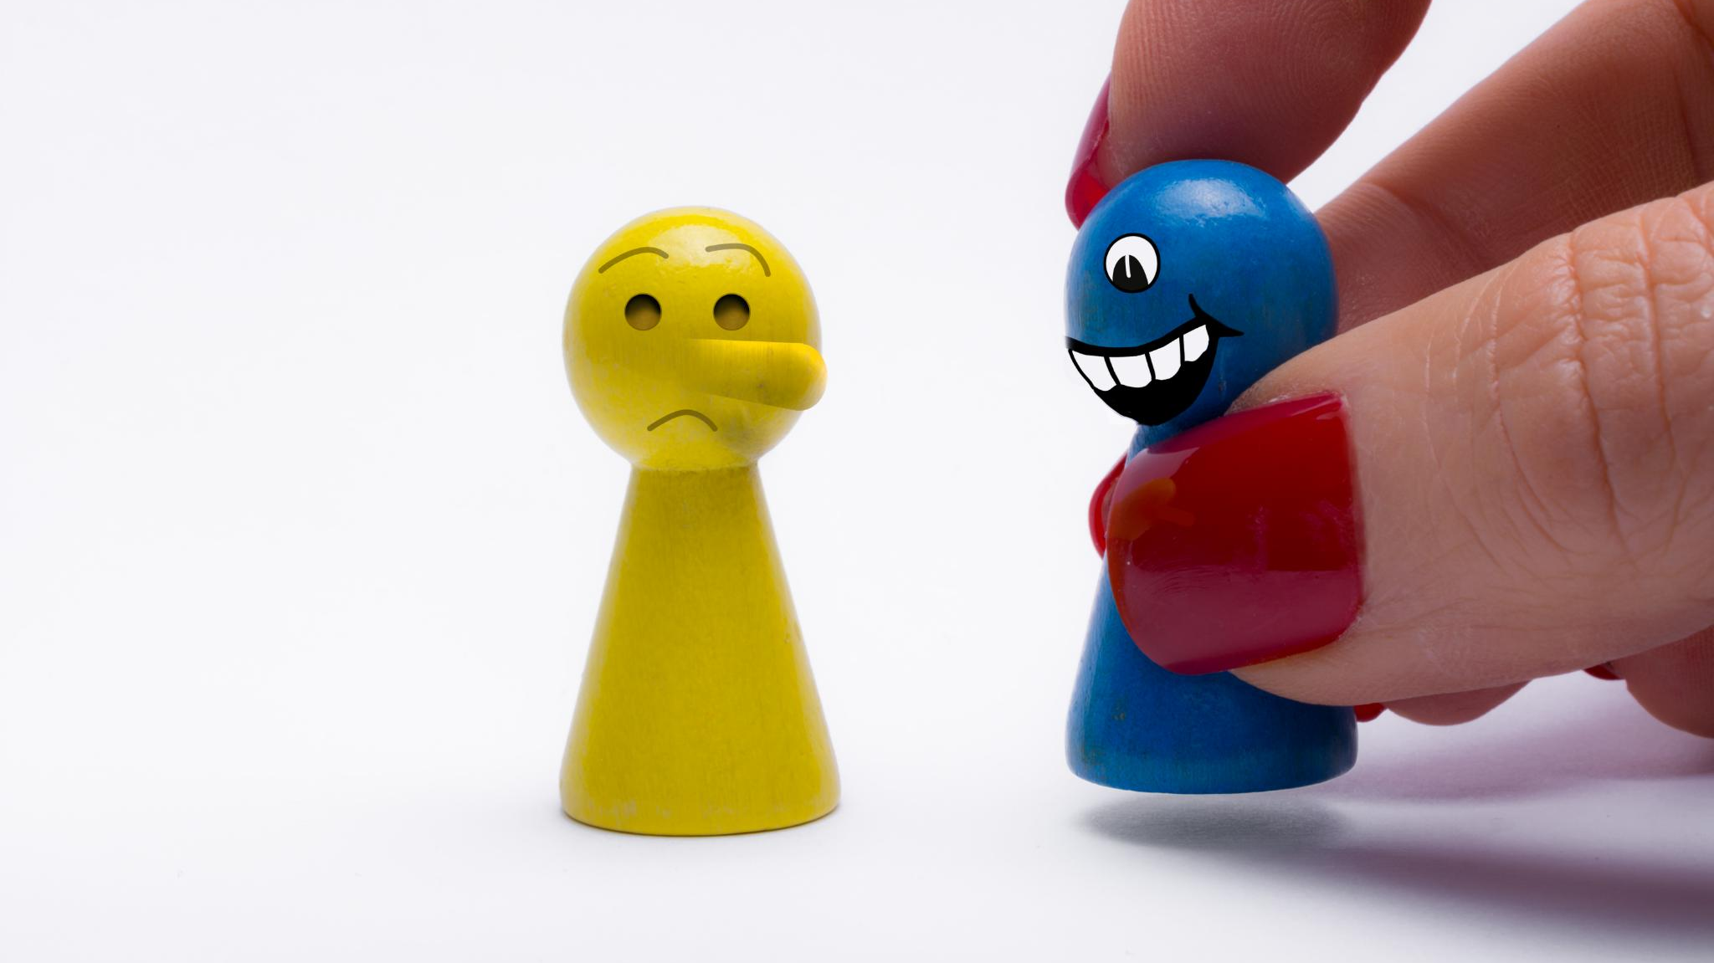
Exploring Stress and Personality
Stress Versus Burnout
  Stress and burnout are different experiences with unique impacts on our well-being and daily functioning.
Understanding Personality Traits
  Personality tests reveal individual traits, helping us understand the variety of personality types and behaviors.
Individuality and Stress Experience
  Each person experiences and responds to stress differently due to their unique personality traits and perspectives.
Role of Relationships in Stress Management
  Supportive interpersonal relationships are essential for managing stress effectively and promoting emotional resilience.
Notes:
Image source: Microsoft 365 content library
We will discuss the difference between stress and burnout, highlighting their distinct impacts. A personality test will help us understand individual traits, followed by an overview of various personality types. We'll examine how individuality affects stress experiences, and explore how interpersonal relationships play a crucial role in managing stress effectively.

Slide 3

Understanding Stress
What Is Stress
  Stress is the body's natural response to challenging or demanding situations, affecting how we feel and act.
Sources and Impact
  Stress can be triggered by external events or internal worries, impacting both physical and mental health significantly.
Short-term vs Prolonged Stress
  Short-term stress may enhance alertness, but long-term stress can result in negative health consequences if not managed.
Notes:
Image source: Microsoft 365 content library
Stress is the body's response to challenging or demanding situations. It can be triggered by external pressures or internal worries, impacting both physical and mental health. While short-term stress can boost alertness and performance, prolonged stress often leads to negative health effects if not managed properly.

Slide 4
What are some things that cause you stress?

Slide 5

Managing Work and Home Stress
Sources of Work Stress
  Heavy workloads, strict deadlines, and challenging colleague relationships are key drivers of stress in the workplace.
Causes of Home Stress
  Family responsibilities, financial strain, and work-life balance pressures often create stress at home.
Effective Stress Management
  Setting boundaries, practicing self-care, and seeking support help reduce both work and home stress.
Notes:
Image source: Microsoft 365 content library
Work stress often arises from heavy workloads, tight deadlines, and challenging relationships with colleagues. Home stress can result from family responsibilities, financial pressures, or balancing work-life demands. Addressing both types of stress involves setting boundaries, practicing self-care, and seeking support from friends or professionals.

Slide 6
How do you set boundaries?
What are some boundaries you have for work?
What are some boundaries you have for home?
How do you maintain your boundaries without guilt?

Slide 7
How do you practice self care?

Slide 8
What is Burnout?
Burn-out is included in the 11th Revision of the International Classification of Diseases (ICD-11) as an occupational phenomenon.
Burn-out is defined in ICD-11 as follows:
“Burn-out is a syndrome conceptualized as resulting from chronic workplace stress that has not been successfully managed. It is characterized by three dimensions:
• feelings of energy depletion or exhaustion;
• increased mental distance from one’s job, or feelings of negativism or cynicism related to one's job; and
• reduced professional efficacy.

Slide 9
What are some things that cause burnout?

Slide 10

Burnout vs. Stress
Nature of Stress
  Stress is usually short-lived, triggered by specific pressures, and can sometimes motivate positive action and focus.
Nature of Burnout
  Burnout is a prolonged reaction to chronic workplace stress, resulting in exhaustion, detachment, and reduced performance.
Importance of Distinction
  Recognizing the difference between stress and burnout is crucial for applying the right coping strategies and seeking proper support.
Notes:
Image source: Microsoft 365 content library
Burnout and stress are related but distinct conditions. Stress is typically short-term, stemming from specific pressures and can motivate action. Burnout, on the other hand, is a prolonged response to chronic workplace stress, leading to exhaustion and detachment. Recognizing the differences is key to choosing effective coping strategies.

Slide 11
Who Am I?
Let’s take a test
https://www.16personalities.com/free-personality-test

Slide 12
Discover Your Personality
Understanding Character Traits
Personality tests provide insights into your unique character traits and preferences, helping you learn more about yourself.
Identifying Strengths and Weaknesses
These assessments can reveal your strengths, weaknesses, and suggest ideal work environments suited to your personality.
Enhancing Self-Awareness
Taking a personality test boosts self-awareness, improves relationships, and supports personal and professional growth.
Notes:
Image source: Microsoft 365 content library
Personality tests help you understand your character traits and preferences. These assessments can reveal strengths, weaknesses, and ideal work environments. Taking a personality test can enhance self-awareness, improve relationships, and guide personal and professional development.

Slide 13

Understanding Personality Types
Key Personality Dichotomies
  The four main dichotomies are Extraversion/Introversion, Intuition/Sensing, Feeling/Thinking, and Judging/Perceiving. These categories describe basic personality preferences.
Sixteen Myers-Briggs Types
  The Myers-Briggs model combines these dichotomies into sixteen types offering a framework for understanding personal differences.
Benefits of Self-Knowledge
  Understanding your personality type can help improve communication, boost teamwork, and support personal growth in various environments.
Notes:
Image source: Microsoft 365 content library
Personality types are commonly categorized using four dichotomies: Extraversion/Introversion (E/I), Intuition/Sensing (N/S), Feeling/Thinking (F/T), and Judging/Perceiving (J/P). The 16 Myers-Briggs types, such as INTJ, ENFP, and ISFJ, combine these traits to describe individual preferences. Knowing your type can improve communication, teamwork, and personal growth.

Slide 14
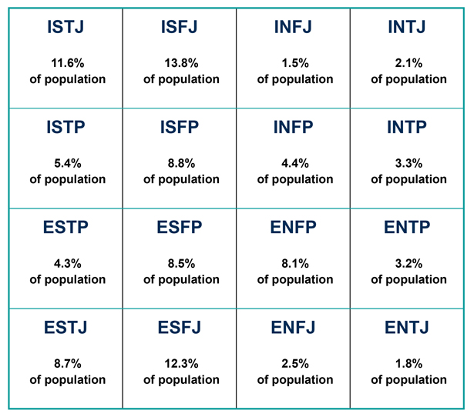

Slide 15
The INTJ Personality
Strategic Thinking
INTJs are known for their ability to think strategically and see the bigger picture when solving problems.
Analytical and Logical
They prefer logic over emotion, relying on clear analysis to make decisions and tackle challenges.
Independent and Goal-Oriented
INTJs highly value independence and are motivated to achieve goals using innovative and efficient methods.
Notes:
Image source: Microsoft 365 content library
INTJs are strategic thinkers, often known as 'Architects' in the Myers-Briggs Type Indicator. They excel at planning and problem-solving, preferring logic over emotion. INTJs value independence, tend to be quiet and analytical, and are highly motivated to achieve their goals through innovation and efficiency.

Slide 16

the INTP Type
Analytical and Innovative
  INTPs are highly analytical, excelling in problem-solving and generating innovative ideas across various fields.
Love for Complex Ideas
  They enjoy exploring abstract concepts and complex theories, often engaging in deep thinking and research.
Valuing Independence
  INTPs prefer independence and autonomy, seeking intellectual freedom in their pursuits and conversations.
Notes:
Image source: Microsoft 365 content library
INTP, or the Thinker, is one of the 16 Myers-Briggs personality types. INTPs are analytical and innovative, often excelling in problem-solving and abstract thinking. They value independence, enjoy exploring complex ideas, and prefer meaningful conversations over small talk.

Slide 17

the ENTJ Type
Strategic Leadership
  ENTJs are recognized for their ability to think strategically and guide teams toward long-term goals with clear direction.
Resource Organization
  ENTJs excel in organizing resources efficiently, ensuring that projects and teams are set up for maximum effectiveness.
Confidence and Motivation
  Highly confident and assertive, ENTJs motivate others and thrive in challenging environments, making them valuable leaders.
Notes:
Image source: Microsoft 365 content library
ENTJs are natural leaders, known for their strategic thinking and decisive nature. They excel in organizing resources and motivating teams towards ambitious goals. Highly confident and assertive, ENTJs value efficiency and often seek out challenges, making them well-suited for management and leadership positions.

Slide 18

the ENTP Personality
Creativity and Curiosity
  ENTPs are known for their inventive ideas and inquisitive nature, constantly exploring new possibilities.
Adaptability and Innovation
  They thrive in innovative environments, adapting quickly and embracing change to foster growth.
Debate and Persuasion
  ENTPs enjoy challenging ideas through debate, using logic and wit to inspire and persuade others.
Notes:
Image source: Microsoft 365 content library
ENTPs, known as 'Debaters,' are characterized by creativity, curiosity, and adaptability. They thrive in environments that encourage innovation and enjoy challenging ideas through debate. ENTPs excel at finding novel solutions to problems, often relying on their quick wit and logical reasoning to persuade and inspire others.

Slide 19

the INFJ Type
Empathy and Intuition
  INFJs are deeply empathetic and intuitive, often understanding and anticipating the needs of others before they are expressed.
Meaningful Relationships
  They value genuine, meaningful connections and strive to make a positive impact in their relationships and the broader world.
Creativity and Compassion
  INFJs excel in creative and helping professions, using their insight and compassion to inspire and support others.
Notes:
Image source: Microsoft 365 content library
INFJs are known for their deep empathy and strong intuition, often sensing others' needs before they are spoken. They value meaningful connections and seek to make a positive impact on the world. INFJs prefer thoughtful communication and often excel in creative or helping professions due to their insight and compassion.

Slide 20

the INFP Type
Empathy and Personal Values
  INFPs are deeply empathetic, guided by strong personal values, and seek authenticity in all aspects of life.
Creativity and Meaning
  They thrive in creative environments, and their pursuit of meaning drives their work and personal fulfillment.
Idealism and Helping Others
  Characterized by idealism and a desire to help, INFPs excel in artistic and humanitarian roles.
Notes:
Image source: Microsoft 365 content library
INFPs, known as Mediators, are deeply empathetic and guided by strong personal values. They thrive in creative environments and seek meaning in their lives and work. Characterized by idealism, open-mindedness, and a desire to help others, INFPs often excel in artistic or humanitarian roles.

Slide 21

the ENFJ Type
ENFJ Personality Traits
  ENFJ stands for Extraverted, Intuitive, Feeling, Judging. These traits shape empathetic leaders who value strong relationships.
Empathetic Leadership
  ENFJs excel at building strong relationships and leading with empathy, inspiring trust within groups.
Motivating and Organizing
  ENFJs are skilled at motivating others and organizing group efforts to help people reach their potential.
Notes:
Image source: Microsoft 365 content library
ENFJ stands for Extraverted, Intuitive, Feeling, Judging, representing a personality type in the Myers-Briggs system. ENFJs are empathetic leaders who excel at building strong relationships. They are driven by a desire to help others reach their potential and are skilled at inspiring, motivating, and organizing group efforts.

Slide 22
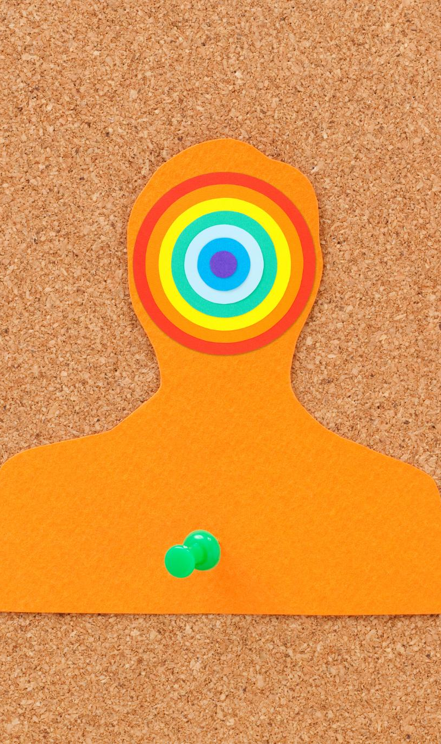
the ENFP type
Creativity and Enthusiasm
  ENFPs are highly creative and enthusiastic, constantly seeking new ideas and experiences to fuel their energy.
Empathy and Connection
  ENFPs are empathetic and excel at connecting with others, inspiring those around them with warmth and positivity.
Authenticity and Adaptability
  ENFPs value authenticity and seek meaningful relationships, making them adaptable and passionate in all settings.
Notes:
Image source: Microsoft 365 content library
ENFPs are creative, enthusiastic, and energetic individuals who thrive on new ideas and experiences. They are empathetic and excel at connecting with others, often inspiring those around them. ENFPs value authenticity and seek meaningful relationships, making them adaptable and passionate in both personal and professional settings.

Slide 23

The ISTJ type
Reliability and Organization
  ISTJs are recognized for being dependable and highly organized in their tasks and responsibilities.
Preference for Structure
  They value tradition and thrive in structured environments, making them effective planners and team contributors.
Logical Problem Solving
  ISTJs approach problems logically, using facts and past experiences to make efficient decisions.
Notes:
Image source: Microsoft 365 content library
ISTJ personalities are known for their reliability, organization, and attention to detail. They value tradition and prefer structured environments, making them excellent planners and dependable team members. Their logical approach helps them solve problems efficiently, often relying on facts and past experiences to guide their decisions.

Slide 24

the ISFJ Type
Reliability and Empathy
  ISFJs are highly reliable and empathetic, often putting others’ needs first and fostering trust in relationships.
Supportive and Organized
  They excel in supportive roles, using strong organizational skills to maintain order and help others succeed.
Value for Tradition and Stability
  ISFJs deeply value tradition and are dedicated to creating stable, harmonious environments in their lives and communities.
Notes:
Image source: Microsoft 365 content library
ISFJs are known for their reliability, empathy, and attention to detail. They thrive in supportive roles, often helping others and creating harmonious environments. With strong organizational skills and a deep sense of responsibility, ISFJs value tradition and are dedicated to maintaining stability in both their personal and professional lives.

Slide 25

The ESTJ type
Practical and Organized
  ESTJs approach tasks with practicality and organization, ensuring responsibilities are managed efficiently and effectively.
Natural Leaders
  They often take charge in group settings, valuing tradition, structure, and rules to guide their leadership.
Goal-Oriented Problem Solvers
  ESTJs use logic and decisiveness to solve problems, focusing on achieving goals and managing tasks efficiently.
Notes:
Image source: Microsoft 365 content library
ESTJs are practical, organized, and decisive individuals, often taking charge in group settings. They value tradition, rules, and efficiency, making them reliable leaders. ESTJs thrive in structured environments and focus on achieving goals, using their logical approach to solve problems and manage tasks effectively.

Slide 26
The ESFJ type
Warm and Sociable Nature
ESFJs are known for their warmth, friendliness, and ability to connect with others, creating harmonious environments.
Nurturing and Supportive Roles
They naturally excel in nurturing and supportive roles, always ready to help and care for others.
Teamwork and Organization
ESFJs are detail-oriented, organized, and thrive in cooperative team settings and community activities.
Notes:
Image source: Microsoft 365 content library
ESFJ personalities, known as 'The Consuls,' are warm, caring, and highly social individuals who value harmony. They excel at building relationships and supporting others, often taking on nurturing roles. ESFJs are organized, attentive to details, and prioritize cooperation, making them effective in team environments and community activities.

Slide 27

The ISTP type
Practical Problem-Solving
  ISTPs excel at hands-on tasks, using their resourcefulness to find practical solutions to real-world problems.
Independence and Adaptability
  They value their independence and quickly adapt to changing, dynamic environments, making them highly flexible.
Logical and Action-Oriented
  ISTPs maintain a calm demeanor, preferring logical strategies, and learn best by exploring through action rather than theory.
Notes:
Image source: Microsoft 365 content library
ISTP personalities are practical and resourceful, excelling in hands-on tasks and problem-solving. They value independence and adaptability, often thriving in dynamic environments. Known for their calm demeanor, ISTPs prefer logical approaches and enjoy exploring new ideas and experiences through action rather than theory.

Slide 28

the ISFP Type
Core Personality Traits
  ISFPs are gentle, flexible, and artistic individuals who value personal expression and living in the present moment.
Strengths in Creative Environments
  ISFPs excel in creative environments where they can express themselves, contribute unique ideas, and appreciate beauty.
Value for Harmony and Details
  ISFPs prefer harmony in relationships and pay close attention to details and the needs of others.
Notes:
Image source: Microsoft 365 content library
ISFP stands for Introverted, Sensing, Feeling, and Perceiving. ISFPs are often described as gentle, flexible, and artistic, valuing personal expression and living in the moment. They excel in creative environments, prefer harmony in relationships, and are attentive to details and the needs of others.

Slide 29

the ESTP type
Energetic and Action-Oriented
  ESTPs thrive in dynamic settings and enjoy taking initiative. Their energy motivates others and drives effective teamwork.
Quick Decision Makers
  ESTPs excel at solving problems swiftly. They rely on practical logic to make sound decisions under pressure.
Social and Adaptable Leaders
  ESTPs are outgoing, flexible, and skilled at building relationships. Their risk-taking fosters innovation and effective leadership.
Notes:
Image source: Microsoft 365 content library
ESTP stands for Extraverted, Sensing, Thinking, and Perceiving. These individuals are energetic and action-oriented, thriving in dynamic environments. They excel at problem-solving and making quick decisions, often relying on practical logic. ESTPs are also social, adaptable, and enjoy taking risks, making them effective leaders and collaborators.

Slide 30

the ESFP Type
Energetic and Spontaneous
  ESFPs are energetic individuals who enjoy spontaneity and excitement in daily life, often seeking new experiences.
Thriving in Social Settings
  ESFPs love social interaction and often become the center of attention in dynamic environments.
Empathetic and Observant
  ESFPs are practical, empathetic, and observant, connecting well with others and adapting easily to change.
Notes:
Image source: Microsoft 365 content library
ESFPs, known as the Entertainers, are energetic and spontaneous individuals who love social interaction. They thrive in dynamic environments, enjoy being the center of attention, and value living in the moment. ESFPs are practical, observant, and empathetic, making them excellent at connecting with others and adapting to change.

Slide 31

How do I Deal with Stress?

Slide 32
How to I Deal with Burnout?

Slide 33

Honesty in Relationships
Importance of Self-Honesty
  Being honest with yourself is essential for emotional wellbeing and helps build resilience against everyday stress.
Balancing Life Demands
  Juggling work, family, and social obligations makes self-honesty challenging, but necessary for maintaining healthy relationships.
Preventing Burnout
  Practicing self-honesty helps prevent burnout and reduces negative effects of constant demands, improving life satisfaction.
Notes:
Image source: Microsoft 365 content library
Balancing work, family, and social obligations can make self-honesty challenging but essential. Being honest with yourself supports emotional wellbeing and builds resilience against stress. Practicing self-honesty helps prevent burnout and reduces the long-term negative effects of constant demands, enhancing your overall relationships and life satisfaction.

Slide 34

Challenges of the Sandwich Generation
Dual Caregiving Roles
  Members of the Sandwich Generation care for both aging parents and adult children, balancing responsibilities across generations.
Emotional and Financial Strain
  Managing these responsibilities often causes emotional stress and financial pressure, impacting overall well-being.
Family Fulfillment and Resilience
  Despite challenges, many find purpose in nurturing family bonds, building resilience and strong relationships among generations.
Notes:
Image source: Microsoft 365 content library
The Sandwich Generation balances caring for aging parents while supporting adult children and sometimes grandchildren. This dual responsibility can lead to emotional and financial stress. Despite these challenges, many find fulfillment in nurturing family bonds and providing multigenerational support, fostering resilience and strong family relationships.

Slide 35

Mindful Tips for Conservators
Grounding for Presence
  Use grounding techniques to remain present and focused during difficult or high-stress conservatorship responsibilities.
Balancing Emotions and Objectivity
  Acknowledge your feelings but avoid letting emotions influence professional decisions, preserving fairness and clarity.
Reflect for Ethical Choices
  Regular reflection helps maintain empathy without losing necessary detachment, supporting ethical and effective choices in complex cases.
Notes:
Image source: Microsoft 365 content library
Practice grounding techniques to stay present during challenging tasks. Acknowledge personal emotions without letting them influence professional decisions, maintaining objectivity. Regularly reflect on your experiences to balance empathy and detachment, ensuring ethical and effective decision-making in complex legal situations.

Slide 36

Prioritizing Wellbeing First
Personal Wellbeing Habits
  Building practical habits like morning exercise and stress management supports your personal wellbeing and sets a positive tone for the day.
Cultivating Soft Skills
  Developing mindfulness, adaptability, and focus helps you respond to daily challenges with greater resilience and clarity.
Daily Effectiveness Practices
  Incorporate short meditations, regular breaks, and movement into your day to boost effectiveness and maintain wellbeing.
Notes:
Image source: Microsoft 365 content library
Begin by developing practical skills to care for your own wellbeing, such as morning exercise routines or managing stress—akin to putting on your oxygen mask first. Next, cultivate essential 'soft skills' like mindfulness, adaptability, and focus. Incorporate practices like short guided meditations, regular breaks, and movement to enhance daily effectiveness.

Slide 37

Mastering Time Awareness
Assessing Available Time
  Recognizing how much time you have helps set realistic goals and prevents overwhelming workloads.
Task Organization Tools
  Creating lists and using a calendar helps organize tasks and deadlines, boosting productivity and clarity.
Accountability Partnerships
  Partnering with someone for accountability helps you stay motivated and on track with your goals.
Notes:
Image source: Microsoft 365 content library
Recognizing the time available helps you set realistic goals and avoid overwhelm. Creating lists and using a calendar organizes tasks and deadlines, increasing productivity. Partnering with someone for accountability ensures you stay on track and motivated, making it easier to accomplish tasks within a reasonable timeframe.

Slide 38
Building Supportive Connections
Importance of Supportive Relationships
Supportive and understanding people are essential for maintaining emotional well-being and resilience during challenging times.
Finding Empathetic Listeners
Connecting with someone who is empathetic can make you feel truly heard and valued, reducing feelings of isolation.
Creating Safe Spaces
Safe environments foster trust, helping self-doubt and loneliness diminish as individuals feel accepted and understood.
Notes:
Image source: Microsoft 365 content library
Developing relationships with supportive and understanding people is crucial for emotional well-being. Although it may feel like no one understands your experiences, someone empathetic can help you feel truly heard. When you find a safe space with others, feelings of isolation fade and self-doubt begins to diminish.

Slide 39

Guidance After Burnout
Empathetic Professional Support
  Mental health professionals who have experienced burnout themselves offer unique empathy and understanding to those seeking help.
Identifying Burnout Triggers
  Guidance includes helping clients recognize specific causes of burnout, allowing for personalized intervention and support plans.
Developing New Coping Strategies
  Professionals introduce effective new techniques for coping with triggers and building emotional resilience for the future.
Notes:
Image source: Microsoft 365 content library
Counselors, therapists, and psychologists who have personally overcome burnout offer valuable insights and empathy. They help clients identify specific triggers that lead to burnout, ensuring tailored support. Most importantly, these professionals guide individuals in discovering effective new coping strategies to process these triggers and foster emotional resilience.

Slide 40
Reframe Your Thinking
Adopt Healthier Perspectives
Changing how you view challenges allows you to react more positively and constructively during difficult times.
Find Meaning in Adversity
Believing that everything happens for a reason helps you discover growth and meaning in tough experiences.
Build Resilience and Resolve
This mindset strengthens resilience, empowering you to move forward and achieve emotional balance after setbacks.
Notes:
Image source: Microsoft 365 content library
Reframing your thinking involves adopting healthier perspectives on life's challenges. By choosing to believe that everything happens for a reason, you can find meaning and growth even in difficult moments. This mindset encourages resilience, helping you move forward and achieve emotional resolve after setbacks.

Slide 41

Rest Your Brain
Benefits of Meditation
  Meditation helps you calm your mind and reconnect with your emotions, fostering inner peace and clarity.
Music and Art Appreciation
  Enjoying music or appreciating art allows your mind to rest and stimulates emotional intuition.
Balance Between Activity and Rest
  Finding a healthy balance between activity and rest is crucial for mental well-being and overall productivity.
Notes:
Image source: Microsoft 365 content library
Taking breaks to meditate, contemplate, enjoy music, or appreciate art helps you connect with your emotions and intuition. These activities allow your mind to recover from stress and overstimulation. Achieving a healthy balance between activity and rest is essential for mental well-being and overall productivity.

Slide 42

Daily Affirmation
“There are 24 hours in every day. I will make the most of every minute. My hours are divided between work and my many other obligations. One of my obligations is me. It is not selfish. It is self-full and its ok.”
–Amy Willoughby Bryant

Slide 43

Thank you
Amy Willoughby Bryant
Office of conservatorship management

