Slide 1

Getting to Know the New Outlook
Vincent Morris, Esq.
Director of Compliance and Legal Technology
Legal Aid Society of Middle Tennessee and the Cumberlands
vmorris@las.org

Slide 2
New Outlook: An Overview (1-2-3)
Get Familiar with the broad strokes
Somethings are really different / Somethings remain the same
Focus on the details of the features that may be useful
Not every feature will matter to every person, and that is okay.
To Toggle or not to Toggle...
You can easily toggle back to the classic view when you need a moment
Faster (saving time)
Cleaner (improving organization)
Smarter (working for you)
Streamline day-to-day work (more integrated)

Slide 3
Getting Started (Setting up your space)
Group messages by conversations:
Puts all emails with the same subject or thread ID into one single expandable stack sorted by time. Feels Clumpy.
Group messages by branches within conversations: Organizes the thread into a tree-like sub-structure. It visually separates diverging replies or side-discussions so you can easily track distinct subtopics and trace who responded to a specific point.
Do not group messages:
Turns off threading entirely. Every single incoming or outgoing email is shown as an individual, standalone line item in your message list sorted by date.

Slide 4
New Features (Let’s get Nerdy)
Companion Tools to Enhance Focus:
New features to customize your focused feed
  Automatic "Focus Time" Booking: Automatically schedules 1-to-2-hour "Focus Time" blocks and mutes your incoming Teams and Outlook notifications
  Smart "Quiet Time" Guardrails: The tool analyzes your designated working hours and silences mobile push notifications outside of those hours.
  It lets you track how well you are disconnecting from work over the weekend.

Slide 5
New Features (Let’s get Nerdy)
Pinning Emails: Pin priority messages to the very top so they never slip below the fold as new mail flows in.
Snoozing Mail: If an important email in your Focused tab cannot be addressed immediately, you can snooze it. This temporarily hides it until it reappears at a specified time.
Advanced Search Folders: Deeper integration allowing you to scope highly specific keyword filters

Slide 6
Artificial Intelligence (A Focused Inbox)
Focused Inbox: Not new to Outlook, but superpowered.
  Unified Drag-and-Drop Training: You can train your Focused Inbox faster
Other Folder: The companion tab to Focused Inbox.
  Acts as a secondary filter where Outlook automatically routes emails that are valid and safe, but less important or non-urgent

Slide 7
Artificial Intelligence (Turning it Off)
Disable Copilot and content-analyzing AI features
Click the Gear icon (Settings) in the top-right corner
Select Copilot from the eft menu and toggle Turn on Copilot to Off
Go to General > Privacy and data > Privacy settings. Turn off the option “Turn on optional connected experiences”

Slide 8
Artificial Intelligence (Turning it Off)
NOTICE: There is no single button that completely strips every trace of AI from the "New Outlook" client, but you can disable its core AI capabilities and hide its interface elements. New Outlook is web-based and features like "Copilot" and smart text assistance are handled on its cloud servers rather than locally on your computer. However, by following the previous steps, you can effectively shut off Copilot drafting and stop Microsoft from analyzing your emails.
NOTICE: Many users note that even after toggling Copilot off, the AI elements randomly reactivate or show back up after an application update or a system restart.
WHAT WILL NOT WORK WITHOUT AI:
Smart Writing Tools | Text Predictions | Advanced Editor Feedback | Search Enhance

Slide 9
Here’s how New Outlook can save you time!
Kathryn Avent-Mann

Slide 10
Email Templates/My Templates
Email templates in Outlook are pre-written, reusable messages that include your subject line, body text, and attachments. They save time by eliminating the need to type the same routine emails from scratch or manually copy/paste from sent folders.

Slide 11
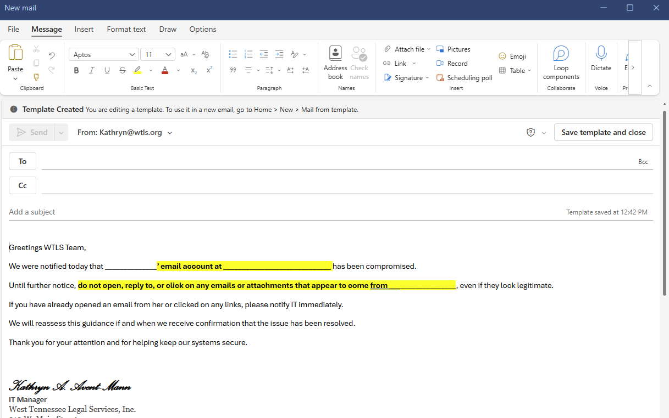
Example

Slide 12

Quick Scheduling Features
The new Outlook streamlines meeting planning with features designed to eliminate back-and-forth emails. Scheduling Assistant to instantly compare attendee calendars, Bookings with me for sharing customizable booking pages, and My Day for quickly dragging email tasks onto time blocks.

Slide 13
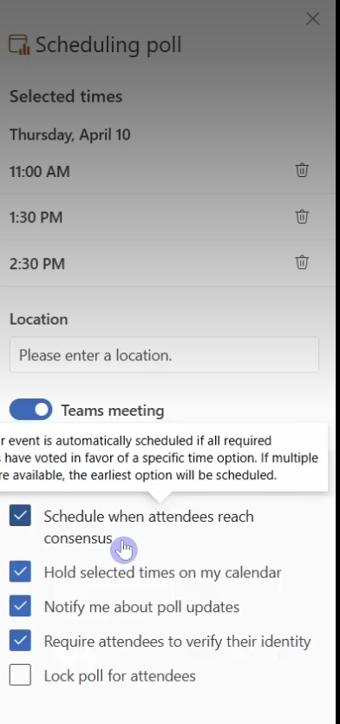
Example

Slide 14
Categories and organization improvements
The new Microsoft Outlook introduces a modernized, web-inspired interface that enhances inbox management through flexible tagging, visual hierarchy, and improved navigation. Key category and organization features include color-coded tags, folder customization, and enhanced search capabilities.

Slide 15
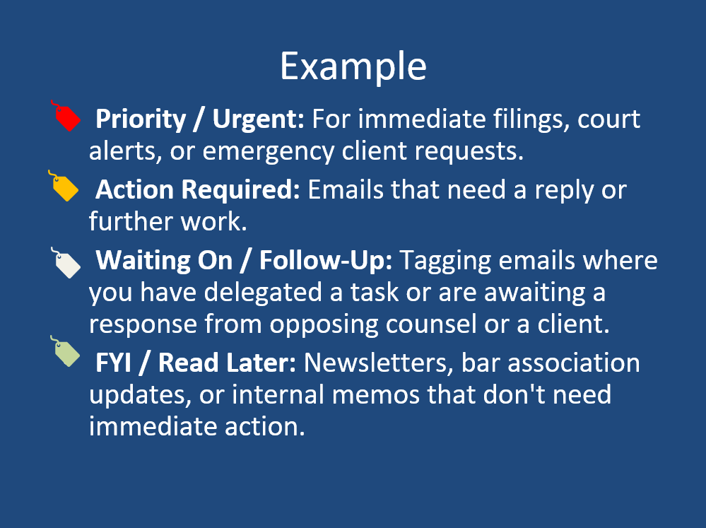

Slide 16
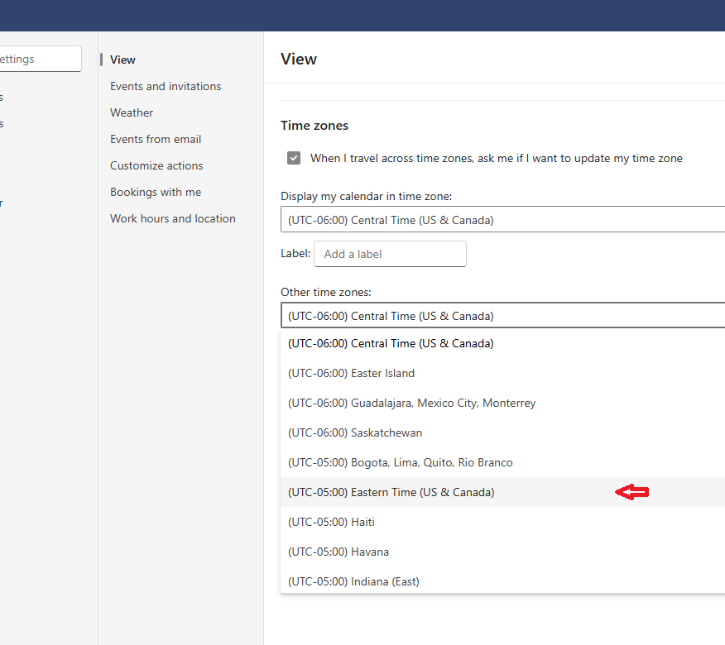
Multiple time zones in Calendar

Slide 17
Better Search and Tips Tricks
The new Outlook for Windows introduces semantic search and improved filters designed to surface files, emails, and calendar events faster. With natural language processing, integrated Copilot (for M365 accounts), and context-aware ribbon tabs, locating specific information requires fewer manual steps.

Slide 18
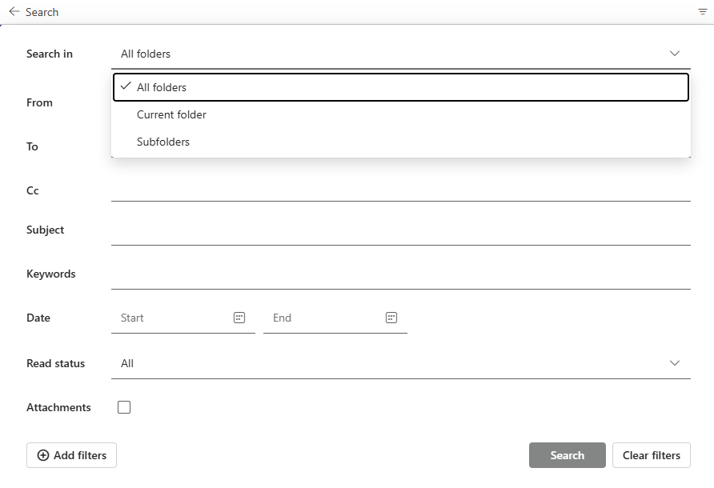
Example

Slide 19
🔧 Daily Workflow Changes New Outlook
📥 Simpler rules
🎨 Less customization
🧭 Cleaner layout
Notes:
Things will feel a little different day to day. If you rely on lots of rules and customization, you’ll notice it. If not, it may actually feel simpler.

Slide 20
🔗 Case Systems & Add-ins
🧩 Add-ins connect tools
❌ Old ones don’t work
☁️ Only cloud-based supported
Notes:
Add-ins connect Outlook to systems like LegalServer. Older ones won’t work here. If your workflow depends on that, test first.

Slide 21
📂 Email Archives
📁 PST = saved email file
❌ Not supported
⚠️ Plan needed
Notes:
A PST is a saved email file on your computer. New Outlook can’t open it. If you rely on one, you’ll need to plan ahead—or keep classic Outlook.

Slide 22
👥 Shared Mailboxes
📬 Intake & team inboxes
⚠️ Works—but different
🔄 Sync may vary
Notes:
Shared mailboxes are critical in Legal Aid. They still work—but this is the biggest area to test before switching.

Slide 23
🌐 Offline Use
📶 Best online
⚠️ Limited offline
💻 Web-like experience
Notes:
New Outlook works best when connected. If you travel or work in court, this is something to think about.

Slide 24
🤖 Automation
❌ No VBA
❌ No macros
❌ No custom forms
Notes:
If you’ve never heard of these, you’re fine. If you rely on them, that’s a strong reason to wait.

Slide 25
🚧 Still Improving
🔄 Ongoing updates
📈 More features coming
➡️ Future direction
Notes:
This is where Microsoft is going. It will improve, but today there are still gaps.

Slide 26
✅ Switch Now If…
✔️ Simple workflows
✔️ Cloud-based work
✔️ No dependencies
Notes:
If your setup is simple and cloud-based, switching now may work great for you.

Slide 27
⏳ Wait If…
⚠️ Shared mailbox heavy
⚠️ Case integrations
⚠️ Archives/automation
Notes:
If your role depends on these, it’s okay to wait. Really.

Slide 28
🎯 Bottom Line
✨ Modern & simpler
⚠️ Not full replacement
👍 Your workflow comes first
Notes:
Closing: The new Outlook is cleaner and where Microsoft is headed. But it’s not about whether it’s better—it’s whether it works for how you do your job today. The goal isn’t to use the newest tool—it’s to work effectively without fighting your inbox all day. None of us came to Legal Aid to spend more time managing email. Switch when it helps you—not just because it’s new. And ideally… without switching back by Friday.

Slide 29

5.0
What, Where, When, Who, How, and...Why?
LegalServer transitions to a new interface design

Slide 30
LegalServer 5.0
WHAT?
  LS 5.0 has significant changes in the user interface.
  The functionality & data are the same, but it looks different.
WHEN?
  Likely before the new year
WILL I need to RELEARN How to use the system?
  NO. The functionality is the same, but it looks different. The changes are visual and navigational only, but the layout is significantly different, so there will be an adjustment period.

Slide 31
LegalServer 5.0
WHAT should I do?
  You are already doing it. Attend trainings, learn what to expect, and get the tips & tricks to make it a positive experience instead of a negative one..
WHY is it Changing?
  LegalServer will NO LONGER continue to support LS 4.0 (probably your current version) after 2026. Also, there will be some real benefits.

Slide 32
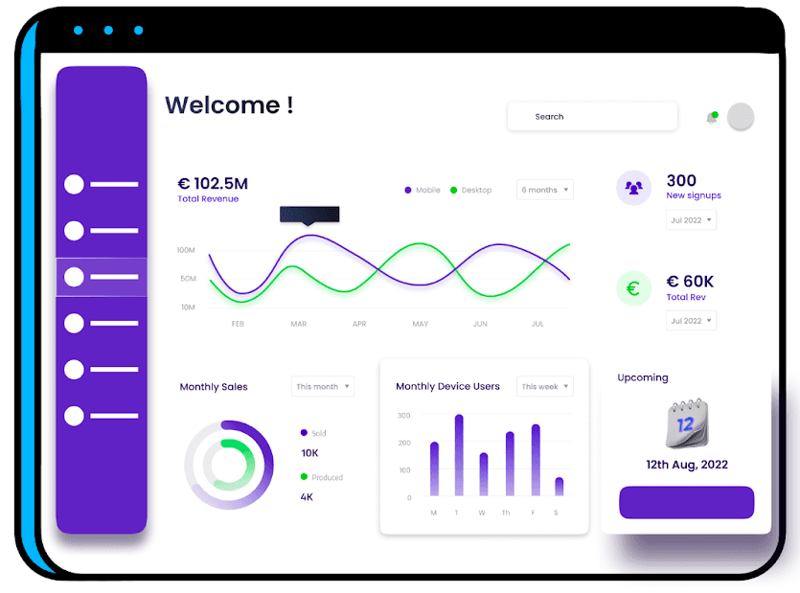
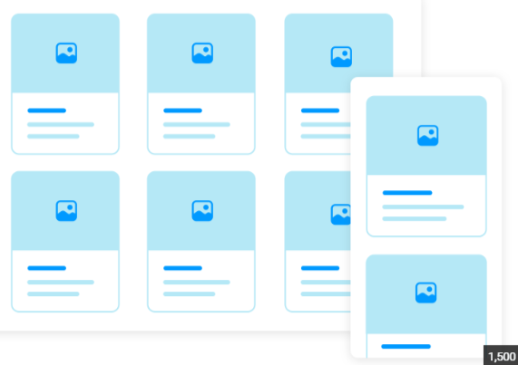
LegalServer 5.0
HOW is it going to be different?
The interface is integrating a “card” UI design instead of the grid like design currently used and changing other color schemes/designs to meet modern design standards for improved accessibility.
The underlining technology changes and UI changes will also allow for more integrations and API connectivity.

Slide 33
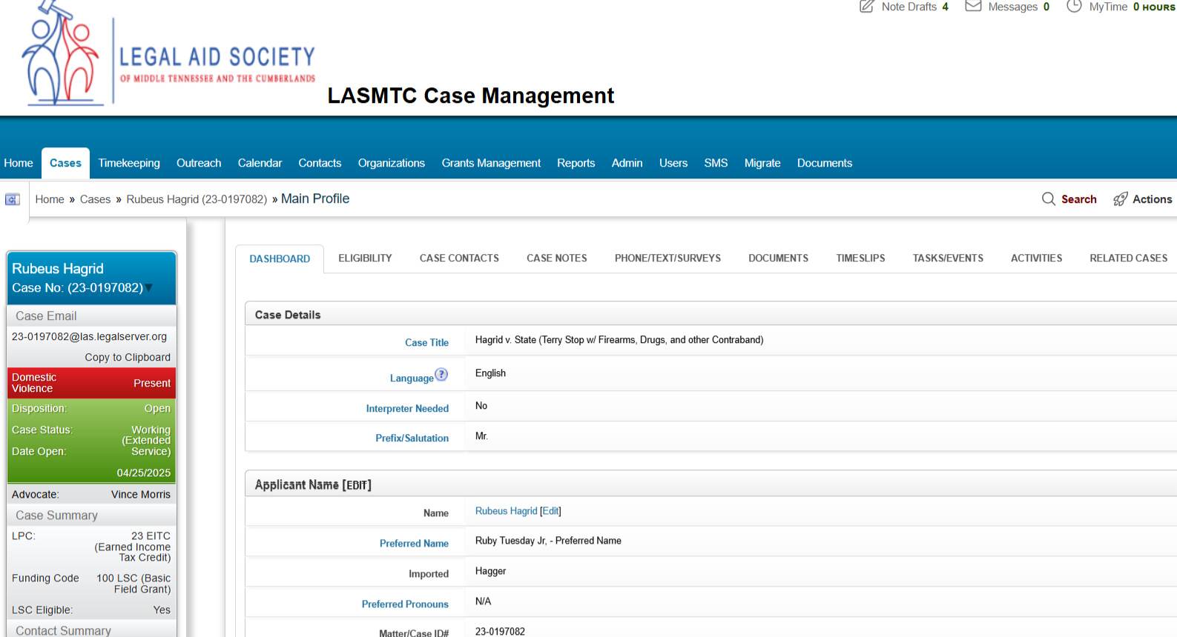
LegalServer
LegalServer 4.0

Slide 34
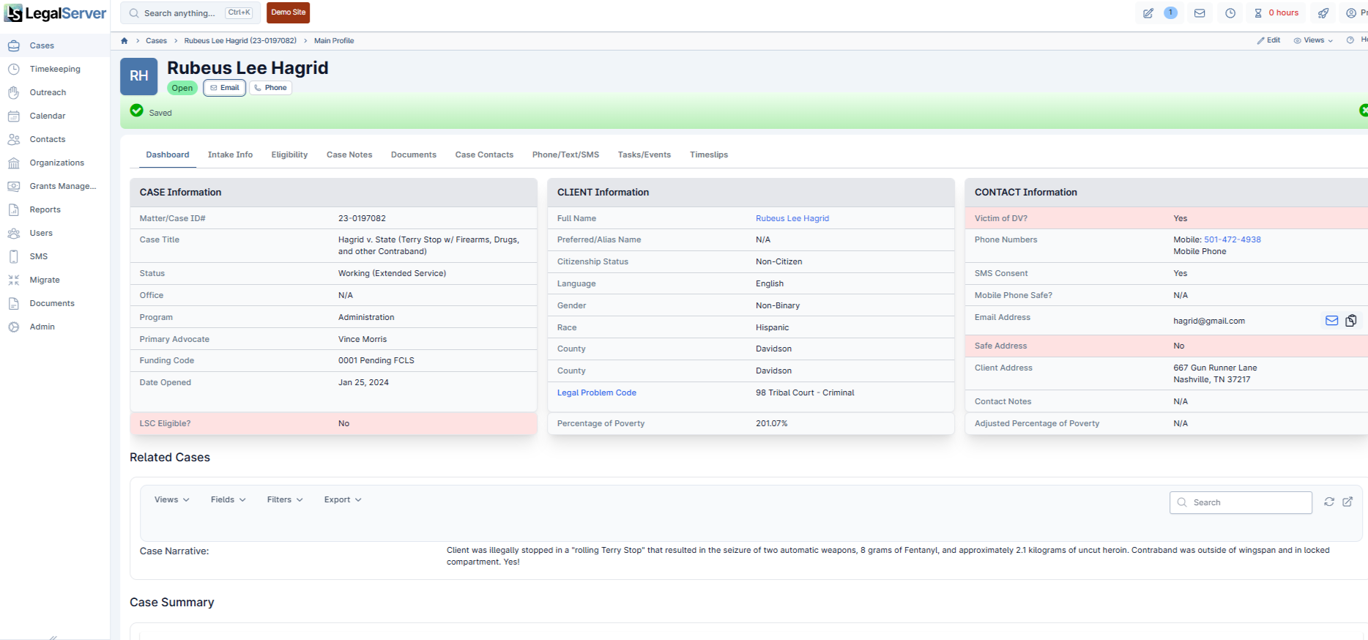
LegalServer 5.0
Actions Menu
Top Nav now Side Nav
Card UI Layout

Slide 35
LegalServer 5.0
Benefits include:
Enhanced accessibility for everyone - including people with vision, hearing, movement, and neurological needs.
More customization options both individually and for the law firm
New tools like “SEARCH ANYTHING” and better filters and data handling
The New Cards Interface
  REDUCE CLICKS
  Lower Reading Fatigue
  Lessen Cognitive Load

Slide 36
LegalServer 5.0
What's Going | What’s Changing? | What Remains?
The Big 4 Changes
The top navigation items will be relocated
The sidebar will be gone (replaced by the top navigation)
The sidebar will now be “CARD” items on the case profile
The Actions Menu (baby actions) is relocated and is now Rocket Actions

Slide 37
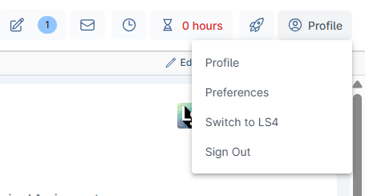
LegalServer 5.0
Change is hard but AFTER the RELEARN it will be worth it for the reduced clicking, reduction in cognitive load, and the customization/integration possibilities.
----------------------------------------------------------------------------------------------------------------
You might be able to Switch Back to LS 4.0 (for a little while)
Open user menu in the upper right-hand corner
Select Switch to LS4
Switch back to LS 5.0 with the button next to your username (top of the page) and click "Switch to LS5"

Slide 38
The work isn’t changing. The buttons are!
Kathryn Avent-Mann

Slide 39
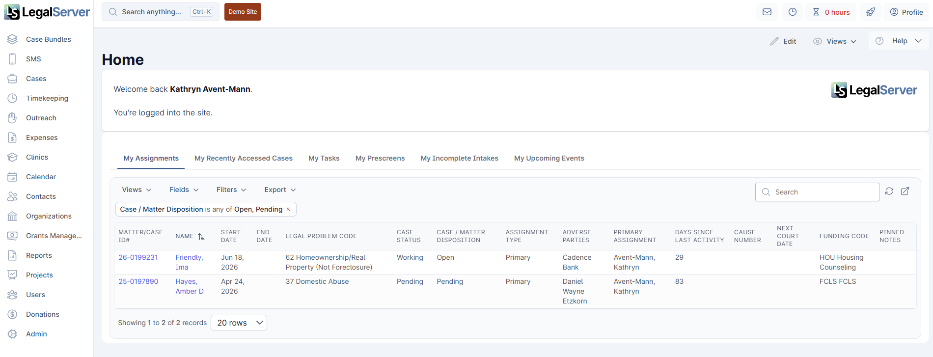
New Layout/Navigation

Slide 40
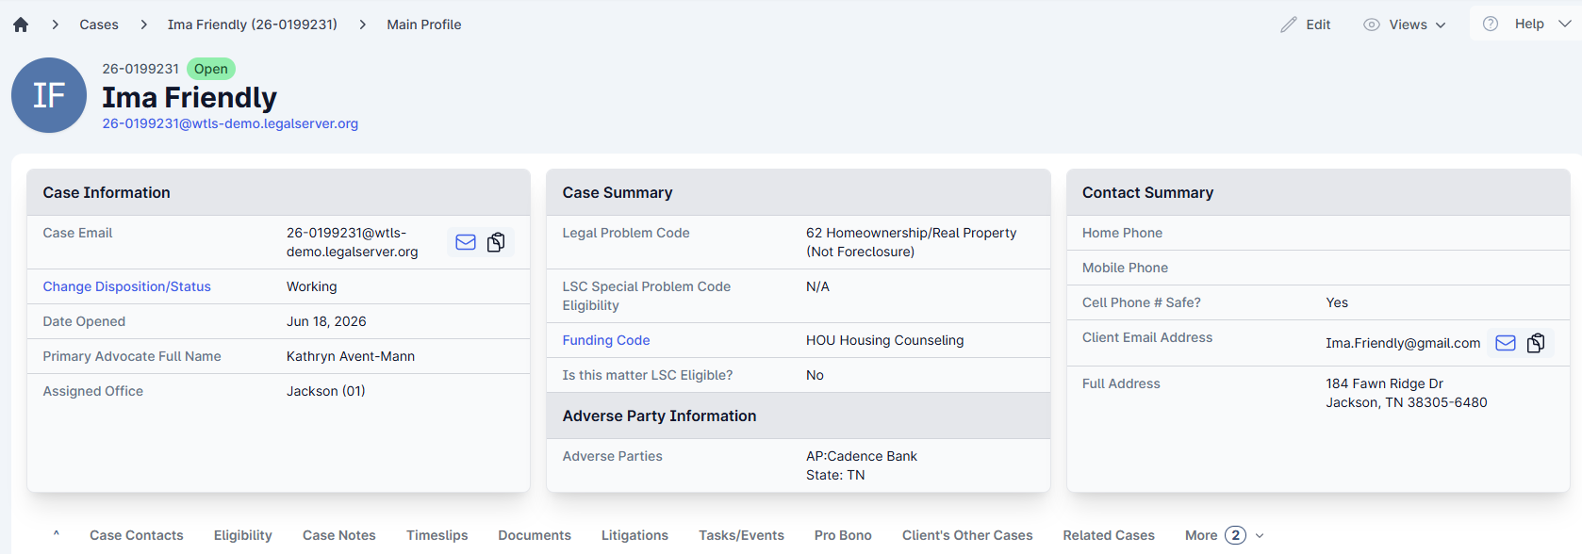
New Look for Cases Profile

Slide 41

The function isn’t new. The presentation is.
In LegalServer 5, the Rocket icon is the Actions menu. It functions as an interface shortcut. When you hover your cursor over it, a quick-view menu or "hover buddy" appears, allowing you to quickly launch frequently used processes.

Slide 42
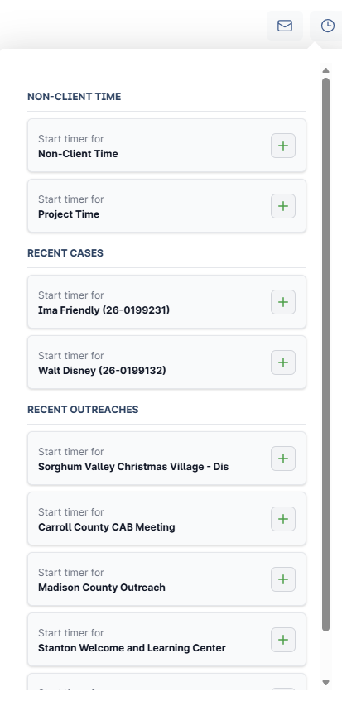

Timer
Timer is a built-in tool that automatically tracks the time you spend on client intakes, cases, or general tasks. It helps caseworkers easily log their hours without having to guess or manually calculate durations later.

Slide 43
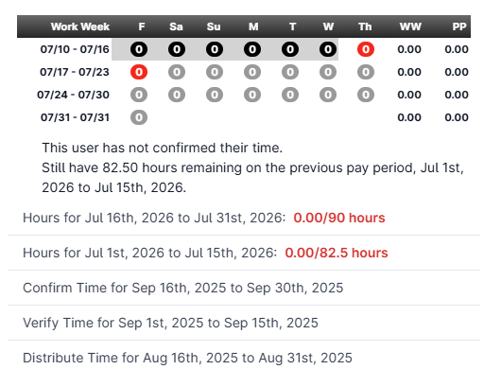

My Time
To check the time you've logged in LegalServer, look for the My Time Widget at the top of your screen or the Your Last 5 Time Entries list.

Slide 44
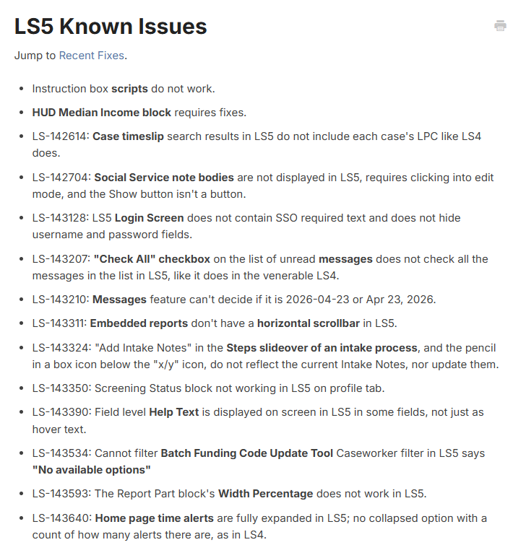
Known issues or limitations
LS5 Known Issues - LegalServer Help

Slide 45
The DATA stays the same!

Slide 46
Let’s Talk About Switching to LS 5
✅ You’ve seen the benefits
⚠️ Now: what to know before switching
🎯 Goal: no surprises
Warning: Go to settings and ensure your notification for calendar events is turned on
There are subtle changes (like MS does) that move things around.
Notes:
Transition: So you’ve seen what the new Outlook can do—now let’s make sure you don’t learn the hard way what it can’t do yet.
Story: Let me start with a quick story. Someone I know switched right away because it looked cleaner. Day one—great. Day two—fine. Day three—they couldn’t find an email archive. Then their case system button disappeared. By the end of the week, they were back in Classic Outlook saying, 'Okay… I need a plan.' This section is about helping you avoid that experience.

Slide 47
LegalServer 5: Preparing for Go-Live
What to expect
Where challenges may occur
How to be ready
Notes:
Opening: Let me start with a quick story.
A team I worked with went live on a new system and felt prepared—until day one, when simple tasks suddenly felt unfamiliar. Nothing was broken, but everything took longer.
By day three, people were saying, 'Okay, this is starting to make sense.'
That’s exactly what this transition will feel like. The goal today is to help you get through those first few days more smoothly.

Slide 48
Go-Live Checklist
Review training materials
Practice key tasks ahead of time
Know how to get support
Expect an adjustment period
Ask questions early
Notes:
This is your practical checklist.
If you do these five things before and during go-live, your experience will be significantly smoother.

Slide 49
What Will Work Differently
Updated navigation
New workflows
Redesigned screens
Notes:
Some tasks will take different steps. Nothing is gone—just reorganized.

Slide 50
Known Issues and Limitations
Minor issues may occur
Some features still evolving
Performance may vary
Notes:
Expect small issues early. Report them so they can be resolved quickly.

Slide 51
Permissions and Security
Roles may change
Access differences
Items may appear missing
Notes:
If something seems missing, it is usually a permissions issue—not lost data.

Slide 52
What Remains the Same
Client data intact
Case history preserved
Core records unchanged
Notes:
Important: Your data is safe. Nothing has been lost.

Slide 53
Training Resources
Guides and job aids
Recorded training sessions
Practice opportunities
Notes:
Encourage users to spend some time reviewing resources. It builds confidence quickly.

Slide 54
Support After Launch
Help desk available
Designated contacts
Report issues early
Notes:
Help is available. Encourage people not to struggle alone.

Slide 55
Frequently Asked Questions
Where did this go?
Why is this different?
Is anything missing?
Notes:
These are expected questions. Normalize them.

Slide 56
Key Takeaways
Adjustment is normal
Support is available
Focus on steady progress
Notes:
Closing: The goal is not perfection on day one. It is steady progress and growing comfort with the system.

