Slide 1
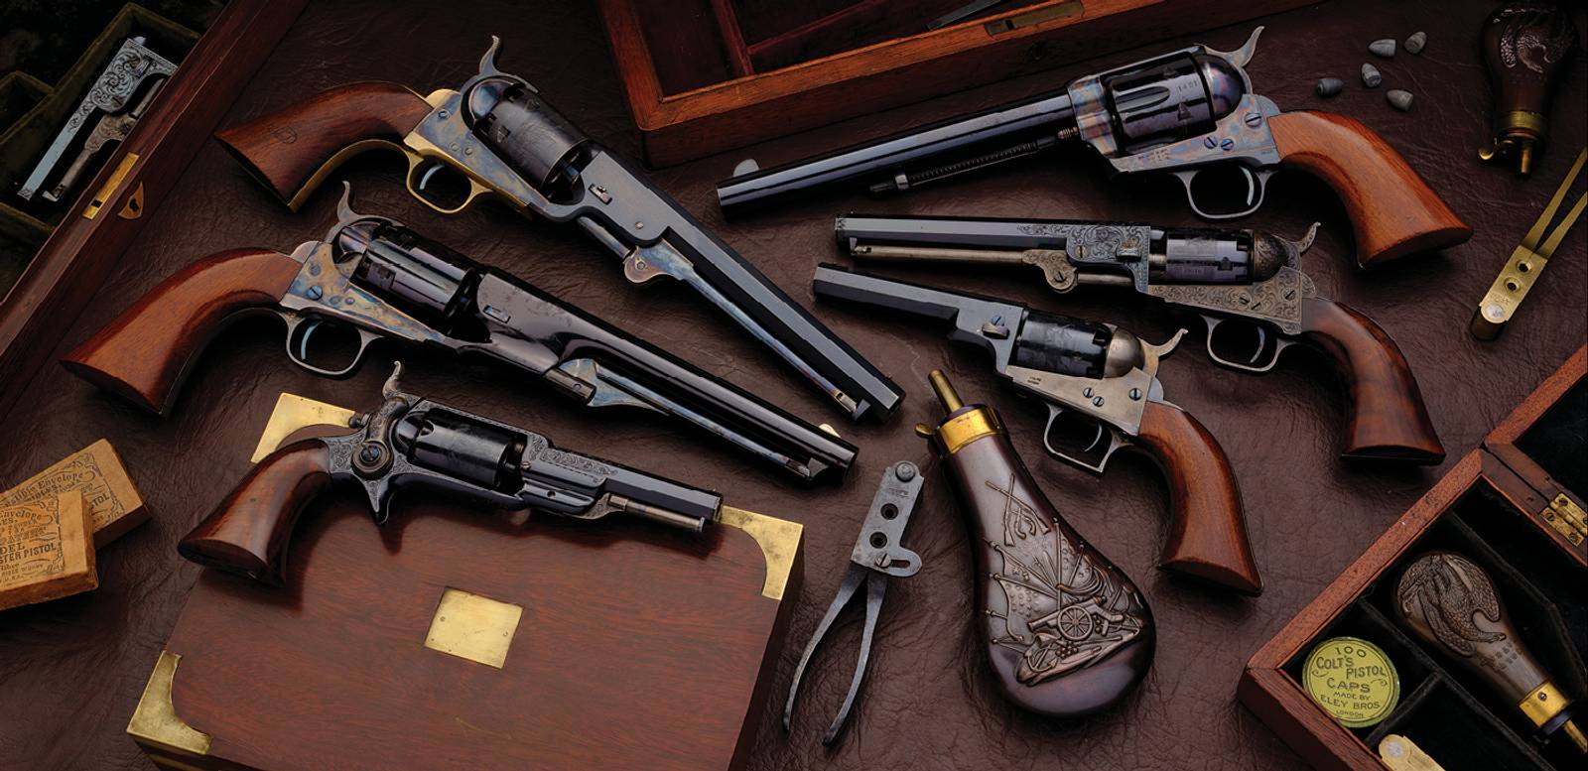
Red State Discovery
Guns, Ammo, Tools and Gear
Legal Aid of East Tennessee
Presented by Tyler Weaver

Slide 2
Vignette
I recently had a divorce case in which an individual who worked as a representative of a firearms company and a firearms content creator on YouTube fell out with his wife and filed for divorce.
I sent this adverse party a detailed discovery request on his large stockpile of firearms, firearms accessories, ammunition, and tactical equipment.
After being served, he offered his wife a settlement far above his previous position – giving her the marital home free and clear, and above-statutory child support – rather than answer discovery.

Slide 3
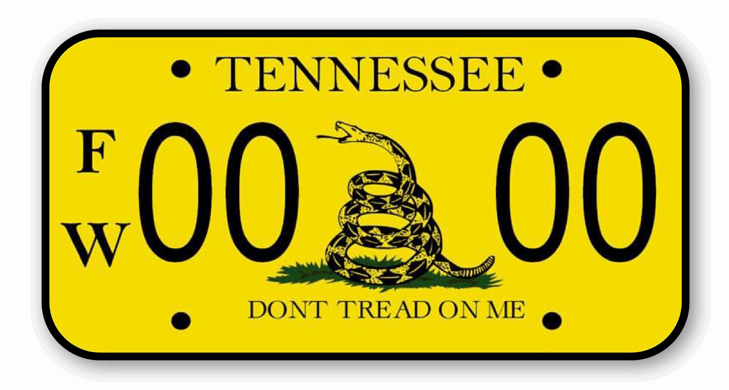
Why you should care
Tennessee is a red state; regardless of your personal politics and policy preferences, you practice in a very conservative jurisdiction
Many people in Tennessee own firearms; some own lots of them.
This goes double for shop tools.
Firearms and the entire “tactical ecosystem” of related products are expensive items that retain value well and can serve as investments
Many gun owners are emotionally attached to their weapons and their self-image as _ armed and independent Americans
Failure to accurately value a gun collection or garage full of tools can lead to clients _ _ being swindled in property division

Slide 4
Property Division in Tennessee - TCA § 36-4-121(a)
(1) In all actions for divorce or legal separation, prior to any determination as to whether it is appropriate to order the support and maintenance of one (1) party by the other, the court having jurisdiction thereof shall:
(A) Equitably divide, distribute, or assign the marital property between the parties without regard to marital fault in proportions as the court deems just based on the factors set forth in subsection (c)[.]

Slide 5
Equitable Property Division Factors – TCA § 36-4-121(c)
(1) The duration of the marriage;
(2) The age, physical and mental health, vocational skills, employability, earning capacity, estate, financial liabilities and financial needs of each of the parties;
(3) The tangible or intangible contribution by one (1) party to the education, training or increased earning power of the other party;
(4) The relative ability of each party for future acquisitions of capital assets and income;
(5) (A) [Contribution to the marital estate]
(5) (B) [Dissipation of marital assets]
(6) The value of the separate property of each party;
(7) The estate of each party at the time of the marriage;
(8) The economic circumstances of each party at the time the division of property is to become effective;
(9) The tax consequences to each party, costs associated with the reasonably foreseeable sale of the asset, and other reasonably foreseeable expenses associated with the asset;
…
(11) The amount of social security benefits available to each spouse;
(12) Such other factors as are necessary to consider the equities between the parties; and
(13) [costs of litigation]

Slide 6
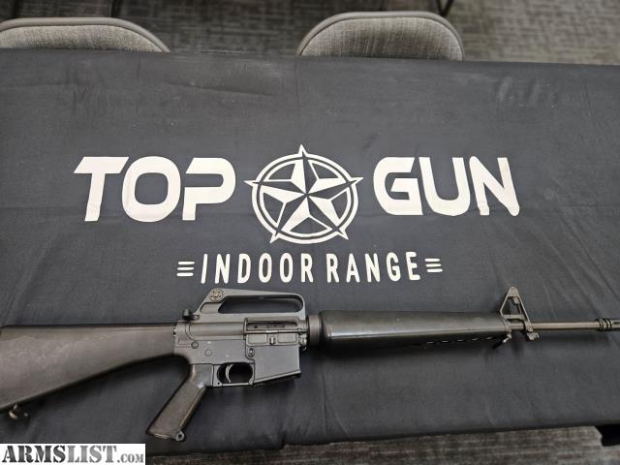
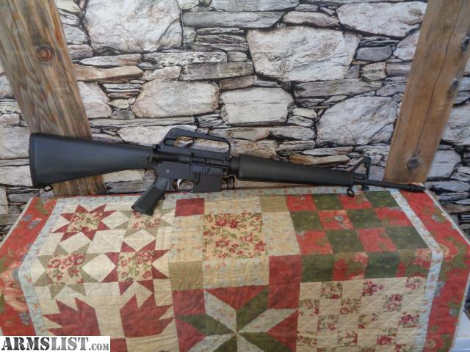
What is the difference between these rifles?
Transferable NFA machine gun
Price: $33,000
Semiautomatic sporter
Price: $985

Slide 7
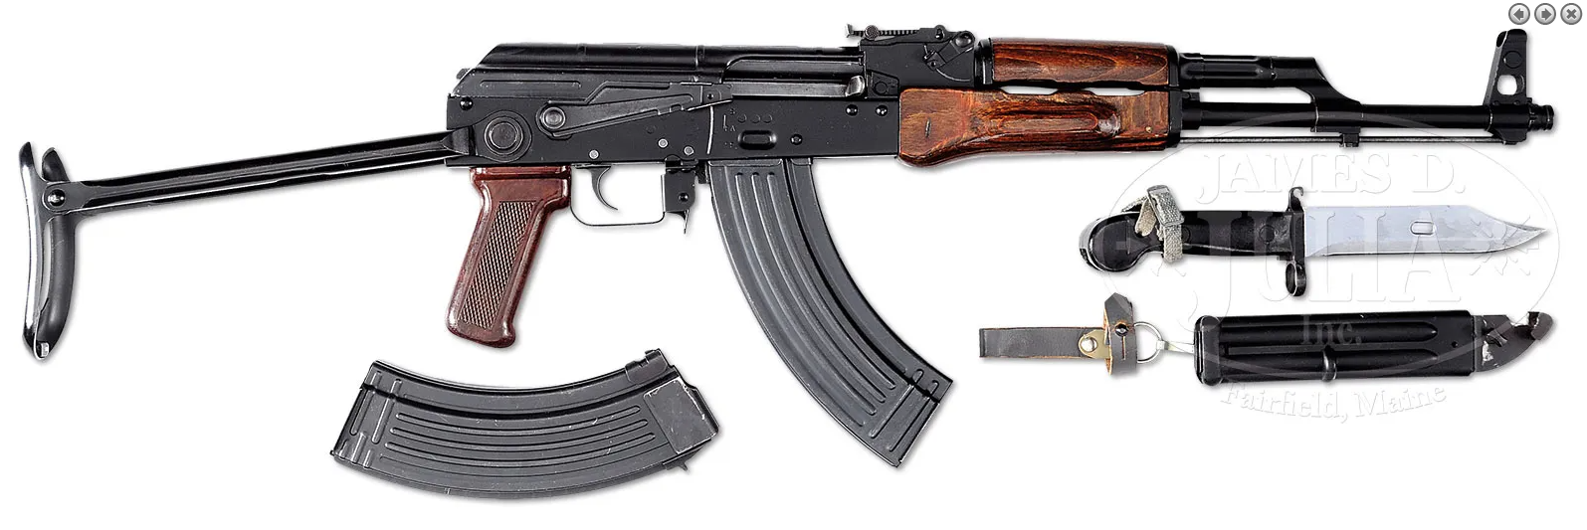
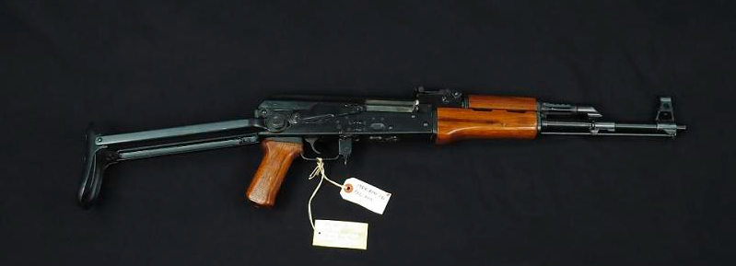
What is the difference between these rifles?
Transferable NFA machine gun
Price: $34,500
Unregistered assault rifle
Price: Federal felony (18 USC § 922)

Slide 8
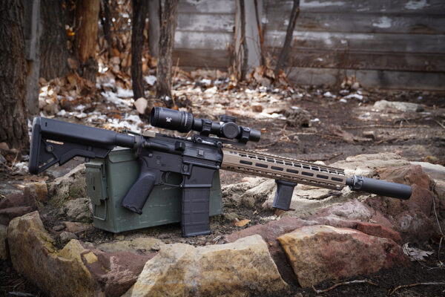
An Introduction to the National Firearms Act
The 1934 NFA requires tax stamps and registration of certain types of firearms.
The three things you’ll commonly see are:
  Machine guns
  Short-barreled rifles
  Suppressors (“silencers”)
The most valuable items in a collection will be NFA items
Ask for a list of NFA items
As a suppressed, short-barreled rifle, this weapon has two NFA tax stamps associated with it. Each of those cost $200 and has an associated ATF Form 4 from the sale.
If somebody has NFA items and no papers, they may be committing a federal felony.

Slide 9
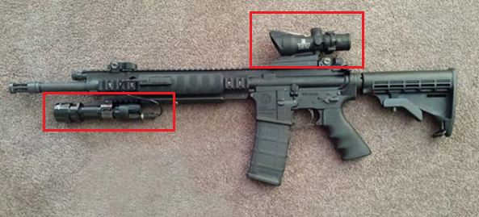
Firearms accessories
It’s quite possible for someone to build an AR-15 for $500 and then hang $5,000 of accessories on it.
You need to ask for lists of optics, laser sights, aftermarket stocks and chasses, and weapon lights
This is a very standard Ruger-manufactured AR-15 that probably cost around $1000 off the rack – with a $2000 Trijicon ACOG scope and a $500 Surefire weapon light.

Slide 10
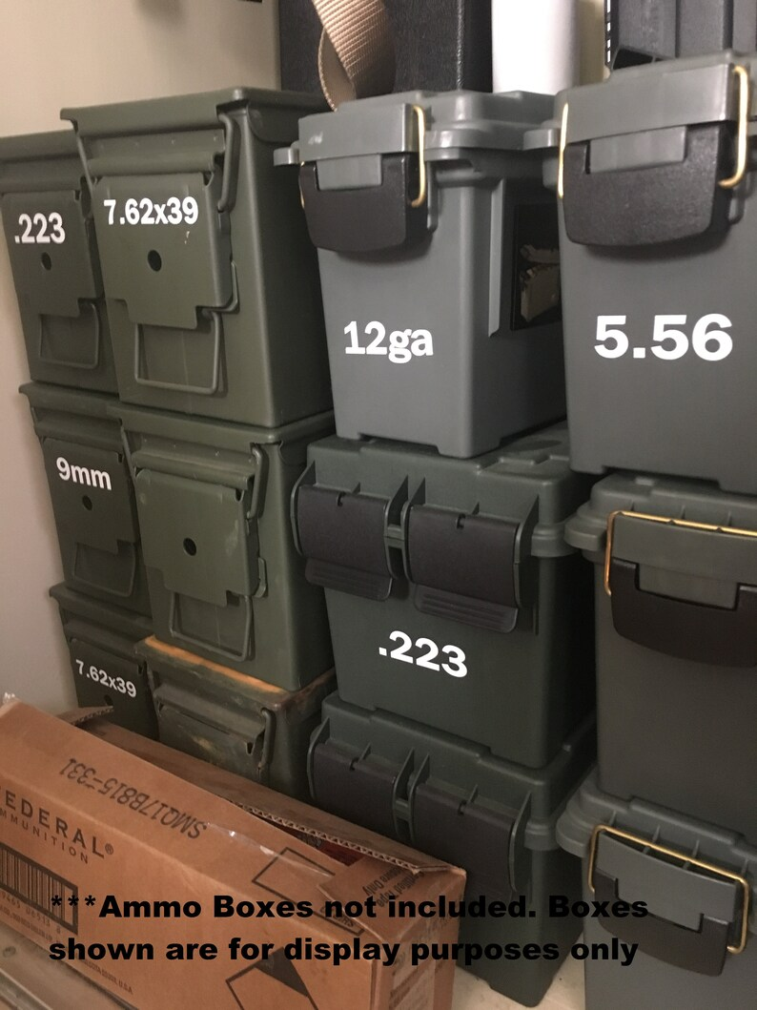
Ammunition
Ammunition is very expensive
Even ubiquitous calibers like 5.56x45mm and 7.62x39mm can cost ~$0.50 PER ROUND
Exotic calibers are far more
Common magazines are $20-40
A single full ammo can is worth hundreds of dollars
A pallet of ammunition is a valuable asset on par with a car
Ask for an inventory

Slide 11
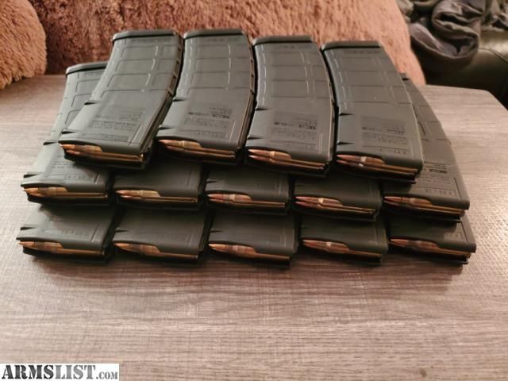
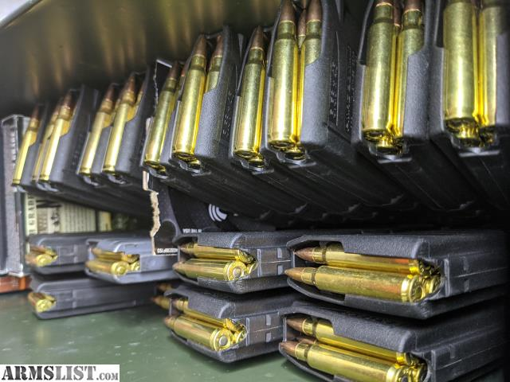
Don’t believe me?
While making this slideshow I was able to find these two lots on Armslist for magazines loaded with 5.56x45mm ammunition
The top one for 420 rounds is going for $350 and the bottom one for 540 rounds is going for $450
You could fit either of these lots into a large shoebox

Slide 12
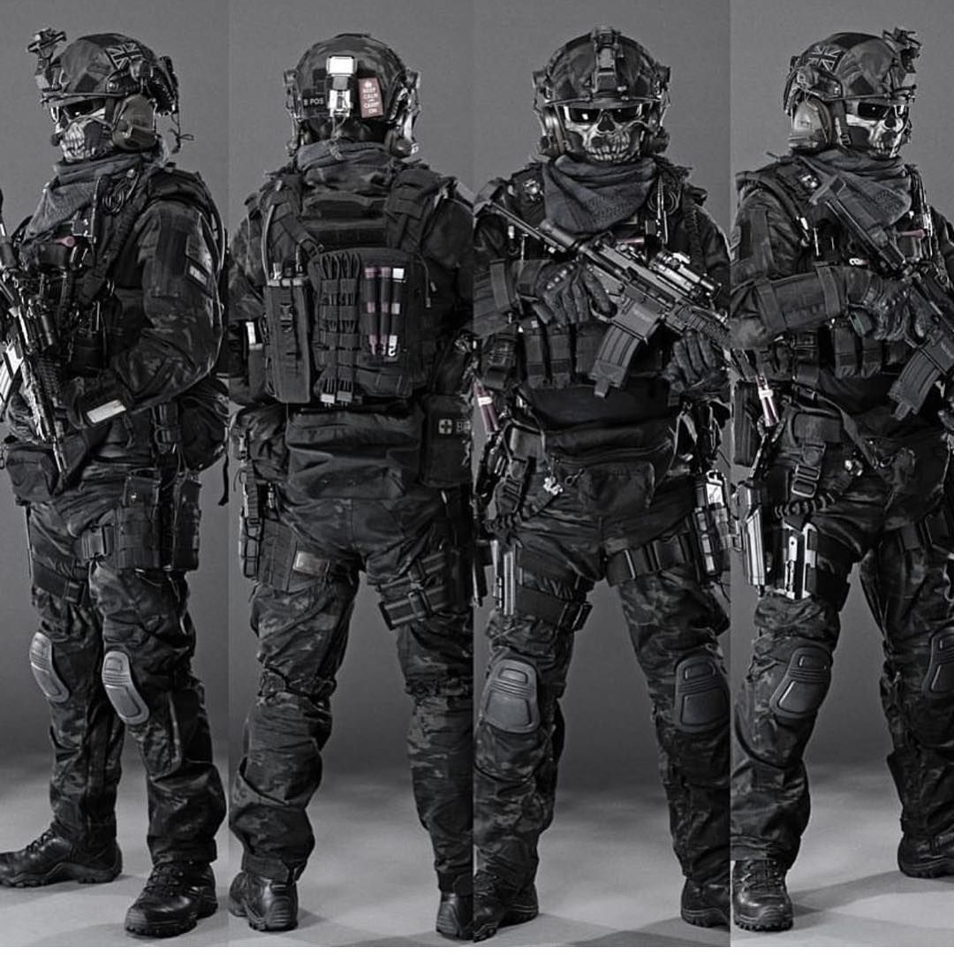
Tactical accessories
Guns and ammo is the tip of the tactical iceberg
Night vision devices are $3000+
Thermals can be $10,000+
Ballistic body armor plates and soft inserts (good ones anyways) can be hundreds of dollars
Radios, knives, drones, game cameras, flashlights, etc.
Tactical (and hunting) clothing can be quite expensive
Ask for a detailed inventory!

Slide 13
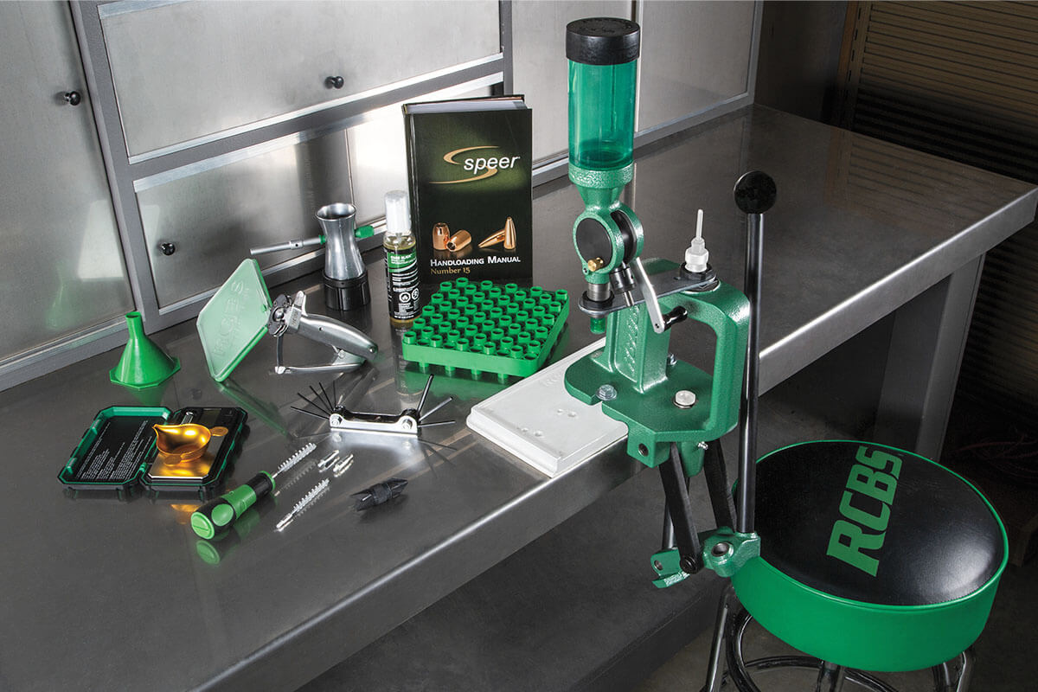
Infrastructure
Gun safes can cost hundreds to thousands of dollars.
Many shooters reload ammunition for cost reasons. Reloading equipment and bulk ammunition components (brass, powder, primers, bullets) all have values.
Hunting blinds and decoys, spotting scopes, even some kinds of targets can be quite valuable.

Slide 14
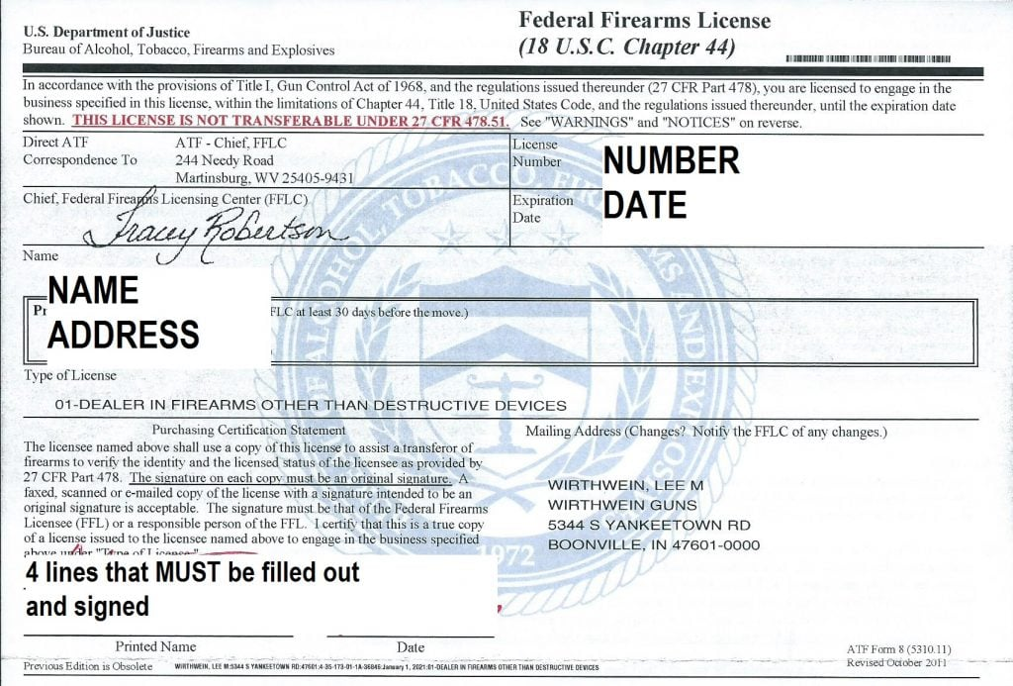
Legal Quirks
Ask if an adverse party has a Federal Firearms License. This lets them deal in firearms commercially.
Some guns and accessories (suppressors in particular) are held in “gun trusts.” As such an adverse party may not technically own a certain item but instead control or have access to a trust that owns it.

Slide 15
Interrogatories that worked for me
Please state if you currently hold or ever have held a Federal Firearms License.
Please provide a list of firearms that you own or which you otherwise have rights to (by trust, etc.), by make, model, and serial number.
Please provide a list of all NFA items that you own or otherwise have rights to (by trust, etc.) such as suppressors, short-barreled rifles, or machine guns, by make, model, and serial number.
Please provide a list of all non-NFA firearms accessories which you own, such as scopes, laser aiming modules, aftermarket weapon stocks, or weapon lights, by make, model and (if applicable) serial number.
Please provide an inventory of all ammunition you have on hand by caliber and description (ex. “30.06 cartridges, handloaded” or “5.56x45mm cartridges, M855 green tip”)

Slide 16
More interrogatories that worked for me
Please provide an inventory of all loose ammunition components you have on hand, such as bulk gunpowder, shell casings, bullets, and primers
Please provide a list of all reloading equipment you own, if any.
Please provide a list of all non-firearm tactical and hunting equipment that you own or otherwise have the rights to (such as by trust, etc.) by make, model and (if applicable) serial number, such as night vision devices, thermal imagers, remote game cameras, drones, tactical vests, armor plates and inserts, backpacks and pouches, flashlights, knives, and/or survival and camping equipment.
Please provide a list of all gun safes and display equipment that you own by make and model.
Please provide a list of firearms and firearms paraphernalia in the above categories that you do not own or have legal rights to (i.e. “borrowed” items), but which you either currently have in your possession at this time or have had possession of in the past year.

Slide 17
Requests for Production that worked for me
Please provide a copy of any Federal Firearms License papers you have.
Please provide copies of all National Firearms Act tax stamps (i.e. completed ATF Form 1 or Form 4) that are in your name or for items which you otherwise have rights to (by trust, etc.)
Please provide copies of any ATF paperwork to register items that you own or control (such as via trust, etc.) that may fall outside of the above category of firearms, such as explosives etc.
If you have sold any firearms, firearms paraphernalia, or tactical equipment in the past year, please provide receipts for the sales.

Slide 18
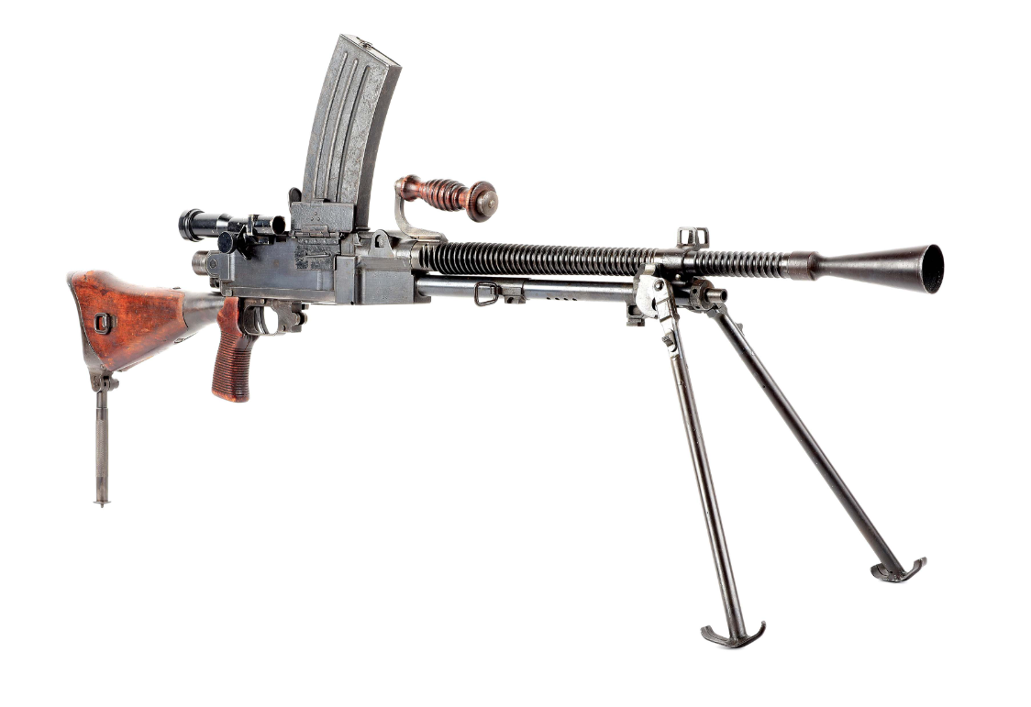
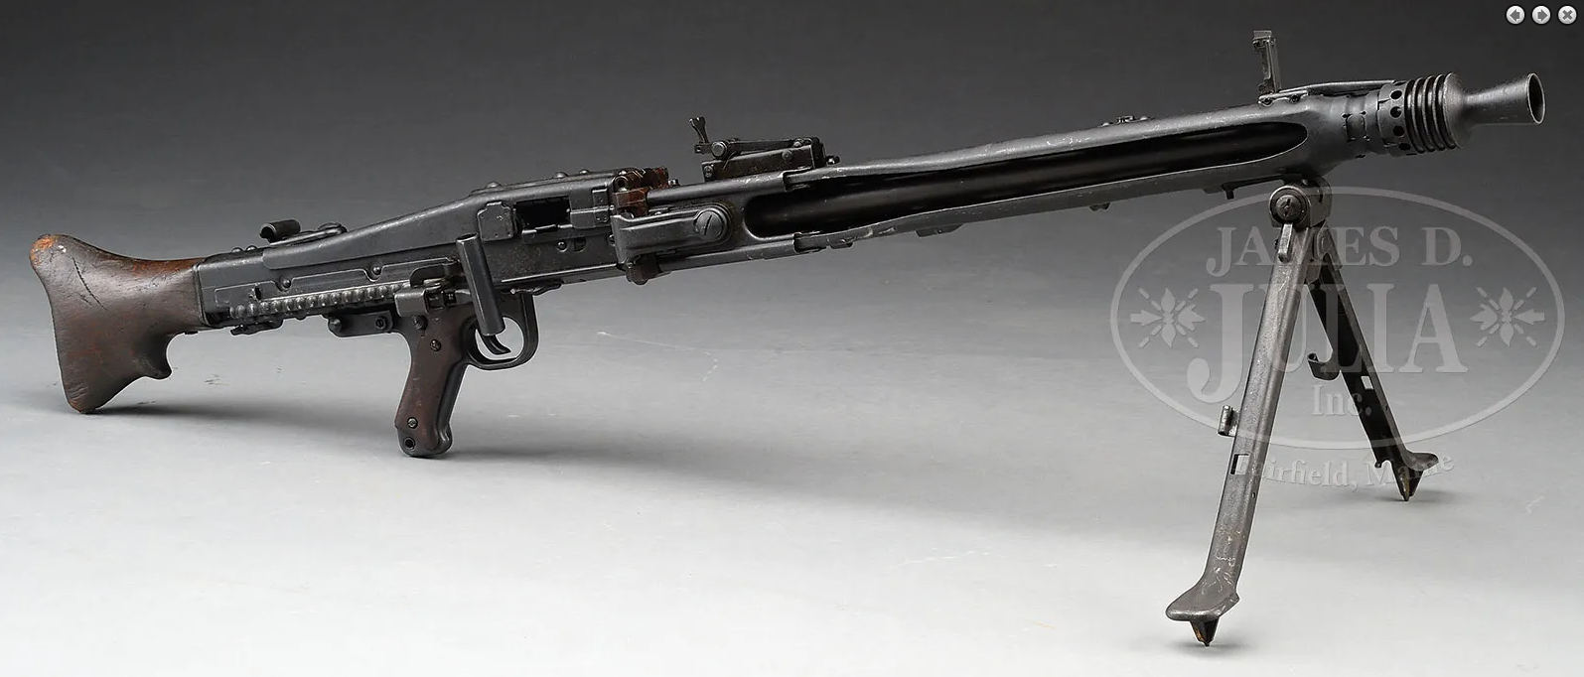
What is the difference between these machine guns?
1943 MG42 (fully transferable)
Nazi Germany
Price: $40,000
1943 Type 99 (fully transferable)
Imperial Japan
Price: $12,000

Slide 19
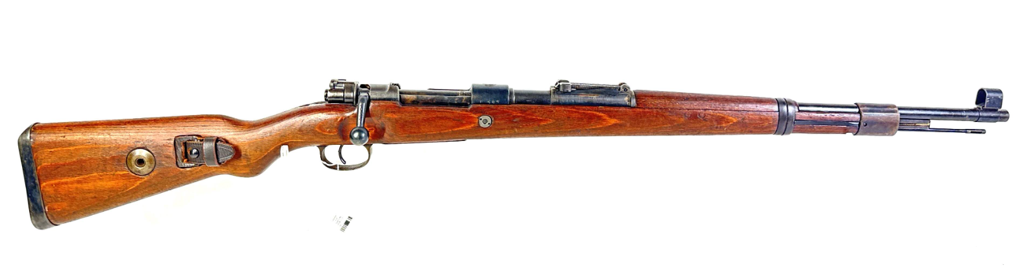
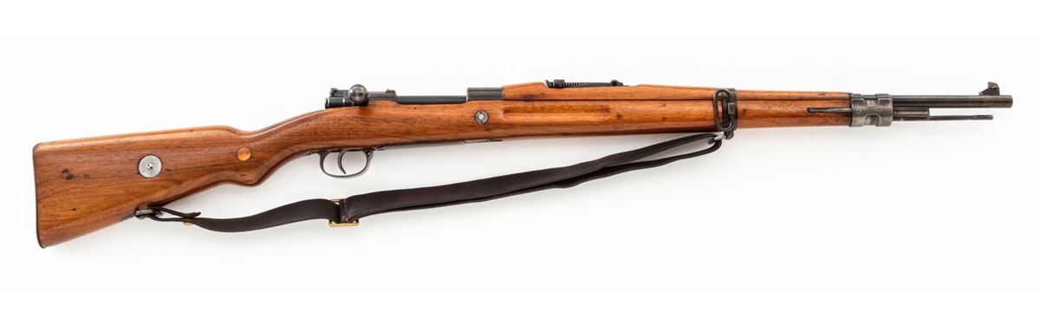
What is the difference between these rifles?
German mid-war K98k
Price: Approximately $1500
Czech vz.24 (prewar)
Price: Approximately $500

Slide 20

Red flags that you may need an expert
Militaria and antiques
  Tactical equipment that is still being manufactured can be easily valued, the difficulty is generally in identifying it
  Antiques can vary WIDELY in value due to market demand
  Some guns are also antiques!
  Nazi-associated antiques are in perpetually high demand and large numbers of fake items circulate the market
Rare Nazi-era typewriter with a double-sig rune key, generally worth over $1000

Slide 21
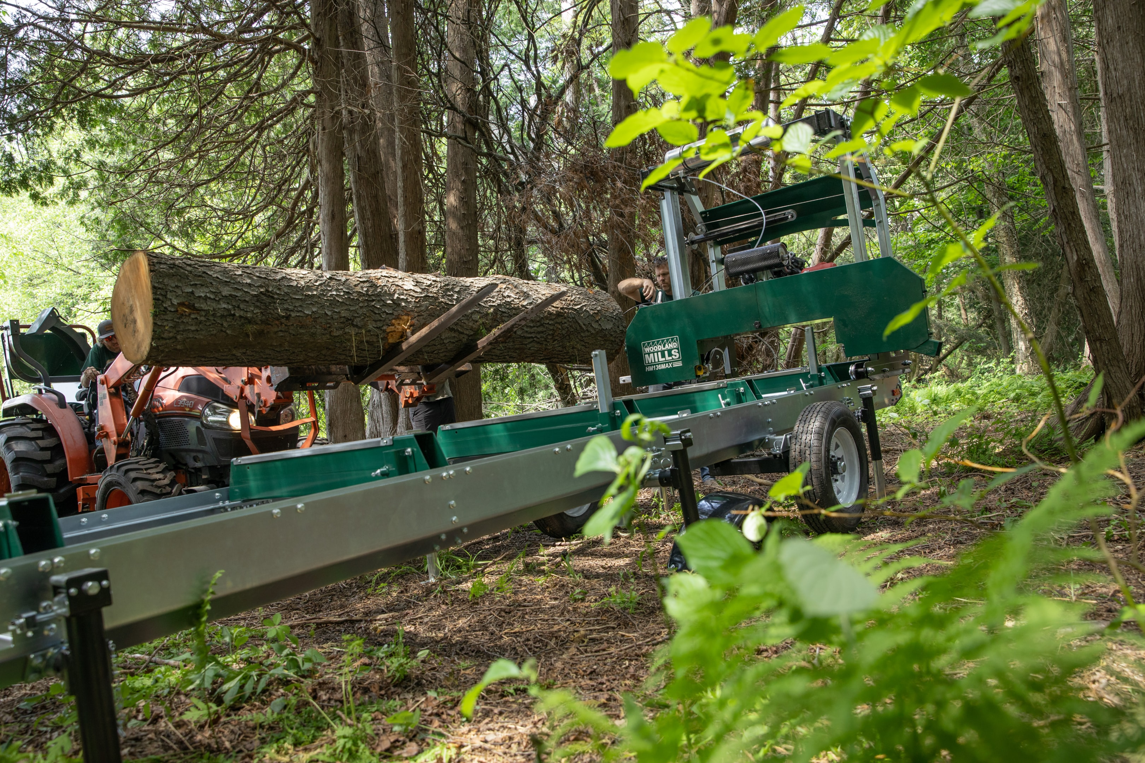
Tools and Shop Equipment
Firearms are by no means the only kind of portable high-value items you’ll find in discovery.
Heavily investigate tool sets and shop equipment
Ask for full inventories!
Ask for brand names - some are much more valuable than others
I had a case recently that involved a portable sawmill. These can go for two to five thousand dollars.

Slide 22
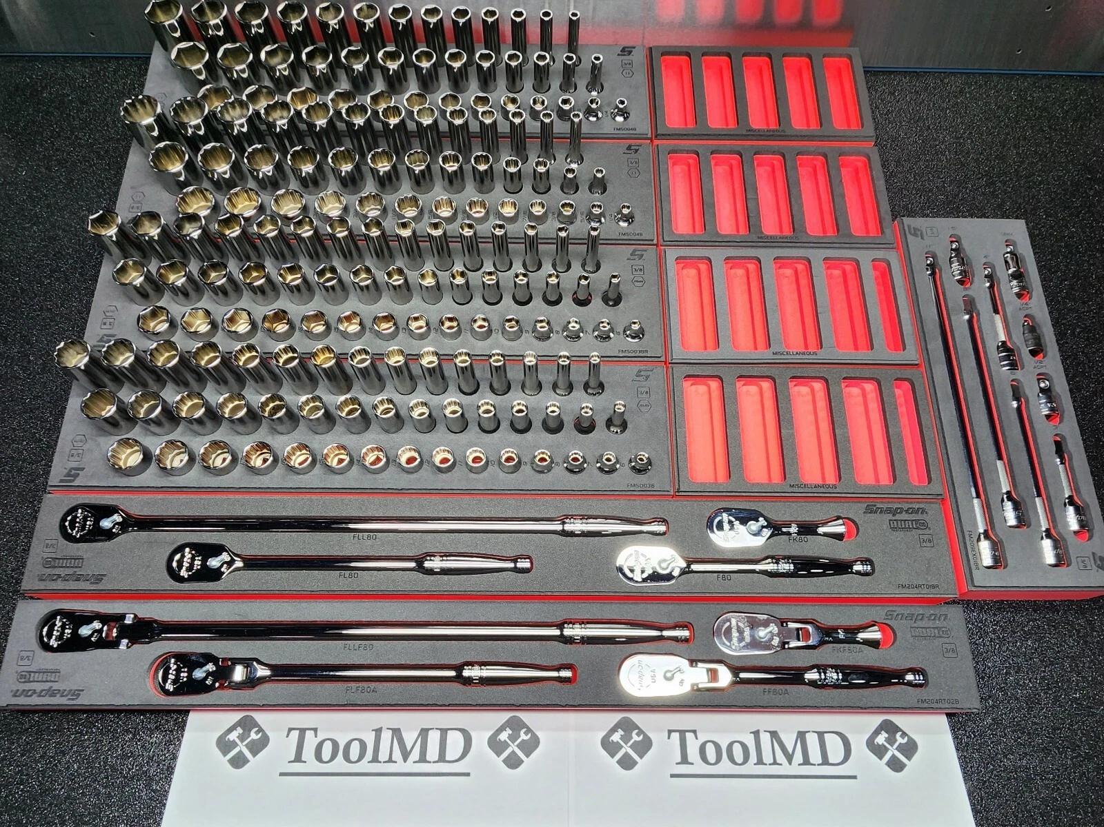
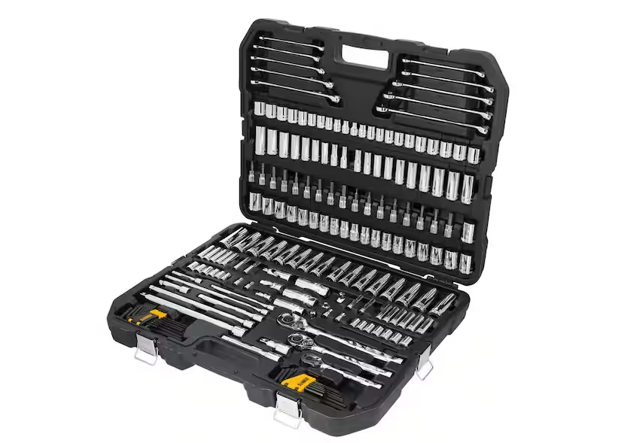
What is the difference between these socket sets?
Snap-on 185-piece socket set
Price: $7,195
Dewalt 185-piece socket set
Price: $349

Slide 23
Resources
Google is your friend
Manufacturers’ websites will generally have MSRPs listed
Auction or yellow-pages websites (gunbroker, armslist, etc.) can help to value items
Experts may be required to assess rare or historic pieces

Slide 24
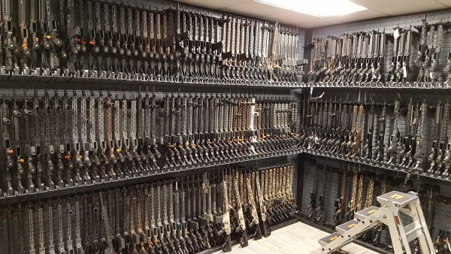
Questions?

