Slide 1


Common Pitfalls for Elderly and Disabled SNAP Clients
PRESENTED BY:
Anna Grace Dastugue
Josiah Mezera

Slide 2


SPEAKERS
Josiah Mezera
Speer Foundation Fellow & Staff Attorney
Anna Grace Dastugue
Director of Nutrition Policy
Notes:
Moderator

Slide 3

For over 30 years, the Tennessee Justice Center has been standing with vulnerable Tennessee families and helping them access basic necessities of life.
Individual case work
Leveraging our knowledge
Moving systems

Slide 4
Agenda
Understanding the Population at Risk
New Barriers Created by HR1
SNAP Work Requirements
Options to Increase Access
  Exemptions to the Work Requirement
  Medical Expenses
Group Living Arrangements
Q&A
Case Study Examples/Hypotheticals

Slide 5
Food Insecurity among Seniors & Older Adults
 | Older Adults (50-59) | Seniors (60+)
TN Food Insecurity | 13.1% | 6.9%
Food insecurity among older adults is rising as the population increase
Disproportionately impacts older adults of color and grandfamilies
Food insecurity is exacerbated by this population's unique needs and circumstances
Conversely, food insecurity deepens chronic health conditions and diseases
SOURCE: Map the Meal Gap & Meals on Wheels

Slide 6
Risk Factors
Many compounding factors increase hunger among older adults & seniors.
Chronic Disease & Health Conditions
Lack of Technology Literacy
Lack of Access to Transportation
Fixed Income
Social Isolation
SOURCE: Feeding America

Slide 7
Outcomes Experienced by Older Adults
Hunger causes trade-offs
  Non-adherence to prescription diets (diabetes, keto, etc.)
  Skipping meals to feed children in their care
  Skipping the purchase of medications or healthcare needs
  Falling behind on other bills
SNAP supports access to food, but it is already difficult to access
  Only 55% of eligible seniors participate
  These rates are increasing over time
Source: NIH, FRAC,

Slide 8
HR 1 Changes Create New Barriers
HR 1, One Big Beautiful Bill Act, passed in July 2025 changed access to SNAP for older adults and seniors.
Increased work requirements
Decreased immigration statuses eligible
Eliminated counting internet costs as utilities
Before HR 1 | After HR 1
55+ not subject to work requirements | 65+ not subject to work requirements
What does this mean?
Adults age 55-64 must now meet work requirements

Slide 9
How USDA Defines Disability for SNAP
SNAP does not use a general or medical definition. A client is “disabled” only if they already receive one of these disability-based benefits.
Who Counts as Disabled
Receiving any one of these establishes disability status
SSI under Title XVI, or Social Security disability or blindness benefits under Title II
A state supplemental payment based on SSI disability rules
Disability-based Medicaid or TennCare
A federal, state, or local government employee disability retirement, where the disability is considered permanent under Social Security standards
A railroad retirement disability annuity, with Medicare eligibility or an SSI-standard disability determination
VA benefits for a service-connected or non-service-connected disability rated total (100%), or for being housebound or in need of regular aid and attendance
VA benefits as the surviving spouse or child of a veteran, where the person is considered permanently incapable of self-support
What this status means:
No gross income test. Only the net income limit applies (100% fpl)
Uncapped deduction for medical expenses over $35 a month
Exempt from the work requirements and the ABAWD time limit
Higher resource limit for the household
May qualify as a separate household if unable to purchase and prepare meals alone
Common Mistake
A pending disability application, less than 100% VA, a doctor’s note, or a visible impairment does not by itself meet the SNAP definition
But it can still support an exemption from work requirements as unfit for work, which we will discuss later.
Practice tip: Ask what benefits the client already receives. Disability status is sometimes missed because the household never reports the benefit that would establish it.

Slide 10
Practice Question
  A child is disabled by Social Security standards and receiving SSI benefits due to her disability. After the death of her father, she begins receiving Social Security death benefits based on her father’s work history. Because the death benefits are higher, her SSI benefits are terminated. Is the child still eligible to receive a SNAP deduction for her medical expenses?
  No, if the child’s eligibility for the medical expense deduction was based on receipt of SSI benefits and she does not meet any other criteria for a determination of disability under SNAP regulations.
Notes:
SNAP Medical Expenses Handbook | Food and Nutrition Administration, pg. 23

Slide 11

How USDA Defines Elderly for SNAP
“Elderly” is simply defined as anyone above the age of 59.
What does it mean to be considered elderly?
Households containing an elderly member are exempt from the gross income test
  Still must pass the 100% FPL net income test.
Elderly household members may deduct eligible out of pocket medical expenses.
Household members above the age of 59 are exempt from the general work requirements.
Elderly individuals (and their spouses) who share a residence with others can be considered a separate household, even if they share meals.
  Must have a permanent disability
  Gross income of other household members must be below 165% FPL.
No cap on excess shelter deduction.
Reminder: Able-bodied household members between the ages of 60-64 are subject to the 3-month time limit and ABAWD work requirements, even if they are considered “elderly” and exempt from the general work requirements

Slide 12
SNAP Work Requirements
SNAP has two separate sets of work rules. Many clients are subject to both at the same time.
General Work Requirements
Most adults age 16–59
Register for work at application and at each recertification
Do not voluntarily quit a job or cut hours below 30 per week
Accept a suitable job offer if one is made
Take part in an employment & training or workfare program if assigned by the state
Noncompliance disqualifies that individual, starting at one month and longer for repeat violations
ABAWD Time Limit
Able-bodied adults without dependents, now age 18–64
Work, train, or volunteer at least 80 hours per month (or 20 per week) to keep benefits
Otherwise, SNAP is limited to 3 months in any 3-year period
HR-1 raised the upper age from 54 to 64, newly covering adults 55–64
HR-1 also narrowed exemptions that had covered veterans, people experiencing homelessness, and former foster youth
Time-limited clients lose benefits after 3 months until work hours resume

Slide 13
Exemptions to the Work Requirements
Screen every client for exemptions. An exemption to the general rules also lifts the ABAWD time limit.
General Exemptions
Excused from the general work rules
Under 16 or age 60 and older
Caring for a child under 6 or an incapacitated individual.*
Enrolled at least half-time in school or a training program
Subject to and complying with another program's work requirement
Receiving or having applied for unemployment benefits
General Continued
Anyone exempt from the general rules is automatically exempt from the ABAWD time limit
Physically or mentally unfit for work*
Working at least 30 hours per week, or earning the equivalent in federal minimum wage ($217.50 per week)
Pregnant
Participating in a drug or alcohol treatment program.
ABAWD-Only Exemptions
Excused from the 3-month time limit
Under 18 or age 65 and older after HR-1
Living with a child under 14 in the household
Members of an Indian tribe or Indian household
Living in an area with a waiver for high unemployment
HR-1 ended the exemptions for veterans, people experiencing homelessness, and former foster youth
Practice tip: Check the general exemptions first. If one applies, the client is out from under both rules. Exemptions are often missed for clients age 55 to 64 who are newly subject to the time limit.

Slide 14

Caregiver Exemption: Child Under 6
A household member responsible for the care of a dependent child under age 6 is excused from the general and ABAWD work requirements.
When It Applies
Scope of the exemption
Covers a parent or other household member responsible for the care of a dependent child under age 6
The care does not have to be provided to a household member
Only one person may claim the exemption for a given dependent, though caring for separate dependents can exempt more than one adult
If the child turns 6 during the certification period, the member must register at recertification unless another exemption applies
How to Claim and Verify
Raise it, then document it if asked
Signing the application registers everyone who is not exempt, so the caregiving must be raised at the interview
A statement from the dependent’s parents/guardians verifying how and when the client watches the child.
A client already registered can claim it mid-certification by reporting the change
“The care does not have to be provided to a household member. The person can live in another residence.”
TN DHS SNAP Q&A (cumulative 9/2021), Q. 50, quoting the SNAP manual, Caretaker (08/10)
Notes:
“Only one person may claim the caretaker exemption for a dependent. If more than one dependent person is cared for, then more than one person may be responsible.” SNAP QA Cumulative 9_2021.pdf

Slide 15

Caregiver Exemption: Incapacitated Person
Exempt a household member who cares for an incapacitated person, regardless of whether that person resides with the household member.
When It Applies
Scope of the exemption
Covers a parent or other household member responsible for the care of an incapacitated person, at any age
No hours threshold applies. What matters is that the caregiving interferes with obtaining employment
The person cared for can live in another residence and need not be on the client’s SNAP case
Only one person may claim the exemption for the same individual, though caring for separate individuals can exempt more than one adult
How to Claim and Verify
Describe the care, not the diagnosis
A doctor’s statement is not needed
If verification is required, a statement from the person being cared for, their family, or a collateral contact is enough
Raise it at the interview, or mid-certification as a reported change
“Caring for ill or incapacitated person is an exemption in itself, the amount of time is not needed, just the fact that caring for the individual interferes with them obtaining employment.”
TN DHS SNAP Q&A (cumulative 9/2021), Q. 100
“A Doctor’s statement is not needed. If verification is needed, it can be a statement from the person being cared for, their family, collateral contacts etc.”

Slide 16
Unfit to Work
Different than how we define “disability.” Medically certified as mentally or physically unfit to work. Unable to work 20 hours a week due to physical or mental unfitness.
When It Applies
Scope of the exemption
Client has a condition, illness, or injury that prevents them from being able to work 20 hours a week.
Not the same threshold requirement as a disability.
  Ex: A broken arm will limit a blacksmith’s ability to work 20 hours until it heals, but would not be considered a disability.
Having a pending disability application with SSA.
Less than 100% VA disability will automatically qualify as an unfitness exemption.
Unfitness can be for a specific period or an indefinite amount of time.
How to Claim and Verify
Clients may need help getting a verification
Medically certified = verification from a medical professional.
  Can be from a physician, physician's assistant, nurse, nurse practitioner, designated representative of the physician's office, a licensed or certified psychologist, a social worker, or any other medical personnel.
Verification is not required when the unfitness is “obvious and observable.”
Does not entitle a client to the medical expense deduction.
“If a doctor’s note has been provided it’s the case workers responsibility based on the contents of the doctor’s note to determine if the customer is unfit for employment, if there are any doctors’ notes that the field is unsure about they can be sent to the SNAP Policy Mailbox.” SNAP Cumulative Q&A, Question 94.

Slide 17
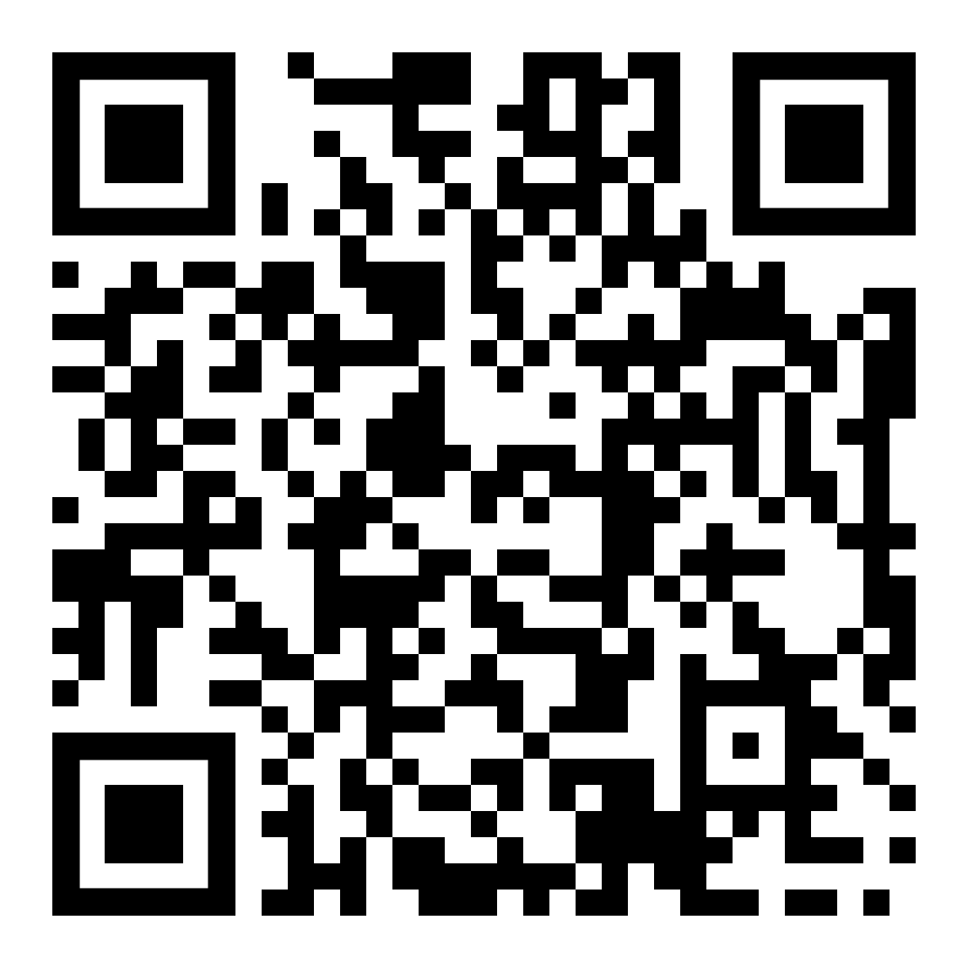
Shameless Plug!
  Want to learn more about the unfitness exemption? Sign up to attend TJC’s free webinar/training on September 17th:
  How Clinicians Can Support Access to SNAP amidst New Work Requirements

Slide 18
The Medical Expense Deduction
Households with an elderly or disabled member may deduct out-of-pocket medical expenses over $35 a month that are not paid by insurance or another third party.
Who Is Entitled
Only elderly or disabled members
Only households containing a member who meets SNAP's definition of “elderly or disabled” are entitled to the deduction.
Certification for a qualifying disability benefit is enough, even if the first payment has not arrived or benefits are fully recouped for an overpayment.
Only expenses incurred by the elderly or disabled member count. Other household members' medical costs are not deductible.
Reimbursed or third-party-paid amounts never count.
What Expenses Count
Prescribed or approved by a practitioner
Medication, supplies, equipment, or services prescribed or approved by a State-licensed or qualified health practitioner.
Health insurance premiums, Medicare, and cost sharing. A family policy is prorated so only the eligible member's share counts.
Reasonable transportation and lodging to obtain treatment, at State-set rates (i.e., mileage reimbursement rate).
Securing and maintaining a specially trained service animal, including food and veterinary bills.
Not allowed: special diets or items purchasable with SNAP, Schedule I substances, and loan or credit card interest.
“Only those medical expenses incurred by the elderly or disabled household member in excess of $35 per month and not paid by insurance or another third party can be deducted.” SNAP Medical Expenses Handbook (FNS, Apr. 2019), p. 1; 7 C.F.R. § 273.9(d)(3).

Slide 19
Practice Question
  A 70-year-old woman was living with her 40-year-old daughter. They had separate SNAP households. The mother is admitted for long-term care in the hospital, so her case is closed. The daughter is making sporadic payments for hospital costs. May the daughter claim a medical expenses deduction for her mother’s hospital expenses?
  No. The daughter is not allowed to claim a medical expenses deduction for her mother’s costs because they were separate households before the costs were incurred.
Notes:
SNAP Medical Expenses Handbook | Food and Nutrition Administration, pg. 23

Slide 20
Regular, Recurring Bills
The worker anticipates what the household expects to be billed during the certification period. Steady bills are allowed as billed; fluctuating bills may be averaged at the household's election.
How the Agency Budgets Them
Expenses are calculated on what the household expects to be billed during the certification period.
Anticipation must be based on the most recent month's bills unless a change is reasonably certain. Workers may not automatically average past bills.
A recurring monthly expense that does not fluctuate is not averaged. It is allowed each month it is billed or becomes due, such as $50 a month in equipment rental.
Fluctuating expenses may be averaged if regularly recurring, reasonably anticipated, and verified.
Bills sent less often than monthly may be averaged forward over the interval between billings, or over the period the expense covers.
Practice Points
Where the client has a choice
Averaging is the household's election. It may instead take each expense in the month billed or due.
If a bill arrives one month and is due the next, the State may allow it in either month, so long as it applies one policy consistently.
A reported change that increases the allotment must be verified; unchanged totals, or changes of $25 or less, may not be re-verified.
Expenses totaling $35 or less should not be verified because they produce no deduction.
A State may allow the budgeting method to change mid-period, but never in a way that creates a double deduction
“Fluctuating medical expenses may be allowed as deductions if regularly recurring, reasonably anticipated, and verified.” SNAP Medical Expenses Handbook (FNS, Apr. 2019), p. 19.

Slide 21
Practice Question
  A household has recurring medical expenses for which the household is billed quarterly on January 1, April 1, etc. The household applies in February. How does the eligibility worker average the quarterly billing amount?
  The eligibility worker would average the quarterly billing amount over the months of January, February, and March to determine the monthly average of medical expenses. The eligibility worker would apply this monthly average to the months of February and March. This averaged amount would not be applied to January as the household was not participating in SNAP at that time.
Notes:
SNAP Medical Expenses Handbook | Food and Nutrition Administration, pg. 25, 26.

Slide 22

One-Time Medical Bills
A one-time bill may be taken in a lump sum or averaged forward.
One-Time Expenses
Lump sum, averaged, or by installment
At certification, the household may elect to average a one-time expense forward over the entire certification period in which it is billed.
Reported mid-period, the household chooses a one-time deduction or averaging over the remaining months. Averaging begins the month the change takes effect.
When averaged, $35 is subtracted from the monthly average each month.
On a 24-month certification, the household also may average over the remainder of the first 12 months.
Agreed monthly installments are allowed in the month each is due, for the life of the payment plan. The arrangement need not be formal but should be verified if questionable.
“Medical expenses carried forward from past billing periods are not deductible... a particular expense may only be deducted once.” Handbook p. 17, citing 7 C.F.R. § 273.10(d)(2).

Slide 23

Unpaid Medical Bills
Past due amounts are deductible in Tennessee, but a particular expense may only be deducted once.
Unpaid and Past Due
Unpaid bills may be counted for the certification period even if they are past due (TN Comp. R. & Reg. 1240-01-04-.17(8)(a)(3).
Expenses carried forward from past billing periods are not deductible, even if included in the most recent bill and actually paid.
A charge account expense is billed when the statement is received. An unpaid balance is then treated like an installment plan; interest is never deductible.
Payments on a conventional loan used for a one-time medical expense are deductible; interest is not, and a mortgage is treated as a shelter cost.
“In the case of a household certified for 24 months that reports a one-time medical expense incurred during the first 12 months of the certification period, the State agency must give the household the option of deducting the expense for one month, averaging the expense over the remainder of the first 12 months of the certification period, or averaging the expense over the remaining months in the certification period..” Handbook p. 19.

Slide 24
Practice Question
  An eligible household has total medical expenses of $635 and third-party liability (health insurance). The household receives the bill for $635 in February. In June, the insurance company pays $400 of the bill. The household is then responsible for paying the remaining $235. How should the eligibility worker calculate the deduction?
  After verification of the reimbursed amount, the eligibility worker can allow a medical expenses deduction of $200 ($235 - $35). This amount can be allowed in one lump sum of $200 in the month it is verified or the $235 expense can be averaged over the remainder of the certification period (minus $35 each month).
Notes:
SNAP Medical Expenses Handbook | Food and Nutrition Administration, pg. 23

Slide 25
Calculating the Deduction
Add the household's allowable monthly medical expenses, subtract $35 once, and deduct the remainder from income when figuring the SNAP budget.
The Math
One $35 threshold per household
Total all allowable out-of-pocket monthly expenses of every elderly or disabled member in the household.
Subtract $35 once for the household. The threshold does not apply per person.
The remainder is the excess medical expenses deduction, subtracted from gross income to reach net income.
The deduction is uncapped for elderly or disabled households, which must meet the 100% FPL net income test.
Every dollar deducted lowers net income, raising the allotment by roughly 30 cents.
Worked Examples
$100 a month in expenses: $100 − $35 = $65 deducted each month.
A $300 one-time expense averaged over the three remaining months: $100 a month, minus $35, is $65 each month.
A $235 expense after a verified reimbursement: $200 in one month, or $235 averaged over the remaining months minus $35 each month.
Quarterly bills for a February applicant are averaged across the billing quarter and applied to February and March only.
Standard Medical Deduction demonstrations replace actual costs with a set amount; the client verifies only $35.01 in expenses. (TN has not implemented)
“If an eligible household incurs medical expenses of $100 a month, the eligibility worker would subtract $35 from the $100 and allow $65 as the medical expenses deduction.” SNAP Medical Expenses Handbook (FNS, Apr. 2019), p. 16.

Slide 26
Group Living Arrangements
Residents of an institution are generally ineligible for SNAP. Residents of a certified group living arrangement are an exception if they are blind or disabled.
What Counts as a GLA
A public or private nonprofit residential setting serving no more than 16 residents, certified by the State under section 1616(e) of the Social Security Act. 7 C.F.R. § 271.2.
Typical settings include group homes, community residences, and residential care facilities certified under the State's 1616(e) standards.
A facility serving more than 16 residents is an institution, and its residents are not eligible on this basis.
Other exceptions to the institution rule: federally subsidized housing for the elderly, drug or alcohol treatment centers, shelters for battered women and children, and shelters for people experiencing homelessness.
Who May Participate
A resident is eligible only if blind or disabled and receiving Title II or Title XVI (SSI) benefits. 7 C.F.R. § 273.1(b)(7).
Residents who are elderly but not disabled under the SNAP definition do not qualify through the GLA exception.
Residents are generally treated as separate households, and may also apply together with others they purchase and prepare food with.
Elsewhere the general rule governs: someone receiving more than half of three meals a day from an institution is ineligible as a resident of an institution.
“Residents of a group living arrangement may either apply and be certified through use of the facility as an authorized representative or apply and be certified on their own behalf.” 7 C.F.R. § 273.11(e)

Slide 27
GLA Residents: Benefits and Deductions
How the facility handles the application, the benefits, and the medical expenses of the residents it serves depends on the arrangement.
Applying and Using Benefits
A resident may apply through the facility acting as authorized representative, or apply and be certified on their own behalf.
A facility serving as authorized representative must be certified by the State and authorized by FNS to redeem benefits.
The facility must report changes in income, household composition, and residency to the agency.
When a resident leaves, the facility returns the EBT card and any benefits still owed, which the resident may then use independently.
A resident's benefits may not be used for anything other than meals for that resident.
Medical Expenses in a GLA
GLA residents are entitled to the excess medical expenses deduction for medical costs they incur over $35 a month.
The worker should first ask the facility to separately identify the resident's allowable medical expenses.
If the facility can provide that amount, it is the figure used to calculate the deduction.
If medical costs cannot be separated from the overall cost of care, no deduction is allowed.
Practice tip: request an itemized statement from the facility early. A bundled monthly rate is the most common reason the deduction is lost. This is true for Shelter Expenses as well.
“Residents of GLAs are entitled to the medical expenses deduction for the medical costs they incur in excess of $35 per month... If the amount paid for medical costs cannot be separately identified, no deduction is allowed.” Handbook p. 20.

Slide 28
Questions?

Slide 29
Practice Time with Hypothetical Scenarios

Slide 30
CONTACT US!
Josiah Mezera
Speer Foundation Fellow/Staff Attorney
jmezera@tnjustice.org
Anna Grace Dastugue
Director of Nutrition Policy
adastugue@tnjustice.org
FOLLOW TJC
@TNJustice
@TNJustice
@TNJusticeCenter
@company/TNJustice
or visit tnjustice.org/socials!

