Slide 1
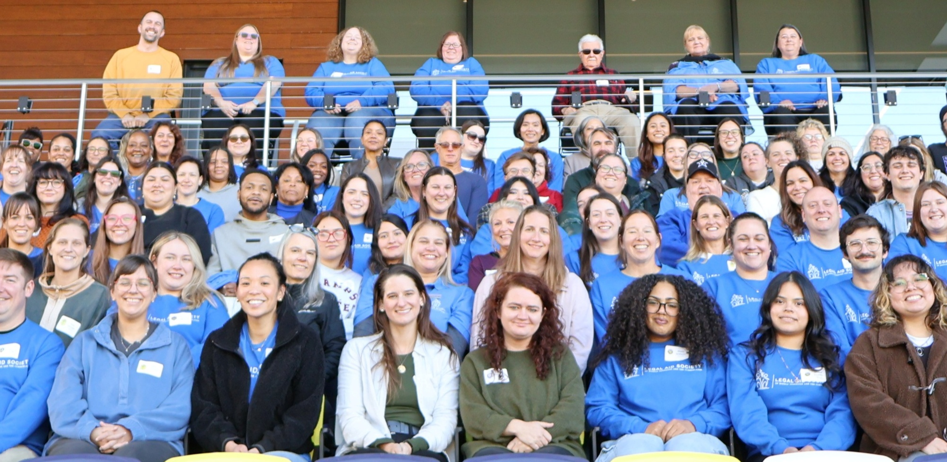

“Mission and Legacy Oriented”
How to Have the Best Damn
“Legal Clinic Ever!
Presented by:
Krista Scruggs, Tomi Robb, and Dean Hinton

Slide 2

What’s a Legal Clinic, You Ask?
A legal clinic (or law clinic) is a hands-on program or organization where law students or (volunteer) lawyers provide free or low-cost legal assistance to the community, typically serving low-income individuals. They offer aspiring lawyers real-world experience while helping underrepresented populations navigate civil, criminal, or administrative issues. (AI generated.)

Slide 3
Why Trust Us?
Gallatin has the most successful monthly legal clinic in the state of Tennessee. (We checked!)
We routinely get 30-40 clients at each clinic – most (2/3) of which are DR-related
Clinic started ~ 2016 and has grown since then.
Learn from our mistakes! Experientia docet = “experience teaches”
Received input from Jordan Springer, Esq. for this CLE

Slide 4
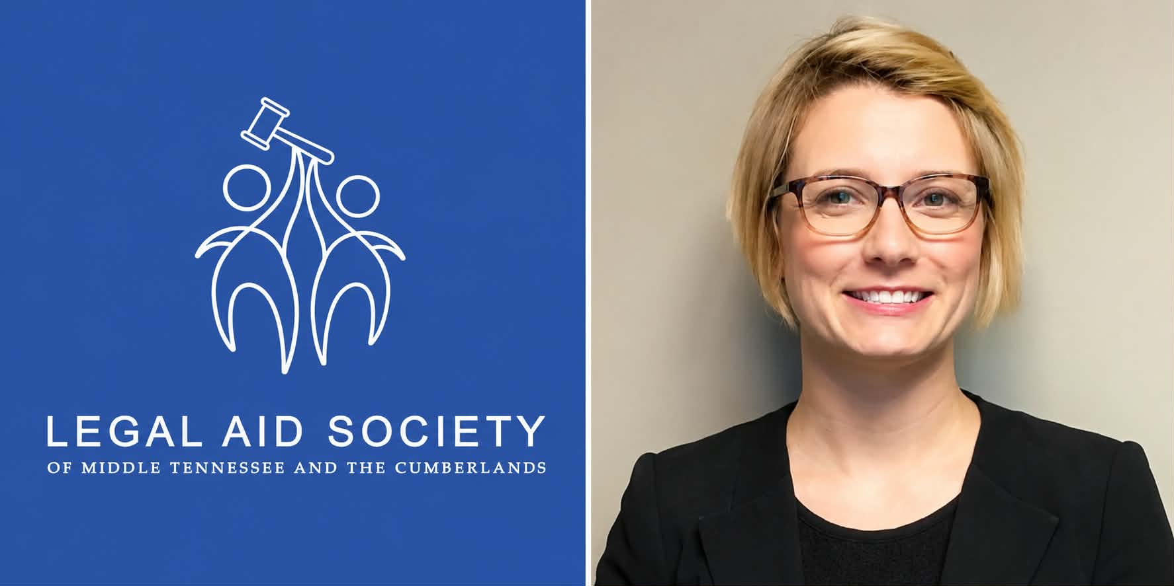
History of Gallatin Clinic
Idea began in 2007 with Jim Hawkins, former Gallatin MA.
Steve Christopher became MA. Ran with idea of clinic in 2016, starting at “old” LAS office, which was a converted two-story house in Gallatin.
Not much traction at first – few clients
Moved to Shalom Zone, converted school in Gallatin used now by non-profits, in poverty-stricken area.
Not many clients.
Moved to current location at Gallatin Civic Center, 210 Albert Gallatin Blvd.
Grew exponentially under former MA Allison Cooley.
AC delegated to KS. The Clinic prospered. “Krista had a passion for clinics.”
Clients routinely come from Davidson, Robertson, Montgomery, and other counties in addition to our service area.

Slide 5
How to Start
A Successful Legal Clinic
Clients + Volunteers + Space = Success (Probably)
Find a pro bono champion if you can. Example: Scott Kimberly and Greenhouse Ministries in Murfreesboro. Someone to rally the troops. Might be a law firm i.e. Bass, Berry, Sims, which hosts a clinic in Nashville. AGs office in Nashville routinely sends attorneys for clinics.
Stable venue, stable date/time every month. (Gallatin does not have clinics in June or December.
Is venue accessible for clinic clients? Public transportation, parking, and other considerations.
Is your library an option? Eg: Bordeaux and downtown in Nashville. Meeting space is built-in.
Consult bar association, judges, clerk’s office. Get buy-in.
Is your county too small? “It’s better to have too many clients than too many attorneys.”
If the clinic will be in a bedroom community (like Gallatin), can you recruit attorneys who live there but work in the downtown area?

Slide 6
Clinic Prep
  Gallatin preps clinic dates and reserves rooms with Civic Center a year in advance.
  Work with comms team in Nov-Dec to calendar clinic dates on web site and FB.
  Continuous reminders to private bar via bar association, social media, sign-ups, personal contact, etc.
  Gallatin distributes flyers on every HIP page in our service area.
  Encourage value-added such as child support services coming to clinic as well.
  Check in with clerk’s offices to distribute clinic flyers, etc. Clerks often provide some insight into who might be coming to clinic.

Slide 7
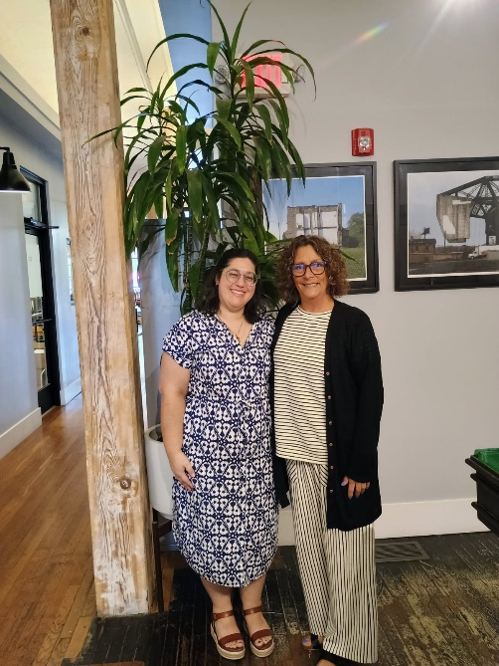
More Clinic Prep
    Get there early. (Anticipate problems like room is locked and must find someone to unlock it.)
    Greet and direct early arrivals. (Have a plan.)
    Set up laptop + printer + hotspot (plus notary stamp)
    Have more than one laptop ready with printer and hotspot?
    Have a system to hand out DR forms and get retainers.
    Have Language Line or equivalent ready. Do you use family members to interpret? Probably not little kids.
    Compliance Forms – every clinic client should have an intake form, citizen attestation, and case summary.
    DR Forms from SELegal. Do not use AOC forms. Can’t use if business or real property or fault-based divorce (no grounds plead other than ID).
    Laptop + printer + hotspot (maybe more than one each)

Slide 8
Clinic Forms
AOC DR forms are limiting – i.e. on real property, no businesses, no retirement accounts, and only ID divorce.
SELegal forms are easier to read, easier to understand, and allow transfer of real property via MDA.
SELegal has forms that AOC does not – i.e. request for Juvenile relief
Other AOC forms (not DR-related) are helpful – i.e. Summons to Recover Personal Property, Slow Pay Motion (AOC.gov)
Attorney sign in and pre-game strategy (does attorney have preference for how to rx clients?)
Play to your strengths.

Slide 9
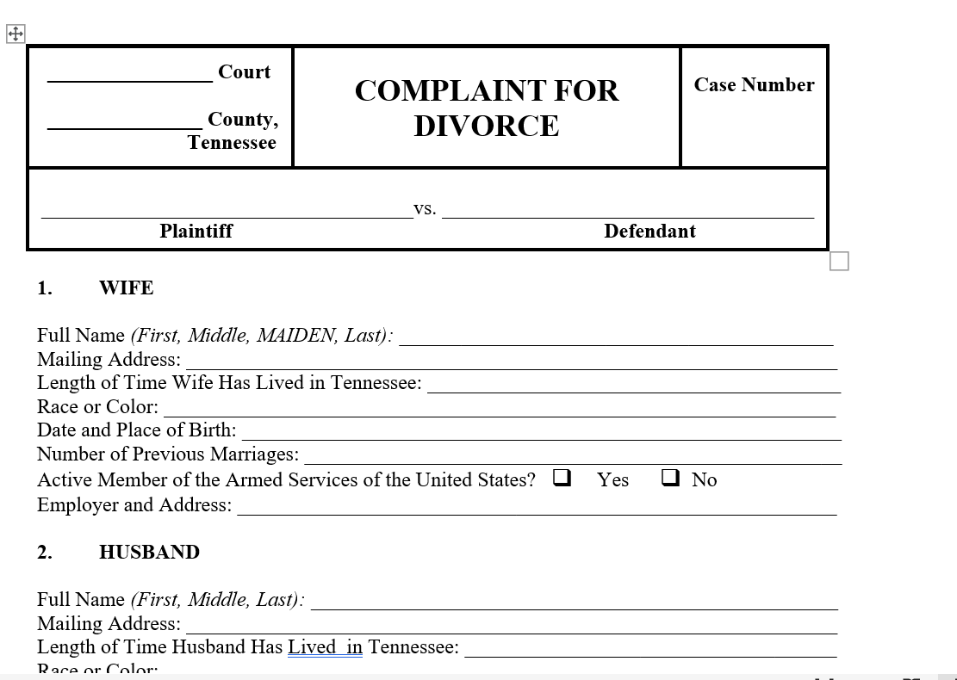
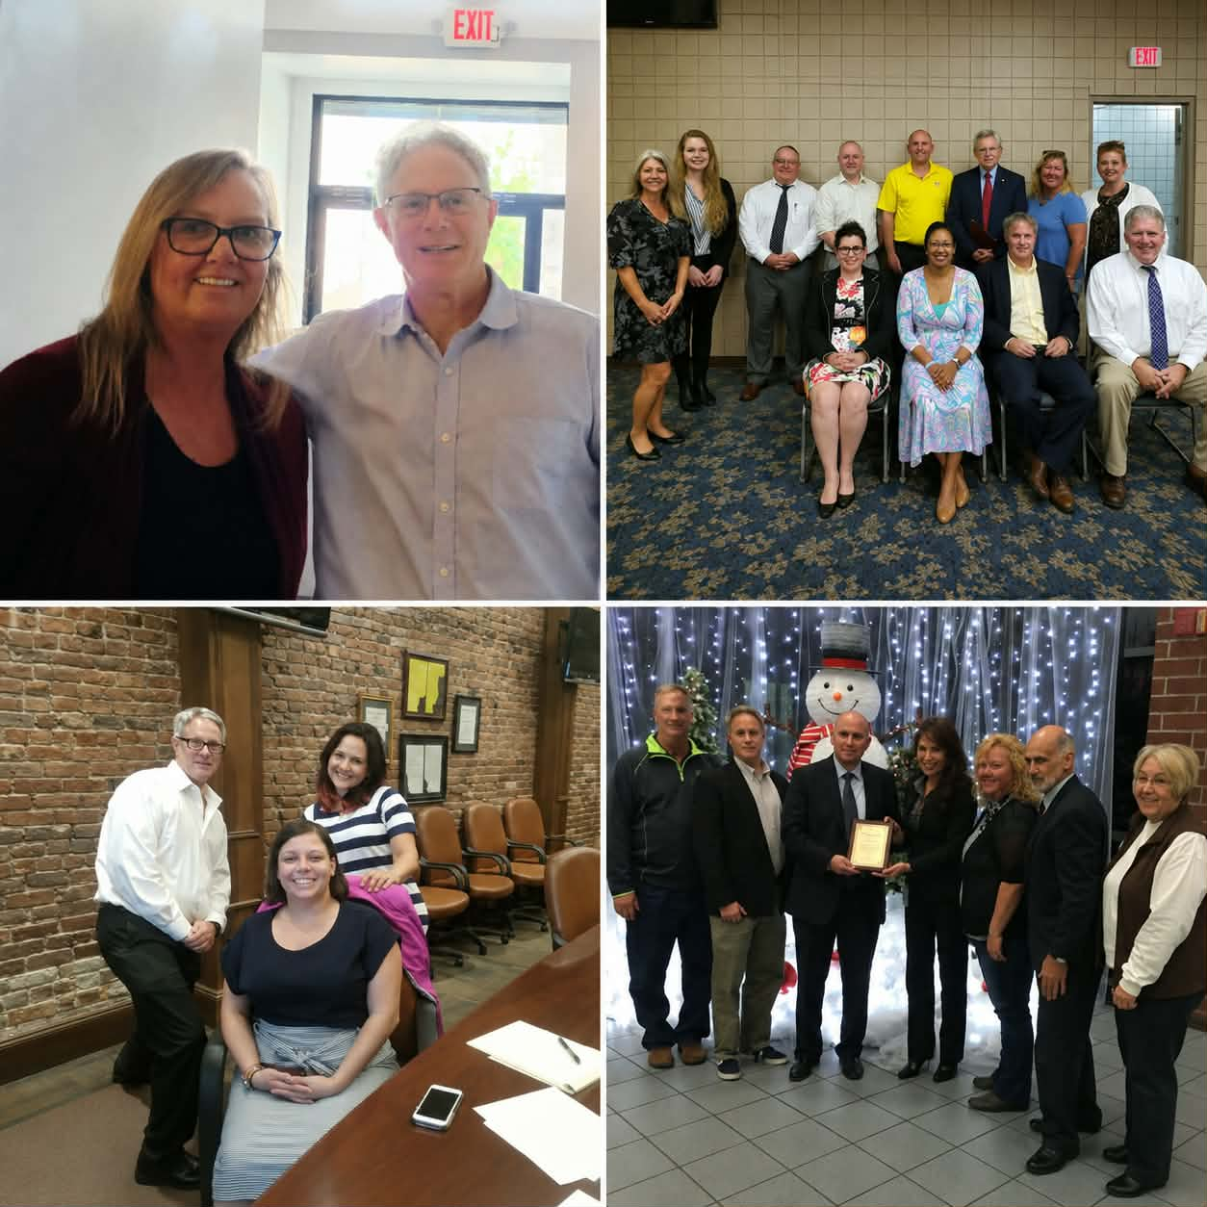
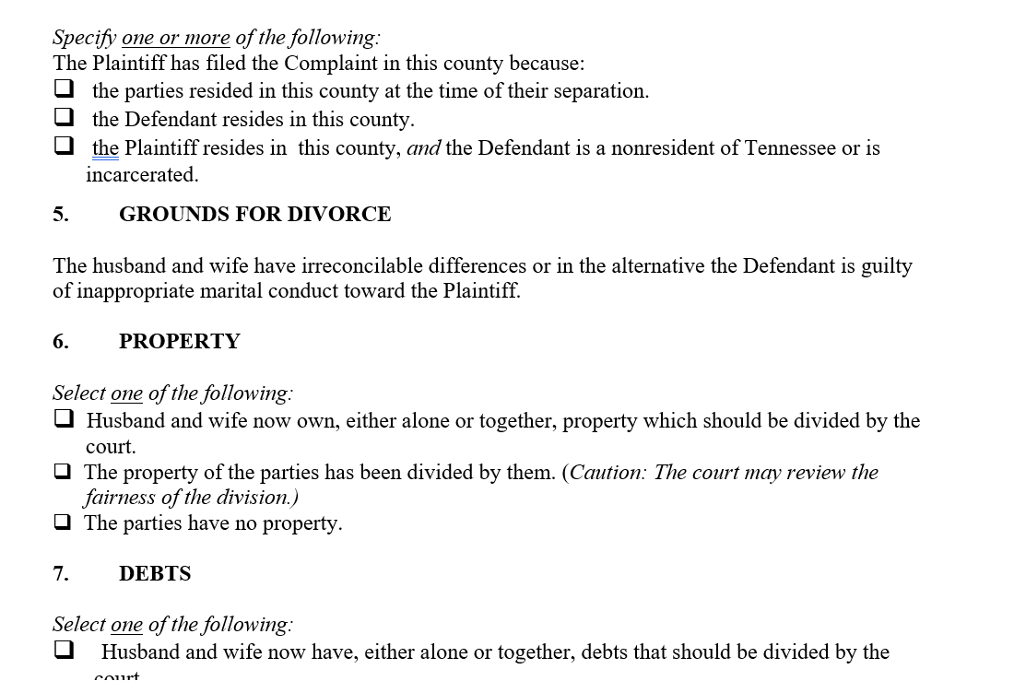

Slide 10
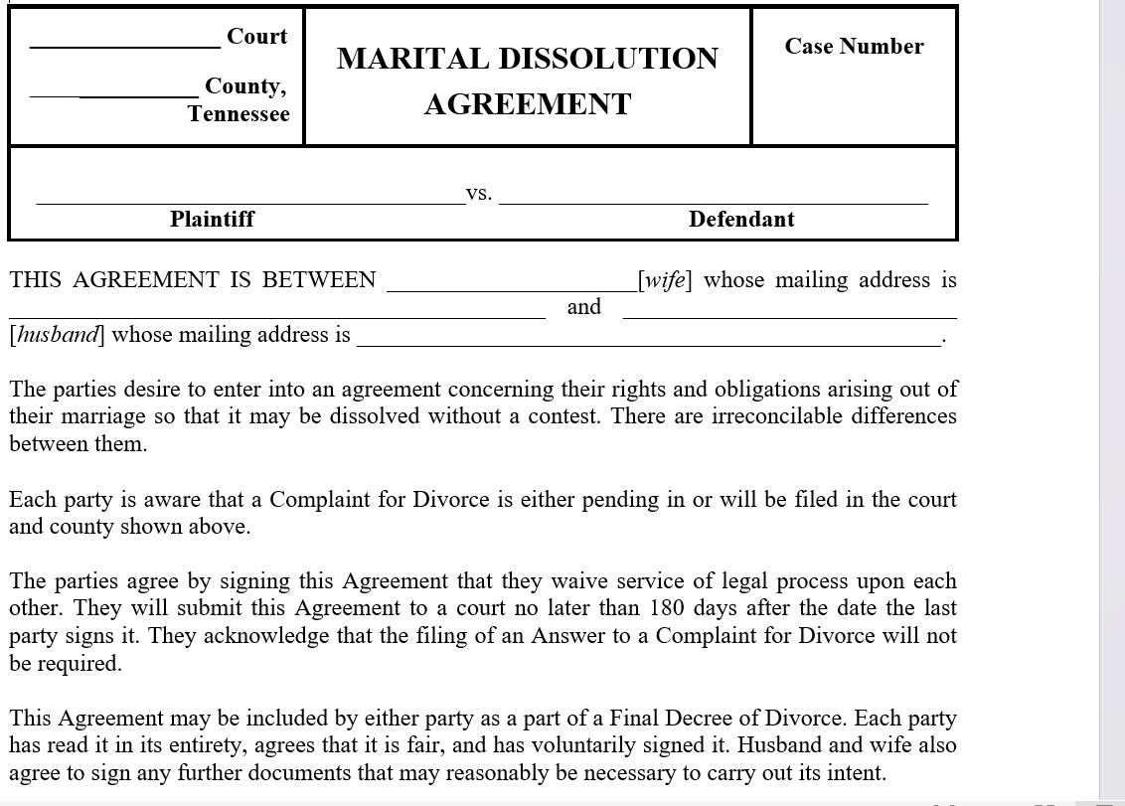
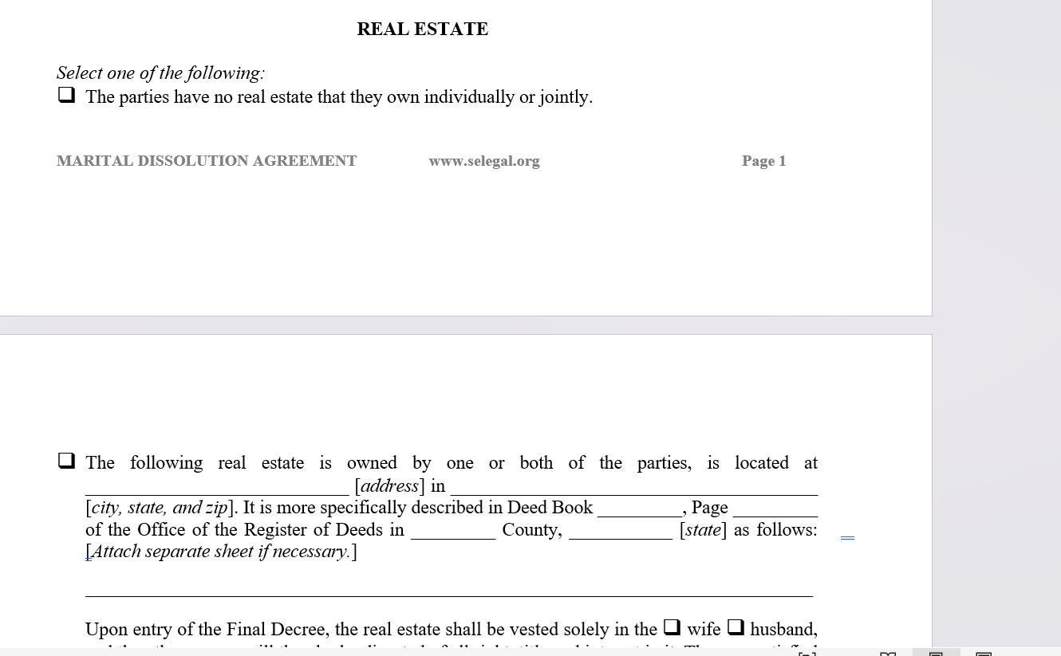

Slide 11
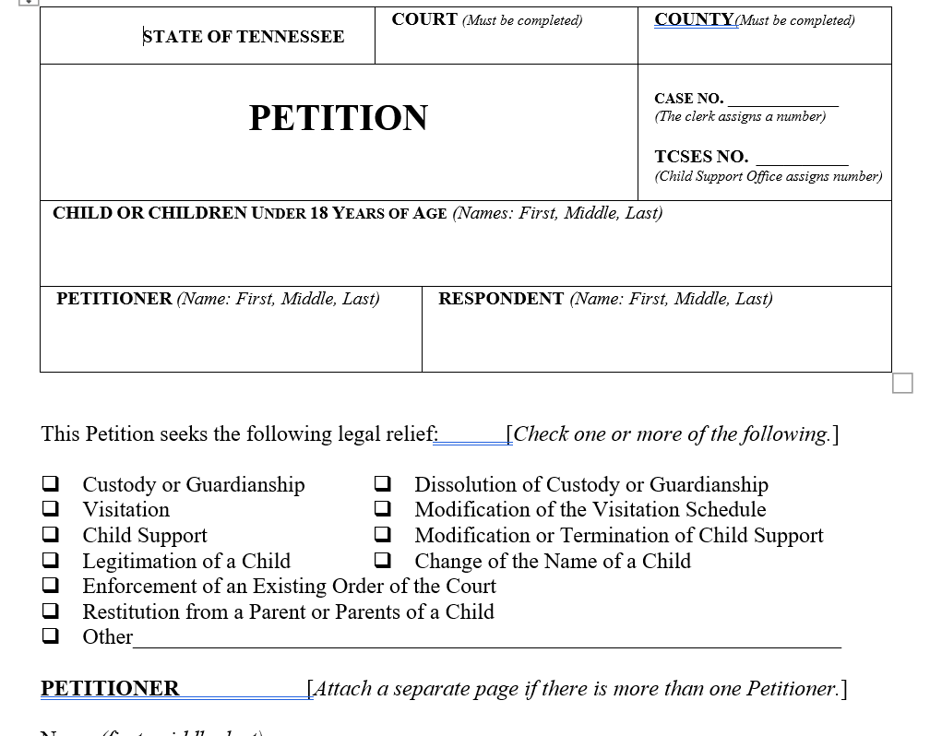
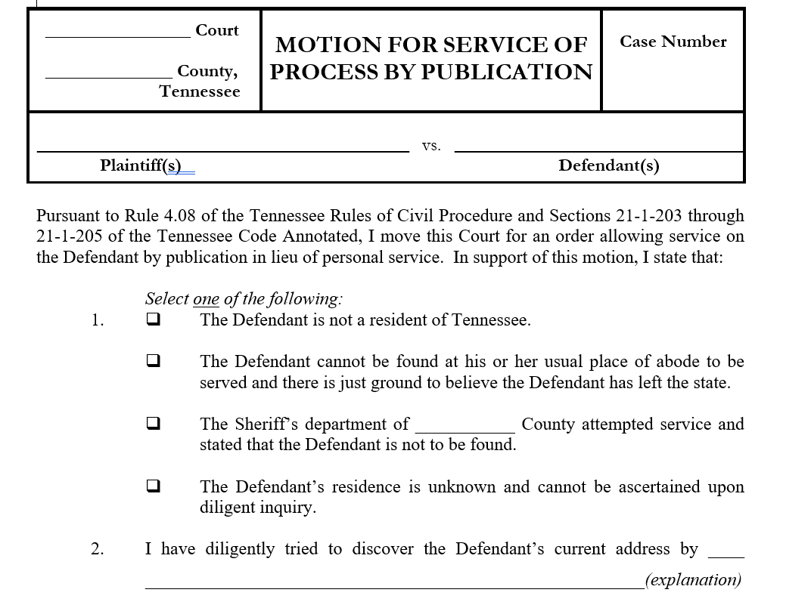
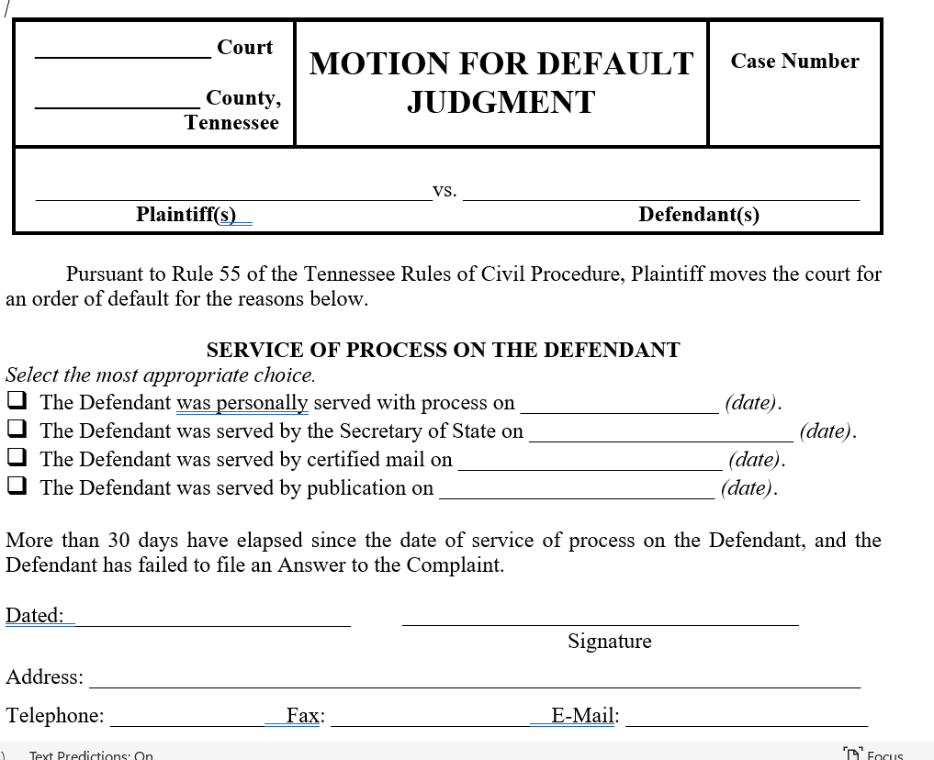

Slide 12
Winning the Clinic
Move fast – stick and move (like boxing, the sport)
Try to make eye contact, try to make sure client is heard while moving fast.
Triage then triage some more! (Triage is the process of sorting and prioritizing tasks (clients) based on the urgency of their need or the severity of their condition, aiming to maximize outcomes when resources or time are limited.) Identify the easy ones and get them out the door first, then work on the more time-consuming cases.
No sign-up sheet. No barriers to success!
Host clinic same place, same time, all the time.
Get clerk buy-in, referrals. Give clerk’s office clinic flyers. Update routinely. Engage.
Embrace the clinic model – not everything is a c&a or full rep. You can continue to guide/advise clients at subsequent clinics. Gives clients skin in the game.

Slide 13
Post-Clinic Considerations
Does your county or counties have pro se days? If so, can or will you attend? (Courts look favorably on help from LAS to get cases off their dockets.)
Follow up phone calls/emails.
Contact with clinic clients who fell through the cracks, weren’t happy with service, etc. Customer service mode.
Entering time and other documentation -- every clinic client should have intake form, citizen attestation, and case summary.
Follow up with private bar referrals.
Decompress – Clinic can be intense experience because of volume and vicarious trauma.

Slide 14
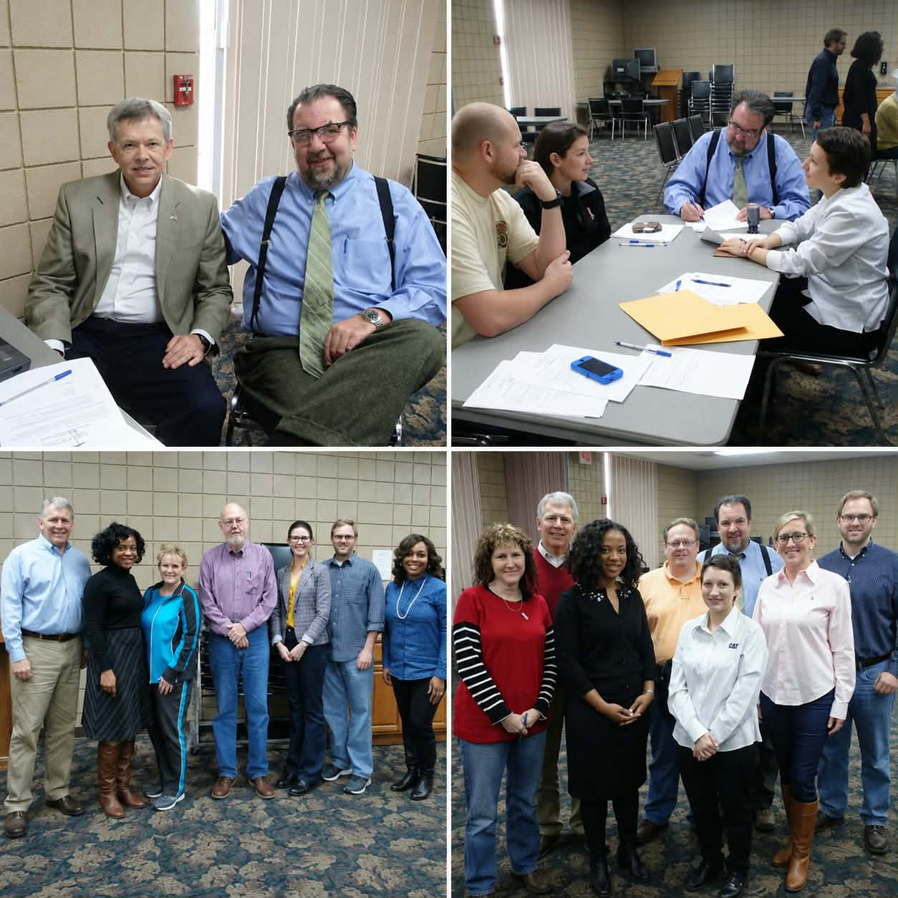
Ethical Considerations
    Non-English speakers
    Angry spouses – separate and/or someone might have to leave (probably the abuser). Safety issue(s)
    Conflicts of interest
    Child support logistics (downward deviations, zeroing out support, providing inaccurate monthly gross incomes) but is child on TennCare?
    Mental health issues (non-legal matter or client is a kook)
    Clients who just want advice – a reason to vent to you (maybe leave for last?)
    Over-income individuals? Private bar does not like those.

Slide 15
Pro Se Days
Are you going to help clients who did not come to clinic? Who you do not have retainers for?
If so, are you prepared for conflict check?
If not, refer to clinic as appropriate. (Have a plan.)
Bring a printer, laptop, hotspot, and notary stamp (treat pro se days as if it’s a mini-clinic.
Stress to clients they can get divorced, but the paperwork has to be fixed.
What is the fix?
Did the other party come to pro se days as well? If so, the fix should be easy.
Common issues: real property, child support (parties want to zero-out child support, ask for deviation), businesses, AOC forms.

Slide 16
Keys to Growth
      Gallatin Clinic Grew Because:
      Clerk of Court buy-in – distribute flyers and ongoing communication with deputy clerks
      Same place, same time, all the time (but you can tweak the schedule such as starting at 3:30 instead of 4:30)
      Have forms ready to distribute
      Fill out CSWs (value added)
      Partner with other agencies (child support services)
      Follow up at pro se days – depends on judge, court, attitudes (some judges don’t have pro se days)

Slide 17
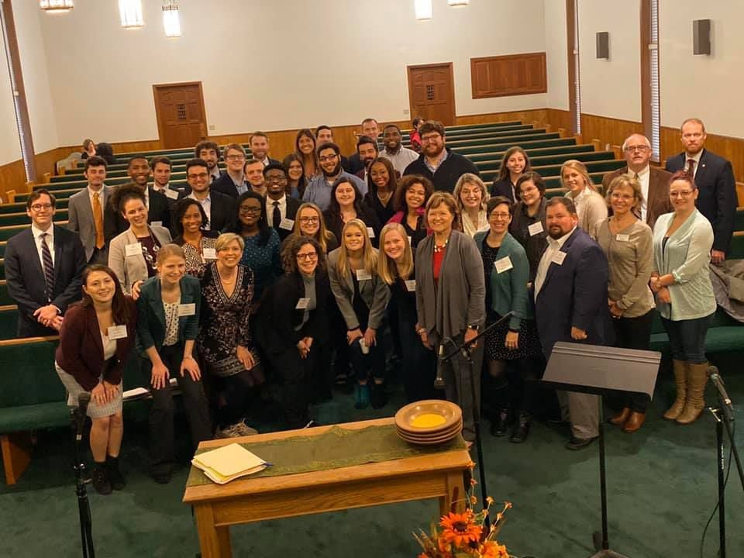
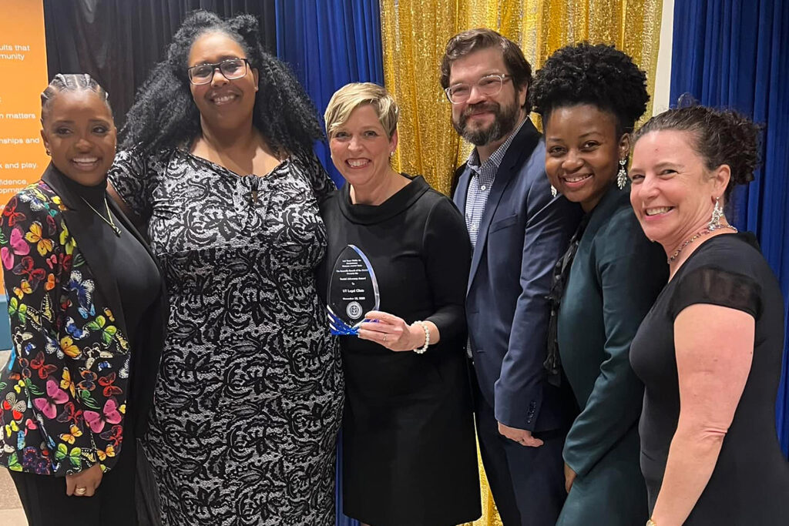
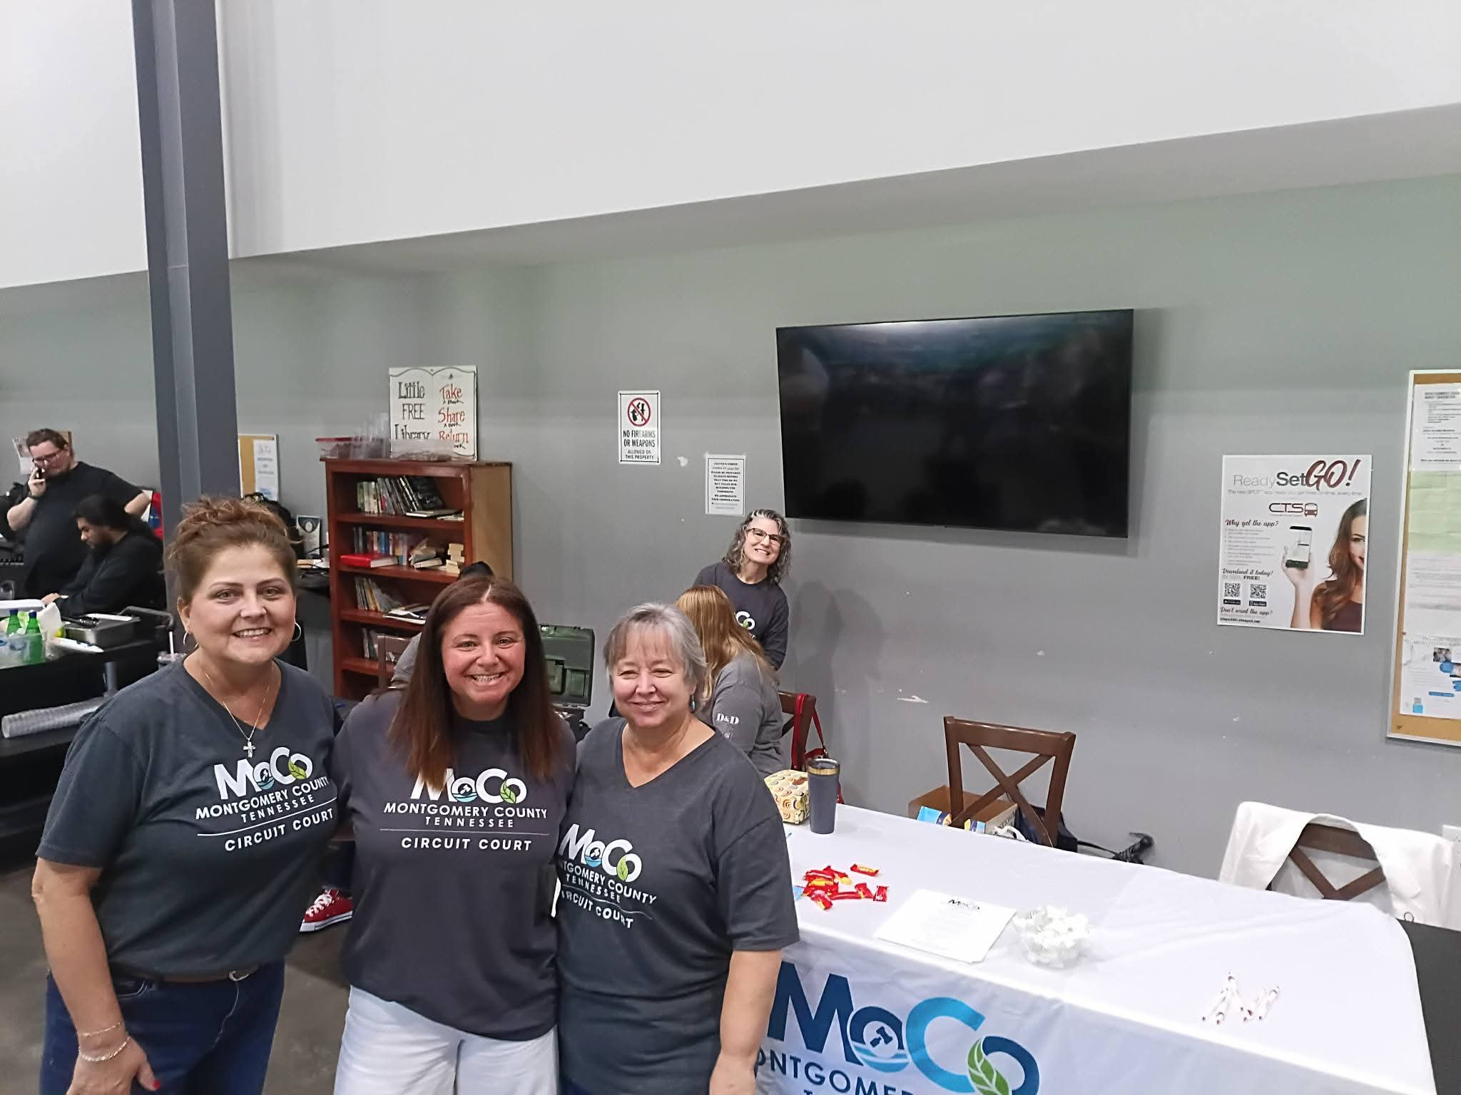
Expungement Clinics
LASMTC Reentry run by Reentry Program Director, Tomi Robb.
University of Tennessee College of Law Expungement Clinic taught by the Director of Clinical Programs, Joy Radice.
Expungements clinics are a great tool because a lot can happen in a short time. You often meet clients who were on the verge of giving up trying to navigate the system.
Expungement clinics have different levels of service that depend on buy-in from the clerk of court, judges, DAs, and (maybe even) the Department of Safety.
Successful clinics across a dozen counties. Willing partners are easier to find in some places than they are in others, but every clinic gives you more contact, more experience, and more opportunity for services in each jurisdiction.
A good start is with clerk of court. They can be a good partner/friend in this.

Slide 18
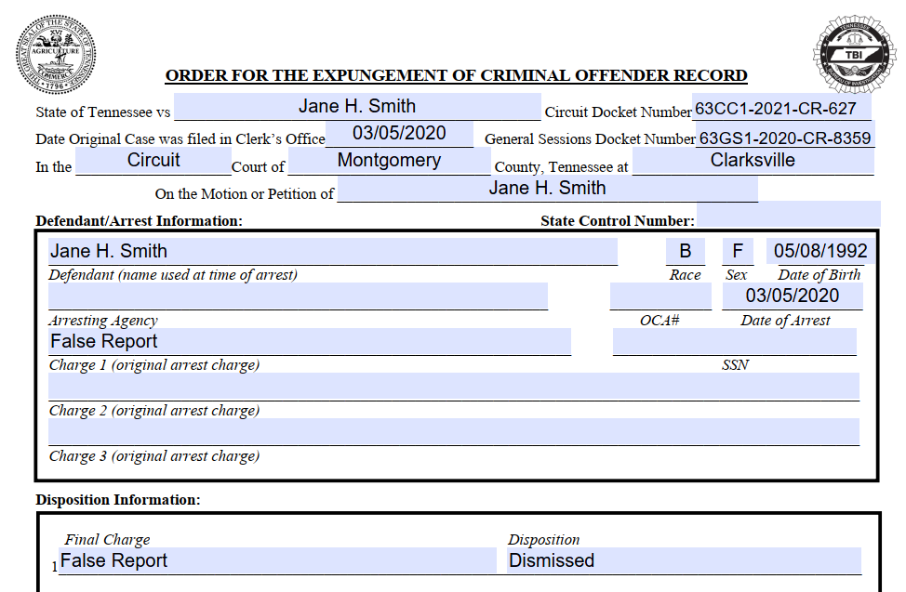
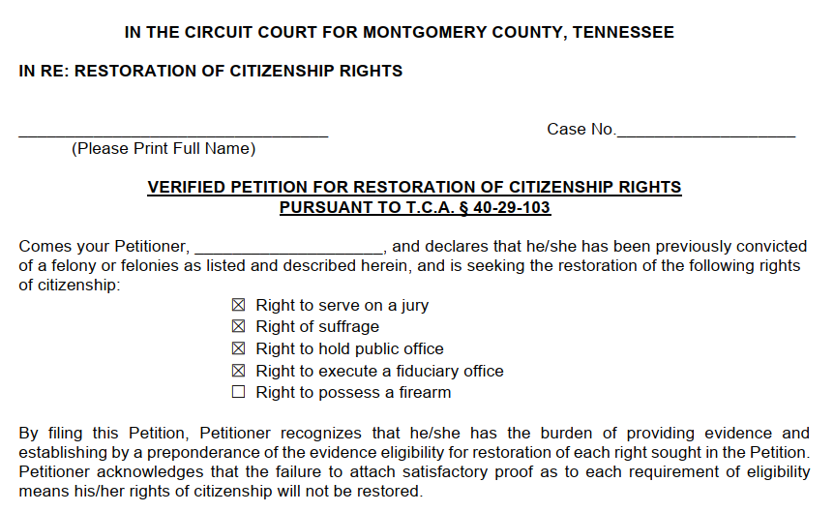
Expungement Clinic Prep
After consulting with clerk of court, obtain space and set date of clinic at least 60 days out.
60 days is necessary to circulate flyers, get sign-ups, obtain records, prepare petitions, packets, and summary sheets.
Client packets may contain motions, AOIs, expungement petitions, restoration petitions, driver license reinstatement requirements, retainers, grievance forms, surveys, and clinic receipts.
Private–bar notice through LAS offices, TBA, flyers. Don’t count on private-bar participation.
In-person and video trainings available for private-bar attys. Newbies can also shadow experienced attys the day-of.

Slide 19
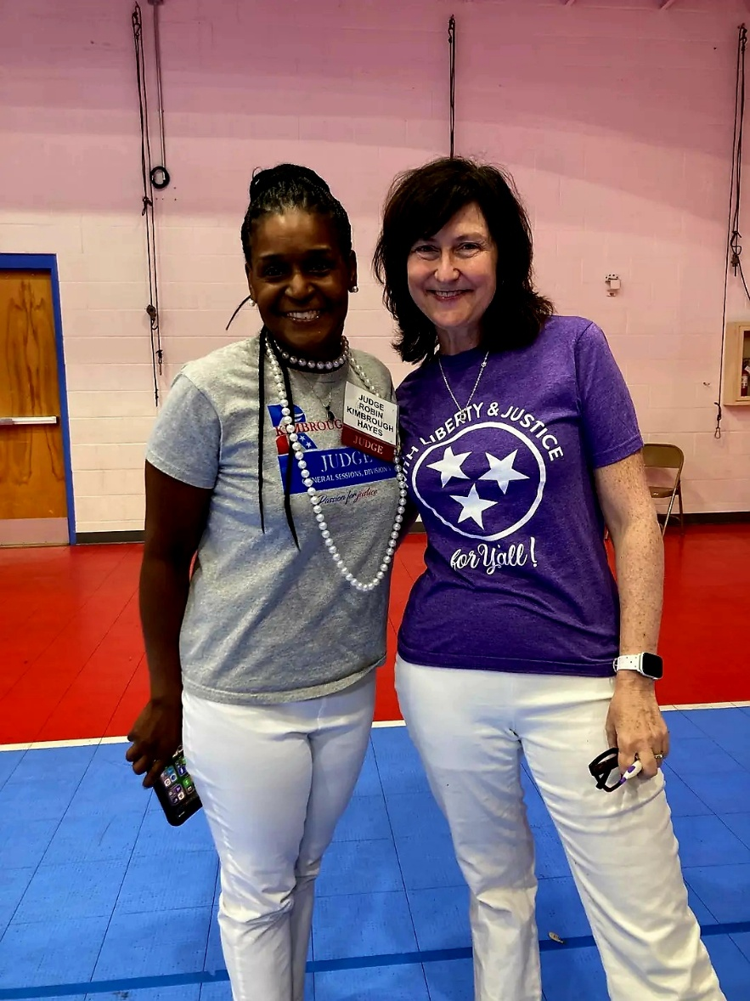
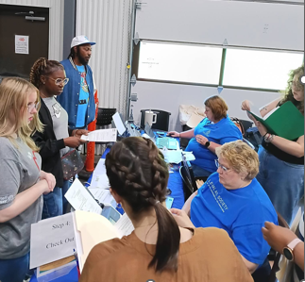
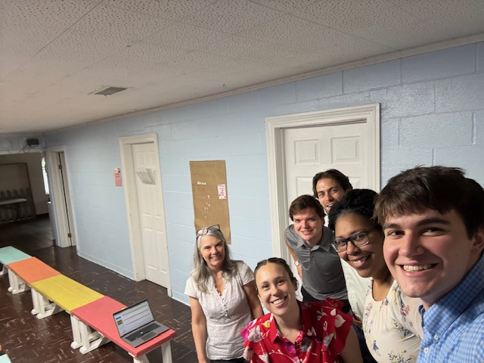
Expungement Clinic Day-Of
Are you going to accept walk-ins? Not recommended. There are multiple reasons for this.
A gatekeeper is a must. There must be someone in control so that the first client gets seen first, the second the second, etc. Check-In and Check-Out must be handled with care.
Conflicts cannot be overlooked.
Need laptops, scanner, hotspots, wifi-password, extension cords, and printer. Bring the branding as well. Tablecloths. Pop-ups. Brochures. Cards.
Make sure everyone has a defined role. Make sure everyone knows the work flow.

Slide 20
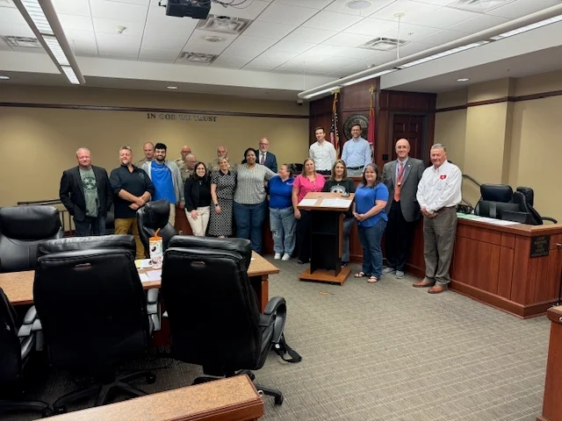
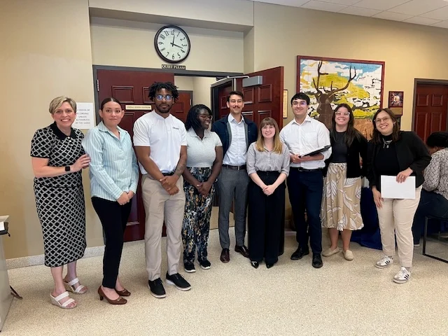
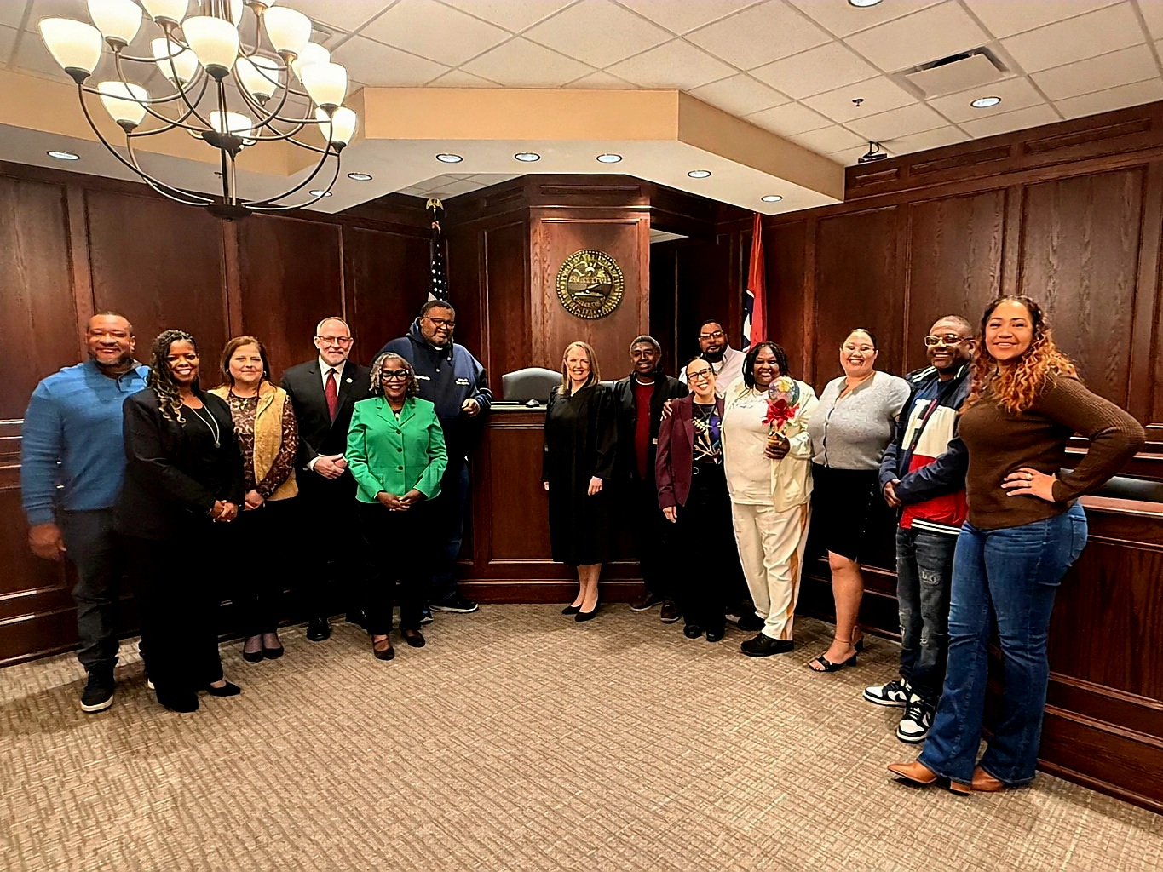
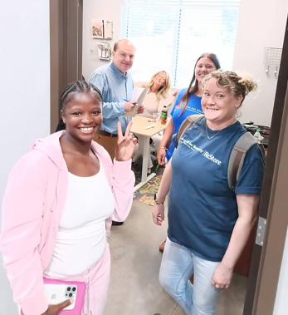
Expungement Clinic Wrap-Up
File Petitions and briefs, if necessary. Upload everything to Legal Server. Make sure no retainers were missed. Check for follow-up items. Did you make promises?
Attend court. (Restoration).
Wait the statutory period for your petitions. Some counties are much faster than others. If they are lingering, get on it. There may be an explanation. You may need to set a hearing.
Closing letter to client with Petitions (which also acts as expungement Order).

Slide 21
Pros of Clinics
Good for branding, reputation, donors, law firms.
We can touch many more clients through clinics (volume).
We can empower clients by giving them the tools to get divorced, for example. Clients are much more resilient than we give them credit for! And skin in the game.
Access to justice – clients meet with attorneys who would otherwise not represent the client.
Often clients just need someone to talk some sense to them. They need a push past their comfort zones.
Opportunity to show dignity, respect to clients through clinics.

Slide 22
Cons of Clinics
Advice will likely be inconsistent from clinic to clinic because of differing attorneys.
Clinics don’t go far enough. It’s better to put time/resources into recruiting attorneys to take cases full rep or otherwise help. Clinics are a “better-than-nothing” service model, low-hanging fruit. They are nothing more than a way for Legal Aiders to feel good about themselves.
Some clinic clients will be disappointed that Legal Aid is not taking their case full rep.
Ongoing issues with private-bar involvement. Participation ebbs and flows.
Some clients are confused about how to follow up with Legal Aid after clinic ends.

Slide 23
Takeaways
Find a champion like Krista and Scott Kimberly.
Be prepared for ongoing efforts to recruit private bar to clinics.
Embrace the clinic model by sending out-of-priority cases and low-lethality cases to clinic.
Try to be as full-service as possible with forms and preparing CSWs for clients.
Location, location, location. Gallatin thrives in part because Krista found a good space.
Treat the clinic like a pilot project. Don’t be afraid to make changes but embrace what is working. Stick with it and you will succeed!

Slide 24

TIMELINE For Non-Expungement Clinic
2-3 months out
4-6 Weeks OUt
1-3 Weeks Out
Day of clinic
After clinic
Clinic Venue
Expectation for client turnout/capacity
Sign-Up only or Walk-Ins?
Will there be a training or CLE?
Identify Co-Hosts and Partners
Have flier prepared at 6-week mark
Send prepared flier to communications—allow 2 weeks communications
Begin advertising at least 4 weeks ahead
Intake Responsibility
Have a list of volunteers, both attorney and non-attorney (if needed)
Send emails/make phone calls to confirm attendance for clients & volunteers
Arrive at least 45 minutes early
Staff should wear Legal Aid clothing
Bring legal aid display materials
Initiate sign-in and intake process (if applicable)
Make necessary entries/updates on Legal Server
Send thank you’s to volunteers and clients
File CLE hours for attorneys

Slide 25





Clinic Building Blocks
Planning
MARKETING
DESIGN
STRATEGY
LAUNCH
Virtual or In-Person?
What part of Tennessee?
Logistics
Fliers, Client Outreach, Sign-Ups vs Walk-Ins
Type of Legal Issue
Number of Clients
Volunteer Base
Training
Responsibility Delegation
Partnerships
Training
Appropriate Timelines
Ensuring Participation
Follow Ups

Slide 26
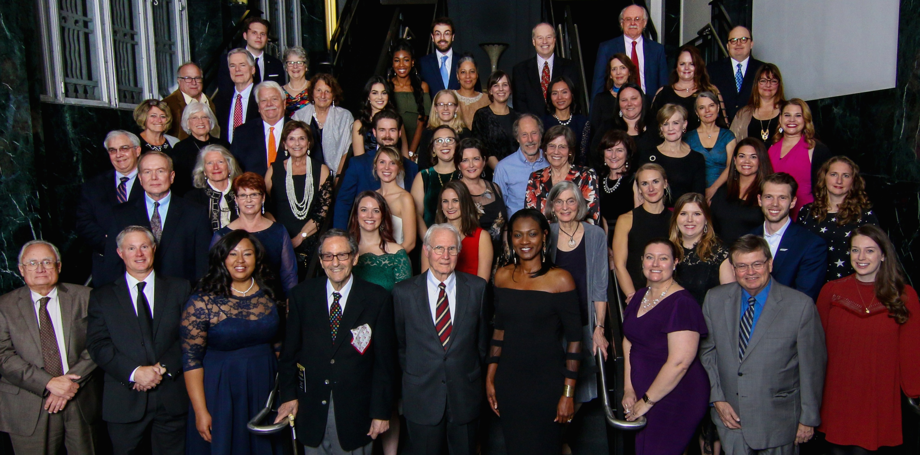
https://legalaidinaction.buzzsprout.com/
Las.org
kscruggs@las.org
trobb@las.org
dhinton@las.org
Questions?
QUESTIONS?
“Mission and Legacy Oriented”

