Slide 1

Tennessee Language Center
UT INSTITUTE FOR PUBLIC SERVICE

Slide 2
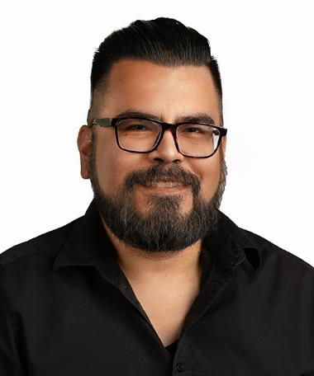
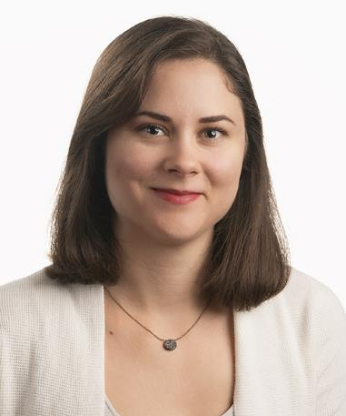
Richard Ponce-de-Leon
Genna Nanda
Richard is the Director of Interpretation and Translation Services
at the Tennessee Language Center. He is a Certified Public
Manager and a Certified Court Interpreter in the State of
Tennessee, and he holds a Master of Science in Higher
Education Administration from the University of Tennessee,
Knoxville. He currently serves as President of the Tennessee
Association of Professional Interpreters and Translators.
Genna is a Training Specialist at the Tennessee Language Center, a nationally certified English/Spanish medical interpreter and a court registered interpreter in the state of TN. After spending over six years living in South America, she returned to the United States in 2019 and began a career in interpretation. She currently manages interpreter training programs at the Tennessee Language Center.

Slide 3
Enhancing Court Outcomes Through Effective Interpreter Preparation
In what way(s) do you work with interpreters?
How often do you work with interpreters?
What do you expect the interpreter to be able to do / not do?

Slide 4
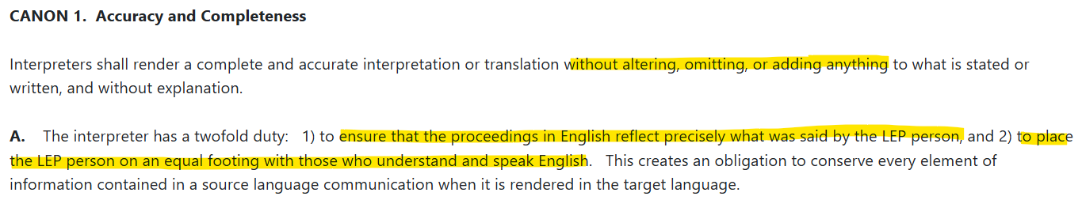
The Court Interpreter’s Job

Slide 5
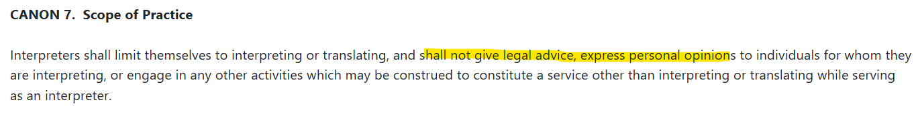
Supreme Court Rule 41

Slide 6
Supreme Court Rule 42
-Oral exam
  - Simultaneous
  - Consecutive
  - Sight translation
Certified Interpreter
-Ethics and skill building workshop
-Background check
-Written exam (English)
-Oral proficiency interviews
Registered Interpreter
Non-credentialed interpreter

Slide 7
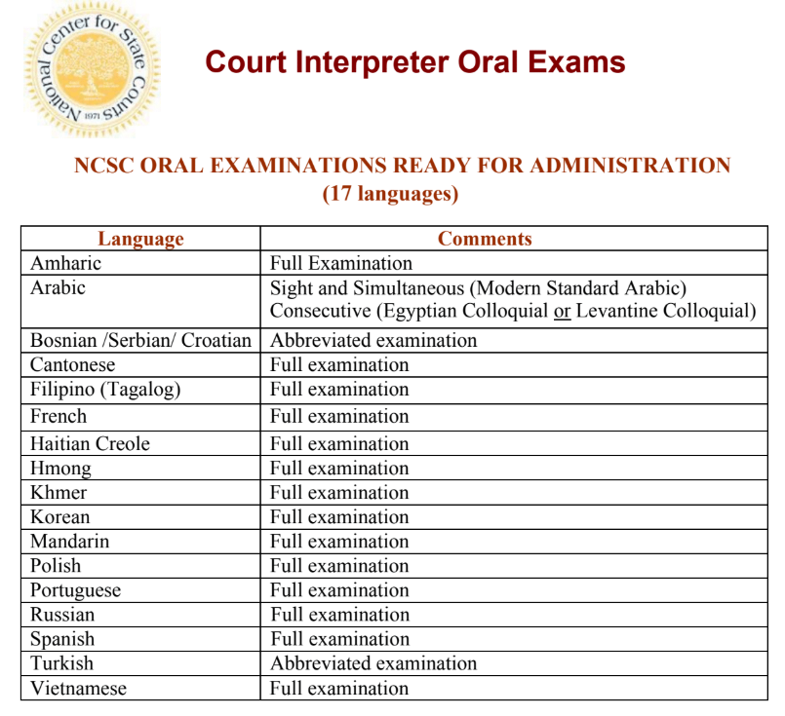
Currently (in TN):
Certified
Arabic
Mandarin
Portuguese
Somali
Spanish
Vietnamese
Registered
Cantonese
Farsi/Dari
French
German
Greek
Haitian Creole
Romanian
Swahili
Turkish

Slide 8

Why preparation matters

Slide 9
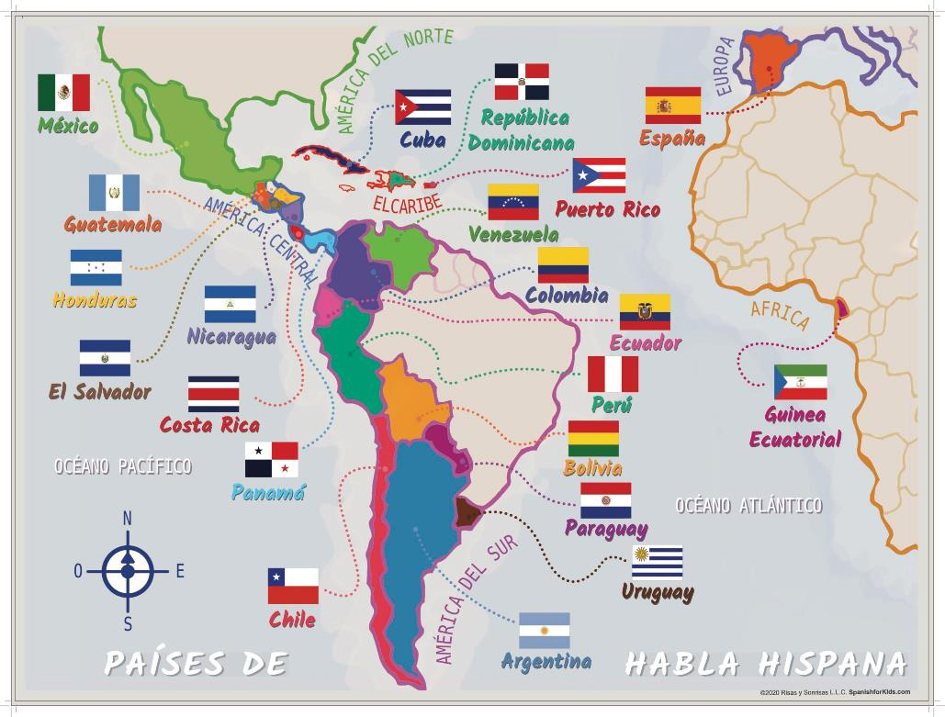

Slide 10
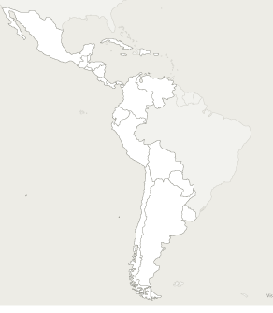
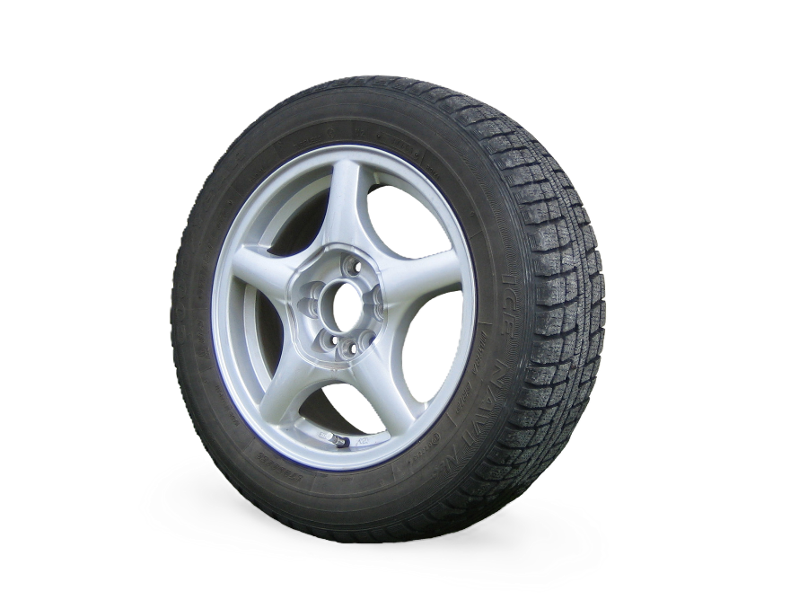
llanta
goma
llanta
caucho
llanta
llanta
neumático
llanta
goma
This Photo by Unknown Author is licensed under CC BY-SA
Notes:
Goma – Argentina, PR, DR
Llanta – Mexico, Colombia, Peru, CR
Llanta in Argentina, Urguay and Child is the “rim” (just metal part)
Neumático – universal, common in chile
Sometimes people say “rueda”

Slide 11
Maya Languages =/= Spanish

Slide 12

Juvenile Court
Criminal Court
Civil Court
Child Custody
Family Court
Probate Court
Domestic Violence

Slide 13
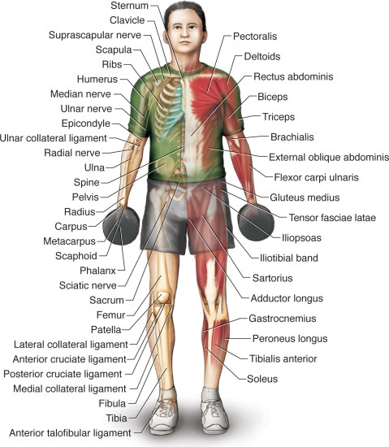

Slide 14

The interpretation is the record!

Slide 15


Slide 16
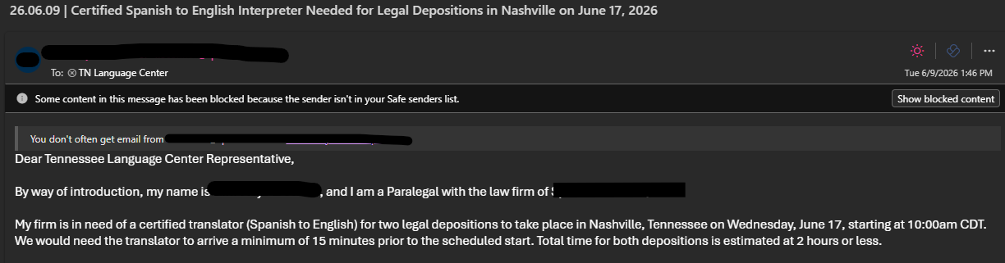

Slide 17
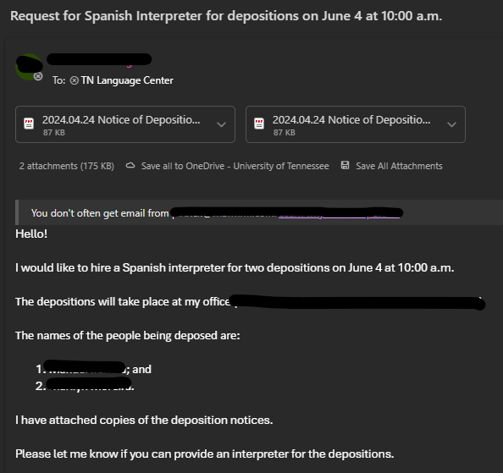
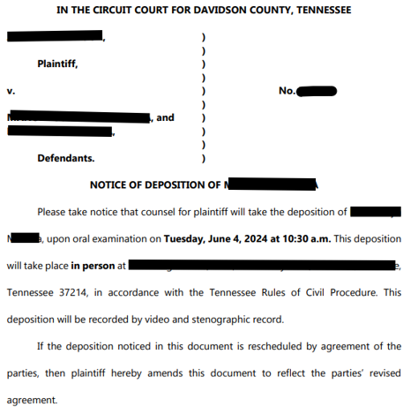

Slide 18
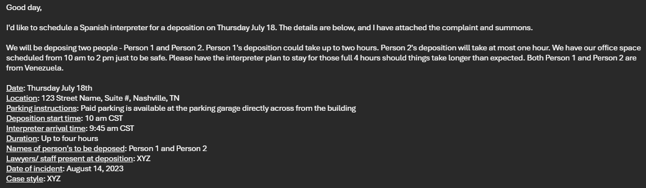

Slide 19
Consistency
Improves communication and reduces misunderstandings.
Ensures consistent interpretation of legal terminology.
Promotes continuity throughout the legal process.

Slide 20
Summary: Helping Interpreters Prepare
When scheduling an interpreter, provide:
  A brief summary of the case and its legal context.
  The type of proceeding (e.g., consultation, deposition, hearing, trial).
  Relevant documents or exhibits, when available.
  Specialized terminology, acronyms, or technical subject matter.
  The names and roles of key participants.
  The expected length and format of the assignment.
  Advance notice of any sensitive issues or communication needs.

Slide 21
