Slide 1


August 26, 2026
www.housingforalltn.org
info@housing4alltn.org
A Campaign to Increase Access to Stable, Affordable Housing
Presenting: Shirley Bondon (Greater Memphis Housing Justice Project, GMHJP) Adam Hughes (Statewide Organizing for Community eMpowerment, SOCM)

Slide 2

Agenda
  About Housing for All TN and the TSP Project Team
  Tenant Screening
  Screening Protections
  Tennessee’s Tenant Screening Protections

Slide 3

WE BELIEVE THAT ALL TENNESSEEANS
DESERVE SAFE AND DIGNIFIED HOUSING
ENDING HOMELESSNESS
All Tennesseans deserve the stability afforded by a home address. When residents can register to vote, hold stable jobs, keep their children in school, build community and a sense of belonging, and plan for the future, we all win.
TENANTS’ RIGHTS
Everyone deserves to live in safe, affordable, and dignified housing. It is our collective responsibility to protect our most vulnerable residents (i.e., seniors, people with disabilities, families with children, and young adults living on their own) from exploitation, dangerous living conditions, and unjust evictions.
AFFORDABLE HOUSING
Housing is the foundation of healthy communities, but for many Tennesseans, affordable housing is out of reach. The housing crisis is one of the most pressing issues in our state, impacting all of us, whether we live in urban or rural areas or come from middle class or low income families.
HOUSINGFORALLTN.ORG

Slide 4

Email: Info@Housing4AllTN.org

Slide 5









Meet the Team
Notes:
Tennessee’s tenant screening protections project grew out of a statewide collaboration led by Statewide Organizing for Community eMpowerment (SOCM) and the Greater Memphis Housing Justice Project to address unfair tenant screening practices and expand housing access across Tennessee. After participating in Unlocked: Opening the Door to Housing Access Through Tenant Screening Protections—an eight-week national Solutions Sprint hosted by Results for America and partner organizations—the team built a 20-person campaign focused on public education, community-informed research, advocacy with state and local leaders, and the development of a policy agenda for tenant screening protections.

Slide 6
Current
Project
Education
Research
Raising awareness about unfair tenant screening protections and what we can do about it
Learning about the experience of Tennessee renters.
We need your voice-especially rural counties!
Policy
Developing statewide policy recommendations to protect tenants during the screening process.
Notes:
Tennessee’s tenant screening protections project grew out of a statewide collaboration led by Statewide Organizing for Community eMpowerment (SOCM) and the Greater Memphis Housing Justice Project to address unfair tenant screening practices and expand housing access across Tennessee. After participating in Unlocked: Opening the Door to Housing Access Through Tenant Screening Protections—an eight-week national Solutions Sprint hosted by Results for America and partner organizations—the team built a 20-person campaign focused on public education, community-informed research, advocacy with state and local leaders, and the development of a policy agenda for tenant screening protections.

Slide 7


Tenant Screening
The background checks that landlords use during the housing application process.
  Electronic rental application
  Applicant pays fees to be considered
  Third-party screening report
Credit, criminal, eviction records
Score or analytical component
Automated decision
  Denials unexplained

Slide 8
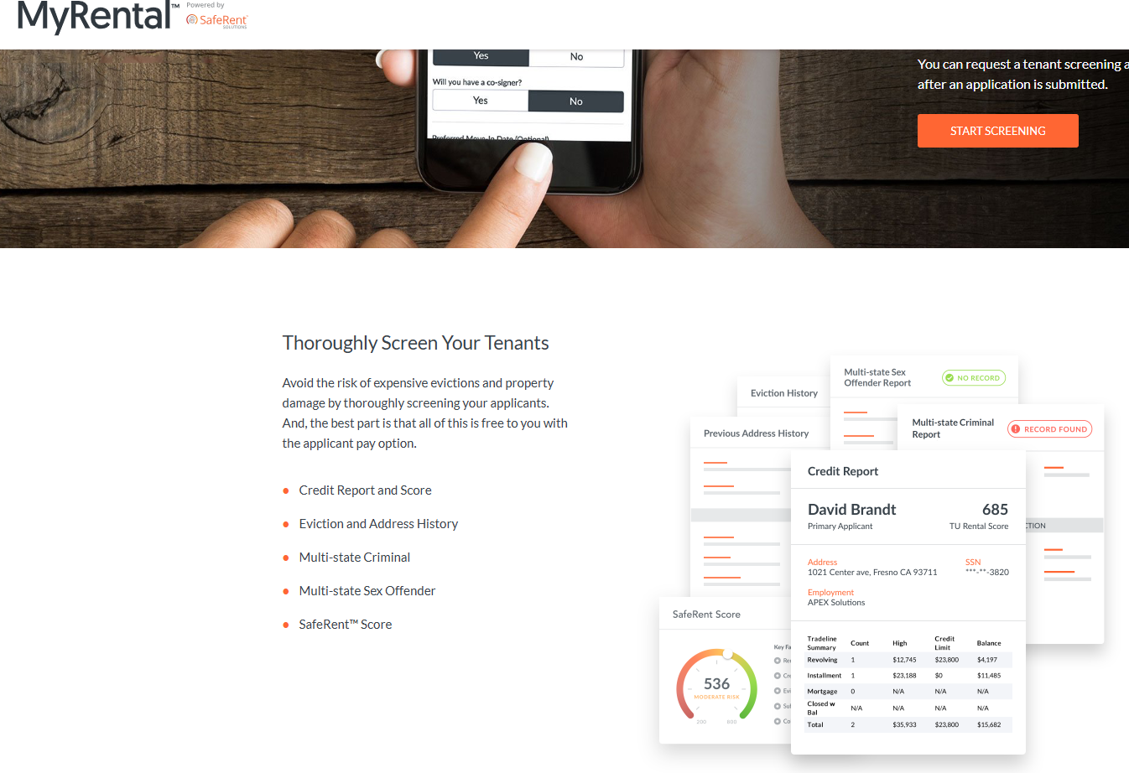
Tenant Screening Reports

Slide 9


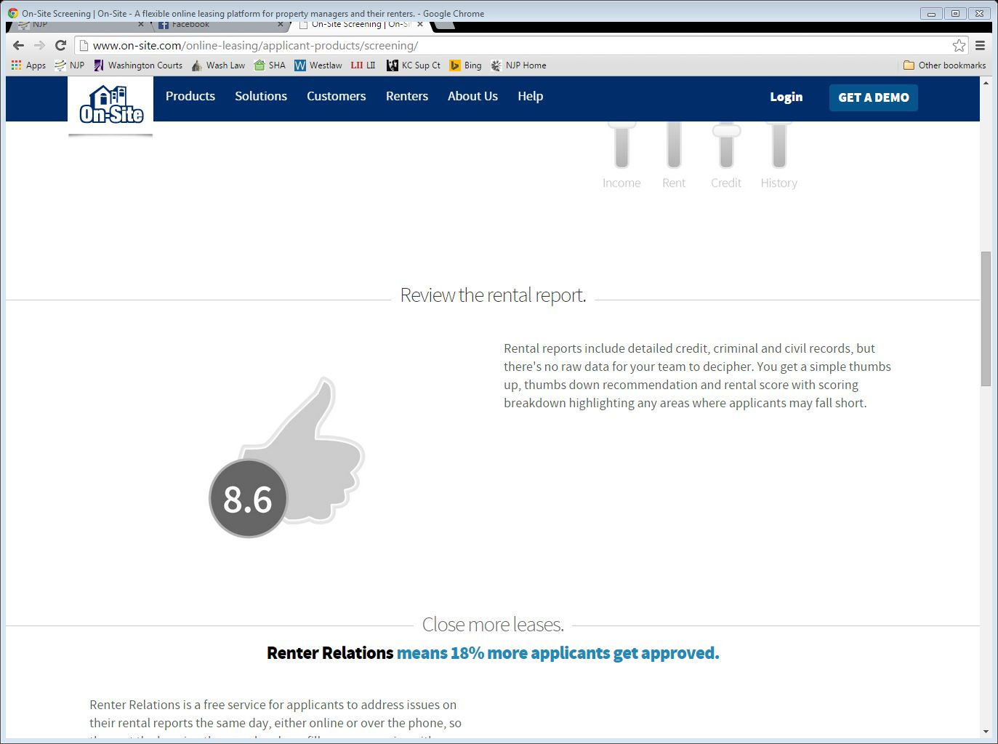
I mean there is literally even a thumb on the screen
Rental reports include detailed credit, criminal and civil records, but there's no raw data for your team to decipher. You get a simple thumbs up, thumbs down recommendation and rental score with scoring breakdown highlighting any areas where applicants may fall short.
19

Slide 10


The duality of stickman. The Jungian thing, sir.
●Three outcomes typically
possible:
○Admit
○Deny
○Admit with conditions:
■Extra security deposit ■ Cosigner/guarantor
●Most housing providers
routinely defer to screening company’s recommendation
20

Slide 11
Screening’s just another word for “we won’t rent to you”
“Rejection,” that’s all I got for my application fees
•Rental application fees: national average $50 (per Zillow.com)
• •
Fees not refunded if application denied
Additional fees increasingly common(e.g., “processing fee,” “administrative fee”)
•Deterrent effect of rental application fees
• •
Makes marginal applicants reluctant toapply, especially to higher-quality rentals
Applicants often try to suss-out likelihood of acceptance before formal application
•
Probably contribute to residential segregation
•
Significant racial disparities in application fees paid:
• •
White & Asian renters average 2 applications, Black & Latinx average 3
38% of Black and Latinx renters submit 5+ applications, vs. 21% of white renters
• •
Key impediments to housing admission more common among Black & Latino renters Fees likely steer Black & Latino renters to lower-quality housing in lower opportunity areas
“The Case Against Rental Application Fees,” 30 Georgetown J. of Poverty Law & Policy 21
(2022)

Slide 12
Who Screens?
“Income, job history, and previous evictions were the most common, with close to 90 percent of landlords saying they check these criteria.”
• Jung Hyun Choi, Laurie Goodman, and Daniel Pang, “The Real Rental Housing
Crisis Is on the Horizon,” Urban Wire (Mar. 11, 2022)
• “[A]bout 85 percent of landlords say they run an eviction report on all applicants. About 90 percent say they always run credit and criminal background checks.”
• Collatz, Andrea, “Landlord Survey: Optimism In Renting Your Property,” TransUnion
Smartmove blog (June 6, 2017)The background checks that landlords use during the housing application process.

Slide 13
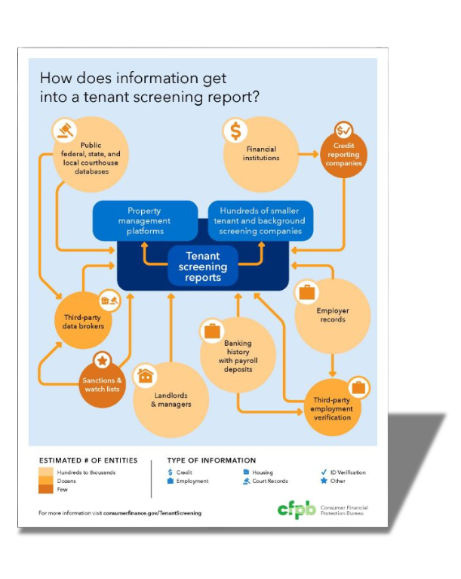

Source: CFPB

Slide 14

As more people experience economic hardships, tenant
screening processes – especially ones that are conducted through AI-based tenant screening products – are locking out millions of people from quality affordable
housing.

Slide 15
The Solution: Tenant Screening Protections
These policies dismantle barriers in housing application processes
  Especially since records tend to be biased, inaccurate, or incomplete.
  22% of eviction records have been found to contain some form of significant inaccuracies.
  They also support landlords and consumer reporting agencies to be in line with fair housing laws.
  Many records (like eviction records) have been used to discriminate against renters who are low-income and/or people of color.
“
“
We need an ecosystem of protections and policies.

Slide 16
The Solution: Tenant Screening Protections
Tenant screening protections can limit the influence someone’s background has on their long-term housing stability by:
  Shielding tenants from the adverse effects of an eviction record by sealing those records.
  Limiting the use of certain information (like eviction records) used by landlords in housing decisions, and/or
  Regulating the use of artificial technologies or algorithmic, tech-backed screening processes which can automate discrimination.
“
“
We need an ecosystem of protections and policies.

Slide 17
The Solution: Three Ways to Protect Tenants
Protection 1
Protection 2
Protection 3
Regulate Landlords
Regulate Tenant Screening Protection Companies
Deny Access to Information
Regulate what screening companies can report.
Regulate which information landlords can use to screen tenants
Prevent information from being collected, sold, and used.

Slide 18

Roadmap for Screening Protections
Fair Housing Basis
Consumer Procedral Protections Lens
Existing policy breaches the Fair Housing Act.
Leverages the Federal Credit Reporting Act

Slide 19
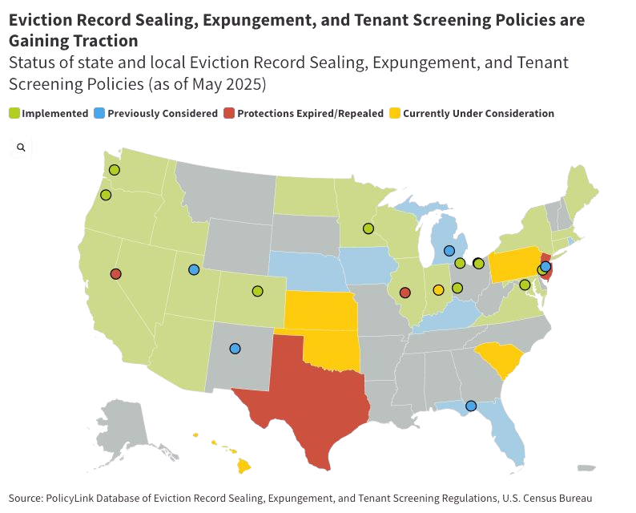
Roadmap for Screening Protections
Federal challenges are real.
● ●
Weakened legal protections Attacks on disparate impact theory
But states and localities are leading the way in tenant screening protections:
● ● ●
12 jurisdictions from 2020-2022 7 jurisdictions from 2023-today 10+ who currently have or had campaigns for tenant screening protections.

Slide 20
Tenant Screening Protections through a Fair Housing Lens
Source of Income
Credit Scores
01
Prohibit landlords or tenant screenings services from using Housing Choice Voucher or other subsidies as a disqualifier.
01
Prohibit landlords and/or tenant screening services from using certain credit scores as a disqualifier.
02
Ban housing denials or added burdens (fees, extra screening) based on source of income. Require acceptance of voucher/nonemployment income.
02
Mandate written, publicly posted screening criteria, and require landlords to accept reliable alternatives (pay stubs, bank statements, vouchers).
03
Require individualized assessments of rental applications, and prohibit automatic denials. Limit consideration to current ability to pay.
Prohibit consideration of missed or late payments if the applicant provides documentation that the amounts were withheld due to poor conditions.
04
State and local protected class, not a federally protected class.
Disparate Impact - federally protected classes.
Requires a local or state ordinance.
State examples.
Requires a local or state ordinance. City and state examples.

Slide 21
Tenant Screening Protections through a Fair Housing Lens
Eviction Records
Criminal Records
01
Prevent screening standards that unduly burden individuals with eviction records.
01
Promotes fairness for people re-entering their communities after engagement in the prison system.
02
Ban housing denials in the presence of eviction records alone.
02
“Ban the Box,” Delay inquiries until after conditional offers, with only relevant, recent evictions allowed; denied applicants given change to explain or provide mitgating information about the record.
03
Limit consideration of eviction records at most to those with a judgment on the merits against the tenant; facilitate sealing and expungement,
Disparate impact - federally protected classes (people of color, women, families with children).
Disparate Impact - federally protected classes (men and women of color).
Requires a local or state ordinance. State example,
Requires a local or state ordinance. City and state exmaples.

Slide 22
Tenant Screening Protections through a Fair Housing Lens
Screening Algorithms & 3rd Party Screening tools
Fee Transparency
01
Mandate Independent bias audits, public disclosure of models, and compliance with HUD guidance.
01
Remove economic barriers to housing.
02
Requiring landlords to verify in leases that they understand that AI services must comply with fair housing.
02
Cap application fees. Require lanlords to disclose screening standards before application is received; applicant not meeting screening criteria triggers refund.
A portable rental application is a standard rental application that includes information such as a background check and credit history, but the application can be reused to apply for multiple rental properties rather than needing to create a new rental application each time. Primarily viewed as a consumer protection tool designed to save tenants money. Strongly linked to fair housing goals by increasing access to housing for lower-income applicants and those in tight markets.
.
03
Disparate impact - federally protected classes - data used by AI is biased.
Facially neutral with discriminatory effect- if it affects federally protected classes more than others.
Requires a local or state ordinance. No examples.
Requires a local or state ordinance. State example.

Slide 23
Tenant Screening Policy Options through Consumer Protection
Right to Dispute Screening Errors | Tenants can correct inaccurate or outdated info in tenant screeing. | Leverages FCRA-like language (e.g. accuracy, notice, appeal) | Ideal in high-rent high-denial areas where renters are hit with repeated fees and denials.
Notice of Adverse Action | Landlords must disclose reasons for denial, including screeing reports. | FCRA notice requirements | Strong fit where credit-style protections exist or where financial transparency laws are popular
Ban on Use of Sealed/Expunged Records | Landlords can’t use sealed evictions in screening decisions, | Mirrors post-bankruptcy or credit rehabilitation policies | Effective where courts or state law already support record-dealing (criminal, financial, civil).
Time Limits on Use & Lookback Period of Eviction Records | Limit eviction record use to 2 -7 years. | Parallels statute of limitations in debt collection, credit reports | Aligns with states limiting negative info in consumer reports and enforcing look-back periods.
Sealing of No-Fault or Dismissed Cases | Automatically seal eviction records if tenant wins or settles favorably. | Procedural justice, similar to vacating or dismissing civil cases | Strong fit where judicial systems support access to justice or court admin rule making (self help friendly courts)
Protection Type
Protection Description
Consumer/Procedural Law Basis
Local or State Context

Slide 24
Tenant Screening Policy Options through on Consumer Protection
Prohitibiting Tenant Scoring Algorithms | Restrict use of opaque algorithmic tenant scores | Consumer protection against automated decision-making (FCRA/AI laws) | Best for states exploring AI regulation or already enforcing algorithmic fairness or explainability laws
Pre Application Disclosure Rights | Tenants see criteria before applying and paying fees | Mirrors consumer rights to clear terms before purchase (TILA) | Ideal in high-rent or high-denial areas where renters are hit with repeated fees or denials
Appeal/Review Process for Denial | Tenants can challenge a denial in writing | Procedural due process / consumer appeal rights, | Works best where there are state or local administrative review bodies
Limits on Public Access to Eviction Data | Bulk eviction data not publicly posted or sold | Data privacy laws | Fits states with strong privacy or data minimization laws and privacy awareness
“Clean Slate” Laws | Record sealing after a set period with no new evictions | Mirrors post-bankruptcy or credit rehabilitation policies | Works well in states already moving toward or considering Clean Slate-style record expungement across sectors
Protection Type
Consumer/Procedural Laws Basis
Protection Description
Strategic Fit Based on Local/Slate Context

Slide 25

Our Goals and New Narratives
Current state of Local Tenant Screening Protections
There are no local tenant screening protections in place. Evictions remain on records Tennessee is a “property rights,” landlord friendly state. Tenants rights are very limited.
Our Goals
To learn about the impact of tenant screening and best practices for designing, implementing, and evaluating tenant screening protections Understand how and in what ways tenants are screened in Knoxville/Knox County and the impact on communities Build relationships with eviction court judges and the courts to explore eviction record sealing options and capacities Connect with Shelby County delegation to compare experiences and explore partnership
Our New Narratives
Values Underlying New Narratives Grace/Forgiveness - appeal to faith Neighborliness/care for each other Deservedness: Housing is a human right Community/Human dignity over profit Livable wages and housing Consumer Protection - transparency and accuracy No permanent government records that hinder housing opportunities

Slide 26




Inclusionary Zoning
Rent Regulations
These programs encourage or require developers to offer some affordable housing for lower income families.
Tenn. Code. Ann. 66-35-102
Local regulations that cap the rate at which owners can increase rents over a period of time.
Tenn. Code. Ann. 66-35-102
Source of Income
Short Term Rentals
Prevent landlords from refusing to rent to people solely because they receive federal assistance. https://www.capitol.tn.gov/Bills/112/Fiscal/HB0593.pdfssistance.
Local regulations have sought to mitigate concerns by restricting the location or concentration of short-term rentals or prohibit them.
Tenn. Code. Ann. 13 -7-603
Preemption
Occurs when a higher level of government limits or removes the authority of a lower level of government.

Slide 27
Timeline for TSP Implementation
Action Steps to Implement TSP | Action Steps to Implement TSP | Action Steps to Implement TSP | Action Steps to Implement TSP | Action Steps to Implement TSP | Deadline
Complete Planning and Material Development (refine coalition, articulate goals, recruit and train tenant leaders for surveys, narrative analysis + development, build social media campaign) | Complete Planning and Material Development (refine coalition, articulate goals, recruit and train tenant leaders for surveys, narrative analysis + development, build social media campaign) | Complete Planning and Material Development (refine coalition, articulate goals, recruit and train tenant leaders for surveys, narrative analysis + development, build social media campaign) | Complete Planning and Material Development (refine coalition, articulate goals, recruit and train tenant leaders for surveys, narrative analysis + development, build social media campaign) | Complete Planning and Material Development (refine coalition, articulate goals, recruit and train tenant leaders for surveys, narrative analysis + development, build social media campaign) | December 2025 (September - December 2025)
Launch Public Education Campaign and Build Relationships with Key Stakeholders (social media campaign started, kick off educational events, meetings with local leaders, hold focus groups with service providers and community members) | Launch Public Education Campaign and Build Relationships with Key Stakeholders (social media campaign started, kick off educational events, meetings with local leaders, hold focus groups with service providers and community members) | Launch Public Education Campaign and Build Relationships with Key Stakeholders (social media campaign started, kick off educational events, meetings with local leaders, hold focus groups with service providers and community members) | Launch Public Education Campaign and Build Relationships with Key Stakeholders (social media campaign started, kick off educational events, meetings with local leaders, hold focus groups with service providers and community members) | Launch Public Education Campaign and Build Relationships with Key Stakeholders (social media campaign started, kick off educational events, meetings with local leaders, hold focus groups with service providers and community members) | April 2026 (December 2025 - April 2026)
Administer Survey (launch the survey online and begin door to door survey, meetings and checks in on progress) | Administer Survey (launch the survey online and begin door to door survey, meetings and checks in on progress) | Administer Survey (launch the survey online and begin door to door survey, meetings and checks in on progress) | Administer Survey (launch the survey online and begin door to door survey, meetings and checks in on progress) | Administer Survey (launch the survey online and begin door to door survey, meetings and checks in on progress) | March 2026 (December 2025 - March 2026)
Participate in Day on the Hill | Participate in Day on the Hill | Participate in Day on the Hill | Participate in Day on the Hill | Participate in Day on the Hill | February 2026
Conduct Survey Analysis (analysis and collective sensemaking, designing visualizations) | Conduct Survey Analysis (analysis and collective sensemaking, designing visualizations) | Conduct Survey Analysis (analysis and collective sensemaking, designing visualizations) | Conduct Survey Analysis (analysis and collective sensemaking, designing visualizations) | Conduct Survey Analysis (analysis and collective sensemaking, designing visualizations) | May 2026 (March - May 2026)
Develop and Disseminate Report and Policy Brief (complete and publish report, meetings with local leaders and community members, meetings with state reps and senators, share results through social media campaign) | Develop and Disseminate Report and Policy Brief (complete and publish report, meetings with local leaders and community members, meetings with state reps and senators, share results through social media campaign) | Develop and Disseminate Report and Policy Brief (complete and publish report, meetings with local leaders and community members, meetings with state reps and senators, share results through social media campaign) | Develop and Disseminate Report and Policy Brief (complete and publish report, meetings with local leaders and community members, meetings with state reps and senators, share results through social media campaign) | Develop and Disseminate Report and Policy Brief (complete and publish report, meetings with local leaders and community members, meetings with state reps and senators, share results through social media campaign) | August 2026 (May - August 2026)
Identify Policy and Begin Drafting Legislation (debrief with tenant leaders and coalition on next policy push, generate ideas based off of what we learned in survey and education, begin drafting legislation) | Identify Policy and Begin Drafting Legislation (debrief with tenant leaders and coalition on next policy push, generate ideas based off of what we learned in survey and education, begin drafting legislation) | Identify Policy and Begin Drafting Legislation (debrief with tenant leaders and coalition on next policy push, generate ideas based off of what we learned in survey and education, begin drafting legislation) | Identify Policy and Begin Drafting Legislation (debrief with tenant leaders and coalition on next policy push, generate ideas based off of what we learned in survey and education, begin drafting legislation) | Identify Policy and Begin Drafting Legislation (debrief with tenant leaders and coalition on next policy push, generate ideas based off of what we learned in survey and education, begin drafting legislation) | August 2026 (July - August 2026)

Slide 28
Our Future Tenant Screening Protection Policy | Our Future Tenant Screening Protection Policy
Policy Focus | Eviction record sealing
Policy Vehicle | Court Rule Change (administrative)
Data + Evidence | AJRC Report, KnoxHMIS Community Dashboard, now defunct Knox Housing Assistance Dashboard, Rental Properties spreadsheet demonstrates the need for a rental property registry, qualitative data from interviews, focus groups, and surveys
Coalition | Community Organizers + Tenants (SOCM, Justice Knox, Knoxville Area Tenants Union), Service Providers (Bridges Refugees, Knoxville-Knox County Community Action Committee) Public Housing Authority, Legal Aid, Researchers (University of Tennessee, Knoxville) Still Need: City and County Government, the Court, Landlords, Property Managers
Local Strategic Fit | Have a relationship with the eviction court and presence Knox County has “problem solving courts,” and a culture that is open to creative solutions Diverse coalition with a depth of experience and expertise in eviction prevention, housing, social services, and organizing
Target Implementation Date | Draft policy by September 2026 with effective by March 2027
Reference Jurisdiction(s) | Idaho, Utah, California, Texas (eviction record sealing) Nashville, TN and Miami-Dade County (landlord registration), Lawrence, KS (data transparency)

Slide 29
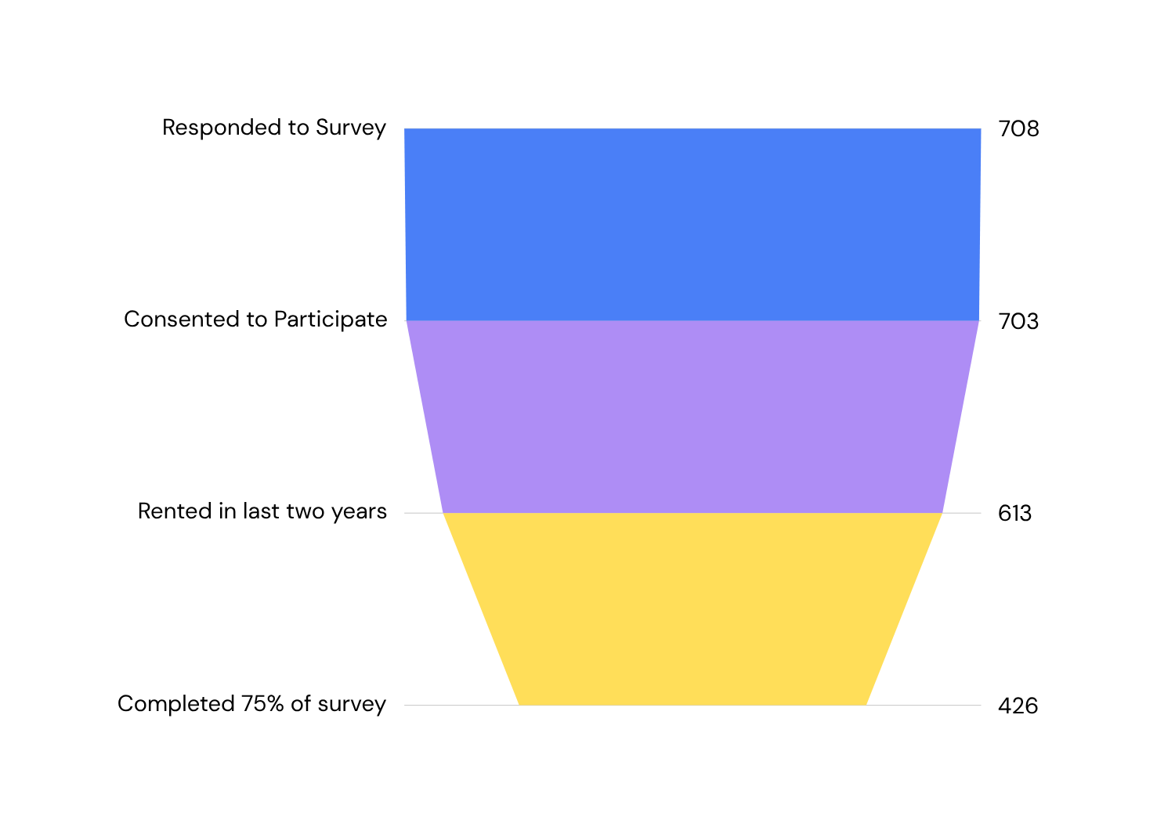
Who did we reach?
A total of 708 Tennessee residents responded to the survey with 426 in the final dataset

Slide 30
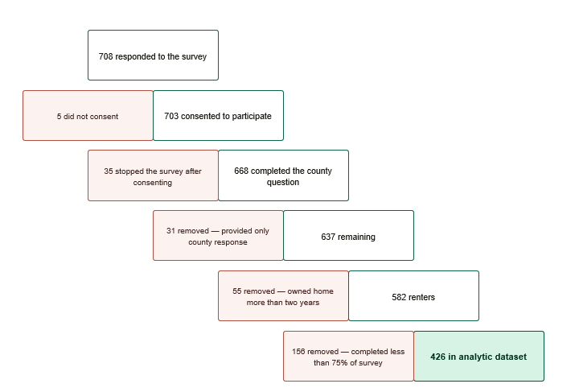
Who did we reach?
A total of 708 Tennessee residents responded to the survey with 426 in the final dataset

Slide 31
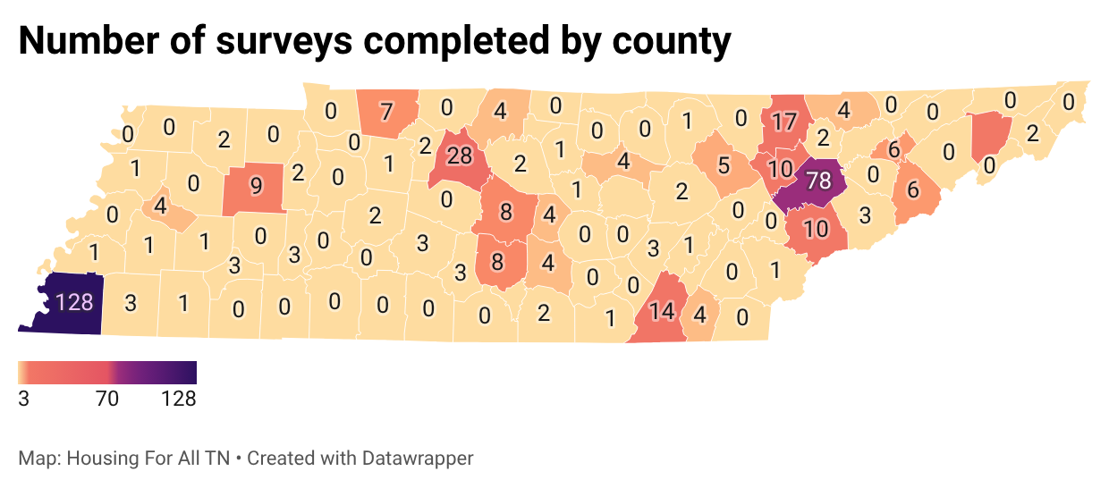
Who did we reach?
Of the 426 respondents, the majority lived in Shelby, Knox, and Davidson Counties, with respondents living in 51 counties across the state.

Slide 32
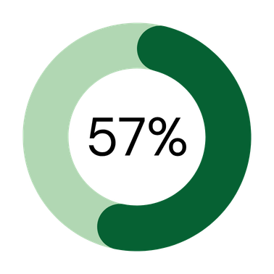
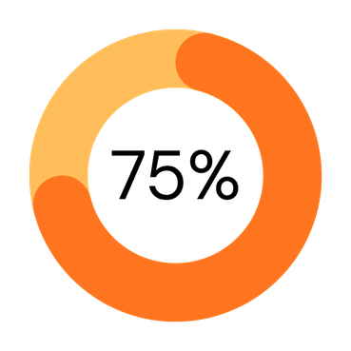
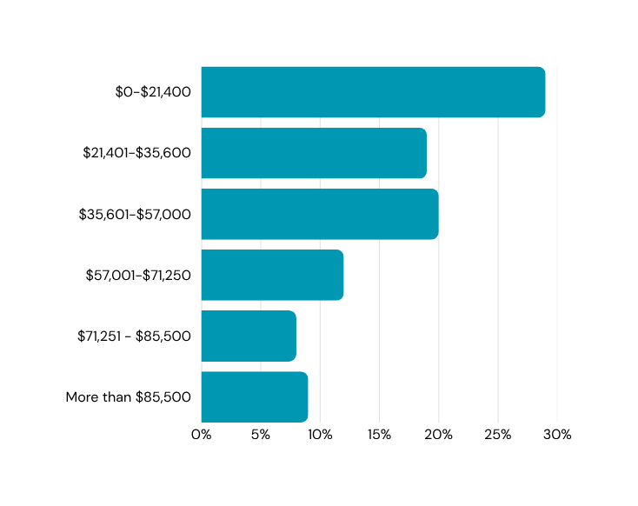
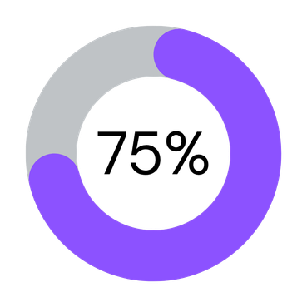
Of the 426 respondents...
Rent an apartment
identify as women
are employed: full-time, part-time or seasonally
Most are lower income

Slide 33
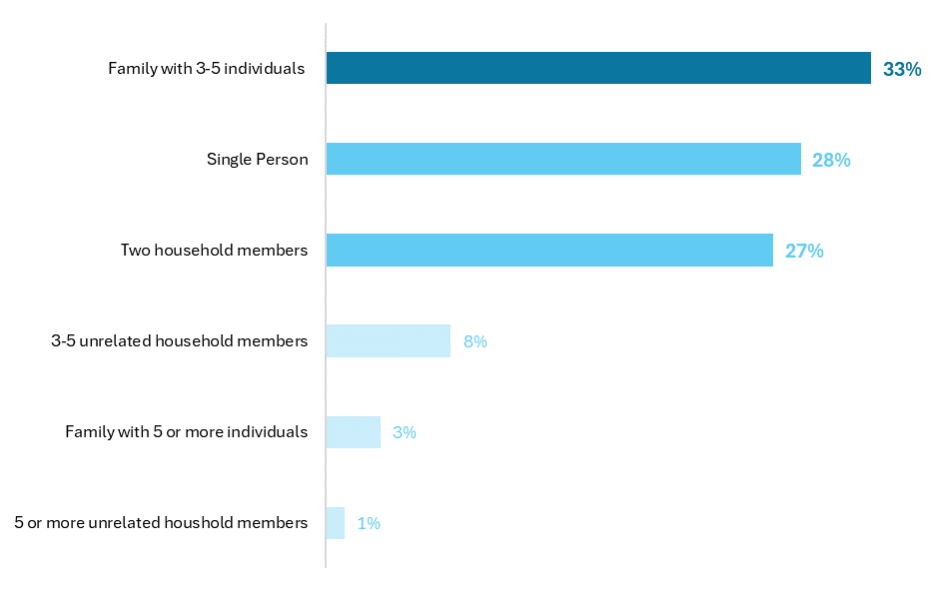
Most respondent households are small
Roughly a third of households are 3-5 family members
hi

Slide 34
Most respondent households are small
About a quarter live in single person households and another quarter in two person households
hi

Slide 35
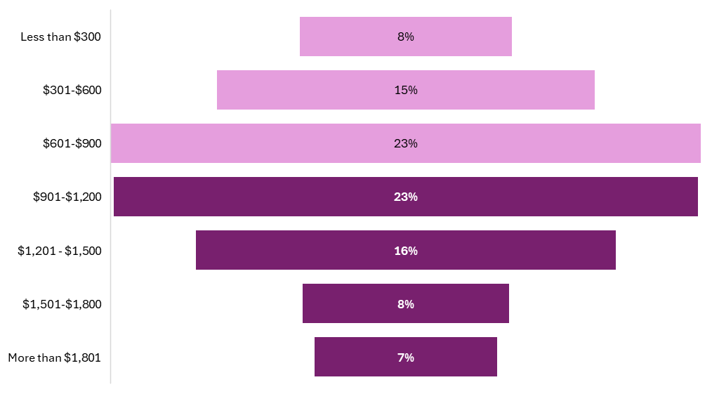
More than half respondents pay more than $900 a month in rent

Slide 36
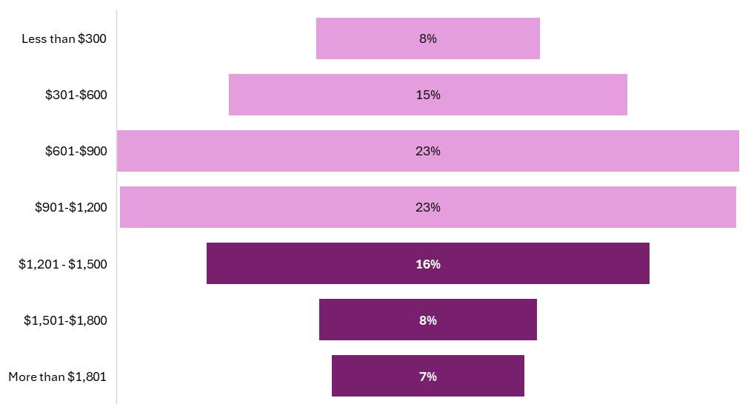
More than half respondents pay more than $900 a month in rent
A third of renters pay more than $1,200 a month in rent

Slide 37
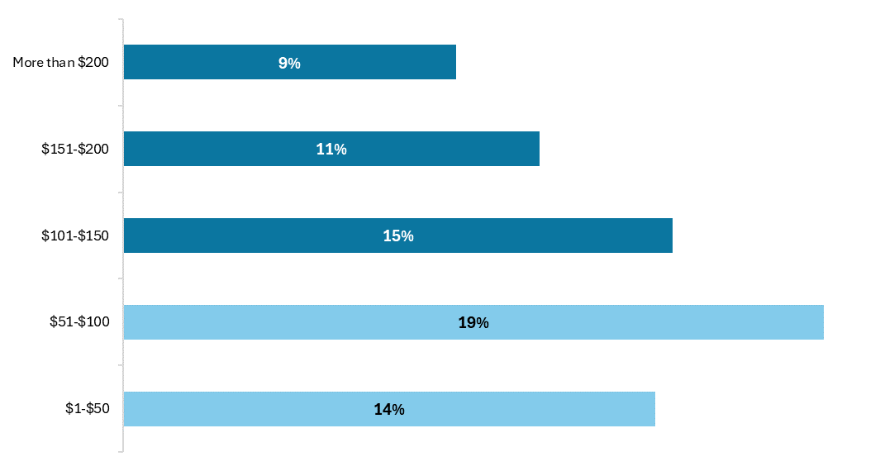
69% of respondents reported an increase in rent in the last 24 months
Half of all rent increases were for $100 or more a month, with the most common being between $50-$100

Slide 38
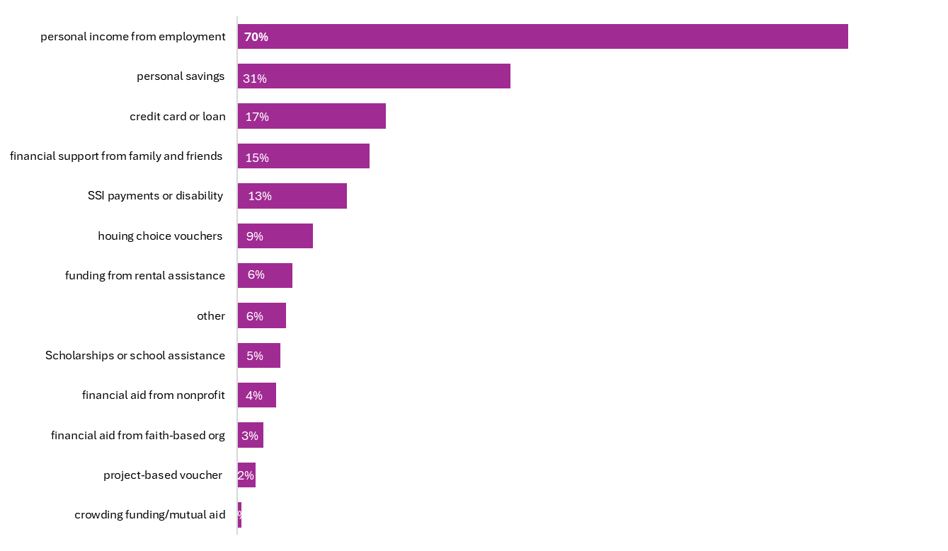
Most respondents pay rent using personal income from employment
But nearly half report paying rent with savings (31%) or debt (17%)

Slide 39
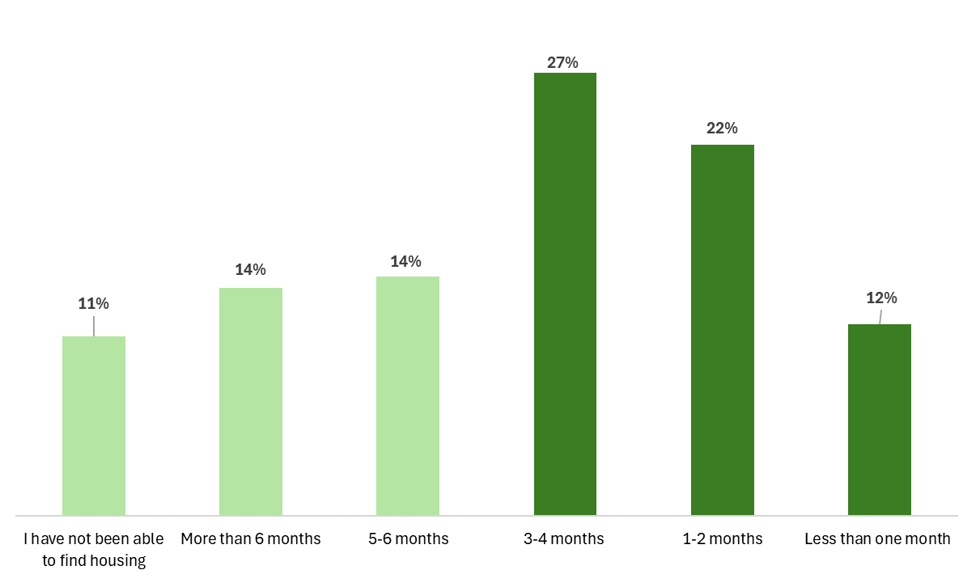

Of the 137 of respondents who applied to a new property in the last 24 months...
61%
The majority found housing within 4 months.

Slide 40
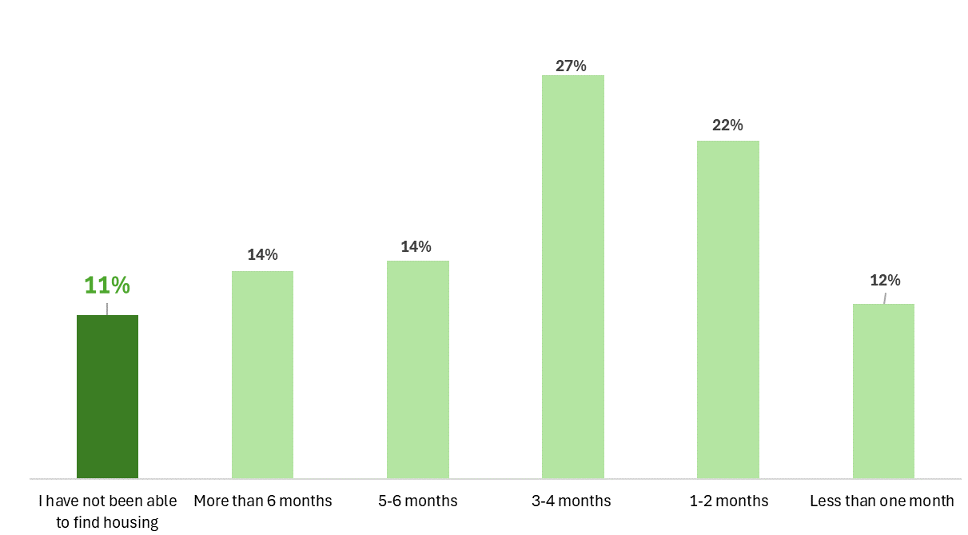
Of the 137 of respondents who applied to a new property in the last 24 months...
11% of respondents have been unable to find housing
Two biggest barriers are:
  lack of available rentals
  lack of affordable rentals

Slide 41
What would make renting better in Tennessee?
“We need more affordable rent cost, application fees, move in costs
“ Give a person a second chance...
“The cost of rent
is too high”
“Have big conglomerates get out owning housing and rental units.”
“There should be inspections on rental properties ...”

Slide 42

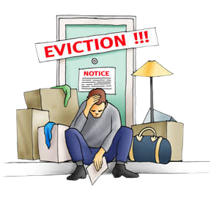
“The Scarlet E” prevents families from finding good, stable housing.
Federally, screening companies are supposed to stop recording evictions after 7 years – but who knows if that happens?
We’ve tracked eviction sealing bills in states across the country – including Republican-dominated states.

Slide 43

Relections
&
Questions
1.
It will still take a while to finish collating survey results.
2.
  Questions
    Where are there gaps in the data? Do we want to work together to fill them?
    How can we present this data to communities?
    How do we shift from a Knox/Shelby project to a statewide project?
3.
We don’t have enough information yet for a comprehensive platform.
4.
We’ve had really good response to an eviction sealing bill, and there’s reason to believe this group could pass something meaningful in 2027

Slide 44

Questions to Answer in Developing a Bill
01
Sealing vs expungement?
02
Automatically, or with a judicial process?
03
Requirements to qualify for sealing?
04
Judgments vs fililngs?
05
What length of time?

Slide 45

August 26, 2026
www.housingforalltn,org
Info@housing4alltn.org
Thank You!
A Campaign to Increase Access to Stable, Affordable Housing

