Slide 1

Behind Both Bars: How the Service Industry Trains Public Interest Advocates
Anne Boatner & Maggie Behringer
Renters’ Rights of Tennessee
1

Slide 2
Outline
  Introduction
  Naming the skills
  Training the skills
  Ethical Considerations
  Questions
2
Notes:
pics? lol

Slide 3
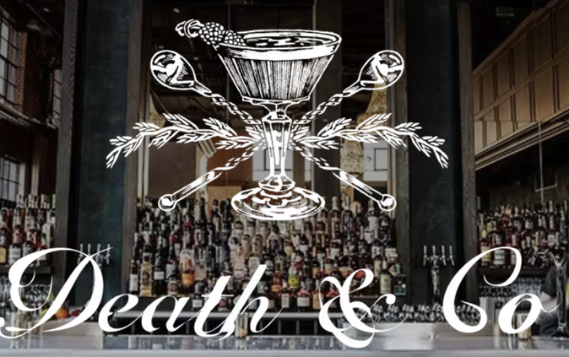

Introduction
Anne
  15 years of service industry experience in Tennessee, New York & Washington, D.C.
  Second place, Mid Atlantic Regional Barista Championships
  Co-opened Brooklyn College Coffee, a student-run, collectively-managed campus coffee shop
  Returned to service industry after law school
Maggie
  Coffee, bar, fine dining, and event experience in Tennessee, Boston, New York, West Virginia, Denver, and Los Angeles.
  General Manager of Main Street Meats in Chattanooga
  FOH and Events Manager at Death & Co Denver before and during COVID
  Ran a Summer Supper Club in her home during law school in LA
3
Notes:
pics? lol

Slide 4





Naming the Skills
Teamwork
Education
Communication
Expectation
Management
Compartmentalization
4

Slide 5
Teamwork
  mandatory for small teams or in high volume, high impact, or high stress workplaces
  creates safe workplaces that promote creativity, efficiency, and better problem solving
  can be difficult to identify and center the shared goal in a way that resonates with everyone
working collaboratively to achieve a shared goal
  Use language that reflects your commitment to collaboration
  Build trust by modeling the behavior you want to see
  Regularly audit your organizational systems & structure to remove obstacles
  Proactively define every role on the team
  Clearly explain how each member of the team contributes to the shared goal
5

Slide 6
Communication
  clear, proactive communication prevents resentment, confusion & inefficiency
  over-reliance on body language, eye contact & facial expression in the workplace inhibits comprehension
  we’re all human; workplace communication can’t exclusively be about work
what to say to your team & how to say it
  Clearly explain expectations about workplace communication
  Address problems quickly, compassionately & proactively
  Respect the diversity of communication styles, preferences & needs
  Build trust by modeling proactive, clear, and compassionate communication
  Create space for honest reflection, genuine conversation, & organic team bonding
6

Slide 7
Education
  effective education increases buy-in, participation, and overall satisfaction
  requires navigating imbalances in knowledge & power to effectively--& sometimes strategically or persuasively--share information & concepts
  plain language is hard to notice when you’re in a bubble
how to share information with clients, customers & other external parties
  Share, but don’t mandate, scripts and sample language
  Periodically observe client interactions to identify what works & what does not
  Make space to discuss those observations individually or in small groups
  Practice explaining complicated concepts to people outside your own bubble
  Encourage formal and informal learning opportunities
7

Slide 8
Compartmentalization
  a thoughtful duality creates a healthy work life balance, prevents burnout, & encourages team member autonomy
  genuine & comfortable client connections still flourish with provider boundaries
  a more system-adverse perspective can generate longer-term buy-in
how to both do the job
& care for yourself
  Demonstrate your own armor
  Communicate openly about how & why this aligns with the organization’s goals
  Coach team members as they navigate what works & what doesn’t
  Periodically observe to ensure client support remains a priority
  Provide the safe space within the team environment to emote when needed
8

Slide 9
Expectation Management
  they say the best defense is a good offense
  clear but flexible expectations within a team facilitate better client interactions & case outcomes
  pairs with and supports the work done around well defined roles and team-wide knowledge
handling internal &
external pressures
  Embrace the joy of the pivot
  Encourage individuals to develop their own systems within the larger framework
  Model how to deliver hard communications with empathy
  Practice the compliment sandwich
  Reiterate support & accountabily in regular one on ones
9

Slide 10
The Ethics of Training Soft Skills
It’s delicate.
Be direct & follow through.
  Acknowledge the inherent challenges of “soft skills”
  Center training on the team members’ needs
  Link those skills to professional integrity
  Rely on the big three: clear expectations, modeling, and auditing
  Leave room for alternations and adjustments along the way
10

Slide 11
Questions?
i
11

