Slide 1
Closer to the Truth
Indicators of Deceptive Behavior & Credibility Signals for Lawyers
By Juan Ibarra, Mediate USA, Inc.
Part 1 of a Credibility-to-resolution Series
Notes:
Image source: AI-generated

Slide 2
Agenda
• Fears and Consequences
•Unintended Messages
• Perception vs Perspective
• Elicitation vs. Interrogation: Asking Questions That Reveal Details
• Indicators of Deception
• Logical Reasoning in Credibility Assessment
• Case Examples and Interactive Q&A
Notes:
Image source: AI-generated

Slide 3
Gains
Attorneys learn how fear and consequences changes memory, language, and cooperation—and how to reduce threat so clients/witnesses disclose truthful statements early.

Slide 4


Slide 5
Interactive Poll: Fears and Consequences
What do you do and feel when driving on a road or freeway and you see a police car in your rearview mirror?
– Without knowing, you take your foot off the gas pedal?
B) – Look down at your Speedometer?
C) – Put your phone down?
D) – Wondering if you are going to be pulled over and how you’re going to explain to your spouse?
E) – All of the above

Slide 6

Fears and Consequences

Slide 7
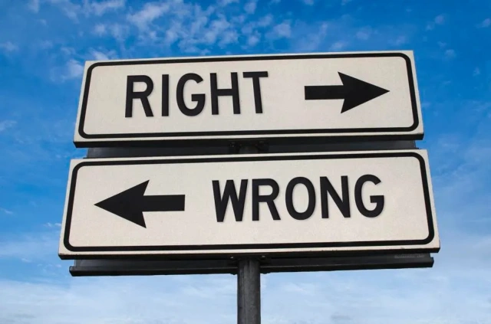
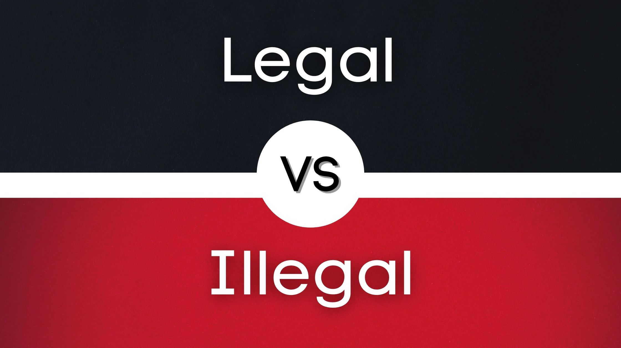
RIGHT VS WRONG
LEGAL VS ILLEGAL

Slide 8
Optimism Bias
“Occurs when a person believes that an activity they are engaged in carries less risk for themselves than it does for another person who engages in the same activity or that they stand a higher chance of a reward.
This bias optimism can lead people to engage in risky behavior because they are convinced they won’t be caught, hurt, killed, or victimized by some other negative consequence.” – Get the Truth and Qverity.com
Notes:
Then you deal with people with Optimism Bias
Big picture, Optimism Bias leads to very risky behavior.
Example 1 – The supervisor who is known for not hiring women in higher paying positions, instead hiring men who do not have any experience or do not have the required degree as the women do.
Example 2 – Threat of Polygraph use and direct evidence leading to settlement for CP.
Lets look at some examples of Optimism Bias on next pages

Slide 9
CONFIRMATION BIAS
Confirmation Bias – “The tendency of people to believe information that confirms their expectation or preconceptions.” (Phil Houston – Get the Truth)
Examples:
Seeking out information that fits our preconceived notion of how something should be ignoring evidence to the contrary.
Interpret a piece of information in a way that suits our view.
Or we may hang on to a particular view even after all the evidence points us in a different direction.
If you do not put your biases aside, we’re easily inclined to form an initial impression and subconsciously seek out any information that CONFIRMS that impression often in the presence of contradictory information or evidence.
Ways to stay away from it: stay neutral
Hear both sides -
DOCUMENT – Take detailed notes!
Must consider all facts including ones that do not comport with your own policies and beliefs.

Slide 10
Unintended Messages
Truth in the lie
Not intentional; happening unexpectedly or by accident; without realizing it, deceptive people express a revealing message in the words they choose to articulate the lie.
Stress responses
High-stakes moments can trigger increased blinking, micro expressions, Dry mouth, perspiration, and voice-pitch shifts.
Avoidance behaviors
Looking away, reduced eye contact, failure to answer the questions, or physical withdrawal may signal discomfort or deception.
Incongruent actions
When words don’t match body language, it often points to uncertainty or dishonesty; neuroscience supports these cues under pressure.
Notes:
Image source: AI-generated

Slide 11
Perception vs Perspective
Notes:
Distinguishing Facts From Assumptions During Witness Evaluation, Methods for Testing a Story’s Internal Consistency, Group Poll: Which Reasoning Strategy Do You Use Most Often? (A) Chronological Review, (B) Fact Verification, (C) Cross-Examination, (D) Pattern Analysis, (E) All of the Above

Slide 12
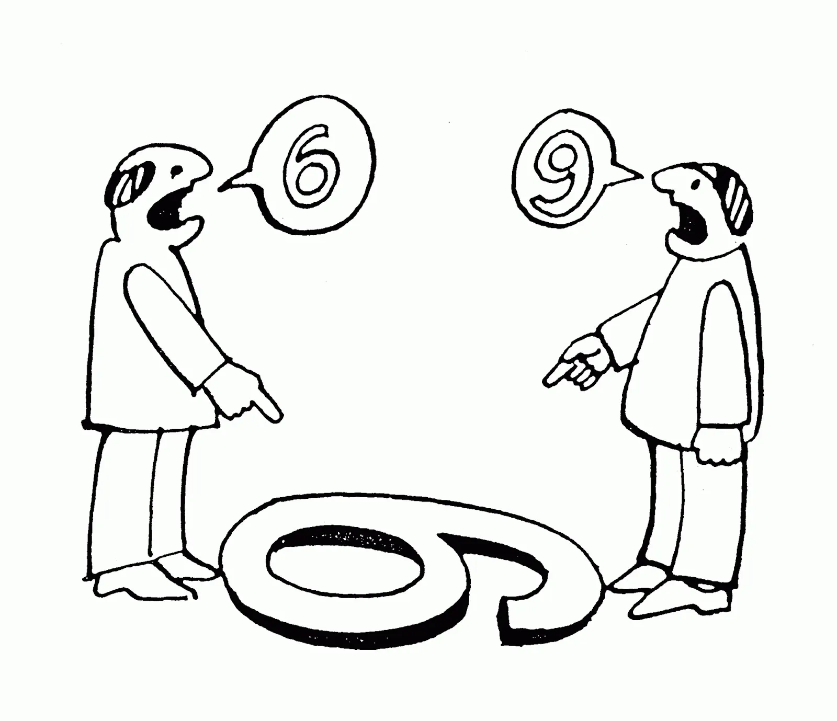
Perception is your interpretation of the world around you.
Perception is unique only to you
  People become argumentative trying to convince other people of their own perspective.
  They stay trapped in their own perception unable to think about a different perspective.
Perspective is the art of observing the world from outside of yourself.
Perception is unique only to you

Slide 13
Perspective VS Empathy
Empathy is about feeling and understanding what other people feel.
Perspective is deeper, it’s understanding more than feelings, but with logic.
Validating a person’s world builds immense trust and it can aid you in seeking more information, persuading, motivating, and building trust.

Slide 14
Elicitation vs. Interrogation

Slide 15
Interactive Poll: Preferred Questioning Style
There are many different questioning styles used among legal professional. Which do you use the majority of the time?
– Direct?
B) – Indirect?
C) – Leading?
D) – Open ended?
E) – All of the above
Notes:
Questioning style preferences vary widely among legal professionals, reflecting differences in case context and personal interviewing style. Direct questions are clear but may provoke defensiveness, while indirect and open-ended questions elicit richer narratives. Leading questions can bias answers but may be strategic in certain scenarios. Polling provides insights into current practitioner trends and guides training focus toward more effective elicitation methods.

Slide 16
Elicitation vs. Interrogation
Indicators ≠ Proof
Elicitation encourages subjects to share information willingly, reducing resistance compared with direct interrogation.
Look for clusters, not single tells
In legal contexts, rapport-building can increase truthful disclosures by lowering defensiveness and promoting cooperation.
Use Indicators to guide follow-up, not accuse
Research indicates elicitation yields richer, more reliable details, often surfacing inconsistencies that direct questioning can miss.
Notes:
Elicitation is a subtle technique focused on encouraging the subject to reveal information voluntarily, reducing resistance often found in direct interrogation. In legal settings, elicitation helps build rapport and trust, which can lead to more truthful disclosures. Research shows elicitation leads to higher quality information because it minimizes defensive reactions and allows facts to emerge naturally, frequently revealing inconsistencies that direct questioning may miss.
Image source: AI-generated

Slide 17
Typical Signs of Fear During Questioning
Sweating
Shortness of breath
Dry mouth and lips
Rapid heart rate
Feeling overwhelmed
Nausea
Word finding
Feeling out of control
Crying
Anxiety
Sense of impending doom
Selective memory
Stuttering
Itchy skin

Slide 18
Responses to Deceptive Behaviors
Four practical pillars for calmer, higher-quality interviews.
Challenge Inconsistencies
Calmly address contradictions to prompt clarification without aggression.
Employ Silence
Use strategic pauses to encourage elaboration or self-correction.
Redirect Questions
Shift to specific details to increase verifiable, truthful responses.
Maintain Neutrality
Avoid emotional reactions to prevent escalation and protect interview integrity.
Notes:
Image source: AI-generated

Slide 19
Encouraging Detail, Reducing Defensiveness
Clarification
Trust, but verify. If it doesn’t add up, tell them. Be aware of your own body language.
Active Listening
Signals genuine interest, building trust so subjects share more comfortably.
Strategic Pauses
Gives time to think; silence often prompts added, unprompted detail.
Notes:
Image source: AI-generated

Slide 20
Indicators of Deception
Evasion, manipulation, aggression, persuasion • live poll
Notes:
Common Verbal Signals: Evasive Answers, Manipulative Statements, Aggressive Tone, and Persuasive Language, Effective Responses to Deceptive Behaviors in Legal Interviews, Audience Scenario: Identify the Verbal Indicator in Sample Statements (Live Poll)

Slide 21
Interactive Poll: Which of the following would lead you to believe the individual is acting and or responding deceptively? Which reaction cue(s) would you notice?
Choose all that apply.
A) – Avoiding eye contact (looking up or down or towards the right or left)
B) – Contradictory/Inconsistent Statements
C) – Fidgeting (scratching skin, dry mouth,
D) – Defensive posture
E) – Convincing statements
F) – All of the above
Notes:
This exercise engages attendees to prioritize attention to various reaction cues, reinforcing observation skills crucial in detecting deception. Research suggests that while some cues like eye contact avoidance are commonly noted, less obvious signals such as contradictory statements often provide stronger evidence. Combining participant choices with expert analysis fosters deeper understanding of cue salience.

Slide 22
Indicators of Deception
01
Evasion
Avoiding direct answers to questions
02
Persuasion
Differentiation between convincing and conveying information
03
Aggression
Hostile responses that may signal dishonesty.
04
Reaction
Inconsistent or delayed emotional responses.
05
Manipulation
Attempts to control or influence through deceit.
06
Behavior Cautions
Noticing Unusual or suspicion behaviors.
Notes:
Testing internal consistency involves chronological review, cross-checking event details, and identifying contradictions within narratives. Research shows that liars often produce inconsistent temporal or contextual elements, while truthful accounts maintain coherence even under stress. Tools such as statement analysis software and pattern recognition further enhance detection of discrepancies in witness accounts.

Slide 23

CAUTION
Detecting deceptive indicators doesn't mean accusing the interviewee directly.
Identifying deception signals means further investigation is necessary.
Mark or circle statements that elicited reactions for follow-up.
Rephrase and ask questions multiple times to clarify responses.
Test and verify information with follow-up interviews.
Notes:
This slide emphasizes the importance of careful handling when potential deception is detected during interviews. Instead of direct confrontation, investigators should use the indicators as leads for further inquiry. Marking responses that trigger reactions and asking questions in varied ways helps to uncover truth. Follow-up interviews and verification are essential steps to validate findings and build a reliable picture.

Slide 24

You’re in control
01
STOP
Raise your hand to pause the situation.
02
First Names
Use their first name to personalize communication.
03
Redirection
Redirect the conversation to maintain focus.
04
Perspective
Acknowledge their emotions to show understanding.
05
Save Point
Go right back to where you left off after interruptions.
06
Cooperation
Reward cooperation by acknowledgment to encourage positive behavior.
Notes:
Testing internal consistency involves chronological review, cross-checking event details, and identifying contradictions within narratives. Research shows that liars often produce inconsistent temporal or contextual elements, while truthful accounts maintain coherence even under stress. Tools such as statement analysis software and pattern recognition further enhance detection of discrepancies in witness accounts.

Slide 25
Logical Reasoning in Credibility Assessment
Notes:
Distinguishing Facts From Assumptions During Witness Evaluation, Methods for Testing a Story’s Internal Consistency, Group Poll: Which Reasoning Strategy Do You Use Most Often? (A) Chronological Review, (B) Fact Verification, (C) Cross-Examination, (D) Pattern Analysis, (E) All of the Above

Slide 26
Facts vs Assumptions in Witnesses
Distinguishing facts from assumptions
Effective credibility assessment hinges on differentiating objective facts from subjective assumptions or hearsay. Psychological studies reveal that witnesses often interweave memory with conjecture, making critical evaluation essential. Investigators and legal professionals employ techniques such as repeated questioning and corroboration with physical evidence to isolate factual information, thereby reducing bias and error in testimony analysis.
Detailed guidance matters
Presenting detailed guidelines and examples helps emphasize the complex process of parsing factual from assumed information.
Guidelines for credibility evaluation
Notes:
Effective credibility assessment hinges on differentiating objective facts from subjective assumptions or hearsay. Psychological studies reveal that witnesses often interweave memory with conjecture, making critical evaluation essential. Legal professionals employ techniques such as repeated questioning and corroboration with physical evidence to isolate factual information, thereby reducing bias and error in testimony analysis.
Image source: AI-generated

Slide 27
Real-World Deception & Credibility
Common deceptive behaviors
Inconsistent storytelling, cognitive overload, and verbal–nonverbal mismatch often surface in sworn testimony.
Credible signals
Detailed sensory recall and a consistent emotional tone align more reliably with truthful accounts.
Practical takeaway
Combining subtle cues with logical evaluation beats isolated “tell” hunting;
Notes:
Analyzing case studies from actual legal proceedings highlights common deceptive behaviors such as inconsistent storytelling, cognitive overload, and verbal-nonverbal mismatch. Conversely, credible signals include detailed sensory descriptions and consistent emotional tone. Case examples offer concrete lessons, showing how subtle cues combined with logical evaluation outperform isolated detection techniques.
Image source: AI-generated

Slide 28
Case Examples and Interactive Q&A
Notes:
Real-World Examples of Deceptive Behavior and Credible Signals, Audience Participation: Analyze Scenarios and Share Strategies, Live Question and Answer Session with Partner Feedback

Slide 29
Conclusion: Legal Insight Through Credibility
Recognize deception patterns
Identify deceptive behaviors by combining elicitation techniques with verbal and reaction cues.
Assess credibility logically
Use structured reasoning to test consistency, plausibility, and evidentiary fit during interviews.
Strengthen investigations
Apply the real-world examples to navigate complex interviews and make informed decisions.
Practice with intention
Build these skills into preparation, questioning, and post-interview review for better outcomes.
Notes:
This presentation has explored key strategies for recognizing deceptive behaviors and assessing credibility in legal contexts. By understanding elicitation techniques, verbal and reaction cues, and logical reasoning, lawyers can improve their investigative effectiveness. Applying these insights with the real-world examples discussed will empower legal professionals to better navigate complex interviews and make informed decisions.

Slide 30
Interactive Poll: Follow-Up
What would be most valuable in a follow-up session?
– Selling risk / creating settlement movement
B) – Navigating impasse and closure tools
C) – Advanced elicitation drills (deposition/investigations)
D) – Managing emotions under pressure
E) – Statement analysis / written credibility
F) – All of the above

Slide 31
Live Q&A
Notes:
Live Q&A sessions provide opportunity for clarification, deeper inquiry, and personalized feedback from experts, consolidating knowledge gained. Partner feedback during Q&A fosters collaborative growth, allowing professionals to refine questioning and detection methods based on real-time critique and encouragement.

Slide 32
Sources
Spy the Lie – Phil Houston
Get the Truth – Phil Houston
Qverity.com
Getting to Yes – William Ury
Getting Past No – William Ury
Tennessee Rule 31 Civil Mediation – Lipscomb University Institute for Conflict Management – Tracy Allen
Emotional Intelligence – Daniel Goleman
Never Split the Difference – Chris Voss
Perception vs Perspective – Andrew Bustamante
The Art of Listening – Simon Sinek
Merriam-Webster Dictionary
Notes:
Engaging the audience in analyzing hypothetical or anonymized cases encourages application of learned concepts. Sharing strategies promotes diversity of approach and reveals best practices in interpreting deception and credibility signals. Peer feedback enriches understanding by exposing participants to varied perspectives and techniques.

