Slide 1

Where Insight Meets Influence

Slide 2
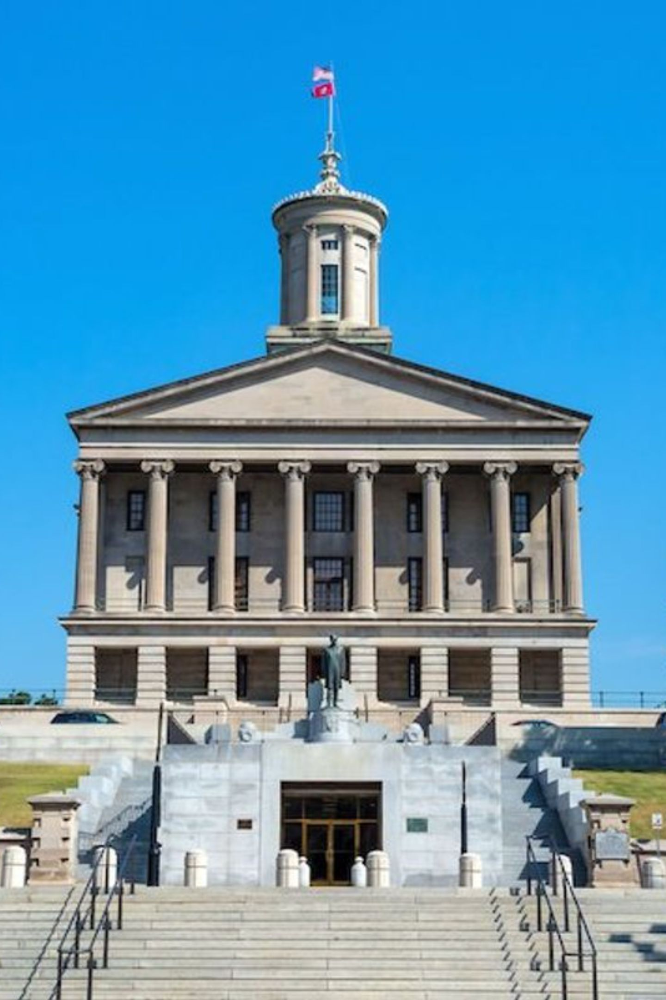
2026 Legislative Update
August 27, 2026

Slide 3
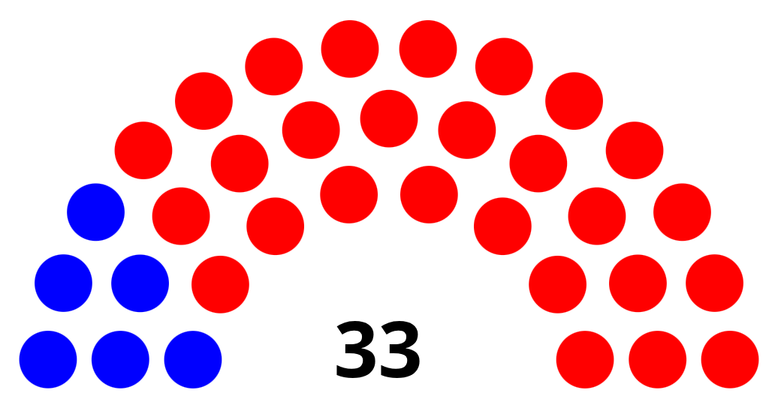

The Tennessee General Assembly
Tennessee Constitution
The Members
Created under Article II, Section 3 of the Tennessee State Constitution. Legislative authority is vested in the General Assembly, comprised of a Senate and a House of Representatives, both popularly elected. Elections are held every two years in November of even-numbered years.
Senate
House
33 Members - Elected to four-year terms
99 Members - Elected to two-year terms

Slide 4
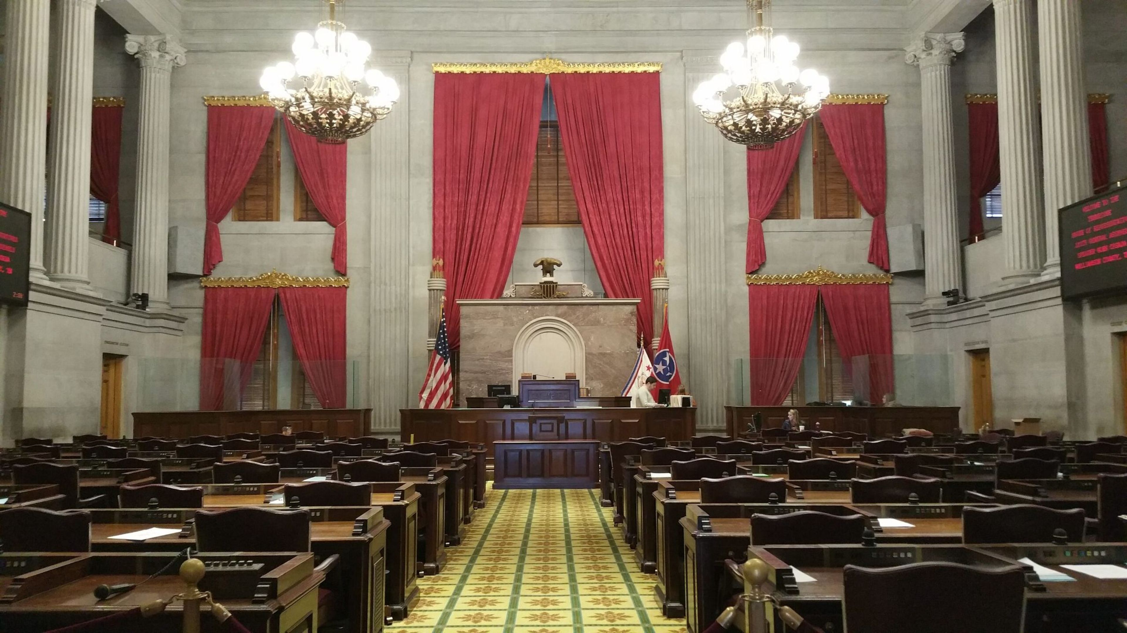
Function of the Legislature
The Tennessee General Assembly's function is to enact, amend, and repeal the laws of Tennessee.
Lawmaking
Appropriations
Taxation
Introduce, debate, amend, and pass legislation governing Tennessee residents and institutions
Authorize all money paid from the state treasury and direct general fund expenditures
Levy and collect taxes; authorize counties and municipalities to do the same
Balanced Budget
Constitutional Requirement — the legislature must pass a balanced budget each year

Slide 5

The State Budget
Each year, the single piece of legislation the General Assembly is constitutionally required to pass is a balanced state budget. The budget bill appropriates all funds to be spent by state government and reflects the legislature's priorities.
Governor Proposes
The Governor submits a budget proposal to the General Assembly at the start of session, outlining recommended spending priorities for the fiscal year.
Legislature Appropriates
The House and Senate Finance Committees review the budget proposal, hold hearings, and ultimately the chambers pass the appropriations bill that becomes law.
Must Balance
The Tennessee Constitution mandates a balanced budget.

Slide 6
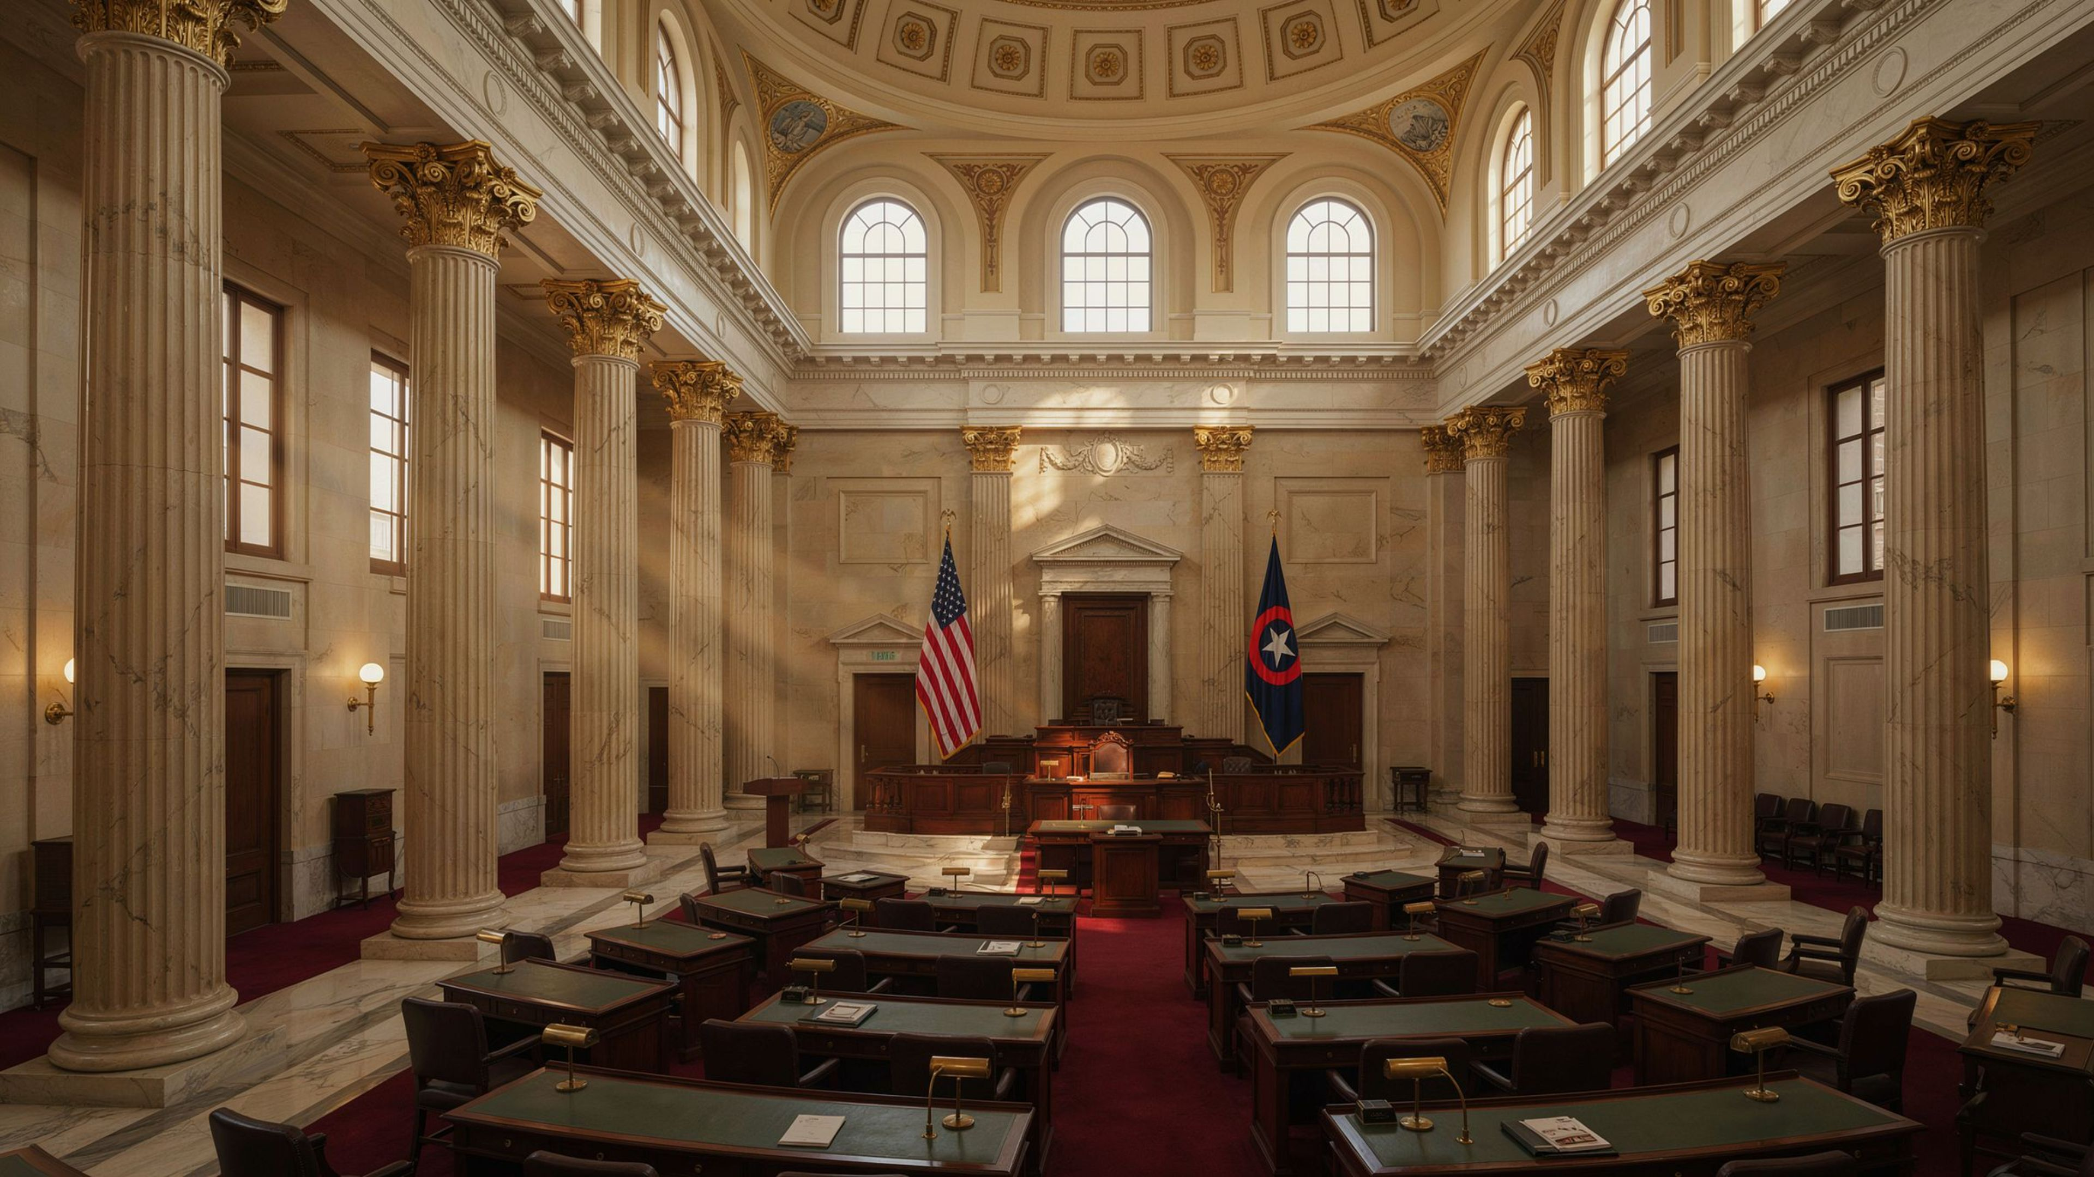
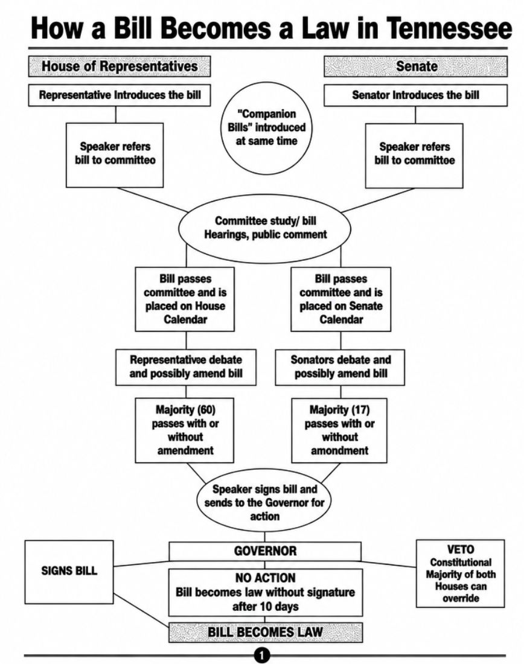
Golden Rule:
For a bill to become a law, it must pass both the House and Senate in the same exact form.

Slide 7
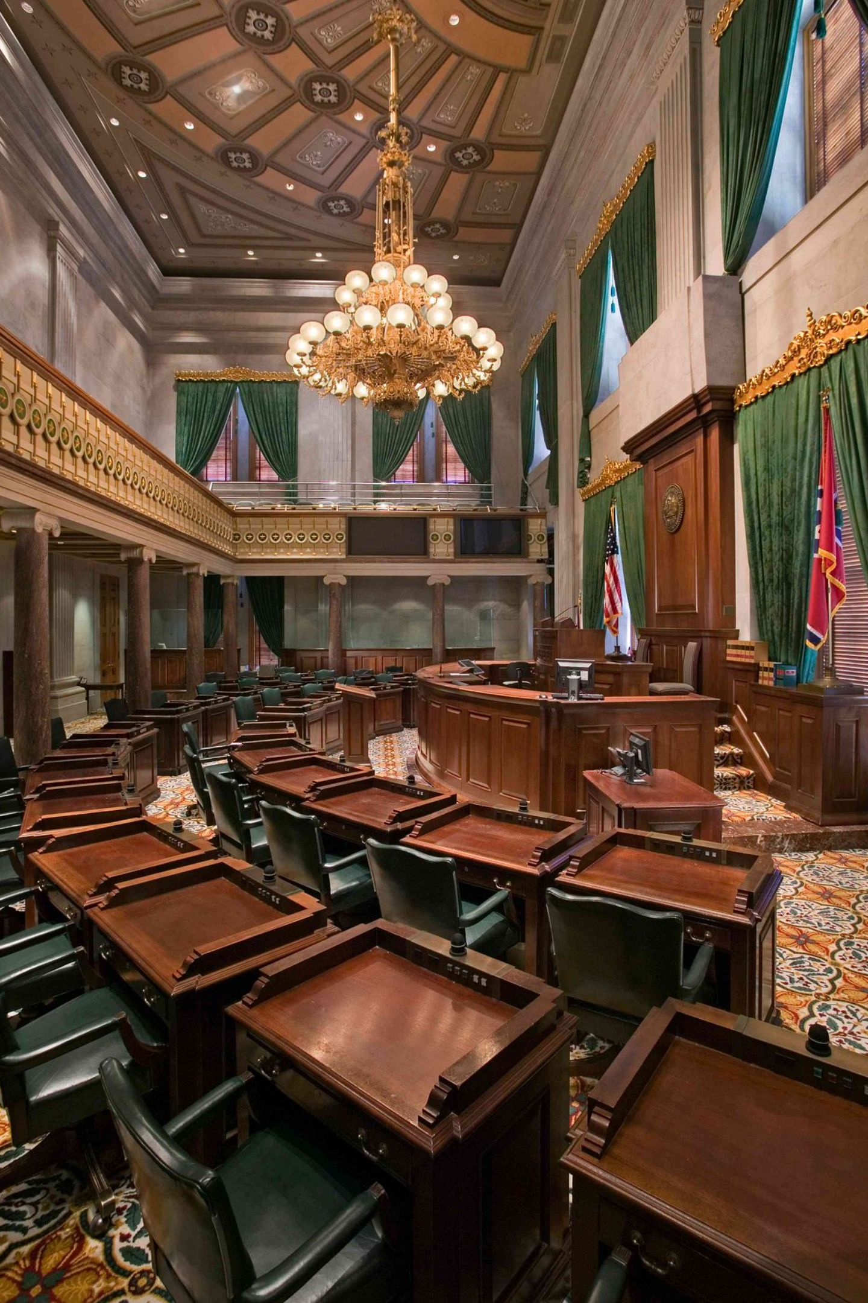
Legislation of Interest
A review of significant legislative activity and budget priorities from the Tennessee General Assembly's 2026 legislative session.

Slide 8
2026 Legislative Session Highlights
Major Topics of the Session
Budget
Healthcare
Immigration
Education

Slide 9
Budget
The Tennessee General Assembly passed a $58.3 billion budget.
$400M
$1.5M
Transportation
Aviation
One-time funds on road projects with an additional $25M recurring from the General Fund
More nonstop international flights
$339M
$155M
Public School Education
Private School Education
Includes teacher raises, bringing the base teacher salary to $50,000/year
Funds "Education Freedom Scholarships" for 35,000 participants
$230M
$125M
TennCare
State Parks
Covers increasing costs associated with medical inflation and increased utilization and services
Creates two additional state parks and funds the reconstruction of the Davy Crockett State Park
$20M
Rainy Day Fund
Totaling $2.2B

Slide 10

Rural Health Transformation Program
The Rural Health Transformation Program is aimed at addressing critical healthcare disparities and enhancing access to quality medical services in its rural communities.
$1B
5-Year
Rural Community
Total Funding
Duration
Focus

Slide 11

Healthcare
Pub. Ch. 1111 – FAIR Rx
Pub. Ch. 904 – Certificate of Public Advantage
Pub. Ch. 887 – Certificate of Need
Pub. Ch. 883 – Parent to Review all Health and Medical Records of the Child
Pub. Ch. 794 – Civil Action Against Healthcare Professional for Gender Transition Surgery
Pub. Ch. 940 – Caring for Caregivers Pilot Program
Emerging Issue – Artificial Intelligence in Healthcare — Downcoding

Slide 12
Immigration
Pub. Ch. 771
Pub. Ch. 772
Creates a Class A misdemeanor of intentionally failing to depart when a final order of removal is outstanding
Requires state and local governments to use the E-verify program before hiring prospective employees
Pub. Ch. 1070
Pub. Ch. 954
Creates a Class A misdemeanor for (1) an employer who knowingly employs a person unlawfully present in the U.S. to operate a commercial motor vehicle, and (2) a person unlawfully present in the U.S. who operates a commercial motor vehicle
Requires driver license testing to be conducted in English only; prohibits license plates and driver licenses to be issued to persons who are unlawfully in the U.S.
Pub. Ch. 955
Pub. Ch. 1106
A person must be a U.S. Citizen or qualified person to hold a professional license, certificate, permit, etc.
Requires state and local governments and local health departments to verify citizenship status before giving a public benefit
Pub. Ch. 686
Pub. Ch. 1035
Enforcement of state and federal immigration laws is confidential and not subject to the open records law
Imposes a tax on money transfers that are initiated in the state and transmitted to a foreign country

Slide 13
Education
Pub. Ch. 963
Pub. Ch. 1069
Increases the maximum number of Education Freedom Scholarships to 35,000 participants = $155M
Revises the assessment testing requirements for Education Freedom Scholarship students
Pub. Ch. 997
The Promising Futures Act establishes three pilot programs: 1) Child Care Workforce Scholarship Pilot Program, 2) CareShare Tennessee Pilot Program, and 3) Smart Steps Plus Program

Slide 14

Adoption and Foster Care
Pub. Ch. 936
Pub. Ch. 386
Provides voluntary out-of-court surrender of parental rights for adoption
Allows all children to be included in a single adoption petition
Pub. Ch. 621
Pub. Ch. 611
Grants state employees mandatory paid leave for fostering a child
Extends Zero to Three Court Programs to include children up to age five
Pub. Ch. 878
$46M for DCS
Judge may waive home study when child has lived with adoptive parents for six or more months
Reduces caseworker caseload ratios and enhances staff safety at DCS facilities for delinquent youth

Slide 15

Criminal Law
Pub. Ch. 921
Savanna's Law Revisions
Pub. Ch. 1021
Creates the offense of Grooming of a Minor
Pub. Ch. 886
Human trafficking victim to use deadly force against human trafficking offender
Pub. Ch. 719
Expungement of certain violent offenses in which the Governor issued a pardon

Slide 16

Judges
Pub. Ch. 953
Requires all courts in Tennessee to cooperate with federal immigration authorities; a judge who obstructs lawful operations may be referred to the board of judicial conduct and removed for judicial misconduct.
Pub. Ch. 1141
Authorizes judges to carry handguns during judicial proceedings.

Slide 17
Property and Housing
Pub. Ch. 1037
Pub. Ch. 1100
Community Workforce Housing Innovation Pilot Program
Lowers the standard for the use of deadly force to protect property

Slide 18

Pub. Ch. 809
Removes the permit fee to own a pet raccoon

Slide 19

2026 Elections

Slide 20
Elections Calendar
State and Federal General Elections
All candidates (including independents) for Governor, U.S. Senate, U.S. House, Tennessee Senate (odd-numbered districts), and Tennessee House.
📅 Early Voting: Wednesday, October 14 - Thursday, October 29
🗳️ Election Day: Tuesday, November 3

Slide 21
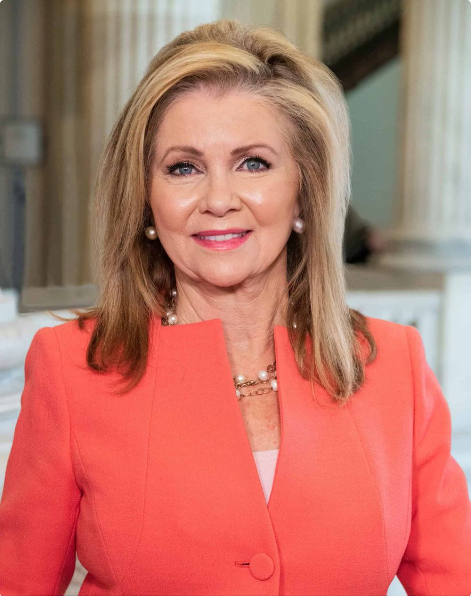

Gubernatorial Candidates
Marsha Blackburn
Jerri Green

Slide 22
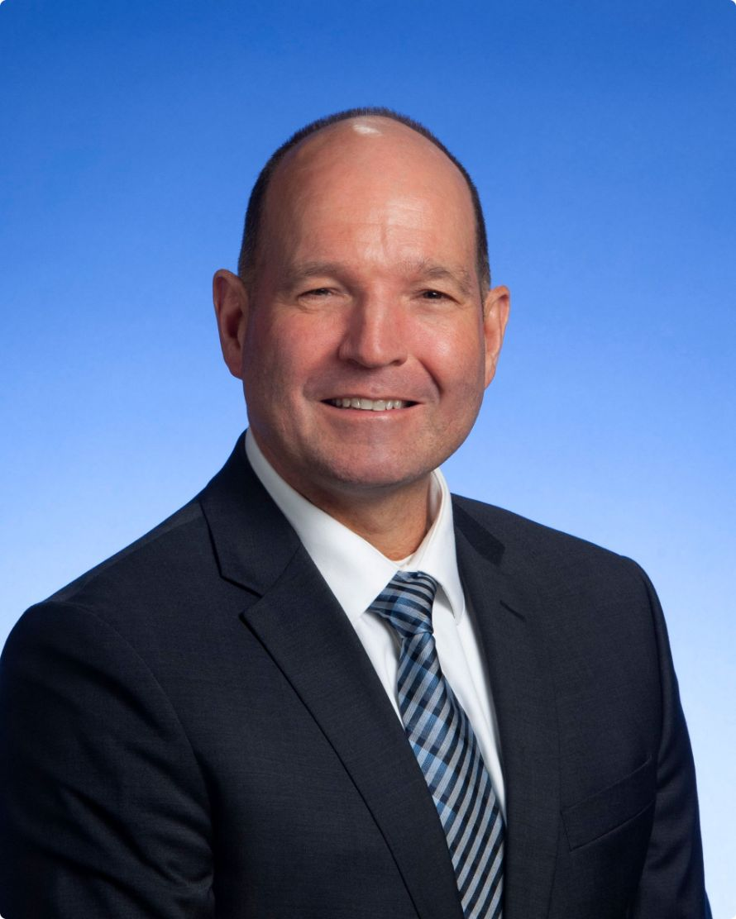

U.S. House Candidates - District 5
Charlie Hatcher
Chaz Molder

Slide 23


U.S. House Candidates - District 6
Johnny Garrett
Mike Croley

Slide 24
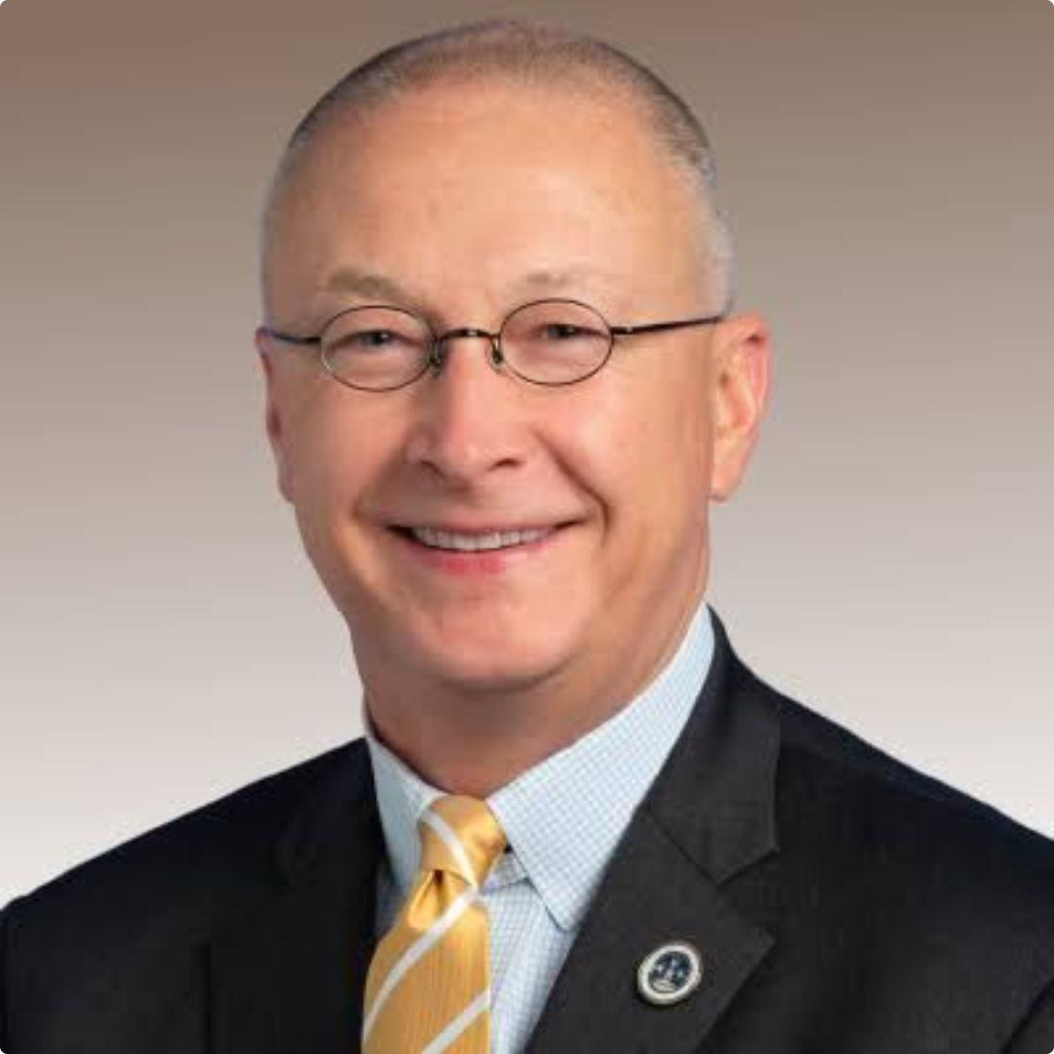

U.S. House Candidates - District 9
Brent Taylor
Justin Pearson

Slide 25
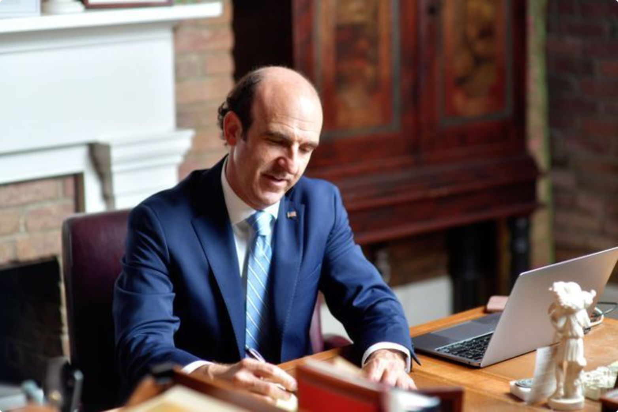

Tennessee House Candidates - District 59
Bill Hancock
Mark Proctor

Slide 26
Contact Information:
Call
Email
(865) 604-2053
lauren@webbgovernmentaffairs.com
Website
Address
www.WebbGovernmentAffairs.com
P.O. Box 154
Nolensville, TN 37135

Slide 27


Thank you!

