Slide 1
Active Listening,
Can you Hear me Now?
Shemeka Petties-Ramsey, Outreach Coordinator, BS, MSW, West TN Legal Services
Active listening • empathy • nonverbal cues

Slide 2
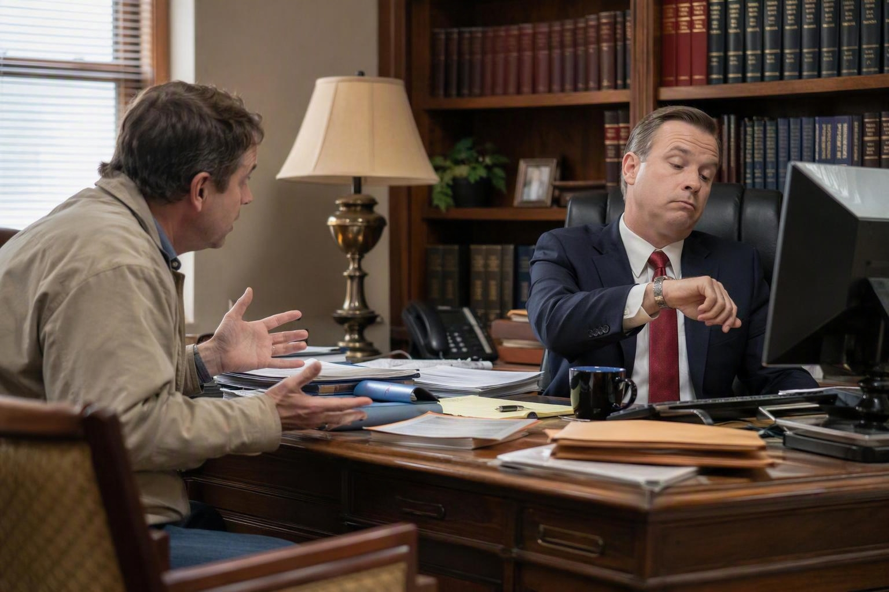
When "Listening" Looks Like This
We’ve all been on both sides of this. A light-hearted reminder of what active listening is definitely not.

Slide 3

Watch: It’s Not About the Nail
A short comedy classic on what happens when we rush to fix instead of just listening. — Jason Headley
Find it on YouTube: “It’s Not About the Nail” (youtube.com/watch?v=-4EDhdAHrOg)

Slide 4
Agenda
A practical session for everyday interactions and professional settings
Why active listening matters in daily life and legal practice
The difference between hearing, listening, and empathizing
Nonverbal cues: what to notice and what to avoid overreading
How your own body language affects trust and safety
Short, 1-minute discussion prompts and pair activities
Takeaways participants can use right away
1-minute discussion
Where do people feel most unheard in your setting?
Active Listening Workshop

Slide 5
Why active listening matters
Being heard changes how much people say and how safe they feel
For general populations
For legal professionals
Improves relationships, trust, and conflict resolution
Helps people feel respected rather than judged or rushed
Reduces misunderstandings and repeated arguments
Encourages fuller disclosure and better fact gathering
Improves client rapport and witness communication
Supports clearer counseling, negotiation, and advocacy
Listening well is not passive. It shapes what people reveal, what they remember, and what they trust.
1-minute discussion
Recall a time when someone visibly relaxed because they felt heard.
Active Listening Workshop

Slide 6
What active listening is
More than silence, it is focused, visible attention
Giving full attention instead of preparing your next response
Using brief encouragers like "go on" or "tell me more"
Reflecting the main idea back to confirm understanding
Asking clarifying questions before solving or advising
Checking both facts and feelings when appropriate
A simple flow
Listen
Pause
Reflect
Clarify
Respond
1-minute discussion
How do people know when you are only waiting to speak?
Active Listening Workshop

Slide 7
Empathy and listening
Empathy helps people feel understood without requiring agreement
Empathy sounds like
Empathy is not
That sounds frustrating.
I can see why that would be difficult.
You have been carrying a lot.
Agreeing with everything said
Promising a specific outcome
Taking over someone else’s emotional experience
In legal settings, empathy builds trust while preserving professional judgment. In everyday settings, it reduces defensiveness and opens real conversation.
1-minute discussion
Which empathy phrase feels natural to you, and which feels awkward?
Active Listening Workshop

Slide 8
Four habits of strong listeners
Small behaviors create big changes
Pause
Paraphrase
Leave a beat before replying so the speaker can add more.
Say back the point in your own words to confirm understanding.
Probe
Prioritize
Ask one open question that invites detail or meaning.
Identify what matters most instead of chasing every side issue.
1-minute discussion
Which listening habit is strongest for you right now?
Active Listening Workshop

Slide 9
What gets in the way
Most listening failures are predictable
Watch for these
Finishing other people's sentences
Looking at devices or around the room
Assuming you already know what they mean
Giving advice before the full story is clear
1-minute discussion
Which barrier appears most often in your workplace or home life?
Active Listening Workshop

Slide 10
Nonverbal cues
Communication is happening even when nobody is speaking
Notice
Interpret carefully
Use questions
Posture
Facial expression
Eye contact
Tone and pace
Look for patterns, not one isolated signal
Stress can look like irritation or withdrawal
Culture and personality affect expression
You seem unsure.
I notice a pause there.
What is coming up for you right now?
1-minute discussion
What nonverbal cues do you notice first in other people?
Active Listening Workshop

Slide 11
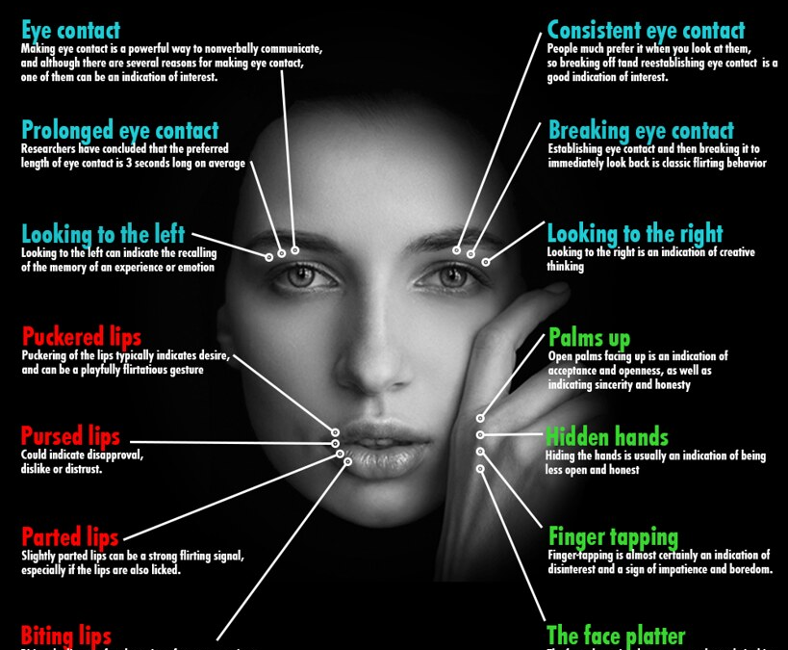

The body never lies
This Photo by Unknown Author is licensed under CC BY-NC

Slide 12

Key nonverbal cues to watch
Use cues as clues, not as proof
Eyes: contact, looking away, blinking, scanning the room
Face: tension, confusion, surprise, relief, or discomfort
Body: leaning in, pulling back, turning away, crossing arms
Voice: faster pace, shaky tone, flat delivery, longer pauses
Remember
A cue is a clue to ask a better question, not a reason to assume motive or truthfulness.
1-minute discussion
Which cue is easiest to misread?
Active Listening Workshop

Slide 13
The signals you send
Your body language affects trust, safety, and openness
Helpful signals
Unhelpful signals
Facing the person with an open posture
Nodding briefly without overdoing it
Using a calm pace and steady tone
Taking notes without disappearing behind them
Crossed arms and a closed stance
Looking at a phone or watch
Rapid-fire questions with no pause
A face that shows impatience or disbelief
1-minute discussion
What message does your posture send when you are stressed?
Active Listening Workshop

Slide 14
General population and legal examples
The same skills apply, but the context changes
Everyday conversations
Legal conversations
Family disagreements
School or workplace tension
Medical, service, or support interactions
Moments when someone needs to feel safe enough to speak honestly
Client interviews and intake
Witness meetings and statement clarification
Negotiations and difficult updates
Balancing empathy with boundaries and accuracy
1-minute discussion
Where does your setting demand the most patience?
Active Listening Workshop

Slide 15
Quick practice
Round 1
Debrief
Partner A speaks for 30 seconds about a frustrating situation.
Partner B only listens, nods, and gives one short reflection.
Switch roles.
What made you feel listened to?
What nonverbal behavior helped the most?
What felt distracting or unhelpful?
1-minute discussion
Run the activity now.
Active Listening Workshop

Slide 16
Discussion starters
Questions that open reflection and dialogue
For general groups
For legal teams
For self-reflection
What does good listening look like here?
When do people feel dismissed?
What habits make others shut down?
How do we show clients we are listening?
What makes a witness or client hold back?
Where do assumptions interfere with accuracy?
When do I interrupt most?
How does stress show up in my body?
What is one habit I want to change?
1-minute discussion
Pick one question and discuss it with a neighbor.
Active Listening Workshop

Slide 17
Key takeaways
Three ideas worth remembering
1
2
3
People listen better when they feel respected and not rushed.
Nonverbal cues are clues, not proof. Check them with curiosity.
Empathy and structure can exist together, even in high-stakes conversations.
1-minute discussion
Which takeaway will you use first?
Active Listening Workshop

Slide 18
References
Selected sources for active listening, empathy, and nonverbal communication
Gordon, T. (1975). Teacher Effectiveness Training.
Rogers, C. R., & Farson, R. E. (1957). Active Listening.
Egan, G. (2013). The Skilled Helper.
Mehrabian, A. (1972). Nonverbal Communication.
American Bar Association resources on client counseling and communication.
HelpGuide.org. Nonverbal Communication and Body Language.
Massachusetts Lawyers Concerned for Lawyers. Active Listening: Soft Skills for Lawyers.
Shemeka Petties, MSW, August 2026
References

