Slide 1



HIDDEN IN PLAIN SIGHT
Practical Issue Spotting Across Practice Areas

Slide 2

Most clients tell us about the one issue they
are most worried about, even if they have
several legal issues going on.
To help holistically, we must think holistically.
Ask clients about other areas of their lives.
Bring up other types of issues your
organization handles.
Consult and collaborate with your colleagues.
2

Slide 3

Agenda
Panel Introductions
Discussion Question – Three Rounds
Working with Traumatized Clients
Audience Q&A
Closing Round
2

Slide 4
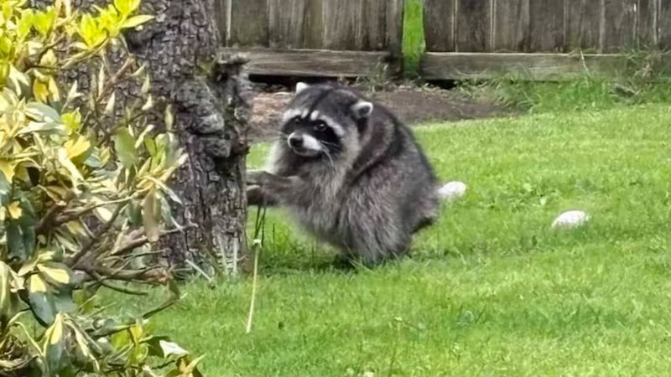
2

Slide 5

Panel Introductions
Moderator: Kerry Krauch, WTLS
Family Law: Amber Vargas, LAS
Consumer: Jake Old, WTLS
Immigration: Emily Stotts, Justice for Our Neighbors
Housing: Colleen Ryan, LAS
2

Slide 6

Clients and legal issues you handle?
Common misconceptions in your field?
2

Slide 7
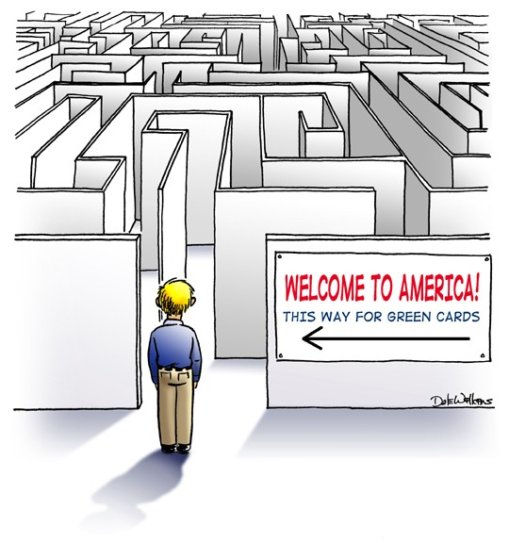
Immigration
Deferred Action
Nonimmigrant Visa Holder
Undocumented
U.S. Citizen
Lawful Permanent Resident
Pending Application
Spectrum of Status
Work Authorization
2

Slide 8
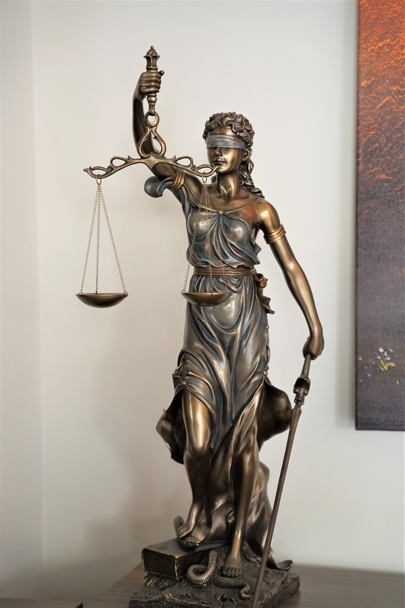
Round One
Understanding Your Clients
2

Slide 9

Round One
Why do clients come to you?
Documents they should bring
The most common situation clients face
Mistakes clients make before seeking help
2

Slide 10
Round Two
Myths & Misunderstandings
2

Slide 11

Round Two
Things people misunderstand about your practice area
What does TV/internet/social media get wrong about your practice area?
What surprises clients the most?
What’s emotionally hardest for clients?
2

Slide 12
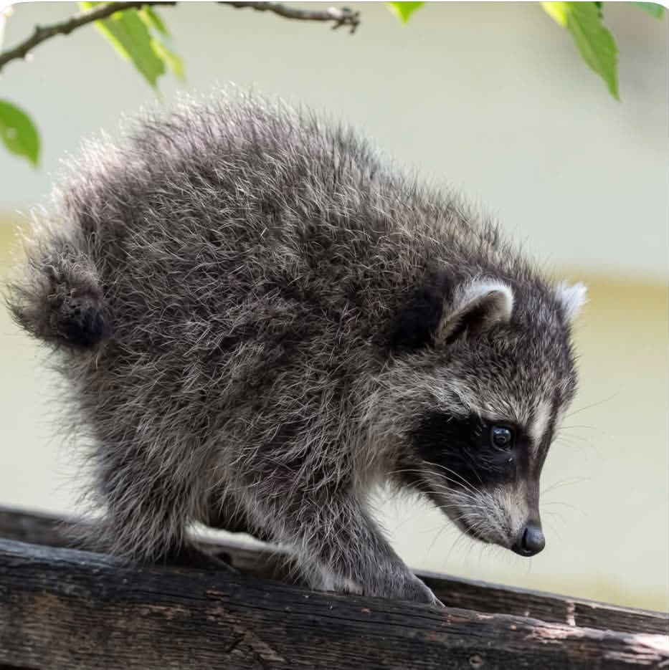
2

Slide 13
Round Three
Connecting the Dots
2

Slide 14

Round Three
What would you like to know about the other practice areas?
How do your practice areas overlap?
Client behaviors that create problems across all fields?
What makes someone a good client?
What legal issue spirals faster than people expect?
What’s the hardest lesson you’ve learned?
2

Slide 15
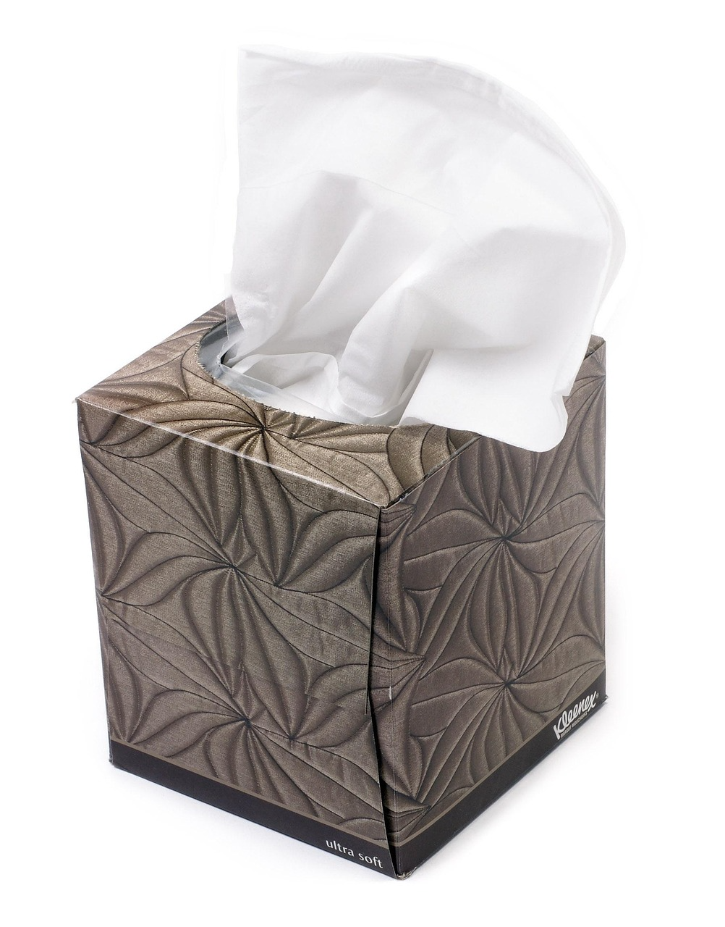
Working with Traumatized Clients
What techniques have been successful in working with traumatized clients?
How do you make the clients feel safer?
What do you do prevent secondary trauma and
burnout?
2

Slide 16
Q&A
2

Slide 17

Resources
← Old school
2

Slide 18
Resources – Domestic Violence
West | Middle | East
YWCA (Memphis) 901-725-4277 | Center of Hope (Columbia): 855-465-4652 | Avalon Center (Crossville) 800-641-3434
Fayette Cares (Somerville) 800-356 -6767 | Mary Parrish (Nashville): 800-334-4628 | Helen Ross McNabb Family Crisis Center (Knoxville): 865-637-8000
WRAP (Jackson) 800-273-8712 | Genesis House (Cookeville) 800-707-5197 | Safe House (Kingsport) 844-578-7233
2

Slide 19
Resources – Housing
West | Middle | East
Hospitality Hub (Memphis) 901-730-1736 | Room in the Inn (Columbia) 931-698-6677 | Bread of Life Rescue Mission (Crossville) 931-707-0503
Fayette Cares (Somerville) 901-465-3802 x 224 | Coordinated Entry (Nashville): 615-862-6444 | Knoxville Area Rescue Misson 865-673-6540
Jackson/West TN Continuum of Care: 1-866-307-5469 | Cookeville Rescue Mission 931-528-5819 | Grace House (Kingsport) 423-732-0522
For low-income housing: https://www.tnhousingsearch.org/
For more programs: https://www.hud.gov/states/tennessee
2

Slide 20
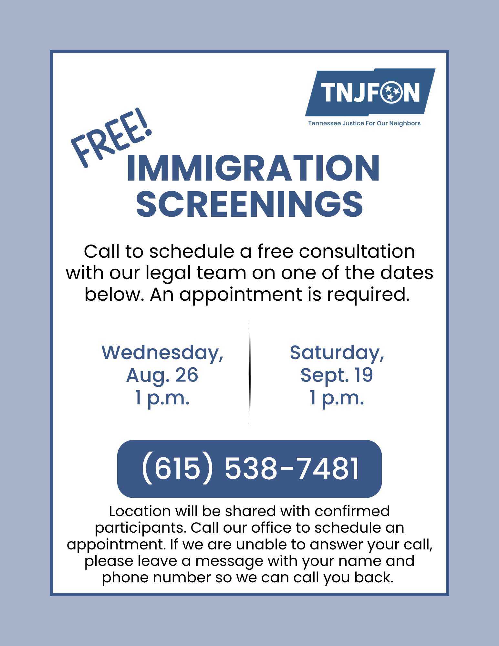
Tennessee Justice for Our Neighbors
tnjfon.org
615.538.7487 call/text
615.424.3078 WhatsApp
Resource Page: www.tnjfon.org/resources
EmilyStotts@tnjfon.org
2

Slide 21
Other Immigration Legal Service Providers in Tennessee
Advocates for Immigrant Rights
airlegal.org
901.729.9560 or 615.971.4104
901.206.4440 detained calls
Community Legal Center’s Immigrant Justice Program
clcmemphis.org
901.543.3395
Tennessee Immigrant and Refugee Rights Coalition
tirrc.org
615.414.1030
2

Slide 22
Resources – Immigration
West | Middle | East
Refugee Empowerment Program (Memphis) 901-500-3844 | Conexión Américas (Nashville) 615-270-9252 | Operation Mercy Ministries (Lenoir City) 727-621-4715
All Saints Immigration Services (Jackson) 731-513-6180 | Hispanic Family Foundation (Nashville) (615) 562-2222 | La Paz Chattanooga 423-624-8414
2

Slide 23
Closing
Questions
2

Slide 24
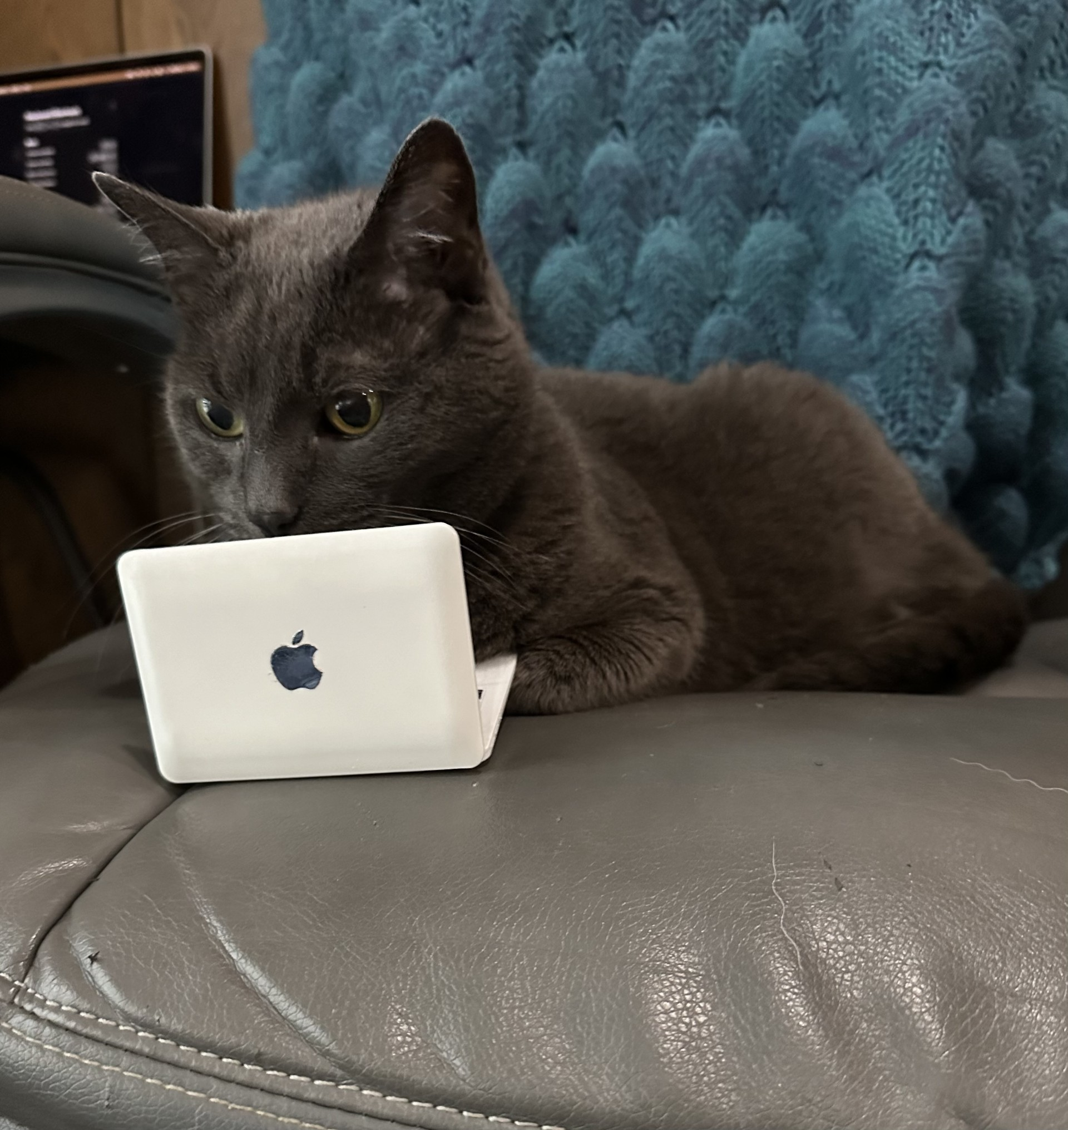
Kerry Krauch
kerry@wtls.org
731-426-1375
Emily Stotts
emilystotts@tnjfon.org
615-538-7487
Jake Old
jake@wtls.org
731-426-1344
Amber Vargas
avargas@las.org
931-771-9170
Colleen Ryan
cryan@las.org
615-780-7110
2

Slide 25



Thank You!
2

