Slide 1


The Sustainable Lawyer:
Rooted
Growing
Thriving
Captain Ronda Webb, M.A., Esq.
Tennessee Alliance for Legal Services – Equal Justice University Conference
August 2026
Notes:
A growing number of attorneys are confronting burnout, compassion fatigue, and the quiet erosion of professional identity. This CLE explores how lawyers can recognize early warning signs, ethically safeguard their mental and emotional fitness, and make informed decisions about career transitions or re-education. Participants will examine the intersection of well being and professional responsibility, learn practical strategies for restoring capacity, and gain tools for navigating career pivots without compromising ethical obligations or client care.

Slide 2
DISCLAIMER
The views and opinions expressed in this presentation are solely those of the author and do not represent the official stance or policies of the Department of the Air Force, the Department of Defense, or the U.S. government.

Slide 3

Agenda
Introduction
Rooted: Ethical Obligations
Growth: Career Satisfaction and Pivoting
Thriving: Production and Purpose
Q & A

Slide 4
Active lawyers in Tennessee
19,614
Notes:
“Per the ABA National Lawyer Population Survey 2025, the number of Tennessee attorneys has increased by 9.18% over the last ten years.
The legal profession is experiencing significant strain, reflected in rising attrition and shifting workplace pressures. Associate departures have climbed sharply—from 9% in 2024 to over 16% in 2025—while overall firm attrition approaches 27%. Legal aid organizations face similar challenges, often without the staffing buffers available to private firms. Efforts to offset losses through lateral hiring offer limited benefit, highlighting retention as a critical stability factor.
At the same time, subjective work allocation—now driving more than a third of assignments—adds to uneven workloads, burnout, and inconsistent client service. Together, these trends show a profession in flux and underscore the urgency for legal aid organizations to strengthen sustainable practices amid escalating demands.

Slide 5

Activity #1
How do you see
YOURSELF
as a Legal Advocate?
Notes:
Knowledgeable, Analytical, Persuasive, Articulate, Perceptive, Skillful, Eloquent, Empathetic, Caring, Trustworthy, Resilient, Collaborative, Adaptable, Experienced, Tenacious , Eminent, Successful, Proven, Diligent, Meticulous, Assertive, Versatile__My list
Give participants one minute.
Ask everyone to write down as many one‑word descriptors as they can that describe themselves as an attorney or as an advocate.
(traits, skills, values, behaviors, or mindsets)
Share-out options:
Invite participants to circle their top three words and share one of them with the group.
Transition:
Use the activity to frame the discussion:
• How do these descriptors support or challenge our ability to practice sustainably?
• Are there traits we rely on that may lead to burnout, stress, or imbalance?
• Are there qualities we could cultivate to enhance sustainability and well-being?

Slide 6

Rooted: Ethical Obligations
Tennessee Rules of Professional Conduct
RPC 1.1 — Competence
RPC 1.3 — Diligence
RPC 1.16(a)(2) — Declining or Terminating Representation
This Photo by Unknown Author is licensed under CC BY-SA-NC
Notes:
Tennessee attorneys are subject to a comprehensive framework of professional responsibility rules governing competency and mental fitness. At its core, Tennessee Rule of Professional Conduct requires mandatory withdrawal when a lawyer's physical or mental condition materially impairs the ability to represent a client.

Slide 7

Rooted:
Ethical Obligations
RPC 1.1 requires a lawyer to provide competent representation, meaning the legal knowledge, skill, thoroughness, and preparation reasonably necessary for the representation.
This Photo by Unknown Author is licensed under CC BY
Notes:
RPC 1.1 sets the baseline for all legal work, a lawyer must be knowledgeable, skilled, thorough, and well-prepared to represent clients effectively, ensuring that the representation is reasonably necessary for the matter

Slide 8

Rooted:
Ethical Obligations
RPC 1.3 requires a lawyer to act with reasonable diligence and promptness in representing a client.
This Photo by Unknown Author is licensed under CC BY-SA
Notes:
In short, RPC 1.3 emphasizes that diligence is a fundamental lawyer duty, balancing thoroughness, timeliness, and ethical conduct to protect and advance the client’s interests.

Slide 9

Rooted:
Ethical Obligations
RPC 1.16(a)(2) states that a lawyer shall not represent a client or, where representation has commenced, shall withdraw from the representation of a client if the lawyer’s physical or mental condition materially impairs the lawyer’s ability to represent the client.
Notes:
In summary: RPC 1.16(a)(2) protects clients and the legal profession by ensuring that lawyers who are physically or mentally unable to represent clients effectively do not continue in that role, thereby preserving the quality and integrity of legal representation.

Slide 10
28%
26%
74%
Notes:
“Career satisfaction in law is mixed. About 74% of legal professionals report general happiness in their roles, while 28% moderately enjoy their work environment and 26% feel undervalued or unhappy.
Do you agree with these statistics?

Slide 11

Activity #2
“Career Satisfaction Spectrum”
This Photo by Unknown Author is licensed under CC BY-SA
Notes:
Purpose:
Helps attorneys assess where they currently stand in their career satisfaction and identify what might be missing. What color are you?
0 = “Not satisfied at all”- 5 = “Extremely satisfied, thriving, energized”
Ask them to silently mark where they feel they are today.
Then ask them to write:
• One word that describes why they chose that number.
• One word that describes what would increase that number.
Debrief prompt:
How might sustainable lawyering help move that number?

Slide 12

Growth: Career Satisfaction
Work-Life Balance
Opportunities For Growth
Culture
Compensation
Notes:
Choosing a sustainable legal career begins with understanding what truly supports long-term satisfaction for attorneys and advocates. Many legal professionals thrive when their work aligns with their values, offers meaningful growth, and exists within a supportive culture that recognizes their contributions. Work‑life balance, fair compensation, and a healthy environment are also central to maintaining energy and motivation. When these elements are missing—limited promotion pathways, disparities in advancement, high workloads, or misalignment between expectations and fulfillment—lawyers often consider pivoting. Exploring alternatives, assessing values, and leveraging transferable skills can help attorneys design careers that offer both professional stability and personal well‑being.
“When was your last vacation or your last meaningful career reflection?”

Slide 13
“A pivot is a change in strategy without a change in vision.”
– Eric Ries

Slide 14
Growth: Pivoting
Compliance Officer
Regulatory Affairs Specialist
Policy Analyst/ Legislative Aide
Government Affairs Specialist
Judge
Mediator / Arbitrator
Ombuds
Conflict Resolution Specialist
Risk Management Specialist
Privacy Officer
Ethics & Integrity Officer
Higher Education Administrator
Nonprofit Director
Investigations Specialist
Notes:
“Pivot Possibilities for JD Professionals”
. These are all roles where legal training is directly valuable, but the day‑to‑day work may offer more balance, alignment, or growth than traditional practice.

Slide 15
Growth: Pivoting
Advocacy Director
Professional Development Educator
Legal Tech Product Manager
Consultant
Auditor
Court Administrator
Grant Writer
Trusts & Estates Planner
Human Resources Director
Employee Relations Specialist
Real Estate Development Analyst
Procurement Specialist
Public Policy Researcher
Academic Roles
Labor Relations Specialist
Notes:
Where will you be in 2027? 2030? 2035?

Slide 16

Thriving: Production and Purpose
Notes:
In the legal profession, it’s easy to feel defined by deadlines, case loads, and the relentless pace of assignment completion. But sustainable, meaningful practice requires more than functioning as cogs in a system built on urgency. Thriving as an attorney or advocate means approaching your work with intention—aligning daily tasks with deeper values, cultivating purpose beyond productivity, and shaping a career that reflects the kind of professional you aspire to become. This section explores how lawyers can move from simply executing assignments to pursuing virtue: a practice defined not just by output, but by growth, integrity, and fulfillment.

Slide 17

I do solemnly swear or affirm that I will support the Constitution of the United States and the Constitution of the State of Tennessee. In the practice of my profession, I will conduct myself with honesty, fairness, integrity, and civility to the best of my skill and abilities, so help me God.
Notes:
What drains purpose and leads to burnout?

Slide 18

“MEANINGFUL” vs.
“MECHANICAL”
Activity #3
Notes:
• What parts of my work feel purely like “production”—checking boxes, reacting, or executing?
• What parts of my work feel connected to purpose, impact, or virtue?
• Where do I want to spend more of my energy: production or purpose? Why?
How do we set meaningful milestones?
Define a 30‑day goal
A small refinement in workflow, a habit change, or one purposeful action.
Define a 90‑day milestone
A measurable shift in responsibilities, learning, or professional direction.
Define a 6‑month milestone
A significant change in role, focus, or practice structure that reflects deeper alignment with purpose.
Review and recalibrate
Assess progress regularly and adjust milestones as clarity and confidence grow.

Slide 19

The Cost of Inaction
Clarify Core Values
Audit Daily Tasks
Choose One Intentional Shift
Seek Supportive Structures
Notes:
When attorneys remain in pure production mode, focused only on deadlines, output, and constant responsiveness, the risks grow quietly but significantly. Professional identity erodes, values drift, burnout accelerates, and the sense of purpose that once fueled the work begins to fade. Over time, the cost is not only personal exhaustion but reduced effectiveness, diminished clarity, and compromised capacity to serve clients with excellence.
Ignoring these challenges can lead to loss of identity and values, and can accelerate burnout.

Slide 20
Nikki Rowe
"Purpose is what will guide you to your best self, and thriving is the result of living in alignment with that purpose."

Slide 21

RECAP
Rooted: Ethical Obligations
Growth: Career Satisfaction and Pivoting
Thriving: Production and Purpose
Notes:
Sustaining Purpose and Professional Well‑Being
Today’s session highlighted the growing reality that many attorneys and legal advocates face increasing burnout, compassion fatigue, and a gradual loss of professional identity. We explored how to recognize early indicators of strain, maintain ethical and emotional fitness, and make intentional decisions about career direction or re‑training. Throughout the presentation, participants examined how well‑being and professional responsibility intersect, identified practical ways to restore capacity, and learned strategies for navigating career pivots while upholding ethical obligations and quality client care. Ultimately, this conversation centered on reclaiming purpose in the legal profession and building a career that supports both effectiveness and personal fulfillment.

Slide 22

Q & A
Notes:
We will now open the floor for questions.

Slide 23
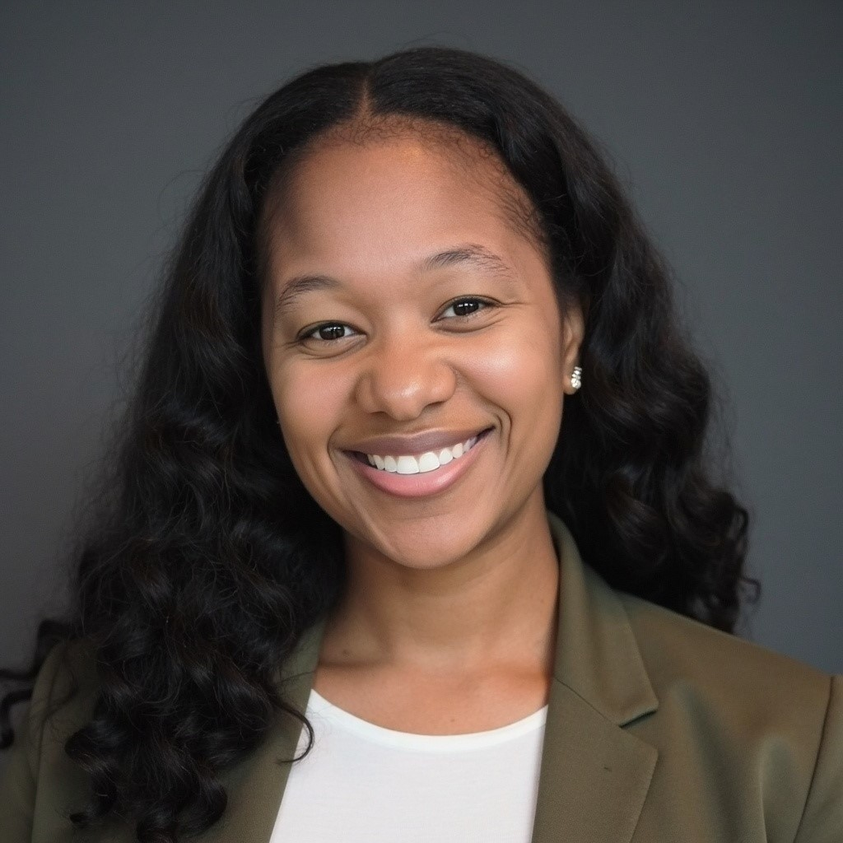
RONDA WEBB
Attorney-Educator-USAF Officer
Building Legacy through Advocacy, Innovation, Service, and Scholarship
For inquiries, consultation, collaboration, and resource sharing:
RondaWebb.AEO@gmail.com

