Slide 1

Social Security Work Incentives
Using Work Rules to Advocate for Your Clients
Cole Adams
& Allison Jones

Slide 2
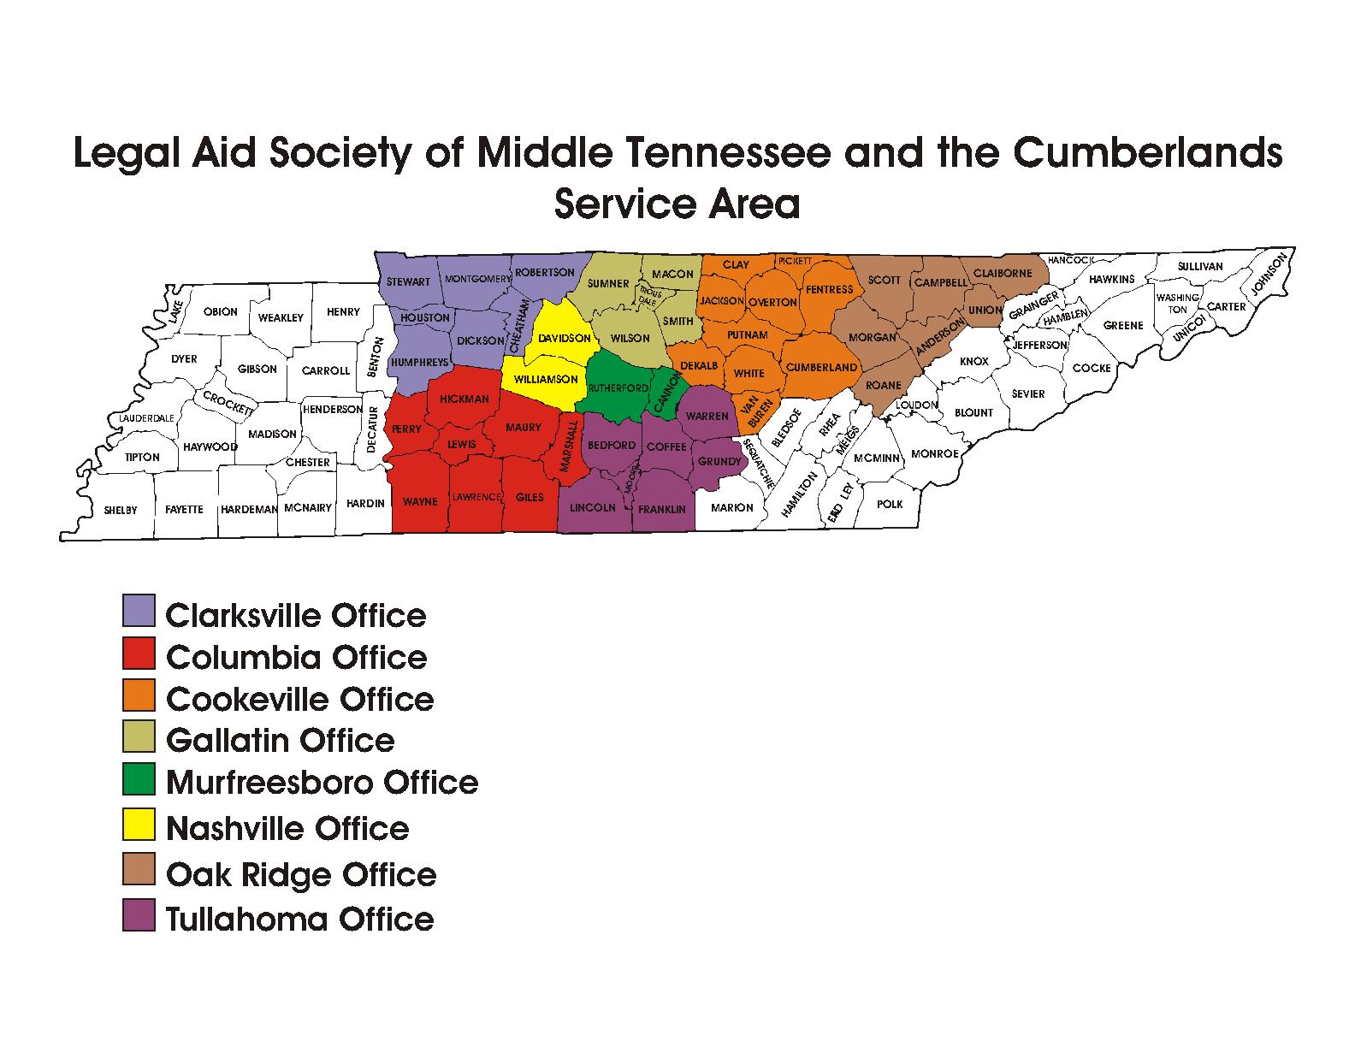
About LAS
To advance, defend, and enforce the legal rights of low-income and vulnerable people in order to secure for them the basic necessities of life. ​
We handle a variety of civil legal cases:​
  Health​, Benefits, and Education
  Housing​
  Consumer​
  Family​
  Immigration​
  Federal Income Tax
  Employment
  Reentry

Slide 3

About Allison
Allison Jones is the lead attorney for the Health, Benefits, and Education Practice Group at Legal Aid Society of Middle Tennessee and the Cumberlands. She also co-directs Legal Aid Society’s medical-legal partnership with Shade Tree Clinic, a comprehensive, free medical clinic staffed by Vanderbilt medical and nursing students. Allison is a legal services veteran, having worked as a consumer law paralegal at Legal Aid Chicago, and then as a housing law clerk and social work practicum student at Legal Services of Eastern Missouri throughout graduate school. She also served as a judicial clerk for the Honorable Laura Denvir Stith of the Supreme Court of Missouri, and for Senior Judge John T. Nixon of the U.S. District Court for the Middle District of Tennessee. She currently co-chairs the TALS Health and Benefits statewide task force. Allison has been with Legal Aid Society since 2016.

Slide 4
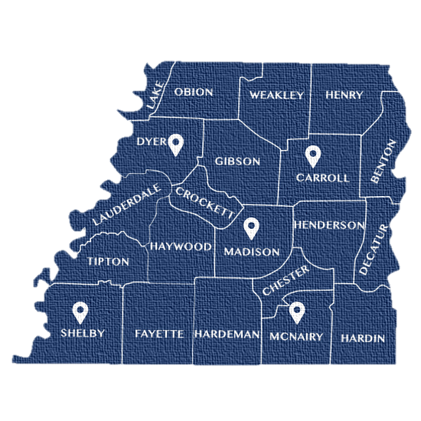







About WTLS
WTLS offers no-cost civil legal aid to West Tennesseans in 21 counties, focusing on issues that affect family safety, cohesiveness, and stability. Our legal practice areas include:
Benefits
Fair Housing
Reentry
Elder Law
Victims Rights
Disaster Assistance
Family Law
Consumer Debt
2

Slide 5

About Cole
Cole Adams (he/him) is a Staff Attorney in the Public Benefits Unit in the Memphis Office of West Tennessee Legal Services. In his practice, he represents and advises clients on Veterans’ Benefits, Social Security, Medicaid, SNAP, Families First, and Unemployment Compensation issues. He co-chairs the TALS Health and Benefits Taskforce. Previously, Cole worked at Disability Rights Delaware (formerly the Disabilities Law Program at Community Legal Aid Society, Inc.), the Protection & Advocacy System for the State of Delaware, where he represented individuals with disabilities with Social Security, Medicaid, Americans with Disabilities Act, and other disability-related issues. Cole graduated from the University of Alabama School of Law in May of 2023. While in Law School, Cole worked at the Alabama Disabilities Advocacy Program (the Protection & Advocacy System for the State of Alabama), Justice in Aging, the American Civil Liberties Union of Alabama, and West Tennessee Legal Services. Prior to law school, Cole received his B.A.C. in Communication Studies with a second major in history and a minor in Social Welfare from the University of Alabama.
2

Slide 6
Objectives and Roadmap
Discuss Social Security Disability and Supplemental Security Income benefits and working
Understand the work incentives, programs, and rules Social Security has in place for beneficiaries who choose to work
Interpret an advocate’s ethical duties regarding clients who were approved for benefits and are considering working
Explore scenarios where advocates are likely to encounter work incentives and their consequences
Reinforce the pathways to receiving benefits again if a client is cutoff or terminated due to working

Slide 7
Background Information
What benefits programs are we talking about today?
What is substantial gainful activity?
At what stages of receiving benefits is this important?

Slide 8
Title II Benefits
Social Security Disability Insurance (SSDI)
  Other Title II benefits include auxiliary, survivors, and retirement benefits
  These are all based on work history
Eligibility
  Be found “disabled” within meaning of the Social Security Act
    Disability is a severe physical or mental condition that stops you from doing substantial gainful activity (SGA). The condition must have lasted—or be expected to last—for at least 12 straight months or result in death.
  Meet “insured” status by earning enough “credits” (formerly “quarters”) through working, OR
    Be eligible to receive auxiliary benefits based on someone else’s work history
General income limit: cannot earn above substantial gainful activity (SGA) amount
  Presumed at $1690 for 2026

Slide 9
Title XVI Benefits
Supplemental Security Income (SSI)
  Indigency benefits, do not require work history
Eligibility
  Same definition of “disabled”
    Also eligible for SSI at age 65 without disability
  Meet income and asset limits
    Asset limit: $2000 for individual or $3000 for married couple
    For approval: income limit is SGA

Slide 10
Substantial Gainful Activity (SGA)
Presumed at $1690 per month for nonblind; $2830 per month for statutory blindness
  This is a cliff; earning $1691 for a month will mean the person is ineligible to receive benefits
Rebutting the presumption
  Usually involves disabled person employed competitively, but not expected to produce at output level of nondisabled person
  When proving disability, this argument usually requires an Administrative Law Judge hearing
When applying for disability, the individual will generally have to be below this amount while the application is pending
After approval, SGA continues to apply to Title II benefits, but not SSI

Slide 11
Calculating Monthly Earnings
Note for earnings paid weekly or biweekly:
  Some months will have 5 paychecks (weekly) or 3 paychecks (biweekly)
  These months could create an issue since there is an additional check
  Possible overpayment/cessation action against these months if earned amount exceeds reduction
§ 404.1574a requires SSA to average earnings if:
  an employee or self-employed person’s work was continuous; without significant change in work patterns or earnings;
  there has not been a change in the SGA level; and
  monthly earnings fluctuate from above to below the SGA threshold.

Slide 12
Work Incentives
What are the different types of work incentives?
What programs would be best for my client(s)?
What are the eligibility criteria?

Slide 13
SSI Earned Income Exclusion
SSI income counting starts with a $20 general exclusion
There is also a $65 earned income exclusion for work income
So $85 total is not counted at all for income
After this deduction, SSI income is reduced $1 for every $2 in income earned
  Income adjustments run on a 2-month delay (e.g. income earned in March will reduce the May SSI payment)

Slide 14
1619(a) – Keeping SSI when working over SGA
Most states, including Tennessee, opt into 1619(a)
Allows people with earnings above SGA to still get a partial SSI payment, up to the “break even” amount (i.e., the amount that reduces the SSI payment to $0)
SSI recipient does not need do anything to take advantage of 1619(a). SSA will move them into 1619(a) the first month earnings exceed SGA but are lower than the break even amount

Slide 15
Trial Work Period
9-months (non-consecutive) where earnings will not impact SSDI eligibility
Starts the first month individual earns above the TWP threshold amount set annually by SSA
  In 2026, that amount is $1,210 per month
Subsequent months counted in period if earning over the threshold amount
Must exhaust TWP within a 60-month period
Once TWP months expire, individual enters extended period of eligibility (EPE)

Slide 16

Ticket to Work
Program designed to promote financial independence by encouraging SSDI/SSI beneficiaries to work
Services
  Provided by either the state’s vocational rehabilitation program or an Employment Network (public or private contractors)
  Job counseling/coaching; possibly placement; other services to promote employment
Benefits to recipient
  Can work without losing benefits immediately (Trial Work Period months apply); participation in program can allow additional TWPs as well
  Medicare continues while on program
  Protected from CDRs while working towards achieving program goals
Not the best program for everyone
  Those working under SGA
  Those who cannot work due to impairments or otherwise do not want to work
  Beneficiaries can decline participation in the program

Slide 17
Income Related Work Expenses (IRWEs)
IRWEs are out-of-pocket costs for items or services that people with disabilities need in order to work, such as medical devices, specialized transportation, or attendant care.
SSA subtracts these costs from gross earnings when calculating eligibility and benefit amounts for SSI or SSDI.
  For SSI: Social Security will deduct the IRWE from gross income when they determine the payment amount.
  For SSDI: the IRWE will be deducted from gross earnings when Social Security determines if the work level is enough to meet Substantial Gainful Activity (SGA)

Slide 18
IRWE Requirements
An IRWE must meet all of the following criteria:
  The item(s) or service(s) enables the person to work;
  The item or service is needed because of a physical or mental impairment;
  The item is not reimbursed by another source (such as Medicare, Medicaid, or a private insurance carrier); and
  The cost is "reasonable", meaning that the cost represents the standard charge for the item or service in your community.
The disabled worker must provide proof that they paid for the item or service. Proof can be a signed self-attestation, copies of cancelled checks or paid receipts as proof of payment.

Slide 19
Blind Work Expenses (BWEs)
Applies to SSI only
This rule allows a blind person to exclude from earned income all expenses that enable the person to work. The expense does not need to be related to the blindness.
Expenses that can qualify include:
  Service animals, transportation to work, taxes, meals eaten during work, medical/non-medical equipment and supplies, attendant care.
To use BWEs, the Social Security record must show proof of blindness
  SSA defines blindness as no better than 20/200 or visual field of 20 degrees or less, corrected, in the better eye.

Slide 20
Section 301
Requires the Social Security Administration (SSA) to continue providing benefits for SSI and SSDI recipients even when recipients no longer meet the SSA disability standard if:
  The recipient is enrolled in an approved employment or education program prior to the month in which the recipient was found not disabled, and
  SSA determines that participation in the program increases the likelihood the recipient will not have to return to the disability or blindness benefit rolls
Common fact pattern – age 18 redeterminations
  Automatically satisfied if the individual is a student age 18 to 21 who is participating in an IEP
  A student age 18 through 21who has an IEP will remain eligible for Section 301 even after leaving high school if the student enrolls in an eligible employment or vocational rehabilitation program within 3 months of leaving high school
Still must meet all non-medical requirements (e.g., income and resources for SSI)

Slide 21
Plan to Achieve Self-Support (PASS)
A PASS is a written plan that allows a worker to set aside income and resources for a specified time to help reach a work goal.
  The goal should allow the worker to earn enough to reduce or eliminate their SSI or SSDI benefit.
Start by submitting an application (Form SSA-545-BK)
Earned income can be set aside to avoid SSI reduction.
Entirety of SSDI payment can be set aside, making the worker eligible for SSI.
Resources can be set aside from the $2,000 limit.
  PASS may allow a household to have a second vehicle.
  (See POMS SI 01130.200)

Slide 22
1619(b) – Keeping Medicaid when SSI payments end
To qualify for continuing Medicaid coverage, a person must:
  Have been eligible for an SSI cash payment for at least 1 month;
  Still meet the disability requirement; and
  Still meet all other non-disability SSI requirements; and
  Need Medicaid benefits to continue to work; and
  Have gross earnings that are insufficient to replace SSI, Medicaid and publicly funded attendant care services.
    Gross earnings threshold in TN in 2026: $41,797
    Earnings above the threshold can be reduced through IRWEs, BWEs, PASS
Common issues: resource limit, confusion about notices

Slide 23
Medicaid Buy In
Medicaid Buy In (authorized in 1999 by the Ticket to Work and Work Incentives Improvement Act) provides people with disabilities an opportunity to work and earn wages while simultaneously maintaining their Medicaid eligibility and coverage.
  Creates a more inclusive workforce.
  Reduces administrative churn.
Tennessee is one of only 4 states (with Alabama, Oklahoma, and the District of Columbia) that does not offer this program.

Slide 24
Extended Medicare Eligibility
Title II recipients who continue to meet the medical disability rules can retain Medicare coverage for 7 years and 9 months (93 months) after they return to work
  Return to work for this purpose is triggered by the end of the 9-month Trial Work Period
Issue—if no longer receiving disability payments, Medicare premiums will need to be paid out of pocket
  Premiums are billed quarterly
  Screen clients for Medicare Savings Program eligibility
    Reminder! MSP countable income rules use the SSI earned income exclusions

Slide 25

Work Incentives Planning and Assistance (WIPAs)
Contracted Agencies that can assist beneficiaries who are working or plan to work
Provide advice and guidance about the Social Security income rules and work incentives
Information should be tailored to an individual’s circumstances and goals
Referrals received by calling the Ticket to Work Help Line 1-866-968-7842

Slide 26
Pathways to Receiving Benefits Again
What happens when someone goes over SGA or income limits?
What options are available for someone to get back on SSI or SSDI if they stop receiving a check because of working?

Slide 27
SSI Suspensions/Terminations (Title XVI)
Months where other income (or resources) reduce the SSI payment to $0
  Placed in “suspension”
  “Suspension” for twelve consecutive months places someone in “termination”
Individual can start receiving SSI again once income or resource change makes them eligible for payment again within twelve months
Termination: individual must reapply for SSI
Note—there is not a uniform “income limit” for SSI. The amount of other income that will reduce an individual’s payment to $0 depends on whether the other income is earned, unearned, or in kind, whether there is spousal or parental deeming, the number of other people in the household, whether those people receive public benefits, etc.

Slide 28
Working over SGA—Title II/SSDI
Trial Work Period: if in TWP, no issues; will still receive check; month will count as TWP month
Outside TWP:
  Benefits placed in suspension while over SGA
    Is individual in Extended Period of Eligibility (EPE)?
    Is the individual eligible for Expedited Reinstatement (EXR)?

Slide 29
Extended Period of Eligibility (EPE)
36-month (consecutive) period following Trial Work Period
If individual exceeds SGA during this period and their benefits are suspended, they can get back on by earning under SGA again
Medicare continues during this time
Receiving benefits again does not automatically address any overpayments that may have occurred
The first month of work over SGA after the end of the EPE, benefit eligibility is terminated.
  2 months of grace period payments

Slide 30
Expedited Reinstatement (EXR)
Period of 60 months following end of Trial Work Period and end of EPE
If income drops below SGA while in EXR timeline, can reapply for benefits using EXR pathway
Abbreviated application and claim is sent to DDS
Individual is eligible for six months of provisional payments while claim is pending
Advocacy avenues:
  Push for a field office to process a claim as an EXR
  Push for a faster processing time if the six-month period of provisional benefits is about to end
EXR is available for both SSDI and SSI
Does not apply to medical cessations

Slide 31
Overpayments
People who work while drawing disability will most likely have overpayments
Common fact patterns:
  Title II—worked over SGA after end of Extended Period of Eligibility, income is either not reported or not processed by SSA until years later, client has an overpayment for all payments received after the end of the EPE and the 2 grace period months
  SSI—client with fluctuating income (or with a spouse or parent with fluctuating income) receives overpayment notices and adjustments every month for the earnings 2 months prior
What to do?
  Appeal
    Remember—an overpayment is a reopening of the eligibility decision; can only go back 4 years for Title II and 2 years for SSI, absent fraud
  Waiver
    Payroll Information Exchange (PIE)
  Repayment rate change
    Default for Title II is 50%; default for SSI is 10% of federal benefit rate ($99.40 in 2026)

Slide 32
Ethics and Advising Your Clients about Work
Rule 1.1: Competence: “A lawyer shall provide competent representation to a client. Competent representation requires the legal knowledge, skill, thoroughness, and preparation reasonably necessary for the representation.”
  Includes an obligation to maintain competence
    SSA publishes frequent updates/revisions to its Program Operations Manual System (POMS) and Emergency Messages with respect to policy and procedural changes here.
    SSA customer service representatives may not be knowledgeable about the POMS applicable to your client’s situation. You will need to educate the agency to provide zealous representation.

Slide 33
Ethics (cont’d)
Rule 2.1: Advisor: “In representing a client, a lawyer shall exercise independent professional judgment and render candid advice. In rendering advice, a lawyer may refer not only to law but to other considerations such as moral, economic, social, and political factors that may be relevant to the client's situation.”
  Everyone approved for disability should receive the SSA publication What You Need to Know When You Get Social Security Disability Benefits or What you Need to Know When You Get Supplemental Security Income
    These are 28 and 32 pages respectively, do not comprehensively explain the impact of working, but are treated by SSA as adequate notice for purposes of pursuing overpayments later on
  Disabled clients may need us to clarify these rules and requirements, and provide advice on the common pitfalls of work incentive programs/working generally

Slide 34
Questions?
ajones@las.org
615-780-7105
cole@wtls.org
731-426-1393

