Slide 1

Providing Victim Advocacy
The First Conversation Can Change Everything
Tammie Sisco
Paralegal & Victim Advocate
West Tennessee Legal Services
Notes:
Good morning.
Today I'd like to do something a little different.
Instead of beginning with laws...
I'd like to begin with a phone call.
Allow the room to settle before the first click.

Slide 2

The Call
CHAPTER ONE
Notes:
We've all had calls that start quietly. Today, we're going to begin with one of those calls.
Pause two seconds before advancing.

Slide 3

Somewhere in Tennessee...
Notes:
AUDIO CUE: Office phone ringtone should play twice.
West Tennessee Legal Services...
This is Tammie.
How may I help you?
Sarah:
Um...
I don't know if I'm calling the right place.
Do not look at the screen. Let the silence and ringtone draw the audience in.

Slide 4
Meet Sarah
Today I'd like you to meet someone we'll call Sarah
Notes:
Read each line slowly

Slide 5
Meet Sarah
Today I'd like you to meet someone we'll call Sarah
She's been married for twelve years
Notes:
Read each line slowly

Slide 6
Meet Sarah
Today I'd like you to meet someone we'll call Sarah
She's been married for twelve years
She has two children
Notes:
Read each line slowly

Slide 7

Meet Sarah
Today I'd like you to meet someone we'll call Sarah
She's been married for twelve years
She has two children
Notes:
Read each line slowly

Slide 8
Meet Sarah
Today I'd like you to meet someone we'll call Sarah
She's been married for twelve years
She has two children
Notes:
Read each line slowly

Slide 9

Meet Sarah
Today I'd like you to meet someone we'll call Sarah
She's been married for twelve years
She has two children
Notes:
Read each line slowly

Slide 10
Meet Sarah
Today I'd like you to meet someone we'll call Sarah
She's been married for twelve years
She has two children
He has isolated her from family & friends
Notes:
Read each line slowly
After the final line, pause and say:
And this morning... Sarah called us.

Slide 11

Notes:
Last night...
Sarah reached a point many survivors reach.
She decided...
she couldn't do this anymore.

Slide 12
"He threatened to kill her
if she ever left."
Notes:
DO NOT READ THE SLIDE. Let the audience ready it.
County slowly
One...
Two...
Three...
Then say quietly:
This is why she called.

Slide 13
Let's stop.
What's your first priority?
Notes:
Ask the audience:
What's your first priority?
Allow discussion before teaching. Guide them toward safety.
Resist the urge to answer immediately. Let the audience think first.

Slide 14
Is it safe
for you
to talk right now?
Safety begins before the story begins
Notes:
Before we ask what happened...
Before we gather facts...
Before we explain services...
We ask one question:
Is it safe for you to talk right now?
That question can protect a life.

Slide 15
Sometimes...
the first conversation...
can change everything
Notes:
Sometimes...
the first conversation...
can change everything.

Slide 16
Seeing Sarah
CHAPTER TWO
Notes:
Now that we've answered Sarah's call, let's take a step back. Before we can help Sarah, we have to understand Sarah.

Slide 17

Notes:
Every survivor reaches this point. Before they dial, they ask themselves questions like these.

Slide 18
Would anyone believe me?
Notes:
Is anyone going to believe me?

Slide 19
Would anyone believe me?
Would anyone understand?
Notes:
Will the person I talk to even understand my situation or will they judge me for being in it?

Slide 20
Would anyone believe me?
Would anyone understand?
Would anyone care?
Notes:
Are they going to care about me or will I just be another call to them?

Slide 21
The abuse began years earlier
Today's phone call...
was only
one chapter
of Sarah's story
Notes:
As advocates, we often meet survivors in the middle of their story—not at the beginning.

Slide 22
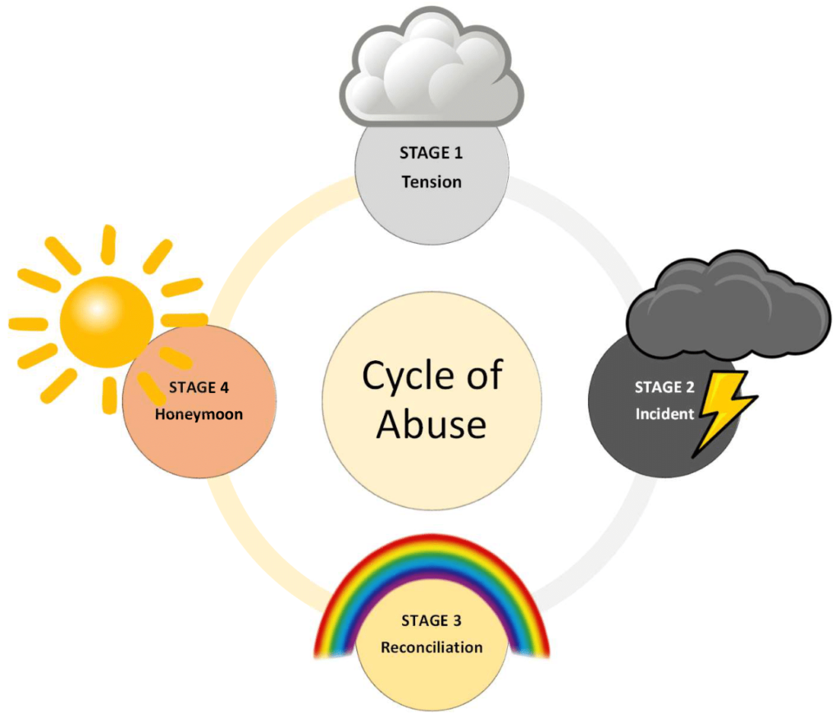
Notes:
Sarah's Story
Stage 1 – Tension Building
Sarah notices that her partner has become increasingly critical, controlling, and easily angered. She finds herself constantly trying to avoid conflict by saying the "right" thing, changing her behavior, and walking on eggshells. She believes that if she can just keep the peace, the abuse won't happen.
Stage 2 – Outbreak (AKA Explosion Phase)
The tension eventually reaches a breaking point, and Sarah's partner becomes physically violent. He assaults and threatens her, leaving her frightened, injured, and wondering what she could have done differently—even though the abuse is never her fault.
Stage 3 – Reconciliation
After the abuse, Sarah's partner apologizes and accepts responsibility for what happened. He tells her he's sorry, promises it will never happen again, and may blame stress, alcohol, or other circumstances for his behavior. He asks for another chance and convinces Sarah that things will be different this time.
Stage 4 – Honeymoon (Calm)
For a while, everything seems wonderful again. Her partner is loving, attentive, and treats Sarah the way he did when they first met. They may spend quality time together, laugh, and enjoy each other's company. These good moments give Sarah hope that the relationship has truly changed and make it even more difficult to leave. Unfortunately, over time, the tension begins to build again, and the cycle repeats—often becoming faster and more severe with each repetition.
Key Takeaway:
One of the biggest misconceptions about domestic violence is asking, "Why doesn't she just leave?" Understanding the Cycle of Abuse helps us recognize why leaving is often a process rather than a single event. Our role as advocates is not to judge a victim's decisions but to provide support, safety planning, and resources whenever they are ready.

Slide 23
How would that change you?
Imagine...
living like this
for twelve years
Notes:
I want you to really think about what it would do to you to live in this cycle—not for a week, not for a month, but for 12 years.
Imagine constantly watching someone’s mood, measuring your words, changing how you dress, what you cook, who you talk to, and how you spend money because you are trying to prevent the next explosion.
Imagine being hurt, then comforted by the same person who hurt you. Imagine hearing apologies and promises over and over until you desperately want to believe them. Then imagine the cycle starting again.
After 12 years, how would that affect your confidence? Your judgment? Your ability to trust yourself? Would you still recognize the person you were before the abuse began?
That is why we have to be careful when we ask, “Why didn’t they just leave?” A better question is, “What has happened to this person over the years that made leaving feel impossible?”
When a victim finally reaches out to us, we may be talking to someone whose sense of normal, safety, and self-worth has been reshaped by years of abuse. Our response should reflect that understanding.
Invite brief reflection. No need to over-discuss.

Slide 24
Sarah didn't call
because she was weak
She called because she found the courage
Notes:
This is the shift: Sarah isn't weak. Sarah is surviving. The call itself is an act of courage.

Slide 25

Notes:
We answered Sarah's call. Now we must respect Sarah's choices.

Slide 26
The Choices
CHAPTER THREE
Notes:
Now that we understand Sarah's story, we come to one of the most difficult parts of advocacy. Sarah has choices to make.

Slide 27
"What should I do?"
Sarah isn't asking us to make the decision
She is asking us to help her understand her options
Notes:
This may be one of the hardest questions advocates answer. Sarah is asking whether she can trust us with her future.

Slide 28
Our instinct is to tell Sarah
what we think she should do
Advocacy is not about taking control
It's about giving it back
Notes:
It is natural to want to solve the problem. But the choices have to become Sarah's choices.

Slide 29
What are some options
Sarah might have?
Notes:
Ask the audience for options. Do not rank them. Group responses as safety, legal, housing, resources, support.
Affirm answers. Emphasize options, not commands.

Slide 30
Walking Through the Options
Notes:
Information creates options. Options create empowerment.

Slide 31
Walking Through the Options
Safety Planning
Notes:
Safety planning is one of the most important things we can help clients do. Every survivor's situation is different, so there is no one-size-fits-all safety plan. Our role is to help them think through options before they need them.
Safe Word or Phrase
Encourage clients to establish a safe word or phrase with trusted family or friends.
It should sound normal in conversation but signal that they need help or that someone should call 911.
This allows them to ask for help without alerting the abuser.
Write Down Important Phone Numbers
Never rely solely on a cell phone.
Abusers often destroy or take phones during violent incidents.
Keep important numbers written on paper in a secure location, including:
Family or trusted friends
Local domestic violence shelter
Attorney
Law enforcement
Children's school or daycare
Creative Hiding Places
Think about places an abuser is less likely to search.
One inexpensive option is a travel-size tampon container sold in many stores, including Walmart. It can hold emergency phone numbers, small amounts of cash, or important information.
Many abusers avoid searching feminine hygiene products, making them a discreet hiding place.
Emergency "Go Bag"
Encourage clients to pack a bag and store it somewhere the abuser cannot easily find—or leave it with someone they trust.
Include items such as:
A change of clothes
Prescription medications
Extra keys
Cash, if possible
Copies of important documents, such as:
Birth certificates
Social Security cards
Driver's license or ID
Marriage license
Protective orders
Insurance cards
Important medical information
Having these items ready can save valuable time if they need to leave quickly.
Keep an Old Cell Phone
Even inactive cell phones can still dial 911 if they have a battery and can connect to a cellular signal.
Store the phone in a secure location and make sure:
The battery is charged.
The ringer, media volume, vibration, and all notification sounds are turned completely off.
This helps prevent emergency alerts or other notifications from revealing the phone's location during a dangerous situation.
Stress Confidentiality
Safety plans should never be left where an abuser can find them.
Even the best safety plan can become dangerous if the abuser discovers it.
Review the plan regularly because circumstances and risks can change over time.
Closing Thought
"The goal of a safety plan isn't to make someone leave. The goal is to increase their options, reduce danger when possible, and help them stay as safe as they can—whatever decisions they make."
TIMING:
5 minutes

Slide 32
Walking Through the Options
Safety Planning
Order of Protection
Notes:
Order of Protection: An Order of Protection is a civil court order designed to help protect victims of domestic abuse, stalking, or sexual assault. It can prohibit the abuser from contacting or coming near the victim, require them to leave a shared residence in some cases, and provide law enforcement with the authority to enforce the court's order if it is violated.

Slide 33
Walking Through the Options
Safety Planning
Order of Protection
Emergency Shelter
Notes:
Emergency Shelter: Emergency shelters provide victims and their children with a safe, confidential place to stay while they escape an abusive situation. In addition to temporary housing, many shelters offer crisis counseling, safety planning, legal advocacy, and referrals to community resources to help survivors begin rebuilding their lives.
Every advocate should maintain an up-to-date list of domestic violence shelters and emergency housing resources in the counties they serve. During a crisis, having contact information readily available can save valuable time and help connect a victim to safety as quickly as possible.

Slide 34
Walking Through the Options
Safety Planning
Order of Protection
Emergency Shelter
Legal Assistance
Notes:
Legal Assistance: Legal assistance can help victims understand their rights, obtain Orders of Protection, address family law issues such as custody or divorce, resolve housing or financial concerns, and navigate the legal system. Advocates should become familiar with the legal aid organizations and community resources in their area so they can make appropriate referrals when a victim needs legal representation or advice.
Advocate Reminder: Our role is to provide information, resources, and options—not legal advice. Many victims have been told by their abuser that they have "no rights," "can't leave," or "will lose their children" as a way to maintain power and control. By connecting victims with qualified legal professionals, we help ensure they understand their actual legal options and can make informed decisions based on accurate legal advice rather than fear or misinformation.

Slide 35
Walking Through the Options
Safety Planning
Order of Protection
Emergency Shelter
Legal Assistance
Counseling & Community Resources
Notes:
Counseling & Community Resources: Domestic violence affects far more than a victim's physical safety. Counseling and community resources can provide emotional support, trauma-informed care, support groups, financial assistance, housing resources, transportation, employment assistance, and other services that help survivors regain stability and independence.
Advocate Tip: Build relationships with the agencies in your community before you need them. Keep an updated list of local counselors, support groups, shelters, food assistance programs, mental health providers, victim compensation resources, and other community partners so you can make timely, informed referrals. Knowing what resources are available—and what services they actually provide—helps connect victims with the right support when they need it most.

Slide 36
Before I became a victim advocate, I was a survivor.
Notes:
Many of you know me today as a paralegal and victim advocate, but before I was either of those things, I was a domestic violence survivor.
My story began in 1998. When I first met my abuser, he made me feel like I was the most important person in the world. Like many abusive relationships, it didn't begin with violence—it began with kindness, attention, and love. The abuse happened gradually. He became easily angered, and I began believing him when he said everything was my fault. Looking back now, I know I was living in the tension-building phase of the Cycle of Violence. I constantly worried about what I said, what I wore, or even what I cooked for dinner because almost anything could trigger his anger. He slowly isolated me from my family and friends, convincing me that they didn't really care about me and that he was the only person who truly had my best interests at heart.

Slide 37
Before I became a victim advocate, I was a survivor.
A good night, a bad night, or an ER night
Notes:
Eventually, I stopped thinking about my evenings the way most people do. Instead, I categorized them as a good night, a bad night, or an ER night. During the ten years I was with him, I made several trips to the emergency room. I suffered broken bones, countless bruises, and multiple concussions. Looking back, I realize how abnormal that sounds—but at the time, it had become my normal.
One night he specifically asked me to cook white beans, ham, and cornbread for supper. I soaked the beans overnight and let them cook all day while I was at work. When I brought him his plate, he demanded to know why I had cooked that meal when we'd just had it a few nights before. I reminded him that it was exactly what he had asked for.
He threw the plate across the room and told me that he wasn’t eating that. I knew whatever step I took next would be wrong, but I still asked him if I should clean up the carpet first or fix him something else to eat first. He got up and grabbed me by my hair, rubbed my face into the carpet, and ordered me to clean up the mess and then cook him something else.
As my face was against the carpet, a scene from the movie The Prince of Tides flashed through my mind. I was absolutely terrified, but I already knew what kind of night this was going to be.
It was going to be an ER night.
Then something unexpected happened. I don't know if it was courage or simply survival, but I remember thinking, If he's going to treat me like a dog, then I'll feed him like one.
I walked into the kitchen knowing I would probably end up in the emergency room anyway. I sautéed onions and bell peppers in butter, added just about every seasoning I could find, opened a can of dog food, mixed it together, and served it over mashed potatoes with a couple of slices of bread. I took it to him and sat on the couch.
Then I waited. I waited for the beating to come. After waiting for what seemed like hours I finally looked over at him; he was eating every bite.
He actually liked it.
I never told him what he had eaten. As strange as it sounds, that tiny secret became one of the few victories I had during those ten years. Every beating I endured after that came just a little easier because I could quietly tell myself, I fed him dog food... and he liked it. It didn't stop the abuse, but it reminded me that he didn't control every part of me.
People often ask why victims stay.
The answer is because not every day is horrible.
The next day he would often come home acting as though nothing had happened. He would watch movies with me; we would work in the yard together or go riding four-wheelers—something I loved. We had good days, and I kept hoping those good days would become permanent. Instead, the cycle kept turning faster. He controlled the money, my confidence, and eventually how I saw myself.
I reached a point where I prayed every night that God would simply let me die in my sleep. I honestly believed no one would miss me. I believed every lie he had told me. I even wrote letters to my children that I hid in a drawer telling them how much I loved them, just in case God answered my prayer.
Then came the moment that changed everything.
One evening he was unusually kind. He offered to pick up supper—which he had never done before. After we ate, we sat on the couch, and he even massaged my feet. I remember thinking something felt different.
I became incredibly sleepy.
The next thing I remember was waking up coughing.
The house was full of smoke.
I couldn't breathe.
The back of the house was engulfed in flames.
I screamed his name over and over, but there was no answer.
When I finally made it outside, he was already standing there.
In that moment, I realized that if I stayed, I wasn't going to survive.
That realization gave me the courage to make a plan and leave. It was the hardest—and the bravest—thing I have ever done.

Slide 38
Before I became a victim advocate, I was a survivor.
A good night, a bad night, or an ER night
I strive to be the advocate I wish I had when I needed one most.
Notes:
Today, when I answer the phone at West Tennessee Legal Services, I never forget what it felt like to believe I had no options.
That's why safety planning matters.
That's why accurate legal information matters.
That's why emergency shelters matter.
That's why counseling and community resources matter.
Sometimes the person on the other end of the phone doesn't need someone to rescue them. They need someone to believe them, listen without judgment, give them accurate information, remind them they have choices, and help them take the next safe step.
I became the advocate I wish I had when I needed one most.
If each of us leaves here today and helps just one person believe there is hope and that they are not alone, then we've done something that truly matters.

Slide 39
We don't walk
in front of Sarah
We don't walk
behind Sarah
We walk
beside Sarah
Notes:
Our role is not to choose Sarah's path. Our role is to walk beside her as she chooses it.

Slide 40
Sarah...
I am proud of you
Making this phone call
took courage
And you should be proud of yourself
Notes:
This belongs near the end of the call, after safety has been established and Sarah has shared her story.
Say it sincerely, not theatrically.
This is validation after listening.

Slide 41
Sometimes...
the greatest thing
an advocate can say is...
Notes:
No explanation at first. Let these words sit. Then gently note that those words begin building trust.

Slide 42
Sometimes...
the greatest thing
an advocate can say is...
"I believe you."
Notes:
No explanation at first. Let these words sit. Then gently note that those words begin building trust.

Slide 43
Every survivor deserves
the dignity of making
their own choices
And every advocate has
the privilege of walking
beside them
Notes:
Domestic violence is about power and control. As advocates, we have the opportunity to help survivors regain their dignity, their voice, and the ability to make their own choices. Our role is not to make decisions for them, but to provide information, support, and empowerment.
Never underestimate the impact of simply listening, believing, and treating someone with compassion. It is a privilege to be trusted with their story, and an honor to play even a small part in their journey from surviving to thriving.

Slide 44
Walking Beside Survivors
CHAPTER FOUR
Notes:
We've answered the phone. We've understood Sarah. We've respected her choices. Now let's talk about what she will remember.

Slide 45
Sarah won't remember
every form
we completed
She'll remember
how we made her feel
Notes:
Years from now, Sarah may not remember every document, but she will remember how she felt when she hung up the phone.

Slide 46
The Words Every Survivor Needs to Hear
I believe you.
I’m glad you called today.
You are not alone.
We’re going to take this one step at a time.
Notes:
Read each statement slowly

Slide 47
Think about
the best listener
you've ever known
What made them unforgettable?
Notes:
Invite the audience to answer. Listen for words like patient, present, nonjudgmental, caring, safe.

Slide 48
Advocacy isn't about
having all the answers
It's about being fully present
for someone who needs to know
they aren't facing this alone
Notes:
Presence is part of advocacy. We do not have to fix everything to make a difference.

Slide 49
Every phone call
is someone's
worst day
But you have the opportunity
to become one of the people
they never forget
Notes:
I want you to pause for just a moment and think about the worst day of your life. Maybe it was the loss of a loved one, a serious illness, a divorce, or another event that completely turned your world upside down. Think about how you felt in that moment—scared, overwhelmed, confused, or unsure of what to do next.
Now remember this: the day a domestic violence victim calls us may be the worst day of their life.
They aren't calling because they're having a good day. They're calling because they're scared, they're hurting, and they need someone who will listen without judgment. Every interaction we have is an opportunity to help restore a little bit of the dignity, hope, and control that abuse has taken from them.
As advocates, we may not be able to change everything they're facing, but we can make sure they leave our conversation knowing they were heard, respected, and that they have options.

Slide 50
Sometimes...
the greatest thing
an advocate can offer...
is their presence
Notes:
Sometimes the greatest thing an advocate can offer is their presence.

Slide 51
HOPE
CHAPTER FIVE
Notes:
We've spent this presentation walking alongside Sarah. We've seen how abuse changes a person, how difficult it can be to leave, and how our role as advocates is to listen, provide options, and respect a survivor's choices.
But here's something I want you to remember...
Our goal isn't to fix someone's life during a single phone call.
We can't erase years of abuse in an hour.
We can't solve every legal problem, every financial hardship, or every fear they carry.
What we can do is something incredibly important.
We can be the first person who believes them.
The first person who doesn't judge them.
The first person who reminds them that they have choices.
Sometimes, that first conversation becomes the turning point in a survivor's life. Not because we had all the answers—but because we gave them something they hadn't had in a long time...
Hope.

Slide 52


Slide 53

Notes:
Hope begins long before a case closes. It begins when someone realizes they are no longer alone.

Slide 54


Slide 55


Slide 56
Dedicated
Notes:
I want to dedicate this presentation to every survivor of domestic violence.

Slide 57
Dedicated
To every survivor...
who found the courage
to make the call

Slide 58
Dedicated
To every survivor...
who found the courage
to make the call
And to every advocate...
who answered with compassion
who reminded someone they were not alone
who gave them hope for a better future

Slide 59
Dedicated
To every survivor...
who found the courage
to make the call
And to every advocate...
who answered with compassion
who reminded someone they were not alone
who gave them hope for a better future
May we never forget...
that sometimes the first conversation
can change everything

Slide 60
Somewhere in Tennessee...

Slide 61
Somewhere in Tennessee...
Someone
is hoping
you answer

Slide 62
Somewhere in Tennessee...
Someone
is hoping
you answer
Make sure they know...
they are not alone
Notes:
AUDIO CUE: Use the same phone ringtone.
Look around the room, smile, and say:
Thank you... for answering the call.

Slide 63

Thank You!

