Slide 1
Trauma Informed Lawyering
The Blame Game
Nick Gau, J.D.
Violet Gau, LPC-MHSP

Slide 2
Agenda Objectives
Introduce trauma informed care
Name the problem
Explore best practices
Establish a basic foundation of shared understanding
Improve awareness in the moment
Gain skills and tools for implementation
Notes:
Why is this training called the blame game and how do we win?

Slide 3
Understanding Trauma
“Individual trauma results from an event, series of events, or set of circumstances that is experienced by an individual as physically or emotionally harmful or life threatening and that has lasting adverse effects on the individual’s functioning and mental, physical, social, emotional, or spiritual well-being.”
(Substance Abuse and Mental Health Services Administration).
Notes:
What is trauma response mode? How do I identify it? Where does it come from? (External factors). What does it do? Anything can be traumatic but we don’t get to decide why it’s traumatic. How trauma affects the brain. How long can it last? It can be inconsistent, even in one person. Lasting impact of traumatic experiences over time. Symptoms of trauma responses. Hold the emotions for them.

Slide 4
What Shapes Trauma
Trauma
Worldview
Experience
Perception

Slide 5

What Happens...
Core beliefs about self, others, and the world
Ability to hope
Form memories
Learn and concentrate
Make decisions
Process and express language
Control impulses
Interpret emotional cues
Trust in the reliability of others
Establish a predictable sense of self
Developing diabetes, heart disease, cancer, and other ailments
Engaging in substance abuse
Attempting suicide
Developing a sexually transmitted disease
Identify and form healthy relationships
Trust others
Express needs and wants to others
Set boundaries
2020 Institute on Trauma and Trauma Informed Care -https://socialwork.buffalo.edu/social-research/institutes-centers/institute-on-trauma-and-trauma-informed-care/what-is-trauma-informed-care.html

Slide 6
Naming the problem
Trauma Symptoms
Tenets of Practicing Law & Personality Traits of Lawyers
Emotion based, overthinking
Self-destructive, hypervigilant
Heightened anxiety, poor concentration, dissociation
Instinctual, impulsive
Fight, flight, freeze
Unwilling/unable to see the problem, need for control, avoidance
Deliberate and Intentional
Logical
Conscientious of time
Analytical
Competitive/ Argumentative
Solve the client’s problem
Notes:
If you engage your client in a competitive or argumentative way, you are unlikely to get meaningful engagement, rather a fight flight or freeze response.
Transposing problems. Dog story
**Goal oriented. Lose the person and get to finish line without them. Focused on solving the problem. Three-Legged Race.
Two columns. Personality types of lawyers. Common symptom of trauma response that is adverse to the personality type. Competitiveness; will get shut down and if engaged, it will not be productive. Not playing the same game.
I’m suffering and I want you to suffer with me…..antagonizing (I can get the better of this). If they’re trying to escalate, you don’t go with them.

Slide 7
Examples
Missing a deadline.
Missing a scheduled appointment.
Not following through on assignments.
Misrepresenting the facts of a case.
Exacerbating issues especially by not following express advice.
Blaming everyone else, including you.
Last but certainly not least… trying to offend you.
Notes:
People will do things that offend you. Could be something small and is never when you want it to be but it’s always going to be a problem. Self-awareness.
Facing people at some of the worst times of their lives, brings out the worst in them. Pride yourself in working with people during the worst time of their life, will experience least motivation, worst behaviors. Take the bad with the bad.

Slide 8
Trauma Informed Approach
Trauma-Informed Care understands and considers the pervasive nature of trauma and promotes environments of healing and recovery rather than practices and services that may inadvertently re-traumatize.
Safety
Trustworthiness
Choice
Empowerment
Collaboration
Notes:
What is the intention behind your questions? If someone missing a deadline, asking them “what happened?” Need to problem solve being reflexive as a lawyer. Lawyers want to take excuses away but this is not productive approach. Don’t ask why but ask, “is there anything I can do to make it easier for you?” Give them the power and choice.
For example, if we truly cannot provide any choice in a specifc mandated situation, how can we at least let the individual know what to expect (trustworthiness) and/or ensure emotional safety during the process? Having a good understanding of each of the values and principles is critical for being able to be deliberate in their use.
Do I want this answer for me or do I want this answer for them?

Slide 9
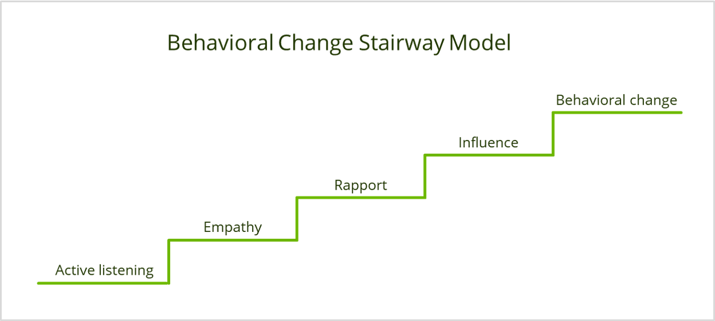
The goal of Motivational Interviewing is to help clients become aware of how current behaviors may lead them away from, rather than toward, their goals.

Slide 10
Motivational Interviewing
A collaborative conversation style for strengthening a person's own motivation and commitment to change.
Open Ended Questions
Affirmations
Summarizing
Reflections
Notes:
What is the intention behind your questions? If someone missing a deadline, asking them “what happened?” Need to problem solve being reflexive as a lawyer. Lawyers want to take excuses away but this is not productive approach. Don’t ask why but ask, “is there anything I can do to make it easier for you?” Give them the power and choice.
For example, if we truly cannot provide any choice in a specifc mandated situation, how can we at least let the individual know what to expect (trustworthiness) and/or ensure emotional safety during the process? Having a good understanding of each of the values and principles is critical for being able to be deliberate in their use.
Do I want this answer for me or do I want this answer for them?

Slide 11

Safety
Summarizing
"Let me see if I have this right..."
Shows you're genuinely listening
Invites further exploration
Client experience is
"you get it"
Gives client time for their own reflection
Create a welcoming environment
Embrace diversity and inclusion
Give consequences using supportive, non-confrontational language

Slide 12
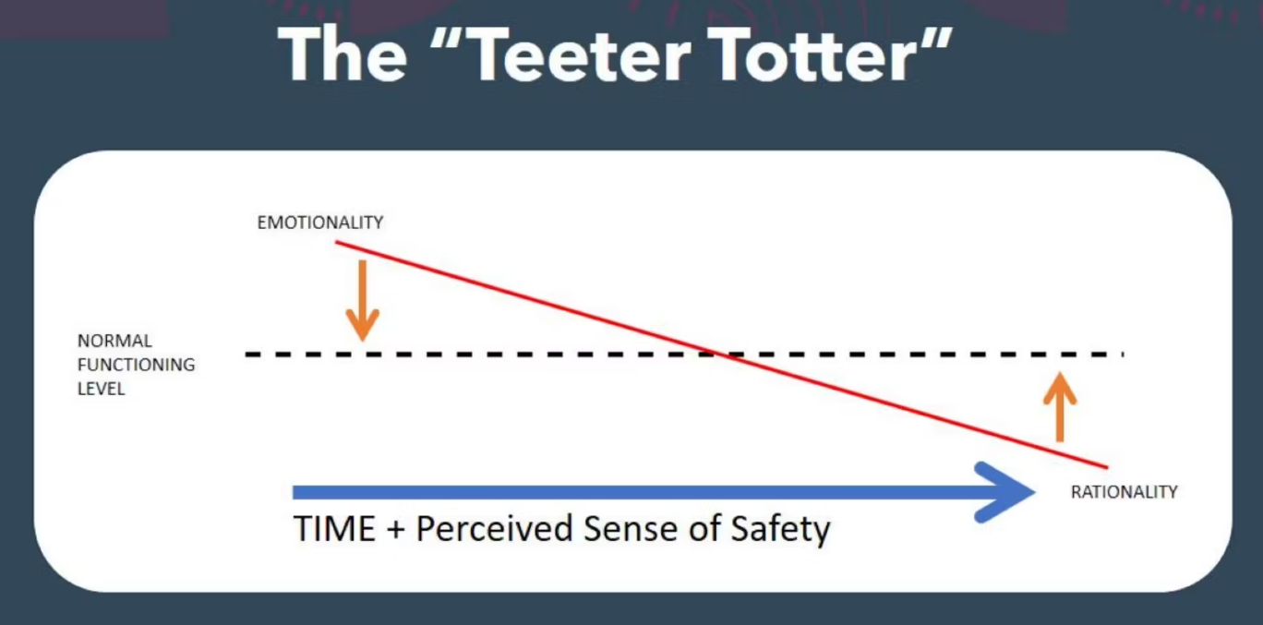

Slide 13
Trustworthiness
Reflections
Allows people to hear thoughts and feelings
Shows understanding of the client narrative
Builds trust
Provide clear information about expectations
Inform others of transitions and process ahead of time
Express patience and acceptance

Slide 14

Choices
Inform others about options available to them
Balance flexibility while defining parameters
Reflect options regarding race, gender, culture, etc.

Slide 15
Empowerment
Affirmations
Recognizes and acknowledges inherent worth
Supports engagement
Reduces threat and notices competence
Not the same as praise
Build on strengths and capacities
Ensure interactions are validating and affirming
Use person-first and inclusive language

Slide 16

Say "Yes, and..."
"It sounds simple, but in fact you could capture all my research findings with a metaphor of a saltshaker.
Instead of filling it with salt, fill it with all the ways you can say yes, and that's what a good relationship is. You sprinkle "yeses" throughout your interactions."
"Yes, that is a good idea"
"Yes, that's a great point. I never thought of that."
"Yes, let's do that if you think it's important."
John Gottman (2007 Harvard Business Review)

Slide 17
Collaboration
Open Ended Questions
"what...?" "how...?" "when...?"
Gives control of dialogue to the client
Invites conversation
Better understanding of client perception and experience
Seek ideas and feedback
Explore others' circumstances from their perspectives
Acknowledge power dynamics

Slide 18
Additional Considerations
Organization Wide Approach
Time
Ongoing development, reflection, and challenging self
Intentionality
Self-Care

Slide 19
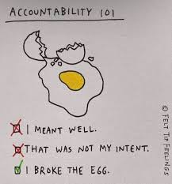

Slide 20

Questions?
Nick Gau
Equal Justice Works Disaster Resilience Fellow
Ngau@tals.org
Violet Gau
Mental Health Cooperative
Partners in Care Co-Response Supervisor
violet.gau@mhc-tn.org

