Slide 1


Slide 2
Table of Contents & Resources to Get You Started
In this Deck
Single Slide to add to any presentation
Full training deck to host your own Diffit Professional Development
Content Area Specific Slides
Instructional Frameworks & Strategies
Resources to Get You Started:
What is Diffit Video
Shareable One Pagers
Diffit YouTube Channel

Slide 3

Objective and Agenda
Objective: Explore and learn how Diffit can create student-ready resources for your classroom.
Agenda:
What does Diffit do?
Generate a student-ready resource
Edit, customize, & add to your resource
Explore how teachers use Diffit

Slide 4
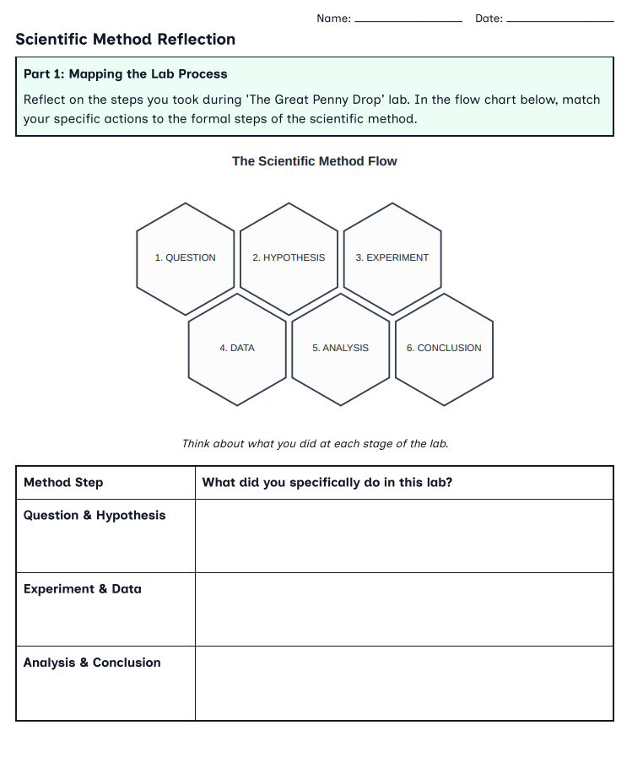
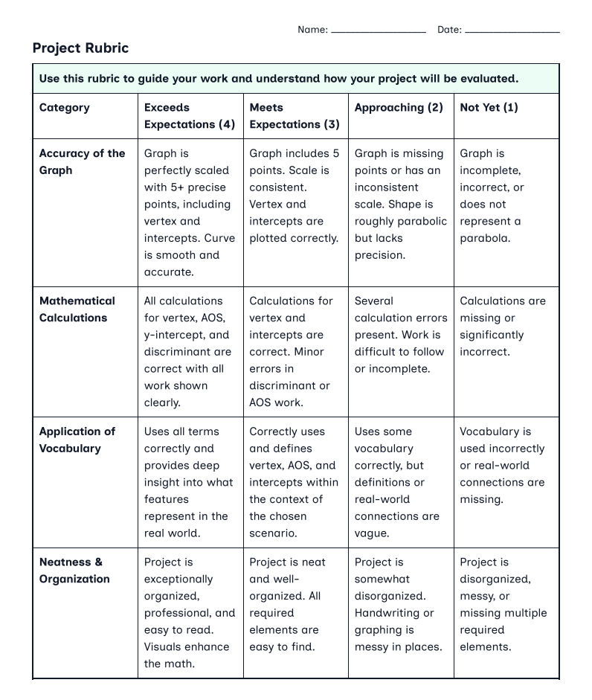
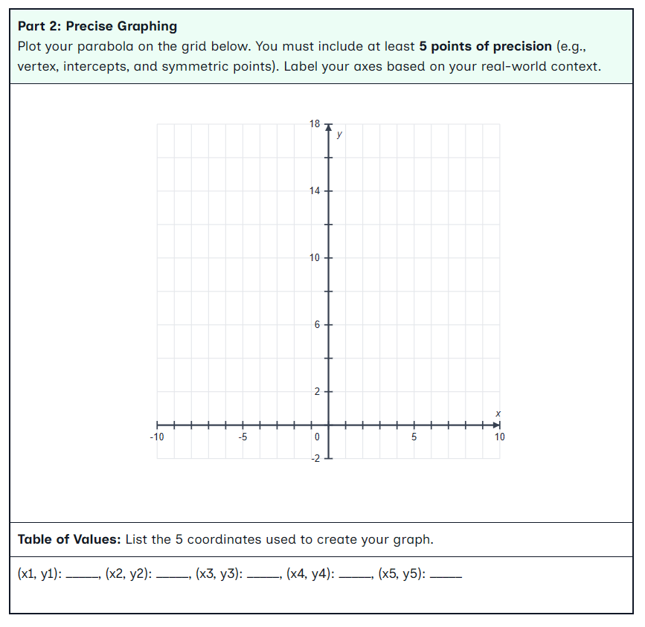
What does Diffit do?
Diffit helps you create differentiated, standards-aligned content and flexible activities—fast.
Start with any topic, standard, or content you already have, and Diffit will generate ready-to-use activities in minutes.
Customize and adapt to meet your students where they are.
Differentiate by grade level and language.
Try it! ➡️ app.diffit.me

Slide 5
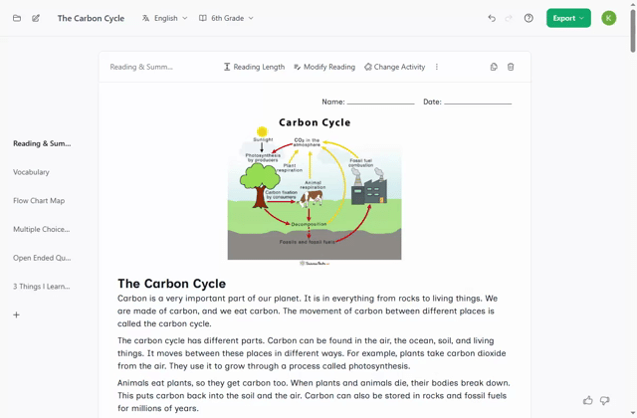
What does Diffit generate?
Each Diffit resource is customized to the grade level, subject area, and learning goals identified by the teacher. You can create:
A comparison activity with multiple texts
A primary source analysis activity
A station rotations lesson plan
Test prep and skills practice
A hands-on science lab
A family resource for at-home math practice
And so much more!

Slide 6
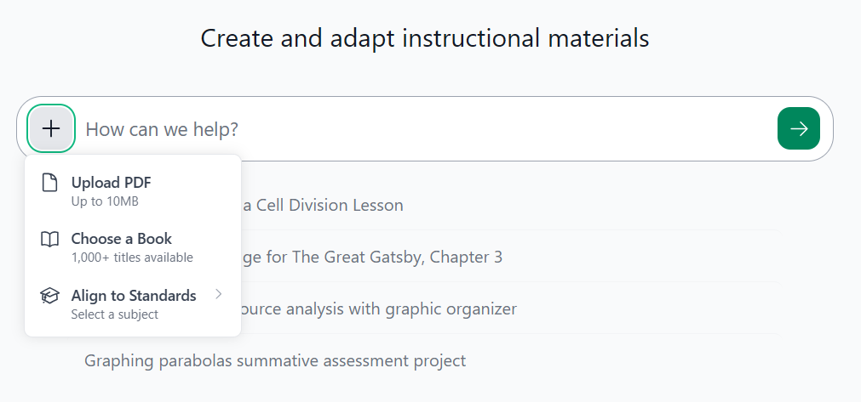
Let’s make a student-ready resource…
Go to app.diffit.me
Start new: Enter a topic or click an option below to either upload your content, adapt the content, select a book or standard you plan to teach.
Start with what you have: upload a PDF, select a book, or link an article or YouTube video
Let’s try it! Create a resource for your classroom.

Slide 7
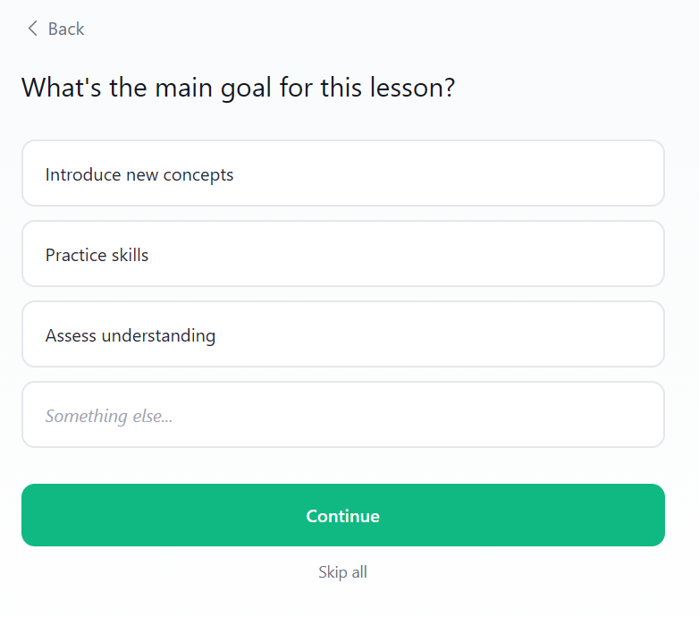
Try it with content you already have
Click the green →
Respond to the lesson planning prompts or select “skip all”
Let’s try it: Refine your request and generate!

Slide 8
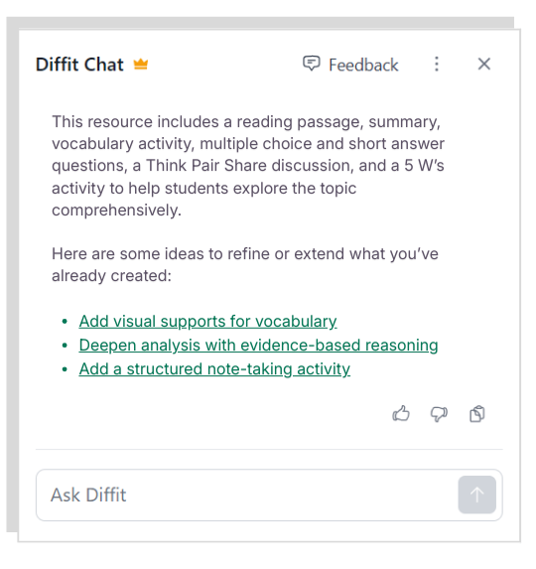
Customize Your Resource
Diffit Chat is a chat assistant that helps teachers create, adapt, and enhance classroom materials in seconds.
Customize resources by asking a question, making a direct request, or choosing a suggestion.
Look for chat to the right of any resource!
Let’s Try It: Edit, modify, and add content to your resource and activities using Diffit Chat.
Notes:
Stop at 2:32

Slide 9
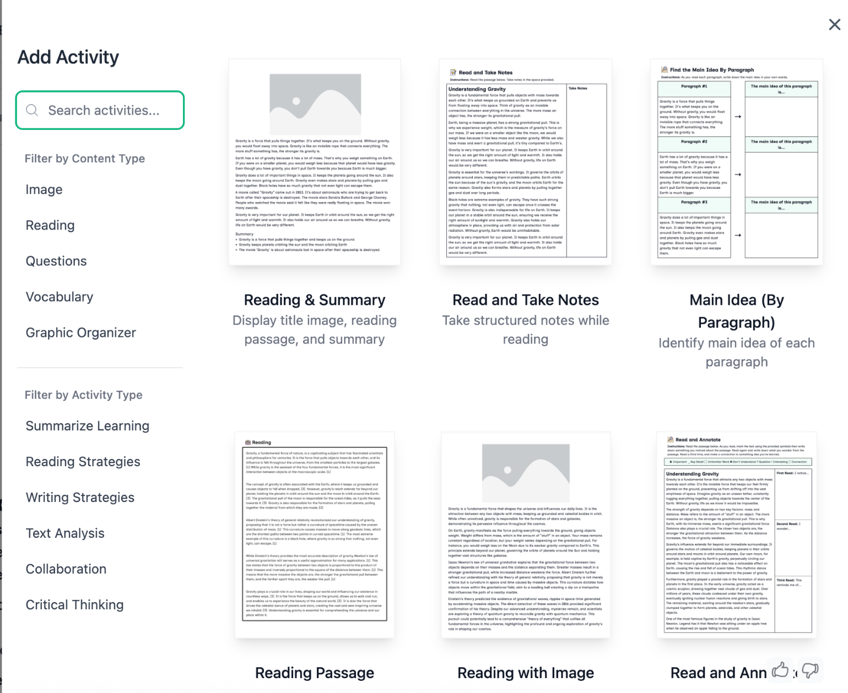
Get Inspiration
You can browse student activities and add ready-to-use templates.
Click “Browse Activities” to explore a library of graphic organizers and activities
Click ‘+’ in your table of contents
Let’s Try It: Click “Browse Activities” and select an activity for your students.

Slide 10
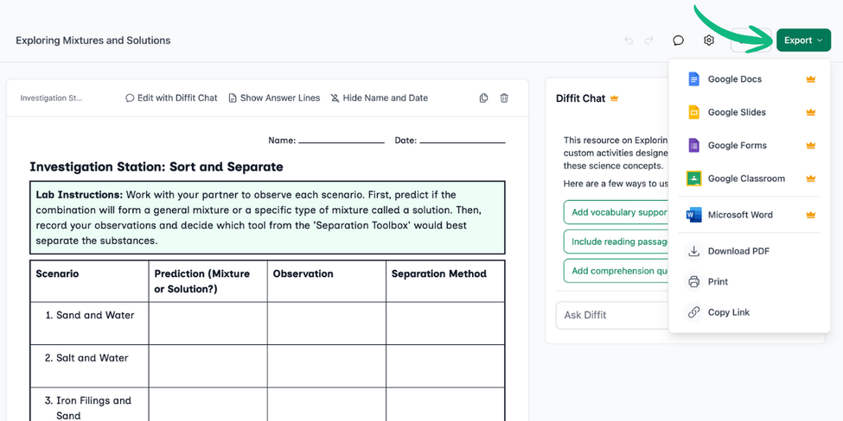
Export to share with students
To share with students click “Export.” From there you can:
Export to Google Docs
Download as a PDF
Export to Google Forms
Export to Microsoft Word
Export to Google Slides
Share to Google Classroom
Print
Let’s Try It: Export to the format of your choice and send it to the colleague.

Slide 11
Teachers use Diffit to…
Quickly create supplemental materials that engage students and reinforce learning
Support project-based learning and generate activities tied to student interests
Create or adapt materials when existing materials don’t meet students’ needs or interests
Turn and Talk:
How might you use Diffit to generate resources for your students?

Slide 12
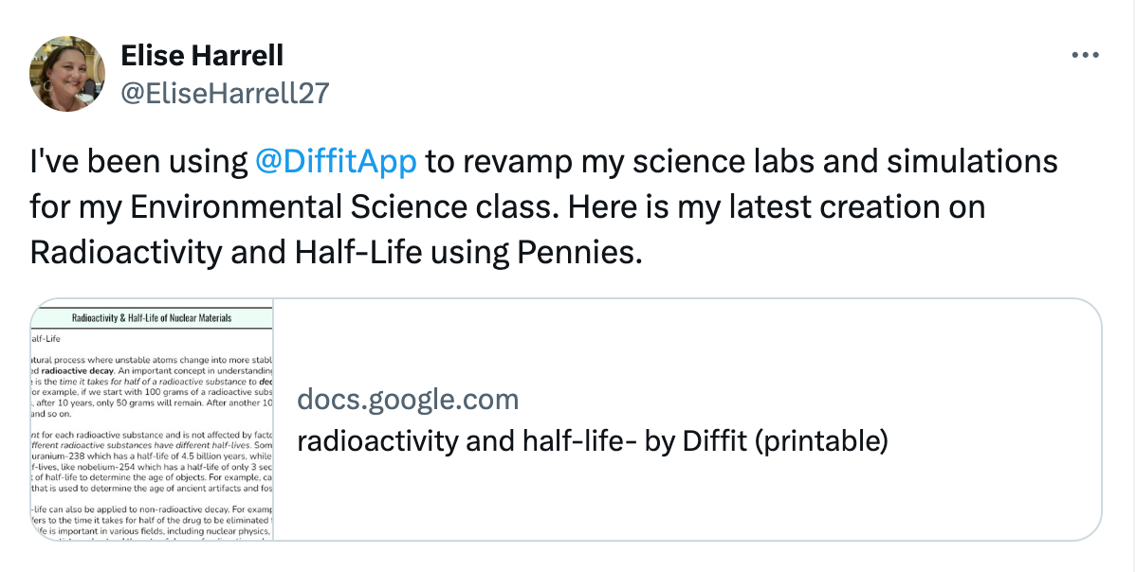
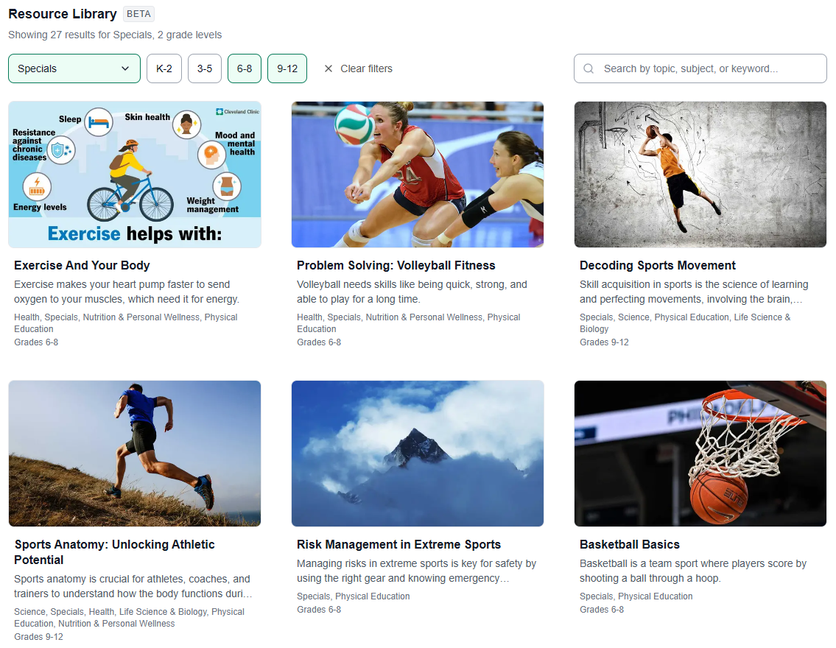
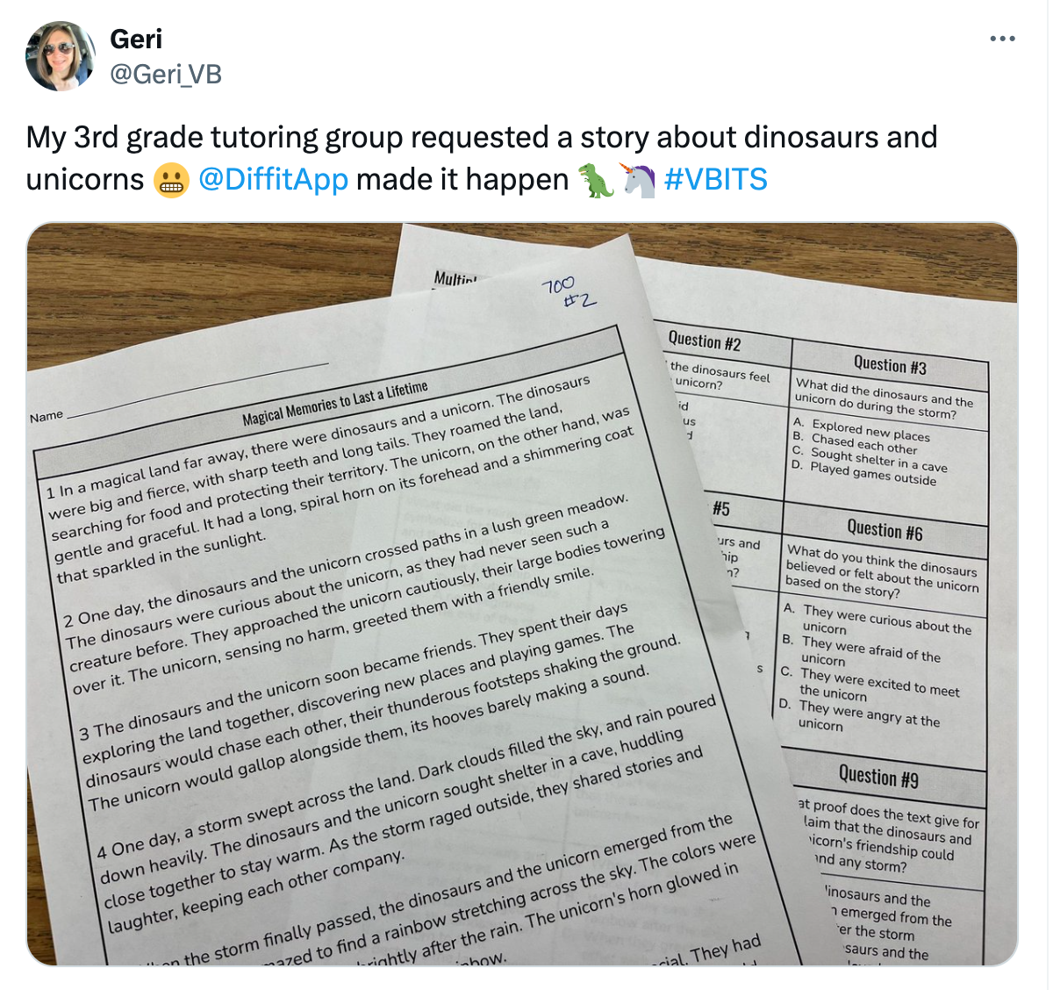
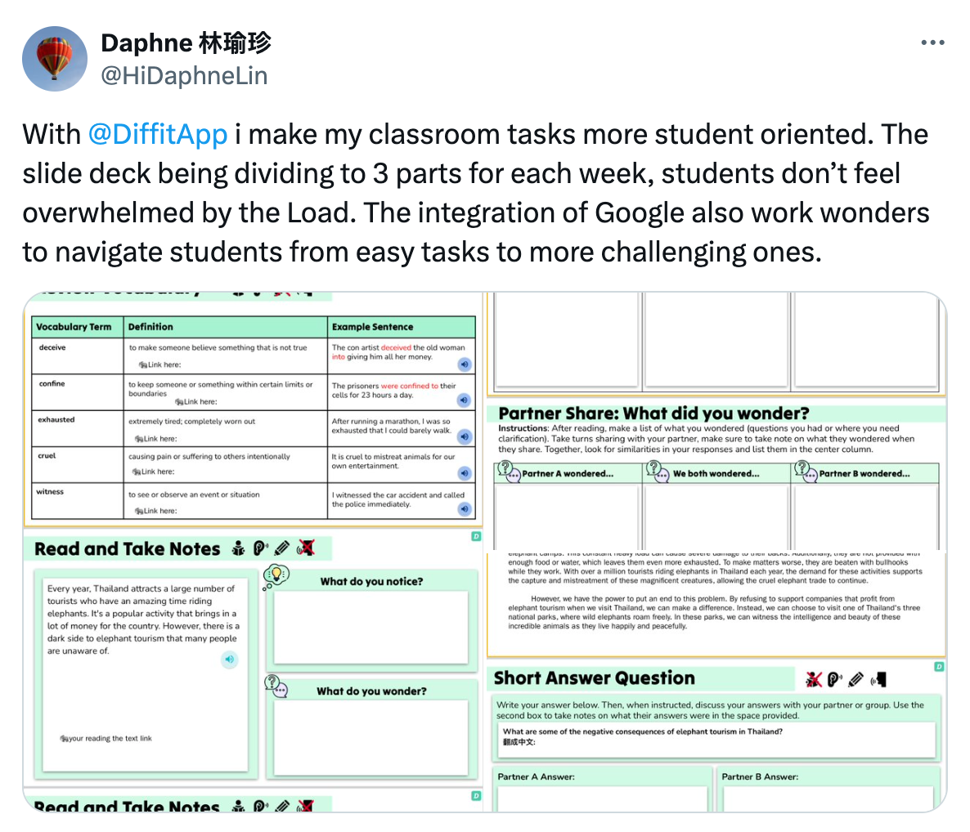
What does Diffit look like in the classroom?
See examples of teacher-created content in our Diffit Resource Library.

Slide 13
Inspiration: Diffit in Your Classroom

Slide 14

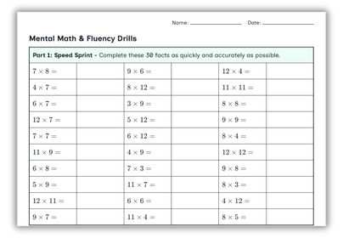
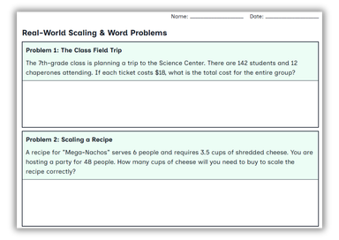
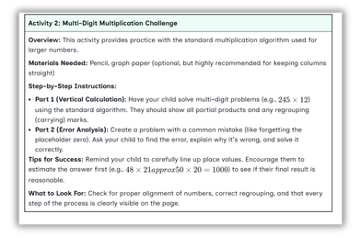
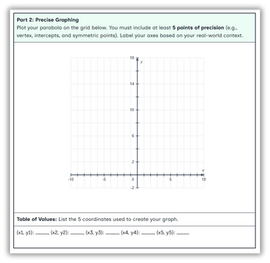
Diffit for Math
Add differentiated skills practice for any concept.
Connect math to real life with relevant examples and story problems.
Add step-by-step problem explanations for students (or families, or colleagues).
Incorporate graphing, data analysis, and other visuals into materials.

Slide 15

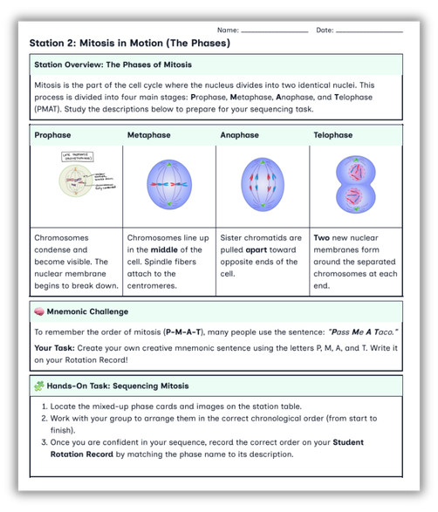
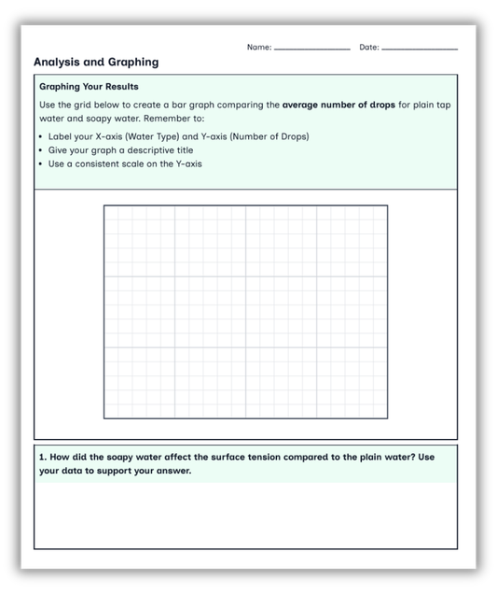
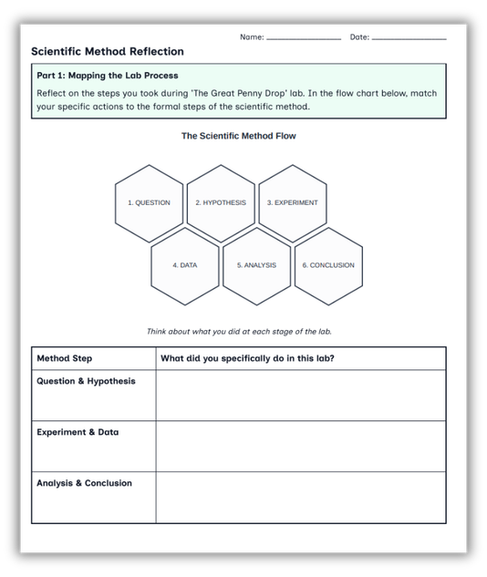
Diffit for Science
  Get lab sheets, mini-lessons, and more in minutes.
  Add tables and graphs for data collection and analysis.
  Prep hands-on or concept-driven lessons faster.
  Incorporate multiple literacies in one science lesson.

Slide 16

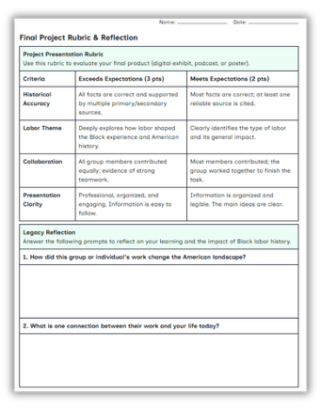
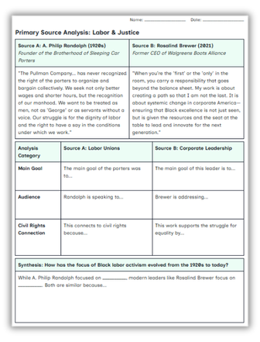
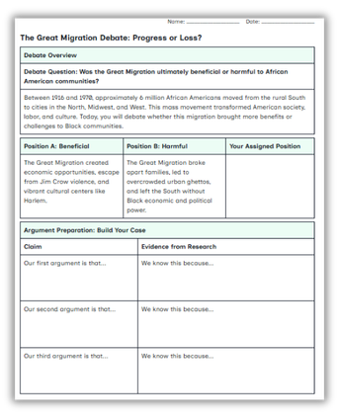
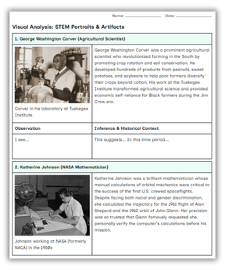
Diffit for Social Studies
Build relevance with custom extension activities and project guides.
Challenge students to think critically when reading primary sources.
Generate discussion, debates, writing prompts, and more.
Incorporate visuals alongside text-based sources for synthesis and deeper thinking.

Slide 17

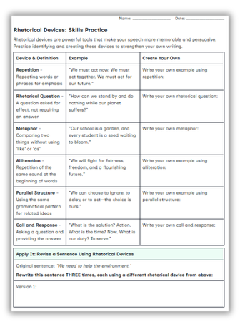
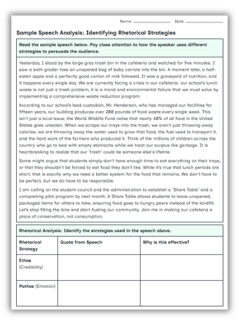
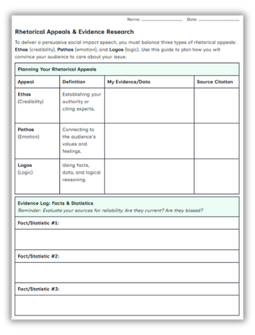
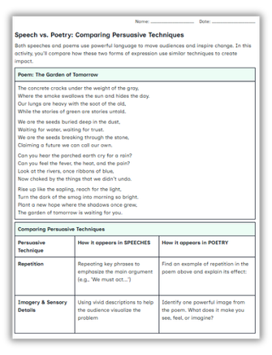
Diffit for ELA
Enhance skills practice with relevant examples and differentiated assessment.
Adapt, annotate, and chunk passages to build comprehension and analysis.
Craft writing prompts, graphic organizers, and rubrics – all in one packet.
Integrate multiple texts in one lesson for synthesis and genre-based practice.

Slide 18

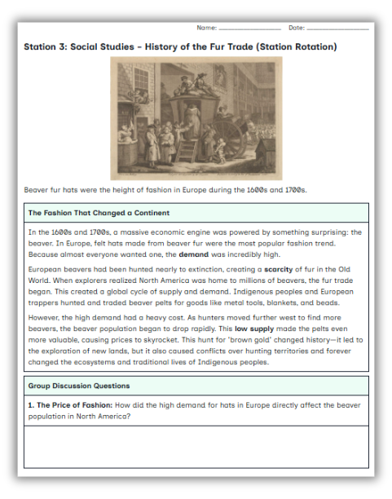
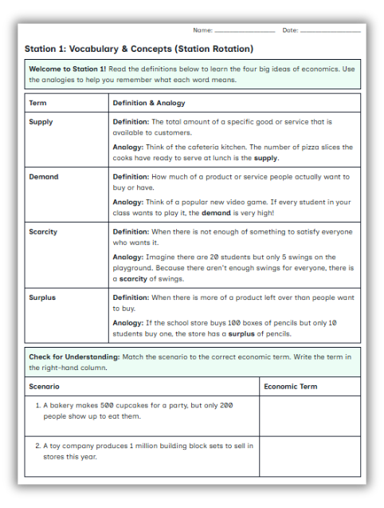
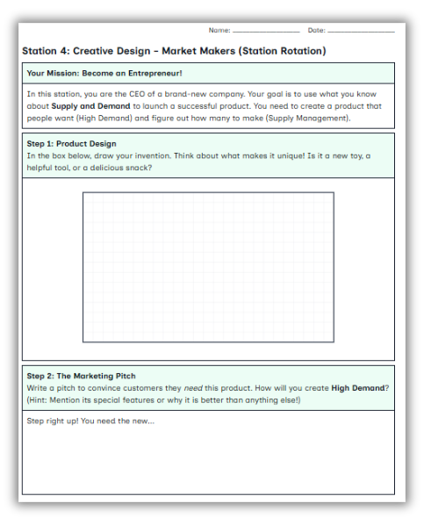
Diffit for Elementary
  Create high-impact activities like stations learning.
  Adapt easy-to-follow learning routines for writing practice.
  Include key visuals like graphs and number lines for math.
  Create interdisciplinary learning opportunities within one packet.

Slide 19

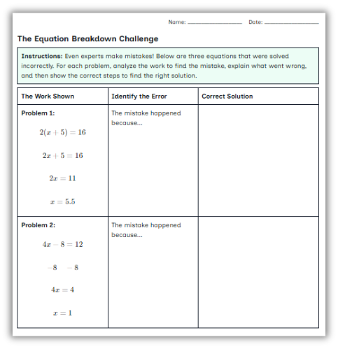
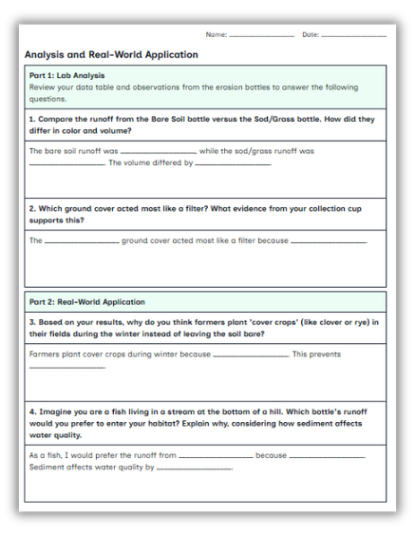
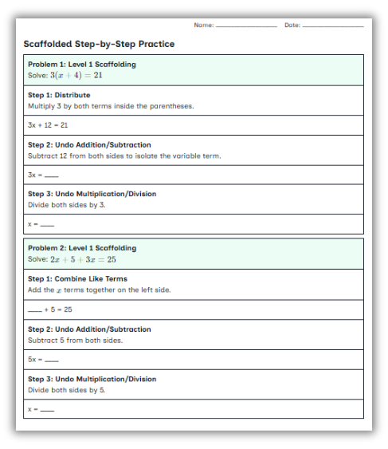
Diffit for Special Education
  Generate multiple versions of one resource for various student needs.
  Adapt and scaffold assignments to help students access grade-level content.
  Easily personalize collaborative learning to ensure all students can participate.
  Quickly add support materials, background learning, and alternative assessments.

Slide 20

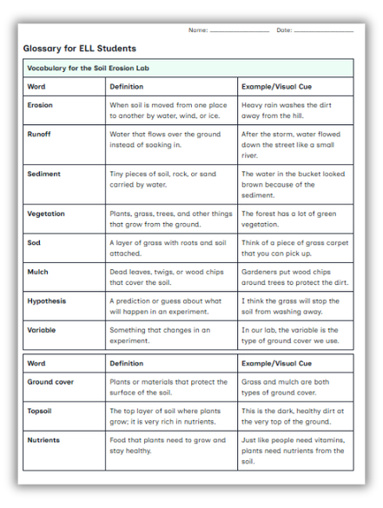
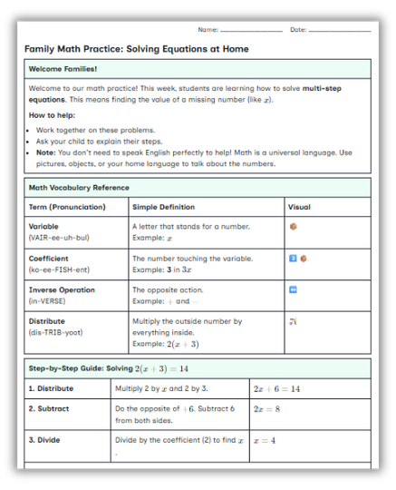
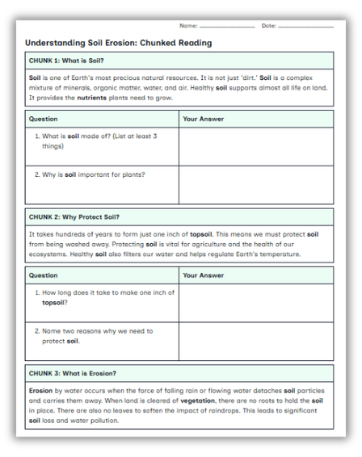
Diffit for English Learners
  Easily support speaking, listening, and writing.
  Get scaffolded texts for all content areas.
  Add summaries glossaries, and visuals to support language learning.
  Translate when necessary, including for at-home support materials.

Slide 21
Diffit for Instructional Frameworks & Strategies

Slide 22
Diffit for Differentiation
Adapting Core Texts: | Personalizing Learning: | Meeting Diverse Needs:
Take a single article and instantly generate multiple versions at different reading levels, ensuring all students can access the same content. | Quickly create differentiated assignments, modifications, and accommodations tailored to individual student achievement levels, fostering success and confidence. | Adapt lessons on a daily basis to meet the varied learning needs within a single classroom.

Slide 23
Diffit for Scaffolding
Gradual Release: | Chunking Content: | Foundational Skills:
Create resources that support the gradual release model, moving students from guided practice to independent application. | Break down complex topics into smaller, more manageable parts with accompanying activities. | Generate vocabulary lists and summaries that provide foundational understanding before diving into deeper content.

Slide 24
Diffit & Universal Design for Learning
Multiple Representations: | Flexible Engagement: | Varied Expression:
Use Diffit to offer content at different reading levels and in various formats (text, summaries, graphic organizers) to represent information in diverse ways. | Create activities that cater to different student interests and learning preferences, increasing motivation and engagement. | Use Diffit to provide options for students to demonstrate their understanding, such as through written responses, discussions, or creative tasks.

Slide 25
Diffit for MTSS and RTI
Targeted Interventions: | Progress Monitoring: | Scaffolded Support:
Quickly create materials for small group instruction or individual interventions, addressing specific student needs identified through MTSS/RTI data. | Use Diffit's varied activities and assessment formats to monitor student progress at different tiers of support. | Use Diffit to provide scaffolded resources that help struggling learners access grade-level content within the MTSS framework.

Slide 26
Diffit and Standards Based Learning
Standards-Aligned Resources: | Targeted Practice: | Curriculum Integration:
Generate resources that aligned to state standards. Add standard-aligned questions for assessment and more. | Create activities and questions that help students practice skills and demonstrate understanding of specific standards. | Use Diffit to integrate standards into various subjects, making it easier to ensure comprehensive coverage.

Slide 27
Diffit and The Four C’s
Communication | Collaboration | Critical Thinking: | Creativity
Diffit has graphic organizers that help students articulate ideas effectively, both in writing and as preparation for verbal discussions. | Provide differentiated materials for group projects, ensuring all students can contribute meaningfully regardless of their reading level, fostering effective teamwork. | Generate more than just comprehension questions. Diffit can create activities that encourage students to analyze information, evaluate claims, and form well-reasoned judgments on complex topics. | Diffit has creative ways for students to summarize and document learning from Draw and Explain to Social Media Summary.

Slide 28
Diffit & Spring Test Prep
Provides ACT/PSAT Style Reading Practice at Multiple Levels Reading in volume This allows struggling readers to practice the same skills as their peers while accessing text they can actually comprehend. | Targets the Exact Reading Skills Tested The ACT and PSAT reading sections assess: Main idea Inference Vocabulary in context Author's purpose Evidence-based reasoning Compare/contrast Analysis of informational text | Builds Academic Vocabulary Vocabulary is often a barrier to success on standardized tests. Diffit can: Highlight critical vocabulary Provide student-friendly definitions Add visual supports Create vocabulary practice activities | Creates Annotation and Close Reading Practice Successful standardized test readers actively interact with text. Diffit includes activities such as: Read & Annotate Main Idea by Paragraph Making Inferences Compare & Contrast Cause and Effect These activities mirror the close-reading habits strong test-takers use.

Slide 29
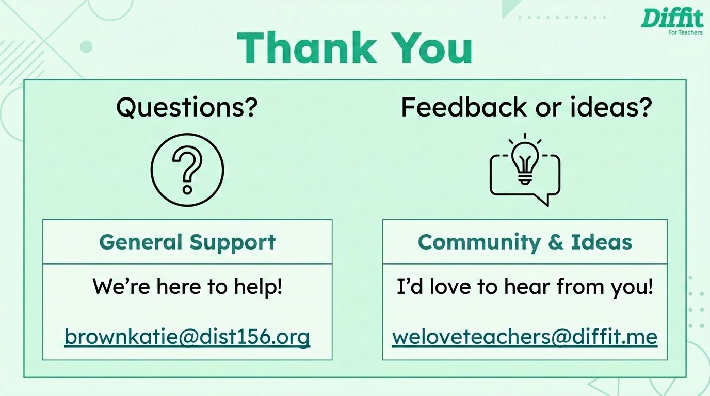

Slide 30
Professional Development Deck
Welcome, Educators!
This Diffit Professional Development Deck is built to help you introduce Diffit and support teachers in using it confidently in the classroom. Every school is different, so we’ve designed this deck to be flexible and easy to adapt.
Here’s how you can use it:
No-Prep PD: Use slides 4–14 to lead a ready-to-go training session. Best if teachers have devices and can follow along.
Customize Your Session: Pick the slides that best fit your team’s needs. Share what resonates most.
Spread the Word: Send slides or videos via email or post on social media to support other educators.
We’ll keep updating this deck with new content as features roll out. You can always find linked videos on our YouTube Channel.
Got feedback or ideas? We’d love to hear from you: weloveteachers@diffit.me

Slide 31
Table of Contents
Resources
In this Deck
Single Slide to add to any presentation
Full training deck to host your own Diffit Professional Development
Content Area Specific Slides
Instructional Frameworks & Strategies
Resources to Get You Started:
What is Diffit Video
Shareable One Pagers
Diffit YouTube Channel
Host a Donuts with Diffit: Lead a short Professional Development session for teachers, and we will send you a $25 Gift Card for snacks and all the training materials you need!
Host a Donuts with Diffit
Got feedback or ideas? We’d love to hear from you: weloveteachers@diffit.me

