Slide 1
Hi!
Teaching that Sticks: Leveraging AI for
Long-Term Learning
McHenry ROE Summer Conference
June 2026

Slide 2


Welcome! I’m…
Hi!
Steph Sukow
Cary-Grove High School
Google Innovator and Coach
English Teacher
College Speech Teacher
@Steph_Sukow (Twitter)
@StephSukow (BlueSky)
ssukow@d155.org

Slide 3

Hi!

Slide 4
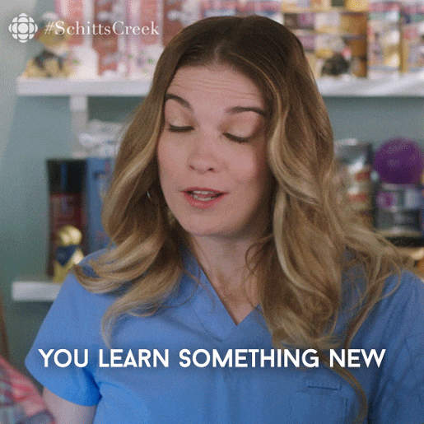

How do we know what we are teaching is sticking?

Slide 5
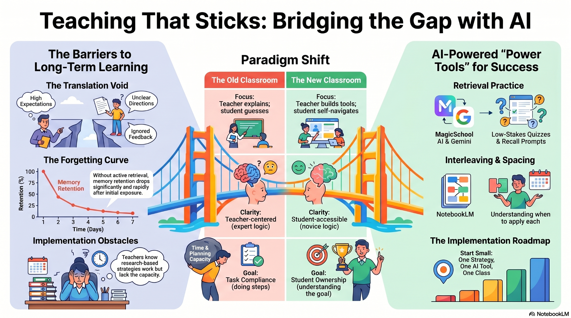

Slide 6

PD Norms
This session is about you and what you need.
It is okay to take your own path.
Consider what will work for your classroom and your students.
Ask questions.
Work on lessons/ideas for next year.
Share what you discover! We are all learning together and can learn so much from each other.
Notes:
🍐 This is a Pear Deck Web Slide.
🍐 To edit the type of question, go back to the "Ask Students a Question" in the Pear Deck sidebar.

Slide 7
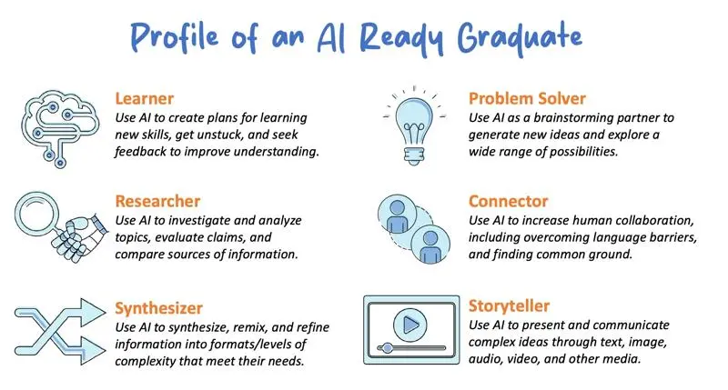
Profile of an AI Ready Graduate
Notes:
🍐 This is a Pear Deck Web Slide

Slide 8
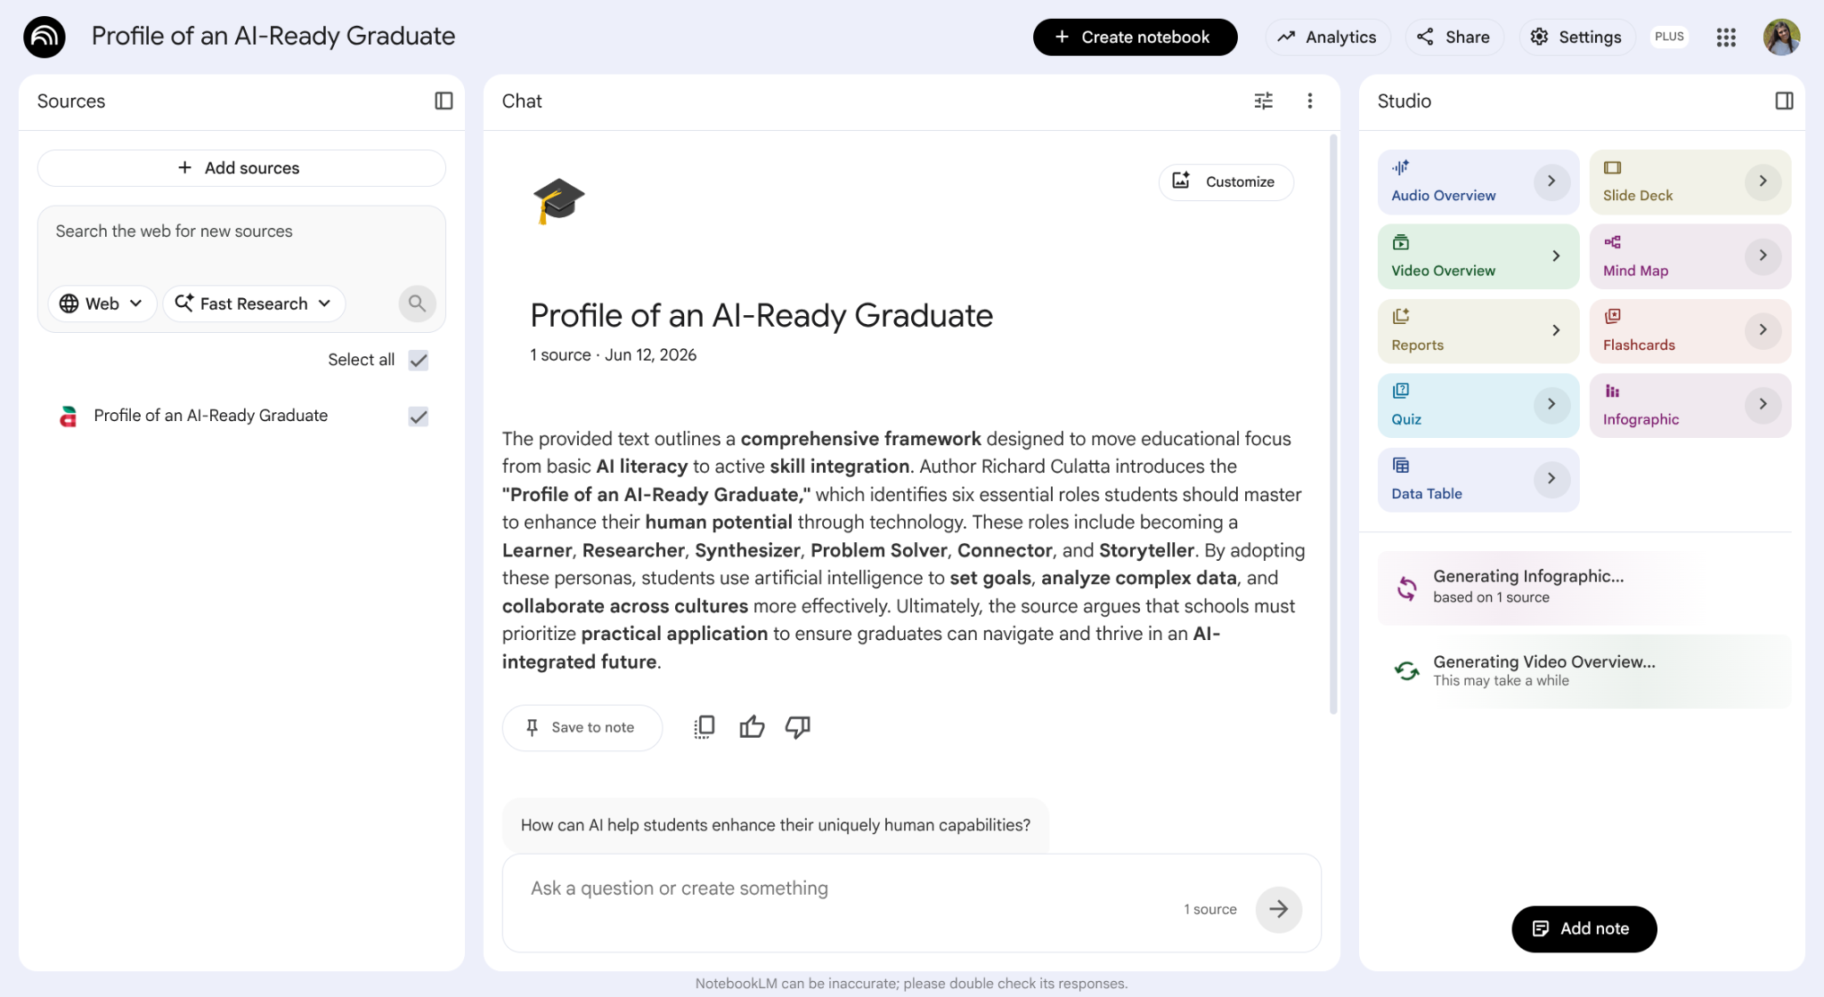

Slide 9
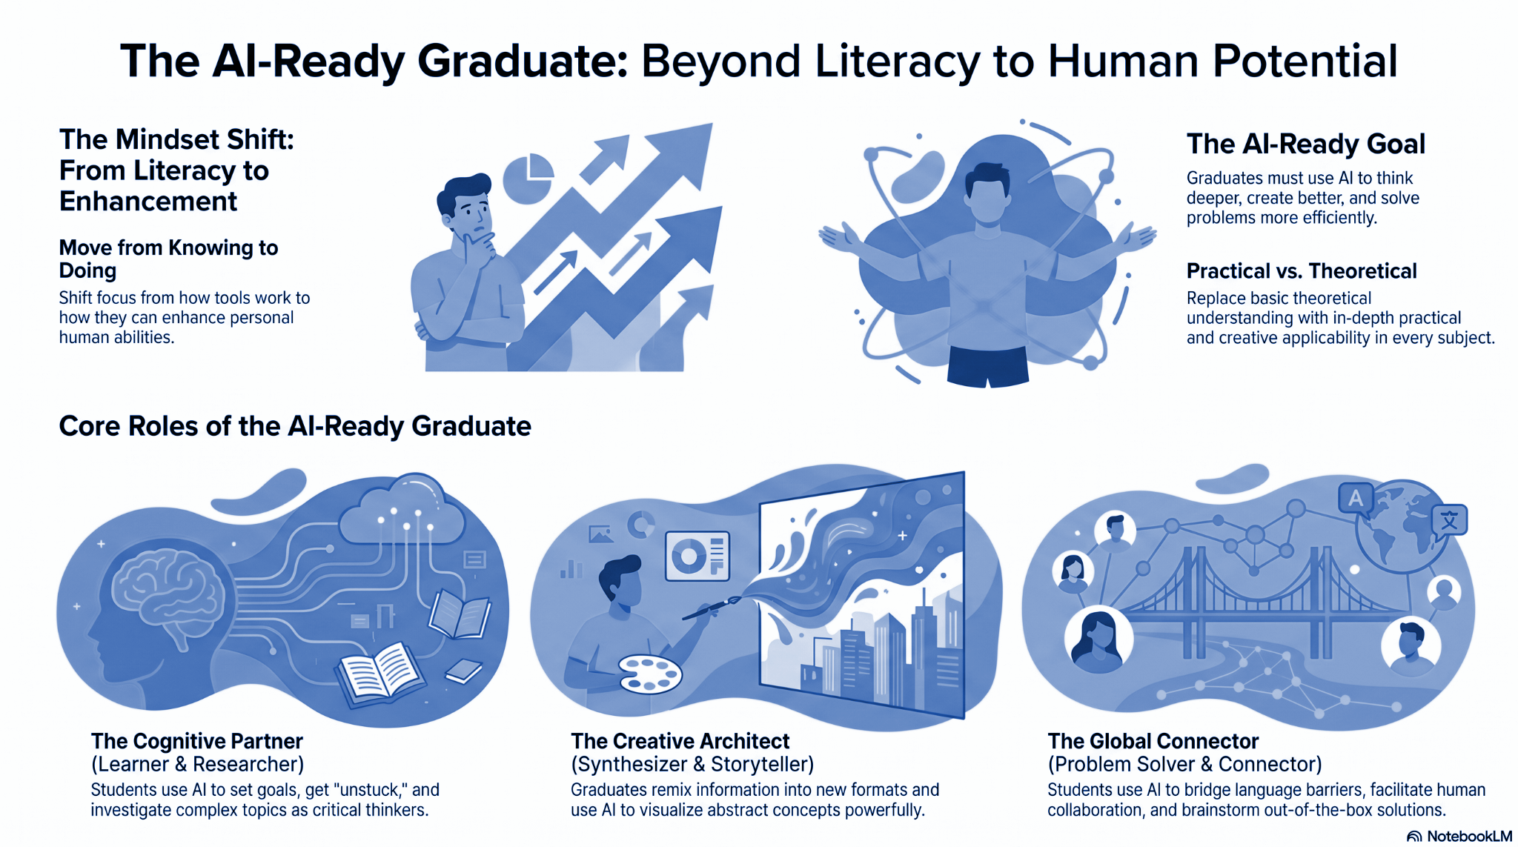

Slide 10
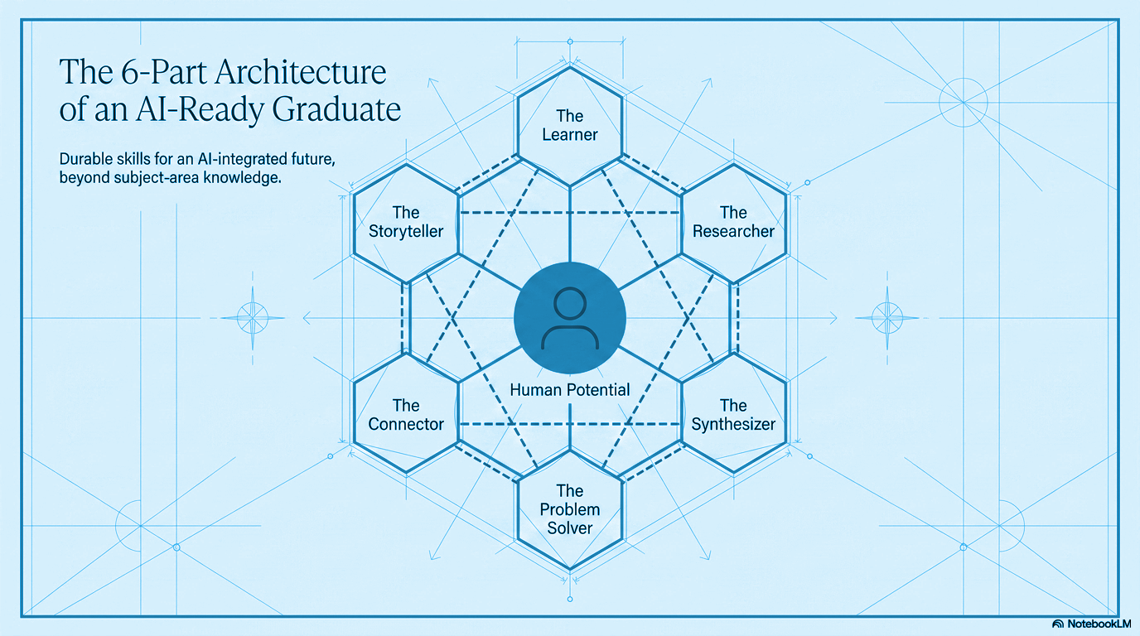

Slide 11
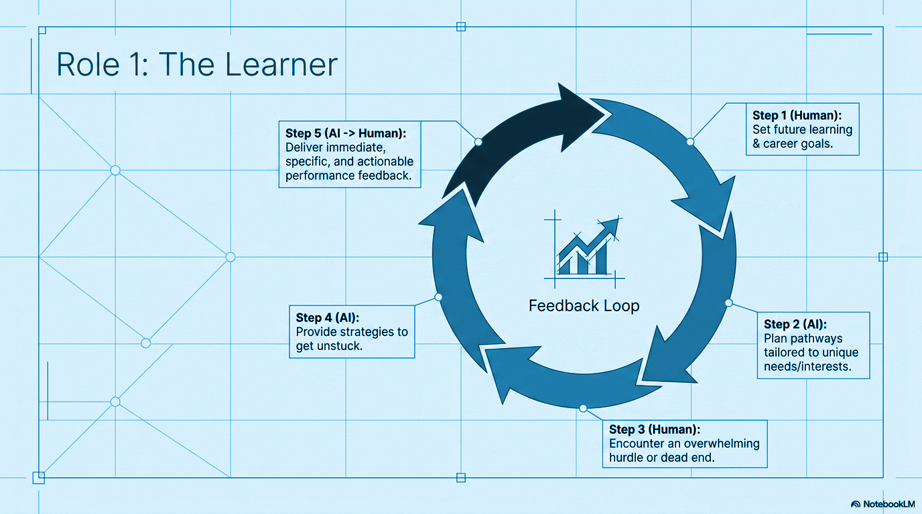

Slide 12
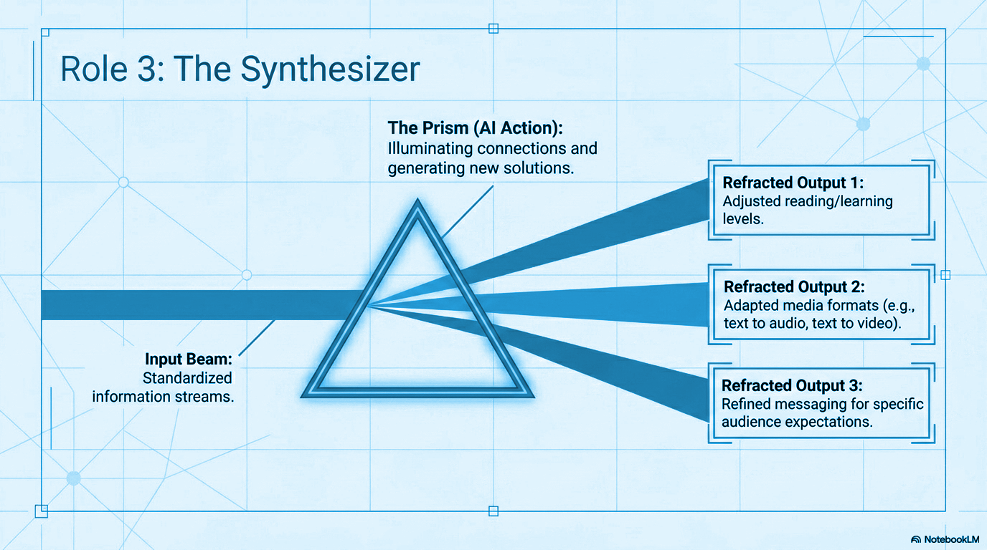

Slide 13

Today, we will . . .
Identify how retrieval, spacing, and interleaving improve student learning.
Explore how AI tools can support these research-based strategies.
Create at least one lesson idea that can be used immediately in the classroom.

Slide 14
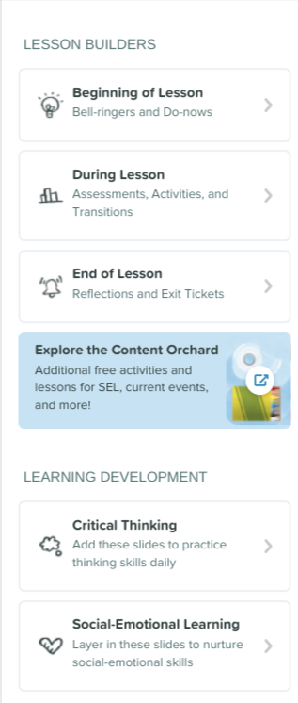
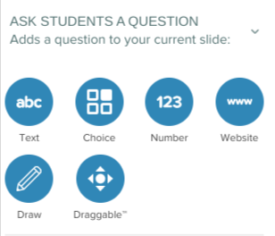
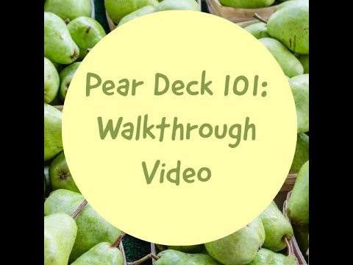

Pear Deck
Pear Deck is an interactive slideshow extension.
It encourages everyone to have a voice and provides different ways to respond and engage with a lesson.
You can monitor engagement and even export data from your slides.
Check out the Pear Deck template libraries .
Link

Slide 15
Welcome!
Take a minute to share who you are and what you teach!
View our roster.

Slide 16

Let’s share!
How do you know when students have really learned something and not just finished the work?
Why do you think students sometimes do well on a test but forget the content later?
Which classroom strategies help learning last? Which ones only work in the short term?

Slide 17
Identify how retrieval, spacing, and interleaving improve student learning.
01

Slide 18

Learning sticks when we design for long term learning.
Research shows learning improves when students:
  Retrieve information
  Space practice over time
  Interleave related concepts
Powerful Teaching bridges cognitive science and real classrooms

Slide 19
Power Tools
Retrieval Practice:
Asking students to recall from memory strengthens learning
Spacing:
Revisiting content over time beats cramming
Interleaving:
Mixing related topics or skills so students learn when and how to use each one.
Feedback & Reflection:
Helping students notice what they understand and what they still need to work on using feedback.

Slide 20
What This Looks Like in Classrooms
Small changes, big impact:
Low-stakes quizzes, bell ringers, exit tickets
Spiral review instead of one-and-done units
Questions that ask students to connect ideas across lessons
Feedback focused on thinking, not just correctness

Slide 21
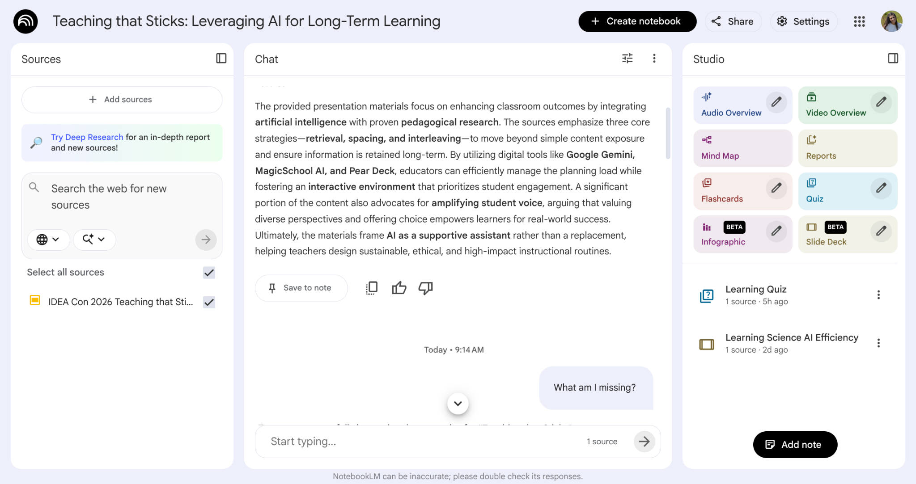
Gaps to Greatness: Notebook LM at ISTE
Notes:
🍐 This is a Pear Deck Web Slide

Slide 22
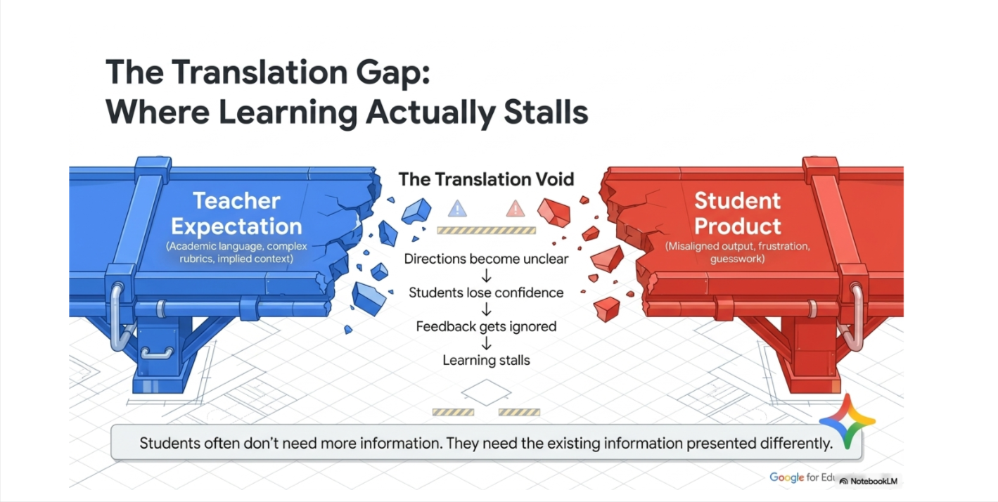

Slide 23
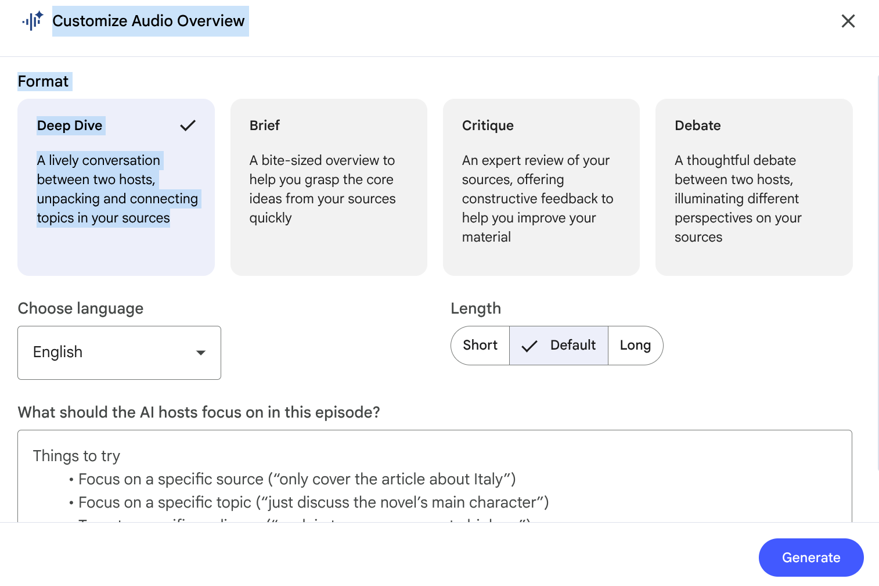

Slide 24
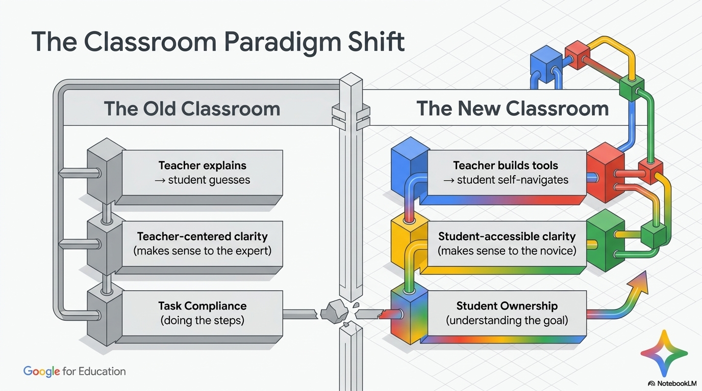

Slide 25
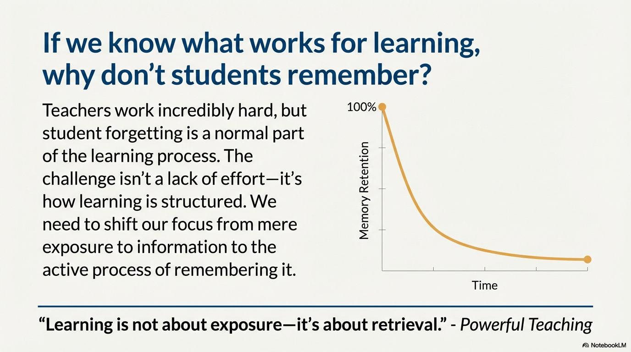

Slide 26
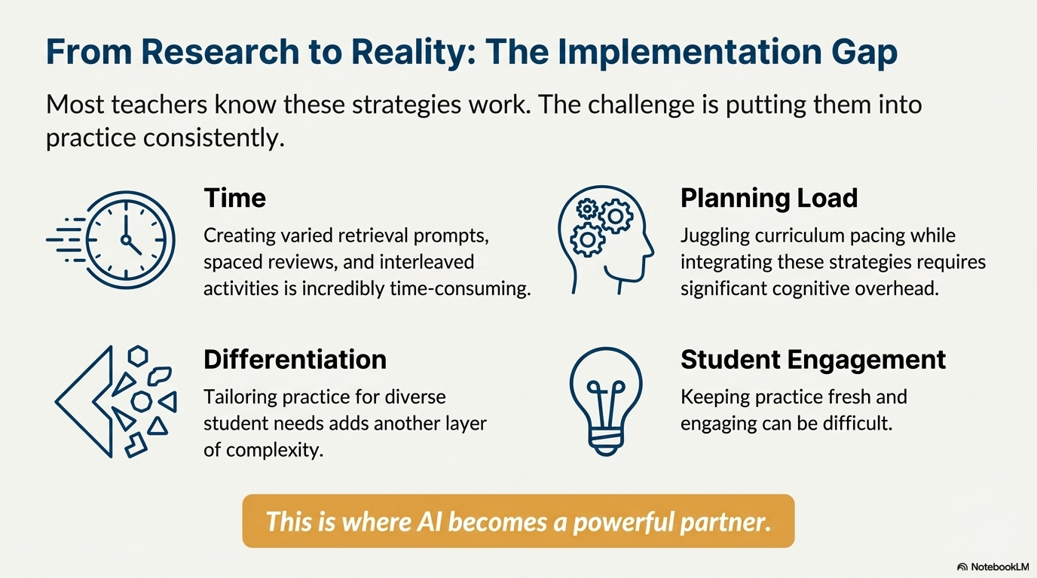

Slide 27

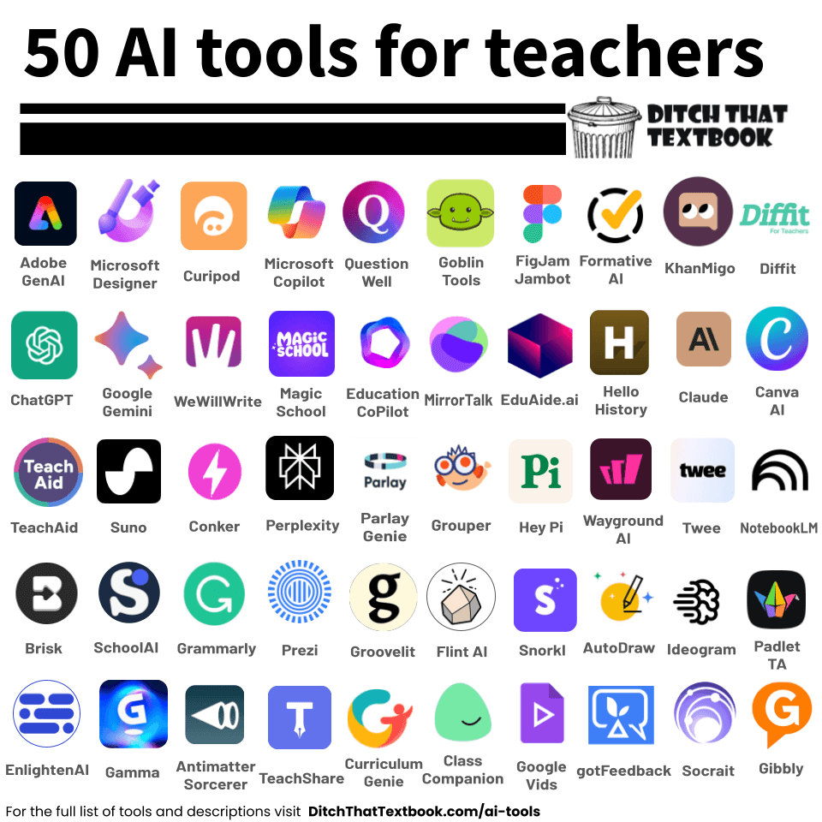


So how does AI help us with this process?
https://ditchthattextbook.com/ai-tools/

Slide 28
What obstacles do we face?
Problem:
Teachers know these strategies, but implementation is hard.
Common Barriers:
Time
Planning load
Differentiation
Student engagement
💡 This is where AI becomes a powerful partner.

Slide 29
Explore how AI tools can support these research-based strategies.
02

Slide 30
AI as an Instructional Assistant
(Not a Replacement)
Reframe AI:
Not grading for us
Not thinking for students
Not (just) a time-saver
Powerful Teaching Tie-In:
Small instructional shifts = big learning gains
AI helps us make those shifts sustainable

Slide 31
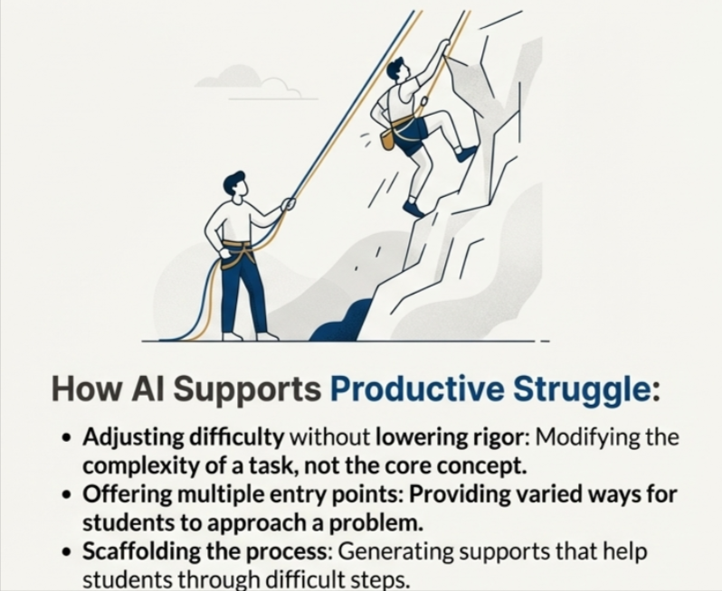

Slide 32
Retrieval and AI
Google Gemini:
  Generate low-stakes retrieval questions
  Create exit tickets from lesson content
MagicSchool AI:
  Quick checks for understanding
  Bell-ringer questions aligned to standards
Canva:
  Visual retrieval slides
  “What do you remember?” prompts
💡 Retrieval does not need to be a formative quiz.

Slide 33
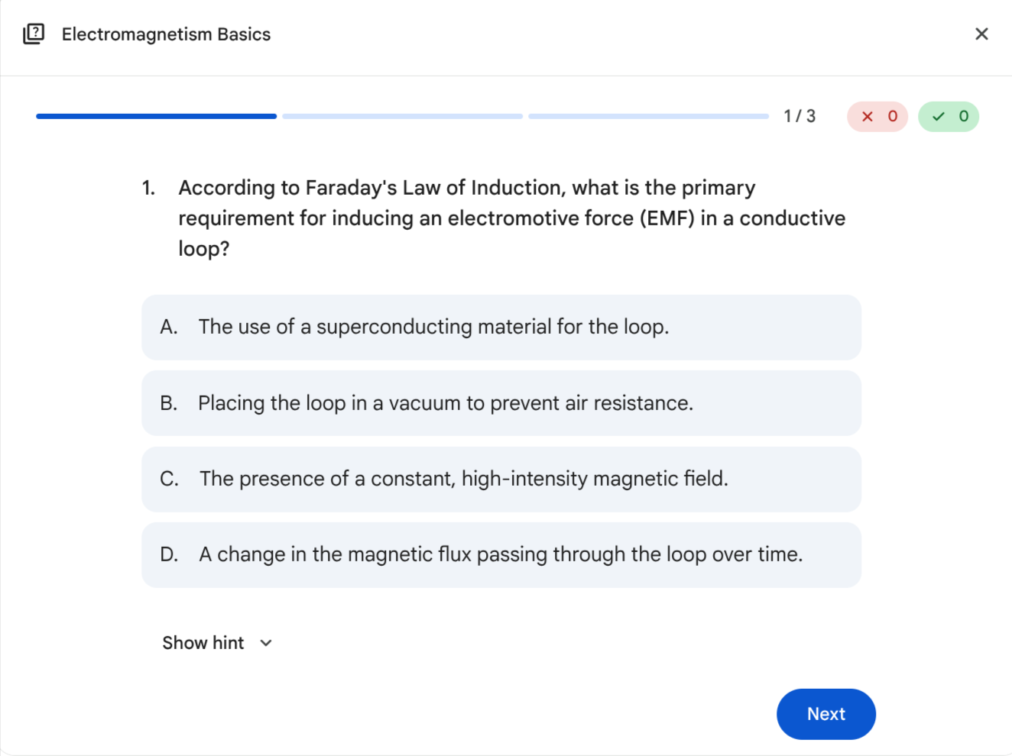
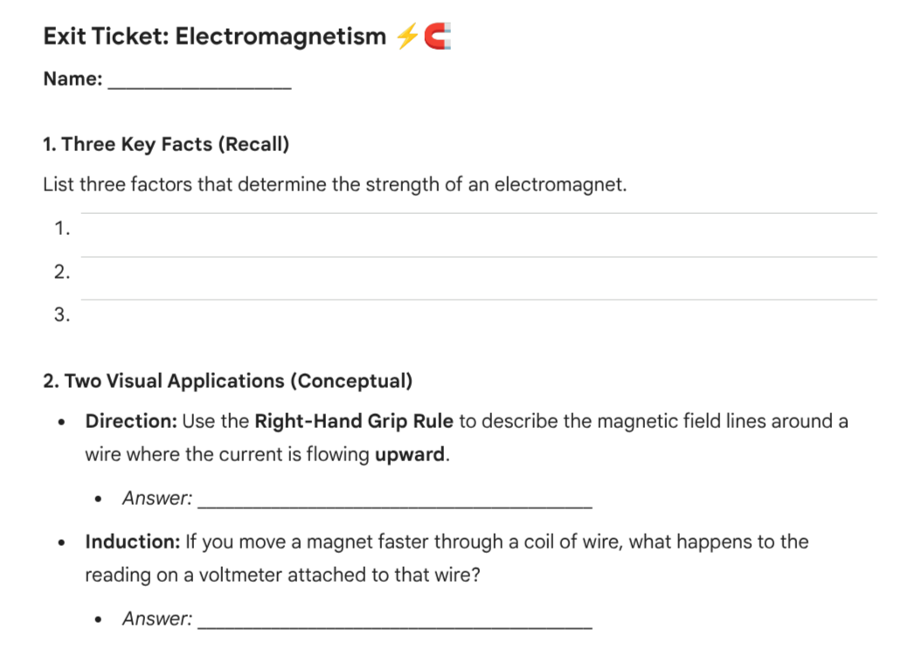
Google Gemini

Slide 34
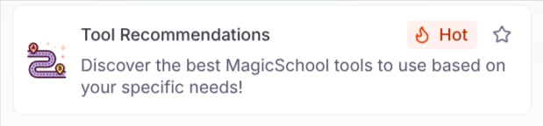
MagicSchool AI
Multiple Choice Assessments - Create frequent, low-stakes retrieval practice quizzes (quick formative checks) that target specific standards or learning objectives; ideal for repeated spaced retrieval with 11th-grade content.
Worksheet Generator - Produce customizable practice worksheets for short retrieval activities, exit tickets, or bell-ringers that you can rapidly adapt for 11th-grade rigor and topics.
Summarize It! - Ask students to summarize lessons or readings as a retrieval exercise; helps strengthen recall and identify gaps in understanding after instruction.
Spiral / Multi-Step Assignment (Multi-Step Assignment) - Create multi-step assignments that break content into repeated retrieval opportunities and scaffolded practice across class sessions, supporting cumulative recall for 11th graders.

Slide 35
Retrieval and AI
How do you encourage recall and retrieval in your own practice?
How might we encourage students to access information that they’ve already learned?
How might AI help students access what they already know before introducing new content?
Notes:
Teachers know strategies that work, but sometimes barriers (like planning load or time), make it harder. This is where AI becomes a powerful partner. Small instructional shifts can make a big difference in learning gains, and AI can help us make those shifts sustainable.

Slide 36
Retrieval and AI
AI can help teachers:
Generate frequent, low-stakes recall questions.
Create exit tickets and bell ringers in seconds.
Revisit learning from days or weeks ago.

Slide 37
Interleaving and AI
Gemini:
  Create a gem to help review multiple skills, lessons, or topics.
MagicSchool AI:
  Build a choice boards that interleave skills
Notebook LM:
  Multiple texts addressing different skills in one lesson
💡Combining and weaving skills leads to deeper learning.

Slide 38
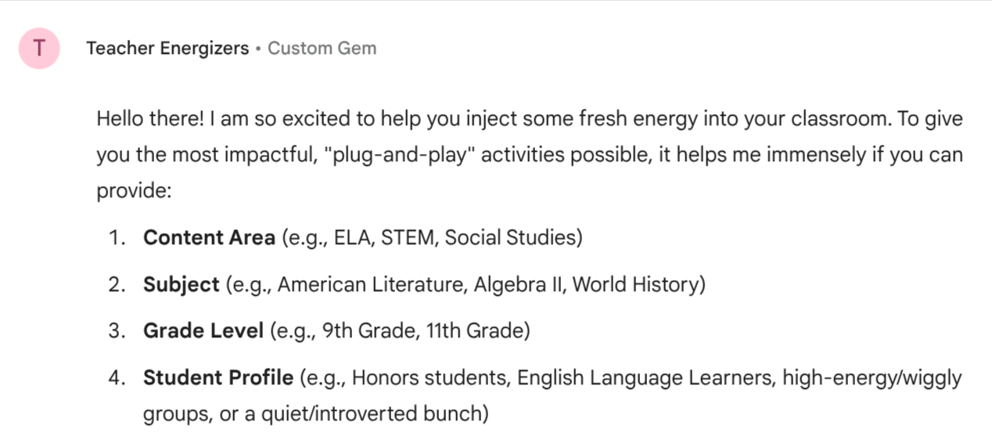
Try this GEM

Slide 39
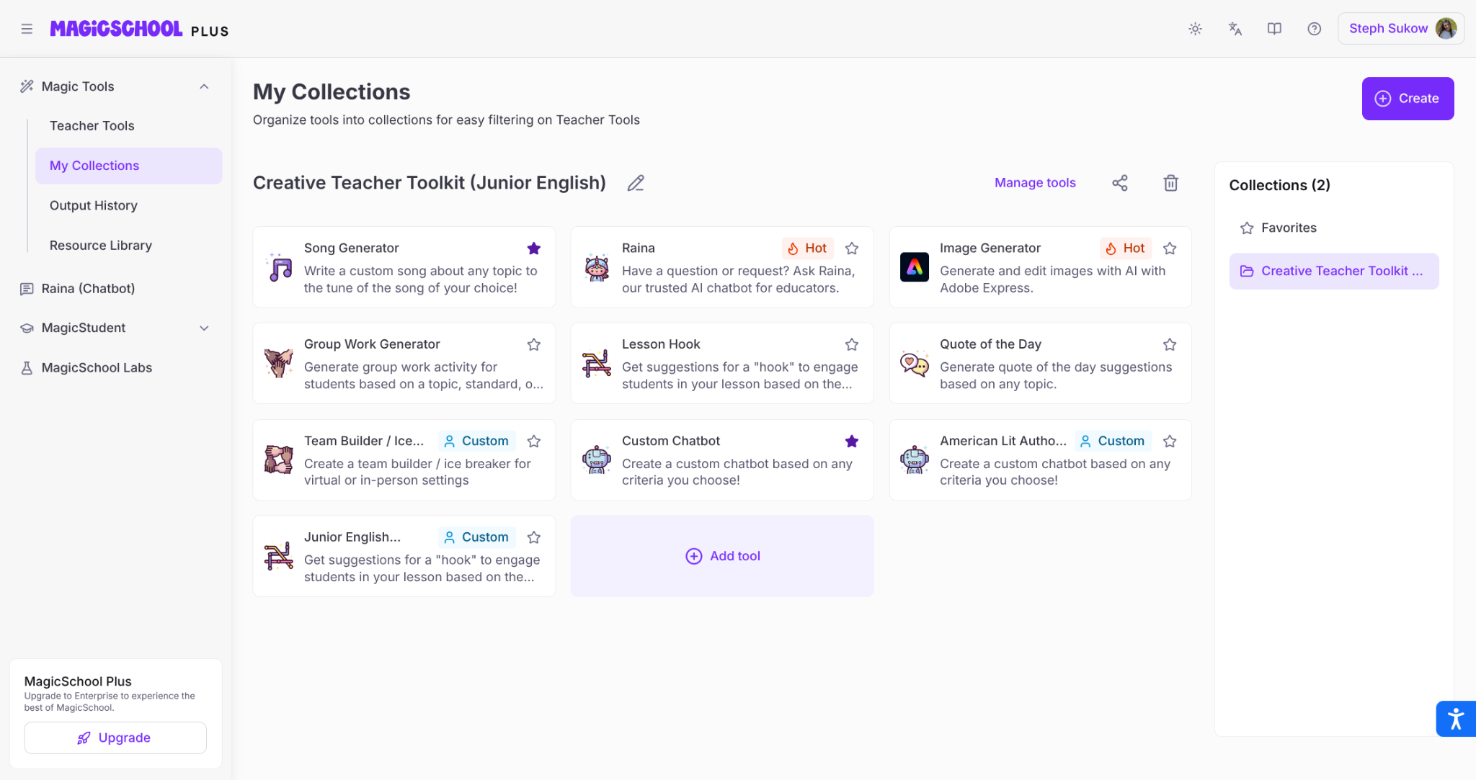
More Energizers with MagicSchool AI

Slide 40


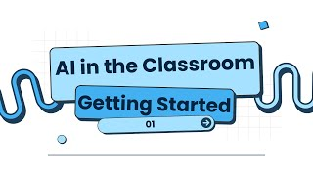
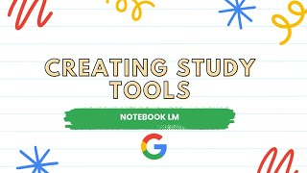
Interleaving and AI
Gemini Gems
Magic School AI
Notebook LM

Slide 41
Interleaving and AI
How do you already mix or rotate skills and topics in your lessons?
How could AI help you mix related concepts while keeping learning manageable for students?
How might AI-generated questions help you connect learning across days, weeks, or units?
Notes:
🍐 This is a Pear Deck Text Slide

Slide 42
Interleaving and AI
AI can help teachers:
Mix related skills or concepts in one task.
Create choice boards that require strategy selection.
Ask students to compare similar ideas or methods.
Notes:
🍐 This is a Pear Deck Text Slide

Slide 43
Feedback, Reflection, and AI
AI can be used to generate timely and actionable feedback.
  Students can use Gemini or MagicSchool for first-round feedback.
  Build a gem that aligns with your rubric and criteria.
Notebook LM:
  Have students create a podcast or video recapping their work for reflection.

Slide 44
Feedback, Reflection, and AI
AI can help teachers:
Create personalized pathways for students.
Encourage metacognition.
  Consider having students explain why they did or did not use AI feedback.
  Feedback becomes more immediate and can be accessed at any time.

Slide 45
Reflection Questions:
Where could this add to (not replace) what I already do?
How could use AI to impact learning in your educational space?

Slide 46
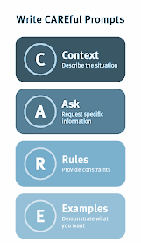
Ideas to consider:
Students need to learn to generate prompts. Create teacher-designed prompts to help scaffold that learning process.
Student thinking should always remains central.
Be transparent with students about when to use or not use AI.
AI supports instructional design, not shortcuts.

Slide 47
Create at least one lesson idea that can be used immediately in the classroom.
03

Slide 48
What does learning that sticks look like?
Notes:
🍐 This is a Pear Deck Drawing Slide
🍐 To edit the type of question, go back to the "Ask Students a Question" in the Pear Deck sidebar.
Sharing Thoughts
Often, you only have time to call on a few students, but who to call on? You don’t want to call on the same eager voices all the time, but you also don’t want to put a student on the spot. After students have time to answer your last question, use this slide to quickly see who feels comfortable to share their thoughts. You might find willingness from students who don’t normally raise their hands.

Slide 49
AI can support all learners by…
Rewriting the same task at different reading levels while keeping the thinking demand high.
Providing hints, sentence starters, or guiding questions instead of answers.
Breaking complex tasks into smaller steps while preserving the core skill.
The thinking stays challenging, but the access can become easier.
Notes:
Teachers know strategies that work, but sometimes barriers (like planning load or time), make it harder. This is where AI becomes a powerful partner. Small instructional shifts can make a big difference in learning gains, and AI can help us make those shifts sustainable. From generating low-stakes quizzes or strengthening a bell-ringer, tools like Gemini, MagicSchool, and Notebook LM support retrieval practices and make spaced practice more effective.
Remember, these tools are instructional supports; your great work still matters. Let’s keep student thinking at the center while we use AI to scaffold, adapt, and guide student work.

Slide 50


How AI Could Save (Not Destroy) Education
Sal Khan
Neuroscience, AI and the Future of Education
Scott Bolland

Slide 51
Challenge:
Create something you could use tomorrow.
Choose one strategy: Retrieval Spacing Interleaving Feedback | And one AI tool to try it: Google Gemini MagicSchool.AI Notebook LM Canva

Slide 52
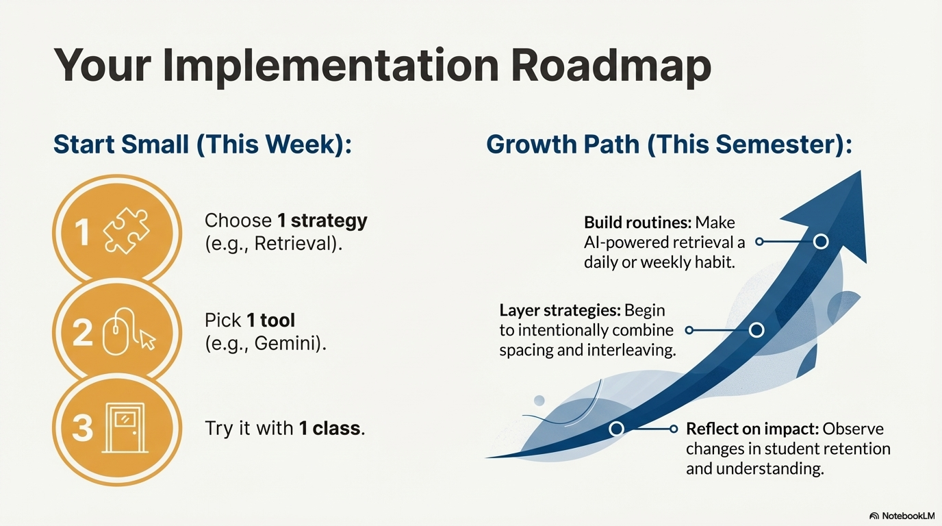

Slide 53
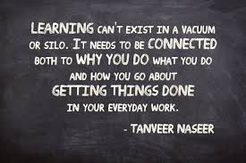
When we combine:
The science of learning
The wisdom of teachers
The efficiency of AI
We create classrooms where
learning sticks.

Slide 54



How are you feeling about supporting long-term learning in your classroom?
Notes:
🍐 This is a Pear Deck Draggable™ Slide.
🍐 To edit the type of question, go back to the "Ask Students a Question" in the Pear Deck sidebar.
Temperature Check
Get a sense for how well your lesson resonated with your students, or how engaged they were.

Slide 55

What questions do you still have?
What are your takeaways from today?

Slide 56

I’m always happy to collaborate and help! Please reach out.
Steph Sukow
ssukow@d155.org
@Steph_Sukow

