Slide 1

Exploring Connections to Nature through Geography Fieldwork
Lauren Satsi
ECT Geography Teacher

Slide 2
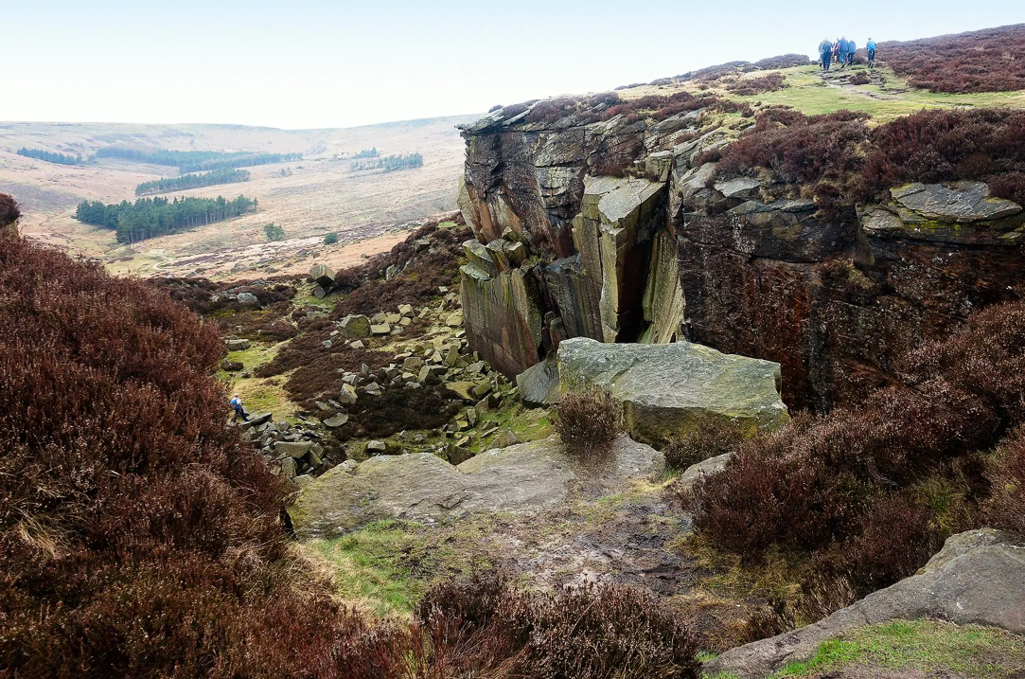
"Learning from and connecting with nature - creating an environment from an early age where we are able to connect to nature is essential for self-enforcement in protecting and valuing nature."
- DfE's Sustainability and Climate Change Strategy paper
(2023; Section 3)
Connection with nature declines in childhood to an overall low in the mid-teens
Dasgupta, 2021

Slide 3
Opportunities for Change
Prioritising increased connection to nature
Recognising the role of schools in environmental protection
Acknowledging the need to model sustainable practice
Focus on areas of education where students already
"develop an understanding of the world and the natural environment"
(DfE SCC, 2023; Action Area 1.1: Learning about the Natural Environment)

Slide 4
Increasing Connection to Nature
Apply learning to natural environments
Have positive experiences outside
3. Challenge student perceptions of nature
4. Allow free exploration of nature
As a subject with a "multi-layered holistic education framework" (Walshe and Perry, 2022; p 94) geography is well positioned to allow students to explore and re-explore their environment from different perspectives.

Slide 5
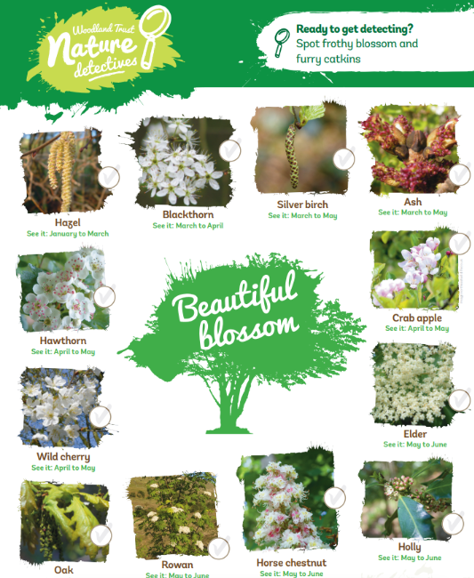
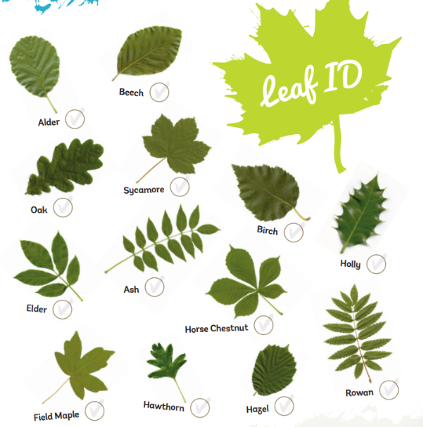
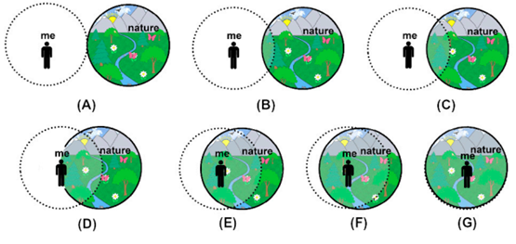
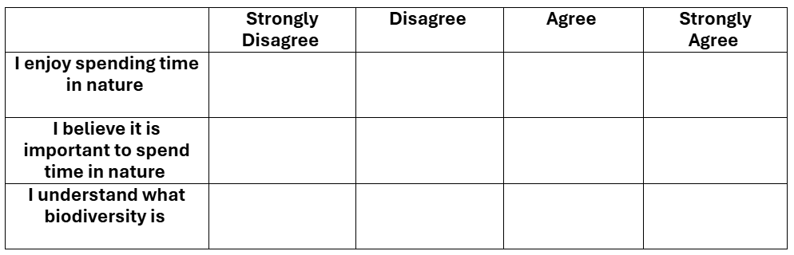
Research Activities
Increased knowledge about biodiversity
Application of knowledge through fieldwork activities
Free exploration through challenges

Slide 6
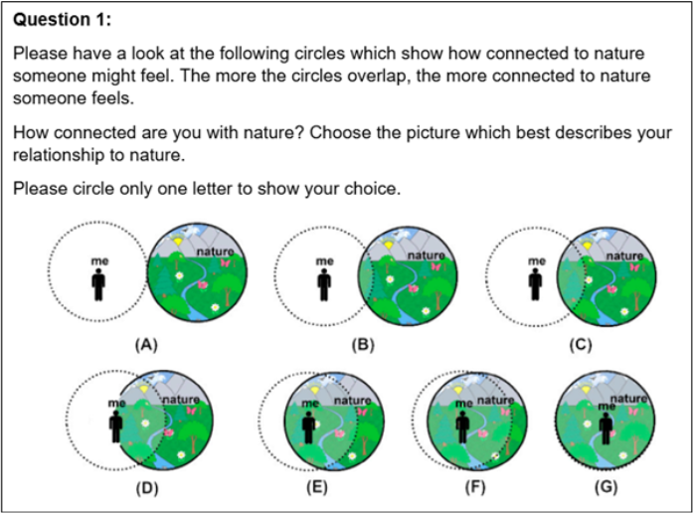
Conceptualising Connection to Nature
Connection to Nature as “seeing the environment as part of ourselves … [and] seeing ourselves as part of the environment”
(Dutcher et al, 2007, p. 489)

Slide 7
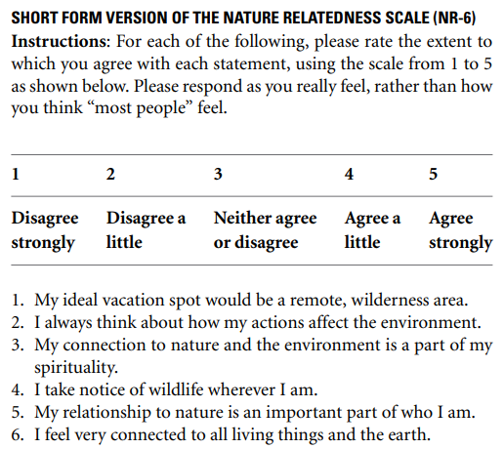
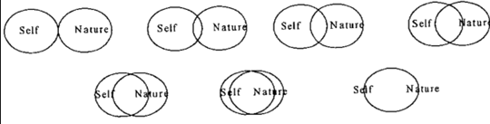
Measuring Connection to Nature
Illustrated Inclusion of Nature in Self Scale (Kleespies et al, 2021; p5)
Inclusion of Nature in Self Scale
(Schultz, 2002; p72)
Nature Relatedness Scale (NR-6)
(Nisbet and Zelenski, 2013; p11)

Slide 8
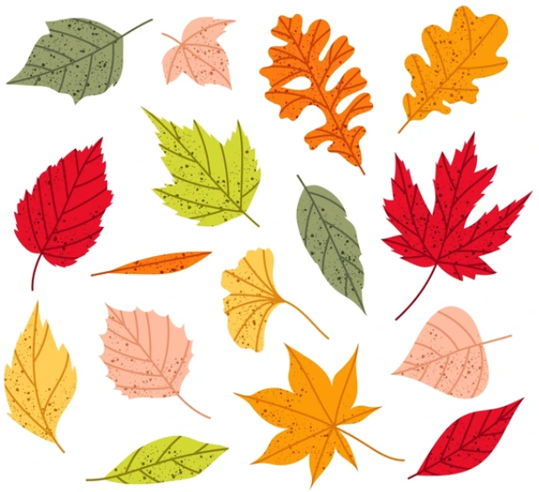
Reframing fieldwork
Fieldwork can be a way for students to explore existent relationships and connections with nature.
Educational spaces can act as safe spaces for students to explore, understand and grow their relationships with their natural surroundings.
In the context of a rapidly changing world, where human-nature relations are being consistently challenged (Taylor, 2017), spaces to explore connections to nature will be vital.

Slide 9
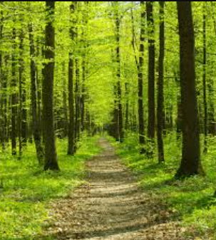
Creating space for connection with nature
Combine deep reflection with the multilayered framework of geography (Giengar et al, 2024)
Give students a sense of protection over their school/local environment (Harris, 2021)
Analyse local issues from human and non-human perspectives (Taylor, 2017)
Explore school environments in novel ways
Encourage free exploration of nature (Harris, 2021)
Thankyou....
Lauren Satsi
laurenhsatsi@
gmail.com

Slide 10
References
Dasgupta, P. (2021) The Economics of Biodiversity: The Dasgupta Review. HM Treasury (London). Available at: https://gov.uk/government/publications/final-report-the-economics-of-biodiversity-the-dasgupta-review
Department for Education (2023) Sustainability and climate change: a strategy for the education and children’s services systems. Available at: https://www.gov.uk/government/publications/sustainability-and-climate-change-strategy/sustainability-and-climate-change-a-strategy-for-the-education-and-childrens-services-systems#contents
Dutcher, D. D., Finley, J. C., Luloff, A. E. and Johnson, J. B. (2007) ‘Connectivity With Nature as a Measure of Environmental Values’, Environment and behavior, 39(4), pp. 474–493. doi: https://doi.org/10.1177/0013916506298794
Gienger, A, Nursery-Bray, M., Rodger, D., Szorenyi, A., Weinstein, P., Hanson-Easey, S., Fordham, D., Lemieux, D., Hill, C. and Yoneyama, S. (2024) ‘Responsible environmental education in the Anthropocene: understanding and responding to young people’s experiences of nature disconnection, eco-anxiety and ontological insecurity’, Environmental education research, 30(9), pp. 1619–1649. doi: https://doi.org/10.1080/13504622.2024.2367022
Harris, F. (2021) ‘Developing a relationship with nature and place: the potential role of forest school’, Environmental education research, 27(8), pp. 1214–1228. doi: https://doi.org/10.1080/13504622.2021.1896679
Taylor, A. (2017) ‘Beyond stewardship: common world pedagogies for the Anthropocene’, Environmental education research, 23(10), pp. 1448–1461. doi: https://doi.org/10.1080/13504622.2017.1325452
Walshe, N., and Perry, J. (2022) ‘Transformative geography education: Developing eco-capabilities for a flourishing and sustainable future’, Teaching Geography, 47(3), pp. 94-97.
All references accessed and up to data as of 31st March 2026

Slide 11
Measures of connection to nature
Illustrated Inclusion of Nature in Self Scale:
Kleespies, M. W., Braun, T., Dierkes, P. W., and Wenzel, V. (2021) ‘Measuring Connection to Nature—A Illustrated Extension of the Inclusion of Nature in Self Scale’, Sustainability, 13(4), pp. 1761. doi: https://doi.org/10.3390/su13041761 (Accessed: 31 March 2026)
Inclusion of Nature in Self Scale:
Schultz, P. W. (2002) ‘Inclusion with Nature: The Psychology of Human-Nature Relations’, in Schmuck, P. and Schultz, P. W (eds) Psychology of Sustainable Development. Dordrecht, Netherlands: Kluwer Academic Publishers, pp. 61-78.
NR-6: Short-form Nature Relatedness Scale:
Nisbet E. K. and Zelenski J. M. (2013) The NR-6: a new brief measure of nature relatedness. Frontiers of Psychology. 4:813. doi: https://doi.org/10.3389/fpsyg.2013.00813 (Accessed: 31 March 2026)

