Slide 1
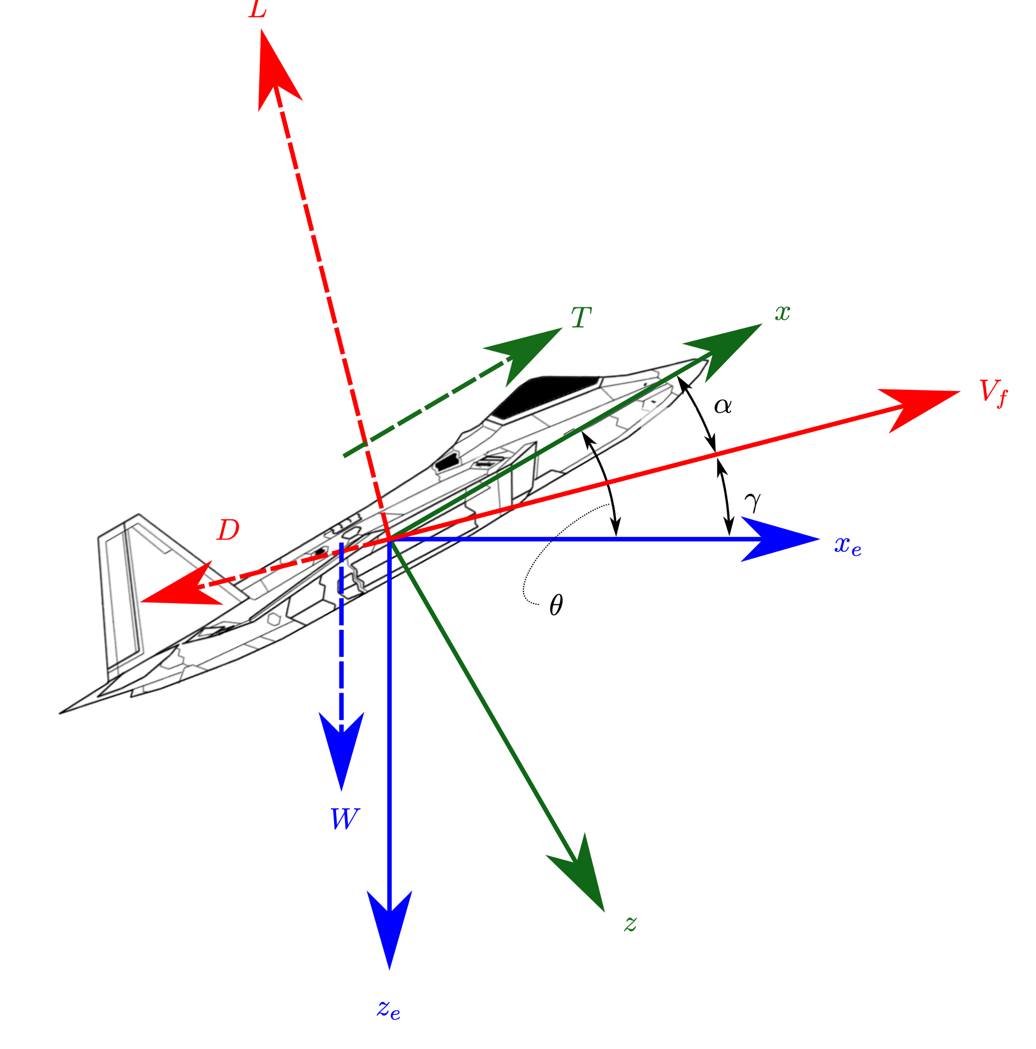
Pushing the envelope: making whole-school difference as a Geography subject leader
Philip Maudsley
Headteacher, Coatham CE Primary School
GA EYPCC
Coatham Primary School
This Photo by Unknown Author is licensed under CC BY-NC-ND

Slide 2

AGENDA
The Leader and Headteacher dynamic
Leadership and self-deception
Three influencing threads:
Simplicity and precision: Cycles and Simplicity
Headteacher
Vision
Ideas

Slide 3
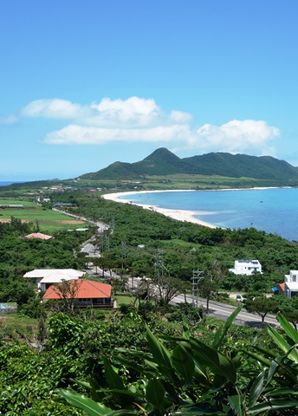
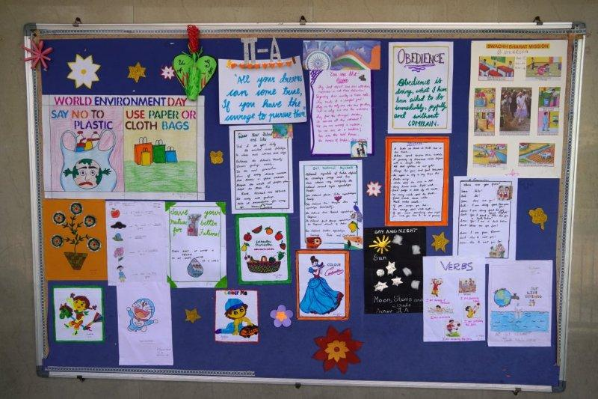
“Hey man, did your Geography teacher tell you what the newest US state is?” “ I don’t know, but Alaska.”
My son got an F in his geography exam today.
I sent him to his room but he ended up in the kitchen
Justin Timberlake is bad at geography
He sings this song, "Crimea River", but I checked, and Crimea is a peninsula, not a river.
This Photo by Unknown Author is licensed under CC BY-SA

Slide 4
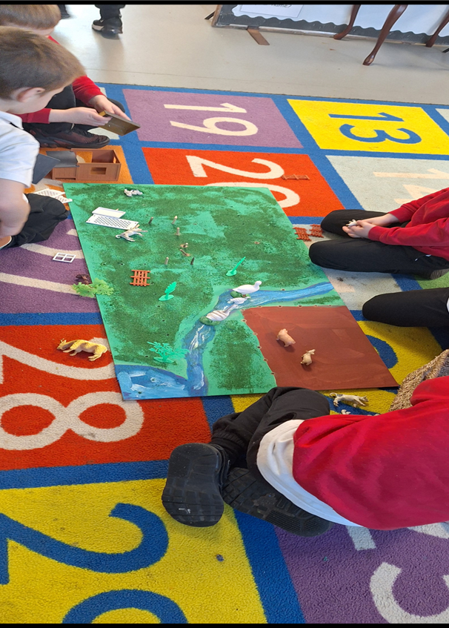
HEADTEACHER/
SUBJECT LEADER

Slide 5
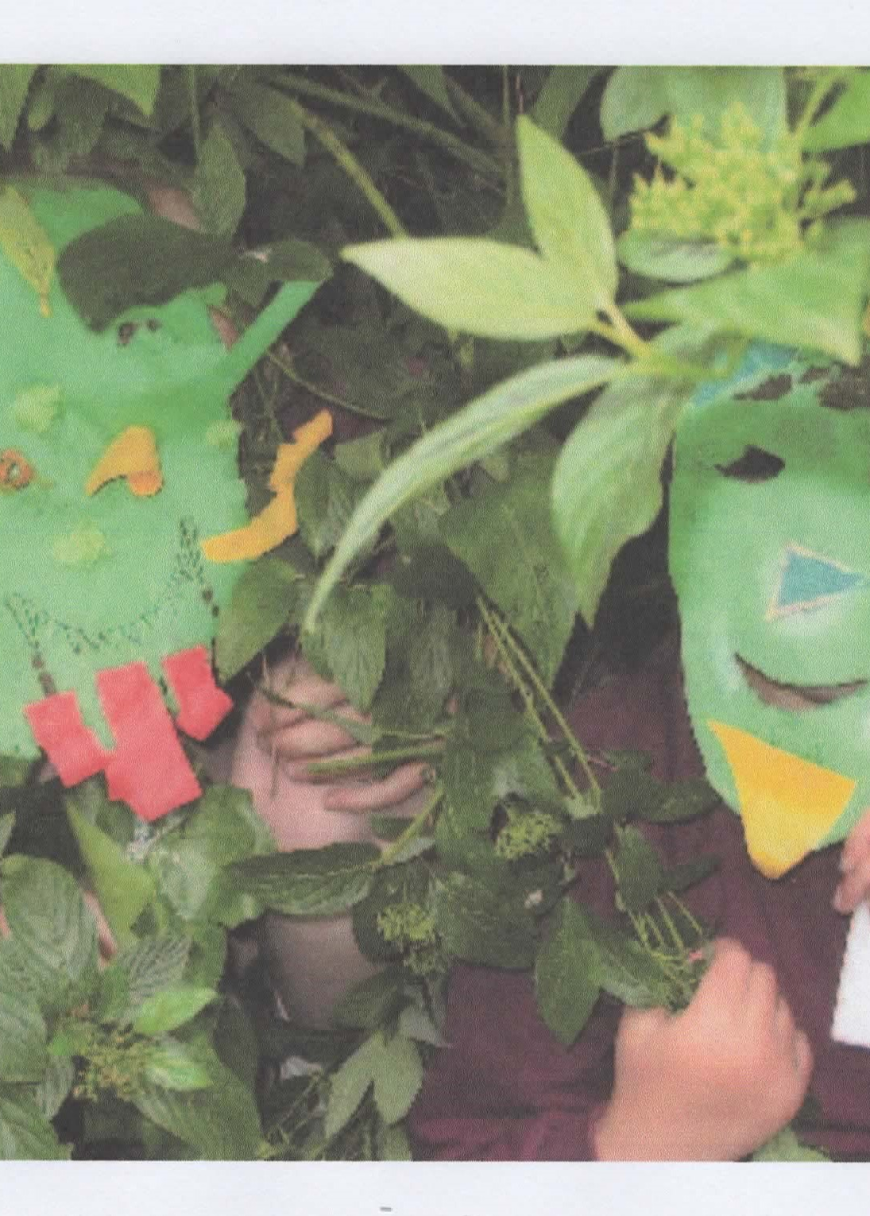

Leadership and Self-Deception
Leadership and Self-Deception Summary and Study Guide | SuperSummary

Slide 6
Leadership and Self-Deception
OUT OF THE BOX
I see myself as others more or less as we are…as people
IN THE BOX
I see myself and others in a systematically distorted way…others are mere Objects

Slide 7
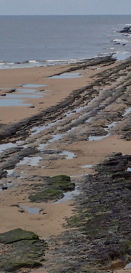
Other subjects LINKS
This Photo by Unknown Author is licensed under CC BY-SA

Slide 8
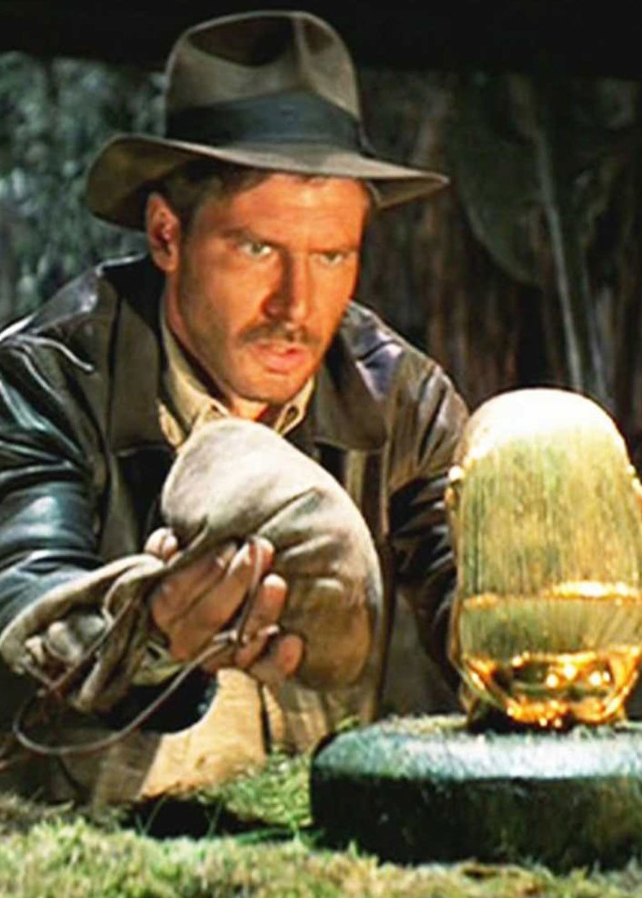
F:\SUBJECTLEADERS\SUBJECT LEADER SUBJECT FILE.doc
SIMPLICITY AND PRECISION
YOUR ENJOYMENT
Make sdp align with school sdp
One overarching scheme/target

Slide 9
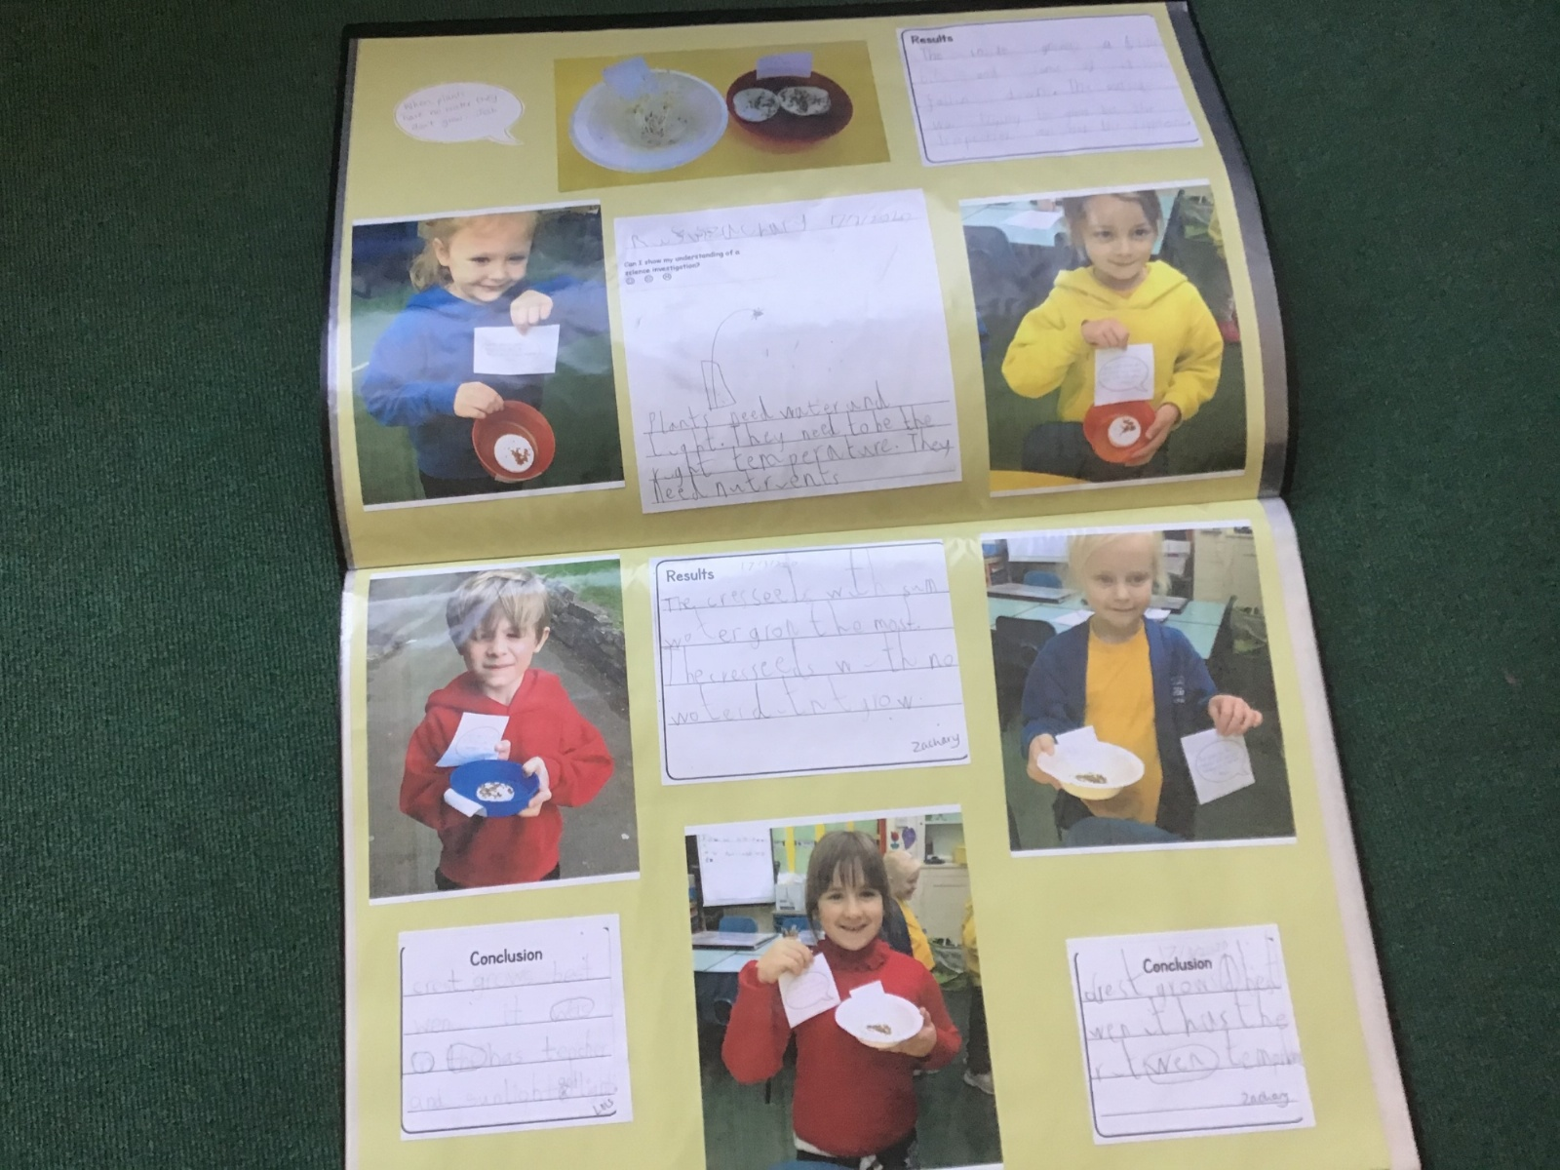
F:\SUBJECTLEADERS\SUBJECT LEADER SUBJECT FILE.doc
I oloved it when you could see all the sand moving in the mini-river
Emma
I LEARNT HOW THE EMANDERS FORM BECAUSE OF THE DIFFERENT SPEEDS, Luna
I was disappointed our waterfall fell to bits, but this was erosion in action!
Alexandru
I was wondering how much different the river would have looked if it had been raining
Sonny

Slide 10
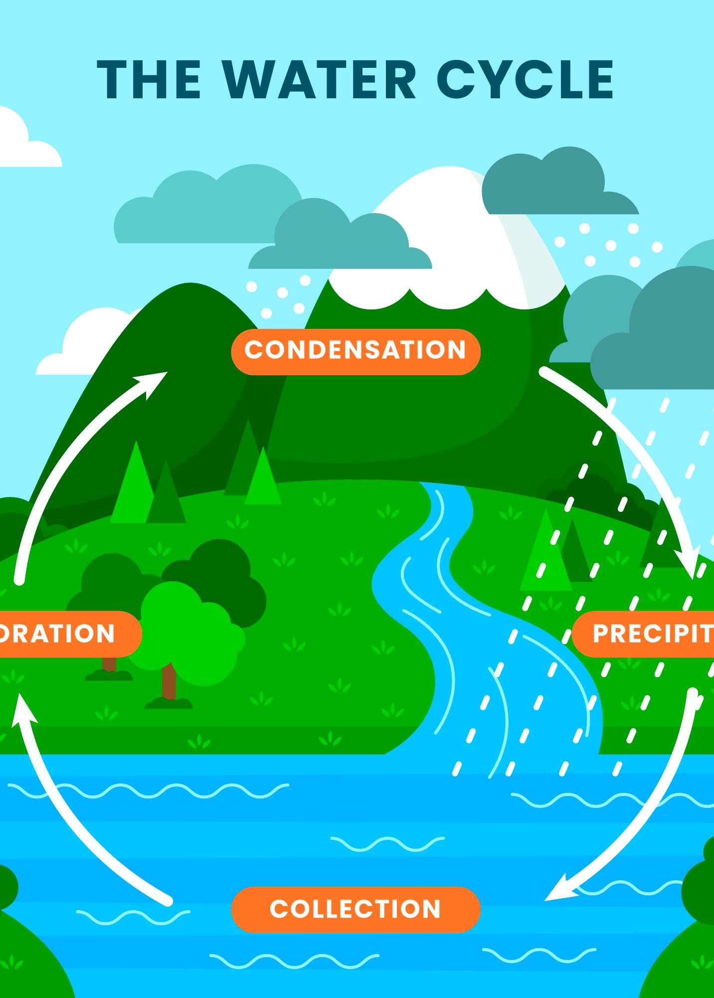
CYCLES
CURRICULUM
MONITORING
This Photo by Unknown Author is licensed under CC BY-NC

Slide 11
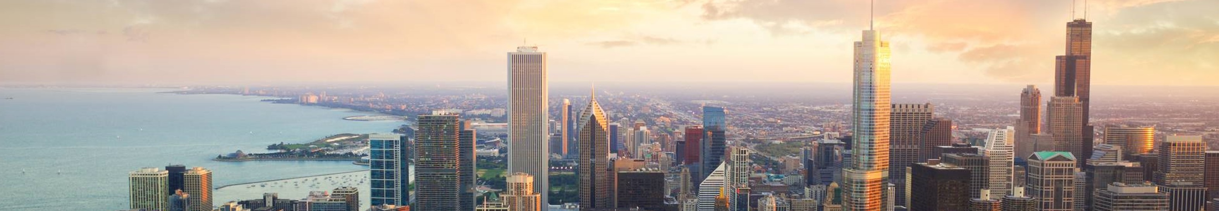
HEADTEACHERS
Telling others what to do
Not being told what to do
Children

Slide 12
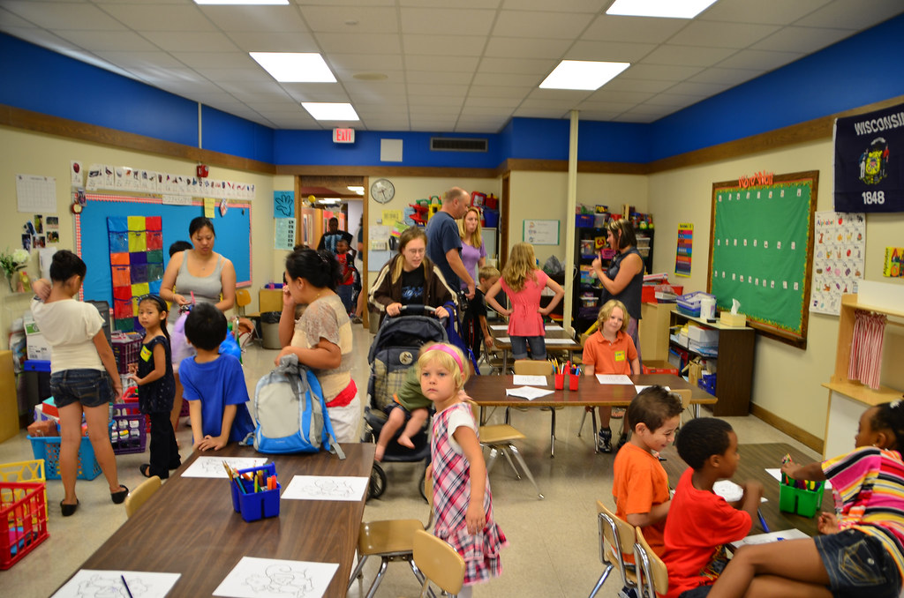
headteachers
Leadership and Self-Deception
Inclusion
Outcomes
Parental involvement

Slide 13
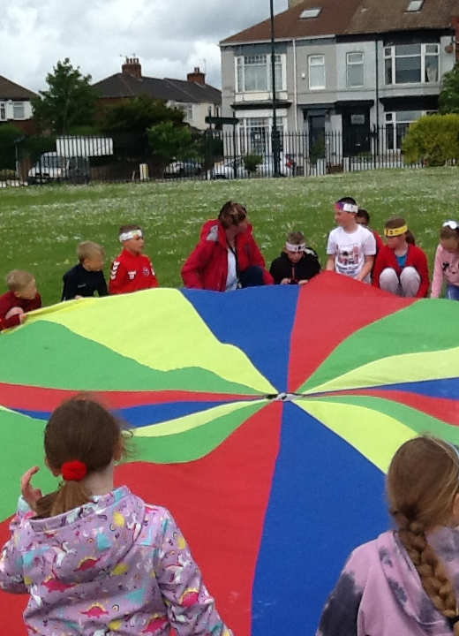
VISION
We are a supportive church school community where every individual is accepted, their interests encouraged, and where everyone is supported to learn to believe in themselves. Through varied and creative learning experiences, we want our children to be successful and resilient, now and in their future, both in this unique community and further afield.
Our Christian values of Friendship, Respect and Fairness run through all of our teaching and learning and help us to understand that we can all make a positive difference to our world, as we love our neighbours as ourselves (Matthew 22:39).

Slide 14
Coatham VISION
Archbishops’ Young Leaders Award — National Society for Education
Sustainability
Eco-club
Other subjects in fieldwork, Beach Schools
This Photo by Unknown Author is licensed under CC BY-SA

Slide 15
VISION

Slide 16
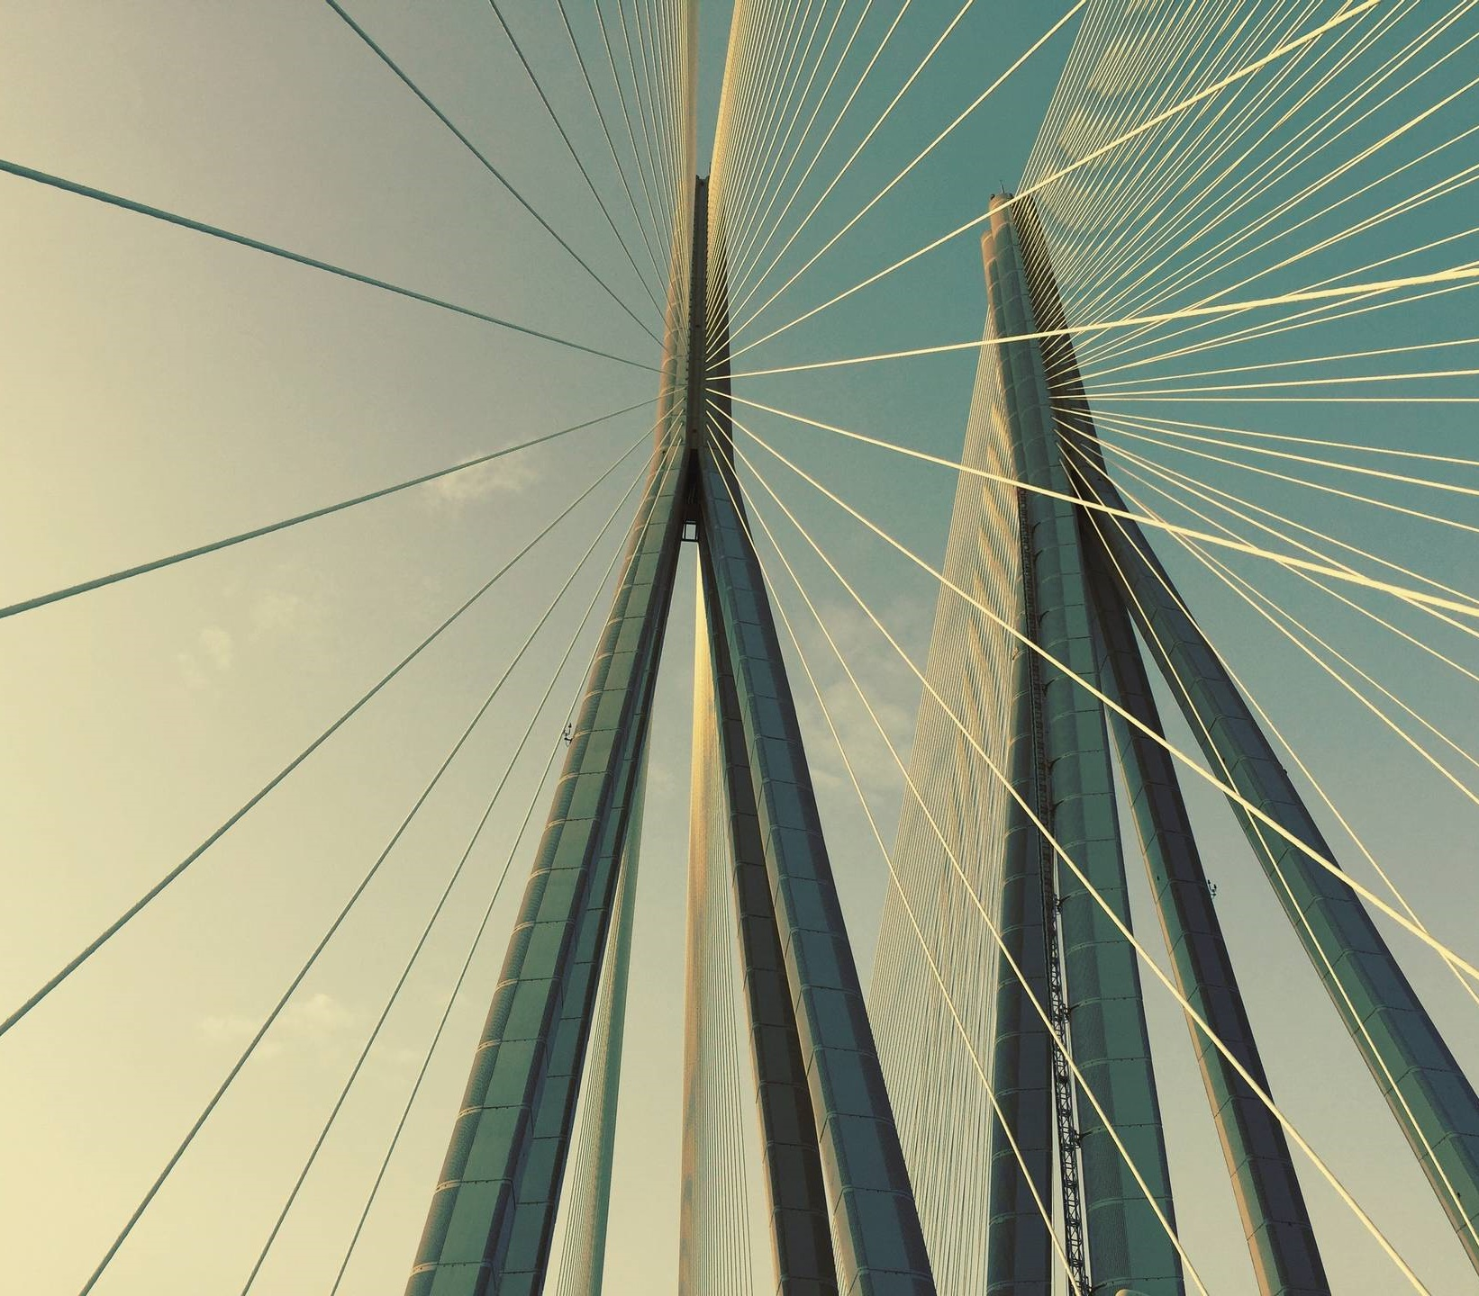
THANK YOU
Jokes and ideas

