Slide 1
Geography in a Hospital School:
How can it make a meaningful difference to young people in challenging situations?
Stephanie Crome, Secondary Geography Lead
s.crome@hospitalschool.manchester.sch.uk

Slide 2
Key questions
What is hospital education?
How can geography teaching can be meaningfully adapted for hospital-based learners?
How can we ensure the emotional, intellectual, and personal impact of geography in challenging contexts?
How can we promote geography as a compassionate, inclusive subject that supports wellbeing and re-engagement?
Ultimately, this is a celebration of Geography to support and engage some of our most vulnerable learners.

Slide 3
What is hospital education?
“Hospital education means education provided at a community special school or a foundation special school established in a hospital, or education provider […] where the child is being provided with such education by reason of a decision made by a medical practitioner.”
Department of Health and Social Care, 2015

Slide 4
Manchester Hospital School
Our Vision
To be a beacon of excellence, providing high quality education which enables children and young people with medical and mental health needs to achieve and experience success.
Our Core Purpose
Each child has the right to an education. The core purpose of our school is to enable pupils to access their entitlement to be educated in line with Article 28 of the UN Convention on the rights of the child.

Slide 5






https://www.manchesterhospitalschool.co.uk/manchester-hospital-schools/
https://www.facebook.com/reel/2136128256861386
Leo Kelly School
AV1 Robots
57 PLACES
Home/ Community
Teaching
Advice and Guidance
Hospitals
ROYAL MANCHESTER
CHILDREN’S HOSPITAL
NORTH MANCHESTER
GENERAL HOSPITAL
371 BEDS
20 BEDS
WYTHENSHAWE HOSPITAL
20 BEDS
GALAXY HOUSE
THE CHRISTIE
12 BEDS
16 PUPILS

Slide 6
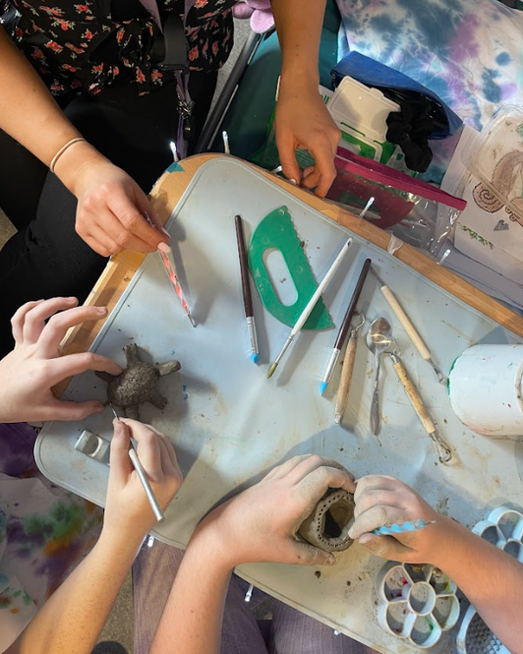
Our Pupils
TRAUMA
ANXIETY
EATING DISORDERS
SELF-HARM
SUICIDE IDEATION
LEARNING DISABILITIES
COMPLEX SAFEGUARDING
SPECIAL EDUCATIONAL NEEDS LINKED TO THEIR MENTAL ILL HEALTH OR PHYSICAL ILL HEALTH OR BOTH
UNDIAGNOSED LEARNING DIFFICULTIES
LONG TERM MEDICATION LINKED TO THEIR CONDITION

Slide 7
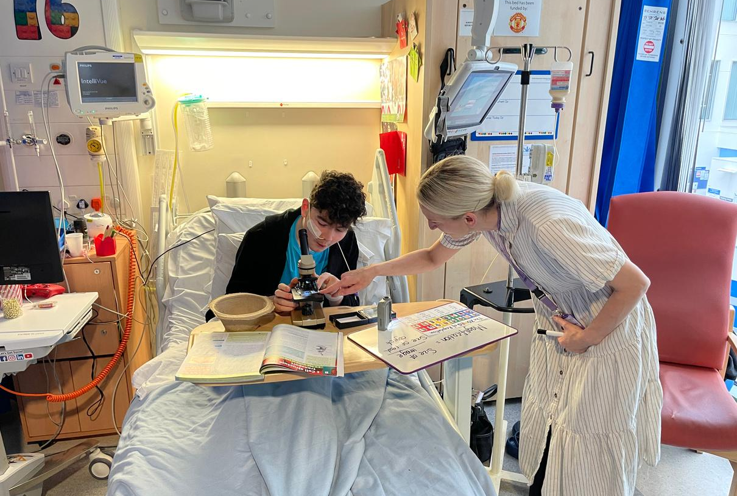
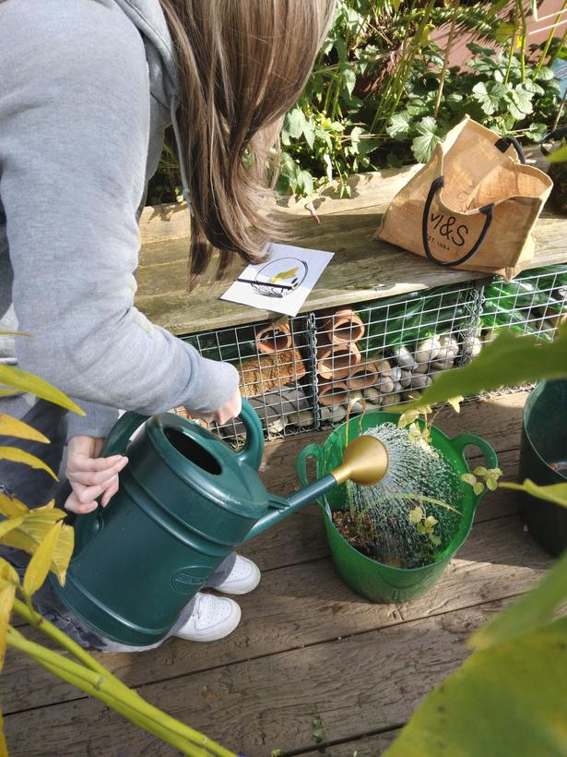
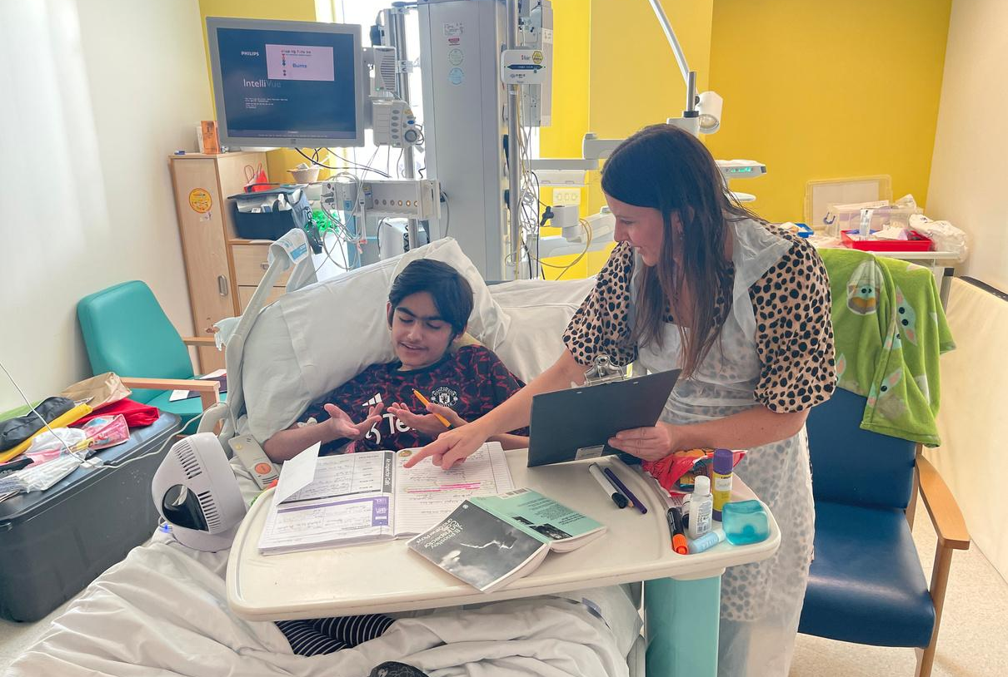
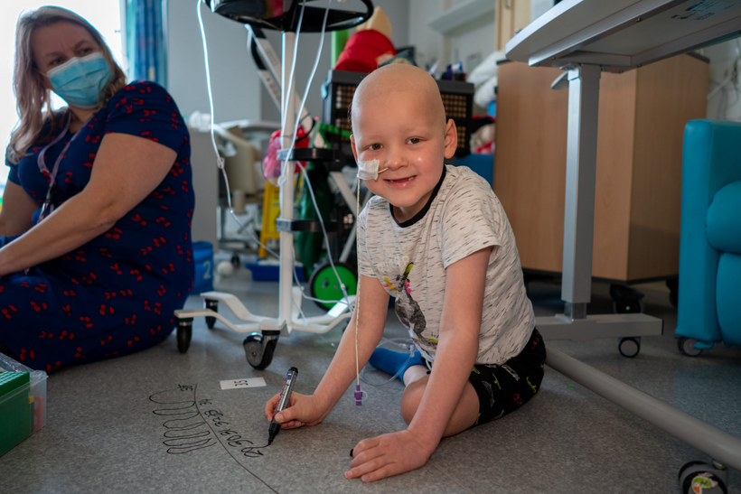
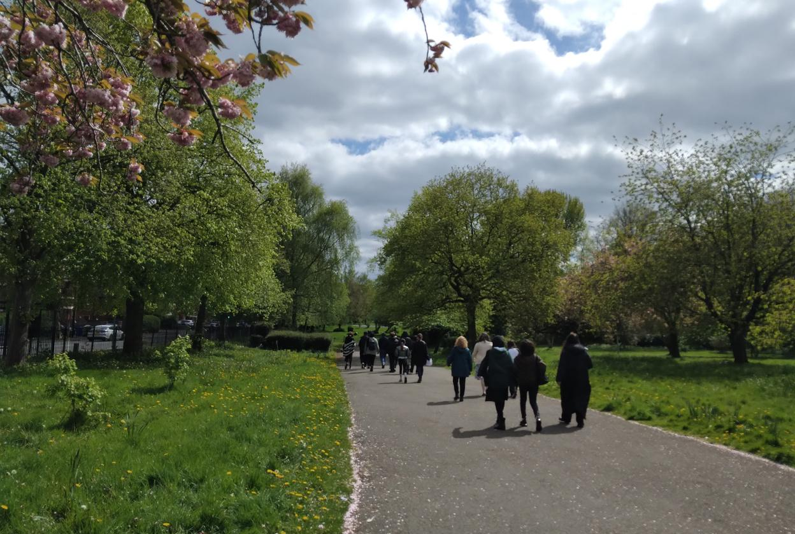
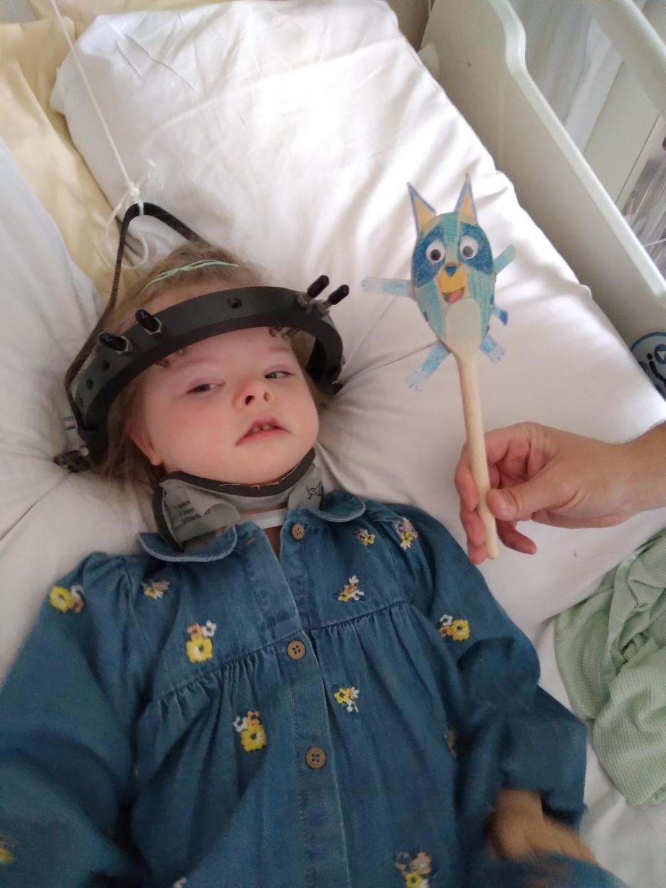
Our Pupils
Notes:
SD
As you will have seen in the video and also in these pictures, our pupils have a wide range of special educational needs, some of which are linked to their mental and/or physical health.
Our main focus today will be on the pupils who attend our school due to barriers related to their mental health. Most of these pupils attend our Leo Kelly school and have received their place through a Section 19 referral.
Our Leo Kelly pupils have a range of mental health conditions such as anxiety, depression, PTSD, disordered eating and psychosis. They tend to have poor sleep hygiene, many are also neurodivergent, have sensory needs and are socially withdrawn. In addition, a lot of our Leo Kelly pupils self-harm and some have expressed suicidal ideation.

Slide 8
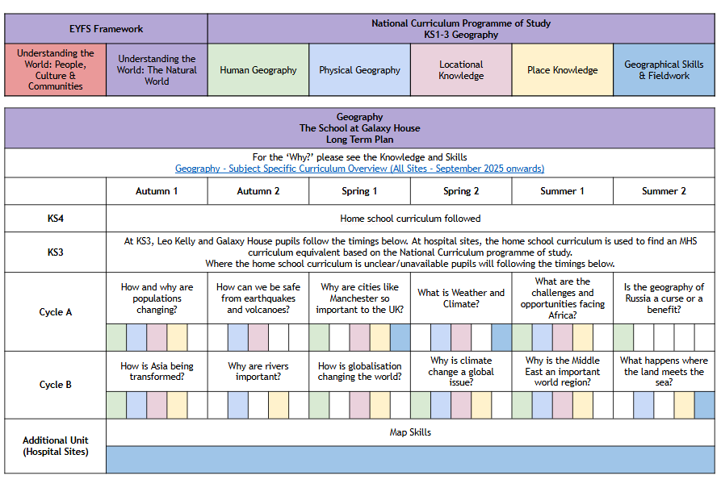
Geography at MHS

Slide 9
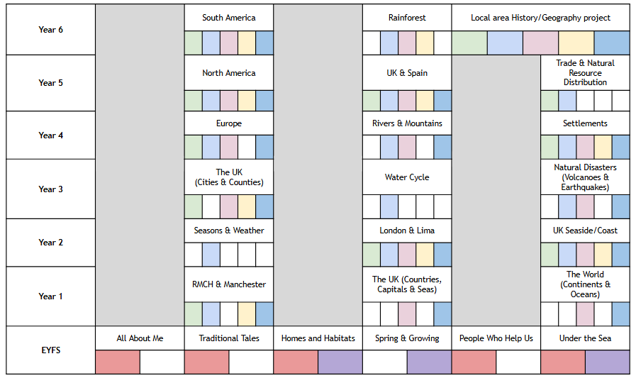

Slide 10
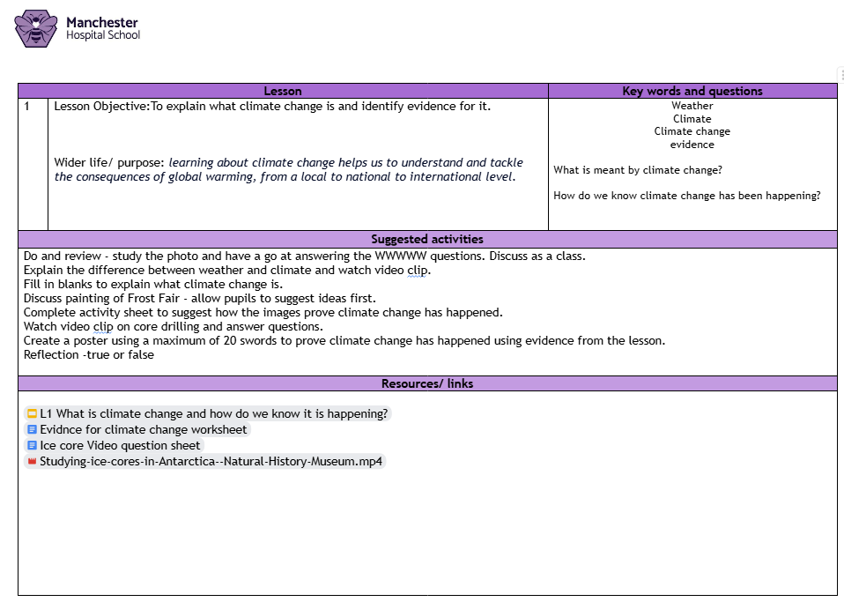
Medium Term Planning

Slide 11
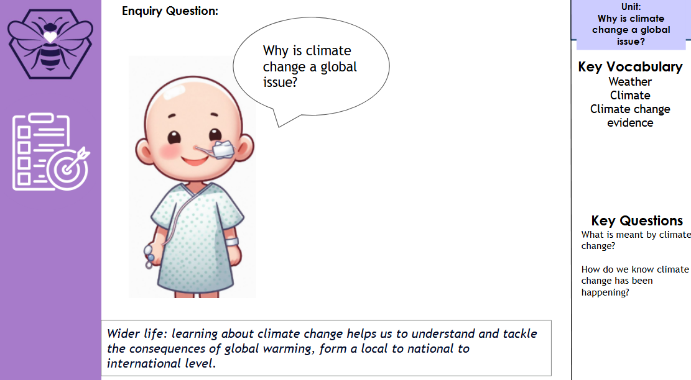
Lesson Planning

Slide 12
Case Studies

Slide 13
Teaching on the wards at RMCH
Pupil A
Pupil A - Year 10 and admitted to hospital during the summer holidays.
We met on our first day back in September. Living with Crohn's disease and scoliosis
Low mood, feeling pretty unwell and unwilling to engage with school.
This required gentle and small steps. She was not a fan of school and had poor attendance due to her health.
Over time, as her physical health improved, we made some progress…
Challenge of Natural Hazards - she was fascinated by this.
Lessons heavily adapted to be accessible, but still covered necessary content and ensured progress.
Lots of low-stakes quizzes and knowledge checks, cards sorts and the use of Notebook LM to simplify what can be heavy text.
Notes:
Already had her summer ruined

Slide 14
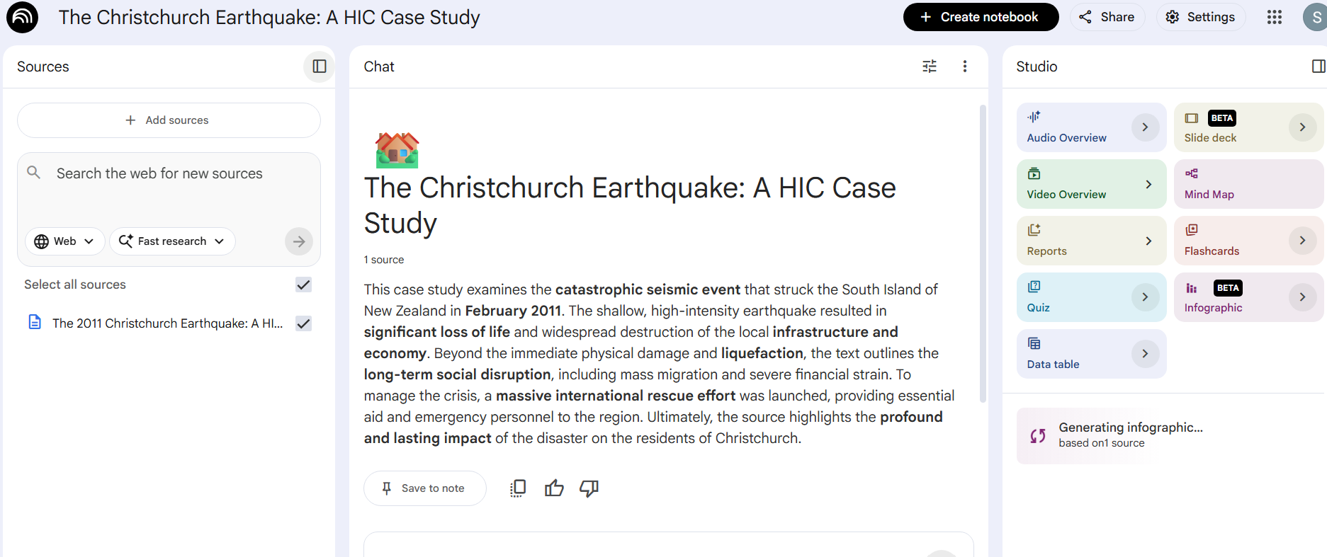
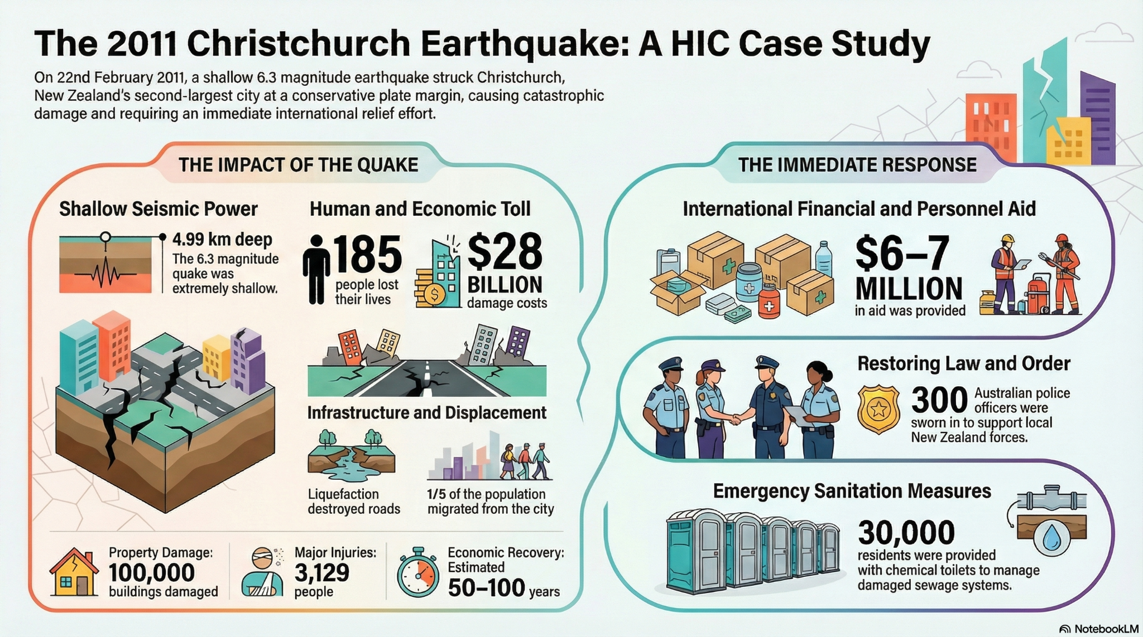
Teaching on the wards at RMCH
Pupil A

Slide 15
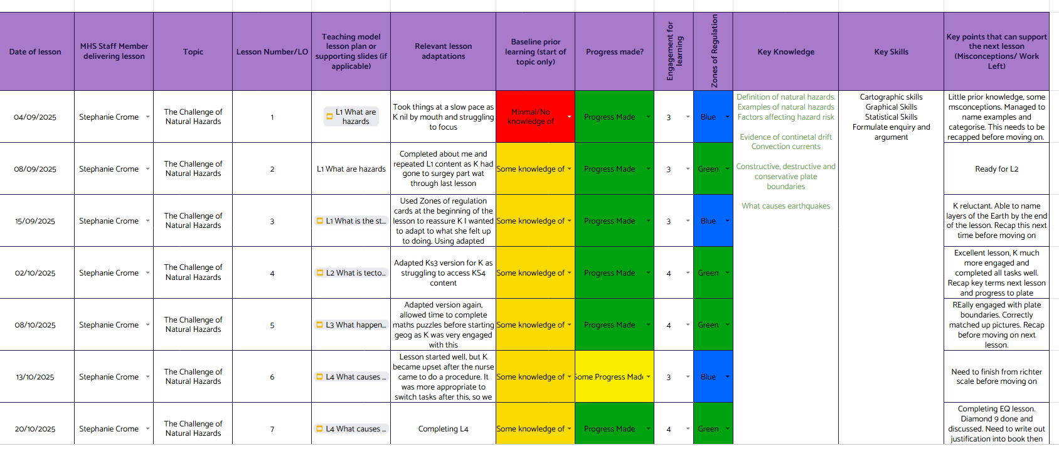

Slide 16
Making a difference
This young person left hospital after 2 months feeling more confident and prepared to go back to school.
She hadn’t missed out on the start of her GCSEs and she had an increased chance of keeping up with her peers.

Slide 17
Teaching on the wards at RMCH
Pupil B
Pupil B - Initially an inpatient during year 9.
LAC and EBSA
But liked Geography!
We started with quizzes and games. Initially he would only engage with this, but it eventually developed into beginning one of our place based units.
Readmitted in year 10. His physical health and home relationships had broken down significantly. He was even more reluctant to enagage with school.
His school had started year 10 with Coastal Landscapes and Processes topic. When I tried to teach this at first, he was not happy. This was not what he thought geography was!

Slide 18
Teaching on the wards at RMCH
Pupil B
I brought it back to what interested him. He had a keen interest in Jamaica as he had some relatives that lived there.
He was happy to do some research on Jamaica.
Made a template and he had some choice in how we did it. He knew this would also cover what he needed to know for his GCSE eventually.
One day we looked at some coastal images of Jamaica, discussed them and looked them up on Google Maps etc.
“I wonder how that beach got there…”
We eventually got into coastal processes and he genuinely wanted to learn.

Slide 19
Making a difference
This young person left hospital after 3 months and had re-engaged with Geography.
He left hospital with a more positive attitude towards school. It was very slow going, but made a real difference to him.

Slide 20
Teaching on the wards at RMCH
Pupil C
Pupil C - Year 7 and undergoing chemotherapy for a cancer diagnosis since intially beginning secondary shcool.
Had been recieving treatment nearer home initially, so she wasn’t at RMCH until this last term.
On meeting, this pupil was very unwell and had a very low mood when it came to the idea of school.
She had missed most of year 7 already.
Fully admitted she was just fed up. We had an introduction to Geography lesson, but she was still reluctant..
So I let her choose. Showed her our whole long term plan - what did she fancy?

Slide 21
Teaching on the wards at RMCH
Pupil C
She just wanted to learn about Europe, she had hopes of travelling in the future. Italy was her dream destination.
So Italy it would be.
I created and adapted lessons for her to ensure she would cover aspects of the KS3 curriculum - locational knowledge as well as physical and human geography. We looked at The Alps and mass tourism.

Slide 22
Making a difference
This young person left hospital excited to go back to school. She now knows what Geography at secondary school is and had a go at it.
She found out where she was going on holiday this summer and told me she was going to “look for human and physical geography” :)

Slide 23
Teaching online for pupils undergoing treatment at The Christie Hospital
Secondary Pupils undergoing treatment at The Christie are usually taught online due to the routine of their treatment schedules.
Pupil D -
Year 7
Super keen and lovel school. She was so upset to be missing out on her learning.
This is an easy one really. She engaged so well, even logging in to one of our lessons in a park because her treatment had over run and she would be late home.

Slide 24
Making a difference
She didn’t miss out, she got to do the same topic as her friends at school.

Slide 25
Teaching at Leo Kelly School - key stage 3 class
This is quite different to teaching on the wards and online.
Our pupils here are not well enough in terms of their mental health to access their own school.
My class this year has had 3 pupils consistently:
Pupil A - experienced significant trauma. Has a diagnosis of autism and longstanding speech, language and communication needs.
Pupil L - Diagnosis of mixed dissociative disorder and autism
Pupil J - diagnosis of autism, anxiety and has historically self-harmed.

Slide 26
Teaching at Leo Kelly School - key stage 3 class
Geography is taught here once per week for one hour. We following our cycle A/cycle B system as it is usually a short-term placement and pupils will not duplicate a topic. Depending on who is present on a given day, the lessons can vary greatly.
I deploy a lot of low-stakes formative assessments. This is accessible and builds confidence
I have begun to embed fieldwork and trips into the curriculum to encourage engagement and motivation. So far we have visited:
The Blue Planet Aquarium
Manchester Museum
Chester Zoo
This has been invaluable. Pupils have loved having the opportunity to go beyond the classroom and it has reflected in their engagement during lessons.

Slide 27
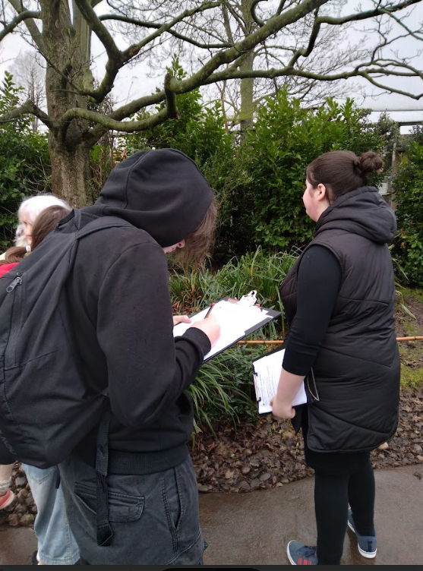
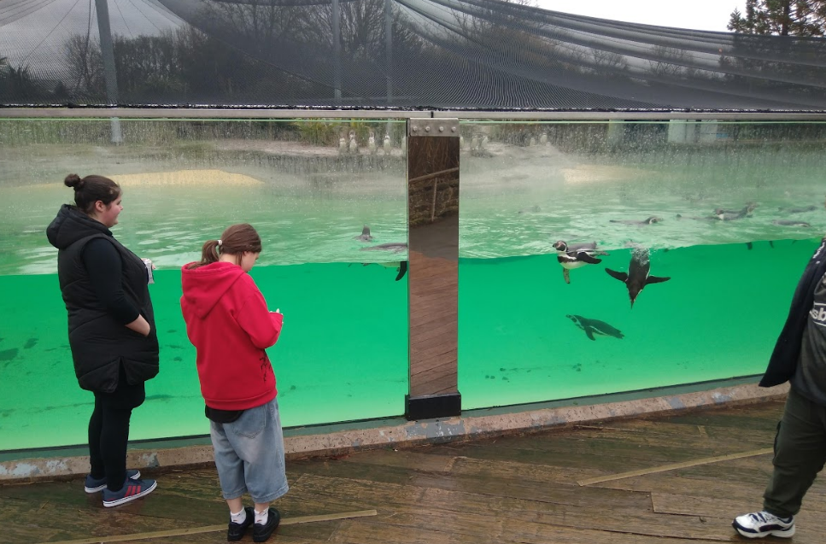
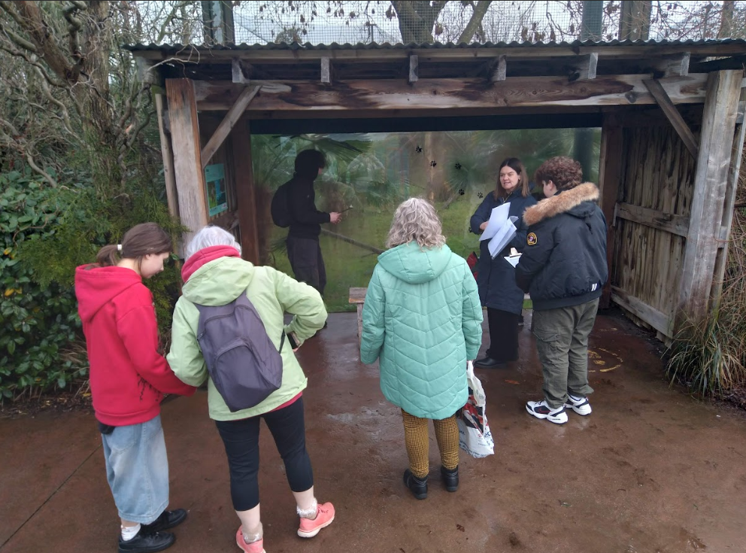
Trips and fieldwork

Slide 28
Making a difference
The Leo Kelly pupils are not only attending school, they are covering a full curriculum of which Geography is fun and relevant to them.
Some pupils are on part time timetables and actively choose to be in school on the day they have their geography lesson!

Slide 29
Teaching Galaxy House
This is a part of a Tier 4 CAMHS inpatient unit.
Our pupils here are inpatients due to their mental health and have often missed out on significant amounts of education.
I have worked with a range of key stage 2, 3 and 4 pupils here.
For Key Stage 3 we follow the same curriculum as at Leo Kelly School
For Key Stage 4 I match what specification they are covering and liaise with their home school.

Slide 30
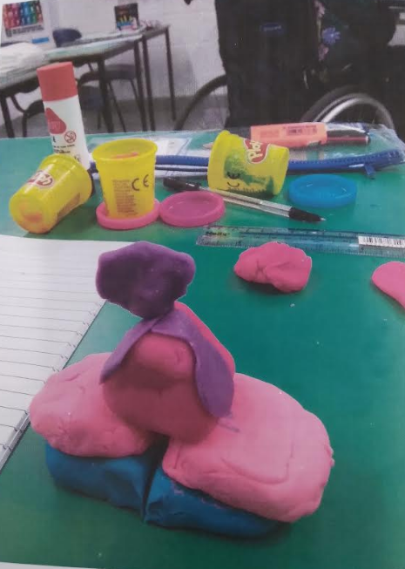
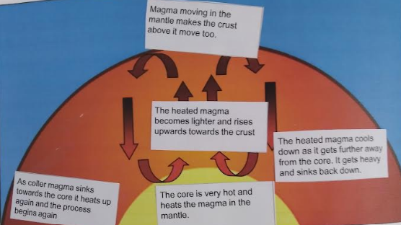
Teaching Galaxy House - key stage 3 class
Pupil T - diagnosis of very complex PAWS.
Presenting as non-verbal and not able to pick up a pen. We were covering natural hazards and he managed to engage brilliantly with some play dough to make a plate boundary.
Eventually, he would place labels on diagrams too..

Slide 31
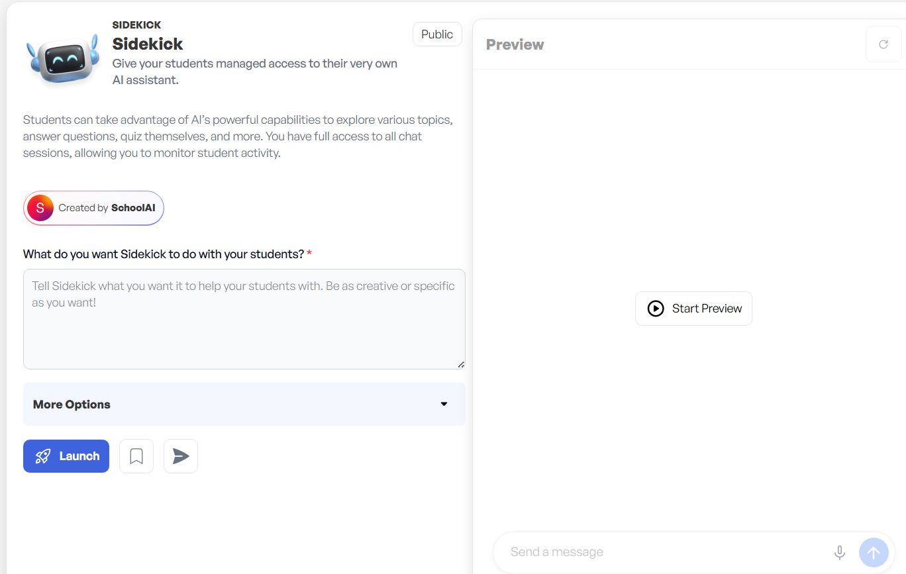
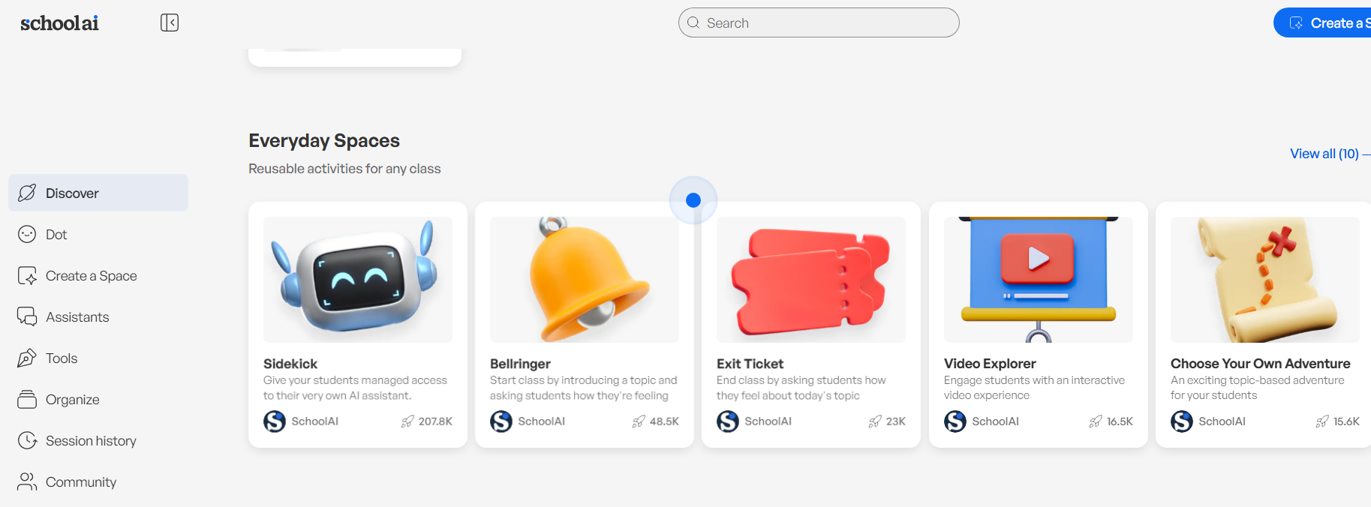
Teaching Galaxy House - key stage 3 class
Pupil S- another diagnosis of very complex PAWS.
Presenting as non-verbal but would complete written work
Lesson required discussion.
Use of Schoolai - Sidekick - pupils can discuss their ideas with Sidekick with no pressure to share with their peers. Teacher can see everything they write. Summary of engagement follows

Slide 32
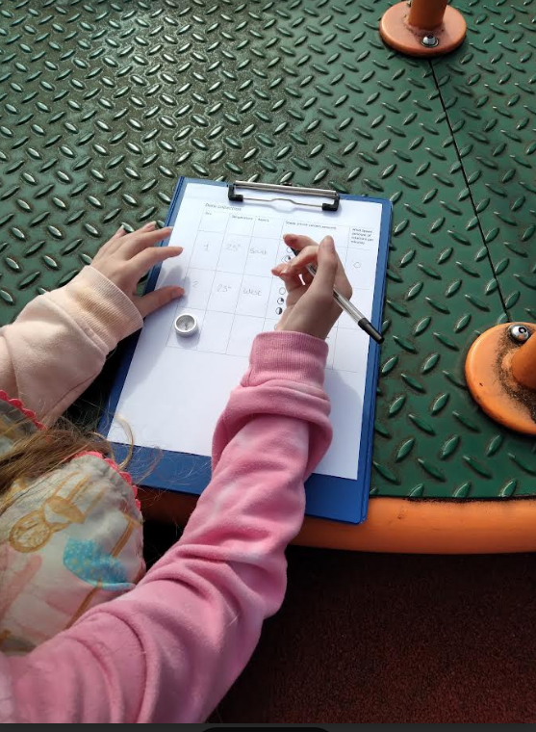
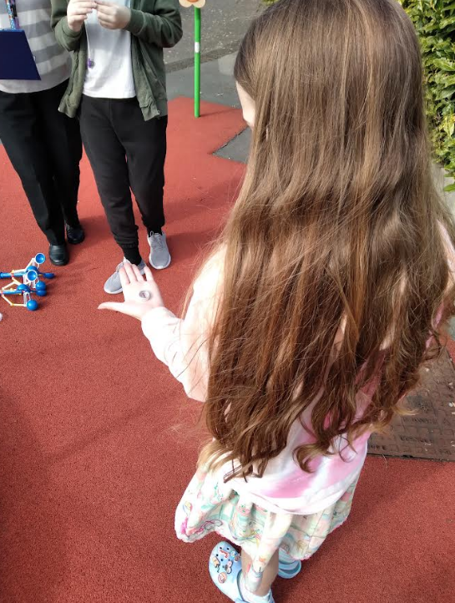
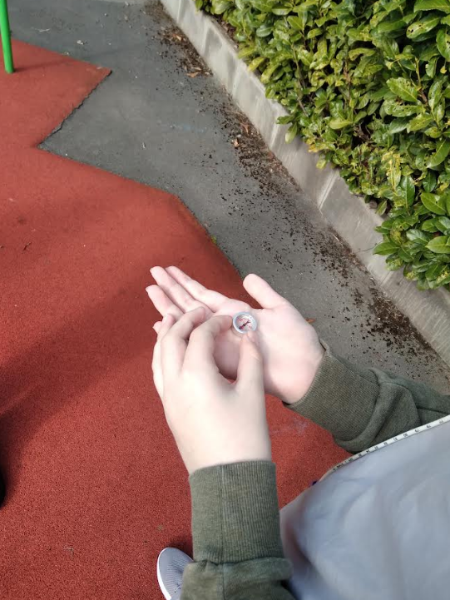
Onsite fieldwork at Galaxy House
Some great success here with on site fieldwork with all pupils including pupil T

Slide 33
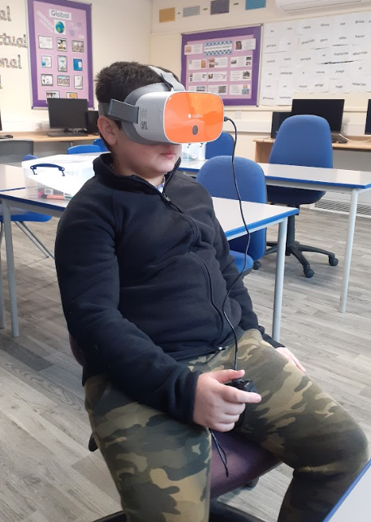
Virtual trips and fieldwork at RMCH
We have made use of VR headsets at RMCH
Bridges the gap between the classroom and the physical world.
Pupils often face mobility constraints or medical isolation that prevent traditional fieldwork, VR provides a "digital passport" to explore distant environments.
This experiential learning makes abstract concepts like coastal erosion or the effects of earthquakes tangible and memorable, while also offering a powerful psychological "escape" from the hospital environment.

Slide 34
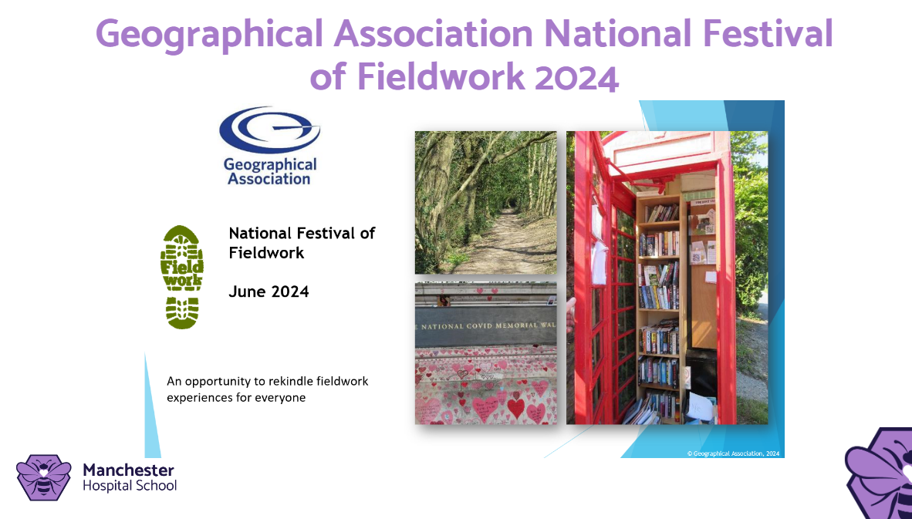
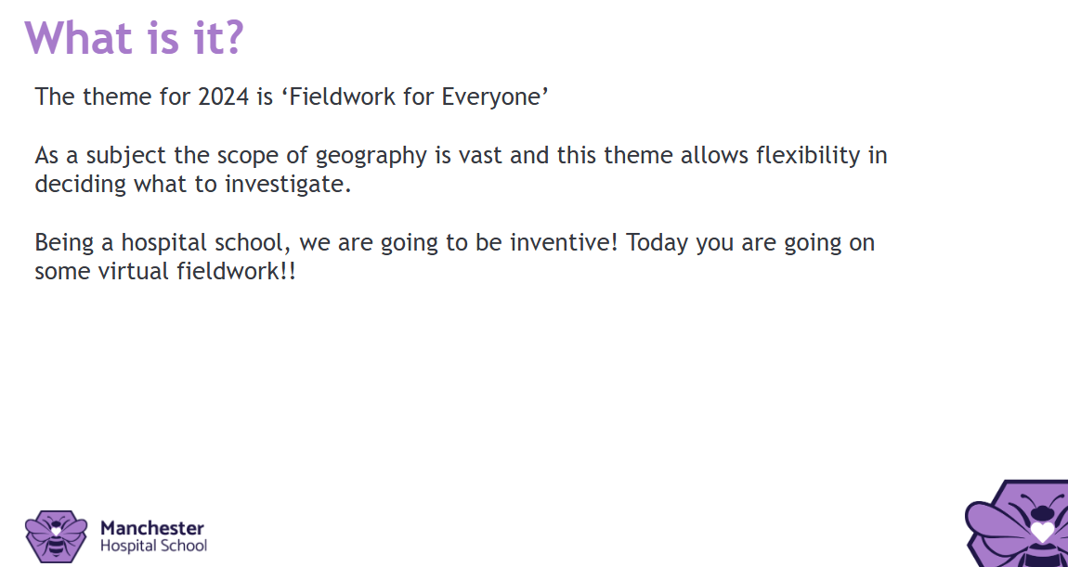
Virtual trips and fieldwork at RMCH - Virtual Assemblies

Slide 35
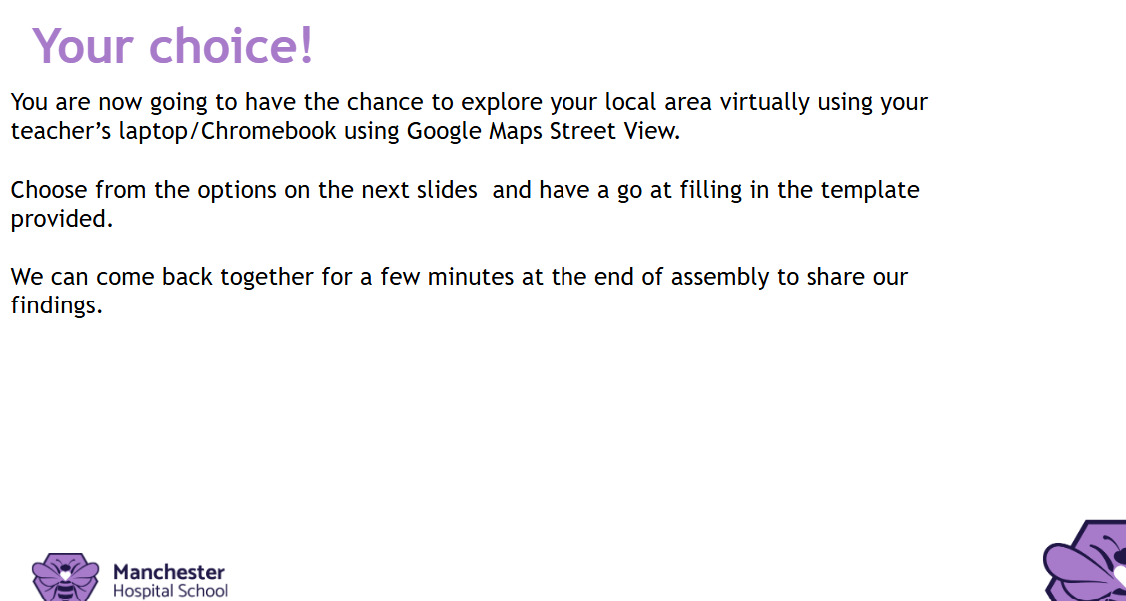
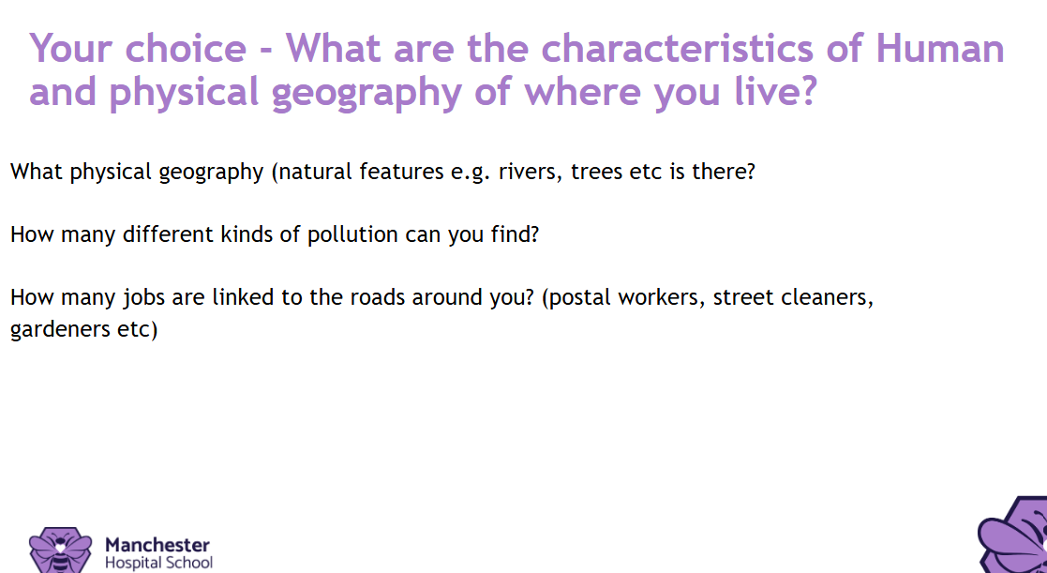
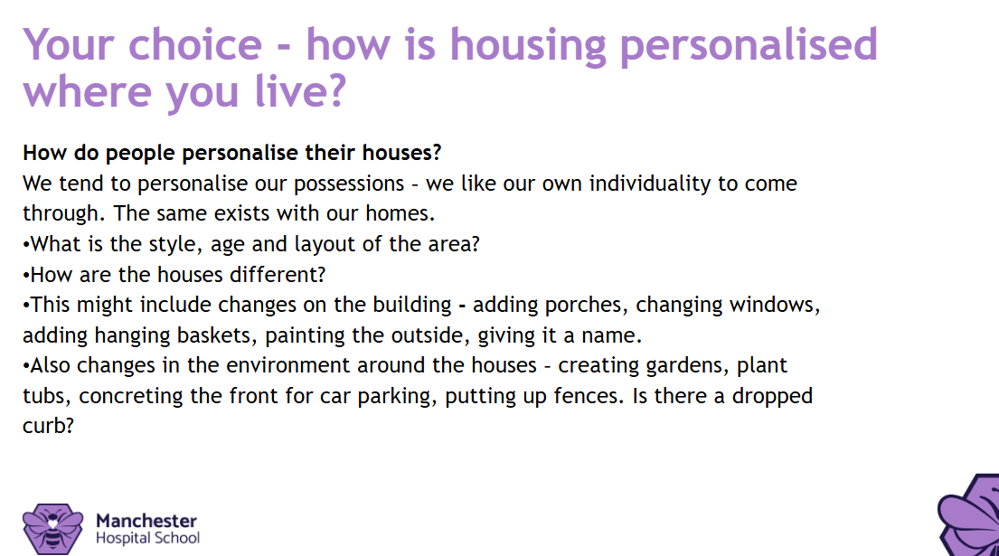
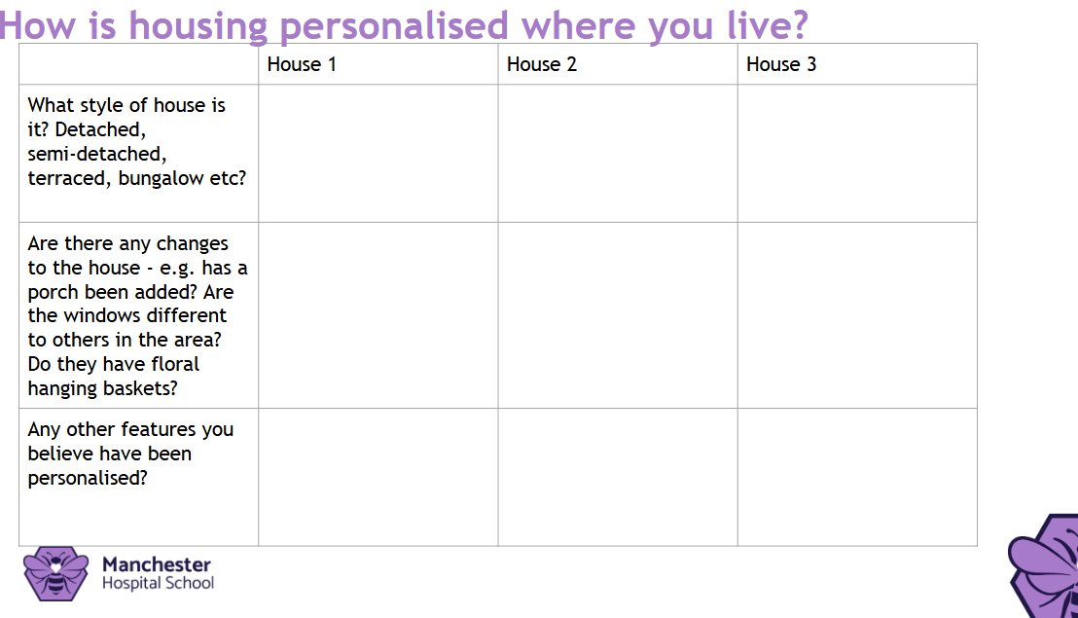
Virtual trips and fieldwork at RMCH - Virtual Assemblies

Slide 36
Geography at MHS is about more than the curriculum; it's about compassion, inclusion, and re-engaging some of the most vulnerable learners.
Questions?
Stephanie Crome, Secondary Geography Lead
s.crome@hospitalschool.manchester.sch.uk

