Slide 1

How is Geography the glue for Transformative Sustainability Education?
An Interactive Workshop for Primary Geographers
Meryl Batchelder & Hannah Tombling

Slide 2
Welcome
What to expect in this session:
Explore how geography connects climate, nature, and sustainability
Discover the Ministry of Eco Education framework
Use some creative thinking and develop strategies for place-based learning
Build networks with fellow educators
Leave with ready-to-use resources for your classroom

Slide 3
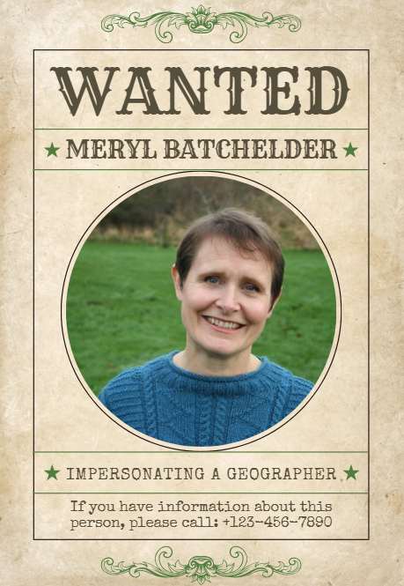
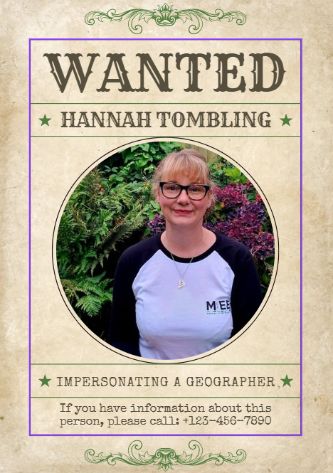

Slide 4
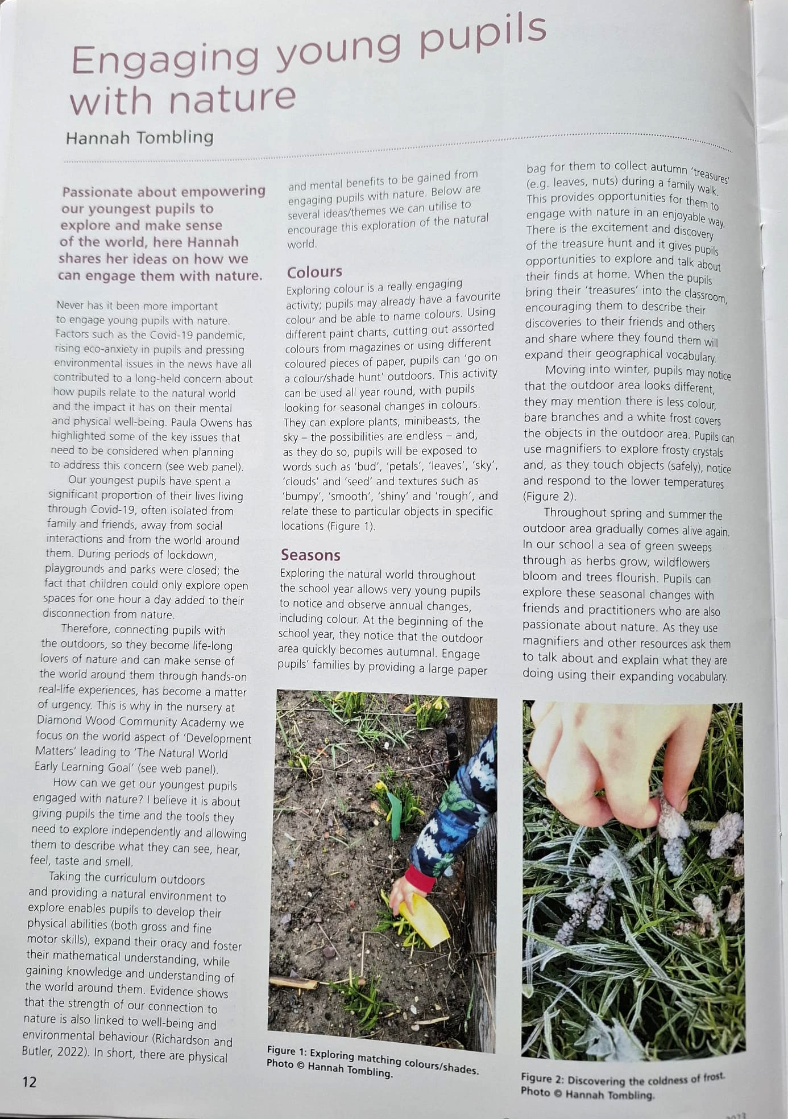
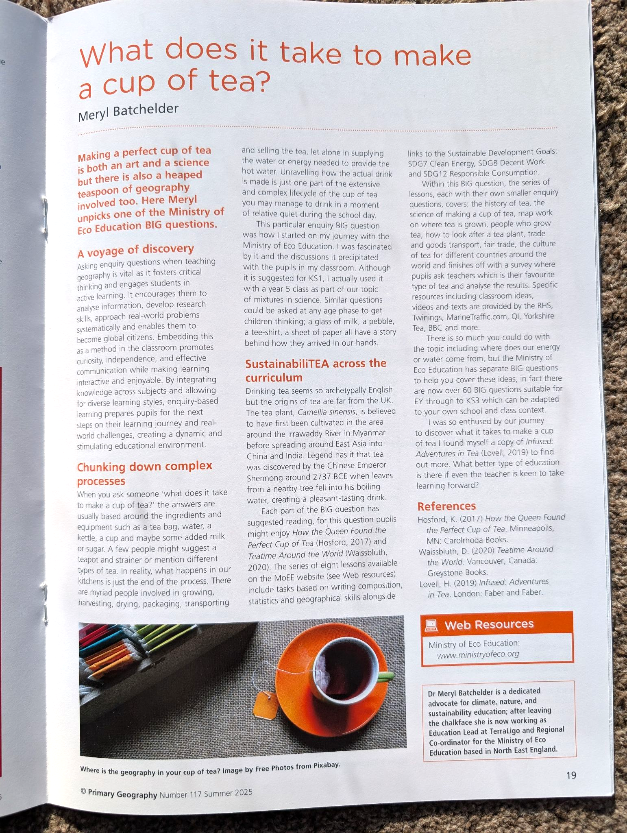
Featured in Primary Geography Magazine, Spring 2023 and Summer 2025

Slide 5
Part 1
Geography as the Foundation for Climate Literacy

Slide 6

Why Geography?
Connects environmental science with social justice
Links local contexts to global citizenship
Develops systems thinking essential for climate and sustainability challenges
Builds understanding of interconnected world systems
Prepares students for green careers and sustainable futures

Slide 7
Geography's Superpowers
What Makes Geography Essential?
Systems Thinking
Understanding interconnections
Spatial Awareness
Seeing patterns across places
Critical Analysis
Questioning causes and effects
Place-Based Learning
Connecting local to global

Slide 8

Reflection Activity
5 Minutes: Share your experience
Think about your own practice:
What geography-centered sustainability initiatives have you implemented?
What impact have you observed from Early Years to Year 6?
How has geography helped develop critical thinking about sustainability?
Share one example with a neighbour

Slide 9
Developing Critical Thinking
Skills for Sustainable Decision-Making
Analysing cause and effect in environmental systems
Evaluating multiple perspectives on sustainability challenges
Making connections between actions and consequences
Questioning assumptions about consumption and resources
Proposing solutions based on geographical evidence

Slide 10

Progression Through Primary
Building Climate Literacy through geography:
Year 6: Preparing for global citizenship and green careers
Upper KS2: Analysing climate, trade, sustainability systems
Lower KS2: Connecting UK geography to global patterns
KS1: Understanding our school, community, and seasons
Early Years: Exploring our local environment and nature

Slide 11

Mapping task
On your tables, use the Post Its to write down where climate, sustainability, and nature are in your curriculum and how they link together/ build on each other.
Year 6 and transition
Year 5
Year 4
Year 3
Year 2
Year 1
Early Years

Slide 12
Part 2
Accessing the Ministry of Eco Education Framework

Slide 13
Ministry of Eco Education Framework
Featured in Primary Geography Magazine, Summer 2025
Enquiry-based approach to sustainability education
Resources and opportunities from 100’s of organisations
Place-based learning that connects local to global
Practical, adaptable activities for EY to KS3
Free school accreditation

Slide 14

Case Study
What Does It Take to Make a Cup of Tea?
Enquiry Questions
Where does tea grow?
How does it reach us?
What impact does this have?
Sustainability Themes
Fair trade
Carbon and water impact
Supply chains
Geography Concepts
Global trade routes
Climate zones
Water systems
Food miles/ transport
Other curriculum links
Writing, composition and storytelling (English)
Statistics (Maths)
Safety and energy (Science)

Slide 15

Hands-On Activity
10 Minutes: Choose a BIG Question
What geographical knowledge does it require?
What sustainability themes does it connect to?
What local contexts could you incorporate?
Which cohort could you use it with?

Slide 16
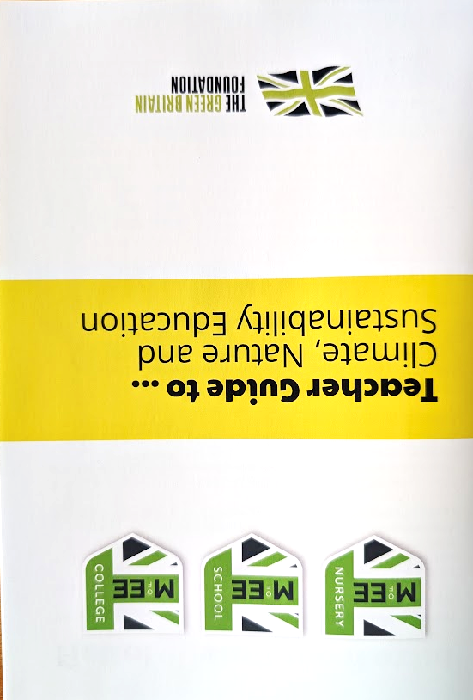
Adapting Your Curriculum
Practical Integration Strategies
Audit existing geography units for sustainability links
Identify local geographical contexts for place-based learning
Use MEE enquiry questions, or design your own, that bridge geography and sustainability
Connect to: science, literacy, numeracy, art
Build progression from familiar places to
global connections

Slide 17
Place-Based Learning
Connecting Local to Global
School Grounds
Habitat, water, energy
Local Community
Transport, food, waste
Regional Context
Landscapes, climate, industry
Global Connections
Trade, migration, climate

Slide 18
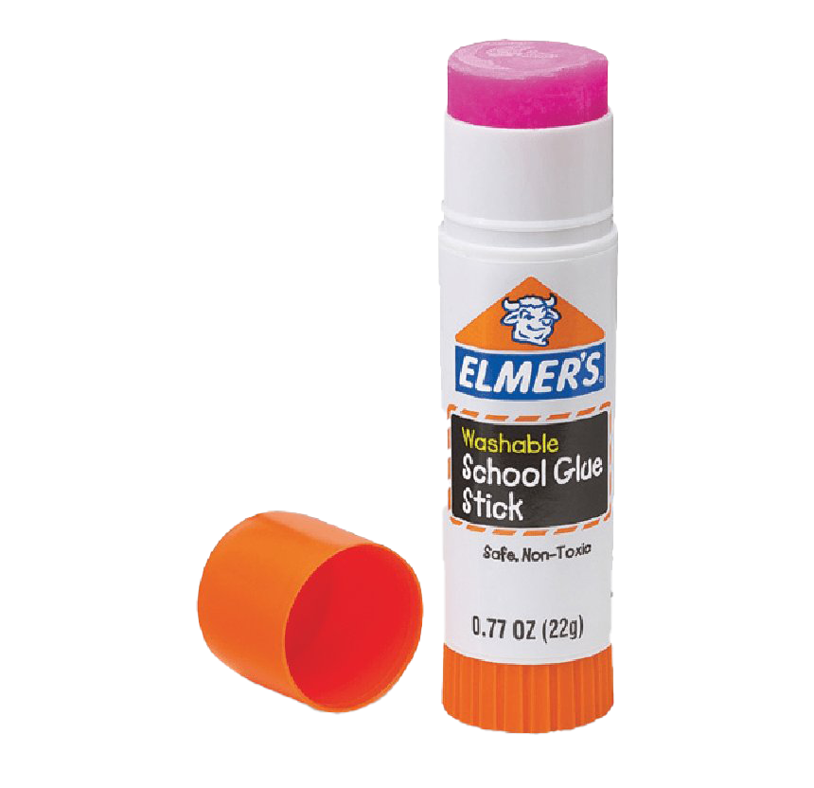
Cross-Curricular Opportunities
Geography as the Connecting Thread
Science: Climate systems, ecosystems, materials
Maths: Data analysis, carbon calculations, mapping
English: Persuasive writing, debate, storytelling
Art: Environmental art, photography, design
Computing: GIS, data visualisation, research skills

Slide 19

Collaborative Planning
8 Minutes: Work together In small groups:
Choose a geography topic from your current curriculum
Identify 3 sustainability themes you could integrate
Develop 1 powerful enquiry question
Share 1 idea with the wider group

Slide 20
Resources & Support
What You'll Take Away Today
Full access to Ministry of Eco Education framework and approach
Ready-to-use lesson plans for immediate implementation
Enquiry question bank for all key stages
Place-based learning planning templates
Contact network for ongoing collaboration

Slide 21
Making the Case
Advocating for Geography's central role to sustainability education:
Share evidence of impact with senior leaders
Demonstrate cross-curricular connections
Highlight development of critical thinking skills
Show alignment with curriculum and Ofsted priorities
Connect to green careers and future-ready education

Slide 22
Moving Forward
Your Journey Continues

Slide 23

Personal Action Planning
2 Minutes: Individual Reflection
Before you leave:
What is ONE thing you will implement in the next 2 weeks?
Who in your school could you collaborate with?
What support or resources do you need?
How will you measure impact?

Slide 24
Key Takeaways
Geography is the glue that binds sustainability education
Systems thinking is essential for climate literacy
Place-based learning connects local action to global challenges
Every geography lesson can contribute to a sustainable future
Every subject can use geographical links to make it relevant

Slide 25


Stay Connected
Join the Network of Activators
Exchange contact details with colleagues today
Access shared resources through the MEE framework
Join communities such as the MEE WhatsApp group
Share your successes and challenges
Continue the conversation beyond this workshop
Come to GroundEd!

Slide 26


Slide 27
