Slide 1
Making a difference through subject leadership
Aidan Hesslewood

Slide 2
Aims
This session explores six key themes of high-quality subject leadership (vision, team leadership, curriculum leadership, impact, stakeholders and management), illustrating how strategic decision-making can have a positive impact on the students we teach.
Participants will have the chance to work through three tasks that help critically reflect on vision, impact and student voice.
This session will be suitable for both existing subject leaders and those aspiring to the role.

Slide 3
About me
Head of Geography @ Spalding Grammar School
Chair of S Lincs GA Branch Geolincs
Corresponding member of TEPC
GA SGQM Moderator
Editorial Board of Teaching Geography
RGS-IBG Ordnance Survey Award 2018
www.linkedin.com/in/aidan-hesslewood-18a1a9349
Ahesslewood@spaldinggrammar.lincs.sch.uk

Slide 4
Key References and Resources
Gardner, D. (2021) Planning your coherent 11-16 geography curriculum: a design toolkit. Sheffield: Geographical Association
https://www.geocapabilities.org/geocapabilities-2/
Hesslewood, A (2026) How can I be a better subject leader of geography? Teaching Geography 51(1): 36-39
Hesslewood, A (2023) Evaluating curriculum impact: using powerful disciplinary knowledge as ‘waypoints’. Teaching Geography 48(3): 107-110
Maude, A. (2016) ‘What might powerful geographical knowledge look like?’, Geography 101(2) 70–6
Owen, C. (2017) ‘Leading the geography department’ in Jones, M. (ed) The Handbook of Secondary Geography. Sheffield: Geographical Association.

Slide 5
Vision (part of intent)
What do you want to achieve? What do you want your students to achieve? Who are they, and what should they learn?
Influenced by GeoCapabilities and powerful disciplinary knowledge (PDK) – what knowledge should students embed in their long-term memories and why (connected to curriculum leadership, later)?
What do you expect? From your teachers, your students, your uptake, your results, your fieldtrips etc.?
Entanglement of ALL aspects of teaching, learning, and assessment in geography (includes SEND)

Slide 6
CORE VALUES:
Becoming better geographers through an engaging curriculum relevant to work and life in the 21st Century
CORE PURPOSE:
Inspire, challenge and enrich
CORE ESSENCE: thinking globally and inspiring future generations to care
DEPARTMENT PURPOSE: Broadening horizons and enhancing capabilities

Slide 7
Team unpicking – what will we see in each other’s lessons?
Teachers of geography are role models for behaviour and attitudes. They will hold students to account on their uniform and behaviour; they will reflect a passion for the subject; and they will uphold the schools’ policies in an equitable manner.
Teachers will demonstrate high standards of communication and require the same from students, helping them develop such skills through the geography curriculum.
Students will be inspired by effective geography pedagogy strategies and assessment for learning.
And students will be inspired to ‘think geographically’, according to the approaches and frameworks set out by the geography department.

Slide 8
1. Clear, explicit instruction
We present new material in small steps with clear explanations and modelling. We reduce cognitive load by being clear, direct, and intentional.
2. Breaking learning into small steps
New content is introduced in small chunks, and we check understanding frequently. In essence, thinking occurs incrementally, not all at once.
3. Frequent checking for understanding
We ask lots of questions and check responses from all students. Learning is constantly made visible and adjusted in real time.
4. Guided practice before independent practice
We provide extensive guided practice before students work independently. Practice is scaffolded and not rushed.
5. High expectations and accuracy
We provide feedback and ensure high success rates. This ensures that every student’s voice is valued. Accuracy matters; students are supported until they succeed.
6. Retrieval practice and review
We ensure students practice retrieval from the short to the long term, strengthening long-term memory. Knowledge and understanding stick through regular retrieval and spaced practice.
7. Focus on classroom atmosphere that supports learning
We insist on orderly, supportive classrooms to maximize learning time. Explicit techniques for routines, behaviour, and engagement ensures this occurs. In essence, a calm, predictable environment enables effective geography teaching.

Slide 9
Team Leadership
“Teamwork makes the dream work”! (most of the time)
What kind of leader are you?
What are your aims (micro-manage, democratic, transactional, transformational, authoritarian, delegation, instructional) and what is actually possible in your context?
Who are your other team members? What do they need? What do they bring to the team?
Main responsibility: support? (what’s in your JD?)
A hybrid approach depending on context?

Slide 10
Curriculum Leadership (intent and implementation)
Depends entirely on institutional structure
Teaching and learning should be the focus
Curriculum-making: “the creative act of interpreting a national curriculum or examination specification and turning it into a coherent, challenging and engaging sequence of teaching and learning” (Geographical Association 2016)
Align the departmental aims with the planned curriculum, which includes long-term plans, schemes of work, lesson plans, resources, homework, assessment, and all the other nuts and bolts

Slide 11
Curriculum-making
We begin with our shared context (the world in which we live). We have an understanding of how teaching geography helps young people make sense of the world (in this day and age). We then start curriculum making … The first question is always who. Who are the children we teach? Teachers need to get to know their students: What are their interests and concerns? What pressures are they under? What do these children need to learn and develop in order to face their futures with confidence?
We then ask the key question why. Why should we teach them geography? Why should we encourage our students to take geography seriously? How does geographical knowledge contribute to their human capability? How does it help students to think?
We are the enabled us to ask what exactly we should teach. We should believe in what we teach. We can the justify that it is worthwhile, relevant, and useful.
Knowing what to teach helps us to think critically about how we teach. We select teaching techniques that are fit for purpose.

Slide 12
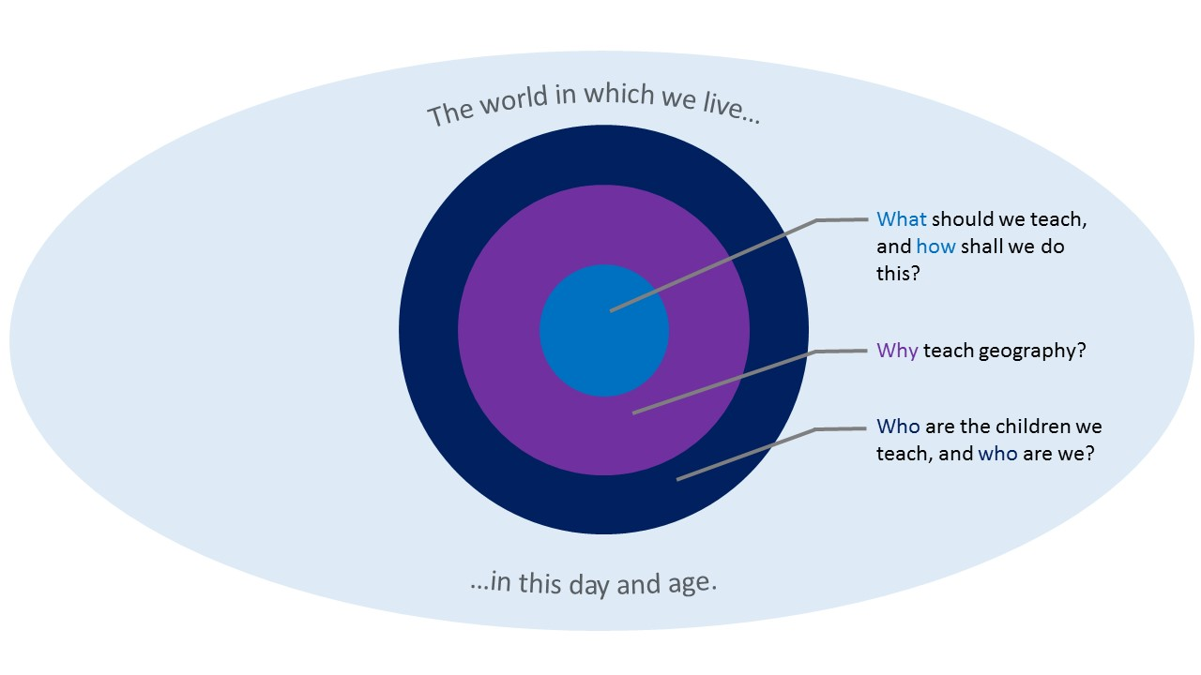
Notes:
We begin with our shared context (the world in which we live). We have an understanding of how teaching geography helps young people make sense of the world (in this day and age). We then start curriculum making … The first question is always who. Who are the children we teach? Teachers need to get to know their students: What are their interests and concerns? What pressures are they under? What do these children need to learn and develop in order to face their futures with confidence?
We then ask the key question why. Why should we teach them geography? Why should we encourage our students to take geography seriously? How does geographical knowledge contribute to their human capability? How does it help students to think?
We are the enabled us to ask what exactly we should teach. We should believe in what we teach. We can the justify that it is worthwhile, relevant, and useful.
Knowing what to teach helps us to think critically about how we teach. We select teaching techniques that are fit for purpose.

Slide 13
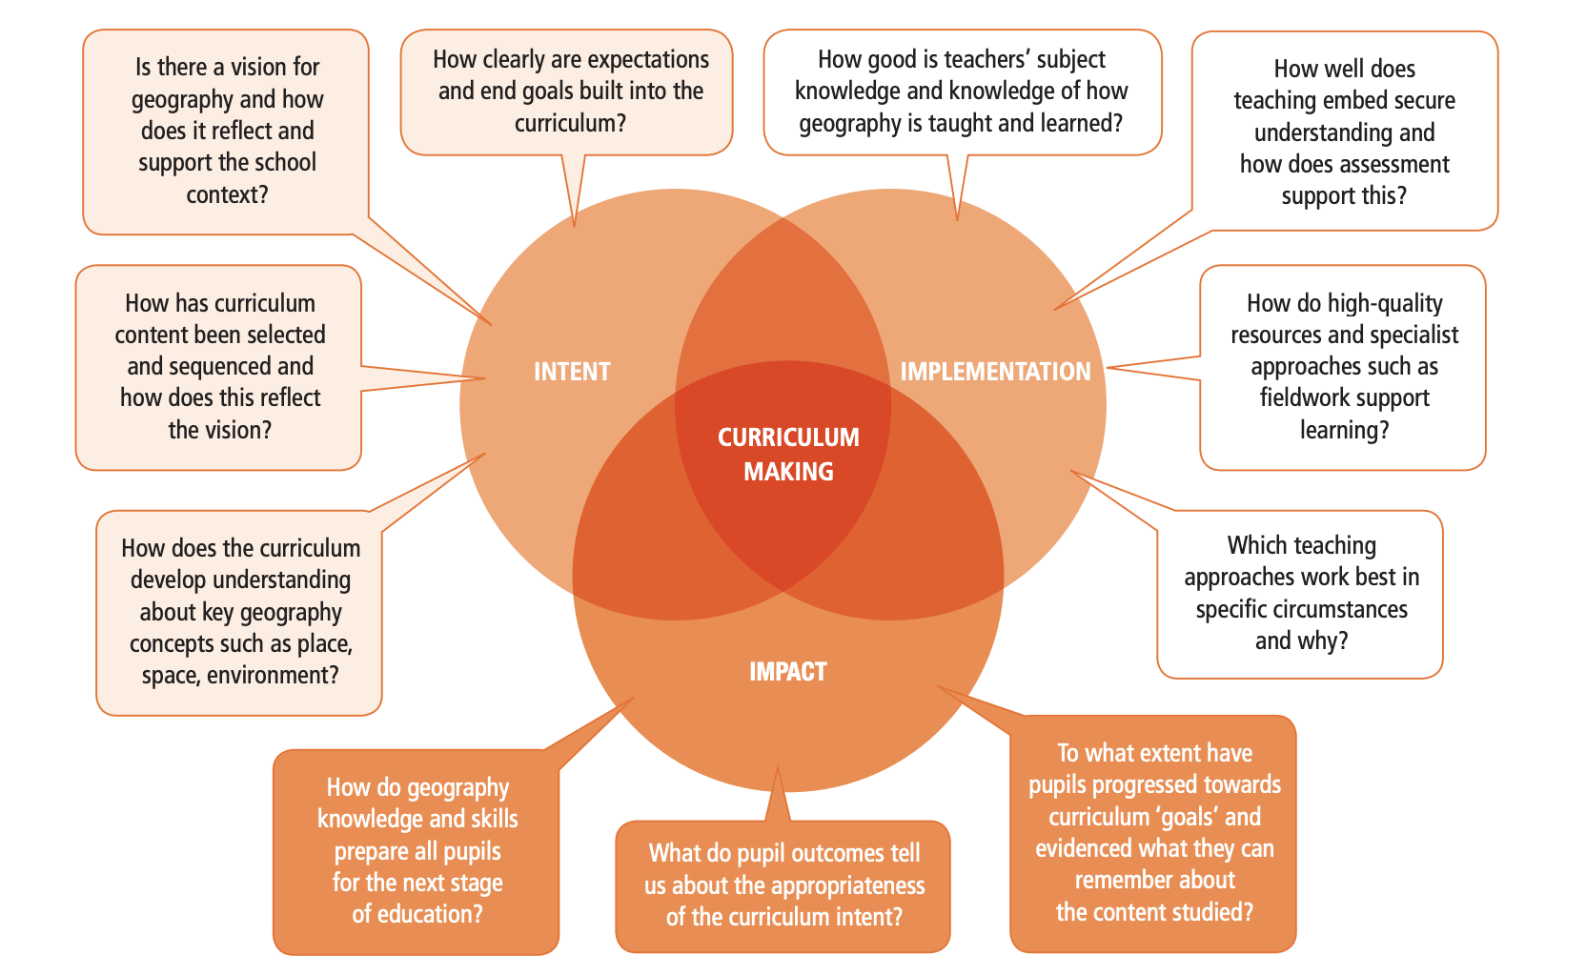
Notes:
Sorry – can’t remember where this came from!

Slide 14
Evaluating (impact)
Accountability and quality assurance
Planned curriculum (part of your “vision”)
Enacted curriculum
Learned curriculum
What are the gaps between these?
Interrogate the learned curriculum through QA / evaluation processes
To what extent does this reflect the planned curriculum (the “vision”)?

Slide 15
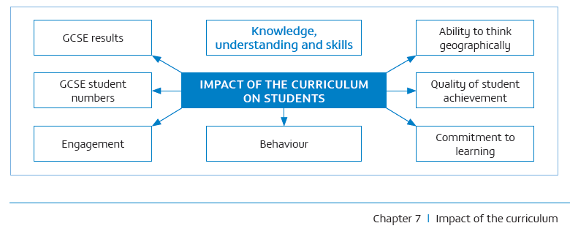
Notes:
From Gardner 2021

Slide 16
Evaluating (impact)
Focus on the “powerful disciplinary knowledge” that students have learned and committed to long-term memory
Acting as “waypoints” through the curriculum – evidence that points to gaps
Example, can students remember the global circulation system? Can they connect this to other areas, like the spatial distribution of biomes? Extreme weather?
Additional focus on groups like SEND – is there equitable access to the curriculum?

Slide 17
“Empowering” knowledge (PDK)
Knowledge that provides students with ‘new ways of thinking about the world’
Meta-concepts like place, space and environment, are used to underpin substantive concepts – the ‘lenses’ through which geography students look
Knowledge that provides students with powerful ways to analyse, explain and understand the world
Analytical concepts, explanatory concepts, and the ability to generalise e.g. climate and vegetation, the concentration of economic activity
Knowledge that gives students some power over their own knowledge
The capacity to evaluate claims about knowledge itself; for students to be independent thinkers able to be critical of the opinions of others; the capacity to discuss
Knowledge that enables young people to follow and participate in debates on significant local, national and global issues
Having knowledge that empowers enables students to participate in ‘real’ debates
Knowledge of the world
General knowledge of the world that takes students beyond their own experiences

Slide 18
Evaluating (impact)
DSEF
DDP
Plan-do-review
The SGQM!

Slide 19
Involving Stakeholders
Your geography students
Your geography team
Senior leaders
Governors
Parents
The GA?

Slide 20
Managing
Leadership
Vision Inspiring students and colleagues Encouraging professional growth
Evaluating the curriculum (impact)
Interpret student attainment data
Observing colleagues and providing feedback
Ensure school policies are applied in the department
Report to senior leaders
Observe teaching
Tackling behaviour issues, including meeting with parents
Setting agendas for departmental meetings
Ensuring deadlines are met (e.g. common assessment tasks)
Budgeting and allocating funds and resources
Management

Slide 21
TASK 1
If you are new to the SL role, consider what you want your team and your students to achieve under your leadership. If you are a more experienced SL, evaluate the extent to which your vision is still a purposeful declaration of your aims. Use the following questions to help, and if possible, undertake this as a team exercise:
To what extent is your vision relevant to the students you teach?
To what extent is your vision precisely articulated and clear to all relevant stakeholders?
To what extent does your vision help you evaluate the impact of your curriculum?
Does your vision apply to all students in an equitable way (i.e. no groups of students are excluded)?
How can you expand on your vision to outline wider expectations of staff and students in geography?

Slide 22
TASK 2
Use the table to begin to evaluate the impact of your curriculum (adapted from Gardner 2021).

Slide 23
Key Question | Methods | Evidence
To what extent is students’ work high quality? | Work scrutiny Lesson observations Lesson study (action research) | Student work is clear and shows understanding of powerful disciplinary knowledge (PDK) and key geographical ideas
To what extent does assessment show student progression, and how does it help us identify whether our students are ready for the next stage in their education? | Internal data analysis Work scrutiny | Overall trends indicate that students know, under­stand, and can do more over time, meeting personal targets and fulfilling GA benchmark expectations [from the progression framework (2020)]
To what extent do students know more over time, and can they remember more of it? | Lesson observations Lesson study (action research) Work scrutiny – student work over time Student voice (student focus groups and student questionnaires) | Students are observed to build on their previous PDK in lessons Student work shows that previously learnt PDK is used to contextualise new knowledge Students state that they know more over time and can remember it
To what extent do the most disadvantaged students – as well as students with SEND – learn the knowledge and cultural capital they need to succeed in life? | Lesson observations Lesson study (action research) Work scrutiny – student work over time Student voice Internal data analysis | Disadvantaged and SEND students work as well as others in class, and book work is of as high quality Disadvantaged and SEND students state that they feel they learn valuable and powerful knowledge Internal data shows no gaps
How do public examination results reflect the knowledge and skills students have gained over time? | Public examination results analysis | Examination results are consistently high or rapidly improving, and are above the national average

Slide 24
TASK 3
One of the most powerful pieces of evidence to help evaluate the impact of your curriculum is “student voice”, and this task provides some prompts to help construct a questionnaire that yields useful and productive information. Student voice is more effective when collecting a large set of data, but this can present problems by way of the format. Online questionnaire packages, such as Microsoft Forms, allows for this but also for open-ended opinion data too.
The first question to consider is the purpose of the questionnaire and how it relates to particular aspects of your curriculum evaluation. Is it to gather information on how much students enjoy geography, how effective they think the teaching is, if they see the value in learning geography, or something else? If questionnaires are too long, I’ve found that it’s easy for students to get bored of it, so try to ensure that your questionnaire isn’t trying to do too much.
The second question to consider is what types of data you want to collect. Do you want to be able to capture lots of quantitative data, or perhaps qualitative data such as students’ thoughts and opinions? Maybe a mixture of both? This may be determined by the purposes of the data. Are you collecting data about a particular topic, year group, phase, fieldtrip, or something else? Who will see the outcomes of your analysis – is it for internal departmental use or to share more widely with senior leadership and governors?
The third question to consider is the method of presenting and sharing this information with relevant stakeholders as part of the QA process. Do you want easily digestible charts to show overall trends? Do you want rich detail from the students’ perspectives? Perhaps a mixture of both? How will this enable you to spot patterns and trends, and how well can it be triangulated with data collected through other QA methods?

