Slide 1
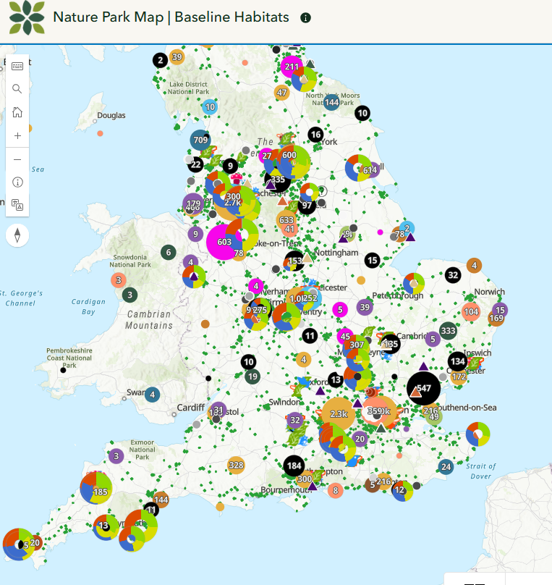

Mapping a sustainable future through the Geography curriculum
Kit Marie Rackley (they/she)
k.rackley@uea.ac.uk

Slide 2
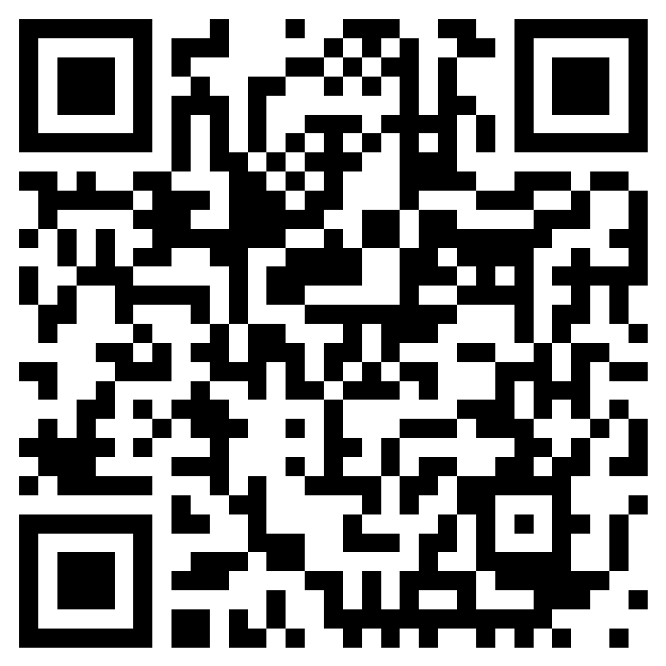
Mapping a sustainable future through the Geography curriculum
Kit Marie Rackley (they/she)
k.rackley@uea.ac.uk
t.ly/nTdXm

Slide 3
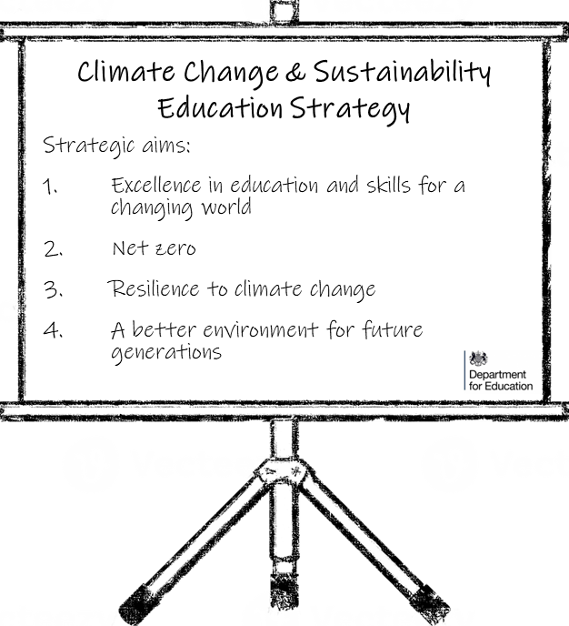
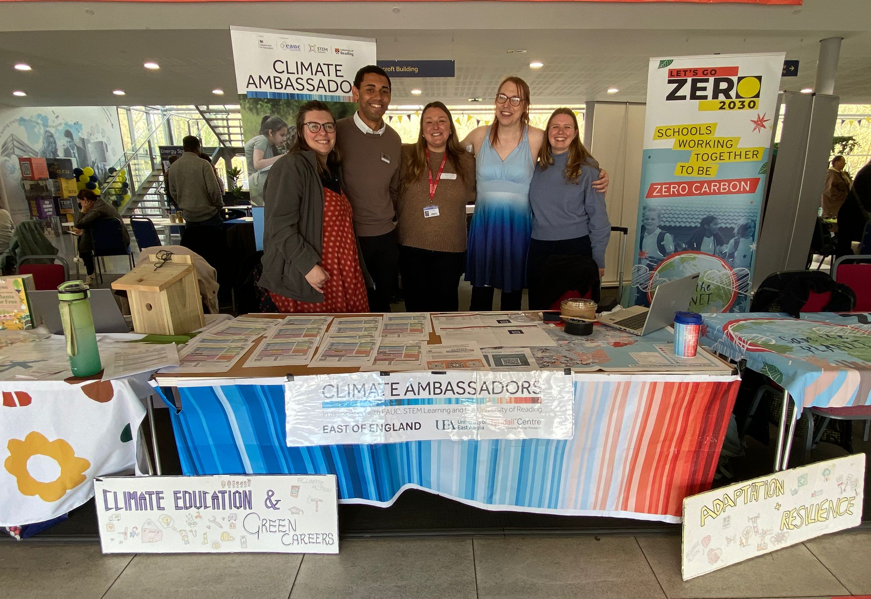


ALL EDUCATION SETTINGS TO HAVE A:
DESIGNATED SUSTAINABILITY LEAD
CLIMATE ACTION PLAN

Slide 4
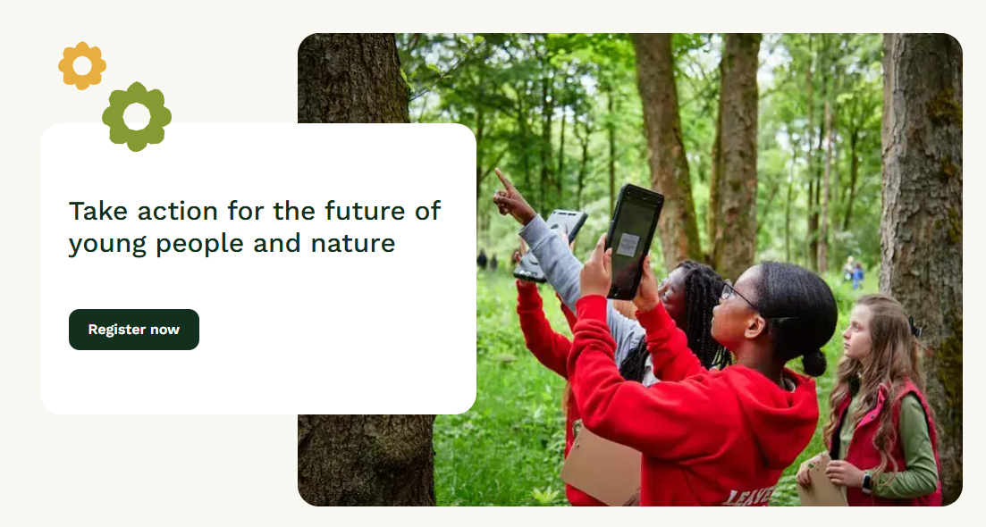
What is the National Education Nature Park?
The National Education Nature Park programme empowers children and young people to make a positive difference to both their own and nature's future. It does this through:
Working with and enhancing existing curriculums
Enable greater outdoor learning opportunities
Turning pupils and teachers into community scientists
Supporting climate adaptation and resilience of school communities
In other words...
It’s a Geography teacher’s DREAM!

Slide 5
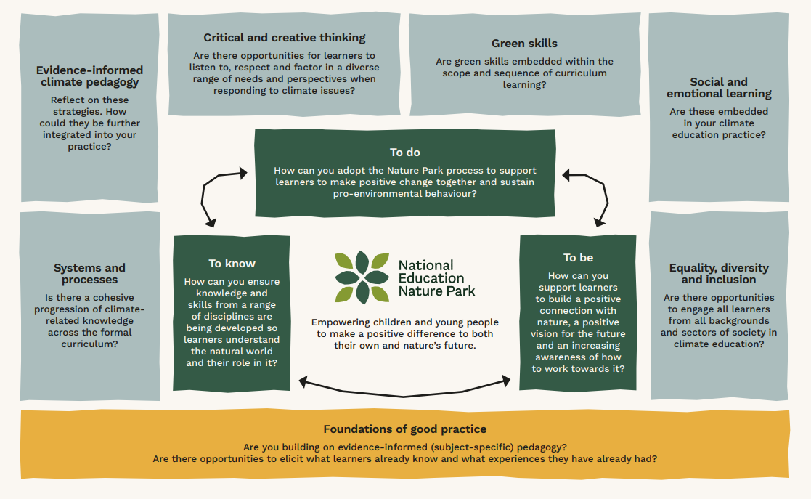
The National Education Nature Park Climate Education Framework - an overarching framework for best practice and progress
t.ly/lYkZ8

Slide 6
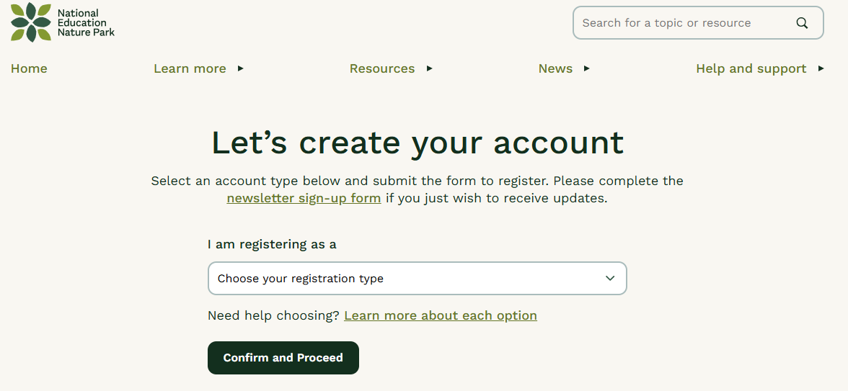
educationnaturepark.org.uk/user/register

Slide 7
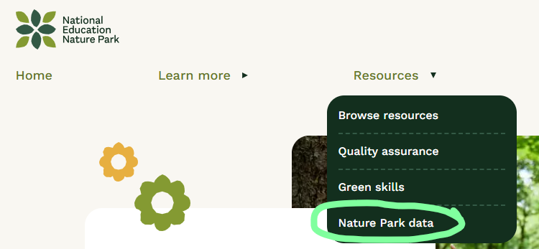

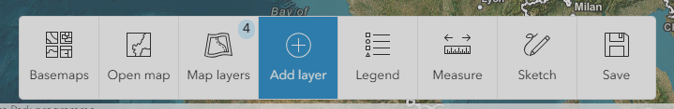
Explore the Nature Park GIS Map
Browse the layers – what kind of activities can you find?

Slide 8
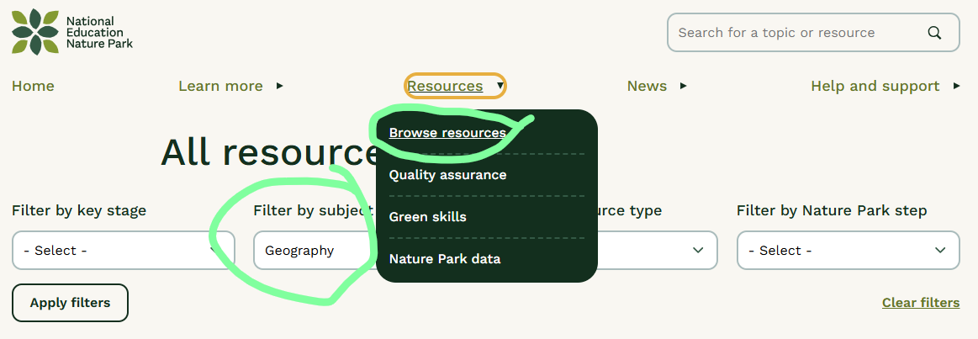
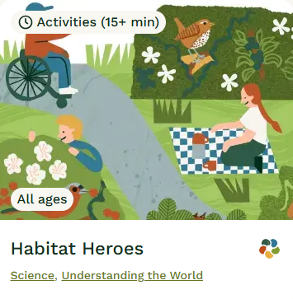
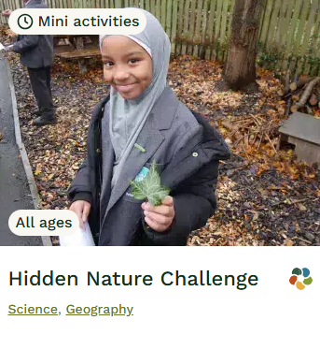
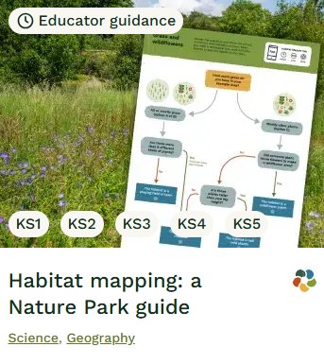
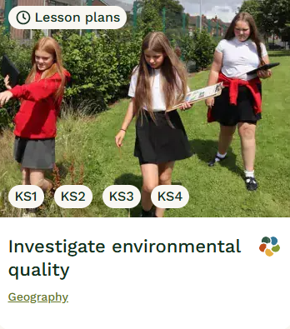
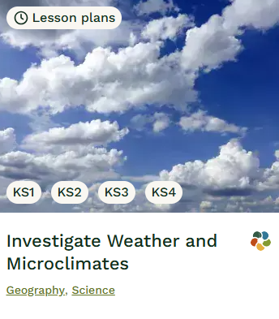
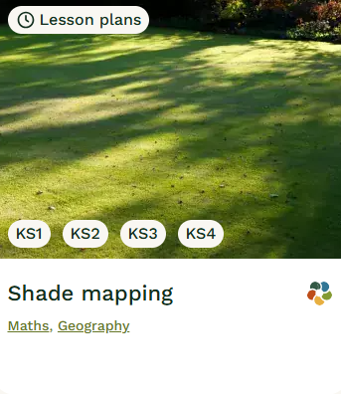

Slide 9
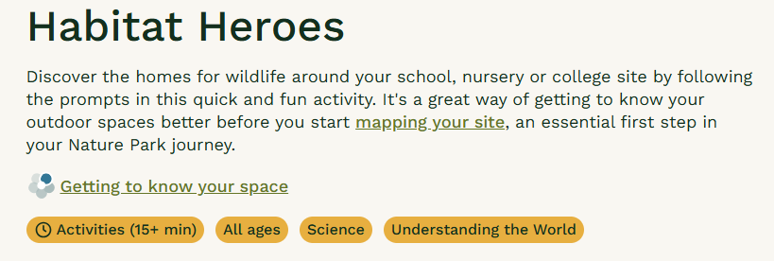
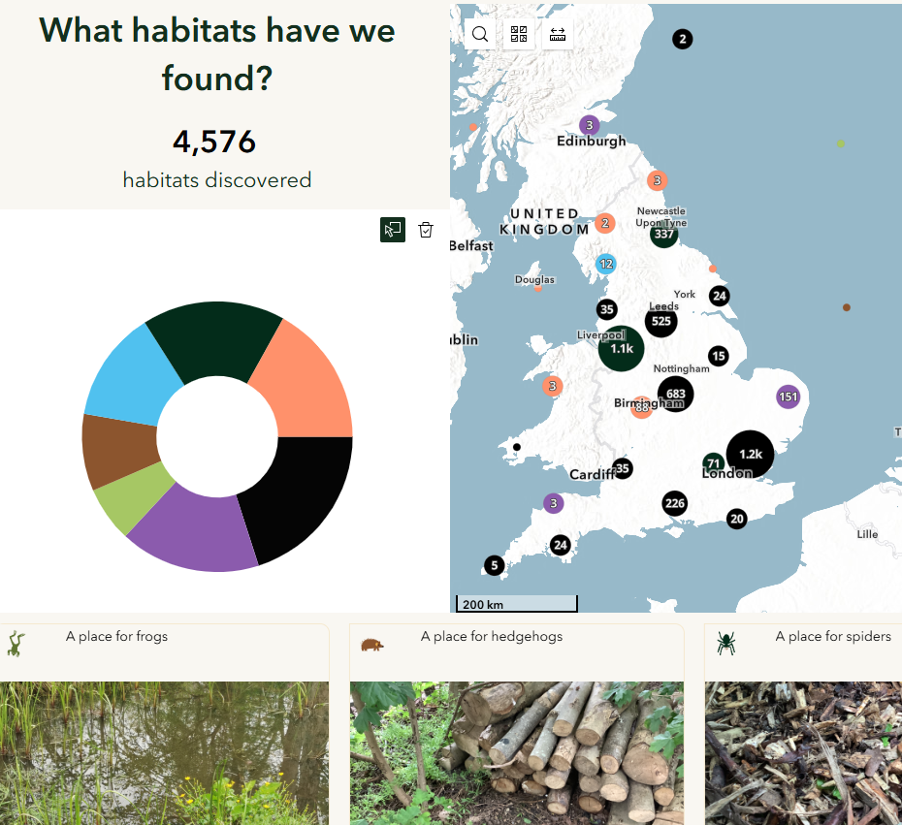
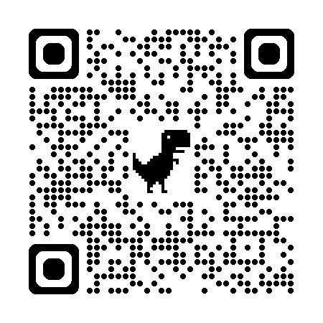
Discussion points:
What makes pupils “heroes”? Name the action pupils take (not just learning). Which idea is strongest: place, stewardship, or human–environment interaction?
One real change. Choose one habitat. What small change could pupils make, and how could they show it worked?
Adding geography. Where does this need more geography? Name one concept you’d teach alongside it (e.g. scale, management).
educationnaturepark.org.uk/resource/habitat-heroes

Slide 10
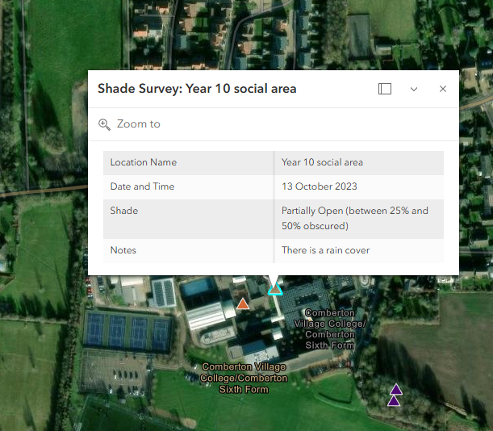
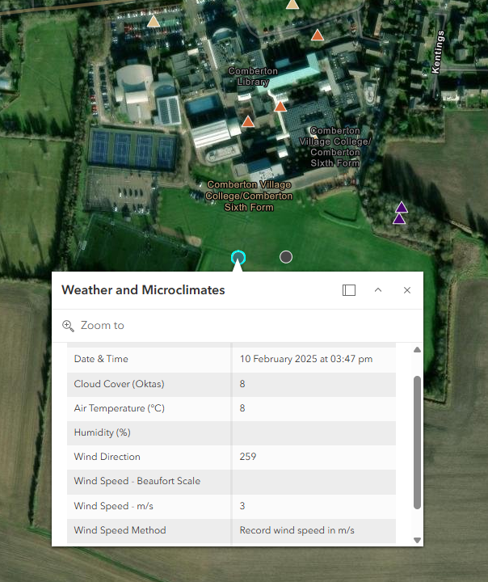
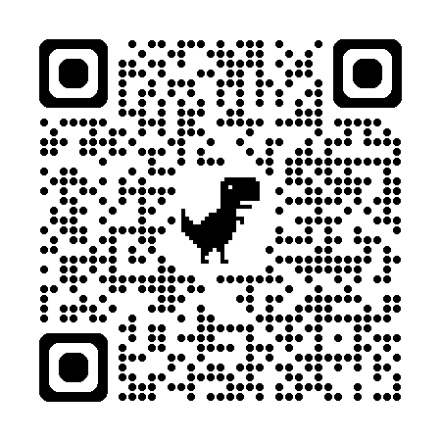
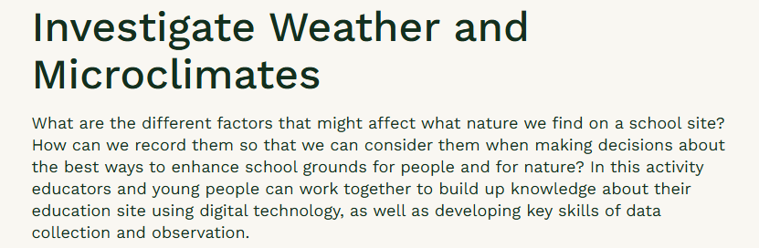

Discussion points:
What microclimates exist here? Where will pupils find hotter, cooler, windier or sheltered spaces? What physical or human features create these differences?
Heat and school resilience: During a heatwave, how could this knowledge be used? Which spaces become risky or protective, and for whom?
From data to decision: What one realistic change could pupils justify (shade, surfaces, use of space)? What geographical concept strengthens the case (e.g. adaptation, risk, management)?
educationnaturepark.org.uk/resource/shade-mapping
educationnaturepark.org.uk/resource/weather-and-microclimates

Slide 11
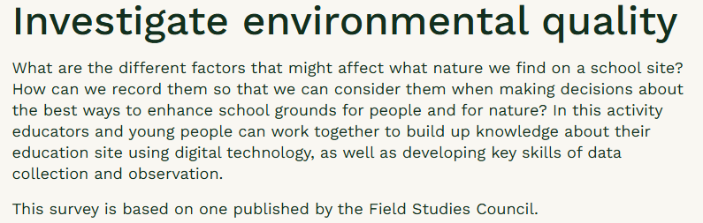

Discussion points:
What counts as “environmental quality”? What indicators are being combined here? Whose definition of quality is embedded in the score?
Comparison and place: How does your school compare with others locally or nationally? What physical or human factors might explain the differences?
From judgement to action: How could pupils use this data to prioritise change? What geographical concept strengthens this (e.g. inequality, management, liveability)?
educationnaturepark.org.uk/resource/investigate-environmental-quality

Slide 12
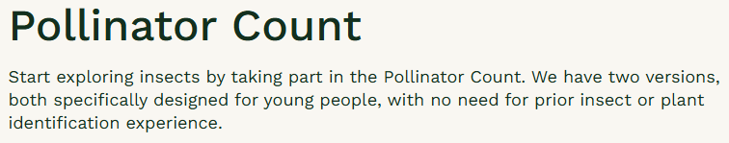
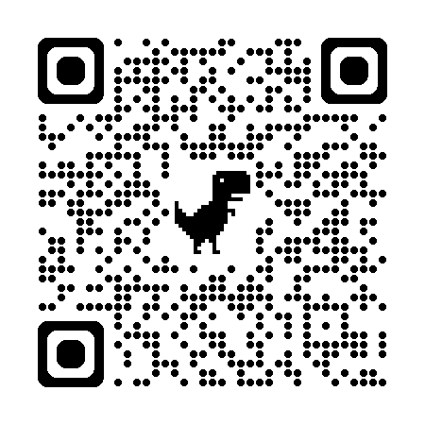
Discussion points:
What kind of data is this? What are pupils actually counting or recording? What does this tell us about pollinators – and what does it miss?
Patterns and explanations: Which places, plants or times might show more pollinators? What physical or human factors could explain differences?
Using the evidence: How could pupils use these results to argue for change? Which concept matters most: biodiversity, sampling, or uncertainty?
educationnaturepark.org.uk/resource/pollinator-count

Slide 13
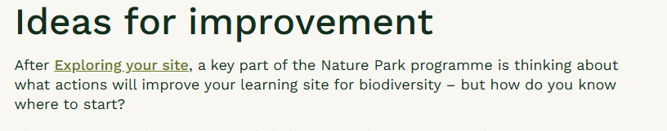
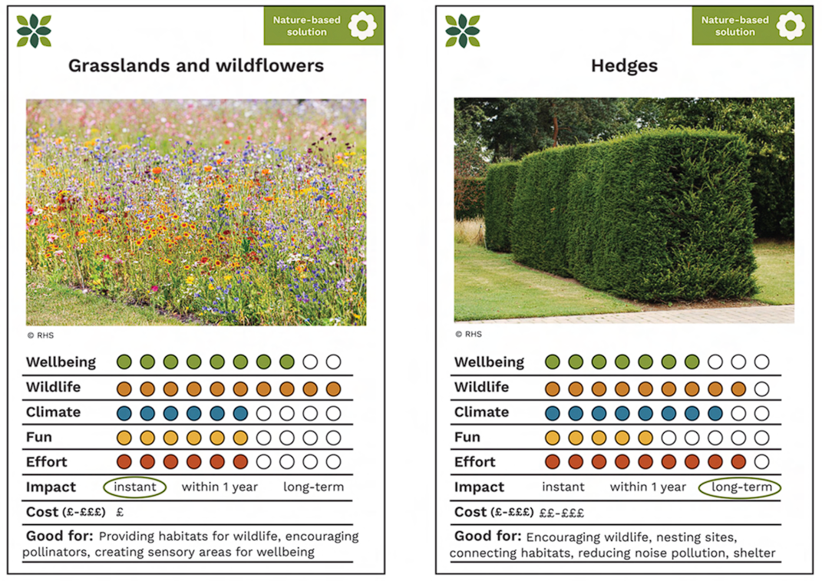
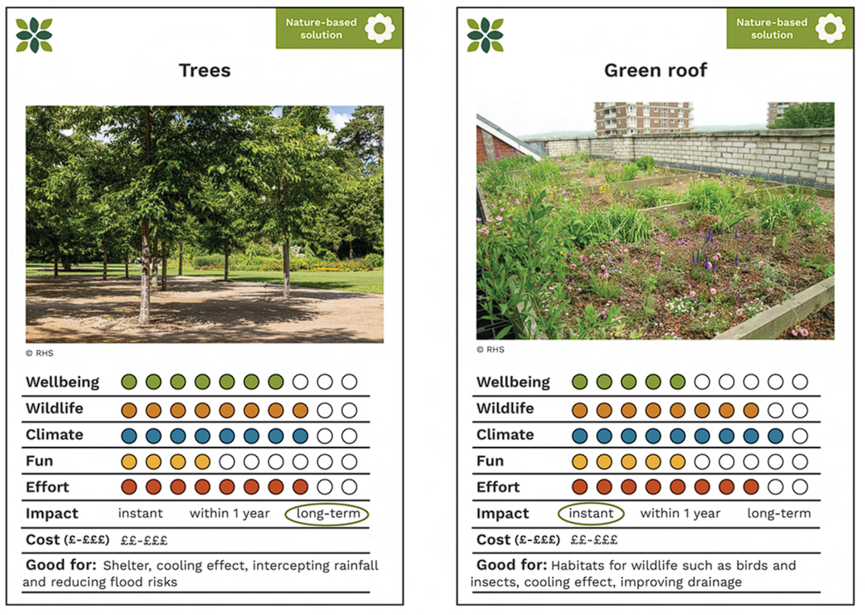
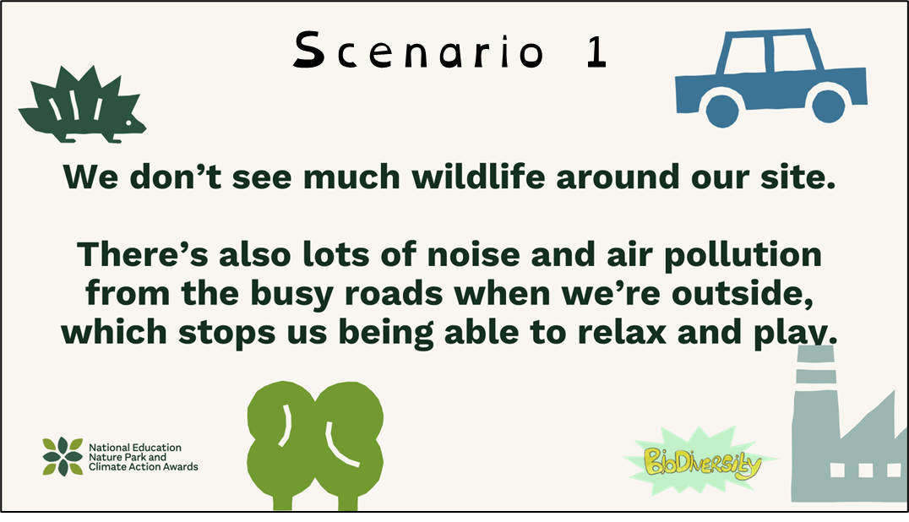

Discussion points:
What makes this an enquiry, not a wishlist? Where are pupils expected to move from evidence → question → proposal? What stops this becoming just “nice ideas”?
Judging and prioritising change: Using the improvement cards, what criteria should pupils use to decide which ideas matter most (impact, feasibility, equity)?
Geography payoff: Which geographical concept gives this rigour (decision‑making, trade‑offs, sustainability)? How does this justify pupil action as geographical learning, not enrichment?
educationnaturepark.org.uk/resource/ideas-improvement

Slide 14



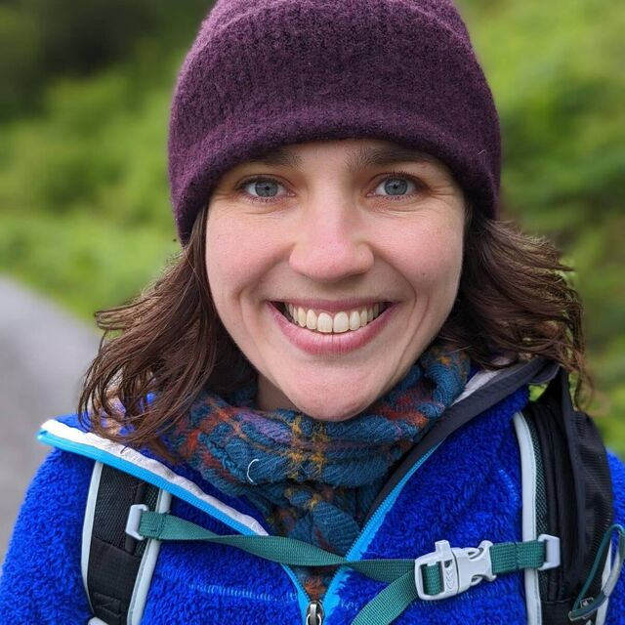
The National Education Nature Park allows geography to:
Start from real places pupils know
Use fieldwork, data and enquiry with clear purpose
Connect climate, nature and people
Support adaptation, resilience and decision‑making
Turn evidence into informed action
Mapping a sustainable future through the Geography curriculum
Kit Marie Rackley (they/she)
k.rackley@uea.ac.uk
Notes:
Jen, Jen and Georgia

