Slide 1

A powerful primary geography curriculum
Geographical Association Conference
April 2026
Emma Lennard
Notes:
This session will look closely at the primary geography curriculum and explore how to select content and implement a well-sequenced, coherent curriculum for long-term learning. It will also consider progression and include opportunities for reflecting on what a pupil’s geography experience looks like as they journey from their early years through primary education. Importantly, we will consider geography's role in developing a child’s identity. Geography is not just about maps and locations; it's about connecting children to their world, fostering a sense of belonging and developing agency to impact the world around them. Geography can make a difference for all children, and in this session we will think about how we can be agents of this change.

Slide 2
The challenge…
Selecting curriculum content
Sequencing for long term learning
Identity and Belonging
People and their impact on the world

Slide 3
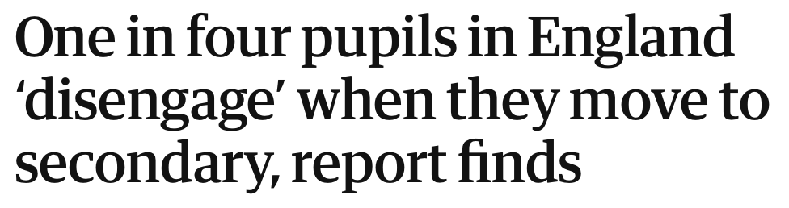


Why power?
What can we, as geography teachers, do?

Slide 4
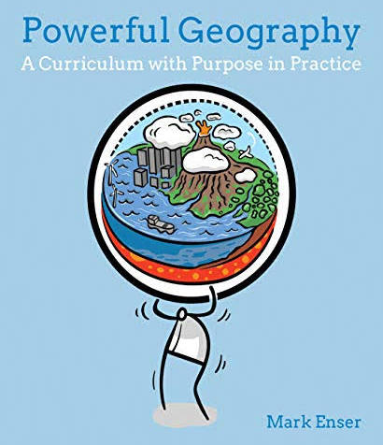
Why power?
Knowledge is powerful ‘if it predicts, if it explains, if it enables you to envisage alternatives’.
Young (2014, p. 74)

Slide 5
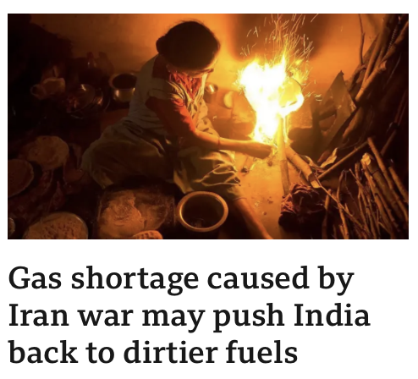
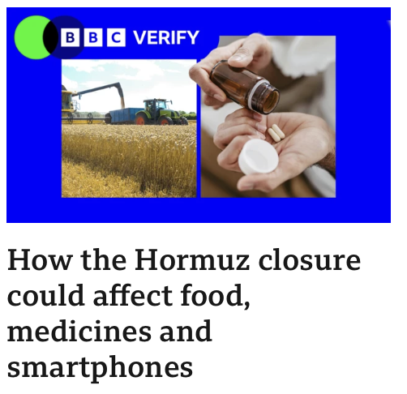
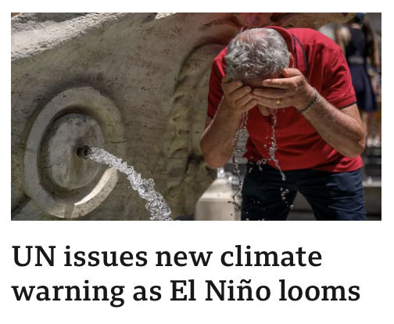
Why power?
What story does our curriculum tell of the world?
What does it help our children to understand?

Slide 6
Geography Curriculum Design
What kind of maps should children be able to read?
What fieldwork do we want children to do, when and why?
Which places do we want children to know about?
Which physical features do we want children to recognise?
What story will our geography curriculum tell of the world?
What do children need to know in order to read a map successfully? When do we teach this?
What do we want children to know about human geography?
Which places will not feature in our curriculum, is that ok?
How will geography develop a sense of identity for our children?
Notes:
My colleague Juli hates this slide- it makes her shudder- Its complex!
But we should not be expected to reinvent the wheel. Workload- we cannot be experts on everything. But what we can do, is take a curriculum, like PKC and really understand it well. Probe it- ask which places children learn about, when and why. Think about the story our curriculum tells.
By questioning and critiquing our curriculum we will be making sure it is serving our children in the best way it can.
Answering these questions feeds into our intent.

Slide 7
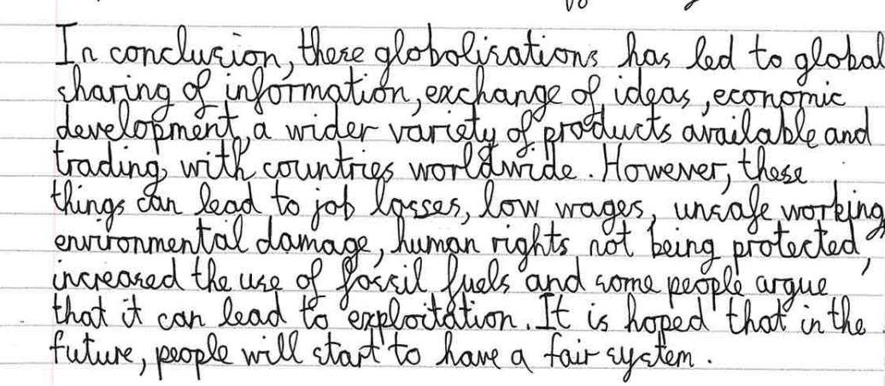
“The more you know the more complex and interesting connections you can make.”
Year 6 Pupil, Earls Court Free School Primary
David Didau and Nick Rose, What Every Teacher Needs to Know About Psychology, 2016
Notes:
This captures what I think is a good point to have reached for Year 6 pupil ready to go onto secondary school – powerful knowledge that will be a foundation for this child’s future learning. We want children to have powerful knowledge that will help them make connections.

Slide 8
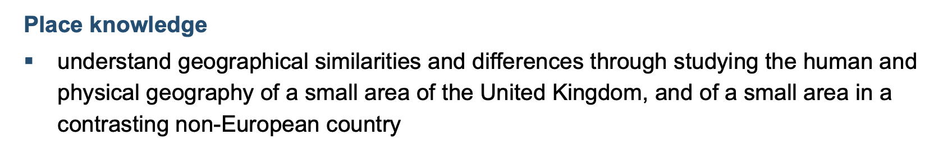
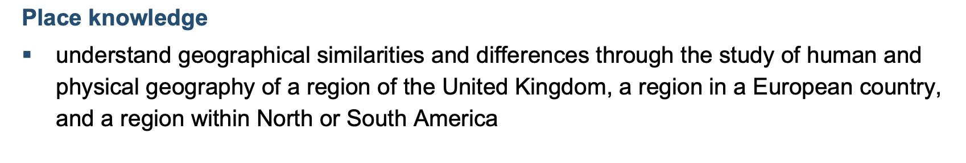
Selecting curriculum content: Which choices must we make?
Which places?
Which features?
What should we compare?
What do I want children to remember about this place?
Why?
Notes:
Powerful choices!
Let’s male these choices purposeful – yes we can buy a scheme but let’s understand why we are teaching particular places.

Slide 9
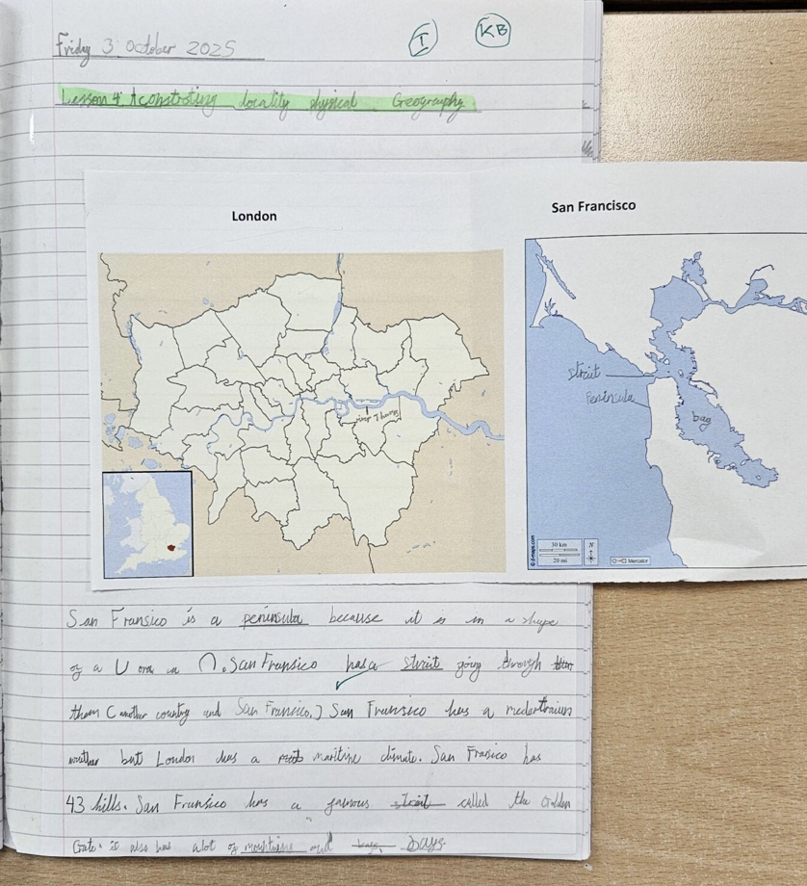
San Franscisco is a peninsula because it is in a shape of a ‘U’ or an ‘n’. San Franscisco has a strait going through them (another country and San Franscisco). San Franscisco has a mediterranean weather but London has a maritime climate. San Franscisco has 43 hills. San Franscisco has a famous strait called the Golden Gate. It also has lots of mountains and bays.
Notes:
Example of a choice we’ve made – they will learn more about North America later in the curriculum – San Fran has a very clear grid system which compares nicely to the meandering roads of most UK cities – so we chose it for that.

Slide 10
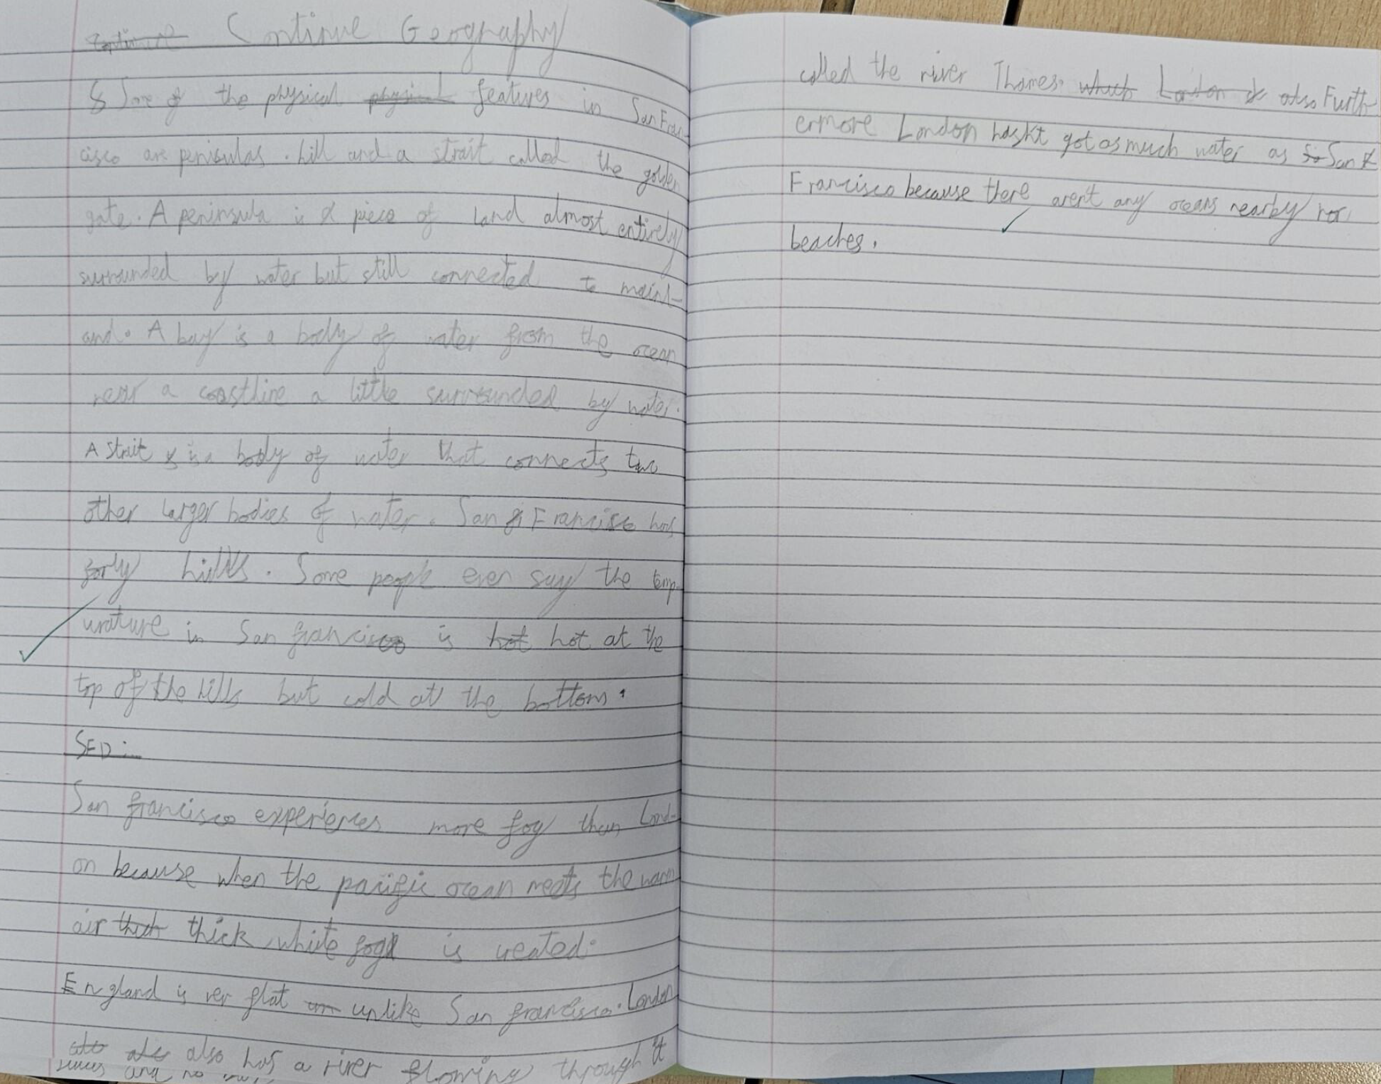
Some of the physical features in San Francisco are peninsulas. A peninsula is a piece of land almost entirely surrounded by water but still connected to mainland. A bay is a body of water from the ocean near a coastline a little surrounded by water. A strait is a body of water that connects the two other larger bodies of water. San Francisco has forty hills. Some people even say the temperature in San Francisco is hot at the top of the hills and cold at the bottom.
Why does San Francisco experience much more fog than London?
San Francisco experiences more fog than London because when the Pacific Ocean meets the warm air, thick white fog is created. England is flat unlike San Francisco. London also has a river flowing through it called the River Thames. Furthermore London hasn’t got as much water as San Franscisco because there aren’t any oceans nearby or beaches.
Notes:
‘England is Flat unlike San Franscisco’ misconception or perhaps a mistake- London is flatter than San Fran but still hills – some mistakes but this child is thinking about the right things!

Slide 11
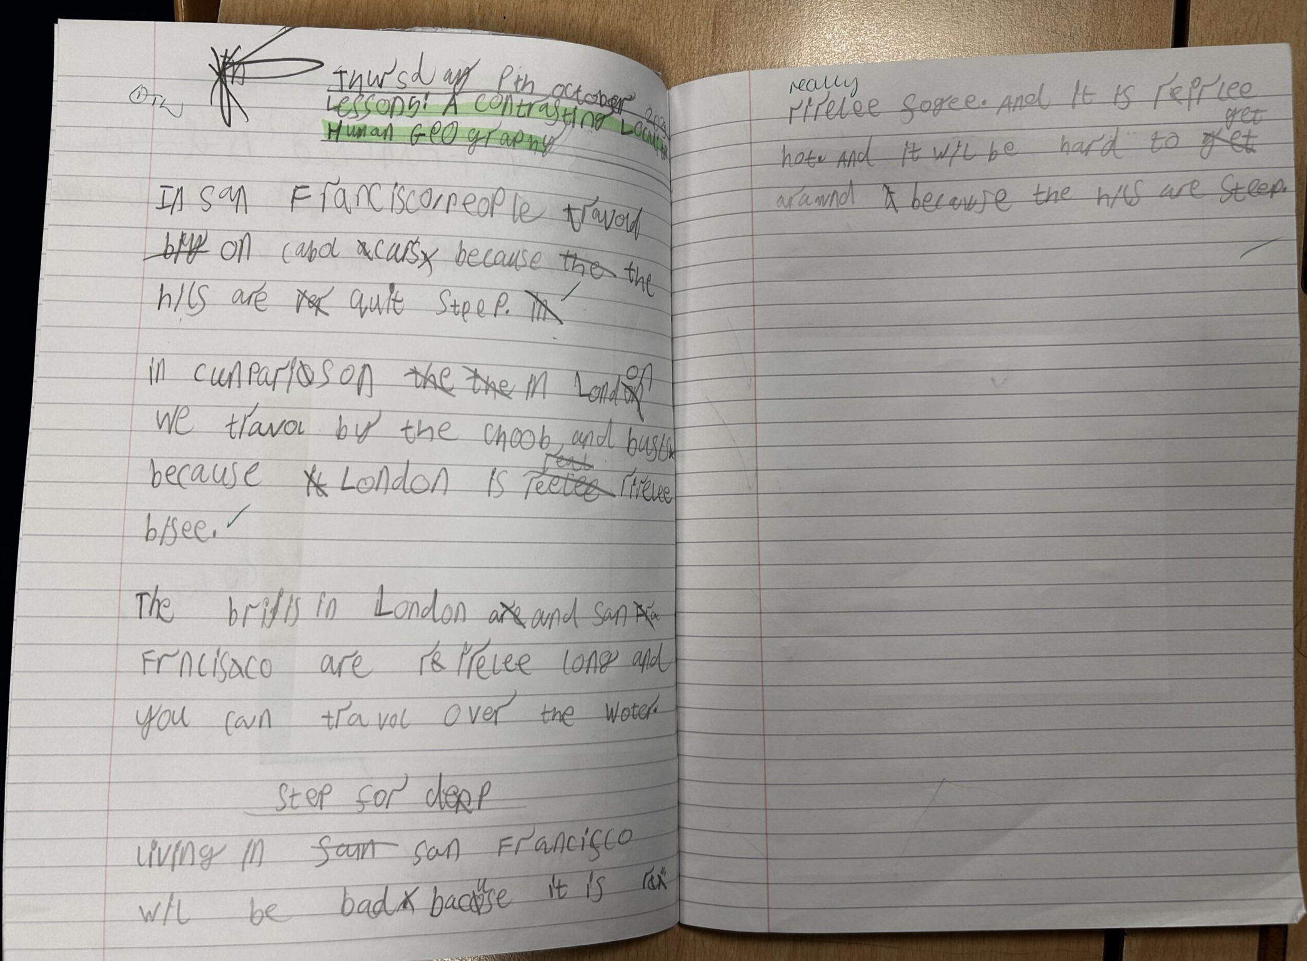
In San Franscisco people travel on cable cars because the hills are quite steep.
In comparison in London we travel by the tube and buses because London is really busy.
The bridges in London and San Francisco are really long and you can travel over the water.
Living in San Franscisco would be bad because it is really foggy. And it is really hot. And it will be hard to get around because the hills are steep.
Notes:
Lower prior attainer – also in this example the step for depth is asking a child if they’d like to live in a place- perhaps not so helpful. So we tweaked the question to previous slide- why is San Fran more foggy than London

Slide 12
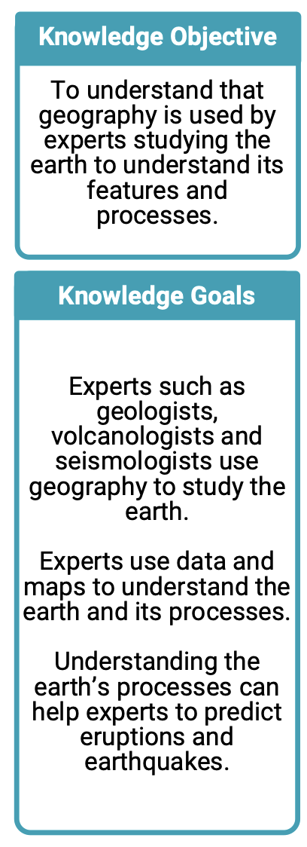
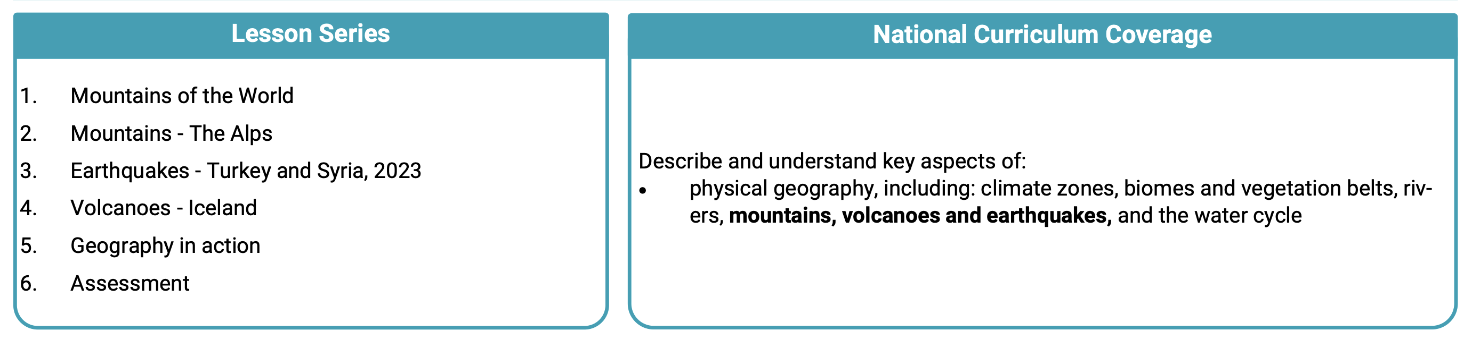
Selecting curriculum content: Which choices must we make?
Which mountains, why?
What do we want primary children to know about volcanoes?
How much detail should we teach about earthquakes?
How do we fit all of this in?
Notes:
Choose stories- which earthquakes? If we choose Japan- it is a wealthier country with the capacity to withstand earthquakes to a large degree, do we choose something recent? We had Christchurch earthquake in 2011, but recently updated it.
Could any of our children, or extended families be impacted by the case studies we choose?
We chose Iceland as it is volcanic land, not a cone shaped volcano as children often imagine.

Slide 13
Considerations when selecting content…
Which places?
Which features?
What should we compare?
What do I want children to remember about this place?
Why?
Notes:
Just to summarise

Slide 14
Selecting curriculum content can create a powerful curriculum because it allows us to choose stories, places and examples that develop children’s geographical thinking.

Slide 15
Sequencing for long term learning:
What do we think children already know, how can we check?
How does this new knowledge link to their prior knowledge?
When will children build on this new knowledge with future learning?
What connections could children make with other areas of the curriculum?

Slide 16

Sequencing map work
EYFS: My community, my local area, travel around the world, explorers, north and south pole (globes)
Year 1: My classroom, my school site, drawing maps, my local area, aerial views, compass points Year 2: My local area, drawing maps, planning a route, globes
Year 3: Maps, compasses, symbols, grid references, fieldwork, contrasting localities Year 4: Globes, tropics, map scale, grid references, local area
Year 5: Hemispheres, scale, co-ordinates, relief maps Year 6: Latitude, longitude, time zones, map projection, world maps
Notes:
It is a progression model because it is specified, sequenced and taught to be remembered. Because children remember things they can get better at geography, they can use what they know and apply it to new contexts. Year 6 teachers can teach challenging content because children come with knowledge, they arent still teaching the countries of the UK, theyre looking at issues such as flooding and children use their knowledge of the UK to understand this issue. If you don’t know what a coast is, what a river does, what low lying land is etc then the issue of flooding will cause cognitive overload.

Slide 17

Map Work
Purpose: to identify locations, to develop spatial awareness, to communicate, to present data, to use symbols and scales for a range of purposes
YR | Understanding the World | Draw and create simple maps from memory
Y1 | Spatial Sense | Draw a map of the classroom
Y2 | Spatial Sense | Draw a map of the local area using symbols in a key
Y3 | Spatial Sense | Use grid references to locate positions on a map
Y4 | Spatial Sense | Calculate the distance between places in the local area using scale
Y5 | Spatial Sense | Draw and label the equator and meridian line on a world map. Draw and label the longitude and latitude lines on a globe. Label the hemispheres.
Y6 | Spatial Sense | Draw a diagram to show why ‘polar night’ occurs and write an explanation.
How do children get better at map work in your school?
Notes:
Discuss

Slide 18
Sequencing for long term learning
Spacing learning can increase storage strength (Bjork et al,. 1992)
When do pupils revisit content?
In EYFS children learn about their local area, then each year children touch on an additional aspect of local geography before exploring some local geographical issues in Upper KS2.
We have a local geography unit in Year 4.
We have one local unit in KS1 and another in KS2.
Notes:
We need to consider where children revisit content and build upon it

Slide 19
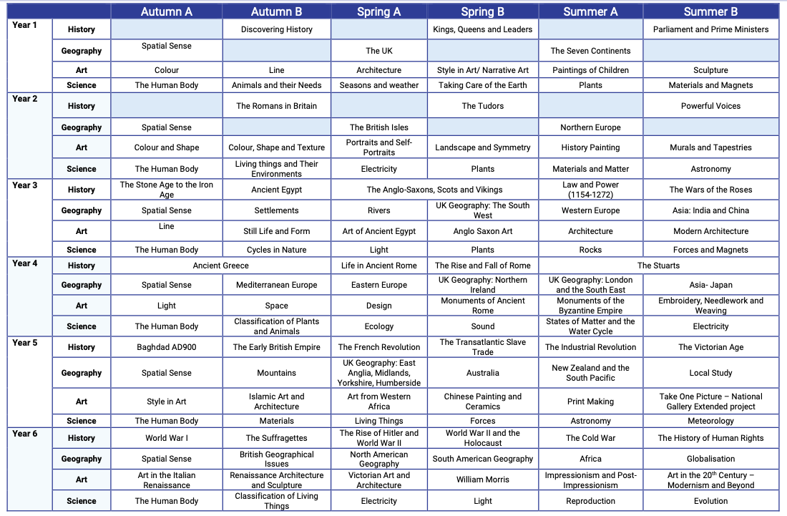

Notes:
This is what it looks like on a curriculum map- orange is prior learning, pink current and green future
When do children bump into content again?
It is messy- curriculum work is messy!
What prior knowledge will children bring? What if they just joined in Year 3? Where will they revisit this knowledge?
Ancient Egypt – The Nile, Anglo-Saxons – travelling by longboat, settlements- near rivers, then onto European rivers, London & the thames, The Tigris River in Baghdad unit, Murray River in Australia Unit, The Mississippi in N.America, etc

Slide 20
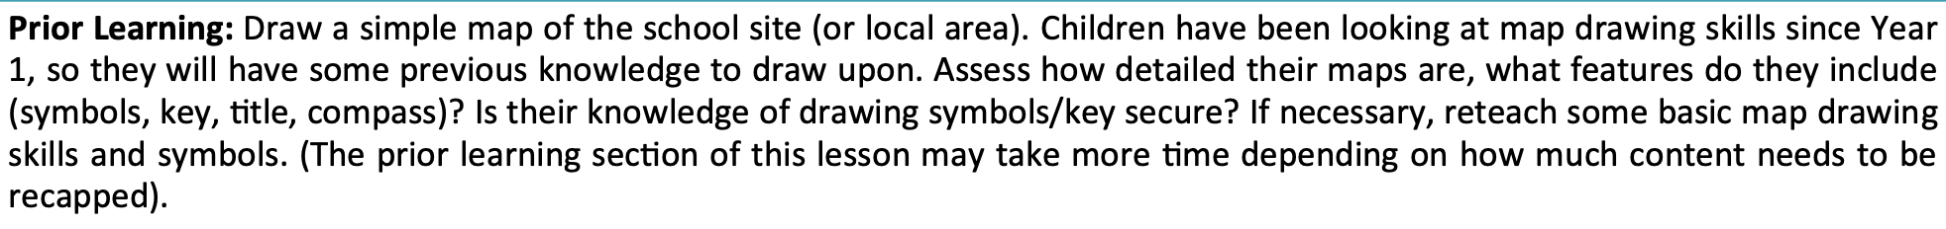
Sequencing for long term learning
In individual lessons:
Year 2 British Isles:
Year 3 Spatial Sense:
Year 4 Eastern Europe:
Year 6 North America:
Notes:
Then we also consider how to flag this sequencing for teachers who may not know the bigger picture

Slide 21
Sequencing for long‑term learning helps to create a powerful curriculum because it allows children to build knowledge gradually and securely, making meaningful connections rather than meeting topics as isolated episodes.

Slide 22
Belonging and identity
Where am I?
Where can I go?
Where do I belong?
Notes:
Really interesting work in this space- Jon Hutchinson’s new book on belonging – work in the GA on Place based learning – or place based pedagogy
Fieldwork we did on Weds!

Slide 23

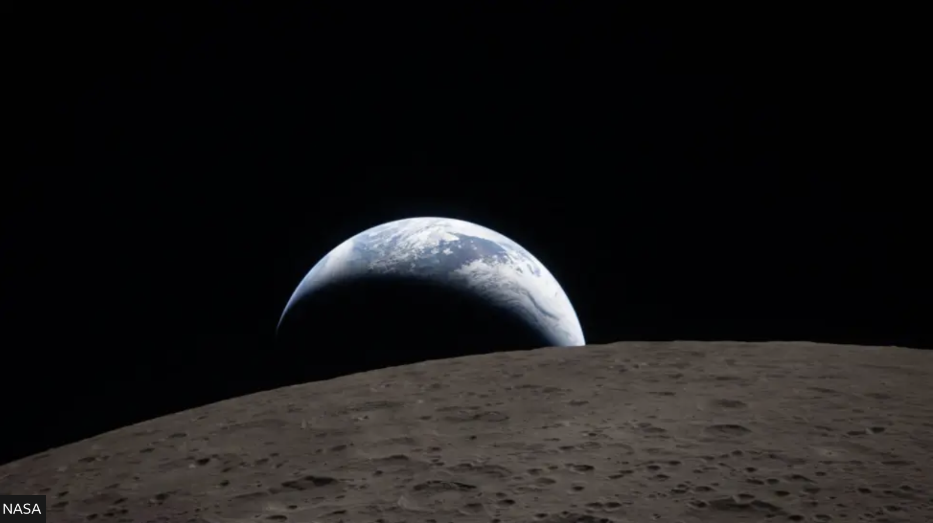
‘Place is not scale specific, it can be as small as a setting at a table and as large as the Earth.’
Cresswell, 2008
Notes:
Challenge of understanding place for primary teachers – when pinning down a definition is hard for geographers!

Slide 24
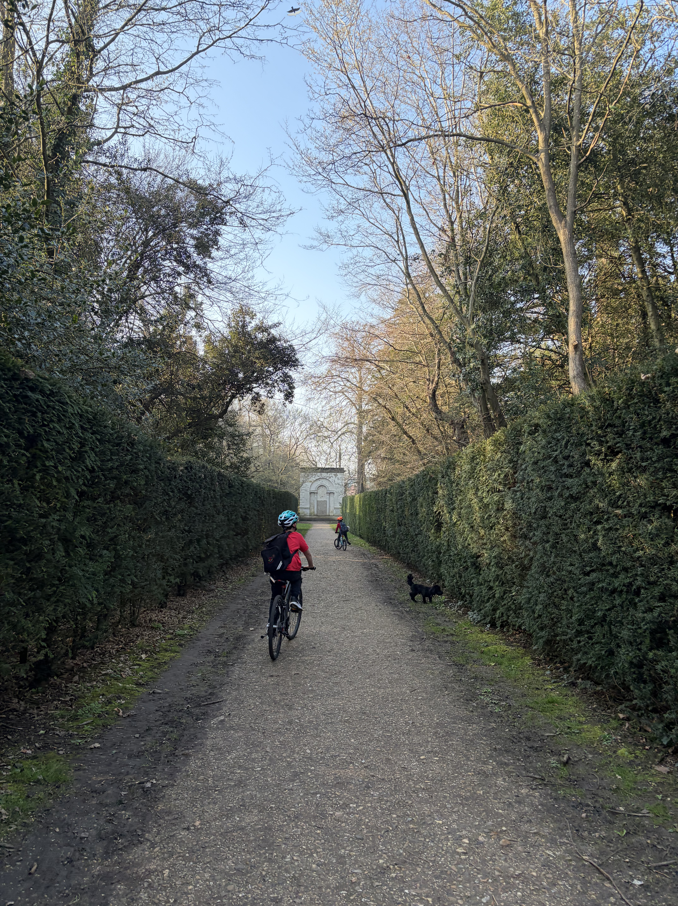
‘Places are locations with meaning.’ (Cresswell, 2008)
Which places are meaningful for the children in our schools?
How do they feature in our geography curriculum?
Chiswick House and Gardens, West London

Slide 25
Understanding Place
Relates directly to children’s own experiences (where they live, go to school, play, visit family, football team, place of worship etc)
Many primary children may experience certain places for the first time through school experiences
Children will have different places that are meaningful to them at different stages of their education
We also want to introduce children to places beyond their experience
How does our curriculum help to develop a child’s understanding of places that are meaningful to them?

Slide 26
Considering belonging and identity helps to create a powerful curriculum because it supports children to understand who they are, where they are and what is happening in the world.

Slide 27
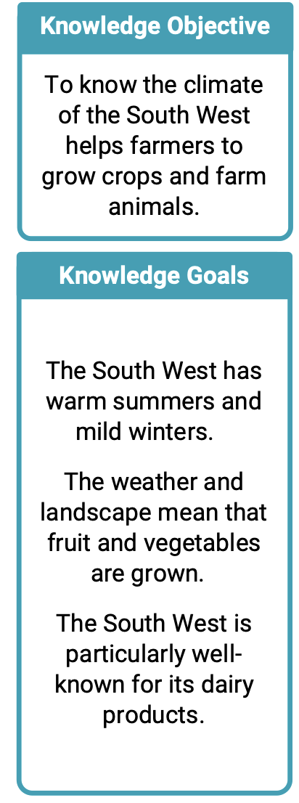
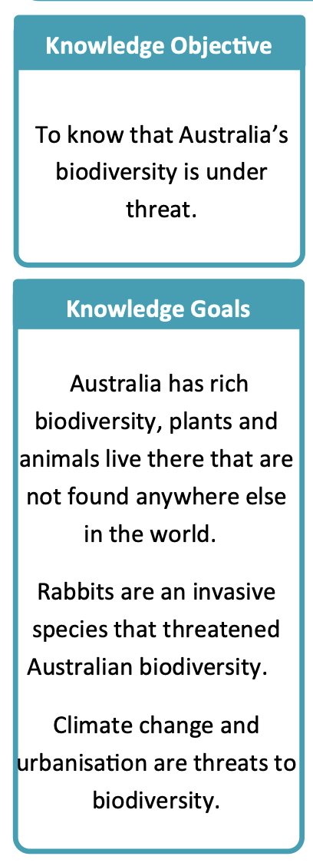
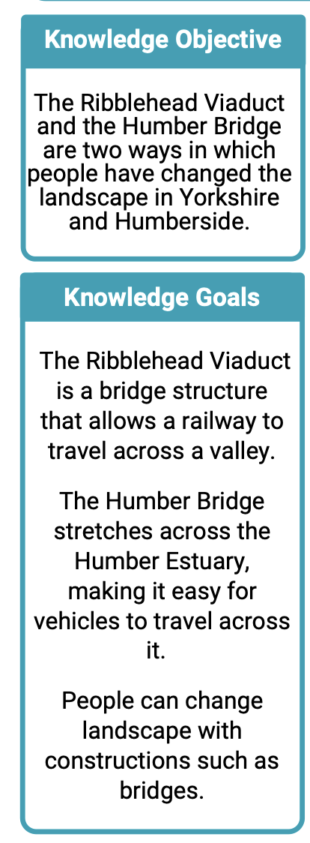
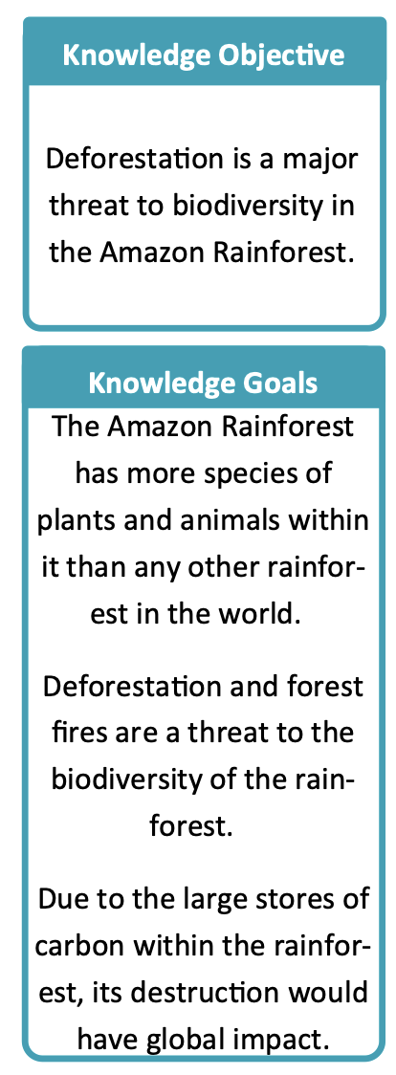
People and their impact on the world
Notes:
Building on understanding of place – we want primary children to understand how people interact with and impact the world around them

Slide 28
Interconnection
Why do people often live near rivers?
Why was this bridge built here?
Why was there a flood here?
Why is the river running dry here?

Slide 29
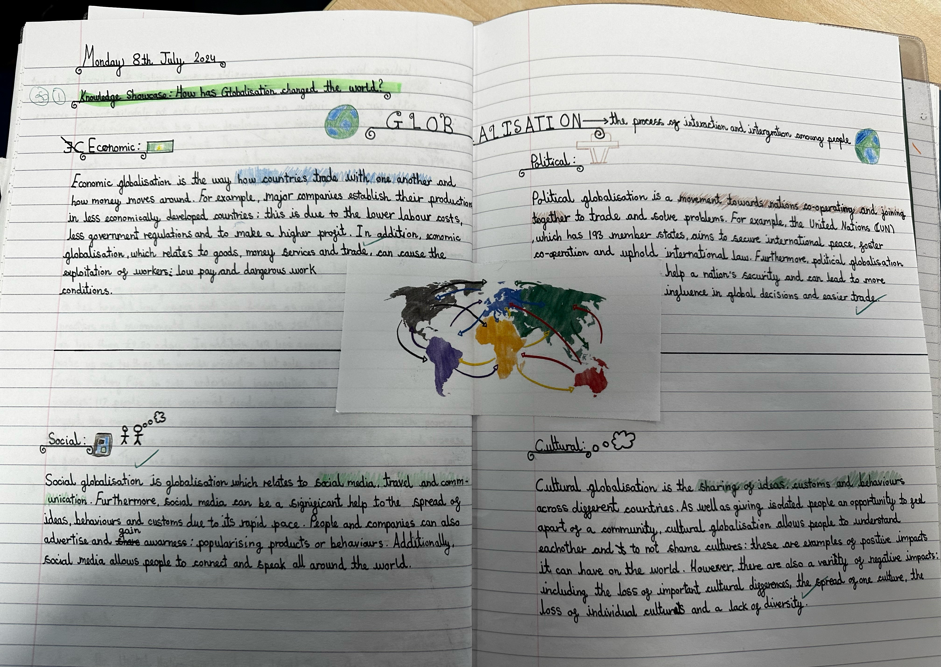
How are places around the world connected?
Notes:
Foundational understanding of how places around the world are linked – start understanding trade in Year 3 (lots knew about it from Minecraft!) finish with a unit on globalization (quote I shared earlier)

Slide 30
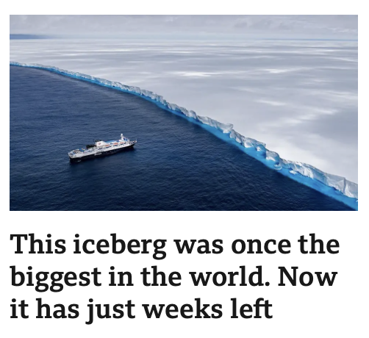
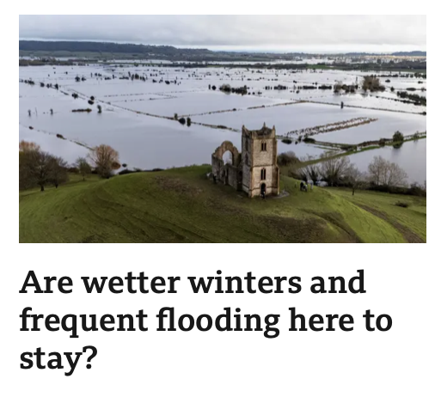

Critical thinking
Notes:
How do people impact the world? How does the world impact us?
Don’t want to terrify children – they are young – but they will see things and we need to be equipped to answer their questions.

Slide 31
Showing children how people impact the world helps to create a powerful curriculum because it builds curiosity about how places are connected, how environments change, and how people interact with the world around them.

Slide 32
The challenge…
Selecting curriculum content
Sequencing for long term learning
Identity and Belonging
Impact on the world

Slide 33
What can we, as geography teachers, do?

Slide 34
What can we, as geography teachers, do?
We can teach in and/or support the schools with the most significant challenges
We can have a powerful geography curriculum
We can continue to be the brilliant, committed and passionate teachers that we are!

Slide 35
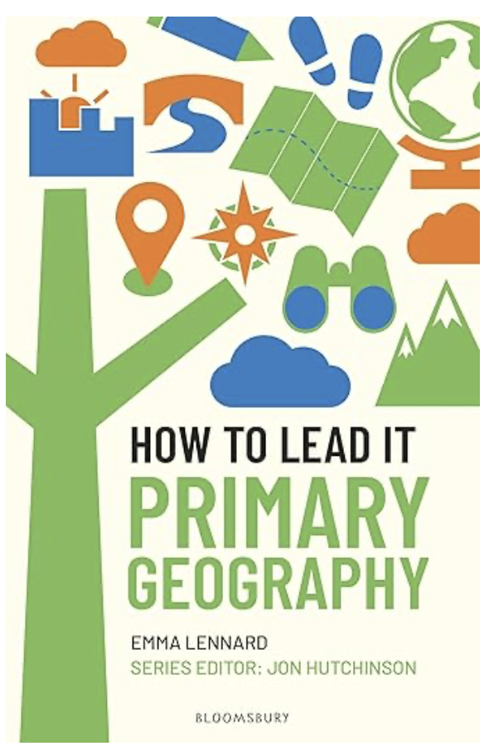

Thank you!

