Slide 1
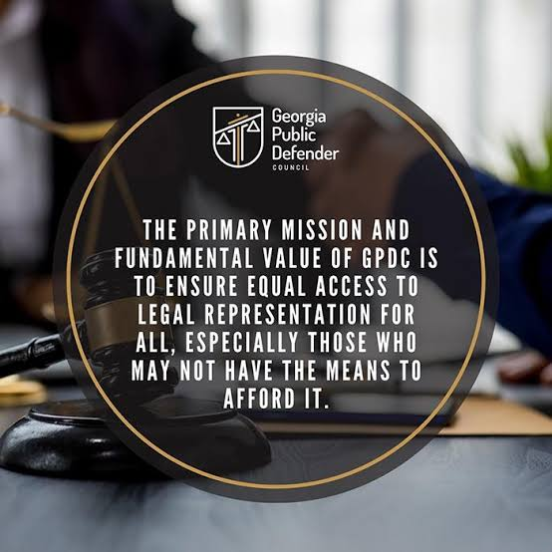

2026 SUMMER PUBLIC DEFENSE CONFERENCE

Slide 2

EQUAL ACCESS…… THE SAME QUALITY OF REPRESENTATION AS THOSE WHO CAN HIRE COUNSEL.

Slide 3
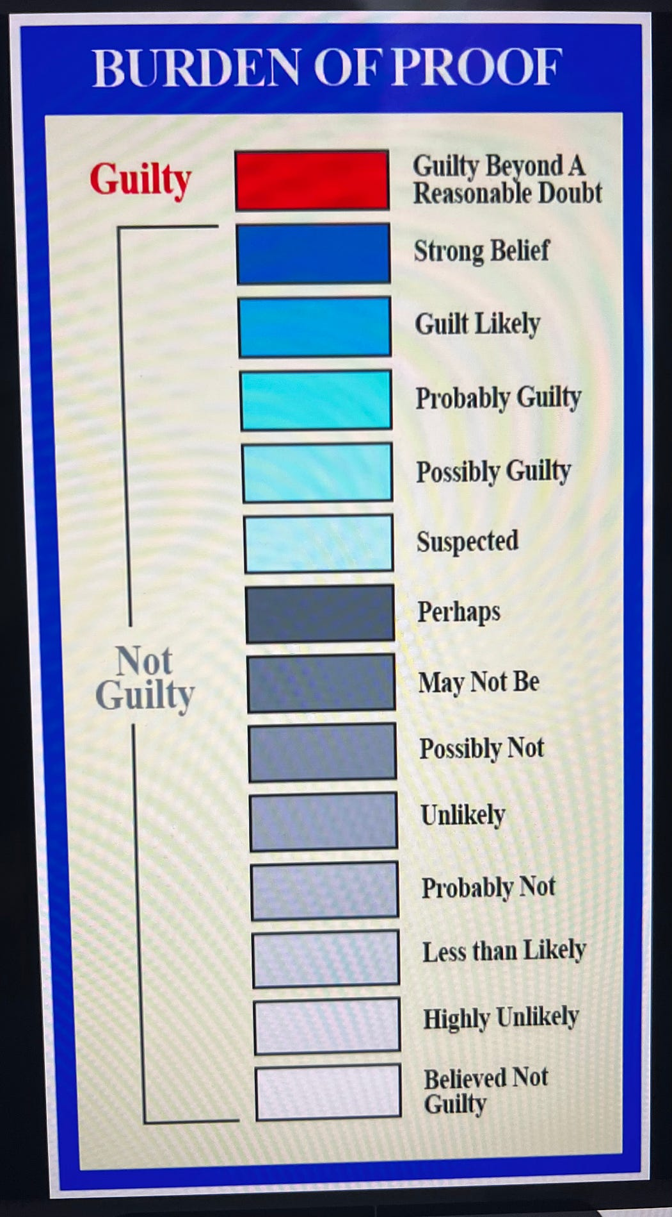
BURDEN OF PROOF…..

Slide 4
Payne v. State, 322 Ga. 433 (2025)
Reminds defense counsel that there is no reason to NOT object to a prosecutor’s closing argument that mischaracterizes the BURDEN OF PROOF.
In this case the State made the statements that suggested that PROOF BEYOND A REASONABLE DOUBT requires something less than proof that leaves a jury with 51% certainty.
The prosecutor’s statement to the jury that under the reasonable doubt standard the State did not “have to prove a case to 50 percent, i.e. less than the far lower standard preponderance. PLAINLY IMPROPER

Slide 5
Specific Crimes and proof needed…..

Slide 6
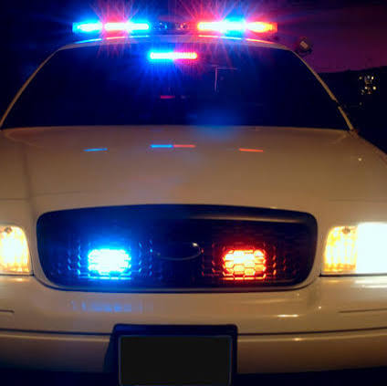
Chambers v. State, 320 Ga. 770 (2025)
Supreme Court held that OCGA 40-6-395 (a) the Georgia statute that makes it a crime to willfully fail to stop or to elude a police officer REQUIRES that that officers be in uniform AND with a badge of office prominently displayed.

Slide 7
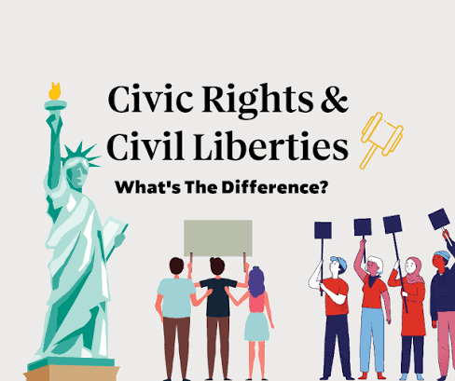
Civil Rights and Civil Liberties

Slide 8
Coleman v. State, 322 Ga. 30 (2025)
Coleman and his co-defendant Walker pled guilty to state charges, and they asserted their Fifth Amendment right to not incriminate themselves by providing testimony against Newton (another co-defendant). Their premise was they remained in jeopardy of federal criminal prosecution for crimes arising from the same events.
The Trial court held each in contempt each time they refused to answer a question, Coleman 19 counts and Walker 21 counts with a 20 days in prison for each count.

Slide 9
Coleman, continued….
While some of the answers to questions posed by the State were appropriate, i.e. questions regarding the crimes they pled guilty, others were not appropriate. Those questions were ones regarding Coleman’s proffer. He was required to repeat facts that would have constituted sworn admissions of his criminal conduct which could assist in a federal prosecution against him
Notes:
While some of the answers to questions posed by the State were appropriate, i.e. questions regarding the crimes they pled guilty, others were not appropriate. Those questions were ones regarding Coleman’s proffer. He was required to repeat facts that would have constituted sworn admissions of his criminal conduct which could assist in a federal prosecution against him
.

Slide 10
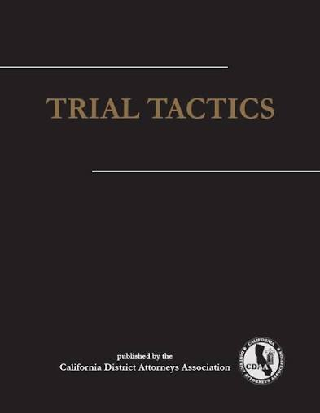

Slide 11
COLLINS v. STATE, 321 Ga. 215 (2025)
Counsel waived any arguments regarding the denial of his motion for mistrial for the appeal where counsel rejected the trial court’s offer of a curative instruction.

Slide 12
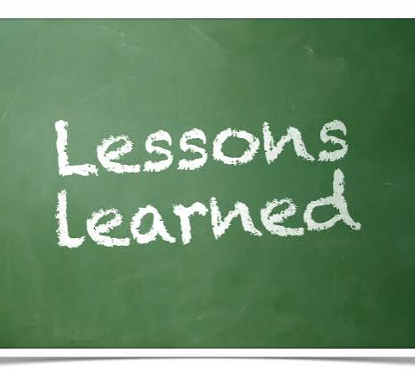
Lesson to learn….
If you decide you do not want to avail your client to a curative instruction, as counsel you should ask to put on the record your reasoning, including why the improper evidence was prejudicial and no curative instruction can cure the improper admission.

Slide 13
Moss v. State, 322 Ga. 757 (2025)
VERY IMPORTANT
If there is testimony that is elicited during trial, you must IMMEDIATELY object. Waiting till the witness completes their testimony and then outside the presence of the jury objecting is TOO LATE.

Slide 14


Slide 15
Ealey v. State, 322 Ga. 509 (2025)
This case is a reminder of what will constitute intrinsic evidence. NT charged with 2 shootings. The weapon was never recovered. The State introduced other acts evidence that they alleged was intrinsic. This included a traffic stop where Ealey was found to possess a Glock, which was similar to the type of gun that was used in the instant murder. The State claimed that the evidence was inextricably intertwined because it was necessary to complete the story of the crime. This evidence showed that Ealey possessed the same type of handgun several months before the murders. The murder in the instant case was never found.

Slide 16
Hall v. State 322 Ga. 378 (2025)
Domestic case. Supreme Court held that evidence of violence against prior domestic partner may be admissible to show intent , absence of mistake or accident but NOT motive when the incidents are unrelated to the charged crime.

Slide 17
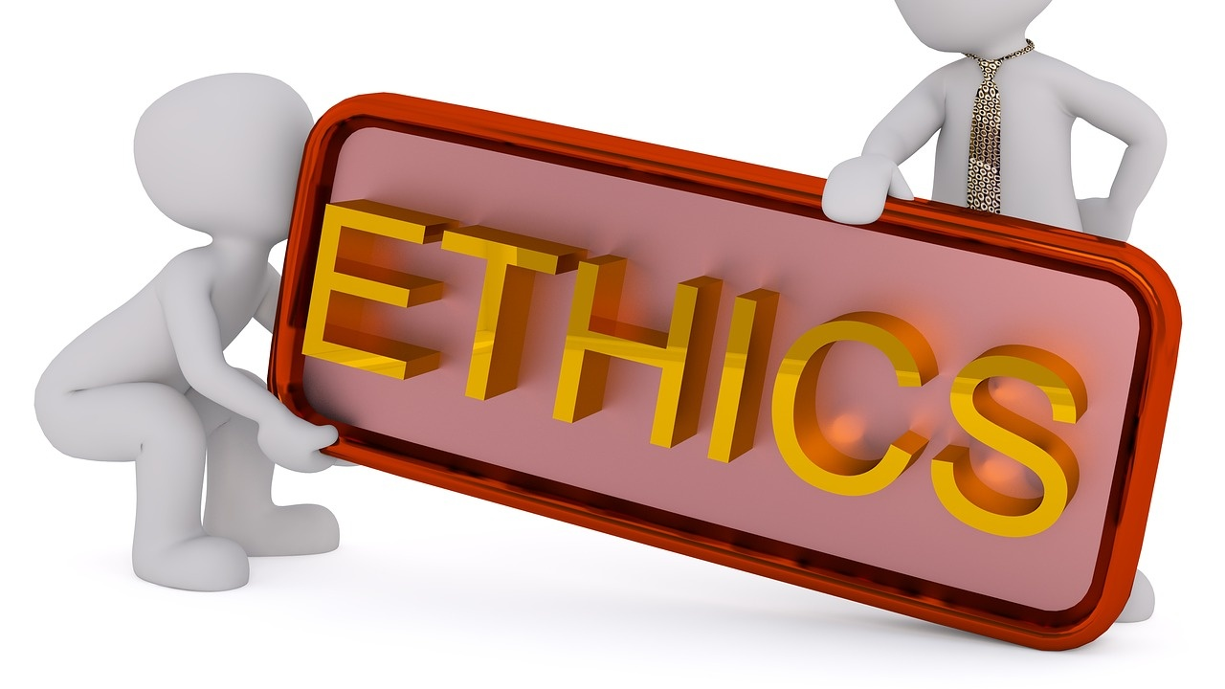
ATTORNEYS AND ETHICS

Slide 18
Payne v. State, NO. S26A0459, 2026 WL 1215905 (Ga. May 5, 2026)
Even with advancing technology we are reminded in this case that counsel must utilize his or her intellect and rely primarily on their own confirmation regarding sources and cites.
An attorney who submits fictitious cases to the Court may expect to be admonished, suspended, and require to complete additional legal training.
How do you avoid this pitfall?????

Slide 19
Simple rules to avoid THIS pitfall……
1. If using an AI tool, read the cases it cites before summarily including in your brief.
1
2. Make sure the case stands for the proposition you are citing in your brief.
2
3. Make sure the citations actually exist.
3
NEVER allow technology to supersede your legal acumen. We paid for it. Let’s utilize that expensive knowledge.
4

Slide 20

APPELLATE PRACTICE

Slide 21
Smith v. State, 322 Ga. 743 (2025)
Filed an Extraordinary Motion for a New Trial based upon newly discovered evidence surrounding the science regarding the diagnosis of brain injuries in infants pointing to a new explanations of brain injury other than Shaking Baby Syndrome.
Supreme Court determined NT was entitle to a hearing upon consideration of test set forth in Timberlake v. State, 246 Ga. 488.
Must be newly discovered
Must have exercised due diligence
Evidence so material it would have probably produced a different verdict
Witness affidavit obtained or its absence accounted for
Evidence serves purpose beyond impeaching witness.

Slide 22
Smith, 322 Ga. 743 (2025) continued….
Newly discovered means just what it says…the trial court was required to make a determination of whether the science presented by NT was unknown at the time of the trial so truly newly discovered.
Our court also found the that trial court rested its diligence finding on determining that NT could have presented testimony “generally critical” of SBS. This is too narrow. The motion relied on the testimony of expert witnesses who offered a NEW analysis of the victim’s medical records. The materiality of scientific development often becomes apparent ony with the passage of time as new theories are subjected to rigors of scientific testing, peer review eand the general scrutiny of the scientific community.
Our court also found that the TC erred in its materiality requirement . The TC relied on its own opinion of the experts credibility in determining materiality. Instead, the court was required to “attempt to account for how the new evidence would have influenced the jury’s assessment of the evidence presented by the State” at the NT’s trial.

Slide 23

Simms v. State, 928 S.E.2d 66 (Ga. 2026)
This factual scenario concerned a perspective juror who was later determined after jury selection and trial to be ineligible to serve.
NT argued his conviction should be reversed. TC denied the MNT finding that counsel did not preserve the claim as no objection was made at trial.
Trial counsel never inquired of the perspective juror’s citizenship which he could have done.
The Supreme Court held that not only must the TC consider whether a party has “impliedly waived” an objection, the TC must ALSO determine whether the party could have learned of the juror’s ineligibility through the exercise of ordinary diligence.
CASE REMANDED FOR THOSE FINDINGS.

Slide 24
Copney v. State, 322 Ga. 794 (2025)
Failure to object to the admission of evidence of an arrest warrant and indictment which was admitted under OCGA 24-6-609(1).
Neither admissible under that rule. OCGA 24-6-609(a)(1) allow admission of CONVICTIONS not arrest warrants or indictments.
Defense counsel failed to object which was deficient BUT NT could not show prejudice so claim for ineffective counsel failed.

Slide 25
Other considerations for defense counsel…..

Slide 26
GENERAL TIPS FOR APPELLATE DEFENDERS FROM JUSTICE COLVIN CHAMBERS
The merits of a trial court’s ruling on GENERAL GROUNDS present nothing for review .
A. Would only grant a general grounds claim if the judge applied the wrong legal standard
B. Since we presume that judges correctly applied the law, a successful general grounds claim must include evidence sufficient to overcome this presumption.

Slide 27
Cite SUPREME COURT cases, rather than COURT OF APPEALS

Slide 28
Ineffective Assistance of Counsel (IAC)
If claiming on appeal that TRIAL COUNSEL was ineffective for failing to investigate some aspect of defendant’s case, appellate counsel MUST produce evidence during the MNT of what more thorough investigation would have revealed. Must establish PREJUDICE- identify what evidence trial counsel missed and explaining how the evidence would have altered the outcome of the trial.

Slide 29
MAKE SURE THE RECORD INCLUDES COLOR PHOTOS
Sometimes color photos are helpful for arguments made on appeal.

Slide 30
QUALITY OVER QUANTITY …..EVERYTIME
Raising a few fully developed arguments provides more credibility than throwing in the kitchen sink with half-baked issues and analysis.

Slide 31
RESEARCH BEFORE YOU BEGIN WRITING…
Reading the relevant case law can provide insight into how to best frame an argument.
Framing arguments in ways that parallel your citations makes it easier for a court to explain in an opinion why your position is correct.

Slide 32
READ THE RELEVANT STATUTE….
RATHER THAN relying only on case law, reading the statute will prevent you from overlooking important issues and may very well help you develop novel arguments.
COMPARE the language of criminal statutes to the jury instructions as even patten instructions can leave out important requirements.

