Slide 1
“There can be no keener revelation of a society's soul than the way in which it treats its children.”
Nelson Mandela
SB440 Cases and Transfers to and from Superior Court
Rachel Gordon

Slide 2
Roadmap
1. Background and Research
2. Strategies for Challenging Transfer Up and Securing Transfer Down
3. Preparation to Mitigate and Preparation for Transfer Hearing
4. The Transfer Hearing

Slide 3

How did we get here?
Notes:
This was a 1995 Weekly Standard cover story, in which political scientist John Dilulio Jr. coined the term “superpredator.” This came shortly after the 1994 crime bill, during the Clinton administration, which was the largest crime bill in the history of the US, and is now often looked at as one of the things that led to our current crisis of mass incarceration. This, along with the fear that Dilulio fomented when referring to America’s youth as “radically impulsive, brutally remorseless youngsters” helped to spur state laws across the country allowing for the charging of youth in the adult system. Georgia’s bill, known as SB440, passed in 1994.

Slide 4
The Research
News you can use!

Slide 5
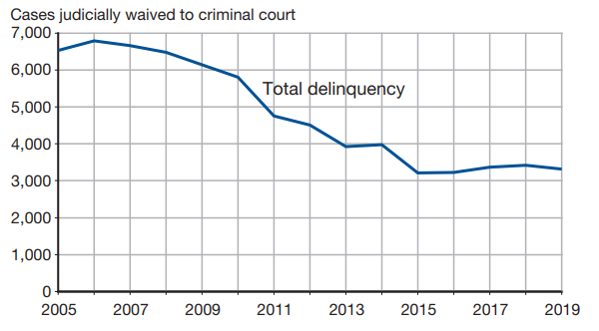
Nationally, over 3,000 youth were judicially waived to adult court in 2019
Disparities persist:
1.1% of cases involving Black youth were waived
0.7% of cases involving white youth were waived
Notes:
This chart is from the National Center for Juvenile Justice Juvenile Court Statistics 2019

Slide 6
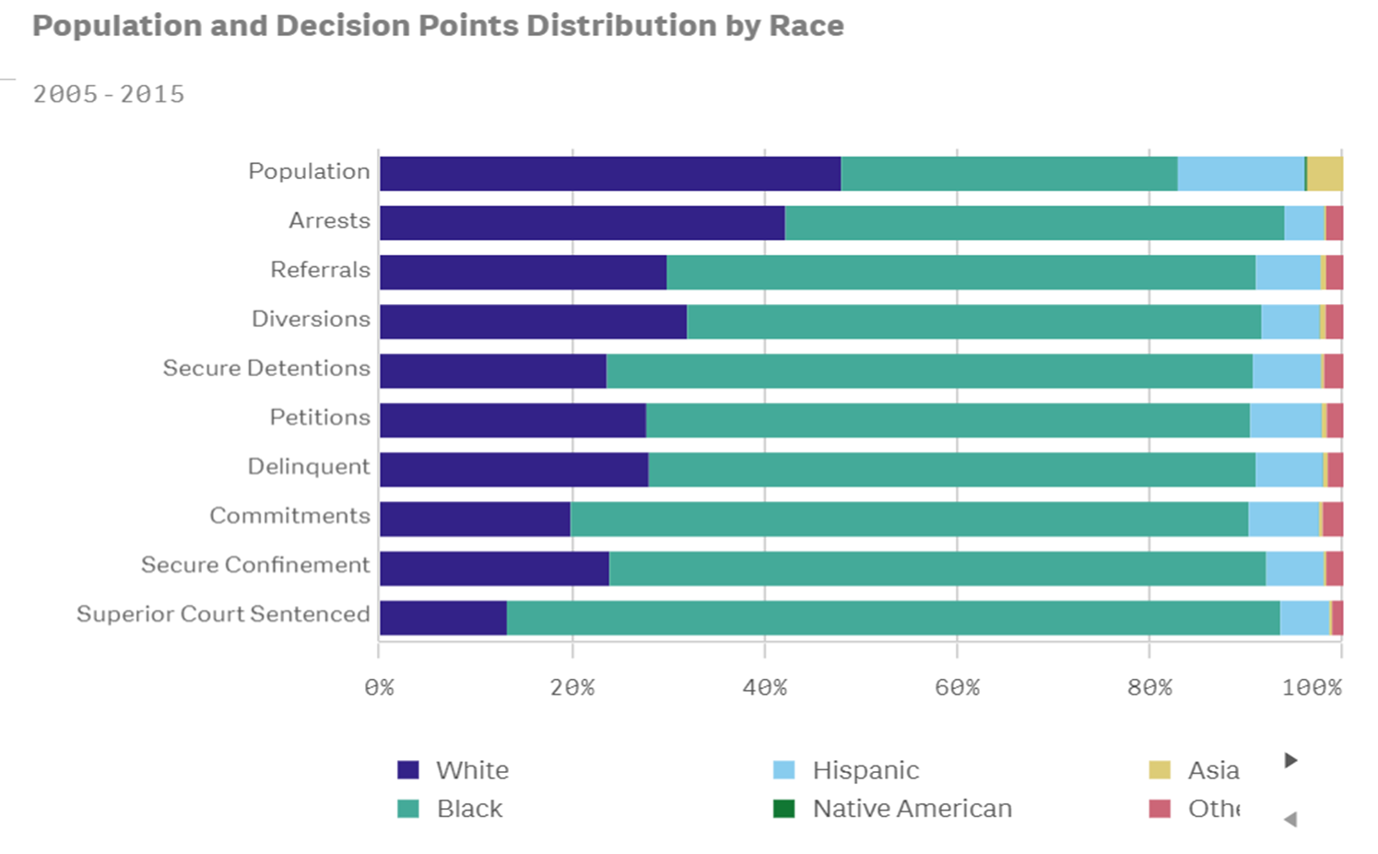
Racial and Ethnic Disparities in Georgia
Notes:
This chart is from the Georgia Juvenile Justice Data Clearinghouse, and is titled the Disproportionate Minority Contact (DMC) Report. The disparities are glaring, and MOST pronounced when we come down to the bottom of the chart and look at superior court sentenced youth.

Slide 7
In 2019…
In DeKalb County, 9 children were sentenced in Superior Court. All 9 of those children were Black.
In Fulton County, 19 children were sentenced in Superior Court. 18 of those children were Black and 1 was Hispanic.
In the State of Georgia, 152 children were sentenced in Superior Court. 29 of those children were white, 9 of those children were Hispanic, and 114 of those children were Black.
Notes:
These numbers are also from the Georgia Juvenile Justice Clearinghouse.

Slide 8
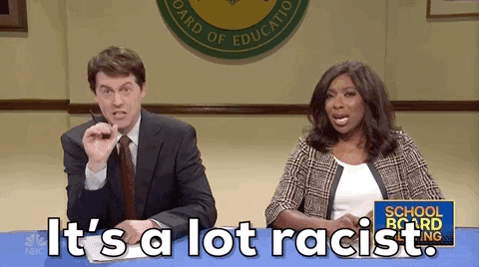

Slide 9
Are there any positive outcomes from trying and sentencing kids as adults? NO.
Trying and sentencing kids as adults results in higher rates of recidivism
Children transferred to adult court experience sexual victimization and other physical and psychological harms
Transfer to adult court results in decreased focus on rehabilitation and family support for the child

Slide 10

Strategies for Challenging Transfer Up and Securing Transfer Down

Slide 11
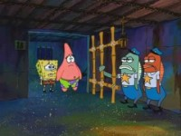
Notes:
This is what we’re up against—people within the system and without thinking that kids, if they “act like adults,” should be treated like adults. This fails to acknowledge everything that we know about child development, brain chemistry, decision making, rehabilitation, recidivism, etc. So we, as advocates, need to be prepared to counter this attitude in every way we can.

Slide 12
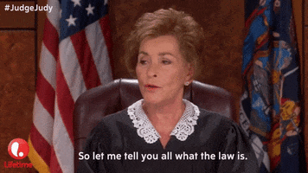
#1:
Know the Law!

Slide 13
Methods of Reaching Adult Court
Judicial Waiver
Discretionary decision by judge
Consideration of statutory factors
Subject to appellate review
Legislative Waiver (jurisdiction statutes)
Focus on age and nature of offense
No review of amenability to rehabilitation
Sometimes permit “reverse waiver”
Prosecutorial Waiver / Concurrent Jurisdiction
Prosecutor decides where to file charges, within limits of legislation
Not subject to appellate review
Focus on age and nature of offense
Review of amenability to rehabilitation?

Slide 14
O.C.G.A. 15-11-561 (Discretionary Transfer)
A juvenile case may be transferred to Superior Court IF:
There is probable cause to believe that the child committed the alleged offense
The child is not committable to a facility for the developmentally disabled or mentally ill
The petition alleges that the child was:
(A) At least 15 & felony
(B) 13 or 14 & (i) punishable by death or life or (ii) aggravated battery with serious injury to a non-law enforcement victim

Slide 15
O.C.G.A. 15-11-560(b): (SB440 / Legislative Waiver)
Superior Court has exclusive jurisdiction over children age 13 to 17 charged with the following:
Murder (1st or 2nd degree) or Attempted Murder
Voluntary Manslaughter
Rape
Aggravated Sodomy; Child Molestation; Sexual Battery
Armed Robbery or Aggravated Assault with a Firearm
Aggravated Battery Against a Public Safety Officer
Terroristic Act Upon a School

Slide 16
Bringing the Case Down to Juvenile Court - O.C.G.A.
15-11-560 (d)and(e)
Before Indictment
(d): Any of the offenses listed in subsection (b) can be transferred down to Juvenile Court by the DA before indictment (DA can also decline to prosecute in Superior Court after indictment, but would need to file appropriate paperwork and Superior Court judge would need to sign off)
After Indictment
(e): After indictment, and over DA objection, the Superior Court may , upon motion and hearing, transfer down any of the offenses listed in subsection (b) EXCEPT for murder, rape, or armed robbery with a firearm

Slide 17
O.C.G.A. 15-11-562: Transfer Criteria
The age of the child
The seriousness of the offense
Whether protection of the community requires transfer
Whether the offense was violent, premeditated, or aggressive
Impact on victim, including physical/emotional injury, expenses, lost wages
Culpability of the child, including level of planning and participation
Whether the offense is part of a pattern that indicates the child is beyond rehabilitation
Record and history of the child
Sophistication and maturity of the child
Programs and facilities available to the juvenile court for disposition
Whether the child can benefit from treatment or programs available to the juvenile court

Slide 18
How are the Factors Weighed?
Adult Court
Juvenile Court
Notes:
Know your judges! Who hates guns the most? Who really doesn’t like sex offenses? How much, if anything, does your superior court judge know about juvenile court and what’s available there?

Slide 19

OCGA 15-11-560(a): Concurrent Jurisdiction
Punishable by:
Loss of life
LWOP
Life

Slide 20
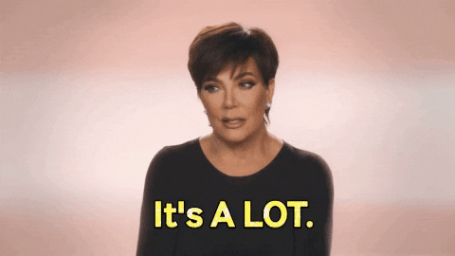
Notes:
It’s a lot to know! But it’s our job to know, and it’s essential to know the law better than anyone else in order to effectively advocate for our clients.

Slide 21
#2: Know Your Client!
Mitigation
Records
(School, medical, mental health)
Juvenile History and Prior Interventions
Family and Community Support
Evaluations/Experts
Notes:
It is up to you and, if you’re lucky and you have one, your social worker, to be an absolute expert on your client. Has he had an incredibly difficult or traumatic life? Has she experienced homelessness; domestic violence; parental substance abuse; food insecurity, etc etc etc? Does he have any cognitive limitations or mental health diagnoses? What kind of juvenile history does she have, and what resources, treatment, counseling, placements, etc have been put in place before? Is this a child who would benefit from a professional evaluation by a psychiatrist or psychologist (I think the answer here is almost always yes in transfer situations)? Are there competency concerns?

Slide 22

#3: Know the Facts!
Investigate your case!
  What does the police report say?
  What actually happened?
    TALK TO YOUR CLIENT!
    LISTEN TO YOUR CLIENT!
  What are the elements of the charged offense?
  What are potential defenses to the charged offense?

Slide 23
Now that you know your stuff, it’s time to…
This applies to transfer up and transfer down
Your DA, unfortunately, has a lot of power here
If you can convince them to keep the case in juvenile court or to transfer the case to juvenile court, you and your client avoid the uncertainty of a motions hearing
MEET WITH YOUR DA!

Slide 24
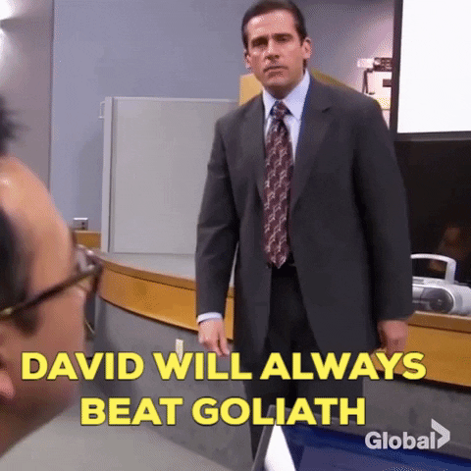

Slide 25
Tips for DA meetings:
Meet IN PERSON
1
Come PREPARED
2
Hit on each category that could sway them:
3
Facts
Mitigation
Law
Ask for ARTICULATED REASONS why they’re saying no
4
Find out if they are the final decision-maker or if this has to go up the chain of command
5
Rehabilitation

Slide 26
If DA won’t consent…
Voluntary manslaughter, aggravated sodomy, aggravated child molestation, aggravated sexual battery, aggravated battery upon Public Safety Officer, aggravated assault, terroristic act, and attempted murder may be transferred to juvenile court by Superior Court judge, upon motion of defense counsel (15-11-560(e))
  Treated as Class A designated felony act, unless Romeo and Juliet provisions apply (Agg. Sodomy, Victim 13-15, Defendant under 18)
  Appealable by the State
FILE A MOTION (if the law allows…and maybe sometimes if it doesn’t)
Notes:
So, what’s left out here? Murder, rape, armed robbery with a gun. Let’s challenge this! Think of the constitution! Think of Supreme Court precedent! Ask me about an equal protection challenge regarding the ability of the court to transfer down all the agg sex offenses but not rape! This slide applies to transferring cases down. If your DA won’t consent to keep a case in juvenile and insists on filing a transfer up motion, then you file a motion in opposition and prepare for your hearing.

Slide 27
What else do you need to consider in preparation for a hearing?
Your motion to transfer down, or opposing transfer up
Challenging State’s expert
Preparing your own expert
Preparing your client
Know your Judge: what will he or she focus on?
Notes:
Your preparation thus far has prepared you for both a meeting with your DA and for a hearing, but a hearing requires additional preparation

Slide 28
THE TRANSFER HEARING

Slide 29


Slide 30
Keep in Mind:
Record
Make a record
Follow evidentiary rules (and hold the state to them!)
Contest
Contest opposing arguments
Articulate your own argument (either stay in juvenile or transfer down)
Put on
Put on an affirmative defense (for a transfer up hearing)
Put up
Put up witnesses and evidence to support your position
State
Clearly state the reasons for your position

Slide 31
Witnesses
Client’s family
Teachers/school administrators
Counselors
Coaches
Religious leaders
Mentors
DFCS personnel
RYDC staff
Expert witness/evaluator

Slide 32
Appeal of a Transfer Decision: O.C.G.A. 15-11-564
Interlocutory judgment
Either the child or the prosecuting attorney have the right to appeal
Criminal proceedings in superior court are stayed
  Detention only in places authorized by juvenile code for pre-adjudication detention (not county jail!)
Abuse of discretion standard on review

Slide 33


Slide 34
Thank you!
Please don’t hesitate to reach out! Don’t reinvent the wheel!
Rachel Gordon:
Rachel.Gordon@fultoncountyga.gov
678-693-3789

