Slide 1
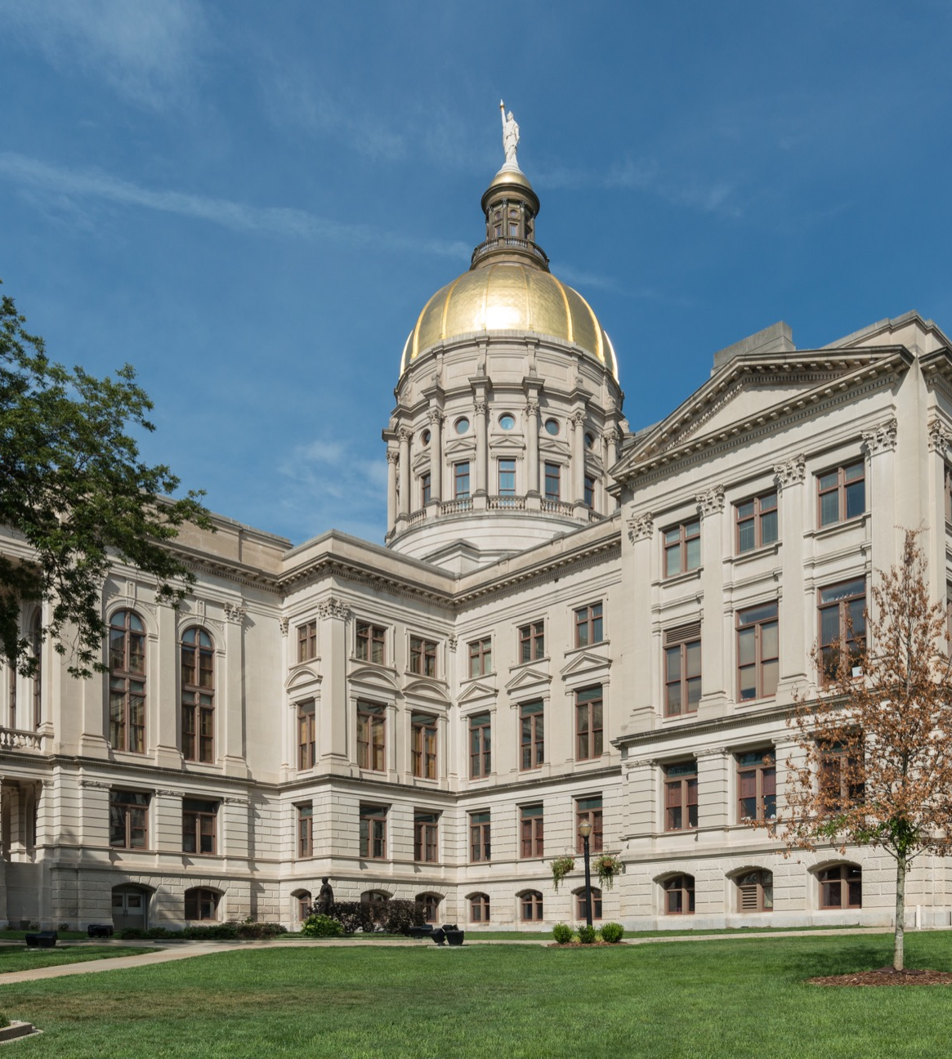
Dignity as Strategy: Humanizing Clients in a Dehumanizing System
GPDC Conference
July 2026

Slide 2
GPDC CONFERENCE・DIGNITY AS STRATEGY: HUMANIZING CLIENTS IN A DEHUMANIZING SYSTEM
Our Journey Together
01
02
03
04
Introduction & Overview
Reflection Activity #1:
A Look in the Mirror
Understanding the Impact of Dehumanization
Reflection Activity #2:
A Look Out the Window
05
06
07
08
How Humanization Transforms Practice
Bringing Humanization to Life
Reflection Activity #3:
A Look into the Crystal Ball
Wrap-Up & Close

Slide 3
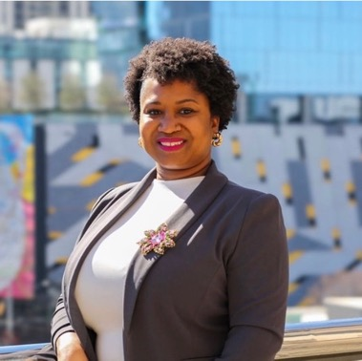
GPDC CONFERENCE・DIGNITY AS STRATEGY: HUMANIZING CLIENTS IN A DEHUMANIZING SYSTEM
Meet Your Presenter
Imani J. Carter, Esq.
Senior Assistant Public Defender
Western Circuit Public Defender Office
icarter@gapublicdefender.org

Slide 4
Overview
GPDC CONFERENCE・DIGNITY AS STRATEGY: HUMANIZING CLIENTS IN A DEHUMANIZING SYSTEM
This session explores how small shifts in mindset, communication, and advocacy can strengthen client relationships, improve representation, and reinforce dignity throughout the legal process.
Together, we will:
01 Recognize the subtle ways dehumanization influences legal practice.
02 Reframe advocacy through a human-centered lens.
03 Learn practical tools to build trust, communicate with dignity, and strengthen courtroom advocacy.
04 Apply strategies that improve both client experience and professional effectiveness.

Slide 5

A Look in the Mirror
This activity is designed to help you become aware of how your lived experiences influence the way you see and understand the people you serve.
Instructions
Take 1-2 minutes to reflect individually.
Read each question and consider what it reveals about the perspective you bring into your work every day.
Reflection Prompts
What is the first thing you tend to notice about a client when you review a new case?
What assumptions do you find yourself making before you've heard a client's full story?
What helps you remain curious when a client's story challenges your assumptions?

Slide 6
Understanding the Impact of Dehumanization
GPDC CONFERENCE・DIGNITY AS STRATEGY: HUMANIZING CLIENTS IN A DEHUMANIZING SYSTEM

Slide 7
What is Dehumanization?
GPDC CONFERENCE・DIGNITY AS STRATEGY: HUMANIZING CLIENTS IN A DEHUMANIZING SYSTEM
Dehumanization occurs when we reduce a person to a single characteristic, circumstance, or legal issue rather than recognizing them as a whole human being.
When we only focus on…
We overlook…
Race or identity
Their story
Socioeconomic status
The context, barriers, and factors that shape their lived experiences
Behaviors
Their strengths, resilience, and capacity for growth
Legal issue/Alleged facts
Their future & their humanity

Slide 8
Recognizing Dehumanizing Language
GPDC CONFERENCE・DIGNITY AS STRATEGY: HUMANIZING CLIENTS IN A DEHUMANIZING SYSTEM
Language is often the first indicator of how we perceive another person. When our language reduces people, our thinking and advocacy can follow.
Labels replace identity
Reducing people to their legal issue
Depersonalizing the individual
Assuming before understanding
Labels replace a person's identity and obscure the complexity of the individual.
A charge or case becomes the primary lens through which a person is understood.
People are reduced to files, case numbers, or legal matters rather than recognized as individuals.
Forming conclusions before understanding a person's story, experiences, or circumstances.
Examples
Examples
Examples
Examples
"The defendant”
"The mentally ill client”
“The non-compliant client”
"The murder client"
"The felony case”
“Repeat offender”
"Case SU26CR0123"
"Can you grab the burglary file?”
“The client with X number of cases”
"They're manipulative."
"They don't care.“
"They're just looking for an excuse."

Slide 9
Recognizing Dehumanization in Practice
GPDC CONFERENCE・DIGNITY AS STRATEGY: HUMANIZING CLIENTS IN A DEHUMANIZING SYSTEM
Dehumanization is rarely intentional. More often, it appears through habits, assumptions, decisions, and interactions that cause us to lose sight of the whole person. Here are four signals to watch for:
1
2
3
4
Communication Becomes Transactional
Assumptions Replace Questions
The Case Takes Priority Over the Person
Systems or Procedures Drive Interactions
Conversations focus primarily on legal tasks, deadlines, and case strategy while overlooking the client's experiences, concerns, goals, and broader context.
Conclusions are formed before seeking to understand the client's perspective, experiences, motivations, or circumstances.
Decisions center on resolving the legal issue without fully considering the client's values, needs, relationships, or long-term well-being.
Processes, policies, and administrative requirements dictate the experience, leaving little room for individual needs, flexibility, or meaningful connection.

Slide 10

A Look Out the Window
We often focus on what is inside the legal case. Human-centered advocacy asks us to remain curious about everything outside of it.
Instructions
Imagine the case file is the window.
The information inside the window represents the legal issue, charges, evidence, and procedural facts.
Now, look outside the window.
Working individually or in small groups, identify everything you would want to understand about the person that may not appear in the case file but could shape your representation.
Discussion Prompt
What might exist outside the window that helps you better understand the whole person?

Slide 11
How Humanization Transforms Practice
GPDC CONFERENCE・DIGNITY AS STRATEGY: HUMANIZING CLIENTS IN A DEHUMANIZING SYSTEM

Slide 12
What is Humanization?
GPDC CONFERENCE・DIGNITY AS STRATEGY: HUMANIZING CLIENTS IN A DEHUMANIZING SYSTEM
Humanization begins by seeing every client as a whole person whose legal issue represents only one part of their story. IT requires us to:
See
Understand
Advocate
Recognize that every client is more than their legal issue, diagnosis, or circumstances.
Listen with curiosity to understand the experiences, relationships, and context that shape each client's story.
Represent clients in a way that preserves dignity, highlights strengths, and provides meaningful context.

Slide 13
Why Humanization Matters
GPDC CONFERENCE・DIGNITY AS STRATEGY: HUMANIZING CLIENTS IN A DEHUMANIZING SYSTEM
Human-centered practice creates value for clients, legal professionals, and the justice system by strengthening trust, improving advocacy, and reinforcing confidence in the legal process.
Client Value
Professional Value
Legal System Value
Clients who trust their attorney become active partners rather than passive participants in their representation.
Understanding the whole person leads to stronger legal strategy, more informed decisions, and more effective advocacy.
Every interaction contributes to how clients experience fairness, dignity, and confidence in the legal system.

Slide 14
Guiding Principles of Human-Centered Practice
GPDC CONFERENCE・DIGNITY AS STRATEGY: HUMANIZING CLIENTS IN A DEHUMANIZING SYSTEM
Human-centered practice begins with a shared set of principles that shape how we think, engage, and advocate for the people we serve.
See the
Whole Person
Lead with
Curiosity
Preserve
Dignity
Recognize Strengths and Potential
Create Space
for Voice and Agency
Every client is more than their legal issue and deserves to be seen first as a person.
Understanding begins with curiosity, intentional listening, and a genuine desire to learn each client's story.
Every interaction affirms the inherent dignity, worth, and humanity of every person.
Every client is recognized for their strengths, resilience, and capacity for growth.
Every client has a meaningful voice in their representation and an opportunity to participate in decisions that affect them.

Slide 15
From Principles to Practice
GPDC CONFERENCE・DIGNITY AS STRATEGY: HUMANIZING CLIENTS IN A DEHUMANIZING SYSTEM
Together, these five strategies illustrate how to move from principle to practice. Each strategy builds on the last, creating a more intentional, human-centered approach to advocacy.
1
2
3
4
5
Build Trust Through Human Connection
Advocate for the Whole Person
Lead with Curiosity and Understanding
Use People-first Language
Influence Better Outcomes
Trust is the foundation upon which every effective client relationship and advocacy strategy is built.
The strongest advocacy reflects the full story of the person, not simply the facts of the case (this case or their previous case).
Curiosity creates the understanding needed to advocate with empathy – try to understand how they’re experiencing this moment from their POV.
Language is a strategic tool that communicates dignity, shapes perception, and reinforces humanity. Avoid trying to appear superior.
Consistently applying human-centered practices influences how justice is experienced, regardless of the outcome. And it helps reinforce our “why” for this work.

Slide 16
Bringing
Humanization to Life
GPDC CONFERENCE・DIGNITY AS STRATEGY: HUMANIZING CLIENTS IN A DEHUMANIZING SYSTEM

Slide 17
Build Trust Through Human Connection
💬
Why this matters?
Trust creates the conditions for meaningful partnership between attorney and client. When clients trust their attorney, they are more likely to:
Share information openly and honestly
Participate in decisions that affect their case
Remain engaged throughout their legal journey
Partner with their attorney in achieving the best possible outcome
Be realistic
Trust is earned long before it is needed. Every interaction either strengthens or weakens the foundation for effective advocacy & representation.
Let’s Discuss!
How might we…
How might we…
How might we…
establish trust from the very first interaction with every client?
ensure every client feels respected, heard, and valued throughout their legal journey?
build stronger attorney-client relationships?

Slide 18
Advocate for the Whole Person
💬
Why this matters?
Effective advocacy requires more than presenting legal facts. Providing meaningful context allows us to:
Present more complete client narratives
Provide meaningful context without changing facts
Strengthen credibility with judges & juries
Negotiate and communicate better with prosecutors
The strongest advocacy tells the complete story. Legal facts explain what happened; human context explains why it matters.
Let’s Discuss!
How might we…
How might we…
How might we…
better understand the whole person behind the legal issue?
consistently incorporate clients’ strengths, lived experiences, and circumstances into our representation?
present a more complete picture of the people we represent?

Slide 19
Lead with Curiosity and Understanding
💬
Why this matters?
Curiosity allows us to discover what assumptions cannot. It enables us to:
Understand each client’s unique circumstances
Replace assumptions with informed understanding
Build stronger attorney-client relationships
Identify information that strengthens our position and our case
Curiosity expands understanding by uncovering the experiences, perspectives, and circumstances that shape each client's story.
Let’s Discuss!
How might we…
How might we…
How might we…
create more opportunities for clients to share their story?
replace assumptions with thoughtful questions?
deepen our understanding of the people we serve?

Slide 20
Use People-First Language
💬
Why this matters?
Language influences perception before decisions are ever made. Choosing people-first language helps us:
Reinforce dignity and respect
Reduce bias and assumptions
Foster more objective conversations with colleagues
Humanize the people we represent and serve
Words do more than describe people. They shape how people are seen, understood, and treated.
Let’s Discuss!
How might we…
How might we…
How might we…
be more intentional about the language we use every day?
consistently use people-first language in client conversations, case discussions, and the courtroom?
people-first language influence how colleagues, judges, and prosecutors perceive the people we represent?

Slide 21
Influence Better Outcomes
💬
Why this matters?
Every interaction contributes to a client's experience of the legal system. Human-centered practice helps us:
Build trust throughout representation
Strengthen client engagement
Improve the experience of legal advocacy
Reinforce confidence in the justice system
Shift the narrative and eliminate the stereotypes of public defenders!
While we cannot control every legal outcome, we can influence how every person experiences representation and justice.
Let’s Discuss!
How might we…
How might we…
How might we …
create a more human-centered experience for every client?
apply these principles throughout the client journey?
strengthen trust and confidence in the justice system?

Slide 22
Wrap-Up
GPDC CONFERENCE・DIGNITY AS STRATEGY: HUMANIZING CLIENTS IN A DEHUMANIZING SYSTEM

Slide 23

A Look in the Crystal Ball
Human-centered advocacy is the cumulative result of thousands of intentional decisions that shape how clients experience justice and their time within the legal system.
Instructions
Imagine it is 2031. A national publication has featured your office on its cover. Your office has become a national model for human-centered advocacy.
Clients, judges, community partners, and legal professionals recognize your team not only for legal excellence, but for transforming how people experience the Georgia legal system.
Working individually:
Identify three actions your office took to make this future possible.
Write the headline you hope others will read about your office.
Discussion Prompt
Which of those three actions could you begin practicing tomorrow?

Slide 24
GPDC CONFERENCE・DIGNITY AS STRATEGY: HUMANIZING CLIENTS IN A DEHUMANIZING SYSTEM
Go Practice With Purpose and Do Great Things!

Slide 25
GPDC CONFERENCE・DIGNITY AS STRATEGY: HUMANIZING CLIENTS IN A DEHUMANIZING SYSTEM
Questions?
Thank You!
Imani J. Carter, Esq.
Senior Assistant Public Defender
Western Circuit Public Defender Office
icarter@gapublicdefender.org

