Slide 1
Introduction to the criminal court system in georgia
LYNDSEY A. HIX
CHIEF ASSISTANT PUBLIC DEFENDER
LAW OFFICE OF THE PUBLIC DEFENDER, AUGUSTA JUDICIAL CIRCUIT

Slide 2
AGENDA
1. TYPES OF COURTS
2. TYPES OF CASES
3. FROM ARREST TO APPEAL – CASE FLOW
4. APPELLATE COURTS

Slide 3
Nothing I say is binding this is not a manual
Every court system functions slightly differently.
I do not present this as a manual, a handbook, a guide or the final word on the criminal court system in all Georgia circuits.
Even within circuits, courts can function differently (example of Richmond County State Court and Burke County State Court).
Please do not rely on MY presentation if your circuit functions differently.
I am providing this information as an introductory guide to the things that might happen and the order they might happen in.

Slide 4
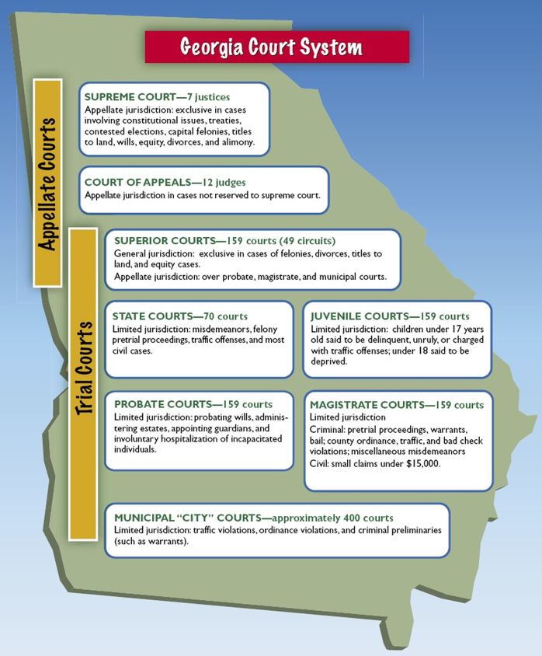
TYPES OF COURTS
1. PROBATE COURT
2. MUNICIPAL OR CITY COURTS
3. MAGISTRATE COURT
4. STATE COURT
5. SUPERIOR COURT
6. COURT OF APPEALS AND SUPREME COURT

Slide 5
TYPES OF CASES
1. ORDINANCE VIOLATION
MAX SENTENCE – Fine and/or up to 6 months in jail
2. MISDEMEANOR (INCLUDES TRAFFIC VIOLATIONS)
MAX SENTENCE – Up to 12 months in jail and/or fine up to $1000
3. FELONY
MAX SENTENCE – More than 12 months in prison depending on offense

Slide 6
FROM ARREST TO APPEAL – CASE FLOW
1. REVIEW CASE FLOW MAPS (SLIDES BELOW) – HIGHLY VARIABLE BETWEEN COUNTIES
2. IMPORTANT EVENTS
ARREST INITIAL APPEARANCE/1ST APPEARANCE BOND HEARING PRELIMINARY HEARING INDICTMENT | ARRAIGNMENT CALENDAR CALL STATUS CONFERENCES MOTIONS HEARINGS TRIAL SENTENCING

Slide 7
Felony Timeline
PRE-INDICTMENT
Client out on bond
Client is arrested
Initial Appearance (POSSIBLY BOND SET)
Preliminary Hearing
(unless already indicted)
Arraignment
Bond Hearing
Grand Jury Returns Indictment!
Trial Timeline next
Client is interviewed for qualification
Trial attorney

Slide 8
Felony Trial Timeline
Appeal (?)
Guilty Plea
Sentencing (mitigation)
Bond Modification Hearing (if needed)
Pre-trial motions and Trial
Arraignment
Guilty
State turns over discovery
Motion Hearings (if needed)
Verdict
Verdict
File Particularized Motions
Calendar Calls
Grand Jury Returns Indictment!
Grand Jury Returns Indictment!
10 Day Motions
& Reciprocal Discovery
Not Guilty
Negotiate Plea (?)

Slide 9
Misdemeanor Timeline (HIGHLY VARIABLE BETWEEN COUNTIES)
Client out on bond
Client is arrested
Accusation filed
Bond set by Jail?
Initial Appearance (Bond?)
Attorney Meets Client for first time (jail cases)
Client is interviewed for qualification if in jail

Slide 10
Misd. Timeline II
Appeal (?)
Negotiate Plea (?)
Guilty Plea
Arraignment
Sentencing (mitigation)
Bond Modification Hearing(s) (if needed)
TRIAL
Motion Hearings (if needed)
Guilty
Verdict
Verdict
Standard Motions Filed/Requests for Discovery
Calendar Calls and Status Hearings
File Motions in Limine and
Jury Charges
Not Guilty

Slide 11
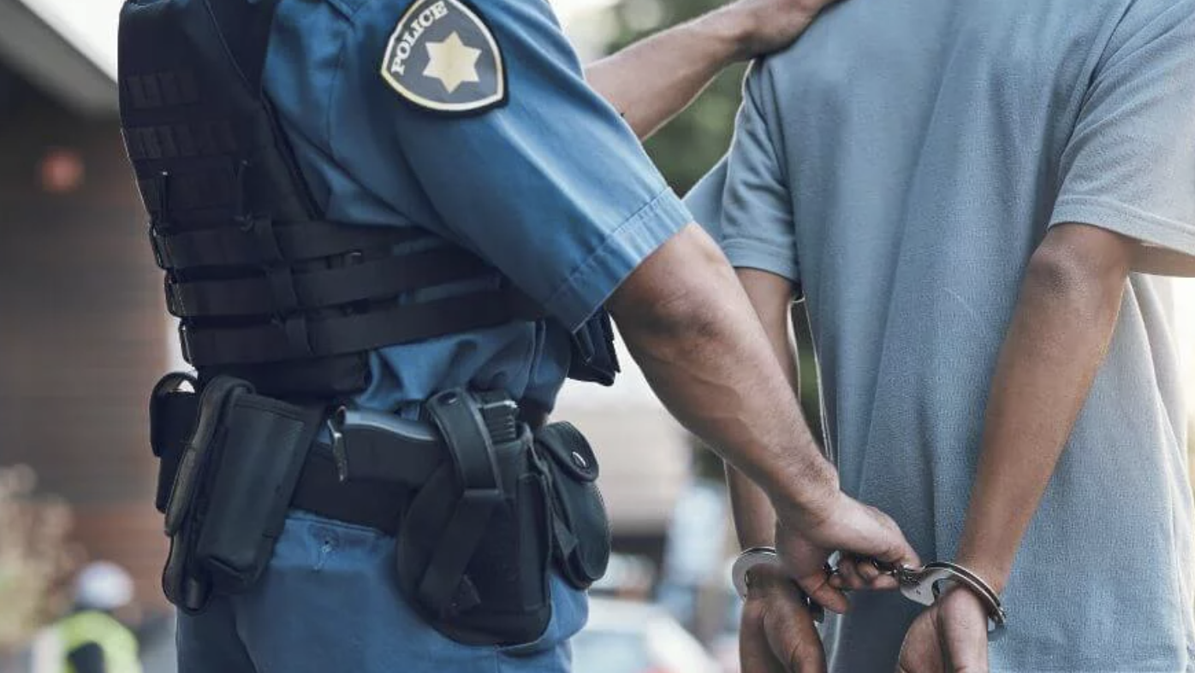
arrest
What is needed for an Arrest to be made?
  Probable Cause
  Arrest Warrant
  After an Arrest:
  Custody
  Booking
  Informed of Charges

Slide 12
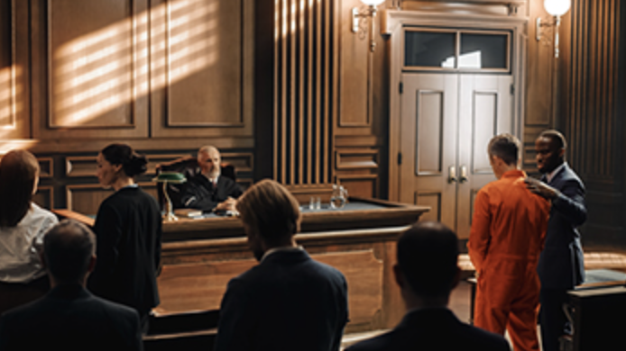
Initial appearance
Typically, within the first 72 hours after an arrest, a defendant will appear in their first court hearing.
What happens in an Initial Appearance?
Judge informs Defendant of charges
Advised of rights
Determination of the qualification for a court-appointed attorney should be made at or before this hearing
Bond may be set, if eligible.

Slide 13
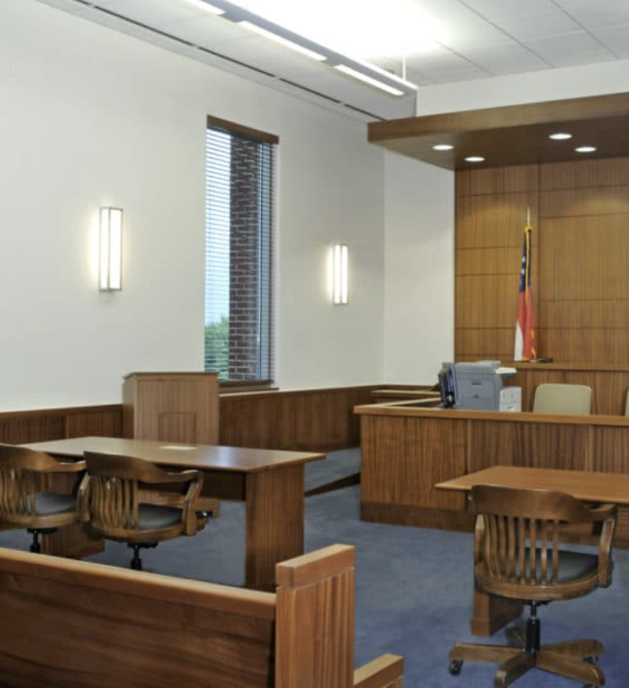
Bond hearing
Either during the initial appearance or at a separate hearing, a bond hearing will occur.
Factors Considered by the Judge:
Criminal history
Danger to the community
Employment/ Ties to the community
Flight risk
The judge may grant bond and set release conditions or deny bond.

Slide 14
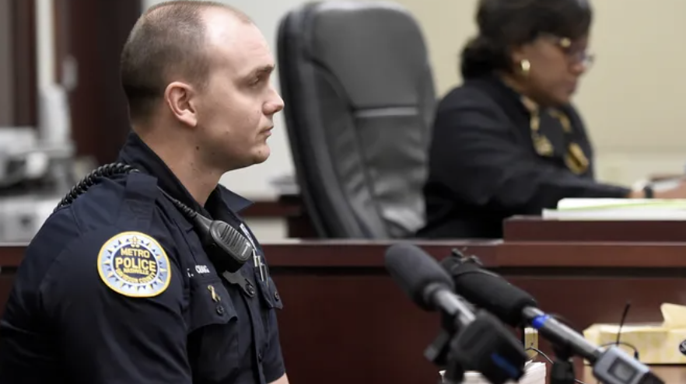
Preliminary hearing
The primary purpose is to determine probable cause.
Steps to a preliminary hearing:
Prosecutor presents evidence and typically calls witnesses
Defense may cross-examine
Judge determines probable cause
Charges may be dismissed, reduced or moved to the next stage
  Reduction or dismissal is not the “final word”

Slide 15
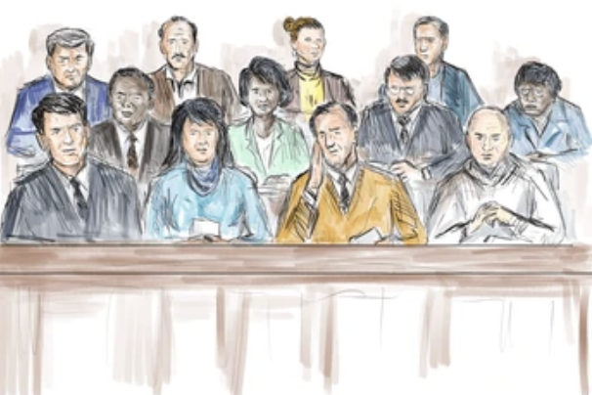
Indictment/
Accusation
Formal written accusation by a grand jury.
What Happens During an Indictment?
Prosecutor present evidence
Grand jury reviews evidence
*Defense council is typically not present
True Bill vs. No Bill
Usually needed for more serious crimes.
Accusations are drafted for misdemeanors and less serious crimes, or if indictment is waived.

Slide 16
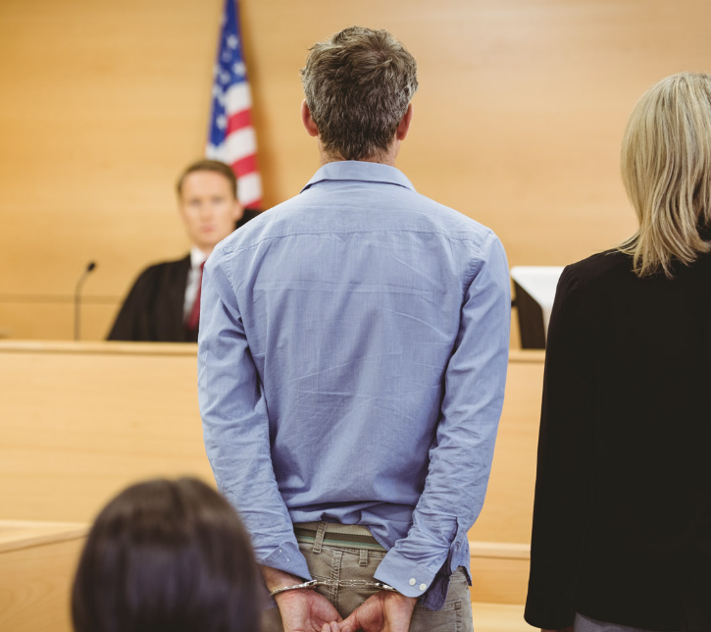
arraignment
The opportunity to enter a plea.
Pleas that the Defendant may enter:
Guilty
Not Guilty
Nolo Contendere (no contest)
Not all courts will allow a Guilty or Nolo plea at arraignment.

Slide 17
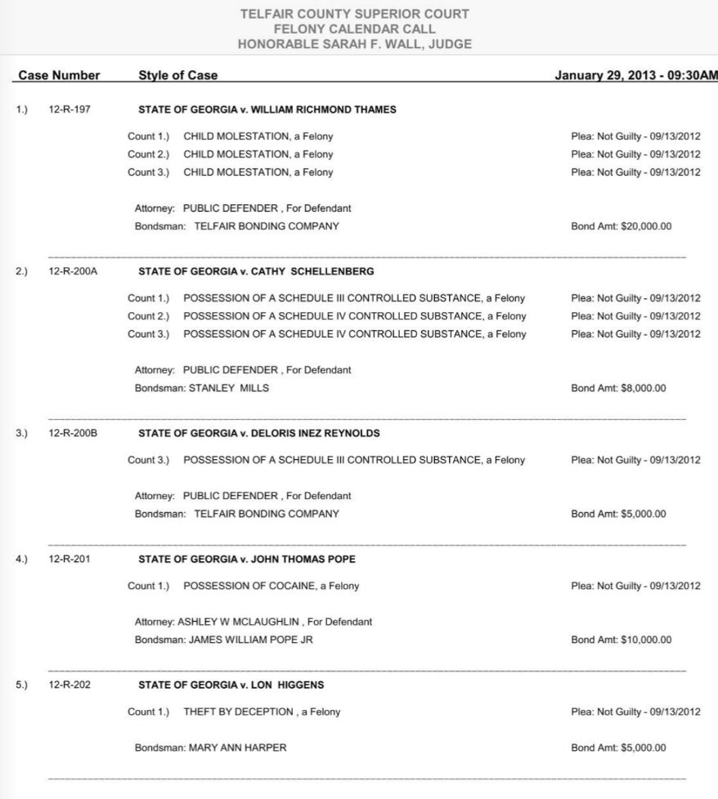
CALENDAR CALL
The Judge reviews the status of cases and schedules them for proceedings.
Defendant and attorneys are present (unless excused).
Cases placed on the trial calendar or are scheduled for motions hearings, status conferences or sentencing.

Slide 18
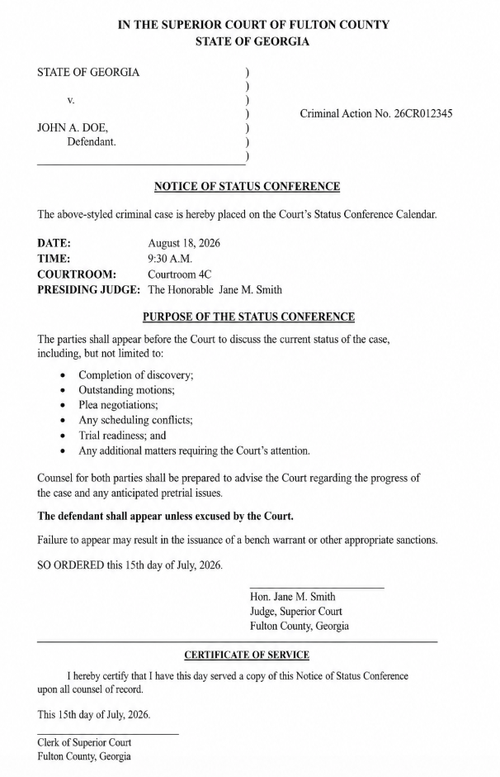
STATUS CONFERENCE
Discusses the progress of a case and resolves issues before trial.
Discovery, plea negotiations, and/or pending motions discussed.
  Should the judge be involved in plea negotiations? No, they should not. But they can hear about the status of negotiations.
More case-specific.
Future scheduling for trial or additional hearings.

Slide 19
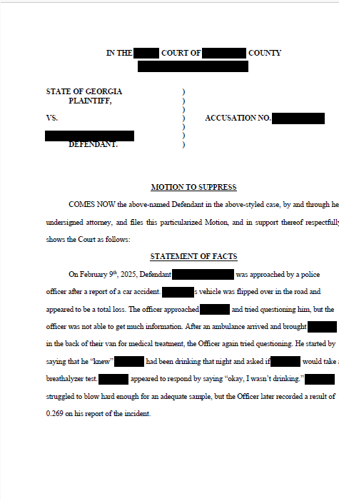
Motions hearings
Judge rules on written requests (motions) made by counsel.
Common Motions in Georgia Criminal Cases prior to trial:
Motion to suppress evidence
Motion for a continuance
Motion in limine
General or special demurrers
Purpose is to resolve issues before trial and ensure a fair trial.

Slide 20
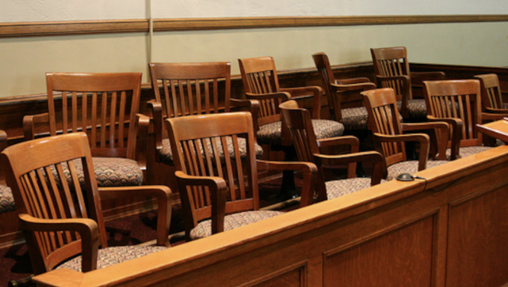
TRIAL
Evidence and arguments presented to determine guilt.
Steps of a Trial in Georgia:
Jury Selection (Voir Dire)
Opening Statements
Evidence Presented by State
Evidence Presented by Defense (possibly)
Charge Conference
Closing Arguments
Charge to the Jury
Jury Deliberation
Verdict
*Verdict Must Be Beyond a Reasonable Doubt

Slide 21
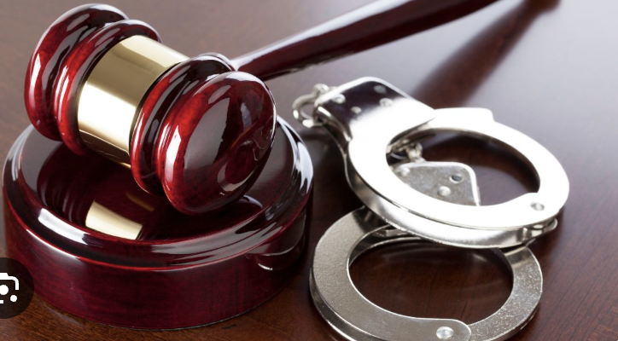
SENTENCING
Judge imposes punishment after a defendant is found guilty or enters a guilty or no contest plea.
Counsel for State and Defense may present evidence suggesting appropriate sentence.
Victim impact statement.
Defendant may speak (sometimes called allocution).
Jail or prison time, probation, fines, restitution, community service, other conditions may be imposed.

Slide 22
WHAT HAPPENS AFTER SENTENCING? SOME OPTIONS
1. MOTION TO WITHDRAW GUILTY PLEA
Deadline: Before the end of the term of court
2. APPEAL
Deadline: 30 days from the date of the final judgment or sentencing
3. MOTION TO RECONSIDER
Deadline: Within 1 year after sentencing
These are hard and fast deadlines with virtually no exceptions.

Slide 23
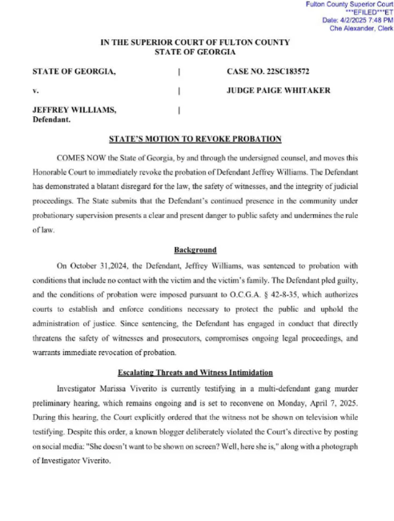
Probation revocation hearings
The court determines whether a person violated the conditions of their probation and whether their probation should be modified or revoked.
Common Reasons for a Probation Violation:
Failing to report to a probation officer.
Failing a drug or alcohol test.
Committing a new criminal offense.
Violating a no-contact order.
The judge may modify the terms of probation or revoke part or all of the probation, requiring the defendant to serve some or all of the remaining sentence in jail or prison.

Slide 24
APPELLATE COURTS
1. COURT OF APPEALS
CASES NOT INVOLVING CONSTITUTIONAL ISSUES OR POTENTIAL DEATH SENTENCES
2. SUPREME COURT OF GEORGIA
CASES INVOLVING CONSTITUTIONAL ISSUES OR POTENTIAL DEATH SENTENCES (EVEN IF DEATH PENALTY WAS NOT SOUGHT); REVIEW OF CASES FROM COURT OF APPEALS, BY APPLICATION ONLY.
3. SUPREME COURT OF THE UNITED STATES
BY APPLICATION ONLY, REVIEWS CASES FROM GEORGIA SUPREME COURT ON ISSUES OF FEDERAL CONSTITUTIONAL IMPORTANCE

