Slide 1
Terabytes & Volumes:
How to handle discovery in a digital age
Presented by veronica o’grady & Jackie tyo

Slide 2
How much data is a terabyte?
A terabyte is approximately 1 trillion bytes.
  More specifically:
    1,099,511,627,776 bytes; or
    1,073,741,824 KB; or
    1,048,576 MB
This is equivalent to…
  85,899,345 pages of Word documents!
  1,000 hours of videos!
  310,000 photos!

Slide 3
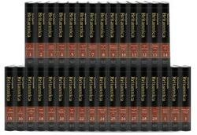

It’s a lot of information.
10 Terabytes = the entire printed collection of the U.S. Library of Congress
1 Terabyte = 1,000 copies of the Encyclopedia Britannica

Slide 4

First Step: Organization

Slide 5
Organizational Triage
Trial
Negotiations
Pleas
If your client is going to trial, their discovery takes precedent.
This is the most important, and will ultimately be the most organized of the three.
If your client is not sure whether they want to go to trial or if they want to plea, then their discovery organization will be mid-level.
Less important than trial, but more important than pleas.
If your client just wants to plea, then their discovery should get the least priority.
Still must review to get best possible deal for the client, but sometimes people are willing to admit their guilt and we need to balance that with our clients who are going to trial or negotiating for a better deal.

Slide 6
Organize as you go.
Regardless of how you triage your clients’ cases, do NOT wait for the last minute to organize!
Organizing as you go provides important insight that can benefit the defendant.
Adobe PDF is a friend – not a foe.
Don’t have to immediately do a deep-dive into the overwhelming amount of discovery the State provided, but it is important to know what you have and what you are missing.
Make sure to OPEN and skim video/multimedia pieces of discovery to ensure that you can actually view it (you don’t want to find out the bodycam is corrupted 2 weeks before trial).
If you receive paper, go ahead and scan it all it however you like; if it was received electronically, it’s likely already in a PDF.

Slide 7
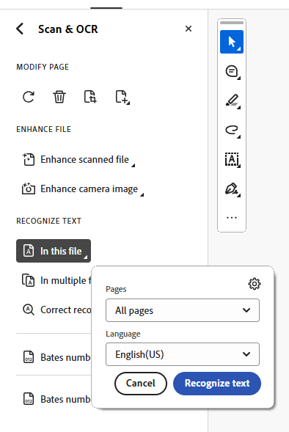
Organize as you go: OCR
Adobe PDF can be searchable documents: If you have a giant PDF, go ahead and type CTRL + F and any word you like to see if it is searchable.
  If it is NOT searchable, then run the Optical Character Recognition (OCR).
  Go to “All tools” and select “Scan & OCR” →
  “In this file” → “All pages” → Hit Recognize text
Running the Scan & OCR takes time on the front end, but saves you time on the back end.

Slide 8
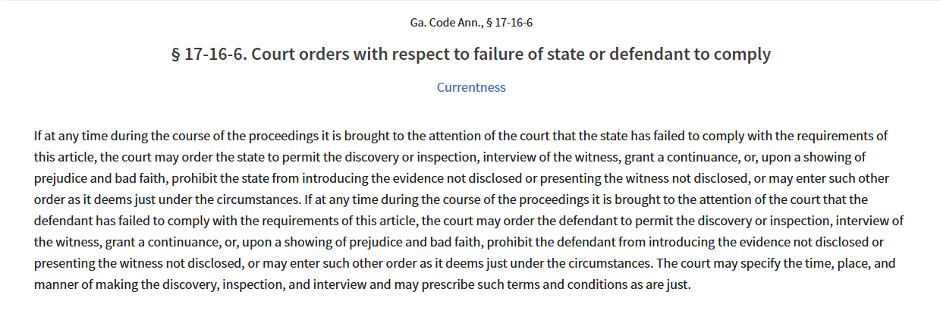
OCR not an option?
If OCR is not an option in your office, and the format the State provided was not searchable, then consider filing a motion to compel.
OCGA Section 17-16-6 allows the avenue for argument: Providing unsearchable data is (arguably) a “failure to comply” because it could be preventing you from adequately preparing for trial w/in the 10-day period of when the State is required to provide discovery.

Slide 9
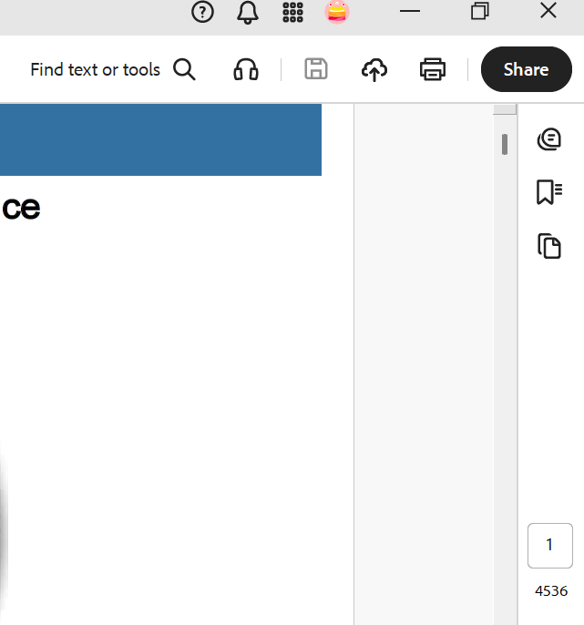
Organize as you go: Bookmarks
Adobe also allows you to Bookmark your PDF.
After you run OCR and save the new file, go ahead and get some bookmarks going.
On the right side of your PDF, there are three icons – you want the middle one.
Notes:
The PDF for this slide and the next is titled “Cellebrite Example for Bookmarking”
Pull it up now to show the organization of the cellebrite, and how there are bookmarks and then bookmarks inside bookmarks.

Slide 10
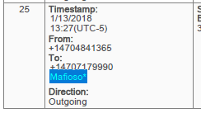
Organize as you go: Bookmarks
There are 6,056 text messages.
The biggest issue in your case is the communication between the owner of the cell phone and “Mafioso”.
You’ve already run OCR and saved it.
There are already bookmarks created, and you know where are all the MMS Messages. Let’s organize it even more.
Go to the MMS Messages Bookmark, and CTRL + F “Mafioso”.
Notes:
Once you’re in the MMS Messages Bookmark, the text recognition is going to start within the text messages. The first time Mafioso appears in on the 25th message.
Once you’ve done this on the screen as an example, then show how to create bookmarks within bookmarks.

Slide 11
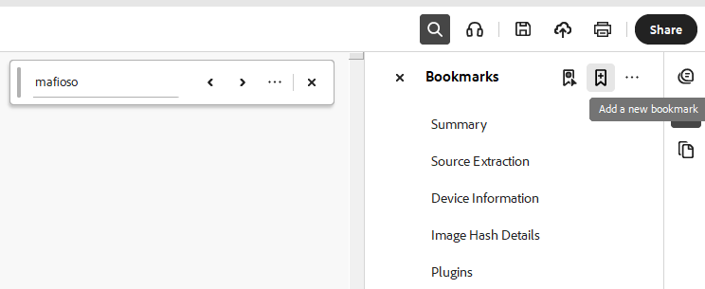
Bookmarks within bookmarks!
While Mafioso is highlighted from the text search, go to the Bookmarks area and select the option “Add a new bookmark”.
You can create a bookmark-within-a-bookmark for every time the name Mafioso appears in the PDF.
Since Mafioso is already highlighted from the search, the Bookmark will automatically give it this name.

Slide 12
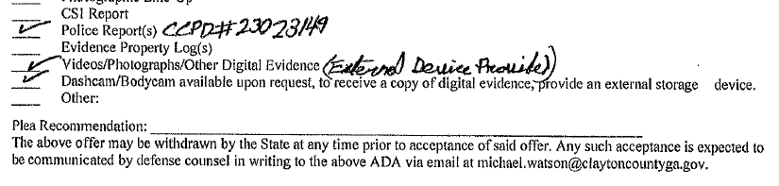
Quick Tip
If you get a certificate of discovery from the State, make sure to see if anything is “available upon request”.
Go ahead and give the State what they need (usually an external device like a USB flash drive) to get what you need.
Notes:
OCGA Section 17-16-4(a)(3)(A) allows the State to provide access to inspect rather than providing a copy, so it’s important to know whether the State has provided everything to you, or just put you on notice that you have access to it.

Slide 13
Organizational “Buckets”
State’s Investigative Files
  Reports
  Witness Statements/Interviews
  Cell Phone Records/Location Data/Social Media
  Photos
Forensic Files
Filings
  Pre-trial Transcripts
  Orders
  Motions
Defense’s Investigative File
  Alternative Suspects
  Notes & Work Product
  Impeachment Documents
  Correspondence
    With Client
    With Experts
    With Witnesses
  Subpoenas & Responsive Documents
  Expert Witness Information
  Filing Drafts

Slide 14
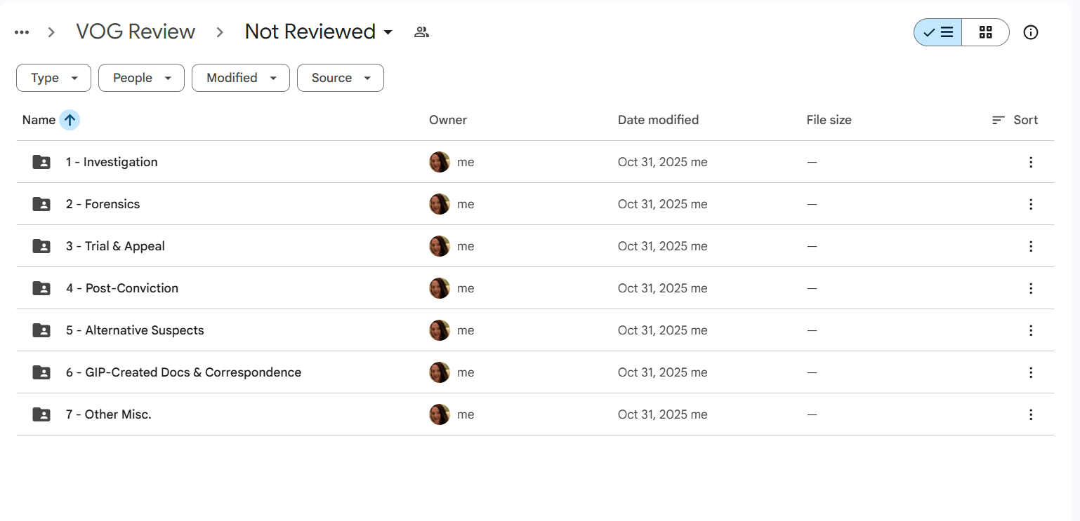
Example!

Slide 15
Why is organizing up front important?
You can’t organize without doing a preliminary review of what you have.
  This is not a deep dive of reading everything word-for-word.
Doing a preliminary review while organizing allows you to know what you do have versus what you don’t have.
Let’s you know upfront if you cannot access something received.
  For example: You receive a video from the State, go ahead and see if it will open. If it does, add the generalized video information to your document digest (i.e., “2024, December 12” Witness Interview”). If it does not, put the State on notice you cannot access it.

Slide 16
Why is organizing up front important?
Did you receive a cell phone dump?
  You should also learn during your preliminary review whether there was a warrant.
    If you don’t have it, now you know to request it.
  That should trigger you to go ahead and file a motion to suppress.
    You can particularize it or withdraw it later.
  Consider a motion in limine to attack the contents.
Notes:
MIL: attack the contents since en masse cellbrite has hearsay and need to establish my client had only access.

Slide 17
Why is organizing up front important?
Did you receive stuff from the GBI?
  You should be able to assess whether additional items are pending test results.
    If that’s the case great reason for a motion for continuance.
  Are all the results in? Do you have the bench notes?
    Time to request those now.
  Needing an expert? If your GBI information is already preliminarily organized, you know where it is and can easily provide it to the expert.

Slide 18
Why is organizing up front important?
Co-Defendant Cases
  What information is specifically against your client?
  What information pertains to all the co-defendants?
  Helps you assess whether a motion to sever is necessary.
Notes:
Discuss on this slide how you can also file a motion asking the State to clarify WHAT evidence it is using specifically against your client. The more you know about this will allow you to particularize the motion to sever, and make it as strong as possible.

Slide 19
How to Tackle the REALLY Big Files
If there are co-defendants, the first thing you want to do when you get a REALLY BIG file is to file a motion asking the State what evidence they are planning on using against your client.
  This is necessary so you can assess whether a motion to sever would be helpful/warranted.
Think of your file like an upside down triangle.
  Put everything into these separate triangles, however it makes sense for you to organize it. (i.e., by co-defendant, physical evidence, digital evidence, etc.)
  Then do a preliminary review on each – run the OCR, Bookmarks.
  Then if you need something, you’ll know exactly where it is and can organize it ever further later (if necessary).

Slide 20

Digesting
What is a digest?
  According to Merriam-Webster online, a digest is “a summation or condensation of a body of information.”
  Cambridge Dictionary defines it as a way “to take information into your mind in a way that gives you the ability to use it.”
  Dictionary.com defines it as a way “to convert food in the alimentary canal into absorbable form for assimilation into the system.” (We’re not talking about this one.)

Slide 21
Discovery & Investigative Digest
Allows you to know who said what and when.
Organize by the date of the REPORT not the date of substance of contents.
Allows you to track any inconsistencies as discovery trickles in (or as you have time to review, since that may happen over weeks or months).
Allows you to track what investigative steps you might need to take or outstanding questions you have based on disc
Notes:
Suggestions to use “Not Reviewed” and “Reviewed” Folders that contain all of these subfolders so you know where you left off.

Slide 22
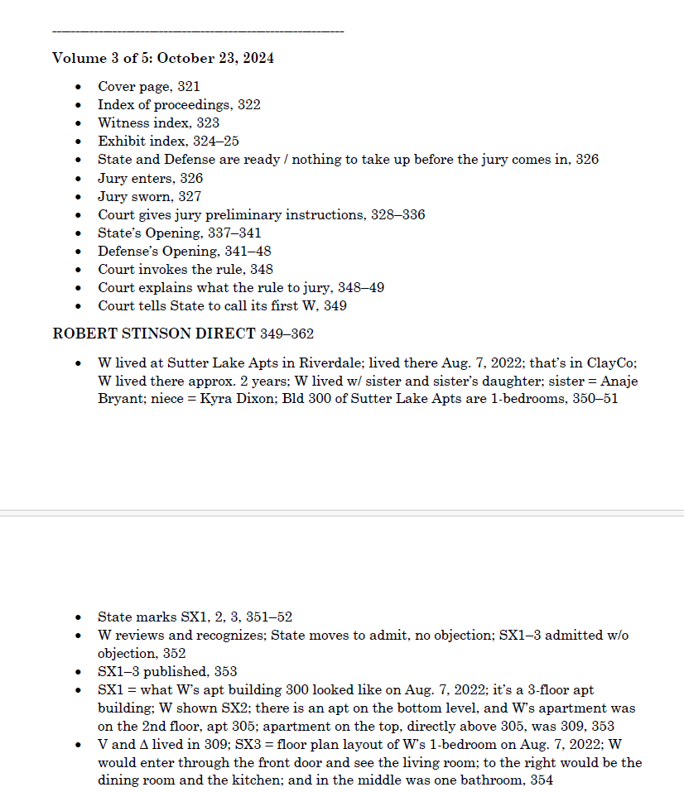
Transcript Digest
If you have a pre-trial (or mistrial) transcript, you need to know who said what for trial.
Is it short?
  PDF Bookmarks
  PDF Comments
Is it long? (Bummer.)
  Make a digest.
  Pro tips: Do NOT use pronouns & be consistent with abbreviations.
Notes:
Guzman digest is saved as an example to show a long transcript digest.

Slide 23
Other Tips
Another option with a really large file is to print to PDF to create smaller, more manageable files.
If you suspect something critical is missing, you could ask the Court to engage in an en camera review of the State’s entire file (including their work product) to determine whether any Brady material was left undisclosed.
Some level of organization may be delegated to a paralegal or intern (if that’s an available option).

Slide 24
A Couple More Ideas
OCGA Section 17-16-4 provides that the prosecuting attorney shall, no later than ten days prior to trial, or as otherwise ordered by the court…
  Use this language to your advantage!
  In complex cases, you can move the Court to set different times for discovery.
    Ask early because getting “rolling” discovery may be easier to manage.
Georgia Rules of Professional Conduct: Rule 3.4 (Fairness to Opposing Counsel):
  Comment [1]: “…Fair competition in the adversary system is secured by prohibitions against […] obstructive tactics in discovery procedure[.]”
  If you get a HUGE file 10-days before trial, you may be able to argue that is an obstructive tactic.
Notes:
This is helpful for if you have lots of co-defendants.

Slide 25
Questions?

Slide 26
Our Contact Information
Vernonia O’Grady
veronica@georgiainnocenceproject.org
Jackie Tyo
jackie.tyo@claytoncountyga.gov
Notes:
(just in case anyone asks)

