Slide 1
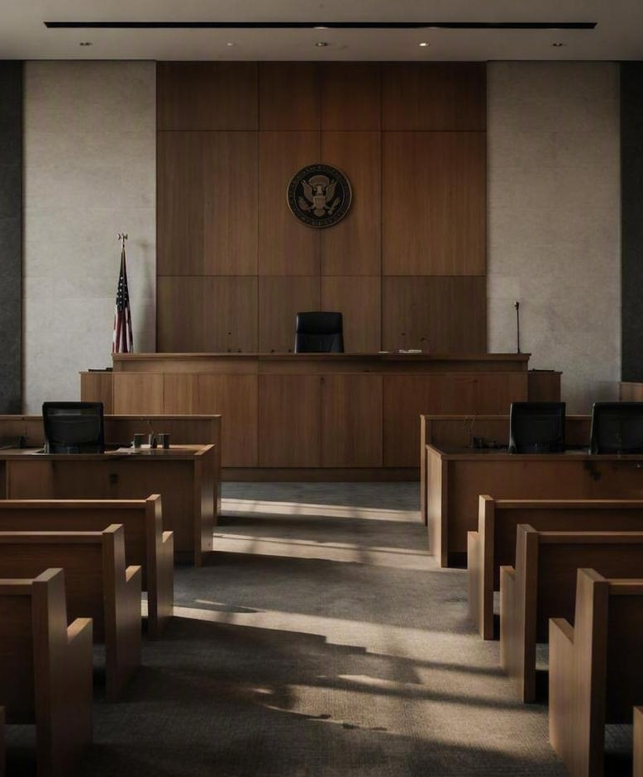

THE QUIET FORCE
A TRIAL-SUPPORT TRAINING
Partners in Crime
Presented by
Whitney Hammons · Shaveena Rogers
Notes:
Welcome and framing for new investigators. 'The Quiet Force' is the criminal defense investigator — the partner working behind the scenes so the attorney can focus on the courtroom. Introduce yourselves (Shaveena and Whitney) and set expectations: today we walk the full arc, pre-trial through building the case. Emphasize that our value is preparation and reliability, not the spotlight.

Slide 2
What We'll Cover
TRAINING ROADMAP
Four stages, following the case from first preparation to closing arguments.
Supporting Attorneys During Trials
Who the investigator is — and why the role matters.
I
Pre-Trial Preparation & Support Tasks
Subpoenas, the trial notebook, and jury investigation.
II
Trial
Jury selection, witnesses, technology, and trial notes.
III
Building the Case
The debrief and the road to closing arguments.
IV
Notes:
Set the map for the session. We move through four stages in order: Section I introduces the investigator; Section II is the pre-trial preparation where most of the work happens; Section III is the trial itself; and Section IV is building the case toward closing. Tell trainees to keep this arc in mind — every task fits one of these four stages.

Slide 3
Supporting Attorneys During Trials
01
WHERE IT ALL STARTS
Introducing the criminal defense investigator — the attorney's partner behind the scenes.
Notes:
Open Section I. Before tasks and checklists, trainees need to understand the role itself. Frame the investigator as the quiet partner who makes courtroom advocacy possible. Keep it short — the next slide gets specific.

Slide 4
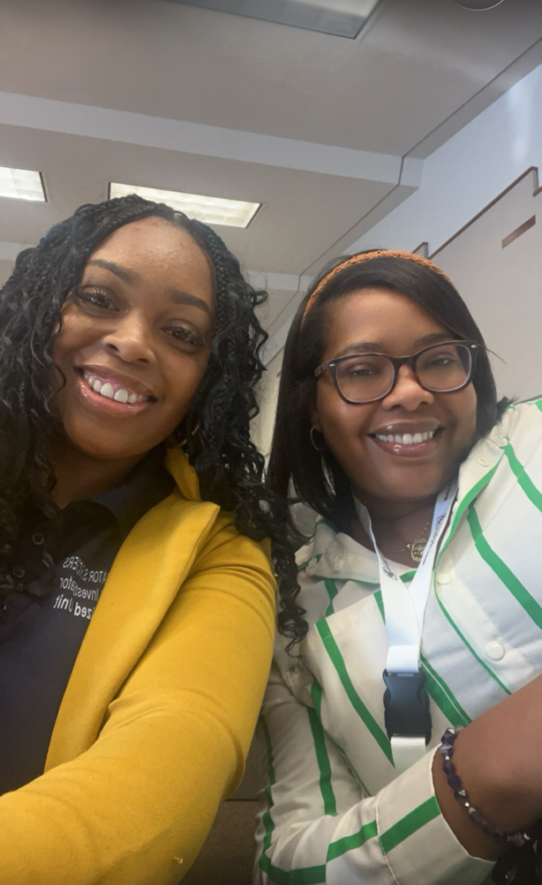
Meet the Criminal Defense Investigator
SECTION I · INTRODUCTION
The investigator is the attorney's partner behind the scenes — the person who gathers, organizes, and safeguards everything the trial team relies on.
1
Prepare the ground
Assemble documents, evidence, witnesses and clothes long before opening statements.
2
Support in the room
Track testimony, exhibits, and reactions while the attorney focuses on advocacy.
3
Protect the record
Keep materials accurate, complete, and ready for the case that follows.
Notes:
Explain the role in plain terms. The investigator does not argue the case — they make it possible to argue well. Three throughlines you'll see all day: prepare the ground, support in the room, protect the record. Everything that follows fits under one of these. Reassure trainees the work is checklist-driven and repeatable.

Slide 5
Pre-Trial Preparation & Support Tasks
02
THE WORK BEFORE THE COURTROOM
A
B
C
Witness Subpoenas
Trial Notebook
Jury Investigation
Issue, serve, and track appearances
Documents, story order, impeachment
Research jurors and build visuals
Notes:
Transition into pre-trial work — where investigators spend most of their time. Preview the three buckets: witness subpoenas, the trial notebook, and jury investigation. Stress that a trial is won or lost here; the courtroom just reveals how good the preparation was.

Slide 6
Witness Subpoenas
SECTION II · A
Getting the right people to the right courtroom, on the right day — with proof it was done properly.
1
2
3
4
Prepare
Serve
Track
Confirm
Draft subpoenas for every witness the trial team intends to call.
Coordinate timely, valid service and capture proof of delivery.
Log who has been served and monitor confirmations.
Verify each witness knows the date, time, and location.
Notes:
Subpoenas are the investigator's first accountability task. Walk through the flow: prepare, serve, track, confirm. Emphasize documentation — proof of service protects the case if a witness fails to appear. A missing or improperly served witness can derail a trial day, so this is unglamorous but critical.

Slide 7
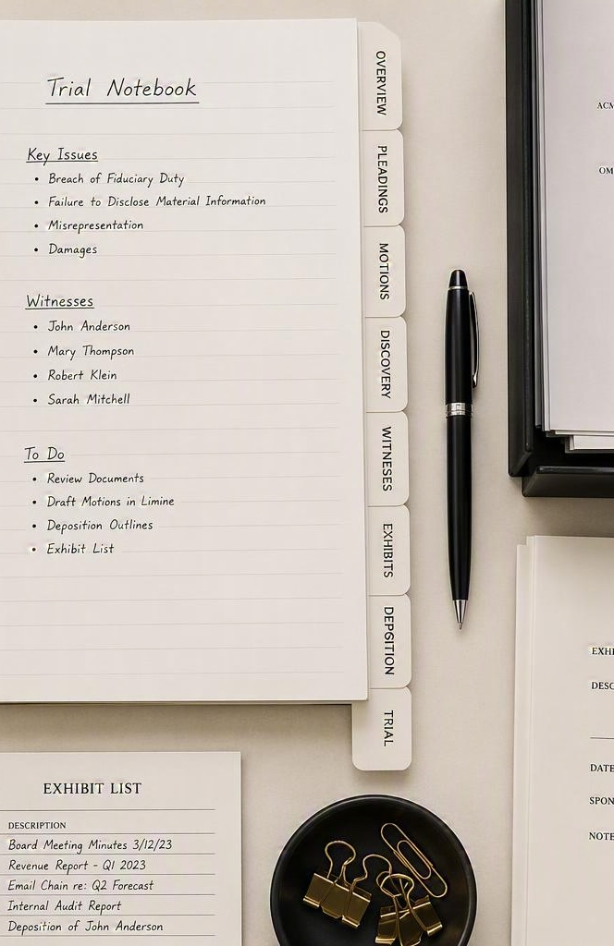
Building the Trial Notebook
SECTION II · B — PART 1 OF 2
1
Gather documents & exhibits
Assemble the witness outline and the key (court) exhibits list.
2
Organize in story order
Sequence evidence and motions to follow the case narrative — with an objection cheat sheet on hand.
Story order matters: the notebook should read like the argument, not a filing cabinet.
Notes:
The trial notebook is the investigator's masterpiece — the single organized source the attorney reaches for under pressure. Part one is gathering and organizing: pull the raw documents and exhibits (witness outline, court exhibits list), then arrange everything in story order with an objection cheat sheet. Story order matters — the notebook should read like the argument.

Slide 8
The Impeachment Packet
SECTION II · B — PART 2 OF 2
The material ready to challenge a witness whose testimony doesn't match the record.
1
2
3
Prior statements
Exhibits
Timelines
Depositions, reports, and earlier accounts to compare against live testimony.
The documents and evidence that contradict or pin down a shifting story.
A clear sequence of events that exposes gaps and inconsistencies.
Notes:
Part two of the notebook is the impeachment packet — the investigator's quiet insurance policy. Three components: prior statements to compare against what the witness says on the stand, exhibits that contradict a shifting story, and timelines that expose gaps. When a witness wavers, the attorney needs the contradiction in hand within seconds. Preparation here is what makes impeachment fast and credible.

Slide 9
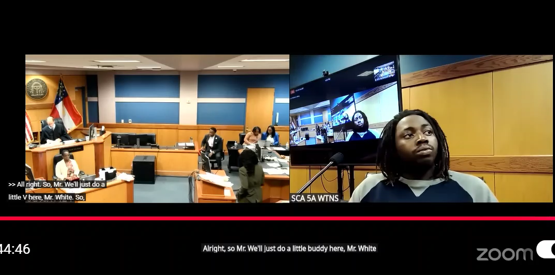
Inv. Rogers showing Atty. Ragas that the witness testimony is different from the initial Incident Report.

Slide 10
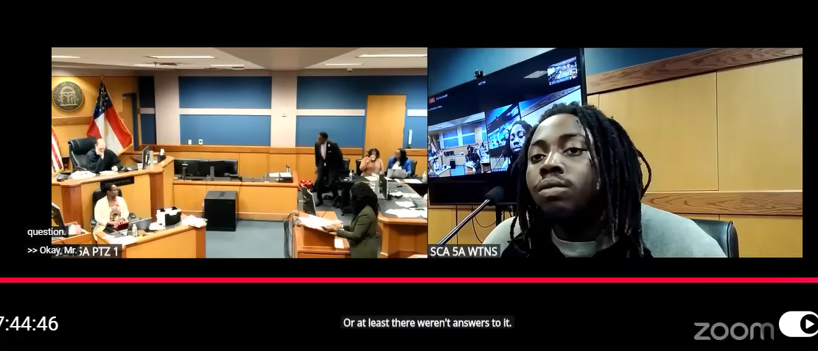
Atty. Ragas pointing out that the witness has testified under oath, untruthfully.

Slide 11
Jury Investigation
SECTION II · C
Understanding who sits in the box — and making the evidence easy for them to follow.
1
2
Research jurors
Build jury-friendly visuals
Gather background and public information to help the trial team read the panel.
Prepare clear charts and timelines that turn complex evidence into a story anyone can follow.
Notes:
Jury investigation has two halves. First, research the jurors — gather background and public information so the team can read the panel during selection. Second, translate the case for that audience: build jury-friendly charts and timelines. Jurors decide on the story they can follow, so clear visuals are persuasion, not decoration. Note the ethical line — only appropriate, public information.

Slide 12
Trial
03
GAME DAY IN THE COURTROOM
A
B
C
D
Jury Selection
Witness Preparation
Technology Test
Trial Notes
Notes:
Shift to trial itself — now the preparation goes live. Four responsibilities during trial: jury selection, witness preparation, the technology test, and trial notes. Remind trainees that during trial the investigator is quiet but constantly working — observing, verifying, and recording.

Slide 13
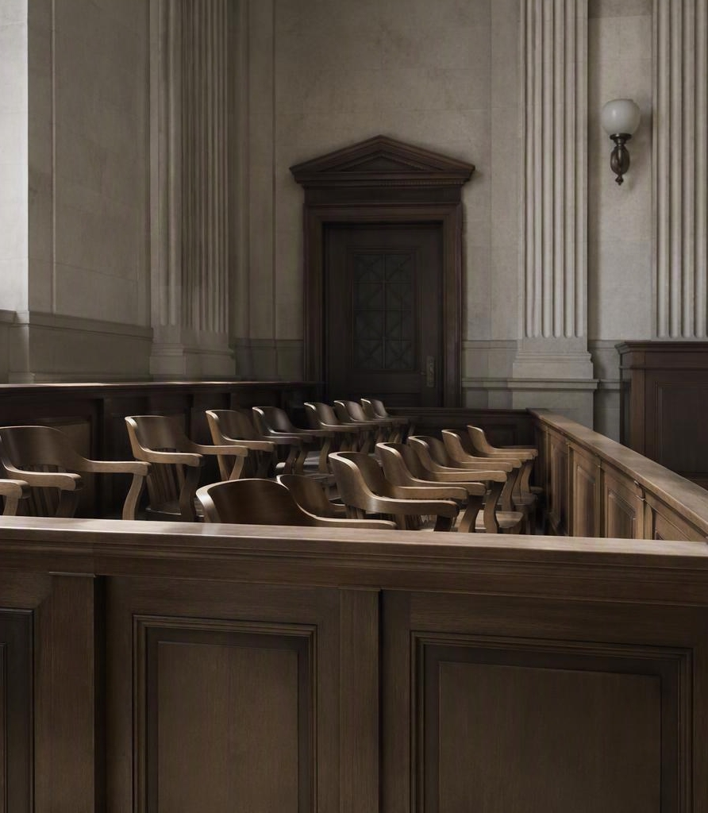
Jury Selection
SECTION III · A
The trial team is watching the panel — and so are you.
1
Monitor juror reactions
Watch body language and responses during questioning and feed observations back for roundtable discussion with the trial team.
Notes:
During jury selection the investigator becomes a second set of eyes. Monitor juror reactions — tone, body language, hesitation — and bring those observations to the team's roundtable so decisions about the panel are informed by more than the questions alone. Take quiet, specific notes; impressions fade fast.

Slide 14
Witness Preparation
SECTION III · B
No surprises on the stand — the right witnesses, ready with the right materials.
i
ii
Verify availability & location
Ready the questioning materials
Confirm each witness is reachable, available, and where they need to be before they are called.
Have the outline of questions, exhibits, and deposition excerpts on hand — including for impeachment if a witness wavers.
Notes:
Two jobs here. First, logistics: verify every witness's availability and location so no one is missing when called. Second, materials: keep the outline of questions, exhibits, and deposition excerpts ready — especially the deposition excerpts used to impeach a witness whose testimony shifts. The investigator makes sure the attorney is never caught flat-footed.

Slide 15
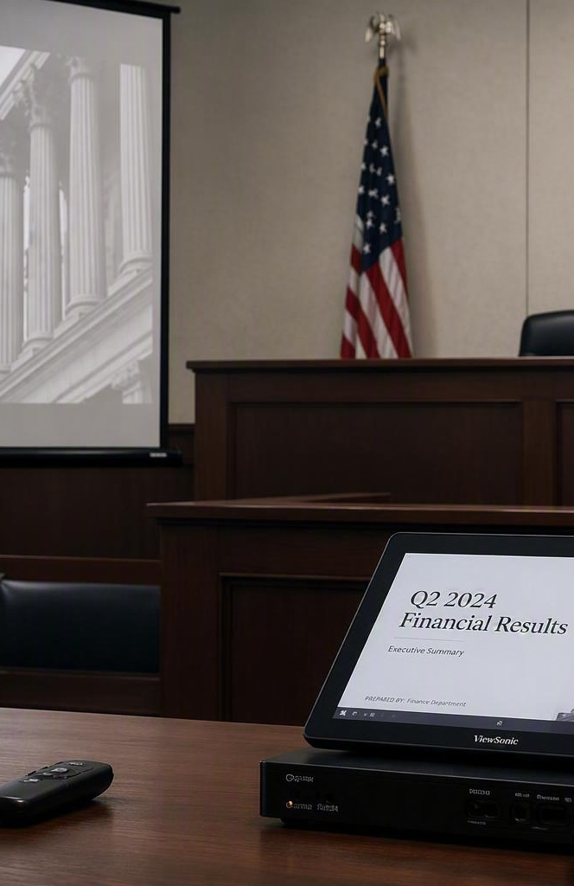
Technology Test
SECTION III · C
Check every device before the jury walks in — not during testimony.
Projector
Monitors
Image displays clearly and on cue
Every screen mirrors correctly
Audio
Clicker
Playback is audible across the room
Advances slides without a hitch
Notes:
The technology test is a pre-flight checklist — run it before the jury enters, never during testimony. Four items: projector, monitors, audio, and clicker. Test the actual exhibits you'll show, not just that the device powers on. A frozen screen or dead clicker in front of the jury breaks momentum and credibility, and it's entirely preventable.

Slide 16
Trial Notes
SECTION III · D — IN THE MOMENT
What to capture live, while the courtroom is moving.
Capture jury engagement
Note the moments jurors lean in — or check out — during testimony and argument.
i
Track objections & rulings
Log opposing counsel's objections and exactly how the court rules on each one.
ii
Notes:
Trial notes split into two jobs. First, the live capture: watch and record jury engagement — when jurors lean in or drift — and log every objection opposing counsel raises along with the court's ruling. These are fleeting moments; if you don't write them down as they happen, they're gone. This is the 'in the moment' half.

Slide 17
Trial Notes
SECTION III · D — PROTECTING THE RECORD
What to reconcile and secure so the record holds up later.
Follow every witness
Record each witness's role and their statements while on the stand.
iii
Reconcile & secure exhibits
Confirm exhibit numbers match the court's admitted list, then secure all materials for the record.
iv
Notes:
The second half of trial notes protects the record. Track every witness — their role and what they actually said on the stand — and reconcile exhibit numbers against the court's admitted list, then secure all materials for the record. This is what feeds appeals and closing arguments, so precision beats speed. Nothing leaves the room unaccounted for.

Slide 18
Trial-Day Checklist
SECTION III · QUICK REFERENCE
Print and carry — check off each task as the trial day unfolds.
JURY SELECTION
TRIAL NOTES
Monitor juror reactions (roundtable feedback)
Capture jury engagement moments
Log objections & the court's rulings
WITNESS PREPARATION
Record each witness's role & testimony
Verify witness availability & location
Confirm exhibits vs. court's admitted list
Ready questions, exhibits & deposition excerpts
Secure all materials for the record
TECHNOLOGY TEST
Projector displays clearly
Reminder: initial and date each page before it goes into the record.
Monitors mirror correctly
Audio audible across the room
Clicker advances slides
Notes:
This is the printable one-page reference. It gathers every trial-day task from Section III into a single checklist: jury selection, witness preparation, the technology test, and trial notes. Hand it out — trainees should carry it and physically check items off as the day moves. The reminder at the bottom reinforces good record hygiene: initial and date each page.

Slide 19
Building the Case
04
FROM COURTROOM TO CLOSING
Turning the day's exhibits and notes into the argument that closes the trial.
Notes:
Open Section IV. Building the case is not a final step — it happens every evening as the team turns the day's record into the next move. Set up the debrief as where the investigator's preparation pays off.

Slide 20
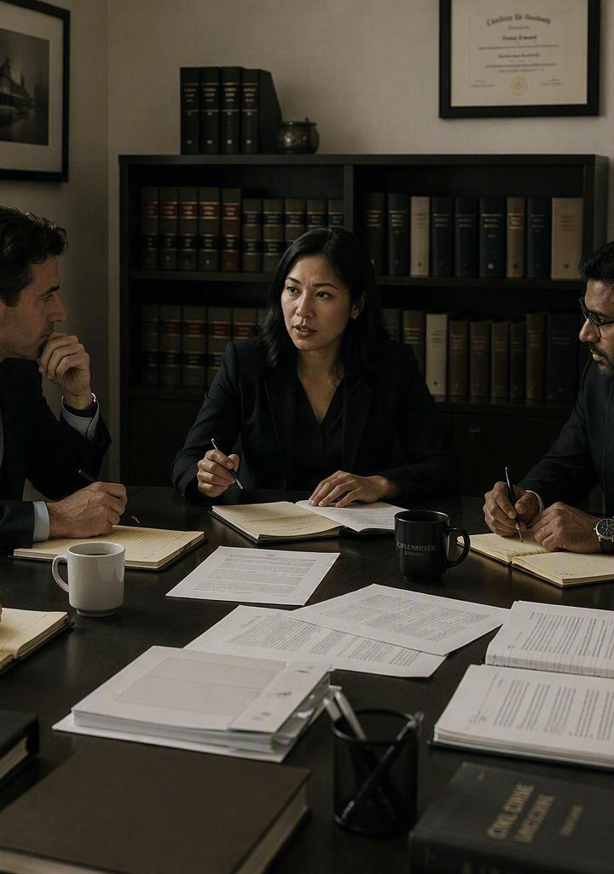
The Debrief
SECTION IV · BUILDING THE CASE
Every trial day ends with the team turning notes into the next move.
1
Review exhibits & notes
Walk back through what went in, what was said, and what the notes captured.
2
Prepare for closing
Turn the day's record into the threads the team will pull together in closing arguments.
Notes:
Building the case is continuous — it happens every evening, not just at the end. The debrief is where the investigator's work pays off: sit with the team, review exhibits and the notes taken, and shape it all toward closing arguments. Good notes make this fast and focused. Close the loop — the quiet preparation becomes the argument that wins.

Slide 21
Key Takeaways
THE QUIET FORCE IN THREE WORDS
Whatever the task, the investigator's job comes back to three things.
1
2
3
Prepare
Support
Protect
Subpoenas, the trial notebook, and jury research win the trial before it starts.
Track reactions, witnesses, technology, and every ruling as the day unfolds.
Reconcile and secure exhibits and notes, then debrief toward closing.
Notes:
Land the session with the three-word summary: prepare, support, protect. Prepare — the pre-trial work wins the trial before it starts. Support — during trial, be the second set of eyes and the reliable hands. Protect — secure the record and turn it into the closing argument in the debrief. If trainees remember nothing else, they should remember these three.

Slide 22
Preparation wins trials.
THE QUIET FORCE
From subpoenas to the debrief, the investigator is the partner who keeps the case organized, accurate, and ready — so the attorney can win the room.
Presented by
Shaveena Rogers · Whitney Hammons
Notes:
Wrap up. Recap the arc: prepare the ground, support in the room, protect the record, and build the case in the debrief. The takeaway for new investigators — you rarely get credit in the courtroom, but preparation is what wins trials. Thank the audience and open the floor for questions.

Slide 24
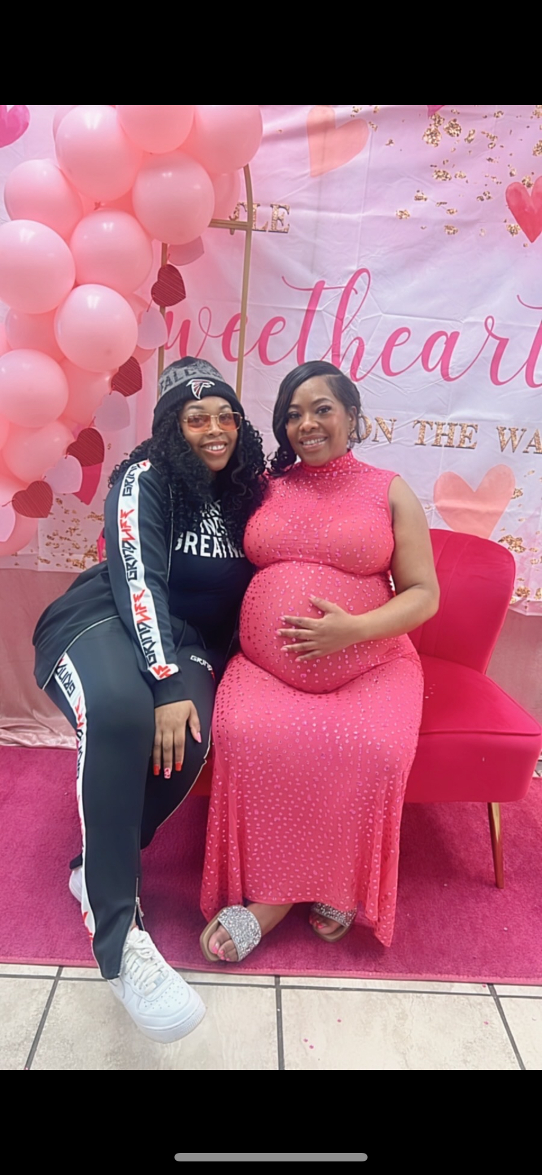
Thank you for attending
THE QUIET FORCE
Partners in Crime
Inv. Whitney Hammons
Inv. Shaveena Rogers

