Slide 1

Interlocutory appeals
GPDC Conference 2026

Slide 2

Rules and timelines
Making a successful application
Practice tips

Slide 3

When can I do an interlocutory appeal?
When decision or judgment is “not final” [OCGA 5-7-2]
The order/decision/judgement “is of such importance to the case that an immediate review should be had” [OCGA 5-7-2]
The State is allowed a direct appeal [OCGA 5-7-1]
  BUT defendant “shall be entitled” to “reasonable” bond pending the disposition of the appeal, except in cases punishable by death [OCGA 5-7-5]
Cross appeals: State can cross appeal when application for interlocutory appeal is granted; Defendant can cross appeal when State direct appeals
  Civil practice rules apply [OCGA 5-6-38]

Slide 4
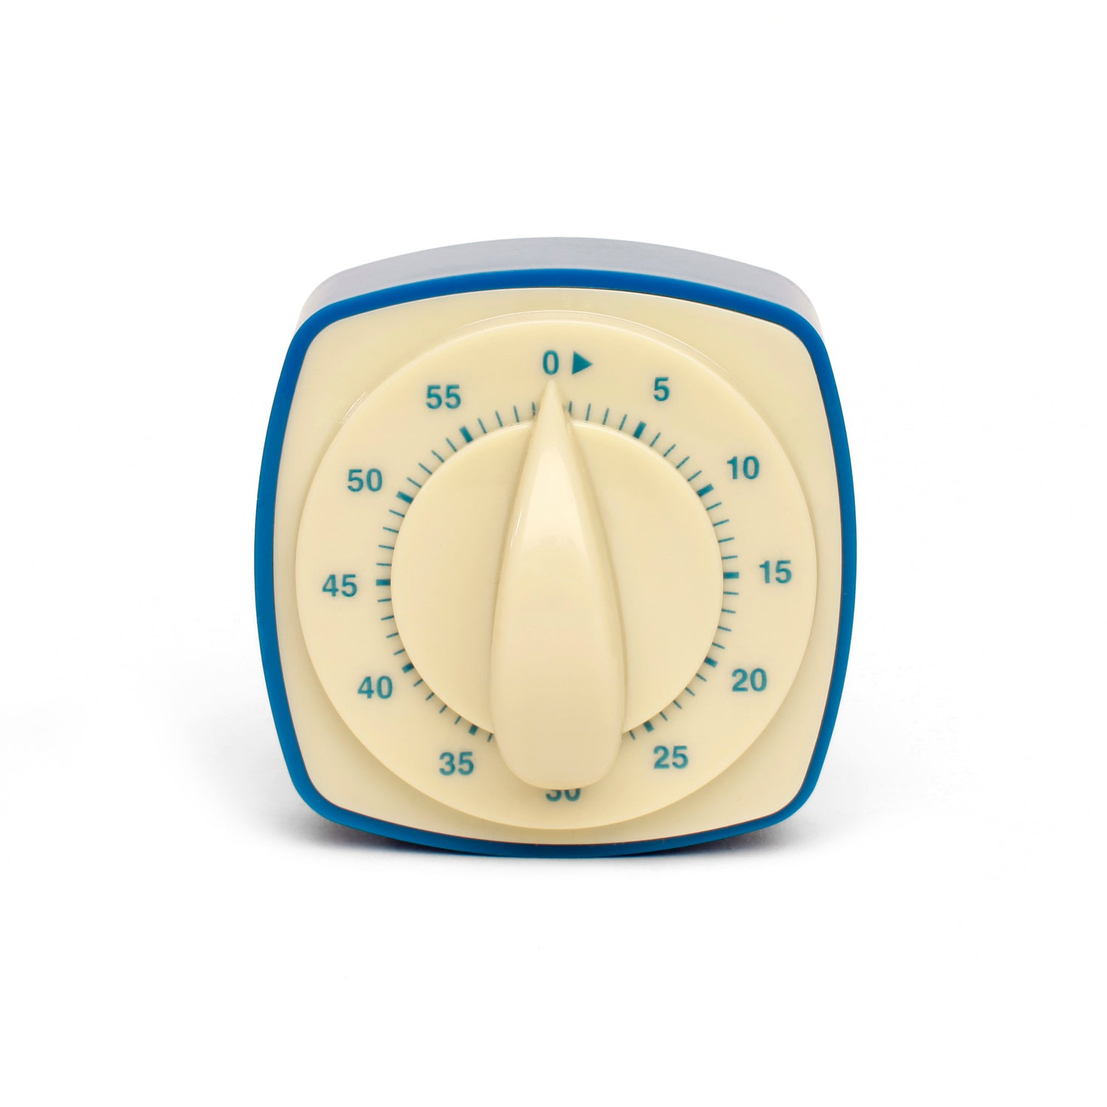
Timelines
Certificate must be issued within ten days from the order entering judgement [OCGA 5-7-2(a)]
  Judgement is entered when the order is filed [OCGA 5-6-31]
Application must be filed within ten days of certificate of immediate review [Rule 30]
State has ten days to respond (not mandatory) [Rule 30]
Court of Appeals has – days to grant or deny application
If order is issued granting appeal, ten days to file notice of appeal [OCGA 5-6-35 (g)]
If a deadline falls on a weekend or holiday, the deadline is extended to the next business day [Rule 3]
NO EXTENTIONS OF TIME ON INTERLOCUTORY APPLICATIONS [Rule 16]

Slide 5

Application for Interlocutory Review
Write your brief- go ahead and put all the work in here.
The Court of Appeals will not be guessing where you are going with arguments
They will fully understand your arguments at the application stage
Your research will already be done in advance of your brief due date

Slide 6

COA Style Rules
Must be searchable PDF [Rule 2]
Double-space [Rule 2]
Serif, 14-point or larger font [Rule 2]
Margins must be at least one inch [Rule 24]
Bluebook style citations
Number pages at the bottom [Rule 24]
14,000 word limit (excluding table of contents, cover sheets, certificates of service) [Rule 24]
$80 filing fee unless pauper’s affidavit [Rule 5]

Slide 7
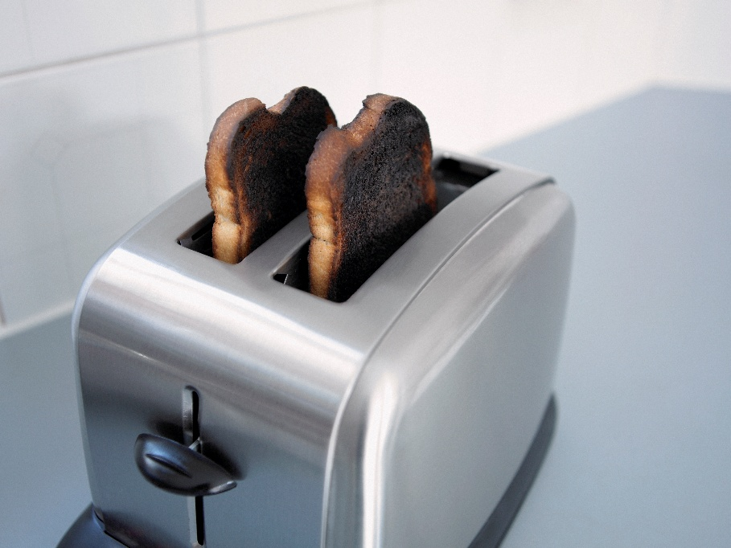
If your application is denied…
Stipulated bench trial
Try the case and get new information
Both avenues allow you to try again to get the attention of the Court of Appeals.
They may not give you much of a chance, but it exists.
Notes:
To preserve issue need trial. Can do a stipulated bench trial

Slide 8

And if it’s accepted- timing is everything
File brief within twenty days of docketing [Rule 23]
State’s brief must be filed within forty days of docketing or twenty days of Appellant’s brief, whichever is longer [Rule 23]
  State is required to file Appellee brief
Reply brief is not required, but may be filed within twenty days of Appellee’s brief
Once docketed, the COA has until the end of the next term of court to decide the case
  Three terms: first Monday in December to March 31; first Monday in April to July 17; first Monday in August to November 18

Slide 9
Appellate Briefs and Responses
For long or complex briefs, a table of contents and authorities, with page references
A concise introduction identifying the key issues and arguments
A concise jurisdictional statement, which must identify:
The basis for this Court’s appellate jurisdiction [OCGA 5-6-34 and 5-6-35]
The basis for this Court having jurisdiction instead of the Supreme Court [Ga. Cont. Art. VI, Sec. VI, Pars. II, III and OCGA 15-3-3.1]
That the appeal is timely [OCGA 5-6-38 and 5-6-39]
Enumeration of errors [OCGA 5-6-40]
Statement of the case—facts, procedural posture, preservation of error
For long or complex briefs, a summary of the argument .
Argument—include standard of review and follow the order of the enumeration of errors
Notes:
Steal the jurisdictional statement. You can use the same/a very similar one every time. Include an example in the materials

Slide 10


How to Get the COA to Notice You
It must be something that really makes a difference in this case
Would it be something that would eventually call harmless error in their opinion?
It needs to be hot and fresh. If it is an issue they have decided several times before then they probably are not going to grant your application.
We have had success with terrible cop behavior- they want to know about it.

Slide 11

Practice Tips
Less than Successful
Fischel [timeline issue—and how to fix]
Young [no good prong 3 issue]
More Successful
Abercrombie [bad cop]
Minor [recent case law needing clarification]

