Slide 1
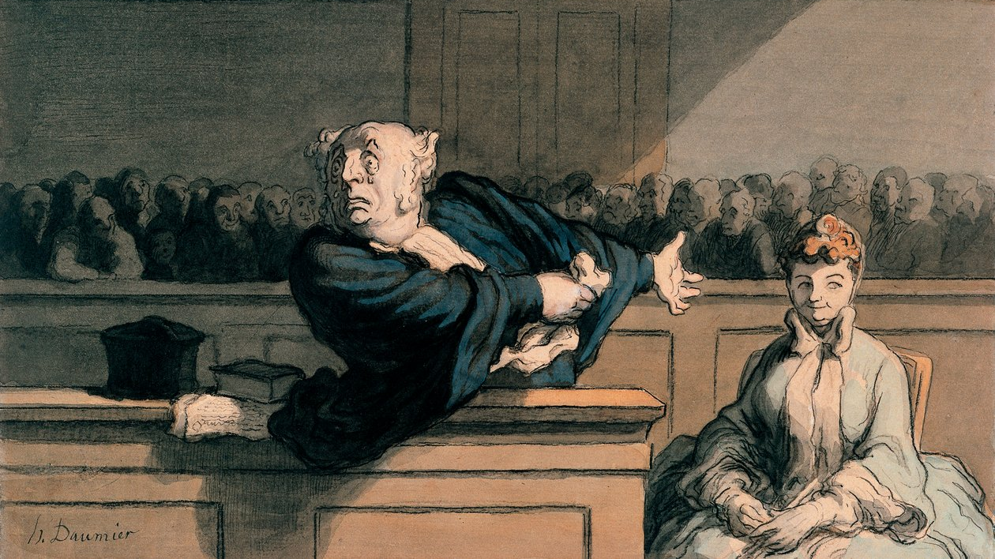
May the Best Story Win
Presented by Kyle Obiora
DeKalb County Public Defender
Persuasive use of themes and storytelling in Opening statements
Notes:
Tree example: to be heard is to exist

Slide 2

Notes:
Question for the room: what percentage of jurors make up their mind about the outcome of a case after opening statements?
Trick question: the research varies (some argue it’s as much as 80-90% and more modest studies indicate it might be more like 15-30%).
But there is good reason to believe that at least some jurors make up their mind before they ever even hear any evidence.
That’s why opening statement is so important.
Telling a compelling story in opening draws jurors in and frames everything that happens after that.

Slide 3
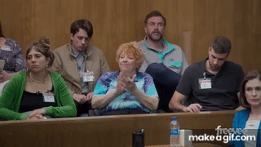
Notes:
Lean into the excitement jurors have to see some drama play out – bring the drama right to them!
Win your jury from the very beginning, draw them in, turn on the charm/charisma.
Mantra: the courtroom is my theater.

Slide 4
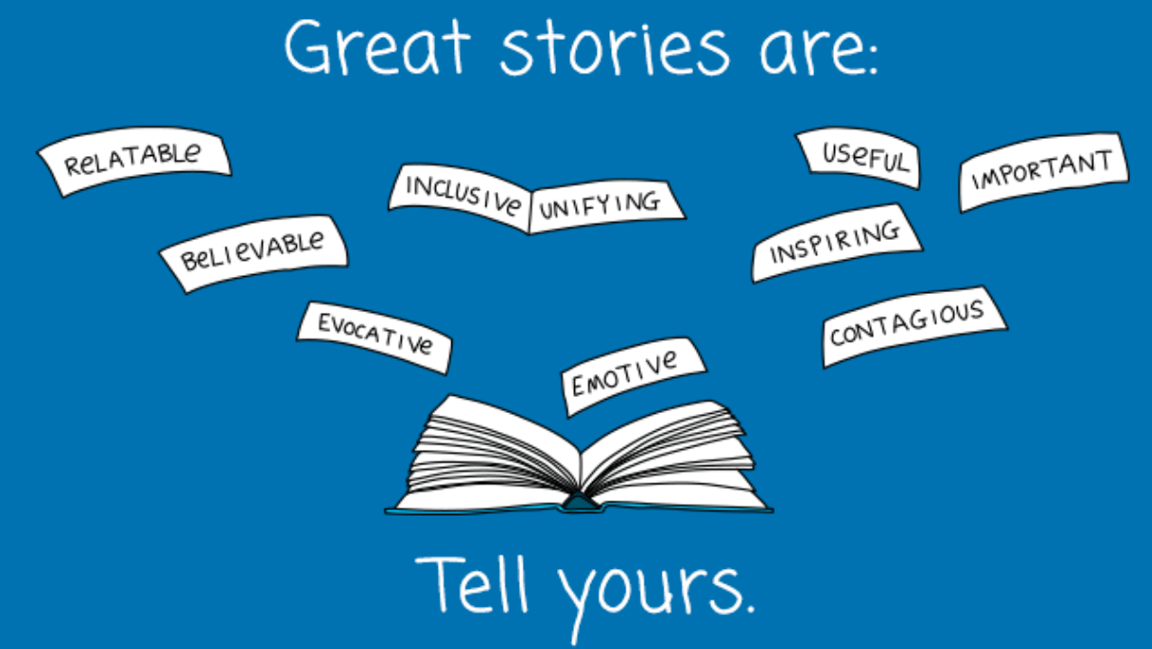
Notes:
Start with a story, not a statute.
Jurors remember stories—they don’t remember procedural language. A strong opening frames the case through a human lens from the very first sentences.
Clear, vivid, emotionally honest storytelling makes the strongest impression.
Make them care first, analyze later.
Before jurors weigh evidence, they’re asking themselves: Do I care? Do I trust this story? A universal, emotionally grounded opening invites them to lean in

Slide 5

Elements of a good story
Clearly defined theme & theory
Well-developed & concise
Faithful to your client
Appropriate for the listener
Vivid & conveys emotion
Notes:
Tell a story – whether it be about your client, the complainant, the police, etc.
In the tree example, the story was about the child witness.
Jane was deprived
Of the medical care she needed to keep her diabetes under control
Of adequate living conditions
Of the loving care that a child needs to thrive
Taken away from her mom and into DFCS custody. Despite all of her failures, Jane loved her mom and wanted to be with her.
“Jane’s mom showed her in a lot of ways that she wasn’t important to her, that she was easily-forgotten, that her mom didn’t care. But there was one thing her mom made very clear she did care about. Over the years leading up to Jane making the claim that brings us to this courtroom, her mother would ask her if anyone ever touched her sexually.”
When she first made allegation, it got mom’s attention and she was able to move back in with her.

Slide 6
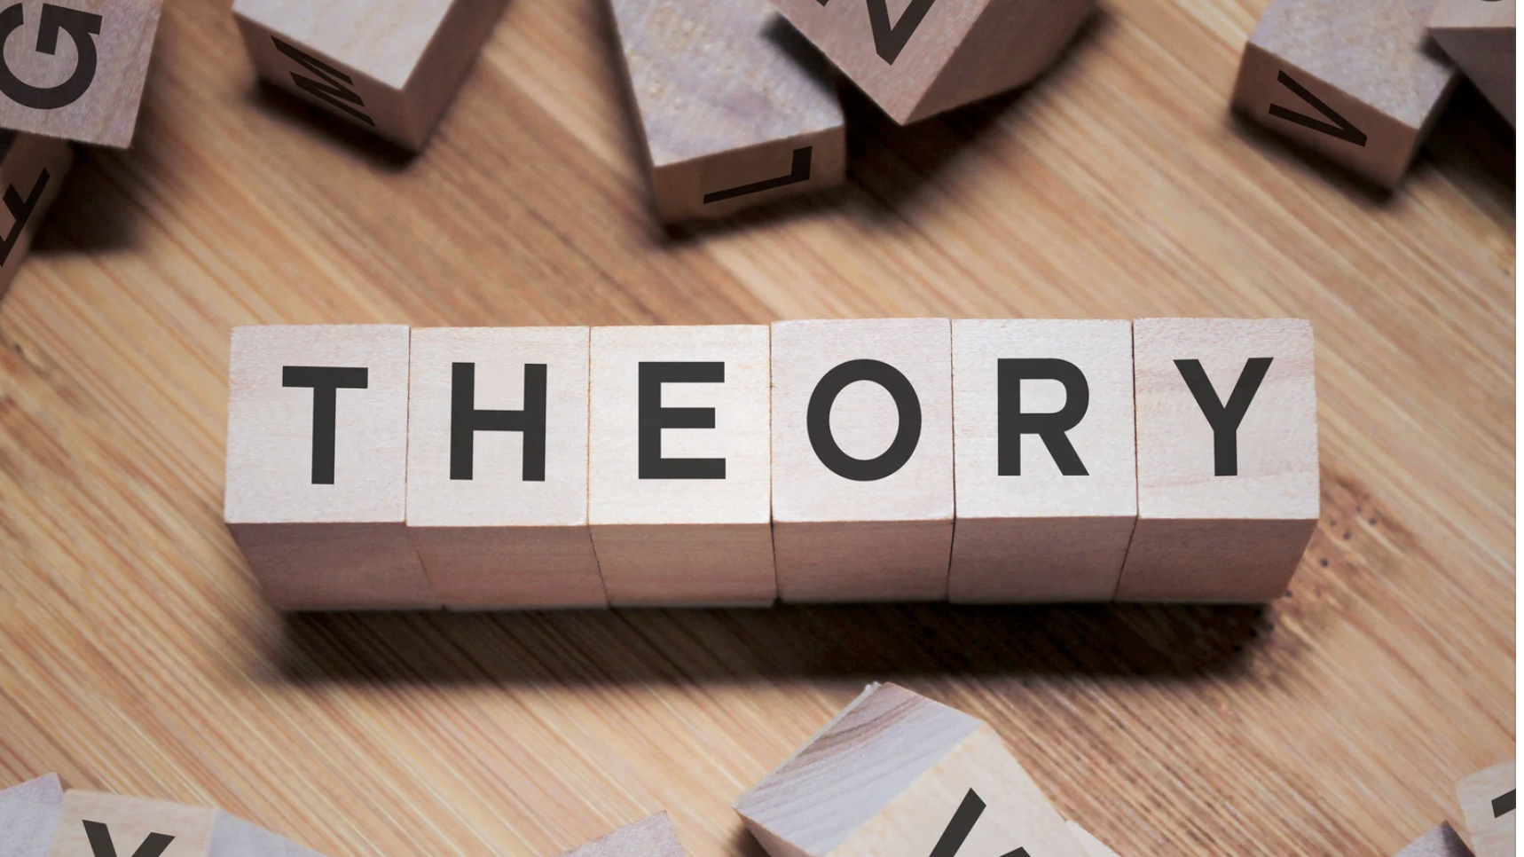
Notes:
Theory: the legal, factual, and emotional basis for why your client is not guilty
Your theory of the case should make sense to a smart friend who’s never set foot in a courtroom.
If you can’t explain the story of the case in plain language, clearly and quickly, then your jurors won’t get it either.
Strip out legal language and procedural framing.
Tell it simply, like a real story.
Sit down with someone outside the legal world. Tell them the story of your case in 90 seconds, as if you were telling them what happened in real life. If they can follow the story and tell you what the case is “about” afterward, your theory is probably clear.
If you find yourself saying, “Well, it’s kind of complicated…” that’s a red flag. Your job is to make it not complicated.
A simple, human story focuses your theme, shapes your fact selection, and guides your cross and closing. If your theory isn’t clear enough for a friend to grasp, it’s not ready for a jury.
Your theme should answer the major “why” questions
When you talk about your case with your colleagues, friends, partner, what are the first questions they ask you? Your theory of the case should answer those questions.
Tree example: why did she say it if it weren’t true?
Had to find an eloquent and delicate way to say she lied for attention.
Don’t save your arguments for closing!

Slide 7
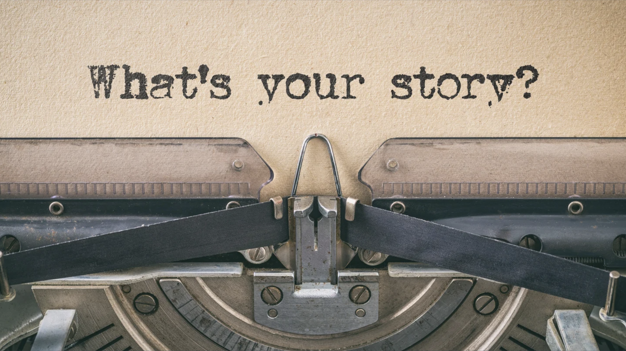
What happened and why?
Notes:
Before you layer in theme, rhetoric, or persuasion, you must be able to answer, plainly and directly:
What happened?
To who?
Why are we here?
If you can’t answer these in one or two clean sentences each, your story isn’t ready for jurors.
What happened is the core event — told like a human story, not a legal summary.
Jurors need to understand the key action that led to the case, simply and visually.
To who centers the story on real people, not legal labels.
It reminds you to humanize your client and orient jurors quickly.
Why are we here frames the conflict — the reason this has become a criminal case.
This gives jurors the narrative stakes.
Jurors need orientation before argument.
These three answers give them a solid mental framework they can follow as the evidence comes in.

Slide 8

Notes:
Theme: catchphrase that jurors will recall that incorporates your theory
Your theme is more than a catchy line — it’s the emotional reason the jury should stand with your client.
As public defenders, we’re often fighting uphill battles against state narratives. A strong theme cuts through legal complexity and focuses the jury on what really matters.
It gives jurors a hook they can take into the deliberation room.
Jurors won’t repeat your legal arguments verbatim, but they will repeat your theme if it resonates.
Illusory truth effect: repeating something, regardless of veracity, gets people to believe it.
Introduce immediately, reinforce throughout entire trial, and drive it home in closing.
When every part of the case points to the same emotional truth, the jury starts to feel the defense story, not just hear it.
Tree example:
When Jane first said that John did something to her, she quickly learned that her mom wasn’t the only one who would pay attention to an allegation like this. Other family members got involved. DFCS got involved. Eventually, law enforcement got involved. Jane started seeing a therapist. People were coming to her home and asking her if she was ok. Jane existed.
Reinforces theme (to be heard is to exist)
Furthers theory by answering a major why question: ok well that may all be true about her mother, but why would she lie to everyone else?

Slide 9
Trilogy | Dreams. Delusions. Disaster.
Contrasts | She drank. She didn’t drive.
Rhyme | Would’ve. Could’ve. Should’ve.
Rhetorical Questions | Why would someone who was guilty call the police?
Appeal to Common Standard | We all expect the police to get the facts before they charge someone with a crime.
Alliteration | Fast and flawed.
Notes:
Examples from my own practice:
Quote: “I beat her mama’s ass”
Rhyme: A house in transition, roommates in addiction, a package in its original condition
Alliteration: Ripped off and run over
Appeal to Common Standard: A mother’s instinct is to protect her child

Slide 10
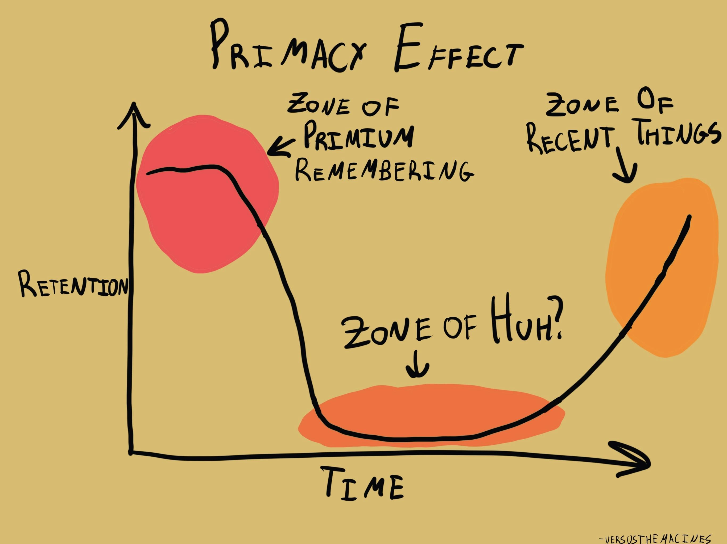
Notes:
Primacy and recency are psychological anchors.
Jurors are most alert and impressionable at the start and end of a presentation. What you say in those moments carries disproportionate weight. The middle tends to blur.
The opening moments of your opening are golden.
Use them to frame the narrative, establish your theme, and build trust. If you spend those first precious seconds thanking the jury or listing procedural points, you’ve wasted a major persuasive opportunity.
→ Start with your story and the emotional reason you win.
The end is your echo.
Whatever you say in your final lines will linger as jurors shift from listening to processing. It’s your chance to lock in the theme and leave them with a moral touchstone they’ll carry into deliberations.
The middle is a danger zone.
Jurors may tune out or lose track, especially during lengthy fact recitations. Don’t put your most important point in the middle and hope they’ll remember it later—they won’t.
Your theme is going to be persuasive and argumentative by its nature. Using it and explaining at the beginning and end generally won’t draw objections.

Slide 11
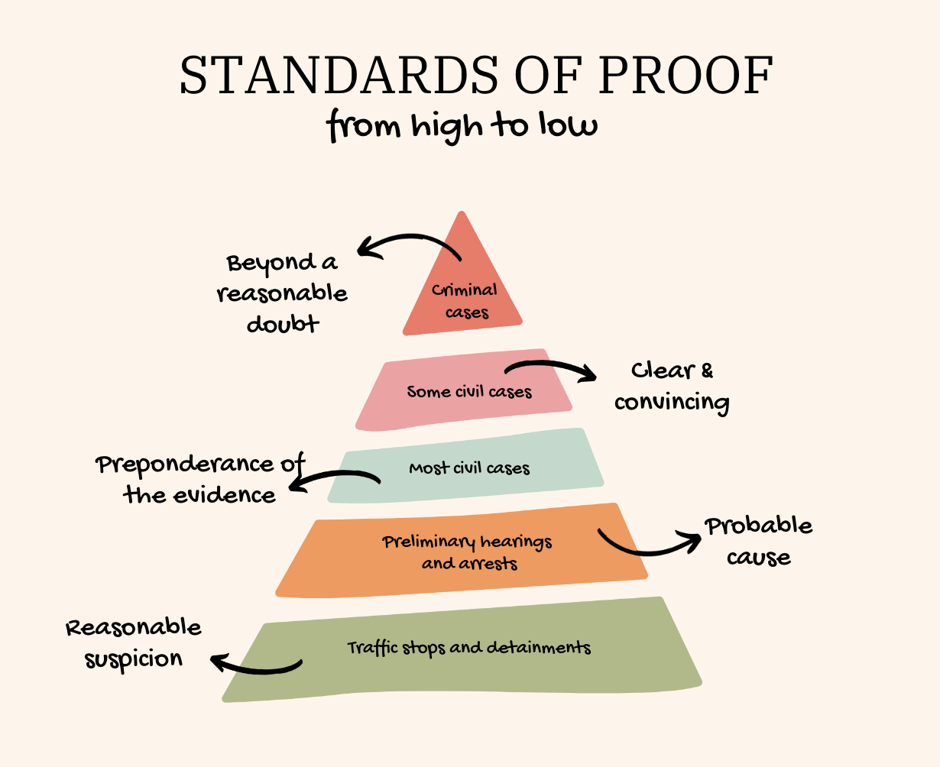
Notes:
Discussing reasonable doubt
Talk about how high the burden is and then explain why it’s so high: preventing wrongful convictions.
The state has the burden of proof: beyond a reasonable doubt. It’s the highest in entire justice system.
Some judges might let you get away with making comparisons about different burdens in different scenarios or using a visual like this one – consider your approach.
“The reason the state has such a high burden is to protect people who are innocent. Because we don’t want to convict someone who maybe did or probably did it – that’s not good enough.
One of the things our legal system tries to do right is that we try to make sure innocent people don’t get convicted of things they didn’t do. At the end of the day, that’s your job as the jury. Hold the state to their very high burden: beyond a reasonable doubt.”
“It’s so important to have this high burden because sometimes the government makes mistakes. The IRS miscalculates. The DMV makes typos. Here the government has made a horrible mistake.”

Slide 12
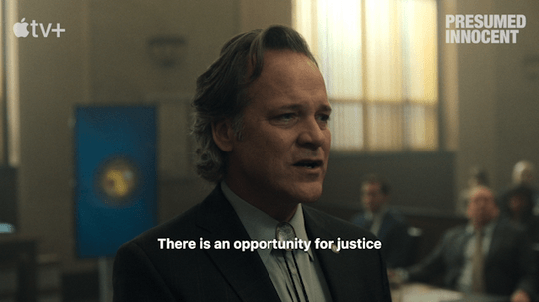
Notes:
Tie the burden to the presumption of innocence
“If you have any reasonable doubt at the end of this trial, any at all, that is an innocence safeguard – that is your cue not to convict an innocent man.”
“You’re the very first people to apply the presumption of innocence in this case. The police who arrested Mr. Smith and the prosecutors who charged him never applied the presumption of innocence. It’s so important that you apply that presumption now.”
Make the juror feel important. Give them a lot of weight to carry.
Tree example:
“Not only is Mr. Jones in fact innocent, but he is presumed innocent by law. Unless/until the state proves to you to the extent that you do not have one single reasonable doubt in your mind at the end of this trial, then that presumption of innocence translates to a not guilty verdict.”
The key: jury needs to be convinced that you actually believe this.
Move away from your notes and speak from the heart. Say it with conviction – you want the jurors to know that 1) you believe it, and 2) it matters.
Because innocence is so powerful, we’re starting with it and ending with it.

Slide 13
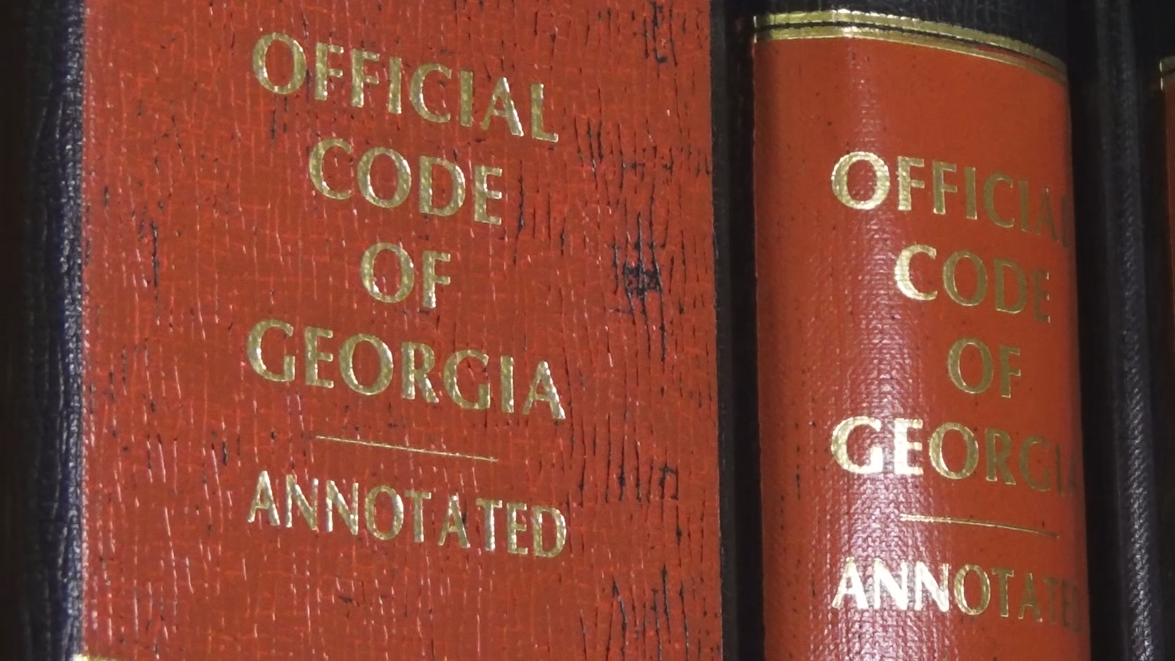
Notes:
To discuss the law or not to discuss the law – aside from the burden.
You don’t need to.
It can be distracting and confusing and take away from your ability to persuade.
You can lean on your story, introduce the key players, and let the jury know that later you’ll get back up there and talk about why the state hasn’t met its burden.
You’ll have a chance to argue the law in closing.
If you decide to discuss the law in opening, follow these rules:
Simplicity is power.
Jurors are not lawyers. They’re trying to make sense of the story while managing a flood of new information. If your opening is cluttered, legalistic, or too complex, they will tune out and remember less.
Clarity beats cleverness every time.
We don’t need to sound like law professors. We need to sound human, honest, and clear.
Avoid legal jargon and over-explaining.
Most legal terms are confusing and forgettable. Instead, translate your ideas into plain, conversational language jurors can understand and repeat.
Simplicity makes you memorable.
If jurors can repeat your theme and basic story to each other in deliberations, you’ve done your job

Slide 14

Notes:
You are not obligated to use every fact.
One of the biggest mistakes defenders make in opening is feeling like they must include everything they know—every timeline point, every witness detail, every procedural step. That’s not your job. Your job is to build a clear, persuasive narrative. That means selecting facts carefully.
Highlight facts that support your theme and theory.
Your theme is the lens through which you want jurors to see the case. Every fact you choose should either reinforce that theme or help jurors build the structure of the story.
If it doesn’t move your story forward or fit the theme, cut it.
Emphasize memorable, vivid details — not trivia.
Jurors retain details that are visual, emotional, or surprising. These are the details that create mental snapshots.
Tree example:
“One time Jane was hospitalized for weeks, and her mom didn’t come to see her. When it was time for her to be discharged, the hospital couldn’t get in touch with her mom, so Jane stayed an extra week by herself.”
Advances my theory of the case because it shows just how much her mom didn’t care about her, which was a significant part of our theory.

Slide 15

UNNECESSARY DETAIL
Notes:
Unnecessary Detail Example:
Procedural facts like timestamps, street names, and who spoke to whom are the kinds of details lawyers care about — but jurors don’t retain them. They clog the opening and drown out the theme.
Edit ruthlessly.
Clutter dilutes power. The more unnecessary facts you include, the less weight the important ones carry.
Strategic emphasis matters.
You can’t emphasize everything. Jurors will remember what you highlight, slow down on, repeat, or anchor with story and movement.
While we’re on the topic of unnecessary detail, let’s talk about PowerPoints:
Use them
Minimal words
Images from discovery, snapshots of bodycam, diagrams, etc.
Tree example:
PowerPoint was only 3 slides and 2 of them were just a black screen.
Only used PowerPoint for timeline visual. Allegations were over a period of several years, lived in different houses, different outcries, etc.

Slide 16

Notes:
The first moments of your opening are primacy gold.
Jurors are alert, curious, and forming first impressions. What you say right now sets the frame for everything they’ll hear next.
Thanking the jury is polite but pointless at the top.
You can thank them later—closing is a better place for that.
Talking about the importance of jury trials isn’t why they’re here.
The beginning is when you can hook the jury emotionally, set the theme, and start telling your client’s story. Don’t trade that away for pleasantries.

Slide 17
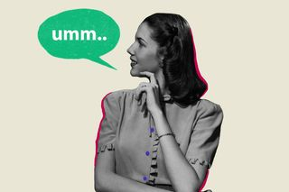
The evidence will show…
Notes:
“The evidence will show…” is a verbal crutch.
Lawyers use it to sound proper and careful — but jurors hear it as filler. It creates distance between you and the story, and it makes your opening sound like you’re reading from a transcript.
Just tell the story.

Slide 18
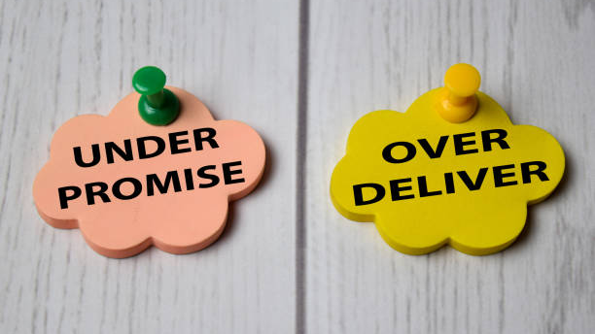
Notes:
If you’re going to include something in your opening, make sure you have a way to back it up.
Do you know for a fact it will come through one of the state’s witnesses? If not, do you have a way to get it in front of the jury?
If you can’t follow through with something you committed to in opening, the jurors will have questions.
There are some details that no one will question. E.g., if you mention in opening that your client has been working at the chicken plant for 10 years to provide for his family, and you ultimately don’t get this onto the record through the course of trial, you’ll probably be ok. This detail humanizes your client. If the state gets up and spends time in closing argument talking about how you didn’t prove that detail, they’ve already lost.

Slide 19

Notes:
Flag things for the jurors to keep an eye out for
When you know something is going to come in to evidence and it’s helpful for your case, tell them to pay attention to it. That way when it’s happening, they’ll remember this is important and I need to lock in.
Tree example:
Forensic interview: “Pay attention throughout the interview to the inconsistencies in Jane’s statement. Pay attention to her body language, her demeanor.”

Slide 20
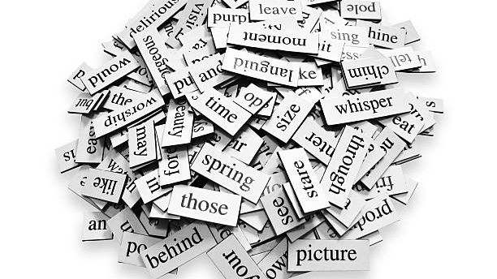
Notes:
Word choice is one of your most subtle but powerful tools.
Jurors build mental pictures as you speak. The specific words you choose are the raw materials for those images. If you don’t choose carefully, the state’s framing fills the gap for you.
Small shifts in language can dramatically reframe a fact.
Consider:
Client: “John” vs. “Mr. Smith”
Sometimes calling your client by their first name humanizes them.
If, for example, you want the jury to see your client as a respected, hard-working father, maybe you call him Mr. Smith.
If you want them to see your client as a relatable, brotherly young person, you might refer to him as John.
“Accident” vs. “Crash”
Accident suggests something unforeseeable, blameless, maybe unlucky.
Crash sounds violent, preventable, and consequential.
Which one fits your theory? Which one subtly shapes jurors’ emotional reaction?
“Pushed off” vs. “Fought”
Pushed off sounds defensive, measured, even passive.
Fought back sounds aggressive, intentional, maybe angry.
The difference in connotation changes how jurors understand the client’s role.
These differences are not semantic nitpicks—they are framing choices.
Be intentional, not careless.
Don’t mimic the police report or the prosecutor’s phrasing out of habit. Choose your own language deliberately to match your theme, tone, and story structure.
Jurors remember emotionally loaded words.
They may not recall dates or procedural details, but words like crash, fight, attack, ignored, trapped, or assumed stick. They shape the jury’s emotional map of the case.

Slide 21
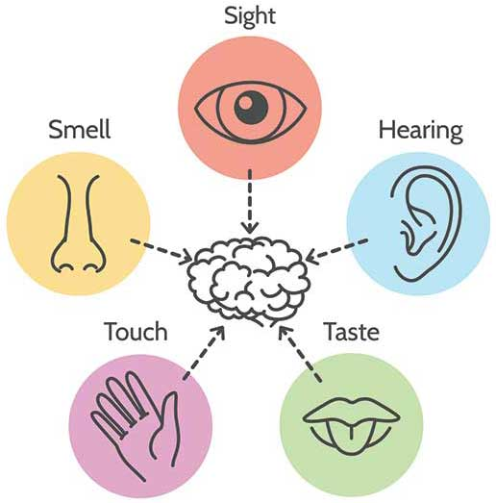
Notes:
Use sensory detail to draw the listener in
Vivid, concrete sensory details about what a witness could or couldn't have seen or heard can undercut the prosecution's account very effectively
Tree example:
Police came to the house that Jane was living in with her mom.
Hit by a terrible smell as soon as they opened the door.
Cockroaches all over the floor and the walls and inside the refrigerator.
No food in the house that wasn’t rotten and moldy.
Rats in the bathroom.
Baby face down in a crib wearing a diaper that hadn’t been changed in a week.

Slide 22

Notes:
Jurors don’t remember everything you say — they remember moments.
When you move intentionally as you speak, you create physical anchors in the courtroom that jurors associate with specific ideas, facts, or turning points. These are “memory pockets.”
If you talk about different phases of the case, different witnesses, or different themes, you can assign physical locations to those elements.
Example:
Far left of the well → “The night everything happened.”
Center → “The investigation.”
Right → “What the evidence really shows.”
Strategic movement marks transitions.
Shifting your position when you move from one part of the story to another tells jurors: pay attention, we’re shifting gears.
This keeps their focus.
It also prevents your opening or closing from feeling like one long, undifferentiated speech.
Movement reinforces theme.
Example: In a case about a rushed investigation, you might step forward suddenly on the line, “They decided first—” and then step deliberately to another spot as you say “—and looked for evidence later.”
The movement visually underlines the contrast, creating a moment jurors remember.
Don’t wander aimlessly.
Pacing or drifting distracts and drains energy. Movement should feel purposeful, driven by the story, not by nerves. If you don’t know why you’re moving, stand still.

Slide 23
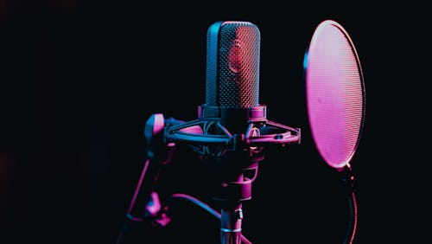
Notes:
Memory pockets work best when combined with vocal variation.
When you pair physical movement with pitch, pace, or a well-timed pause, the moment lands even harder and sticks longer.
Pitch & Pace & Pause — Control the Room
Pace: Slow down for key moments; speed up slightly to build momentum.
Pitch: Vary tone to emphasize emotion and keep attention.
Pause: After a key fact, pause—let the silence do the work.
Strategic pauses let important points land.

Slide 24
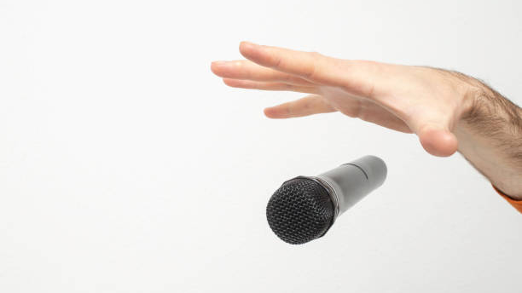
Notes:
The “ask” is one of the most important moments in your trial.
At the end of opening or especially in closing, you must tell the jury exactly what you want them to do.
Be clear and direct.
Tree example:
Jane is a victim – of neglect, of awful parenting, of the system
We don’t blame her
Jane deserved to be cared for, to be acknowledged. These allegations are a cry for someone to notice her existence, and she deserves that too
But unfortunately, John is also a victim
He’s caught the ricochet effect; he’s the collateral damage of all of this
Jane’s life matters. John’s life matters too
You have the power to prevent any further victimization, to save an innocent man
Not guilty
Jurors take their cue from your confidence.
If you seem hesitant, they’ll doubt. If you sound firm, they’ll listen. They expect you to believe in your client and your case. Your delivery should show that belief without hesitation.

Slide 25
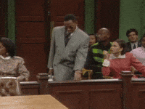
Notes:
Take risks. Dare to try something new.
The courtroom is your theater. You are both the performer and the director. You get to decide where to linger, what are the decisive moments of your story, whose POV it’s told from, what tense.
Prepare. Memorize. This is the one part of trial that should be completely predictable. Take advantage of that.
Walk into the courtroom confident and ready to capture the jury’s attention.
Buy in to it. Believe in it. Sell it.

