Slide 1
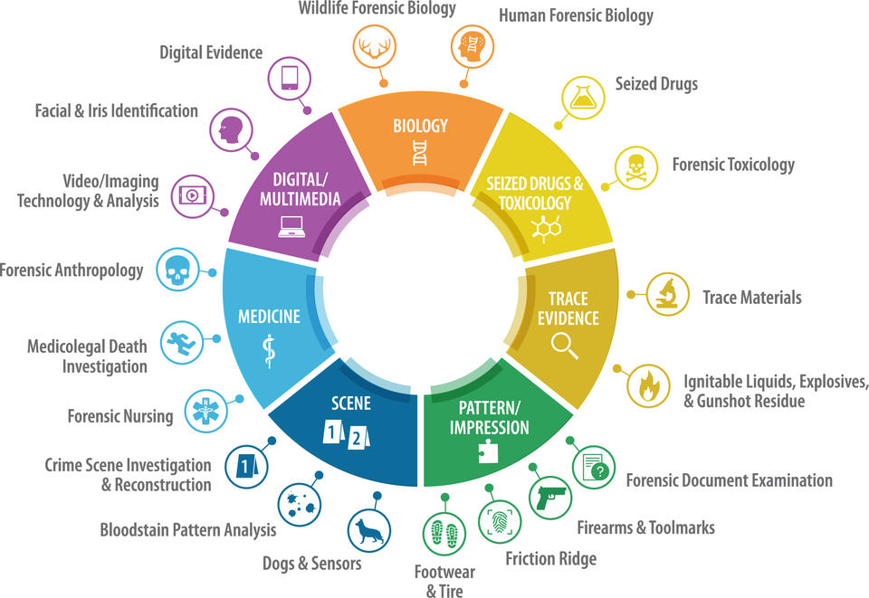
Forensic Science
Issues in Serious Cases
By:
Mary Dayton
Notes:
All of the OSAC (Organization of Scientific Area Committees) in Forensic Science there are 19 sub-committees
OSAC subcommittees bring together subject matter experts and other relevant stakeholders to identify, draft, and review discipline-specific standards.

Slide 2

Forensic Science Issues in Serious Cases
In serious cases, forensic science can become the engine that drives guilt.
The defense lawyer’s job is not to become a scientist overnight. It is to know where forensic science evidence tends to go wrong or be overstated.
Notes:
Every criminal case presents unique forensic challenges. Sometimes the evidence is old or degraded. Sometimes there are multiple analysts, conflicting opinions, scene reconstruction issues, or interpretation of medical findings.
Regardless of the type of case, forensic evidence can sound far more certain than it really is. Our job is to slow it down, examine its limits, and ensure the jury hears not only the conclusions, but also the assumptions, uncertainties, and limitations behind them.

Slide 3
Why Forensic Evidence Matters
Jurors often treat forensic evidence as uniquely trustworthy and objective
Weak/overstated forensic evidence can anchor an entire case
Serious cases can often involve older or degraded/complex evidence
Notes:
Every criminal case presents unique forensic challenges. Sometimes the evidence is old or degraded. Sometimes there are multiple analysts, conflicting opinions, scene reconstruction issues, or interpretation of medical findings.
Regardless of the type of case, forensic evidence can sound far more certain than it really is. Our job is to slow it down, examine its limits, and ensure the jury hears not only the conclusions, but also the assumptions, uncertainties, and limitations behind them.

Slide 4
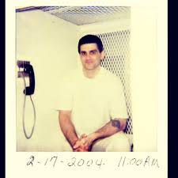
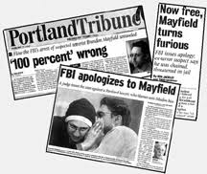
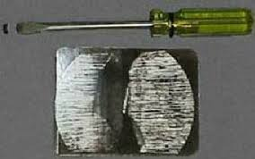
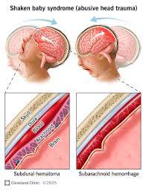
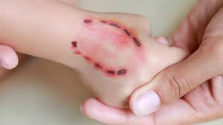
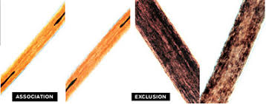
Notes:
Misapplied forensic science contributed to more than half of our wrongful conviction cases and nearly a quarter of all wrongful conviction cases since 1989.
Over the years, DNA testing and advances in forensic science disciplines have revealed weaknesses in the scientific foundations of several methods that were once widely accepted by the criminal legal system and used to help secure earlier convictions. These methods include:
Bite mark analysis*
Hair comparisons – FBI and Innocence Project joint task force in 2015 to notify clients about wrongful testimony in cases / mis or overstated “matches” – DNA proved they were wrong
Tool mark evidence
Arson investigation
Fingerprint analysis
Dog scent evidence
Comparative bullet lead analysis
Shaken baby syndrome diagnosis
Bloodstain pattern analysis

Slide 5
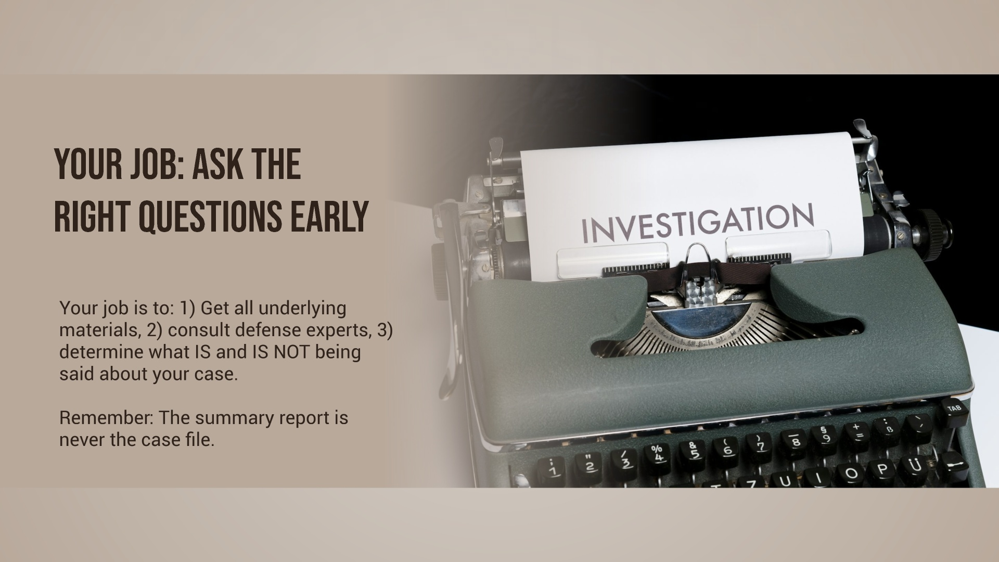
Notes:
Finally, our role is to build a record. Even when the court allows forensic evidence to come in, we need to preserve our objections and ensure the limitations of the science are clearly documented. Scientific evidence should never go unexamined simply because it appears technical or intimidating.
Our job is to make sure the science stays within its real limits and that the jury hears not only the conclusions, but also the uncertainty, assumptions, and weaknesses beneath them.

Slide 6
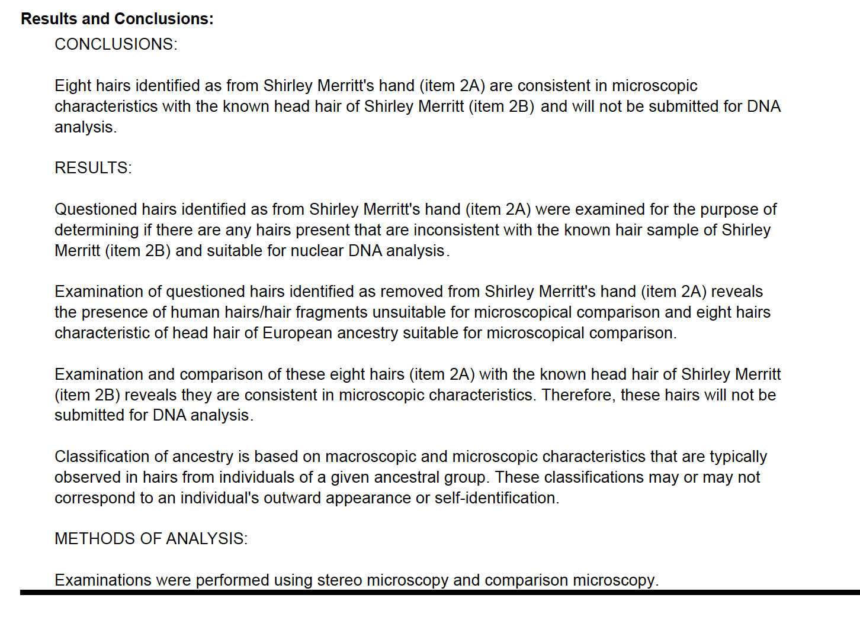
GBI in 2022
Notes:
This is a summary report – on hair microcopy – done on a case in 2022
Question – what is wrong with this report from a defense perspective?

Slide 7
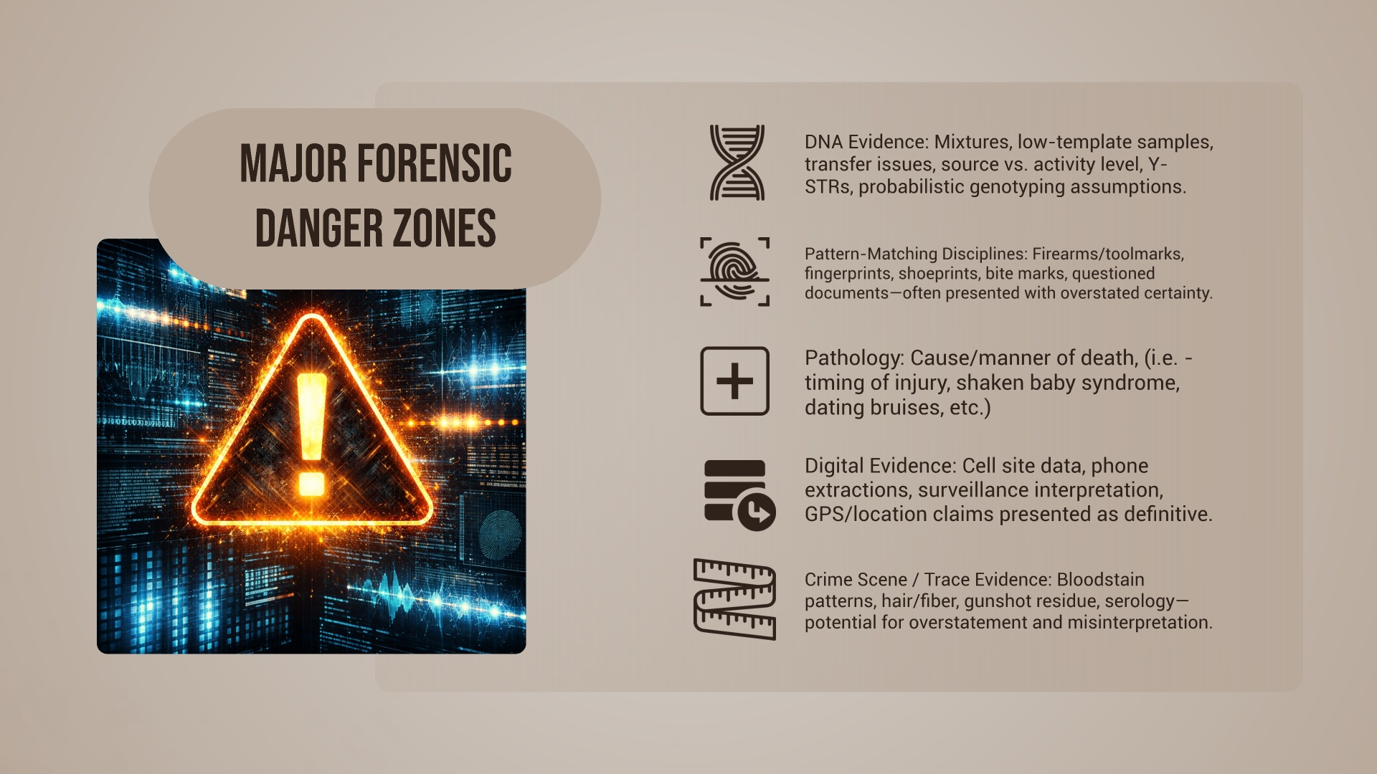
Notes:
The first major category is DNA evidence. DNA can be powerful, but it is not always simple. Problems often arise with mixtures, low-level or degraded samples, transfer issues, Y-STR testing, and conclusions that sound stronger than the data actually supports. A DNA result may answer one question while leaving several others unresolved.
The second category is what I would call pattern-comparison/matching evidence, such as firearms, fingerprints, shoeprints, tire impressions, or other forms of examiner comparison. These disciplines are often presented with a great deal of confidence, but involve human subjective interpretation.
The third category includes pathology, medical, and cause-of-death evidence. In capital cases, these opinions can be extremely influential, especially when the prosecution uses them to create a clean narrative of what happened, when injuries occurred, or what caused death. Argue – do we need manner of death? Invade the province or the jury? Homicide? SBS/AHT – telling the jury that your client is guilty of a crime
And finally, there are other technical areas like digital evidence, cell site analysis, bloodstain pattern evidence, gunshot residue, trace evidence, and scene reconstruction. The common thread through all of these categories is that they can sound highly scientific and highly certain, even when there are significant limits, judgment calls, or unanswered questions underneath them.

Slide 8
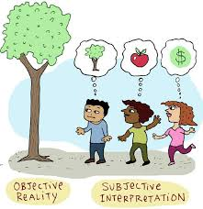
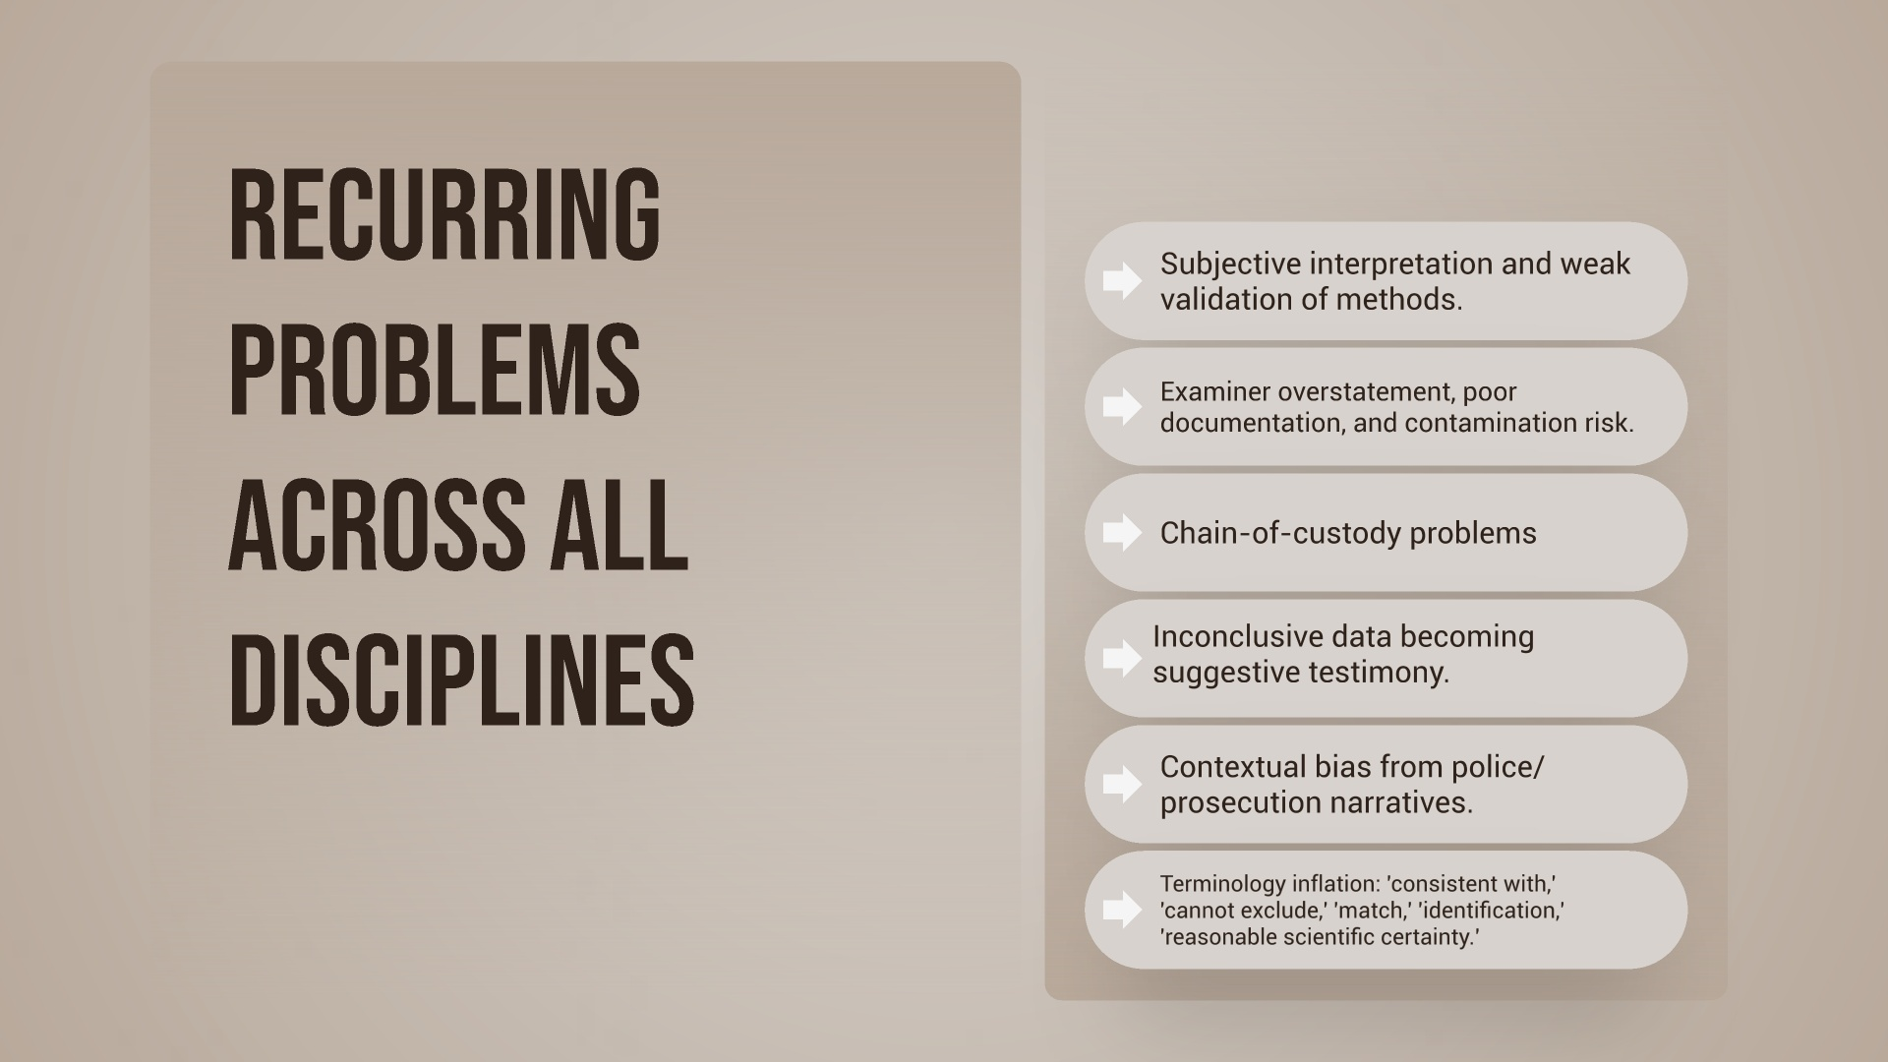
Notes:
Many of the underlying problems are actually the same. (see slide) why does this happen?
When jurors hear ‘crime lab,’ they assume a uniform system with mandatory national standards. That assumption is wrong. In reality, forensic oversight in America is patchwork
First, there is no single national licensing system for forensic scientists.
Second, lab accreditation is not the same thing as examiner competence.
Third, even where credentials exist, they are often voluntary, uneven, or discipline-specific.
Forensic evidence often sounds standardized and scientific, but across the United States there is no single national rulebook that requires every crime lab to have the same certification, the same training, or the same quality controls. Some labs and examiners are excellent and highly accredited. Others are not. In many places, accreditation is encouraged rather than universally required, and individual examiner certification is often optional rather than mandatory.

Slide 9
Where do I begin?
OSAC
NIST Foundation Reviews

Slide 10
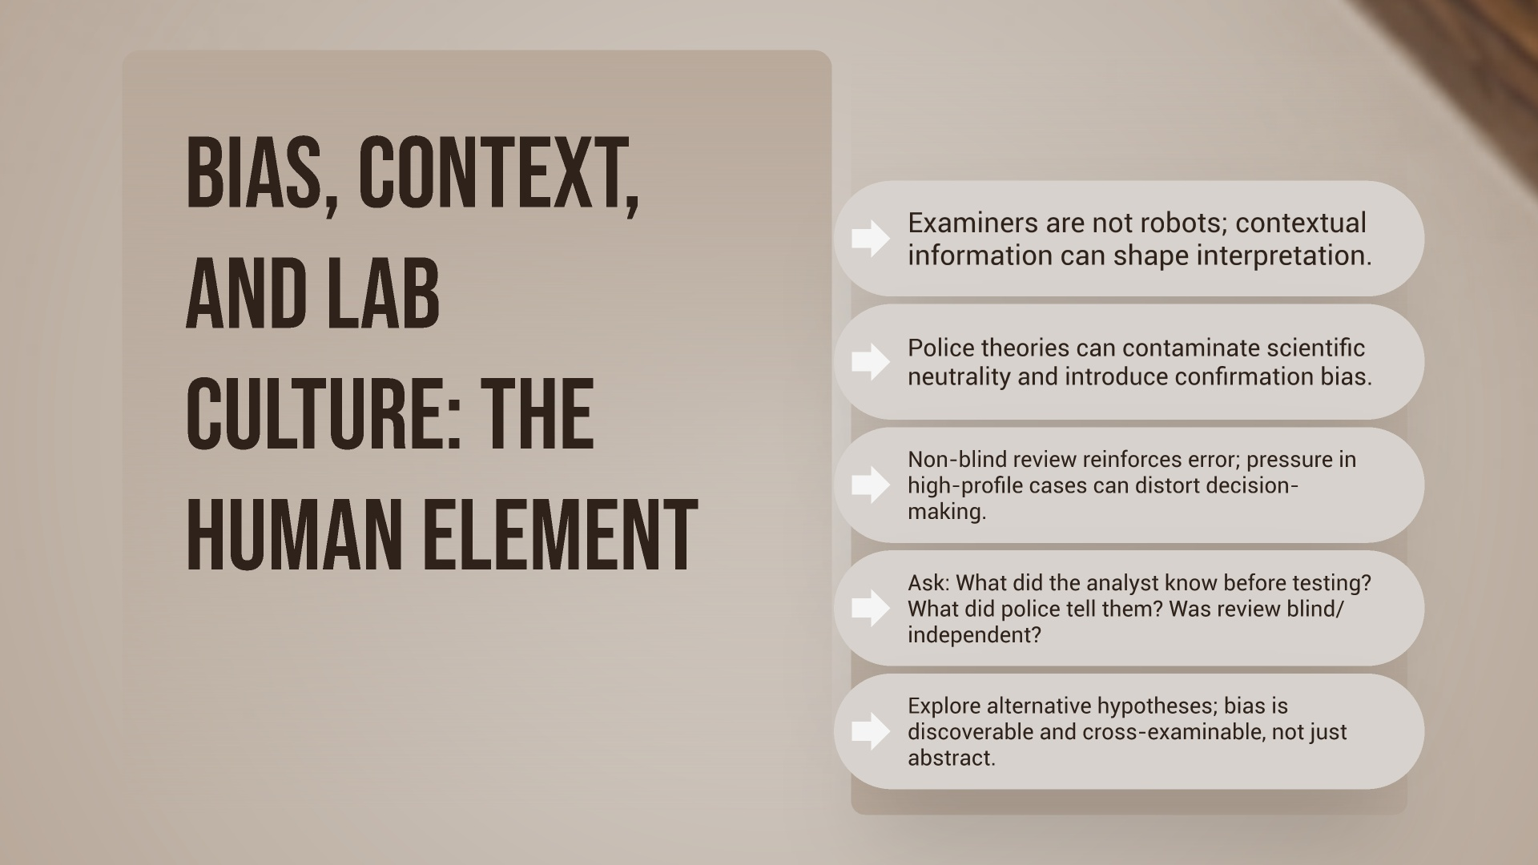
Notes:
critically important, but often invisible to jurors: forensic evidence does not interpret itself.
Behind every report is a human being working in an institution, often with information from law enforcement, under time pressure, and inside a system that may rewards conclusions that fit the prosecution’s theory. They have letters in their permanent file thanking them.
One of the biggest concerns here is contextual bias. If an analyst knows the police suspect, knows the prosecution’s theory, or is told facts suggesting guilt before conducting the analysis, that information can influence how ambiguous results are interpreted.
The same concern applies to non-blind review, where a second examiner is not truly independent because they already know the first analyst’s conclusion or the theory of the case. GBI does not do “blind-reviews”.
Lab culture matters too. In high-profile homicide and capital cases, there can be tremendous pressure to produce results, confirm a theory, or present findings in a way that sounds strong and courtroom-ready. Sometimes that pressure shows up in what gets tested –
For defense counsel, this means bias is a practical litigation issue. We should be asking what information the analyst had, when they had it, how the review process worked, whether alternative explanations were considered (this matters a lot with likelihood ratios) , and whether the lab’s procedures were designed to reduce bias or simply to ratify conclusions. (some labs do this now – not GBI)
The question is not only what the analyst concluded, but what they knew, what they were told, and what institutional pressures may have shaped the path to that conclusion.

Slide 11
Wall of Shame
Brookhaven PD on GBI Evidence submission form (2022): “Suspect is BM; sister witnessed the rape; suspect refused to provide a statement and retained an attorney”
DeKalb DA Investigator email to GBI Forensic Biologist (2017): “The ME won’t call this a homicide – so it is up to you now.”
Sr. GBI Biologist during EMNT Hearing (2022): “So according to the policy at the time and when we re-reviewed the cases for the CAR in 2018, her case -- her work did not violate the policy, so there was no step that she did that she wasn’t supposed to or didn’t do that she was supposed to do. Hindsight, looking at it now in, you know, 2022 or 2021, we see the problems of that CPI probably never should have been applied to that data. But, again, I said the policy wasn’t robust enough to prevent her from using CPI on the data.”
Sr. GBI Biologist during Trial (2024): Yes, the TrueAllele results matched a retired GBI agent (who had nothing to do with the case) – but we did not report those results because we could not replicate them.*

Slide 12
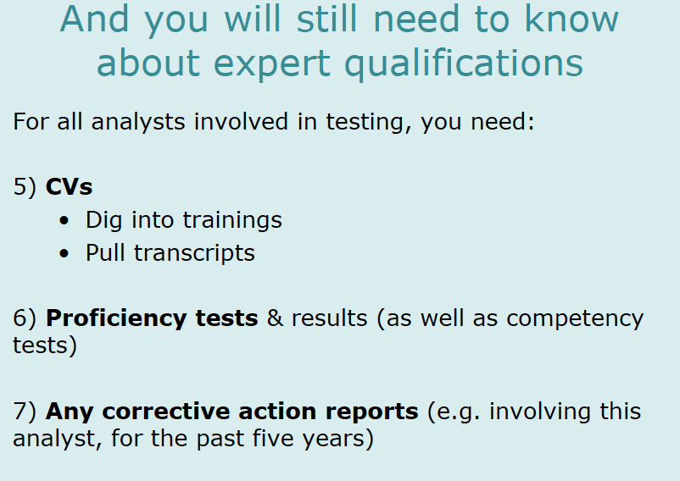
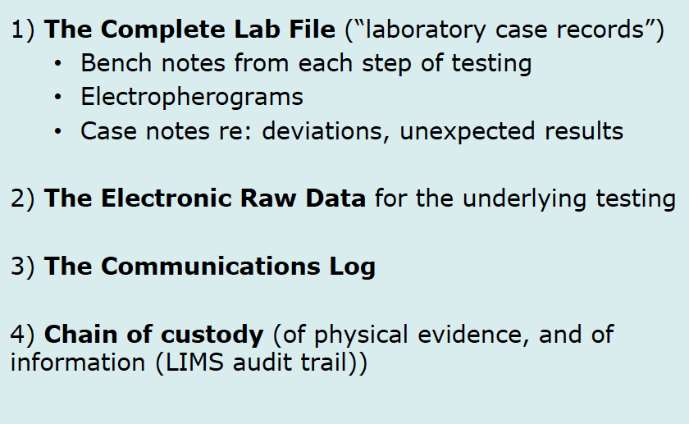
Get the Discovery your Client deserves:

Slide 13
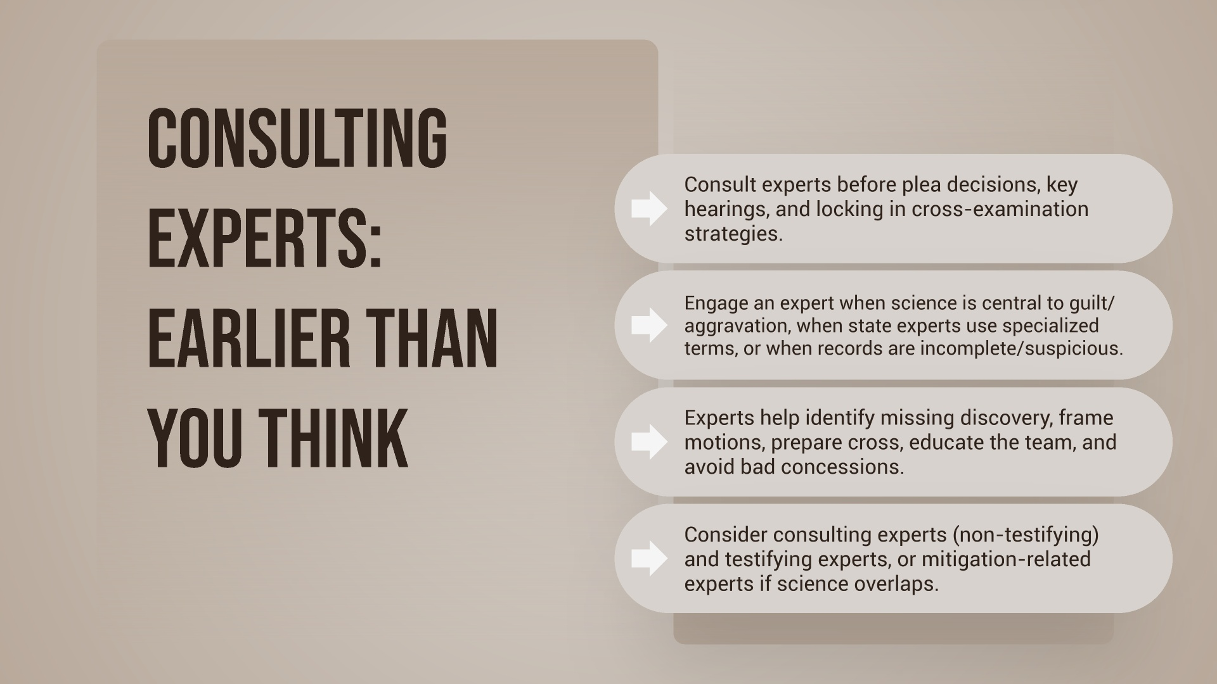
Notes:
One of the most common mistakes in forensic cases is waiting too long to involve a defense expert. By the time counsel is preparing for cross-examination or gearing up for trial, the expert should ideally already have reviewed the records, helped identify the real weaknesses, and assisted in shaping the defense response.
A good defense expert does far more than testify. The expert can help counsel understand what discipline is actually in play, what underlying materials are missing, whether the state’s testing or interpretation appears reliable, and whether the conclusions are being overstated.
They can also help identify whether additional testing should be requested, whether independent testing is necessary, and whether there is a basis for a Daubert challenge, a motion in limine, or a more focused cross-examination.
Just as importantly, the defense expert can help the team avoid bad strategic decisions.. The expert helps narrow the issues and translate the science into something useful for litigation.
In capital litigation, expert use also needs to happen early enough to affect major decisions: theory of defense, plea posture, investigation priorities, motion practice, and record building. Waiting until the eve of trial can mean lost opportunities that cannot be recovered later.
So the basic lesson here is simple: if forensic evidence matters to the case, bring in the right expert early enough for that expert to shape the defense, not just react to the prosecution.
The best use of a defense expert is not last-minute damage control; it is early, informed case strategy.

Slide 14
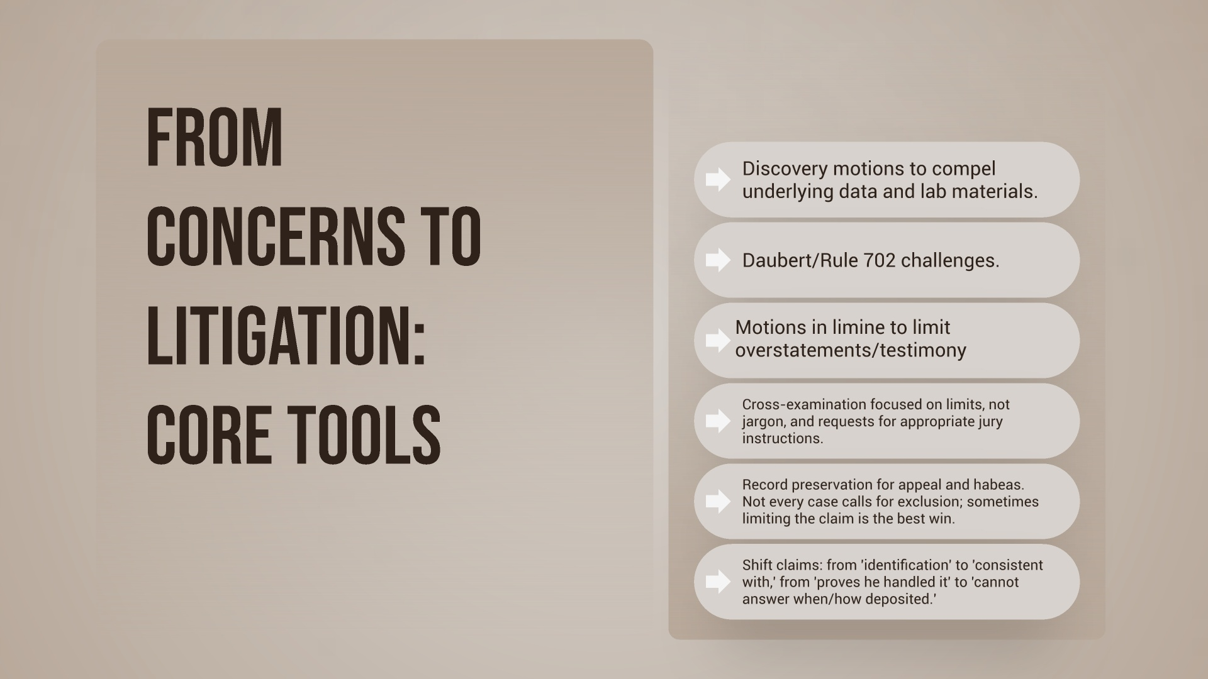
Notes:
Spotting the issue is only the first step. The next question is how to translate that concern into litigation that actually protects the client and builds the record.
In some cases, the right response after an ORR or subpoena may be a motion to compel, because the immediate problem is that the defense does not yet have the underlying materials needed to evaluate the evidence. In other cases, the issue may call for expert funding, independent testing, or additional consultation before counsel can decide what challenge makes the most sense.
If you elect to do a Daubert/Rule 702 challenge – please be clear about which one: foundational challenge or an “as applied” challenge – maybe both? .
But exclusion is not the only remedy. In many cases, the more realistic and more effective goal during the Daubert hearing is to teach the court the real limitations of the science, knowing that they will not completely keep it out, but hoping that testimony will be limited so that overstatements are not made, cannot use inflated terms like “match or identification” without proper foundation, and cannot present “possibility of scientific certainty” b/c no one actually knows what that even means.
The most effective cross is often the one that forces the state witness to become your witness – make them concede what the testing does not show, what assumptions were made (# of contributors), what is subjective, and what the jury cannot properly infer from the result.

Slide 15
Forensic evidence often becomes the prosecution's strongest claim to objectivity.
FORENSIC
EVIDENCE:
CASE
STRATEGY
Weak or limited findings may be presented as though they conclusively establish guilt.
Early forensic review shapes investigation, negotiation, motion practice, and trial strategy.
Once overstated testimony hardens into the record, undoing it becomes much harder.
Notes:
In a death penalty case, forensic evidence can take on outsized importance because it often becomes the prosecution’s strongest claim to objectivity and moral authority. (i.e. – you heard the bloodstain pattern analyst – worst scene he’d ever seen).
That makes forensic overstatement especially dangerous in the capital context. A weak or limited result may be presented as if it confirms the prosecution’s theory in a decisive way.
Jurors may not remember every technical detail, but they often remember the impression that the science “proved it.”
Capital cases also frequently involve forensic evidence in its most difficult form: old evidence, degraded evidence, multiple rounds of testing, evolving scientific standards, emotionally charged facts, and experts who may be presented as neutral truth-tellers. All of that creates a real risk that forensic testimony will carry more persuasive force than it actually deserves.
For defense counsel, that means forensic work in a capital case is not a side issue. It has to be integrated into case strategy from the beginning. It is about insisting on reliable science, fair presentation, and appropriate limits before the state asks a jury to impose the most irreversible punishment.

Slide 16
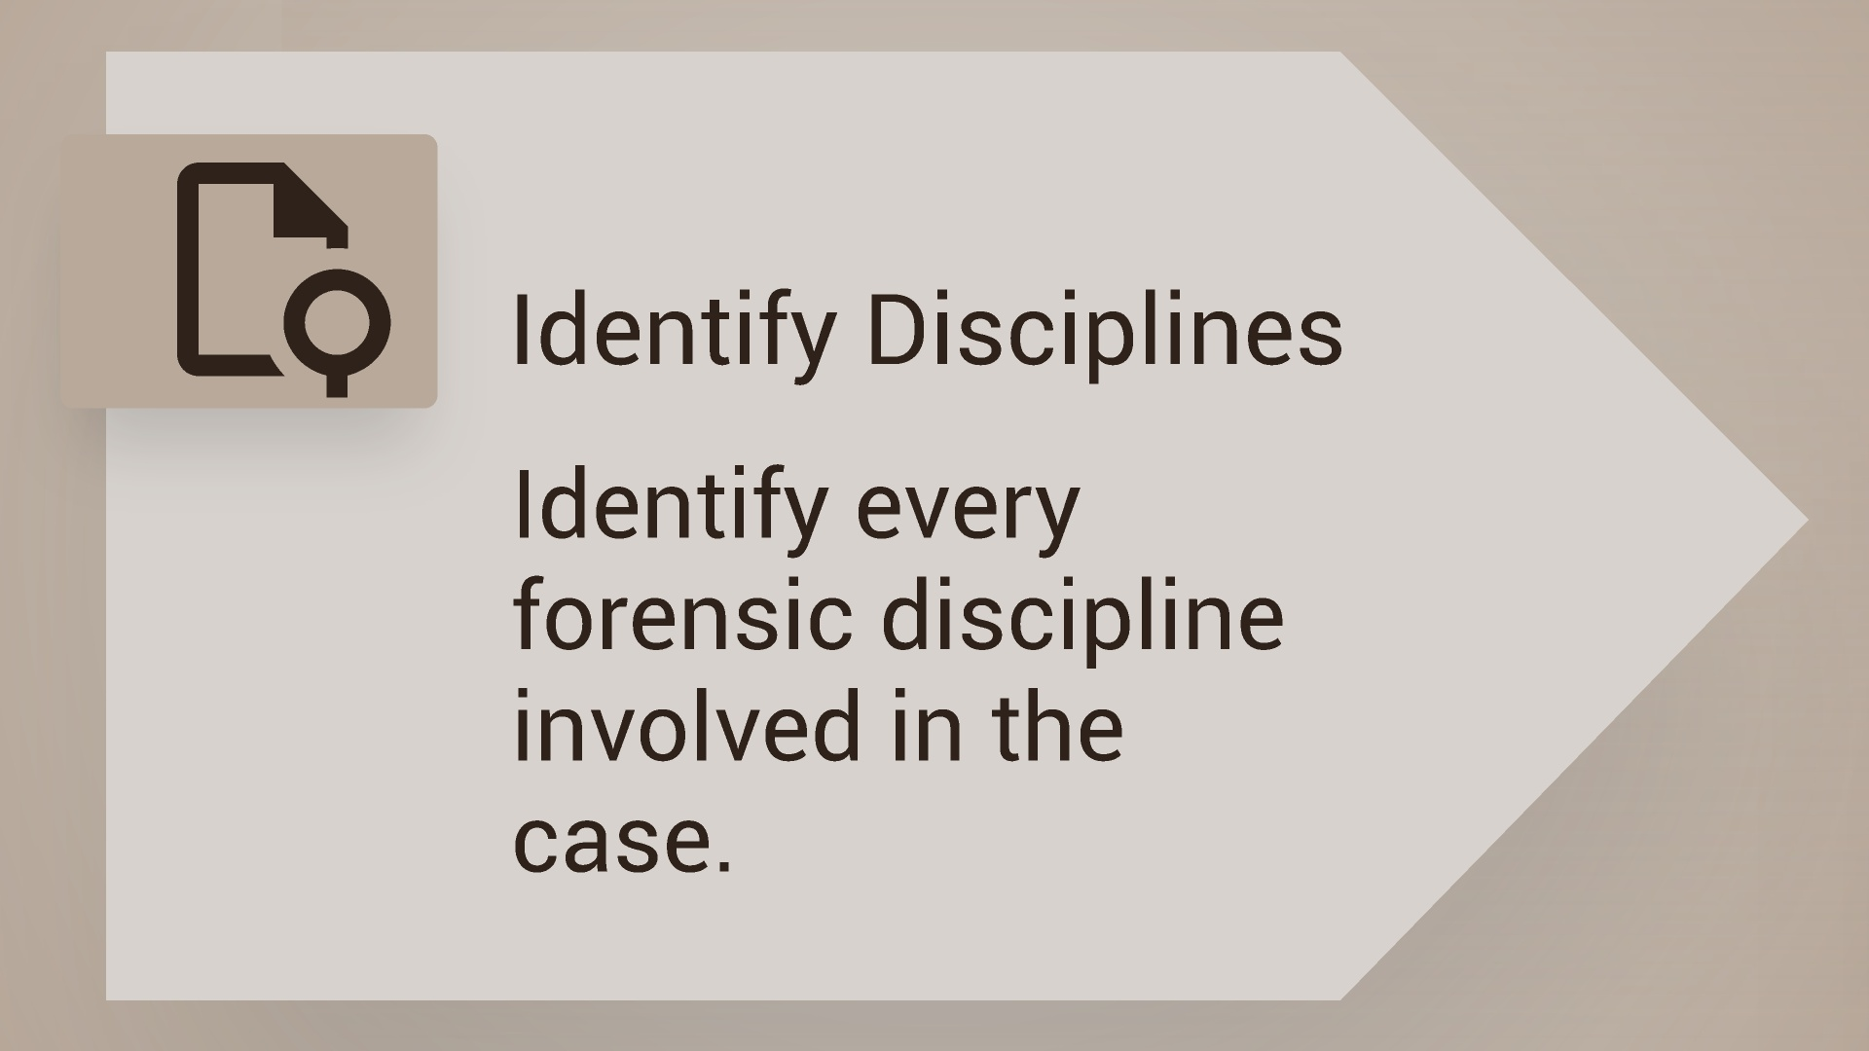
Notes:
Make a list

Slide 17
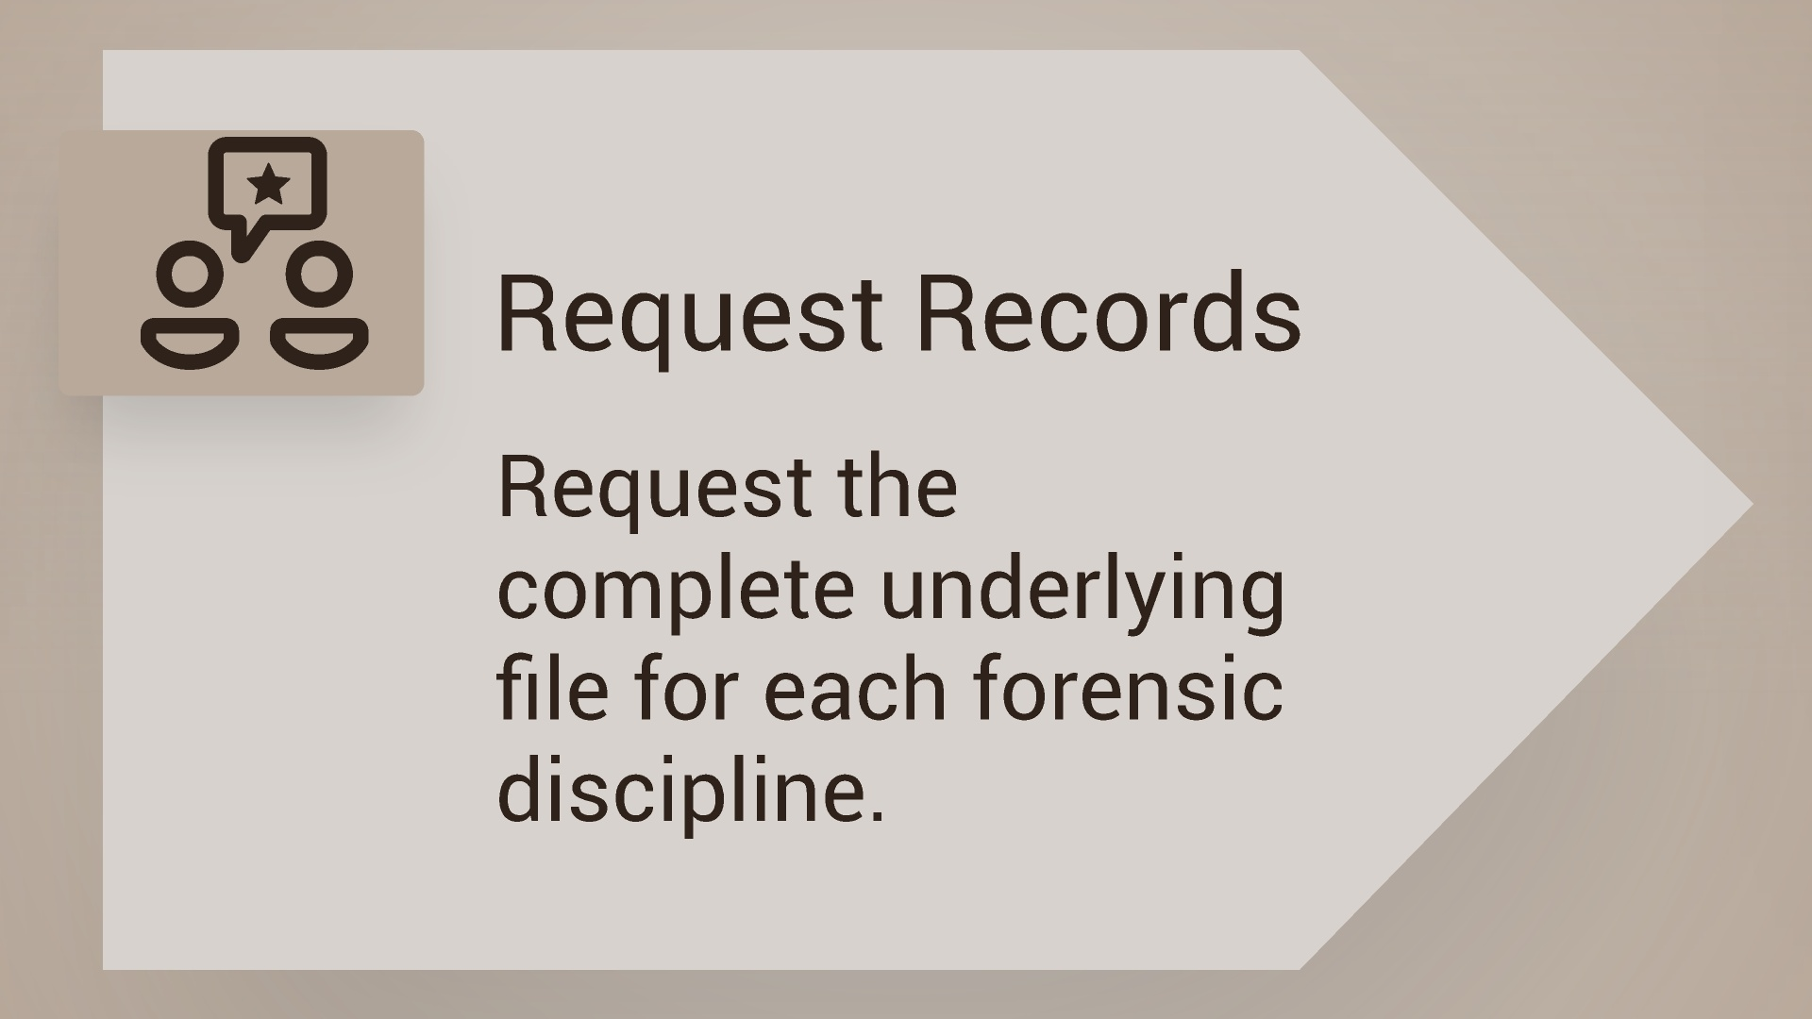

Slide 18
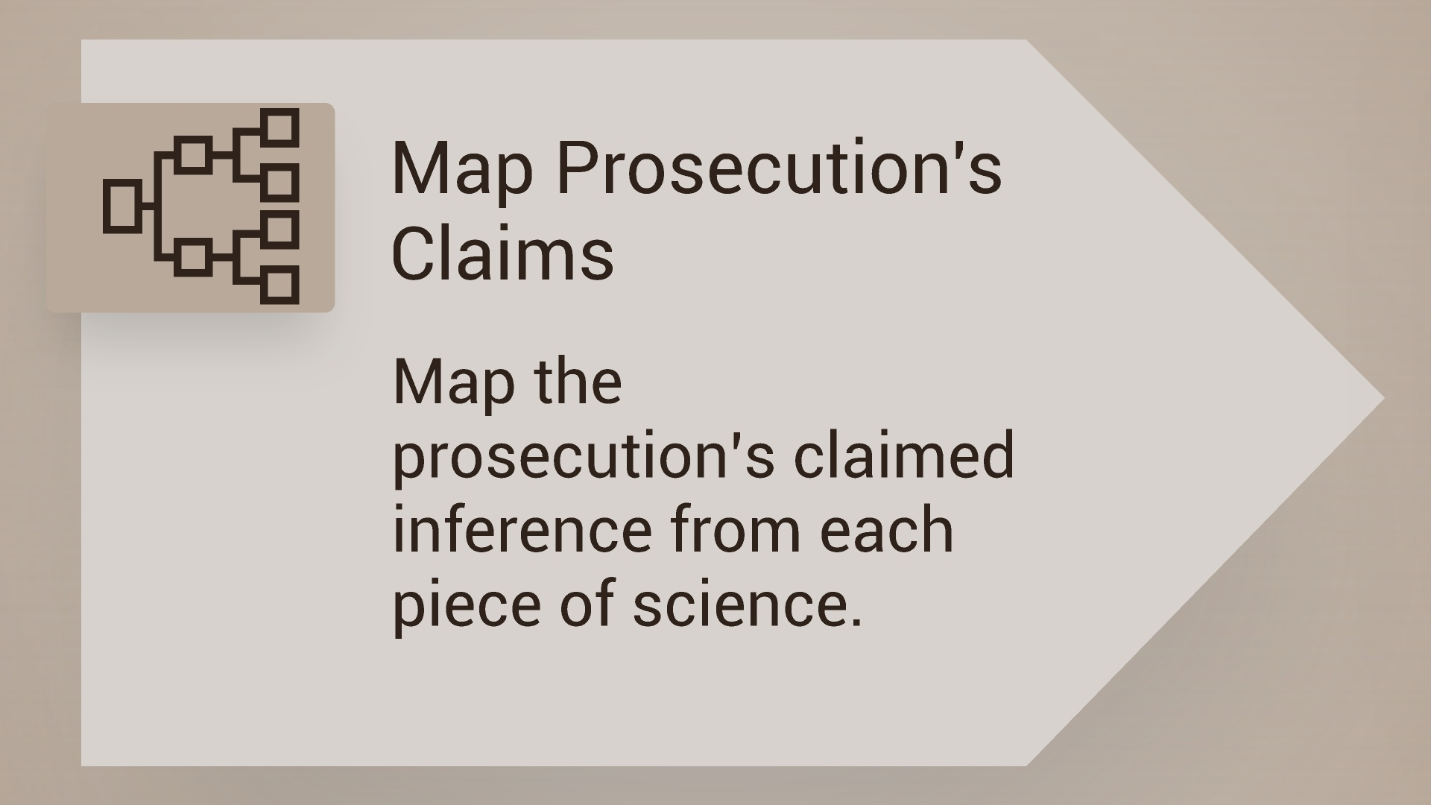
Notes:
Look at the summary reports and chart out what the DA is going to say vs. what do we as the defense want to say…..meaning how does this work with our theme and theory of the case?

Slide 19
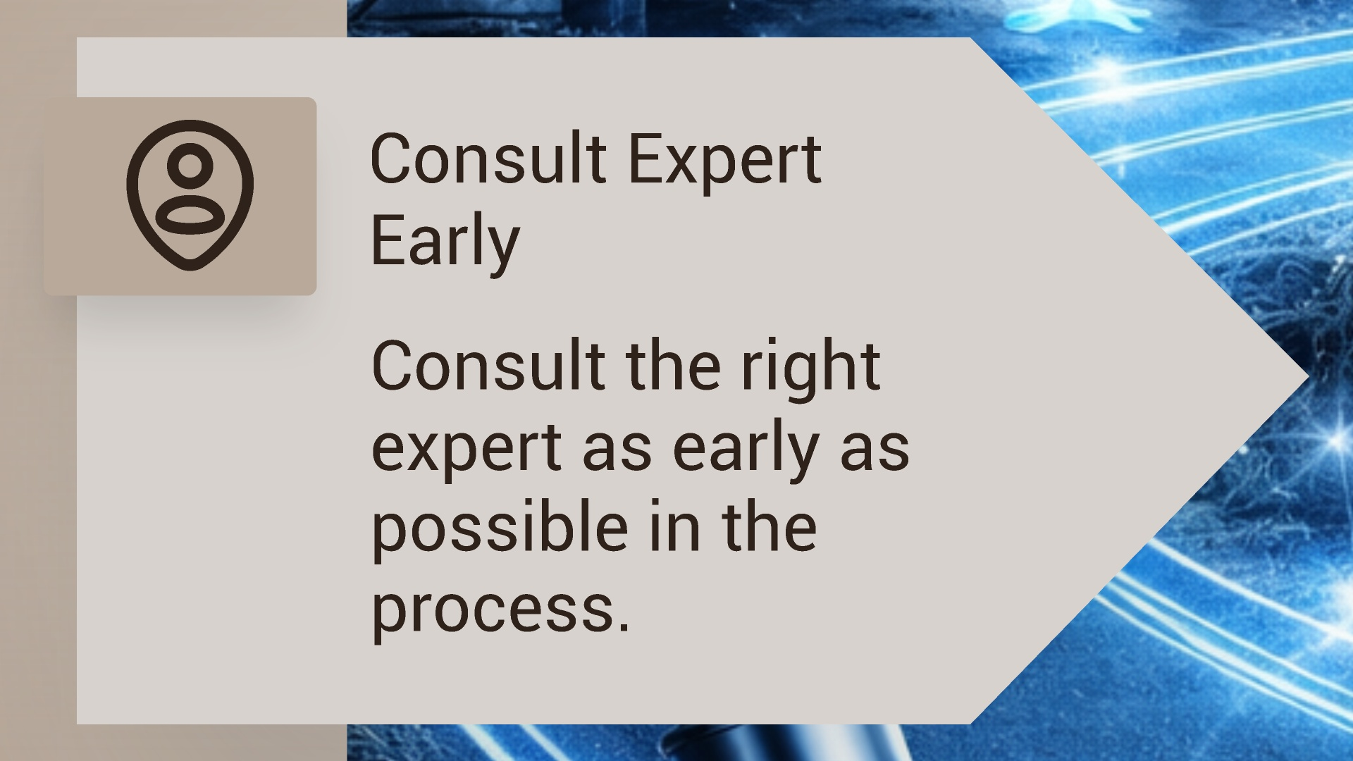
Notes:
The expert is BUSY – also they cannot do anything with the summary reports / GBI takes FOREVER to respond to ORRs for lab files (90+ days)

Slide 20
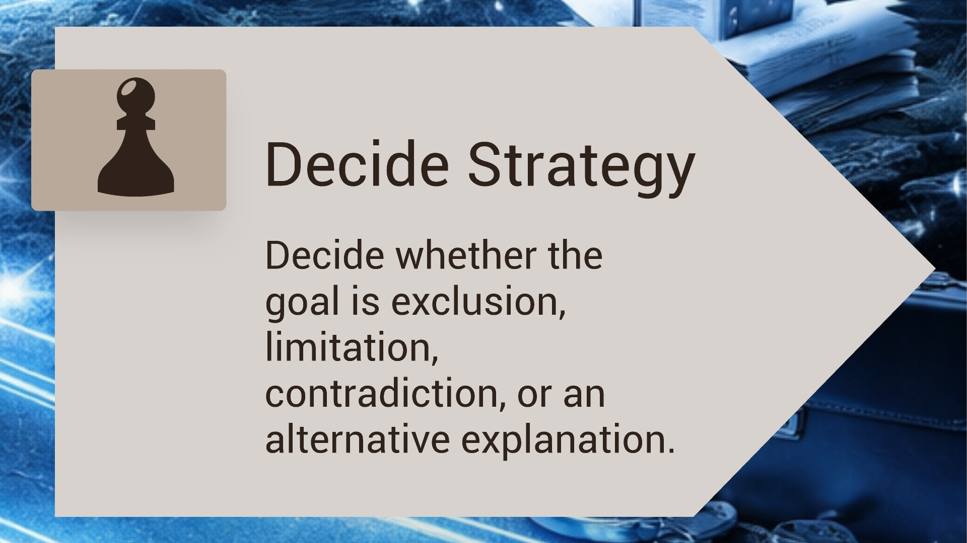
Notes:
After talking to your expert and knowing what you have – decide the road that you will take / please do not file a Daubert challenge before you know your case/and you know what the science says – trying to make good law

Slide 21
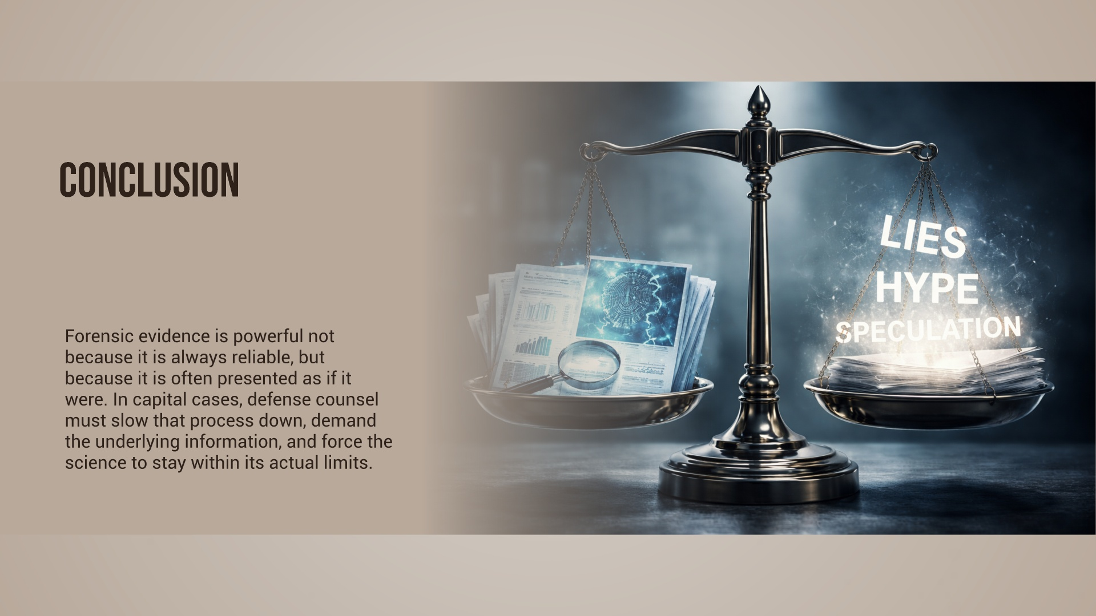
Notes:
Our job is to educate the judge and the jury.
To ask harder questions. To get the full file. To involve the right experts. And to make sure the science stays within its real limits.
We do not have to master every discipline, but we do have to be alert to overstatement, missing information, subjective judgment, and claims that go further than the data can support. I
So the takeaway is simple: do not accept the conclusion without examining the foundation.
In capital litigation, careful forensic work is not optional. It is part of how we protect our clients’ lives.

Slide 22
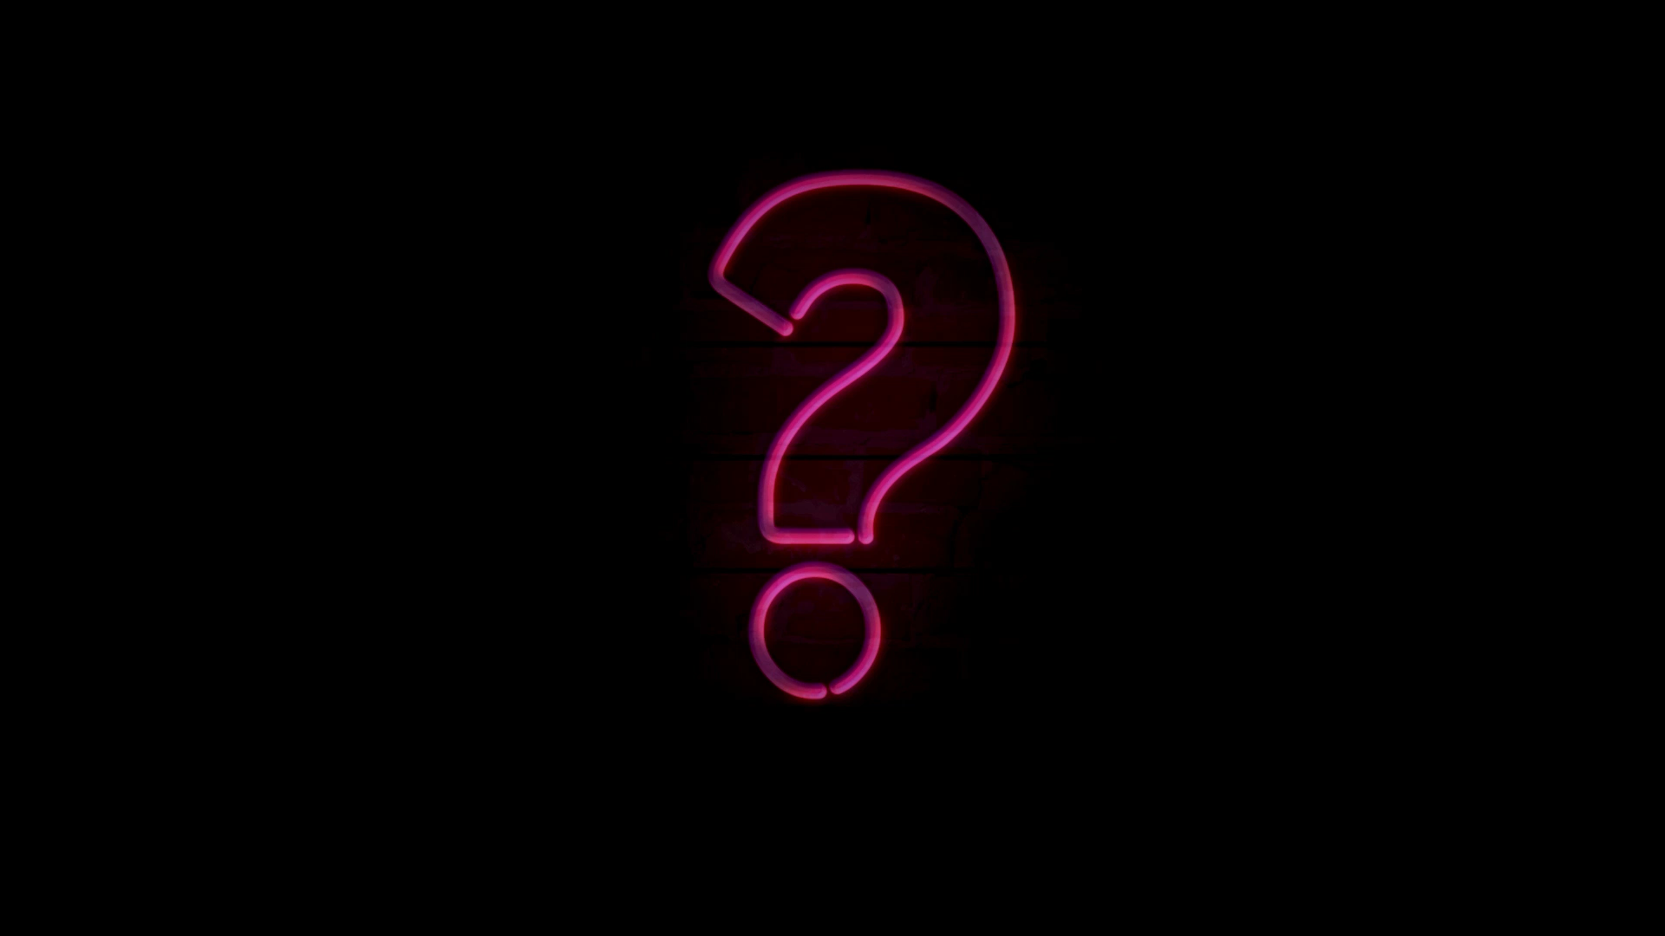
Questions?
Mary Dayton
(678) 561-0755 - cell mdayton@gapublicdefender.org

