Slide 1

Order in the court (files): sharepoint for case & team management
Cpd Josh Brockington
Apd ginny purdee
Atlantic circuit public defender’s office

Slide 2
What is sharepoint?
Secure place to store, organize, share, and access information from any device. All you need is a web browser and/or the OneDrive or SharePoint app.
You can add a shortcut in your OneDrive that links to SharePoint.

Slide 3
What’s the difference between sharepoint and onedrive?
OneDrive = Individual File Management
SharePoint = Group/Office File Management

Slide 4
How we use sharepoint:
Discovery and Client Files
Forms and Templates
Syncs w/ Outlook Office-Wide Calendar
Tracking Accountability Court Referrals/Acceptances
Accessible From Office, Jail, Home, Cell Phone, Anywhere w/ Internet
Trial Prep
Working on Documents w/ Colleagues in Real Time

Slide 5
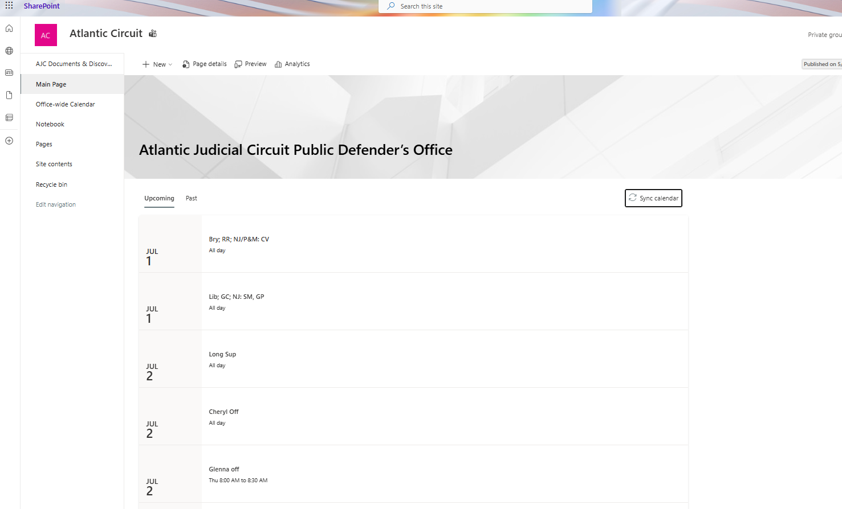
Main Page

Slide 6
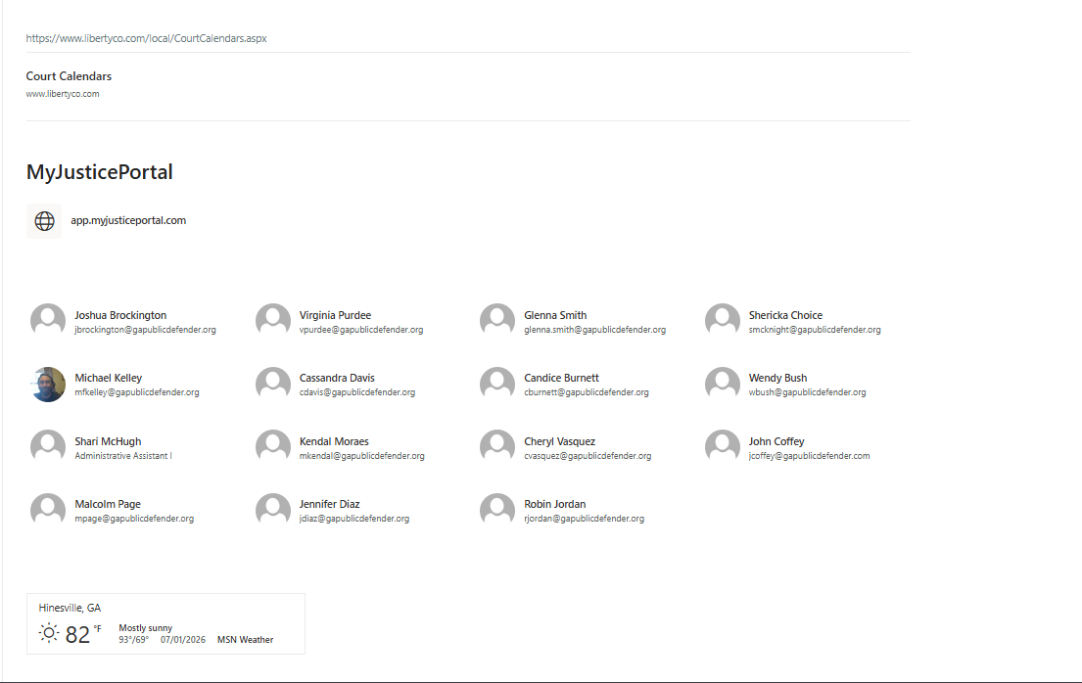
Main Page Cont’d
Frequently Used Links

Slide 7
Link to AJC Office-Wide Calendar

Slide 8
Main Page
Link to AJC OneNote Notebook

Slide 9
Most of the Important Stuff

Slide 10
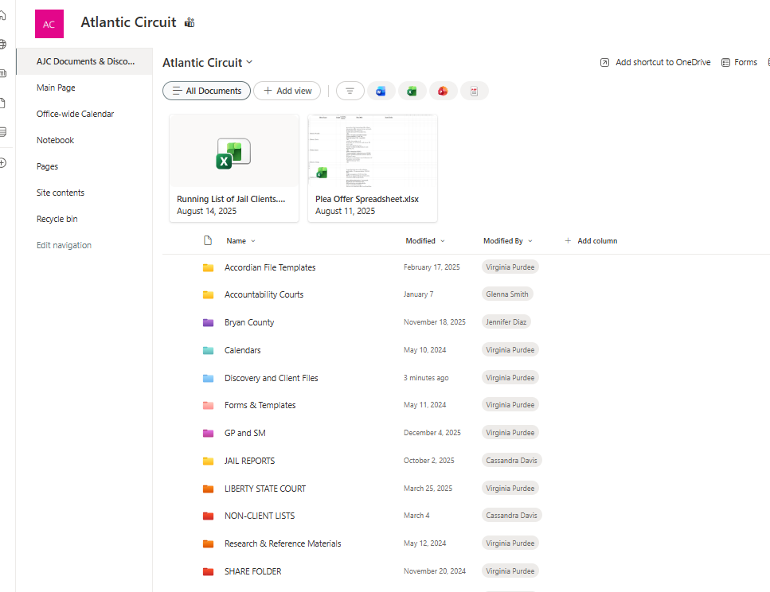


Slide 11


Slide 12
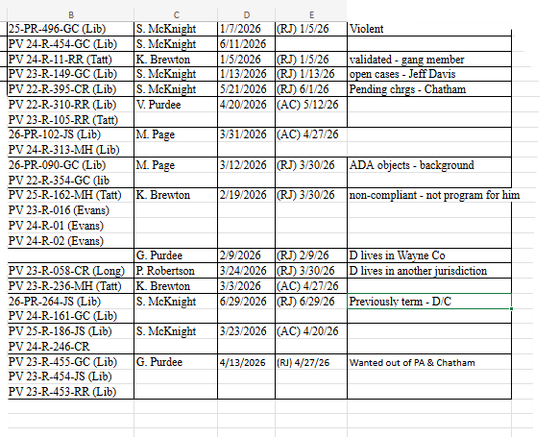
Tracking Accountability Court Statuses in Live Time

Slide 13
Things to consider
Preserving client files and discovery
Maintaining confidentiality
2-Factor Authentication
Internet Access

Slide 14
Questions?

