Slide 1

Resilient by Design: Thriving as a Public Defender
“Bloom where you are planted!”
Jennifer Cooley
Assistant Public Defender IV
Chattahoochee Judicial Circuit

Slide 2

Are you surviving or thriving as a Public Defender?

Slide 3

Chattahoochee Judicial Circuit
OUR TEAM
Chief Public Defender: Moffett Flournoy
Deputy Chief Public Defender: Jose Guzman
Mark Buis
Candice Barker
Leah Carroll
Jennifer Cooley
Gwendolyn Davis
Shaun Dunaway
Maria Felix
Simon Hinrich
William Herlth
Rachelle Hunter
Stephen Hyles
Grace Irvin
Robin King
Jerrika Kight
Arlene Ledesma
Sandra Matthews
Alescia Miller
Nancy Miller
Angela Morelock
Vicki Novak
Robert O’Melveny
Kajuanna Patton
Marie Pardue
Gwen Scott
Tyecia Stancil
Jasmine Story
Raylette Taylor
Payton Vernon
Eric Webb
John Wilson
Shelia Wright

Slide 4

WHY did you become a Public Defender?
Trial experience
Courtroom
Law school law forgiveness
Law school internship
Desire to be a public servant
Political aspirations
Employee referral
State/City/County benefits
Childhood dream
Your specific reason

Slide 5
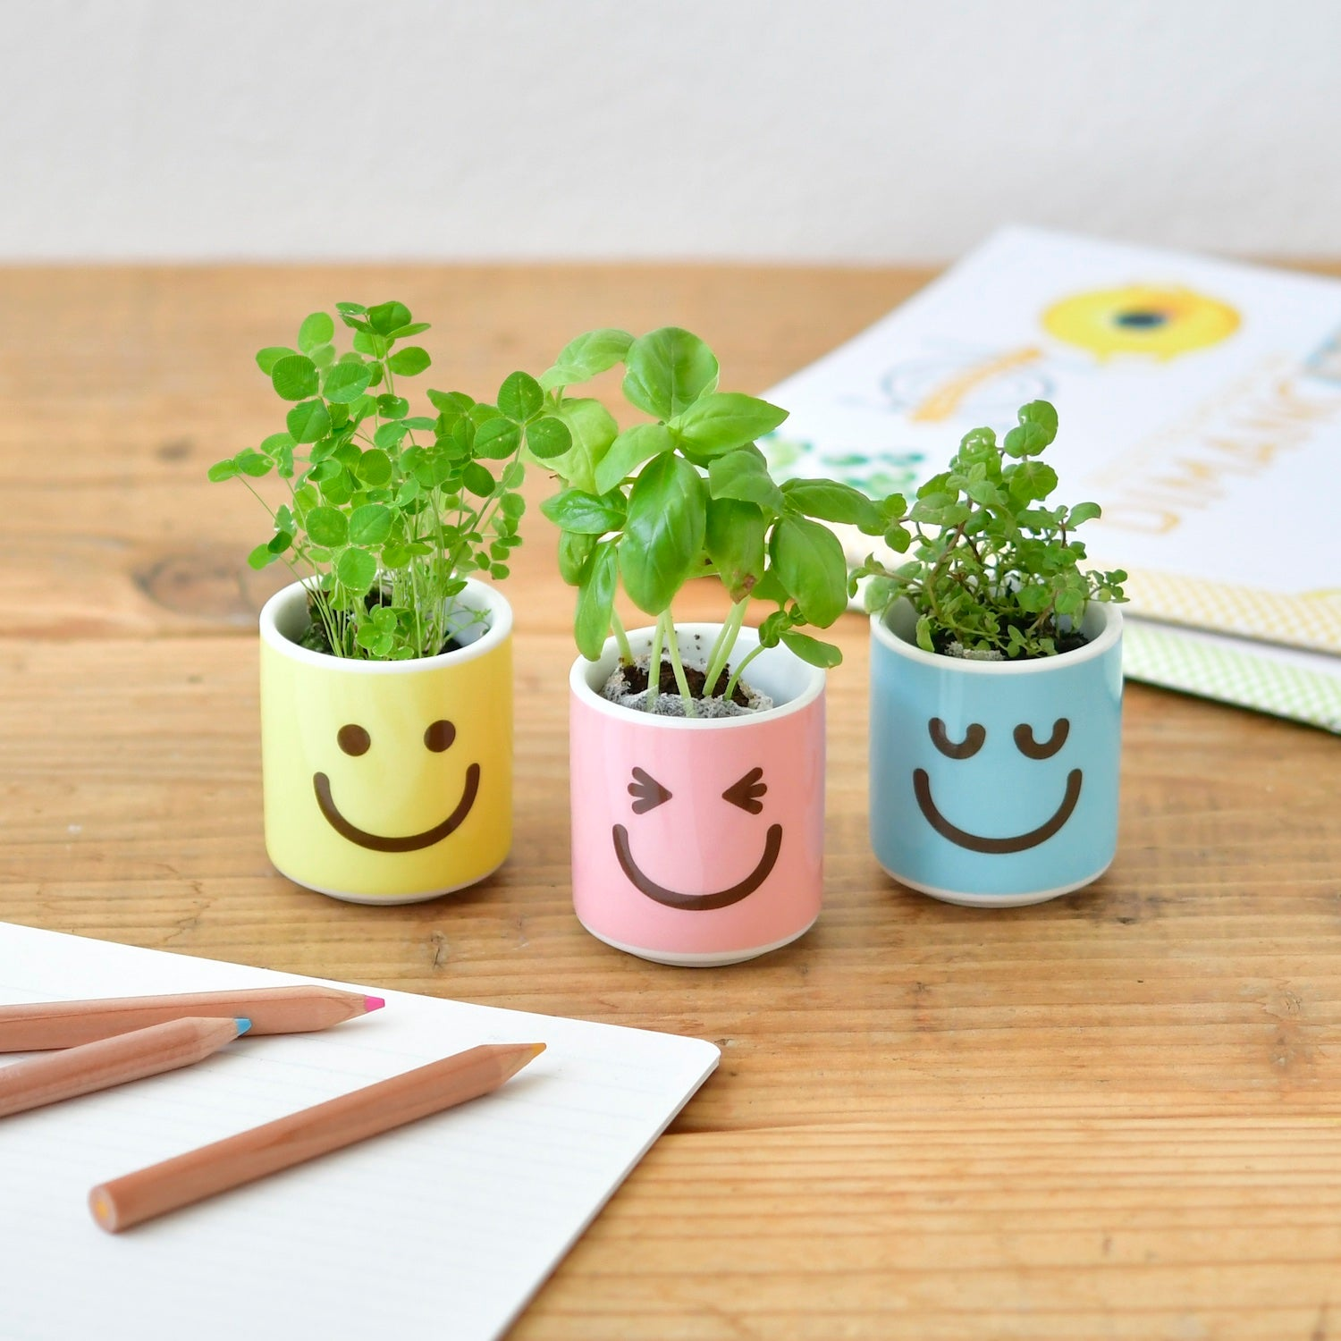
How would you describe your attitude about your career choice as a Public Defender?
Delighted
Enthusiastic
Eager
“Problem Solver”
Team player
Positive vibes in workplace
Creativity
Fulfilled
Exhausted
Overwhelmed
Underappreciated
Confused
Lack of direction
Isolated
Frustrated
Stifled or lack of opportunities

Slide 6
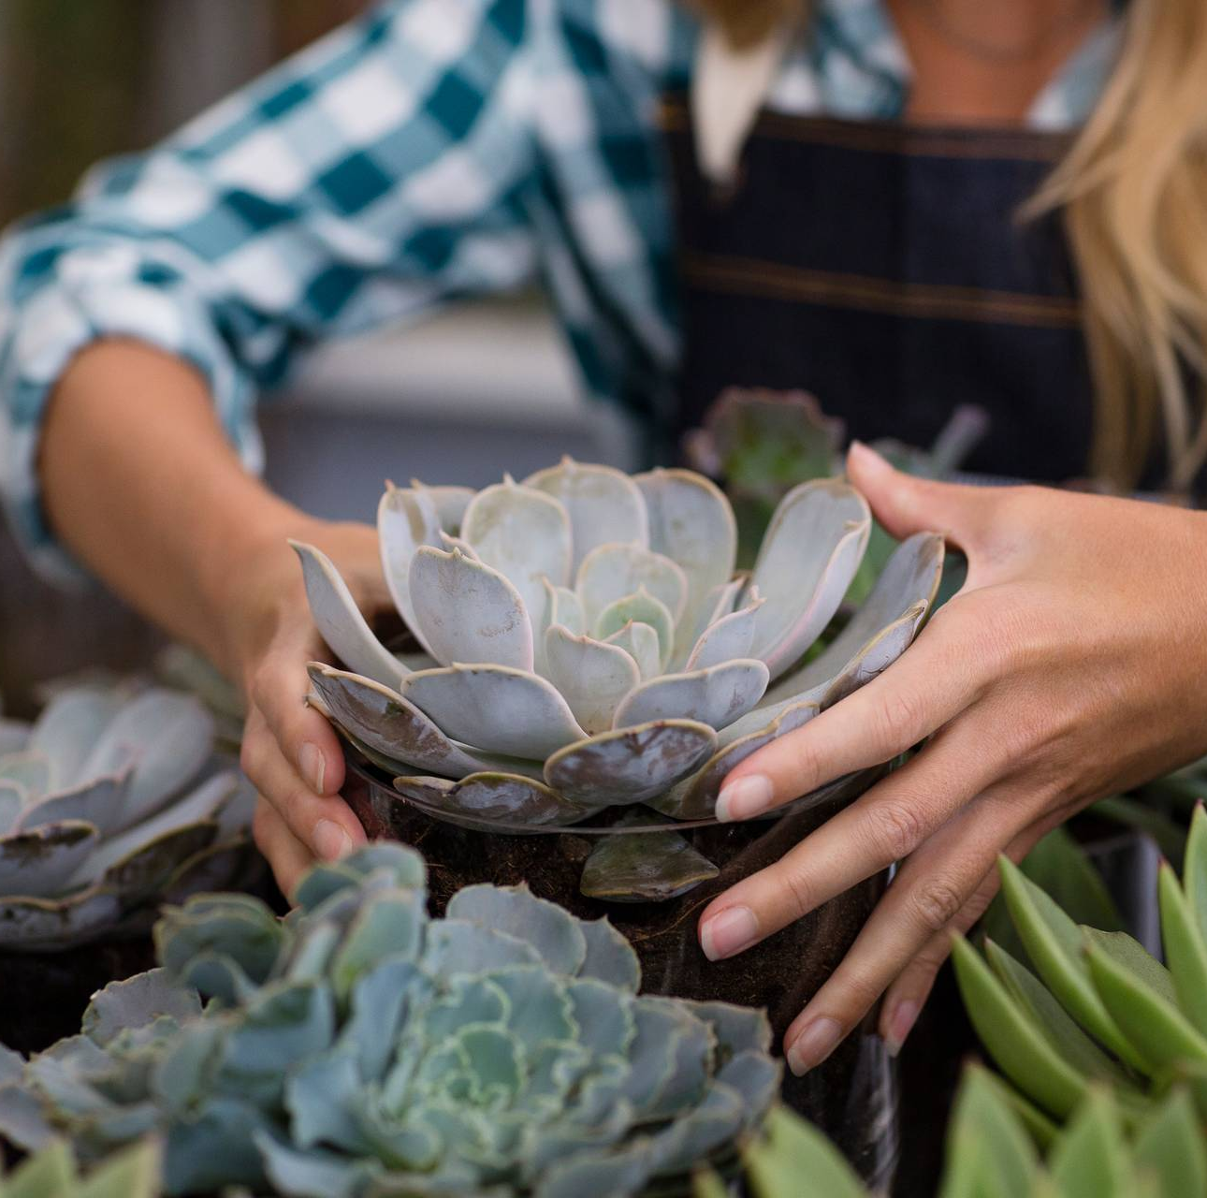
“Bloom where you are planted” sounds nice but can it truly become a reality in your life?
Show me your habits. Habits=Future
How do you manage your time?
How do you take care of yourself?
Do you have a “scarcity” mentality towards others?
How do you prepare for each day?
Do you set goals for yourself in written format where you can see them daily?
With whom do you spend your time?

Slide 7
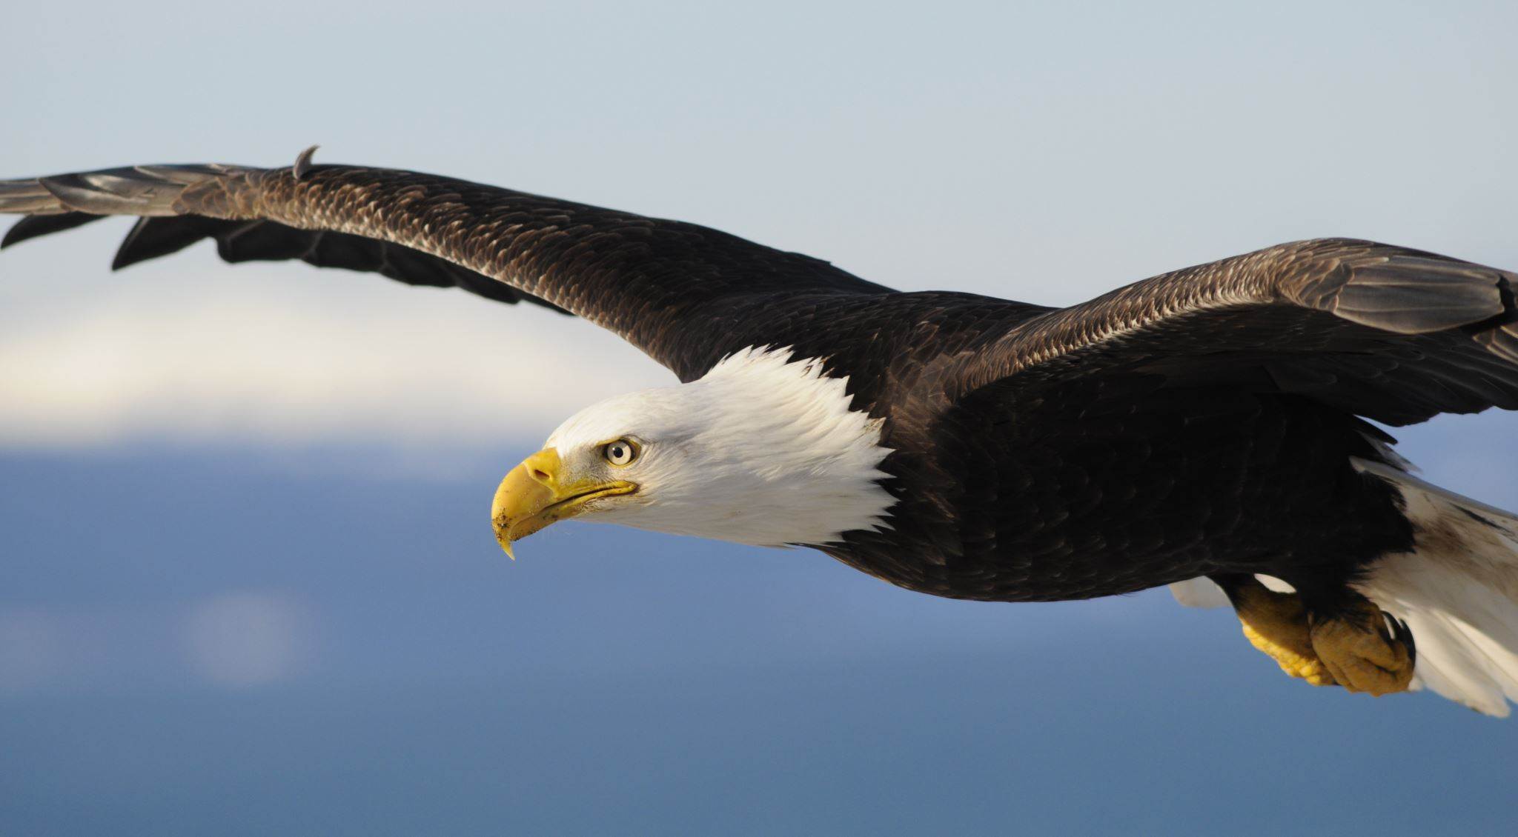
Your environment matters. I repeat, your environment matters.
When you operate and move in your purpose, success is a byproduct. You can thrive in the right environment!
Fish don’t need swimming lessons. The swim is already in the fish.
Birds don’t need flying lessons. The flight is already in the bird.
The fish appears untalented on land. The bird appears weak in the water. The right environment matters.
Lam Chau (Instagram is @withlamchau)

Slide 8
Leadership Quotes for Discussion Groups
“The ultimate measure of a man is not where he stands in moments of comfort, but where he stands at times of challenge and controversy.” Martin Luther King, Jr.
“ A leader is one who knows the way, goes the way, and shows the way.” John C. Maxwell
“Leaders think and talk about the solutions. Followers think and talk about the problems.” Brian Tracy
“Leadership is about making others better because of your presence, and making sure that impact lasts in your absence.” Sheryl Sandberg

Slide 9

Gratitude
“Someone is sitting in the shade because someone planted a tree long ago.” Warren Buffet
“If I have seen farther than others, it is because I was standing on the shoulder of giants.” Isaac Newton
“Mountaintops inspire leaders, but valleys mature them.” Winston Churchill
“Set and maintain high standards. If you have to be hard on people, do it with love and a genuine wish for them to improve. Praise people when they hit the standard.” Sam Altman

Slide 10
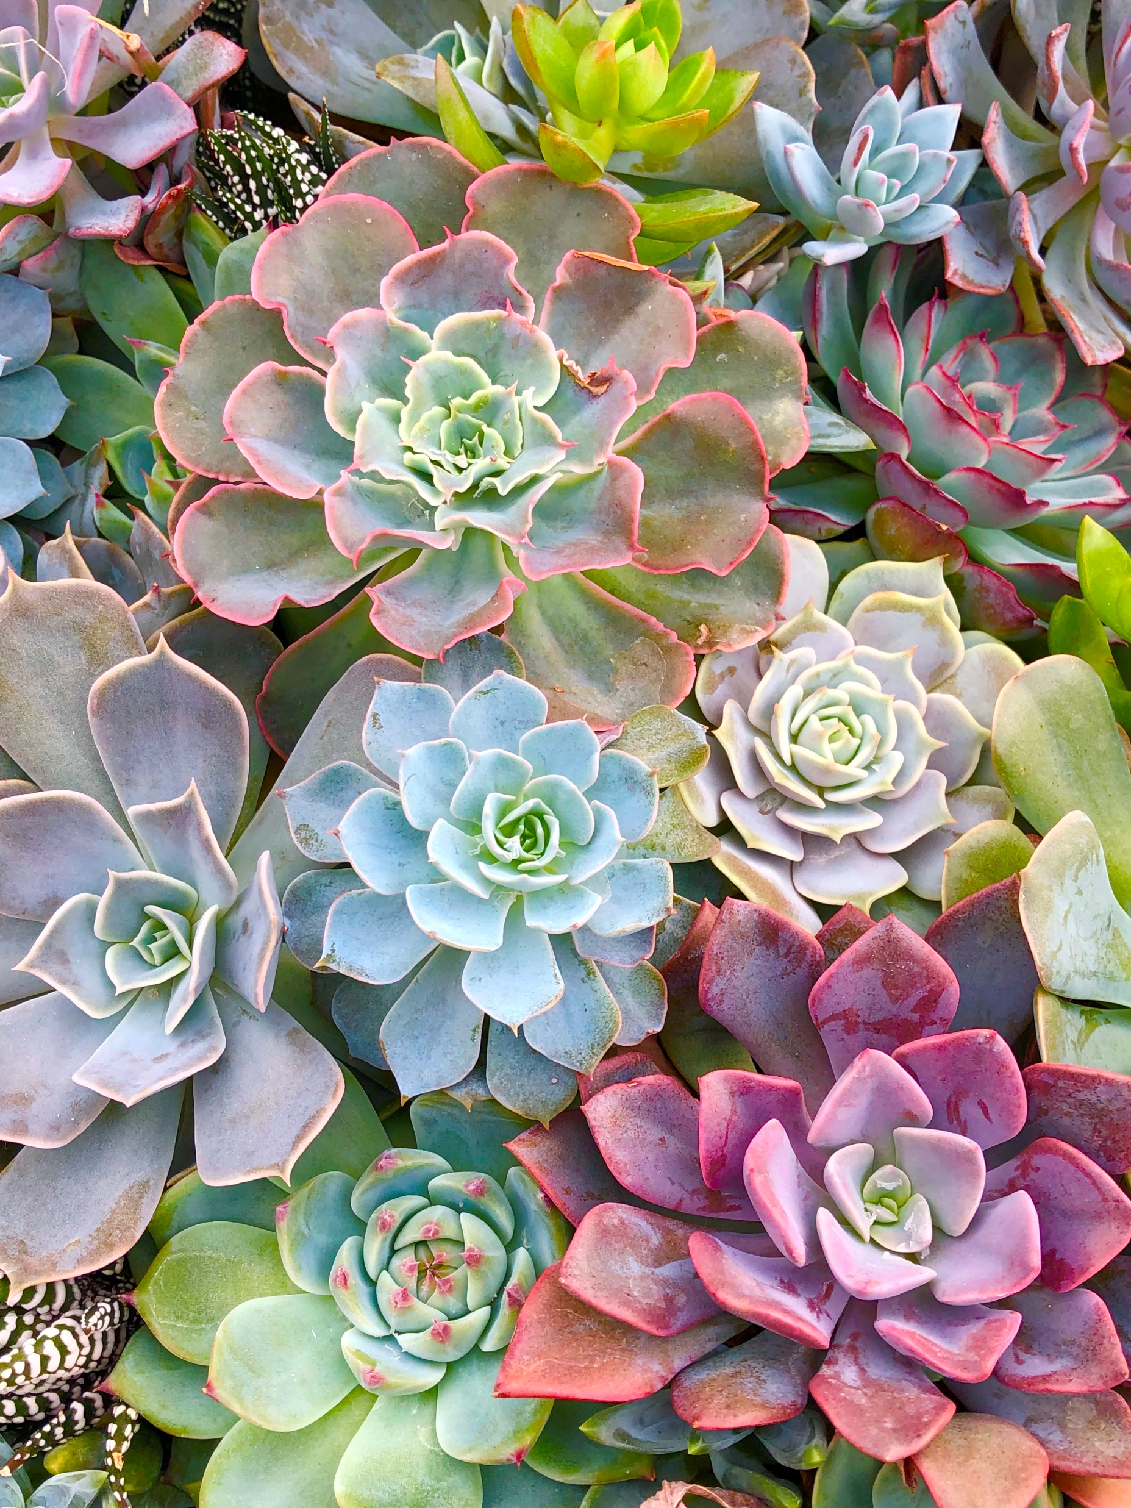
Objectives for this presentation:
To inspire you to become the BEST version of yourself each day!
B: Believe that you can commit to the process of growing better each day. Be fully committed to continual and long-term growth. Don’t give up!
E: Encourage yourself, your team, and your clients. Your attitude can begin to change the culture in your department/office/team.
S: Slow and steady growth is not stagnation. Be consistent and faithful in daily habits. Stretch yourself as you grow, develop, and mature into your best self. Your daily habits determine your future self.
T: Treasure small and big moments. Whether it’s sharing a cup of coffee with a friend or celebrating a not guilty verdict with your trial team, treasure it. Gratitude amplifies your ability to thrive!

Slide 11
Jennifer Cooley
Assistant Public Defender IV cooley.Jennifer@columbusga.org
Personal Contact Information: Instagram: @jcoolandpeeps
Facebook: Jennifer Cooley
Amazon: Daily Word with Jennifer, Volume I, II, and III

