Slide 1
How We Made Developers Faster by Automating Governance
05/2026
Oleks Bidiuk

Slide 2




About Intuit
~100M
customers
$105B
tax refunds on our platform per year
$2T+
invoices managed on our platform per year
18M
total US workers paid annually via QB payroll
Notes:
If you haven’t heard of Intuit, Intuit is a global financial technology company that is building a platform that serves 100M customers across our various brands TurboTax, CreditKarma, Quickbooks, and MailChimp

Slide 3
Speaker Bio
Senior Software Engineer at Intuit with 10+ years of evolution from JavaScript roots to complex systems. Outside the IDE, I bridge the gap between digital and tactile as a craftsman. I’m currently restoring the last "analog" Porsche 911—a hands-on project spanning everything from sewing the interior to 3D printing custom components and chassis updates. A former inline skating instructor and current dad to two dogs.
I’m obsessed with anything that can be optimized, printed, or driven.

Slide 4
Agenda
1. Why Manual Reviews Break at Scale
2. Smarter Tools, Better Governance
3. Unlocking Velocity: Quantifying Our Success
4. Looking Back, Looking Forward
Notes:
We'll structure our talk into four parts. First, we’ll set the stage by showing you why the traditional manual review process completely breaks at Intuit's scale. Then, we'll dive into the smarter tools we built to create a better governance model. After that, we'll share the results—the real, quantifiable impact this had on our developer velocity. And finally, we'll share our key lessons learned and a glimpse into the future.

Slide 5
Why
Manual Reviews
Break at Scale
Notes:
This is a blank slide layout to be used when other master layouts do not fit your content.

Slide 6
50k+
Schema validations / month
500+
Community Members
Devs
90+
Subgraphs
40k+
Fields
8k+
Types
Intuit's GraphQL Galaxy
demands smarter governance.
Notes:
To understand our pain, we need to understand our scale. We visualize it as a GraphQL galaxy. And at the very heart of this galaxy, our developers are the gravitational center—the force that holds everything together and pulls innovation forward.
Orbiting them are over 90+ subgraphs in production, our planets, creating a system with tens of thousands of fields and held together by a community of over 500 individuals, who participate in everything from code reviews to strategic discussions
But a galaxy isn't static; it's constantly in motion. For us, that motion is churn. Our tools capture over 50,000 schema validations a month—that’s 50,000 potential course-corrections needed to keep the system stable. At that velocity, trying to manually govern every change isn't just a bottleneck—it’s like trying to calculate every orbit by hand. It's completely unsustainable.

Slide 7
Schema Authoring Experience
01.
Initial Supergraph Onboarding
02.
Ongoing Schema Changes
Notes:
The friction in our developer's journey happens in two key workflows that you see on the slide.
First, there's the Initial Supergraph Onboarding. This is the critical first step. A developer has just built their new service and is ready to connect it to our platform. This process is designed to ensure their schema is high-quality and can safely join our ecosystem without causing conflicts. Historically, this was where the first major delays would happen.
But the pain doesn't stop there. The second, and more frequent, challenge is managing Ongoing Schema Changes. This is about the entire lifecycle of a service. Every time a team adds a field or changes a type, we need to ensure it maintains not only the quality of their subgraph but the health and stability of the entire supergraph for hundreds of other teams. This created a continuous cycle of reviews that was a major source of friction.

Slide 8

Supergraph Onboarding
Create Subgraph
Initiate Onboarding
Review Schema
Publish
New GQL Subgraph Service is created
>
Self-serve, automated workflow is triggered
>>
Feedback provided
Issues resolved
>>>
Compliant subgraph is approved & published
Notes:
Let's walk through our onboarding flow. It starts as you'd expect: a developer Creates a Subgraph which includes all the code logic and schema etc, then Initiates Onboarding when their service code and schema is fully runnable. Next they submit their schema for review. The final step is to Publish to the Supergraph where they are only allowed to publish their schema to the supergraph only after it’s compliant
But it was the step in the middle that was crushing our velocity.
(Click to animate and highlight Step 3)
This one: Review Schema. This single box represents what was a black hole of manual effort—an endless cycle of feedback, revisions, and waiting in queues. This manual review was the bottleneck that was actively preventing our teams from shipping faster.

Slide 9
Ongoing Schema Changes
Propose Changes
Make Revisions
Finalize Updates
Inspect Issues
Notes:
But the pain didn't stop after onboarding. A similar bottleneck appeared with every single schema change.
(Click) It would start simply enough, when a developer would Propose Changes.
(Click 2, 3, 4) They would then need to Inspect Issues, Make Revisions, and Finalize Updates.
Now, this looks like a standard process, but in reality, it was a trap.
(Click 5)
Developers were stuck in this endless, manual loop. They would wait for feedback, make revisions, wait again, and make more revisions. This cycle was essentially the same bottleneck we saw in the previous supergraph onboarding process, and it was crushing developer productivity.

Slide 10

When Governance Becomes the Enemy
Long review time
Complex best practices can't be captured by static rules
Developers waiting in approval queues
Inconsistent feedback across teams
Manual processes don't scale with team growth
Notes:
So, this is what happens when a well-intentioned governance process becomes the enemy of velocity.
The impact on our developers was immediate: long review times had them stuck waiting in approval queues for days, sometimes weeks.
Meanwhile, our expert reviewers were completely burned out. They were context-switching all day, leading to inconsistent feedback. And we realized some of our most important, complex best practices couldn't be captured by a simple linter.
It became clear this manual process couldn't scale with our teams. It was fundamentally broken.

Slide 11
Smarter Tools,
Better Governance

Slide 12

The Hybrid Revolution
TRADITIONAL
LINTING
Catch simple issues before they become problems
AI-POWERED
LINTING
Validate complex rules that traditional linters can’t capture
AI-SEMANTIC COLLISION DETECTION
Prevent naming conflicts across your entire supergraph
Notes:
1. Traditional Linting to catch simple issues before they become problems.
2. AI-Powered Linting to validate complex rules that traditional linters can’t capture.
(Mention prompt engineering to construct contextual queries and pass it to genAI/LLM for execution,
and maybe have an example of AI rule vs Traditional rule)
3. AI-Semantic Collision Detection to prevent naming conflicts across your entire supergraph.
(Mention cosine similarity/semantic check against types, fields, and descriptions within subgraph and against supergraph for intentional schema design/definition and client/developers/future AI discovery ease of use)
Developers interact with these tools primarily through an IDE Plugin/Agents and CI/CID pipelines

Slide 13
CI/CD Flow
Exceptions
GLOBAL + SUBGRAPH
Schema Guardrails
Traditional Linter
Has errors
Push Event
Schema Composition
No
Pipeline Succeeds
AI Linter
Yes
Collision Detection
Pipeline Fails
Notes:
In the CI/CD Flow, a Push Event triggers Schema Composition. This is where the governance tools, or Schema Guardrails, run. These guardrails include the Traditional Linter, the AI Linter, and Collision Detection. We allow for specific Exceptions that can be set globally or at the subgraph level.

Slide 14
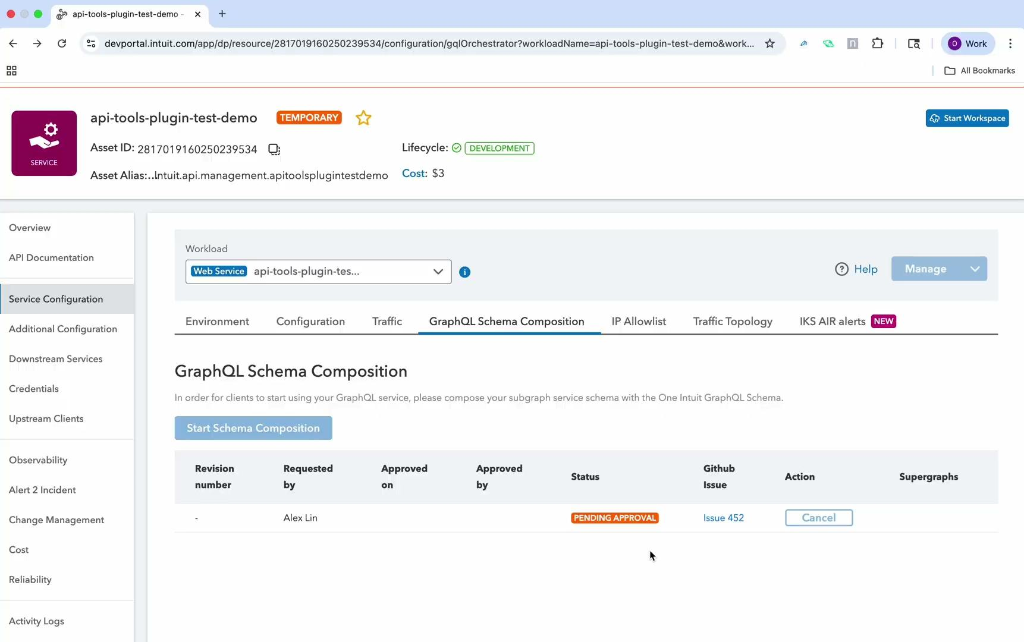

Slide 15

Developer flow
IDE/Agents
Schema Change
Traditional
Linter
Schema
Immediate Feedback
Collision Detection
Notes:
Shifted left! From CI/CD Flow

Slide 16
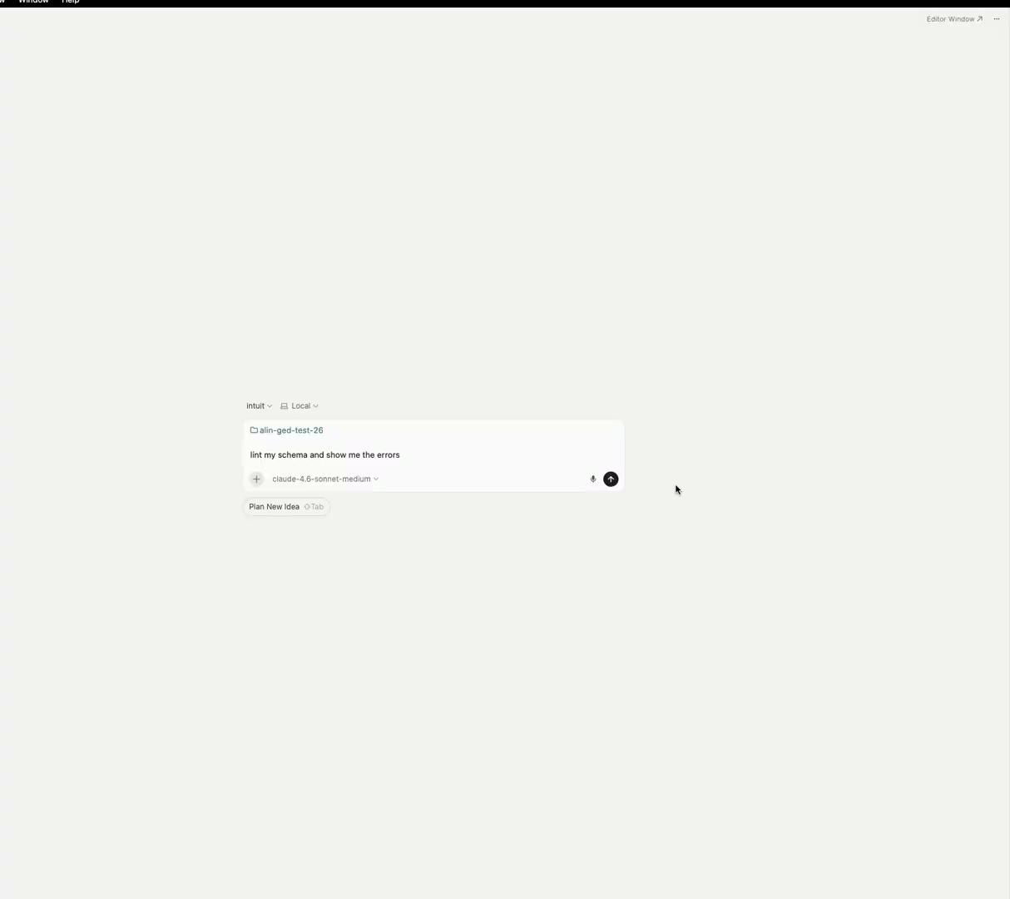

Slide 17
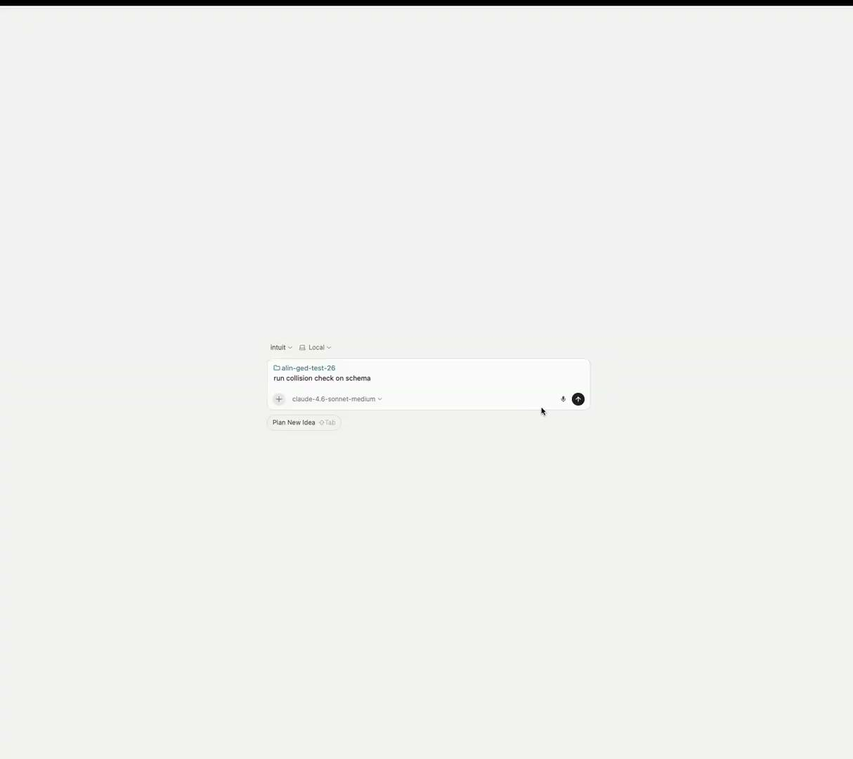

Slide 18
Unlocking Velocity:
Quantifying Our Success

Slide 19

Results: The Numbers Don't Lie
Onboarding days reduction
Launched Automated Self-Serve Supergraph Onboarding
Released IDE API Plugin Tool
Agentic Experience
Days
to onboard
May 2024
August 2025
90+
< 10
August 2023
March 2025
April 2026
Integrated Schema Quality Insights into the Onboarding Workflow
Phased Rollout of AI-Powered Schema Guardrails
Notes:
"We can confirm that The Numbers Don't Lie when it comes to Unlocking Velocity. Our primary metric for developer velocity was the onboarding days reduction.
Looking at our timeline: we launched Automated Self-Serve Supergraph Onboarding in August 2023. We Integrated Schema Quality Insights into the workflow by May 2024. In March 2025, we released the IDE API Plugin Tool, followed by the Phased Rollout of AI-Powered Schema Guardrails in August 2025.
The combined result of these efforts is a radical reduction in the Days to onboard a new service: we went from 200+ days down to fewer than 10 days
Provide “before” as context, tell where developers got stuck
Can talk a little bit more in detail about each feature release

Slide 20
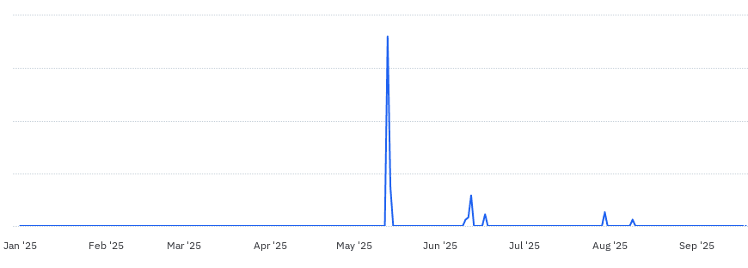
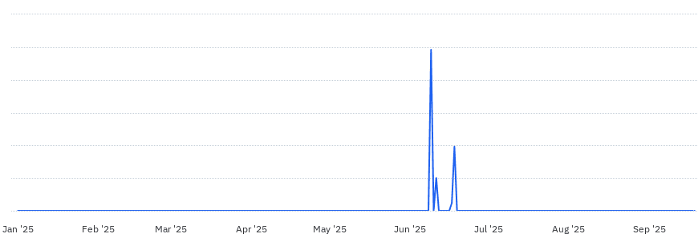
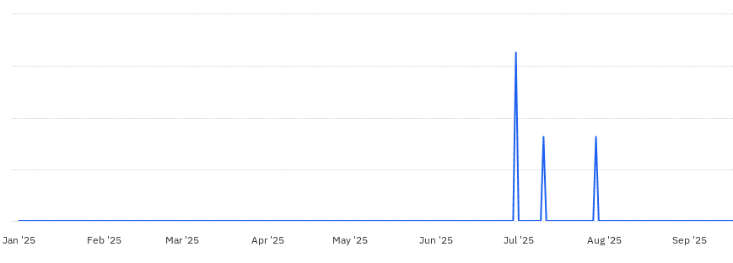
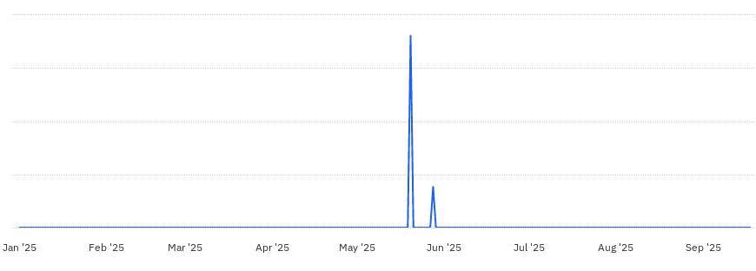
Results: The Numbers Don't Lie
Linter errors reduction by subgraph
Find & Fix Errors On-Demand in the IDE
Result: Cleaner Schemas & Higher Velocity
Impact: Zero Blocked Deployments
Notes:
"Beyond speed, we saw a massive improvement in quality. We achieved a significant Linter errors reduction by subgraph.
The ability for developers to Find & Fix Errors On-Demand in the IDE has been critical, leading to Cleaner Schemas & Higher Velocity. Crucially, this level of automation and enforcement has resulted in Zero Blocked Deployments, stabilizing our release process."

Slide 21
Looking Back,
Looking Forward

Slide 22
"Shift Left" Is Not Enough
A Rule's "Severity" Is Entirely Dependent on the User's Persona
Your "Exception" Logs Are Your Best AI Roadmap
Lessons
Learned
Notes:
You Have to "Shift the Right Information."
Simply putting a linter in the IDE isn't a silver bullet. Our early feedback showed that just flagging an error without providing clear, actionable context is more noise than help. We learned we had to invest heavily in crafting high-quality error messages, linking directly to documentation, and using AI to explain why something is a problem. The lesson is that the quality of the feedback is more important than the speed of its delivery.
We started with a universal standard for errors and warnings. But we quickly learned that what a schema author considers a minor warning, an API reviewer might see as a critical issue. The lesson is that governance tools need persona-aware configurations; the same rule might need to be a non-blocking suggestion for a developer but a hard blocker for a final governance review. While we’re still working on perfecting this, we have has several iterations in figuring out the appropriate severity category for each of our guidelines.
A surprisingly rich source for our AI roadmap came from studying the limits of our rule-based system. This insight came from two directions: first, by analyzing why developers requested exceptions for their nuanced use cases. But just as importantly, it came from us proactively identifying the problems we couldn't solve deterministically.
Every time we hit a wall with a static rule, or a developer's valid use case broke our assumptions, it became a perfect signpost. Each of these "exceptions" pointed us directly to where AI’s ability to understand context and nuance could deliver the most significant impact.

Slide 23
The Future of GraphQL Governance
Automate Supergraph Onboarding Approval
API Discovery Through AI
Proactive AI Schema Analysis
Strategic
budgeting
Strategic
budgeting
Strategic
budgeting
Decrease avg time-to-hire by 20%. Achieve 50% participation in leadership program.
Decrease avg time-to-hire by 20%. Achieve 50% participation in leadership program.
Decrease avg time-to-hire by 20%. Achieve 50% participation in leadership program.
XX
1
XX
2
XX
3
Notes:
"We're incredibly proud of what we've built, but we're just getting started."
"Our roadmap is focused on deeper AI integration.
We're exploring automated approvals for low-risk changes and supergraph onboarding requests we have high confidence in based on the reports from our tools"
And lastly we’re trying to enable AI-powered API discovery, allowing developers to use natural language to find exactly what they need across our entire graph.
Our ultimate vision is a self-governing ecosystem—one that automatically enforces its own rules with the guardrails we showed you.
And we're building towards a self-healing one—where the system doesn't just find problems, but uses AI to actively fix them

Slide 24
Thank you

