Slide 1
Generic Names Supporting Organization
Celebrated 20 years in 2023
  Created from the DNSO split into ccNSO and GNSO
  There were a handful of original gTLDs, then came 14, then came ~1500
,
Generic Names Supporting Organization (GNSO)
  Stakeholder Groups (SGs)
    Registries Stakeholder Group
      Brand Registry Group, GeoTLD.group
    Registrars Stakeholder Group
    Commercial Stakeholder Group
      Business Constituency, IP Constituency, Internet Service Providers Constituency
    Non-Commercial Stakeholder Group
Non-Commercial Users Constituency, Not-for-Profit Organizations Constituency
1

Slide 2
Generic Names Supporting Organization
GNSO Council - gnso.icann.org
  Representative body bringing together the GNSO SG/C
+ NomCom Appointees and Liaisons
  Meets Monthly and several times during ICANN in-person meetings
    All sessions are open, anyone can observe – an open mic session each ICANN
  Manager of the Policy Development Process (PDP)
    Scopes/Charters PDPs
    PDPs – delegated to working group of members of the community
    Regular reports back to Council
    Initial Report and recommendations subject to public comment before being finalised
    Recommendations adopted by Council who transmits to the ICANN
Board
2

Slide 3
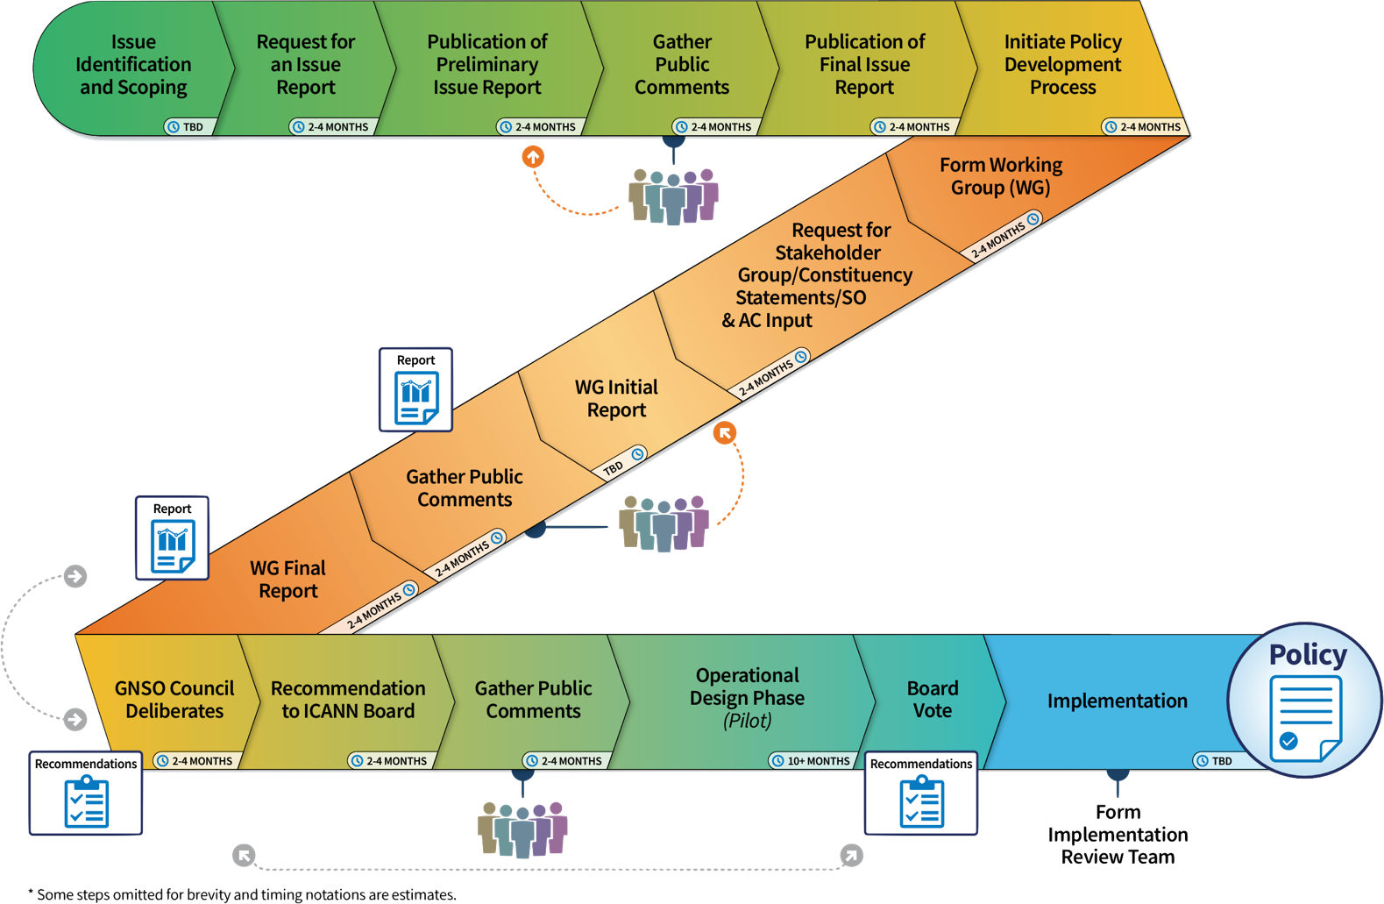
Generic Names Supporting Organization
PDP… process

Slide 4
Generic Names Supporting Organization
Current PDPs
  Latin Script Diacritics
    Public Comment on Initial Report just closed
    WG will review comments and finalise Report over coming weeks
    2 meetings at ICANN 85 on Saturday
  DNS Abuse PDP1: Associated Domains Checks
    WG formed and beginning its work
    4 meetings during ICANN 85 on Saturday and Monday
  DNS Abuse PDP2: Safeguards for API Access for New Customers
    Not yet commenced
    Council has voted to initiate
    Timing to be determined and Charter finalised

Slide 5
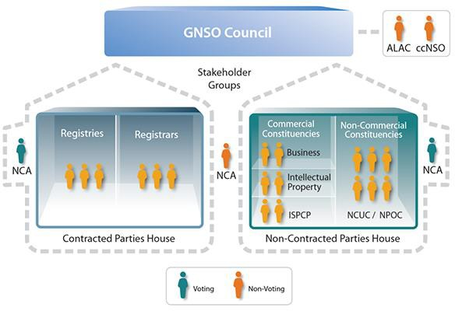
Generic Names Supporting Organization
GNSO Council
  21 councilors
  3 NomCom Appoint’s
  2 + 1 Liaisons
  Leadership
    Chair
    1 Vice Chair per House

Slide 6
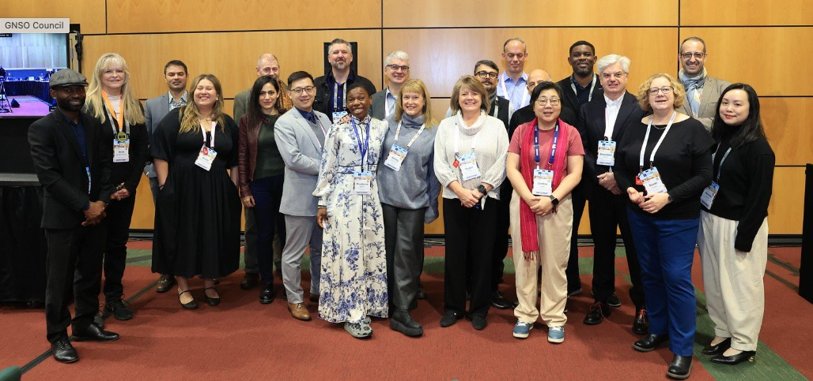
Generic Names Supporting Organization
GNSO Council
A fine crop of outstanding individuals!

