Slide 1
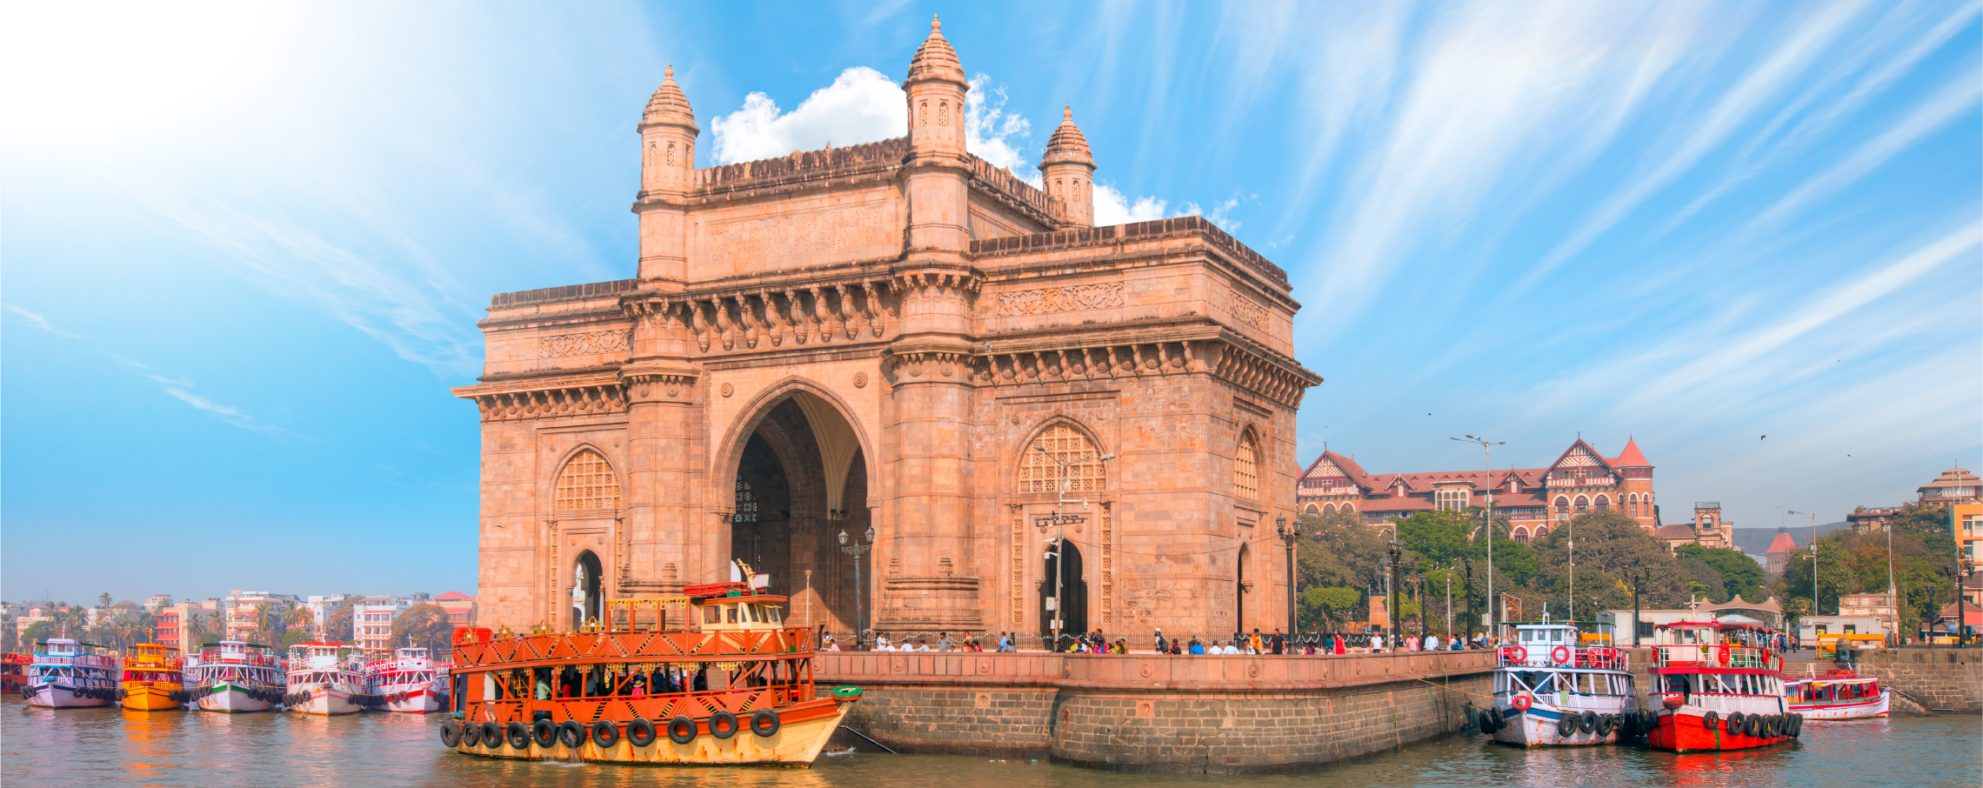

Small Island Developing States (SIDS)
ICANN85, Mumbai
11 March, 2026

Slide 2
Agenda - 10:30 am -12:00 pm Wednesday, March 11, 2026
Topic | Lead
Welcome | Chair
Session Background (3 Mins) | Rodrigo de la Parra, VP LAC GSE
Review of follow up activities from Last Meeting (5 Minutes) | Chair
Current ICANN SIDS Activities / Initiatives (15 Minutes) | Save Vocea (Oceana), Yaovi Atohoun (Africa), Albert Daniels (Caribbean),
2026 Round of gTLDs [Cook Islands Application] - (20 Minutes) | Chair / Community
SIDS Capacity Building Program Proposal (20 Minutes) | Champika Wijayatunga (ICANN OCTO)
Planning for 3rd SIDS IGF (15 Minutes) | Chair / Community
Any Other Business (12 Minutes) | Chair
Introduction of Co-Hosts | Shernon Osepa (CTU)
Session Background | Rodrigo de la Parra

Slide 3
Small Island Developing States – United Nations (UN) Members
Caribbean Region (Albert Daniels) | Oceania Region (Save Vocea) | Africa Region (Pierre Dandjinou)
Antigua and Barbuda, Bahamas, Barbados, Belize, Cuba, Dominica, Dominican Republic, Grenada, Guyana, Haiti, Jamaica, St. Kitts & Nevis, St. Lucia, St. Vincent & the Grenadines, Suriname, Trinidad & Tobago | Fiji, Kirbati, Marshall Islands, Federated States of Micronesia, Nauru, Palau, Papua New Guinea, Samoa, Solomon Islands, Tonga, Tuvalu, Vanuatu | Cabo Verde, Comoros, Guinea-Bissau, Mauritius, São Tomé and Príncipe, Seychelles
Samiran Gupta : Maldives, Singapore, Timor-Leste
SIDS - Non-UN Member/Associate Members of the Regional Commissions
Caribbean Region | Oceania Region
Anguilla, Aruba, Bermuda, British Virgin Islands, Cayman Islands, Curacao, Guadeloupe, Martinique, Montserrat, Puerto Rico, Sint Maarten, Turks and Caicos Islands, US Virgin Islands | American Samoa, Commonwealth of Northern Marianas, Cook Islands, French Polynesia, Guam, New Caledonia, Niue, Tokelau, Wallis and Futuna

