Slide 1
“Hello, my name is ______________ and I am participating during this session in a speaking role.
I am testing my audio and my speaking pace to confirm whether all technical service providers are able to hear me clearly. If you would like me to repeat this test, please let me know - thank you.”
Notes:
https://docs.google.com/document/u/1/d/1ASbEbsy7fIdcmBzFOoOlZOXzyv-9SV7h/edit

Slide 2
ICANN Expected Standards of Behavior
ICANN Community Anti-Harassment Policy
ICANN Community Participation Code of Conduct

Slide 3


Policy Implementation and Reviews
What’s New & What’s Next
23 February 2026

Slide 4






Introductions - Presenters
Michael Karakash
Sr. Policy Research Manager
Karen Lentz
VP Policy Research
& Stakeholder Programs
Jason Kean
Sr. Manager, Reviews & Stakeholder Support
Antonietta Mangiacotti
Policy Research and Implementation Sr. Manager
Jessica Villaseñor
Sr. Manager, GDS Research Services
Alice Jansen
Stakeholder Programs Director – Reviews
Alice Jansen
Stakeholder Programs Director – Reviews

Slide 5






Introductions
Isabelle Colas-Adeshina
Sr. Manager, Policy Research & Stakeholder Programs
Peter Eakin
Policy Research Specialist
Jean-Baptiste Deroulez
Review Support & Accountability Associate Project Manager
Jessica Puccio
Review Support & Accountability Sr Coordinator
Jenn Shin
Research Specialist
Leon Grundmann
Policy Research Specialist

Slide 6
ICANN85 SESSIONS
GDS: IGO-INGO Curative Rights IRT Work Session | Saturday, 7 March |
3:30 UTC / 9:00 IST
GDS: PPSAI IRT Working Session | Tuesday, 10 March | 3:30 UTC / 9:00 IST
Policy at ICANN: from Idea to Implementation | Tuesday, 10 March | 5:00 UTC / 10:30 IST
Review of Reviews Cross Community Group | Thursday, 12 March | 3:30 UTC / 9:00 IST
📚 Explore Our Team’s Resources & Information:
  Consensus Policy Implementation Framework (CPIF) / Policy Implementation page
  Policy Research and Stakeholder Programs (PRSP) Briefing
  Quarterly Specific Reviews Implementation Reports

Slide 7
Agenda
Introduction – 5 minutes
Policy Implementation Projects – 20 minutes
Reviews Related Work – 10 minutes
Looking Ahead – 10 minutes
Questions – 15 minutes
Notes:
For remarks here: refer to NXR session for those updates. Also note the inclusion of our reflections on successes/challenges

Slide 8
Policy Implementation Projects

Slide 9





Privacy & Proxy Service Accreditation Issues (PPSAI)
Current Status: The GNSO Council provided additional implementation guidance to the PPSAI IRT in November 2025. ICANN org reconvened the PPSAI IRT on 8 January 2026 and are now aligned on a proposed Implementation Plan, consistent with GNSO Council guidance.
Next Steps: Following alignment on flow of requirements, ICANN org will develop a Draft Consensus Policy. ICANN org and the IRT will review the policy in the following sequential modules: Definitions > Consensus Policy > Disclosure Frameworks.
Est Completion Date: Q3 2027 Announcement of Policy Effective Date. Note: Timing and implementation plan are a collective goal, discussed and agreed between ICANN and IRT.
Challenges: Navigating changes to law, policy, and industry practices since the PDP WG first developed PPSAI recommendations and the former IRT started work on implementation. Parallel work on RDRS is expected - PPSAI IRT will work to align as much as possible, but will not delay its work in order to wait for alignment, as per GNSO Council guidance.
Successes: Continued IRT commitment and ongoing productive dialogue, and rapid turnaround from GNSO Council regarding key Threshold Question responses.

Slide 10
Registration Data Policy (EPDP Phase 1) | Urgent Requests
Current Status: ICANN org published the Public Comment Summary Report for Timeline for Urgent Requests for Lawful Disclosure of Nonpublic Registration Data in Jan. 2026. The results of the proceeding are being shared with the Council, Board, and GAC to inform the discussion on next steps.
Next Steps: The Board, GAC, and GNSO Council to align on remaining steps for Urgent Requests.
Est Completion Date: Q1 2026
Challenges: Extended community discussions to reach resolution on open issues; balancing a wide range of community views.
Successes: Ongoing productive dialogue and strong engagement from key stakeholders (governments, law enforcement, registries, and registrars).

Slide 11
GNSO IGO-INGO Curative Rights Policy
Current Status: ICANN is leading the implementation of updates to the UDRP and URS to facilitate access by IGOs: organizing the IRT, drafting updated policy language and guidance, identifying and engaging potential vendors to administer a new arbitral pathway to resolve UDRP/URS disputes involving IGOs.
Next Steps: Goal to launch public comment on updated UDRP and URS in Q1 2026.
Est Completion Date: Q2 2026
Challenges: A newly identified policy interpretation question required escalation to the GNSO Council for guidance, delaying the planned Q4 2025 public comment.
Successes: Strong collaboration between the IRT and staff enabled rapid agreement on this complex issue, minimizing impact on the project timeline.

Slide 12
Rights Protection Mechanisms - Phase 1
Current Status: Facilitating discussions on Trademark Clearinghouse Requirements revisions. Implementing data collection and new compliance mechanism(s) recommendations. Note: Recommendations from two of the five groups have been implemented; remaining groups are expected to be completed in 2Q26.
Next Steps: Publication of revised Trademark Clearinghouse Requirements and Uniform Rapid Suspension compliance mechanism in Q1 2026.
Est Completion Date: Q2 2026
Challenges: Internal resource constraints; managing overlaps with the next round work.
Successes: Efficient collaboration between internal and external stakeholders.

Slide 13
IDN EPDP Phase 1
Current Status: Aligning implementation with IDN EPDP Phase 2 and planning consensus policy documentation for all relevant IDN recommendations.
Next Steps: Draft consensus policy documentation for remaining IDN recommendations.
Est Completion Date: Q2 2026
Challenges: Internal resource constraints.
Successes: Successful incorporation of all Next Round related EPDP Phase 1 recommendations into the Applicant Guidebook. Also, efficient collaboration between internal and external stakeholders.

Slide 14
Reviews Related Work

Slide 15
Continuous Improvement Program (CIP) Implementation
Current Status: 4 SOs/ACs have begun their respective CIP efforts and are in the process of defining tailored criteria and indicators (“Assessment and Prioritization Phase”). PRSP is tracking implementation progress and supporting CIP efforts, as needed.
Next Steps: Continue to track implementation progress and offer resources (e.g., templates, checklists, etc) & support (e.g., workshops, survey development, data analysis), as needed.
Est Completion Date: Q3 2028, once one CIP cycle is complete.
Challenges: Ensure all SOs/ACs/NomCom are 1) aware of the process and actions needed for each phase and 2) follow the CIP framework.
Successes: Currently on schedule.

Slide 16

Review of Reviews
2 ICANN staff Members
Observers
Current Status: Design proposal for discussion at ICANN85.
Two Advisors
Next Steps: Draft Report for Public Comment and discussion at ICANN86 (June 2026).
Est Completion Date: Q3 2026 - Final Report and documentation of support shared with Board in August 2026.
2 Members per SO/AC
2 ICANN Board Members
ICANN org Support

Slide 17
Looking Ahead:
Enhancing Visibility, Transparency, and Reporting

Slide 18
Visibility, Transparency, Reporting
As part of ICANN’s effort to enhance reporting, visibility, and transparency in policy development and implementation, ICANN’s Policy Research & Stakeholder Programs (PRSP) team contributes by making both existing and evolving information easier to find, understand, and track:
Consensus Policy Implementation Framework (CPIF) webpage: Includes implementation framework and resources, links to all implementation project workspaces. The CPIF / Policy Implementation page is available here.
Quarterly Specific Reviews Implementation Report: Published each quarter, this report provides implementation status and documentation for open recommendations from Specific Reviews. The latest Quarterly report is available here.
ICANN PRSP Briefings: Published ahead of each ICANN meeting to consolidate available information; evolving to better explain project status, changes to timelines, and explanations for delays or timeline changes. The latest PRSP Briefing is available here.
Big-Picture View of PRSP Work: Developing a comprehensive, data-driven view of ongoing PRSP projects to provide up-to-date visibility into scope, progress, and workload visibility.

Slide 19
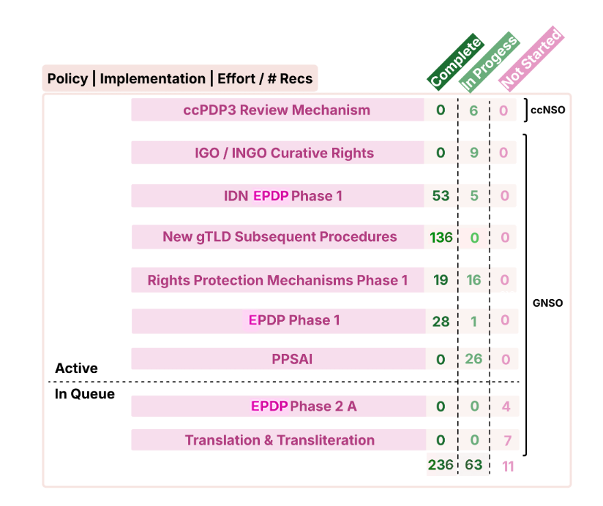
Visibility, Transparency, Reporting

Slide 20
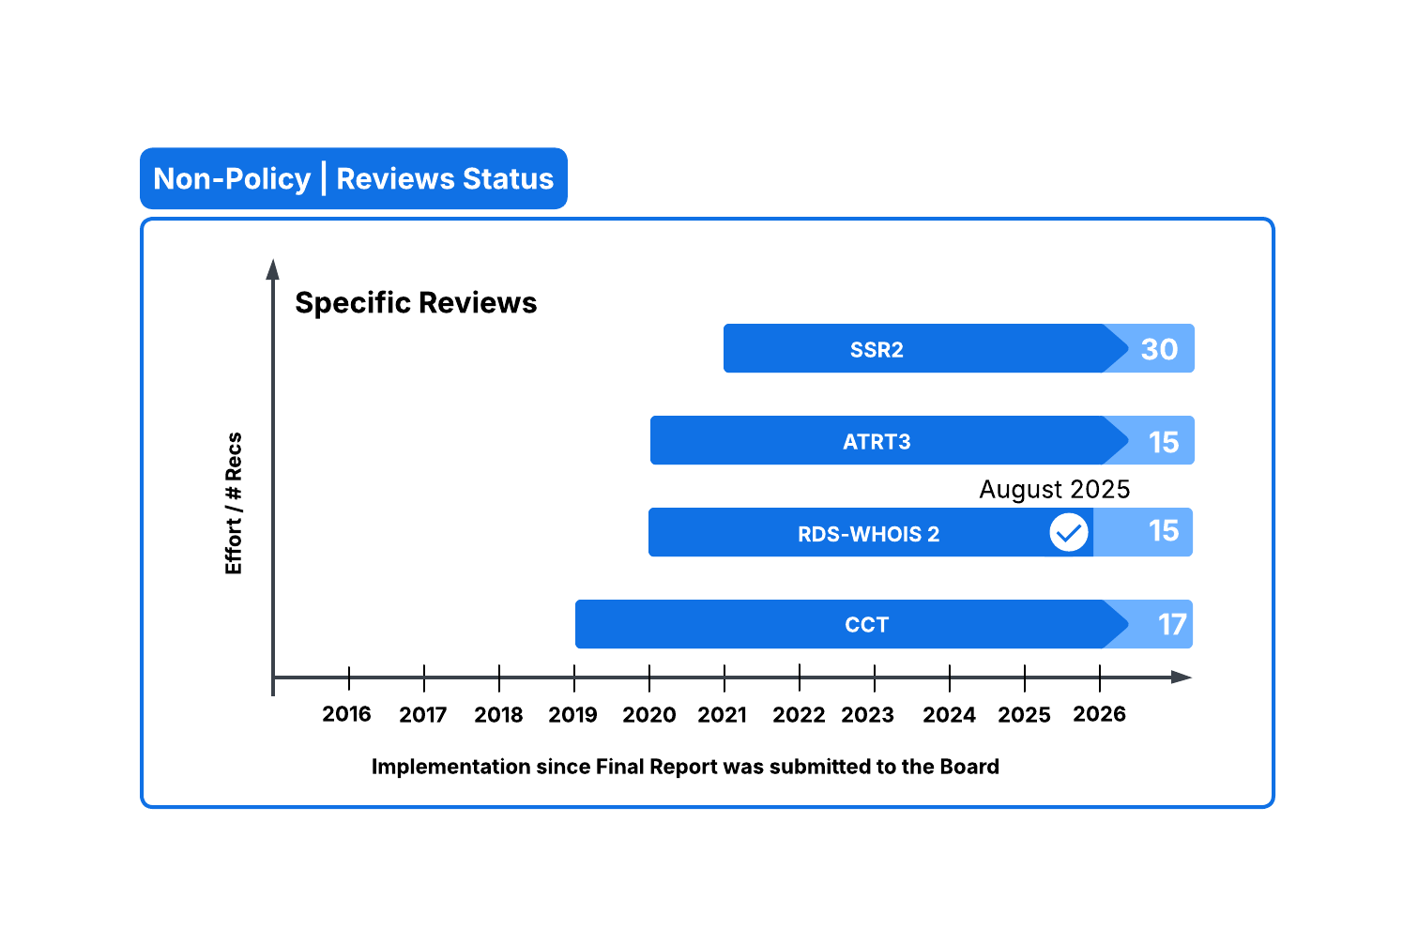
Visibility, Transparency, Reporting

Slide 21
Questions

Slide 22

Resources and Information
CONTACT US:
Policy Research & Stakeholder Programs: prsp-contact@icann.org
    Consensus Policy Implementation Framework (CPIF) / Policy Implementation page
      This page contains information on how policy is implemented at ICANN, including implementation projects timelines, policy effective dates, and policy status reports.
    Policy Research and Stakeholder Programs (PRSP) Briefing
      These briefings are published ahead of each ICANN meeting and describe our team’s active involvement in current policy and implementation processes.
    Quarterly Specific Reviews Implementation Reports
      These quarterly report provide an update on the implementation status of Specific Reviews and serves to capture implementation highlights as the ICANN organization (org) progresses through implementation.

Slide 23

ICANN Webpage and Social Media Links

