Slide 1
Malicious Registrations in the Domain Name Market:
An Analysis of 2025 gTLD Registrations and Cybercriminal Demand
Interisle Consulting Group
Greg Aaron & Karen Rose
ICANN86 Seville
June 2026

Slide 2

Cybercriminal Demand in the 2025 gTLD Market
Purpose: put the domain abuse problem into context.
Key study questions:
What % of new registrations were sold to bad actors?
Where were they concentrated?
What can associated domain checks reveal?
What are the economic issues at play?

Slide 3
Approach and Methodology
Reputation Blocklists (RBLs)
  List domains/URLs being used for malicious/dangerous/risky activities: (phishing, malware, fraud and scam sites, etc.
  Practical measure of real-world abuse.
Massive data set. All source data is publicly or commercially available.
  Our results can be replicated
ICANN Metrica, NetBeacon, and others use overlapping (but fewer) RBLs, some similar methodologies
Complete methodology in report.

Slide 4
Q1: What % of new registrations were sold to bad actors?
Notes:
NEW registrations are they key measure relevant to abuse. New domains represent demand. And criminals need domains but don’t renew.

Slide 5
~20% of gTLD registrations were made by bad actors
85 million new registrations in 2025
8.5 million of those added to blocklists by May 2025.
  = 10% of all domains sold during 2025.
10% is the floor.
  More 2025 domains will become blocklisted → 12%

Slide 6
How Bad is the Situation Really?
Blocklist providers do not detect or list all abusive registrations.
ICANN OCTO associated domain study: For every three domains appearing on blocklists, two additional and unlisted domains are associated. https://www.icann.org/en/system/files/files/detecting-malicious-domain-registration-batches-13feb26-en.pdf
= 1 in 5 new registrations, or 16.8 million domains
Our case studies confirm large numbers of associated domains.
Notes:
The ICANN study was conservative. Infoblox blocked 25%

Slide 7
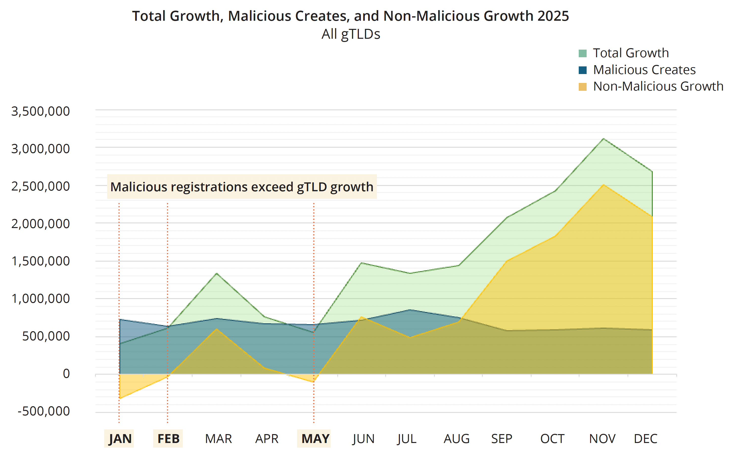
Monthly % of domains blocklisted

Slide 8
Volume’s been increasing

Slide 9
Q2: Where is abuse concentrated?

Slide 10

Abuse is widespread, but highly concentrated
Some level of abuse observed broadly across the market: in virtually all open gTLDs and 88% of all accredited registrars.
But highly concentrated at certain:
  Registrars
  TLDs, and
  Registry and registrar “families” (companies that own multiple registrars or TLDs)

Slide 11
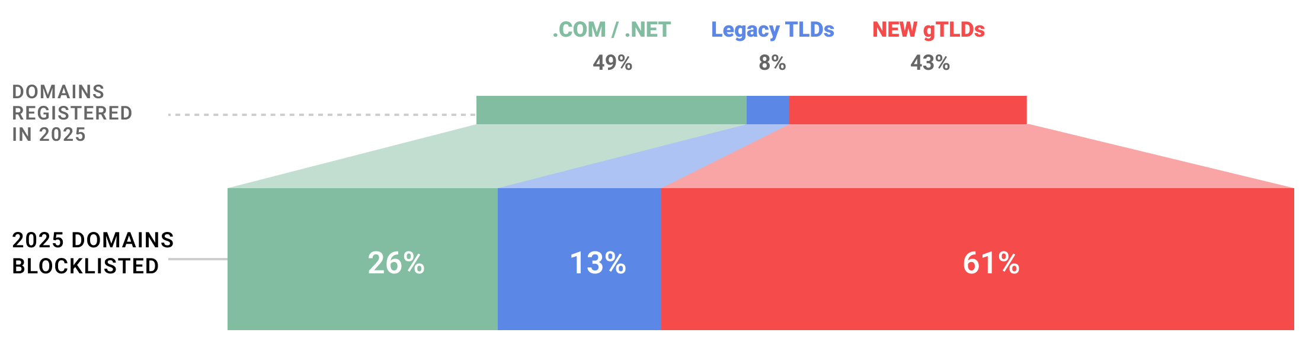
20% of all registered gTLD domains are in the new gTLDs, but…
Notes:
nTLDs disproportionately registered last year, and an even bigger share of abuse

Slide 12
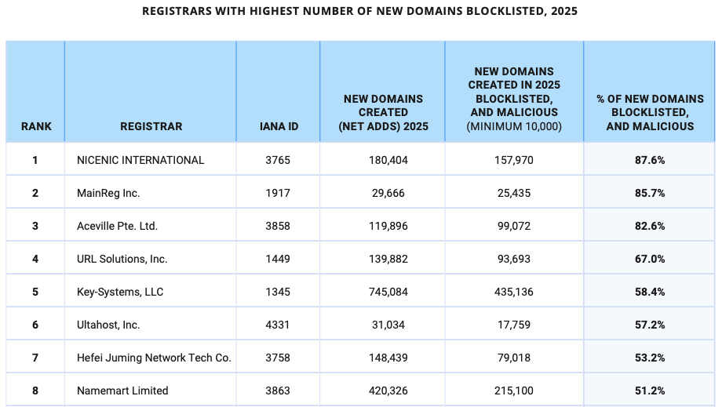
8 registrars had over half of new registrations blocklisted

Slide 13
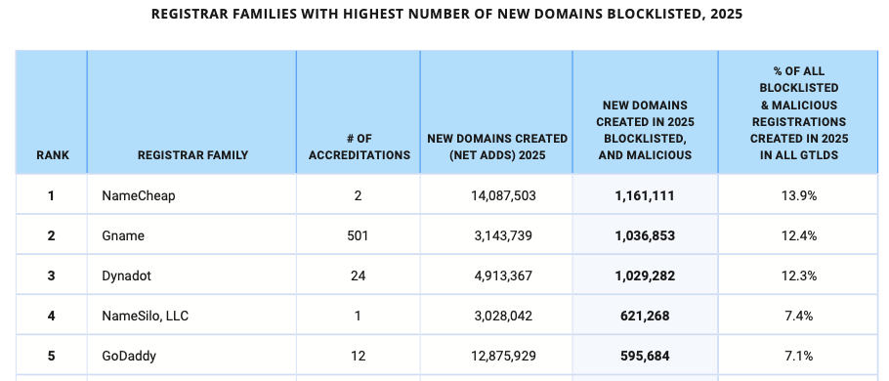
5 Registrar Families accounted for 53% of all gTLD blocklisted registrations
Total Registrations:
4,444,198
53.1%

Slide 14
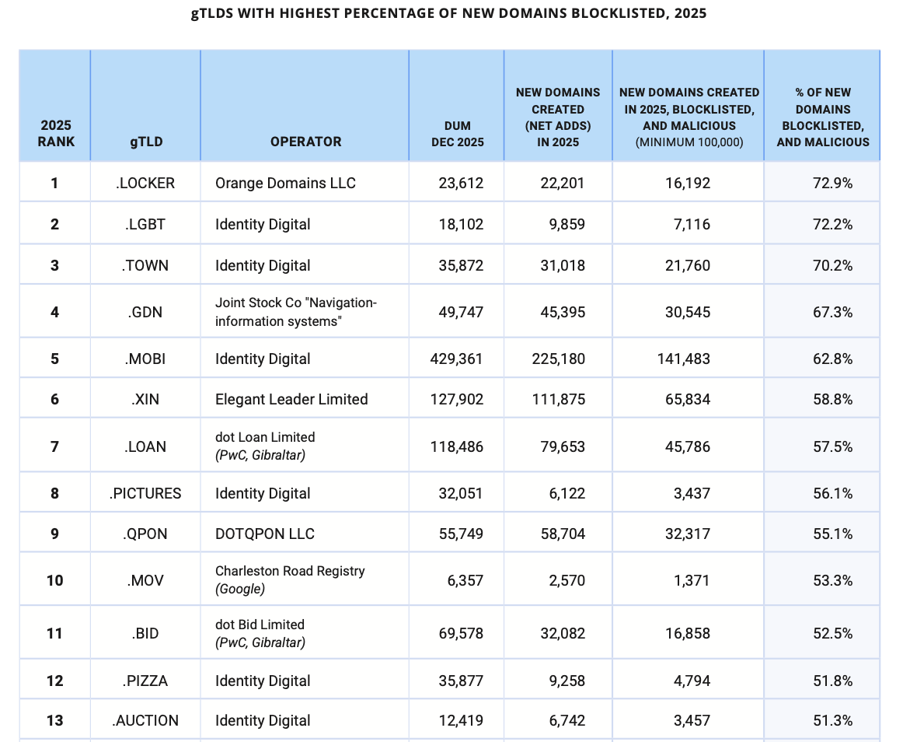
13 TLDs had more than 50% of their registrations blocklisted

Slide 15
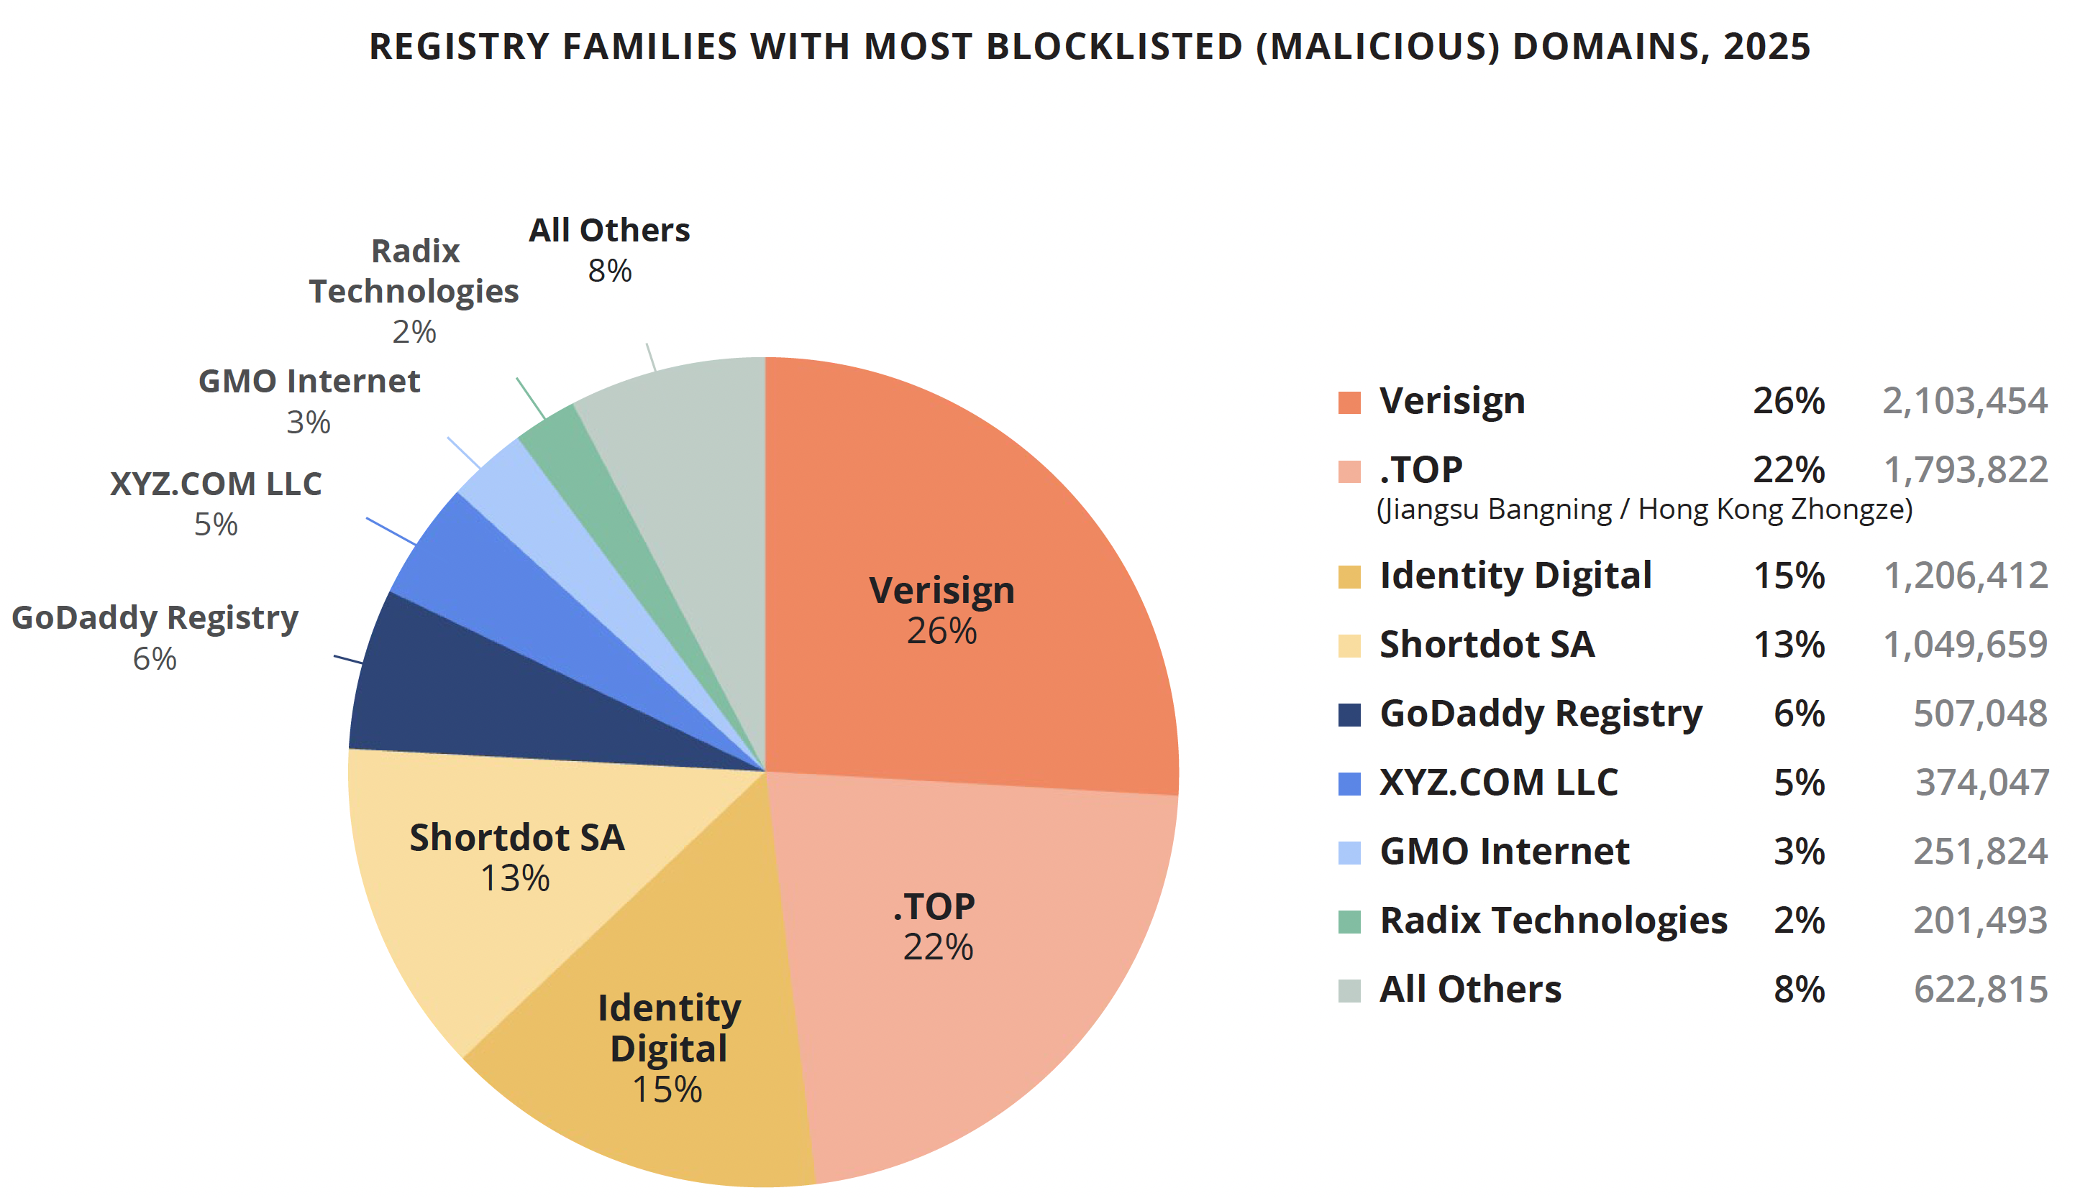
4 Registry Families had over 1 million blocklisted domains each
Top 4 TLD operators had 6.15 million blocklisted domains.
That’s 76% of all domains registered in 2025 that were blocklisted

Slide 16
Q3: What can associated domain checks reveal?

Slide 17

Associated Domain Checks Find More Abuse
We started with blocklisted domains and looked for associated domains in several TLDs. Associated domains are those that fulfill all of these:
some in the batch were blocklisted
created by same registrar
registered in time-bound batches
use same hosting (nameserver pairs, A records)
domain strings follow a pattern; lexical similarities

Slide 18
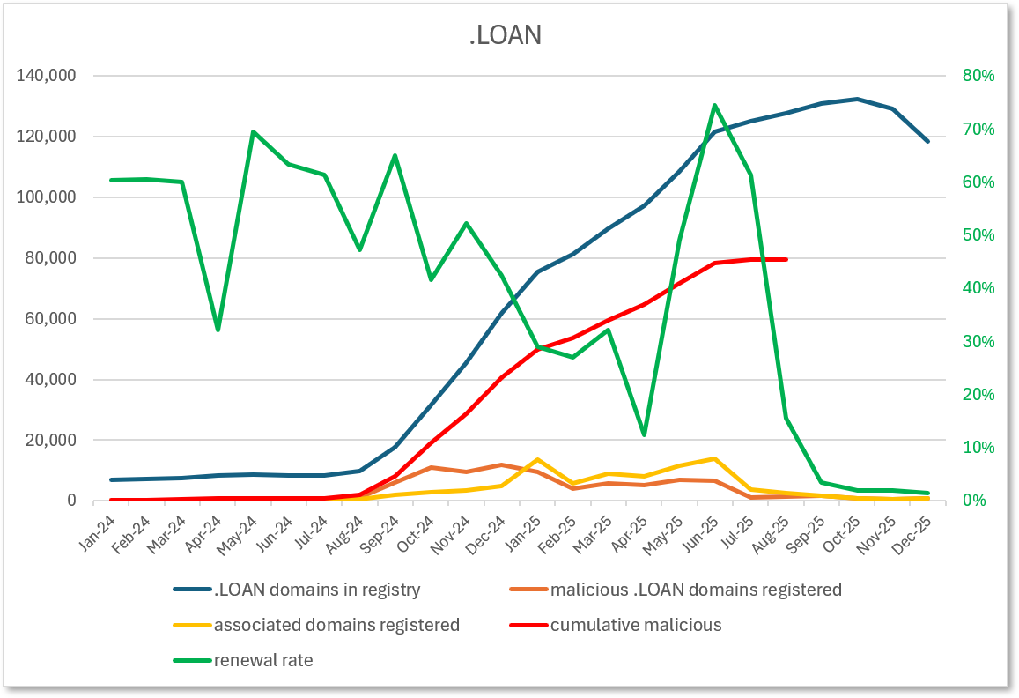
Cybercriminals use domains and then discard them
77,000 domains blocklisted = 58% of the TLD
We found 32,000 additional associated domains: 41% more
= 82% of domains in registry associated with abuse
~100K domains registered by FUNNULL, a sanctioned cybercriminal organization.
.LOAN renewal rate dropped to 4.6% after the wave of abuse

Slide 19
Other Case Studies:
.PINK
    38% expansion
    = 76.3% of the domains in the TLD were associated with abusive actors. (FUNNULL)
    renewal rate dropped from ~65% to 3.1%
.GIFT:
    63% expansion
    = 15% of registry consisted of abusive registrations.
    Renewal rate = 61.3%
.BOND
    Phishing and malware activity
    Renewal rate = 0.5%

Slide 20
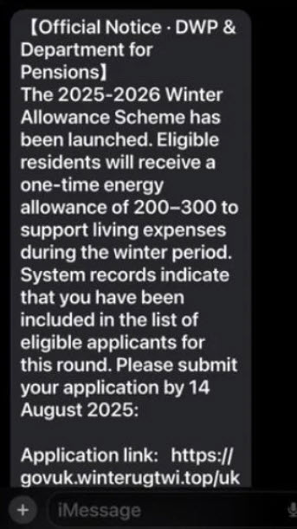
Example: Associated domains
Phishing the U.K. Department of Works & Pensions (U.K. DWP)
https://gov.uk-dwpaph.bond/uk/
https://gov.uk-dwpcjh.bond/uk/
https://gov.uk-dwpclc.bond/uk
https://gov.uk-dwpclw.bond/uk
https://gov.uk-dwpclj.bond/uk/
Also in .LIFE, .CFD, .TOP, etc.
Notes:
U.K. Department of Works and Pensions

Slide 21
Example: Associated domains
uk-dwpaaa.bond uk-dwpaab.bond uk-dwpaac.bond uk-dwpaad.bond uk-dwpaae.bond uk-dwpaaf.bond uk-dwpaah.bond uk-dwpaai.bond uk-dwpaaj.bond uk-dwpaak.bond uk-dwpaal.bond uk-dwpaam.bond uk-dwpaan.bond uk-dwpaao.bond uk-dwpaap.bond uk-dwpaaq.bond uk-dwpaar.bond uk-dwpaas.bond uk-dwpaat.bond uk-dwpaau.bond uk-dwpaav.bond uk-dwpaaw.bond uk-dwpaax.bond uk-dwpaay.bond uk-dwpaaz.bond uk-dwpaba.bond uk-dwpabc.bond uk-dwpabd.bond uk-dwpdia.bond uk-dwpdie.bond uk-dwpdig.bond uk-dwpdih.bond uk-dwpdil.bond uk-dwpdim.bond uk-dwpdir.bond uk-dwpdiu.bond uk-dwpdod.bond uk-dwpdoi.bond uk-dwpdon.bond uk-dwpdoo.bond uk-dwpdot.bond uk-dwpdov.bond uk-dwpdoz.bond uk-dwpdpc.bond uk-dwpdpe.bond uk-dwpdph.bond uk-dwpdpk.bond uk-dwpdpp.bond uk-dwpdpr.bond uk-dwpdpu.bond uk-dwpdpv.bond uk-dwpdpw.bond uk-dwpduz.bond uk-dwpead.bond uk-dwpeae.bond uk-dwpeag.bond uk-dwpeam.bond uk-dwpean.bond uk-dwpeao.bond uk-dwpeay.bond uk-dwpeaz.bond uk-dwpeb.bond uk-dwpec.bond uk-dwpecb.bond uk-dwpecg.bond uk-dwpeck.bond uk-dwpecq.bond uk-dwpecr.bond uk-dwpecs.bond uk-dwpecu.bond uk-dwpecv.bond uk-dwpecw.bond uk-dwpeda.bond uk-dwpedc.bond uk-dwpedj.bond uk-dwpedk.bond uk-dwpedn.bond uk-dwpedp.bond uk-dwpedv.bond uk-dwpedx.bond uk-dwpedy.bond uk-dwpee.bond uk-dwpeea.bond uk-dwpeec.bond uk-dwpeej.bond uk-dwpeek.bond uk-dwpeen.bond uk-dwpeeo.bond uk-dwpeer.bond uk-dwpees.bond uk-dwpeet.bond uk-dwpeey.bond uk-dwpef.bond uk-dwpeh.bond uk-dwpei.bond uk-dwpej.bond uk-dwpek.bond uk-dwpel.bond uk-dwpep.bond uk-dwpeq.bond uk-dwpeqc.bond uk-dwpeqm.bond uk-dwpeqp.bond uk-dwpeqq.bond uk-dwpeqr.bond uk-dwpeqs.bond uk-dwpequ.bond uk-dwpeqv.bond uk-dwpeqy.bond uk-dwpera.bond uk-dwperd.bond uk-dwpere.bond uk-dwperw.bond uk-dwpesa.bond uk-dwpesc.bond uk-dwpese.bond uk-dwpesi.bond uk-dwpest.bond uk-dwpesu.bond uk-dwpesv.bond uk-dwpesw.bond uk-dwpesy.bond uk-dwpewd.bond uk-dwpewg.bond uk-dwpewi.bond uk-dwpewj.bond uk-dwpewo.bond uk-dwpewt.bond uk-dwpeww.bond uk-dwpewx.bond uk-dwpewy.bond uk-dwpewz.bond uk-dwpexc.bond uk-dwpexf.bond uk-dwpexg.bond uk-dwpexk.bond uk-dwpexn.bond uk-dwpexp.bond uk-dwpexr.bond uk-dwpexx.bond uk-dwpexz.bond uk-dwpeza.bond uk-dwpezd.bond uk-dwpezh.bond uk-dwpezi.bond uk-dwpezj.bond uk-dwpezl.bond uk-dwpezr.bond uk-dwpezs.bond uk-dwpezv.bond uk-dwpezy.bond uk-dwpfa.bond uk-dwpfb.bond uk-dwpfc.bond uk-dwpfd.bond uk-dwpfe.bond uk-dwpff.bond uk-dwpfg.bond uk-dwpfh.bond uk-dwpfi.bond uk-dwpfj.bond uk-dwpfk.bond uk-dwpfl.bond uk-com.bond uk-dwpdaj.bond uk-dwpexz.bond uk-dwpdie.bond uk-dwpaao.bond uk-dwperd.bond uk-dwpexc.bond uk-dwpefa.bond uk-dwpaqb.bond uk-dwpaqd.bond uk-dwpaqf.bond uk-dwpaqi.bond uk-dwpaqj.bond uk-dwpaqq.bond uk-dwpaqx.bond uk-dwpawc.bond uk-dwpawd.bond uk-dwpawt.bond uk-dwpaww.bond uk-dwpazd.bond uk-dwpazf.bond uk-dwpazh.bond uk-dwpazj.bond uk-dwpazl.bond uk-dwpazo.bond uk-dwpazx.bond uk-dwpazz.bond uk-dwpebb.bond uk-dwpebd.bond uk-dwpebf.bond uk-dwpebk.bond uk-dwpebm.bond uk-dwpebn.bond uk-dwpebq.bond uk-dwpebz.bond uk-dwpefa.bond uk-dwpefd.bond uk-dwpefi.bond uk-dwpefo.bond uk-dwpefq.bond uk-dwpefr.bond uk-dwpeft.bond uk-dwpefu.bond uk-dwpefy.bond uk-dwpegf.bond uk-dwpegj.bond uk-dwpegk.bond uk-dwpegl.bond uk-dwpegr.bond uk-dwpegs.bond uk-dwpegy.bond uk-dwpegz.bond uk-dwpeha.bond uk-dwpehd.bond uk-dwpehh.bond uk-dwpehi.bond uk-dwpehj.bond uk-dwpeht.bond uk-dwpehw.bond uk-dwpejd.bond uk-dwpejj.bond uk-dwpejo.bond uk-dwpejq.bond uk-dwpejs.bond uk-dwpejt.bond uk-dwpeju.bond uk-dwpejv.bond uk-dwpela.bond uk-dwpeld.bond uk-dwpelf.bond uk-dwpelk.bond uk-dwpelm.bond uk-dwpelt.bond uk-dwpely.bond uk-dwpenc.bond uk-dwpeng.bond uk-dwpenk.bond uk-dwpenm.bond uk-dwpens.bond uk-dwpeny.bond uk-dwperg.bond uk-dwperi.bond uk-dwperm.bond uk-dwpern.bond uk-dwpetd.bond uk-dwpeth.bond uk-dwpetm.bond uk-dwpeto.bond uk-dwpetp.bond uk-dwpetq.bond uk-dwpett.bond uk-dwpetu.bond uk-dwpeve.bond uk-dwpevf.bond uk-dwpevl.bond uk-dwpevm.bond uk-dwpevu.bond uk-dwpevx.bond uk-dwpevy.bond uk-dwpevz.bond uk-dwpeyd.bond uk-dwpeyg.bond uk-dwpeym.bond uk-dwpeyn.bond uk-dwpeyo.bond uk-dwpeyt.bond uk-dwpeyw.bond uk-dwpeyz.bond uk-fuel.bond uk-fuels.bond uk-dwpexg.bond uk-dwpens.bond uk-dwpaic.bond uk-dwpaif.bond uk-dwpaig.bond uk-dwpail.bond
et cetera

Slide 22
Lessons from the Case Studies
Malicious domains are often obvious once you start looking for them.
Batches are often large: hundreds, to hundreds of thousands.
Abuse detection and mitigation was partial and far from effective.
  Registrar/registry suspension rates for blocklisted domains were 7.4% to 16.3%.
  Apparently no associated domains were suspended.
Payments from cybercriminals are going through to registrars.

Slide 23
Q4: What are the economic issues at play?

Slide 24
Economic incentives/disincentives
Some registry and registrar operators appear to gain commercial benefit from taking abusive registrations
  Cybercriminals are a large, reliable source of demand
  Apparently profitable, even at low or negative margins.
Low-margin sales strategies and volume-discount programs are intended to drive growth and market share…
  But they can also incentivize sales to high-volume, repeat customers, such as cybercriminals
Tolerating abusive customers can be commercially rational, even when they generate little to no revenue, when:
  The cost of carrying them is low, and
  Deterrence is more costly.
  Introducing friction risks losing sales, and higher-value customers

Slide 25
Negative externalities impose social costs and harm
While cybercriminals and some registrars and registry operators benefit, the costs of cybercrime fall on victims, businesses, and society at large.
In economic terms, this is a classic negative externality:
  the parties who benefit from the transactions pass costs on to unrelated parties.
Negative externalities are a form of market failure that undermine the benefits of competition.

Slide 26
Policy needs to match the increasing scale and severity of the problem
Domain abuse is industrialized. Policy needs to respond to this reality.
Abuse at this scale is not inevitable, however.
  Some registries and registrars grew without attracting outsized levels of abuse.
  Providers make choices that can affect whether business is driven by legitimate demand or abusive demand.
Absent change, the increase in competition and supply from new gTLDs will exacerbate the current situation.
Abuse prevention is key – mitigation is not enough.

Slide 27
In Conclusion
Malicious registrations are 20% (or more?) of all gTLD domains being sold today.
This is a serious and unbalanced situation, creating harm.
Policy should stress prevention, measurably reducing abuse and harm, while sustaining legitimate business.
Notes:
What should this community do next?
We hope the numbers, case studies, and analysis in the report will help policymakers and the broader ICANN community develop more effective ways to reduce cybercriminals’ access to domain names while supporting sustainable business from legitimate customers.

Slide 28
Where do we go from here? https://interisle.net/insights/cybercriminaldomaindemand karen@interisle.net greg@interisle.net

