Slide 1
Generic Names Supporting Organization
Policy-development body within ICANN responsible for policies relating to generic Top-Level Domains (gTLDs)
There were a handful of original gTLDs, then came 14, then came approx. 1500 after 2012 Round of New gTLDs
2026 Round could see another approx. 1000
4 Stakeholder Groups (SGs) grouped as 2 Houses:
  Contracted Parties House:
    Registries Stakeholder Group
      Brand Registry Group, GeoTLD.group
    Registrars Stakeholder Group
  Non-Contracted Parties House:
    Commercial Stakeholder Group
      Business Constituency, IP Constituency, Internet Service Providers Constituency
    Non-Commercial Stakeholder Group
      Non-Commercial Users Constituency, Not-for-Profit Organizations Constituency
1

Slide 2
Generic Names Supporting Organization
GNSO Council - gnso.icann.org
  Representative body bringing together the GNSO SG/Cs + NomCom Appointees and Liaisons from ALAC and ccNSO
  Meets Monthly and several times during ICANN in-person meetings
    All sessions are open, anyone can observe – an open mic session each ICANN
  Manager of the Policy Development Process (PDP)
    Scopes/Charters PDPs
    PDPs – delegated to working group of members of the community
    Generally one member of Council will serve as a Liaison to each PDP
    Regular reports back to Council from Liaison and/or Chair
    PDP Initial Report and recommendations subject to public comment before being finalised
    Recommendations adopted by Council then transmitted to the ICANN Board
2

Slide 3
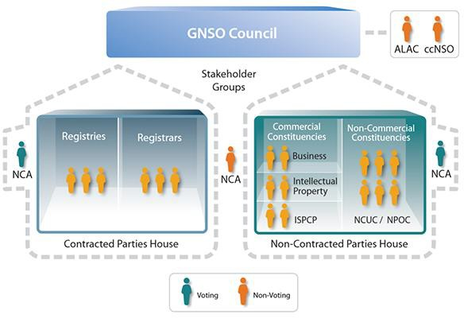
Generic Names Supporting Organization
GNSO Council
  21 councilors
  3 NomCom Appoint’s
  2 + 1 Liaisons
  Leadership
    Chair
    1 Vice Chair per House

Slide 4
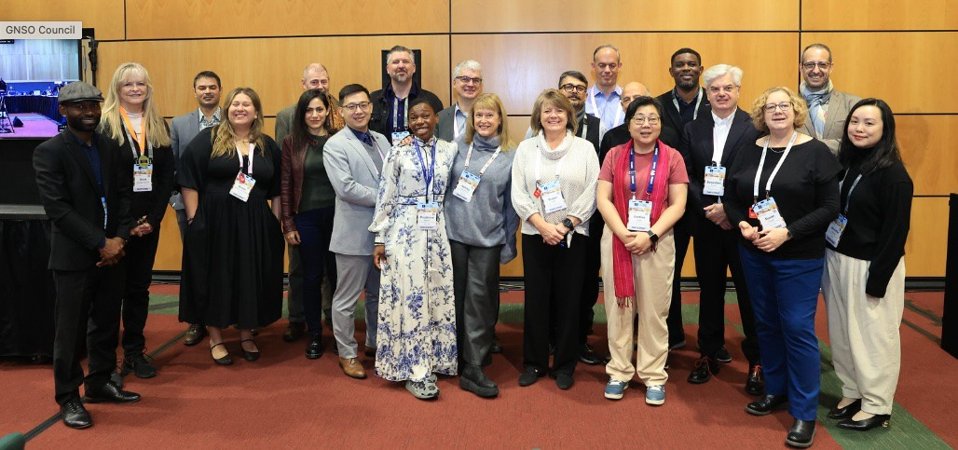
Generic Names Supporting Organization
GNSO Council
A fine crop of outstanding individuals!

Slide 5
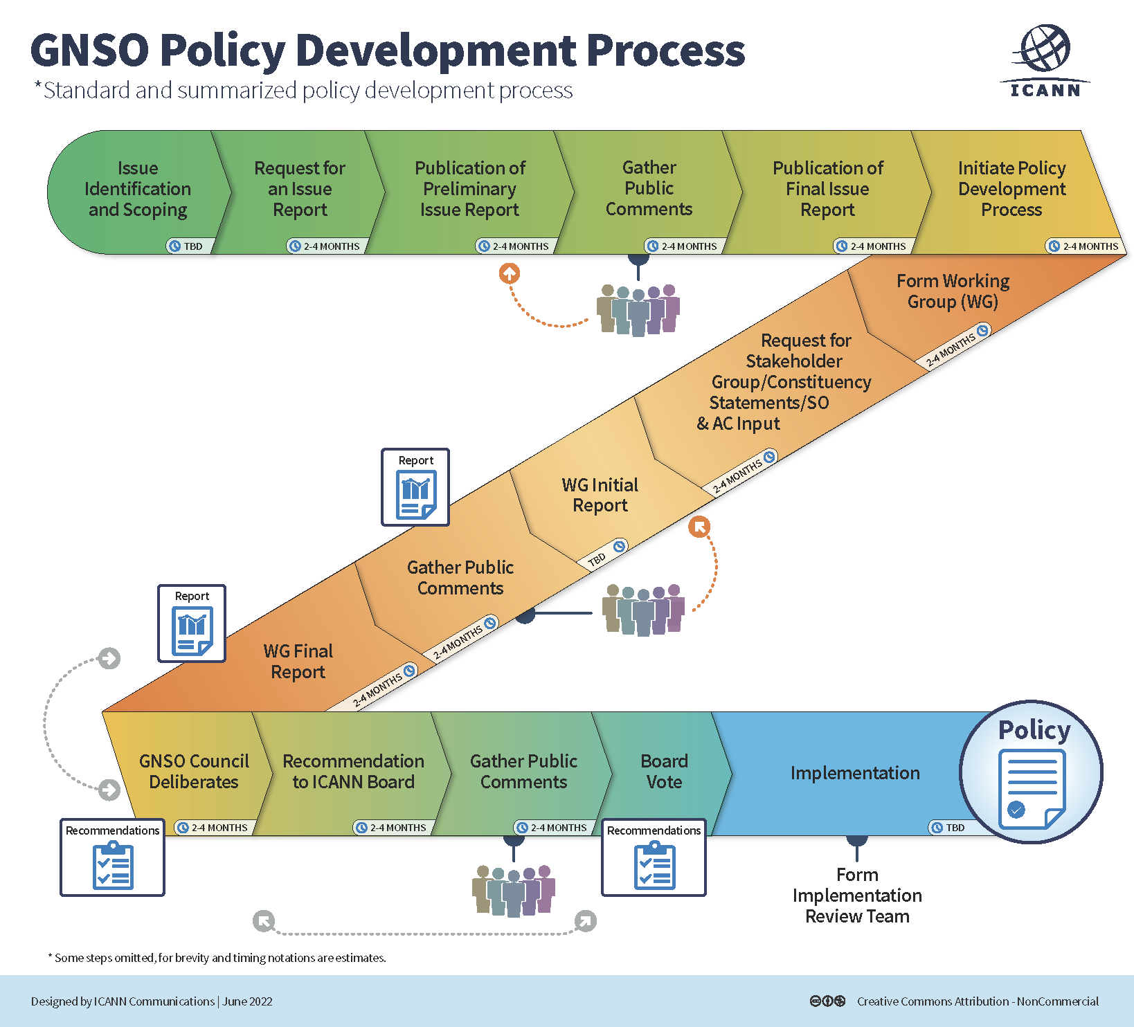
Generic Names Supporting Organization
PDP… process

Slide 6
Generic Names Supporting Organization
Current PDPs
  Latin Script Diacritics
    Final Report delivered to GNSO Council
    Council expected to vote to adopt on Wednesday
  DNS Abuse PDP1: Associated Domains Checks
    WG formed and began work at ICANN85
    Public comment period on the Initial Report closed end September, 40 submissions received
    4 meetings during ICANN87 on Saturday, Sunday and Thursday
  DNS Abuse PDP2: Safeguards for API Access for New Customers
    Not yet commenced
    Council has voted to initiate, and is working on the draft Charter

